Slide 1
Leistungselektronik in der Aufbereitung, Übertragung, Verteilung und Speicherung elektrischer Energie
Power Electronics in Power Conditioning, Transmission Distribution and Storage of Electric Energy
Peter Zacharias
Universität Kassel, Kompetenzzentrum für Dezentrale Elektrische Energieversorgungstechnik (KDEE)
www.kdee.uni-kassel.de
Frühjahrssitzung des Arbeitskreises Energie der
Deutschen Physikalischen Gesellschaft 2013, Bad Honnef

Slide 2
Outline of the Presentation
General Situation of the Electric Power Supply System with Germany as Example
New Types of Electric Generators with Power Electronic Converters (Solar, Wind Power)
System Problems and Power Electronic Solutions
Useful Life Time and Reliability
New Semiconductor Devices
Conclusions

Slide 3
1. General Situation of the Electric Power Supply System
Up to 10 years before
coal
nuclear
hydro
Central generation
high
voltage
grid
Sizing for coverage of max. load
Time-invariant tariffs
Load rejection at customer
medium
voltage
grid
No information of grid status for customers
Strict power limits for feed-in
Large power reserves for unexpected
loads or failure of power plants required
low
voltage
grid
Only unidirectional control required
Ref: Prof. Dr. J. Schmid. ISET Kassel

Slide 4
1. General Situation of the Electric Power Supply System
Today and in future
coal
nuclear
hydro
gas and steam
Additional decentralised
generation
Load coverage by trading
Time-variable tariffs
Load and cost optimisation by
means of dialog
Up to date information by
means of variable tariffs
wind farm
Variable power limitation
depending on present load
Power reserves will be reduced
by means of trade
PV
BZ
Wind
PV
BZ
KWK
Bidirectional communication
and large flow of information
Ref: Prof. Dr. J. Schmid. ISET Kassel

Slide 5
1. General Situation of the Electric Power Supply System: New Types of Generators
Solar
Bio Mass
Wind
Hydro

Slide 6
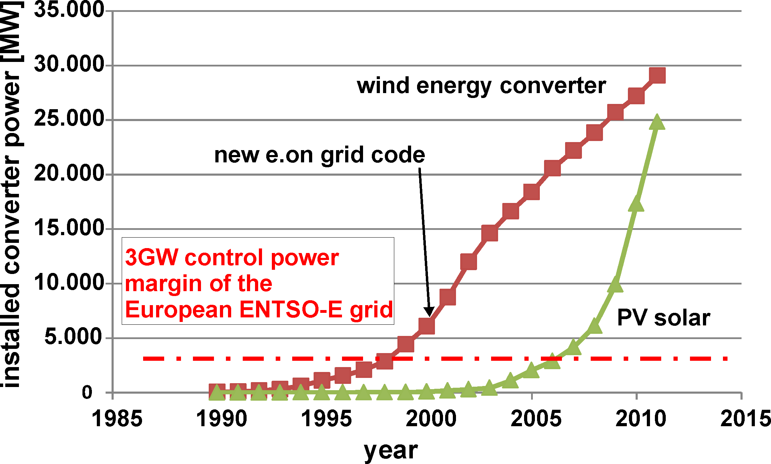
1. General Situation of the Electric Power Supply System: Implementation of Converters for Wind and Solar Energy
Total power of active German utility companies: 85-95GW
Total installed power: ~118GW
(source: BMU 2012, e.on)

Slide 7
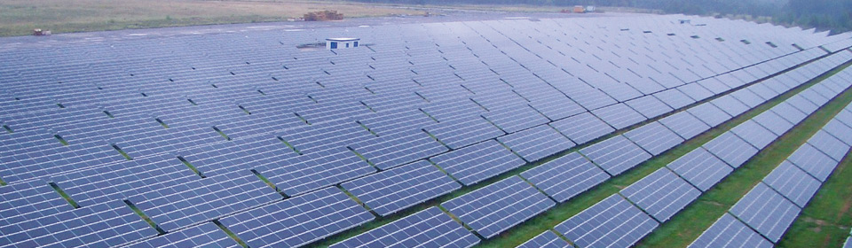
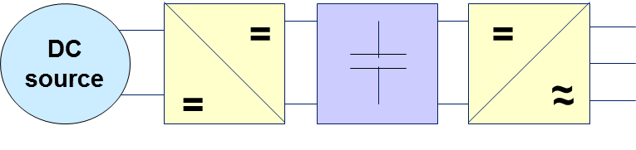
New Types of Electric Generators: Solar Energy Converters
Source: SMA Solar Techology AG, Niestetal: 38MWp Solar Park Waldpolenz

Slide 8
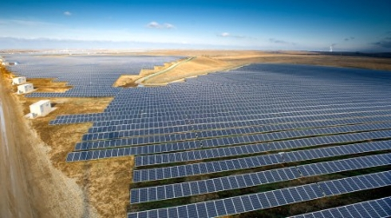
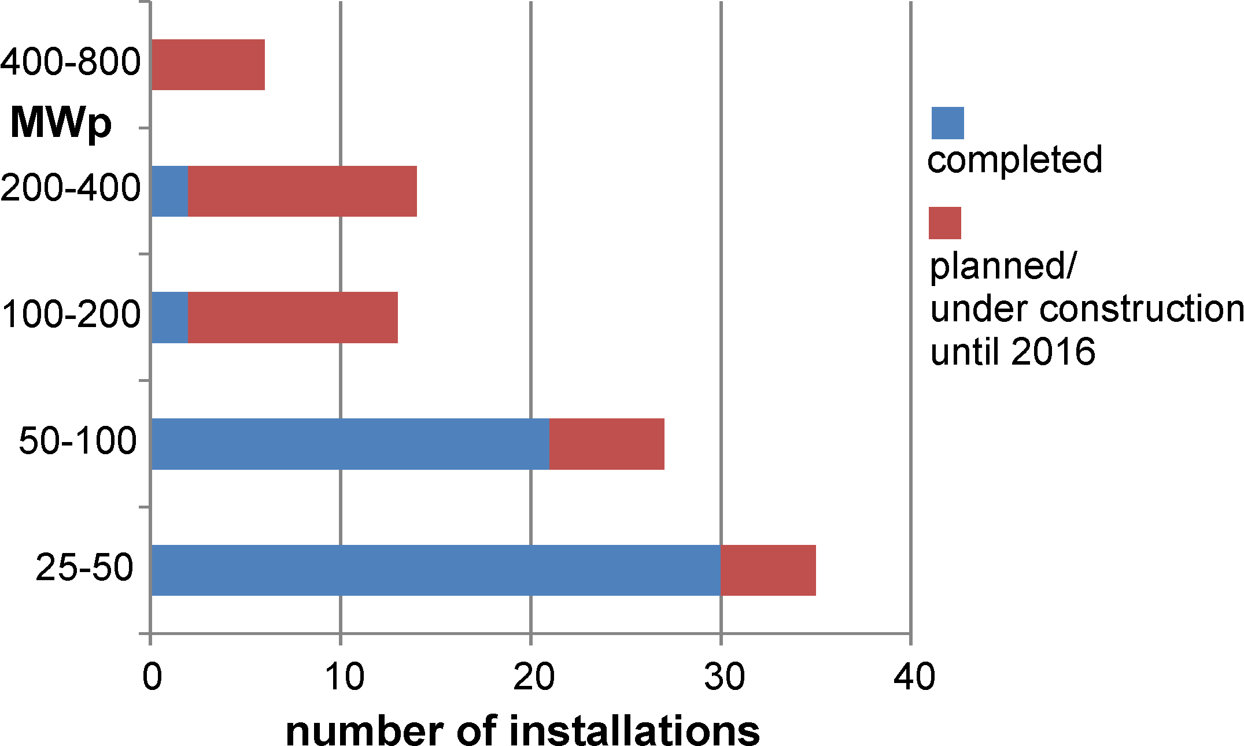
New Types of Electric Generators: Solar Energy Converters
System size: higher and higher power
Activ Solar's 100 MW Perovo PV plant
in Ukraine's sunny Crimean Peninsula,
commissioned in December 2011
Large installations are coming up quickly due to decreasing investment costs and predictable maintanence costs compared to solar thermal installations
Source: List of photovoltaic power stations. Wikipedia 2012

Slide 9
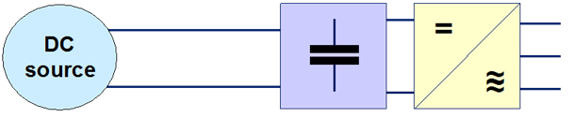
New Types of Electric Generators: Conversion Tasks
3~ IGBT inverter principle

Slide 10
New Types of Electric Generators: Wind Energy Converters
Growth of wind energy converters since the beginning of electric power production [source: ISET, Kassel]

Slide 11
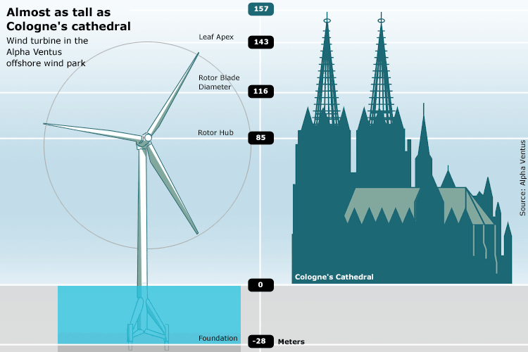
New Types of Electric Generators: Wind Energy Converters
source: http://www.spiegel.de

Slide 12
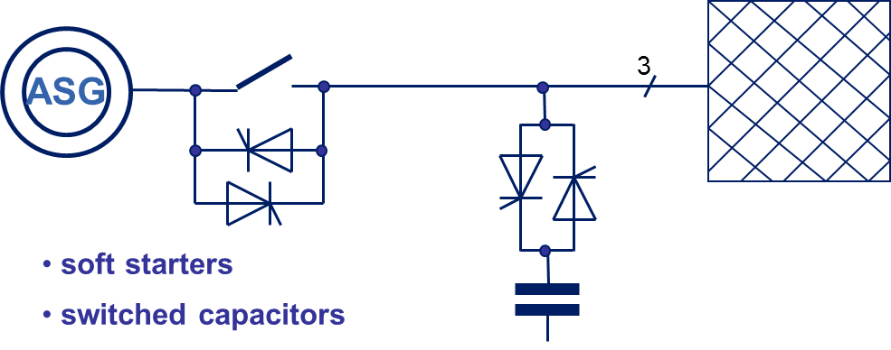
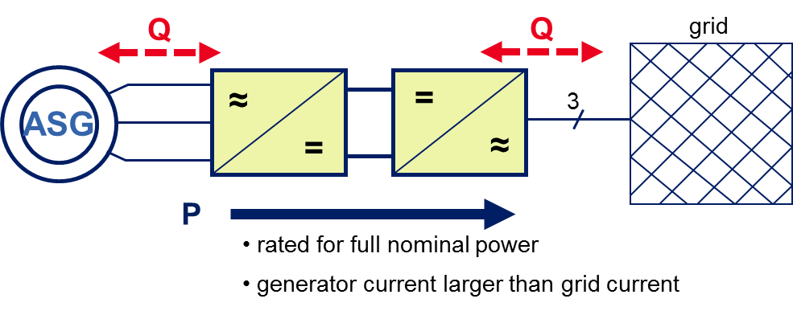
New Types of Electric Generators: Wind Energy Converters
grid
P
induction generator in it‘s simplest configuration: squirril cage induction generator
Small power only
No FRT control
induction generator with squirril cage induction generator + back to back converter
Up to 2MW
Big size
Full FRT Control

Slide 13
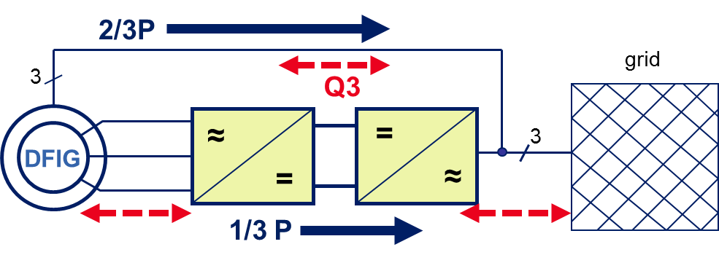
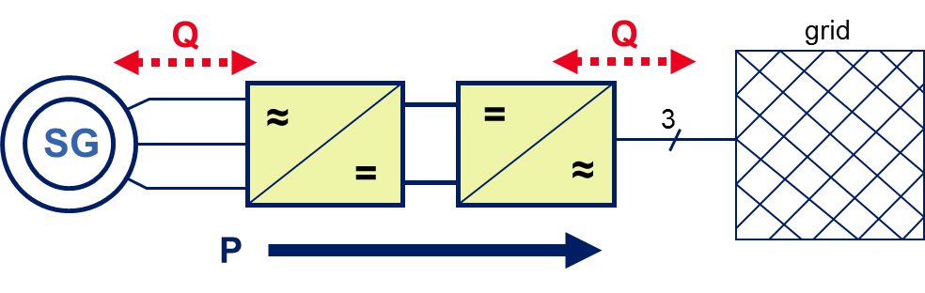
New Types of Electric Generators: Wind Energy Converters
Doubly Fed Induction Generator (DFIG)
Only 1/3 of Power to be handled by electronic power converter
FRT Problems
Synchronous Generator (SG)
Full power to be handled by electronic power converter
Full FRT control

Slide 14
New Types of Electric Generators: Wind Energy Converters
DC link voltage 1100V
AC output 3~690V
Phase current 837A
IGBT current density ~1A/mm² @1700V class
Diode current density ~2A/mm² @1700V class
active Silicon area 150cm²/MVA
Full 5MVA back to back converter requires >750cm² Silicon!
Only 1/3 of total power to be handled by electronic power converters for doubly fed induction generators

Slide 15
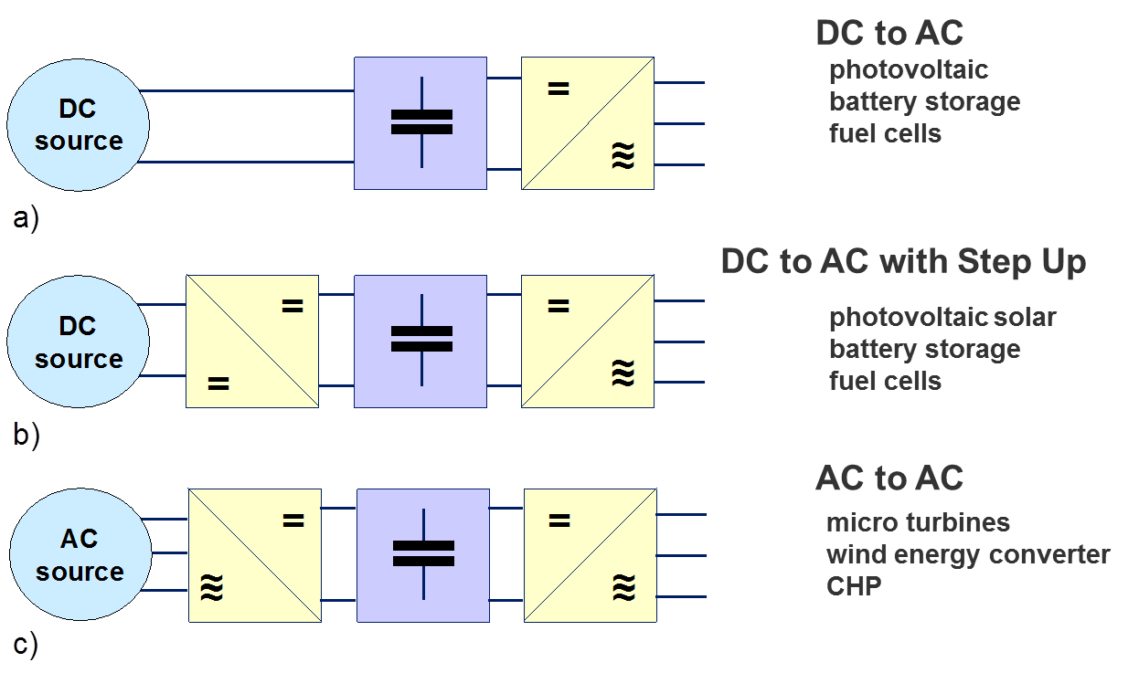
2. New Types of Electric Generators: Basic Conversion Tasks

Slide 16
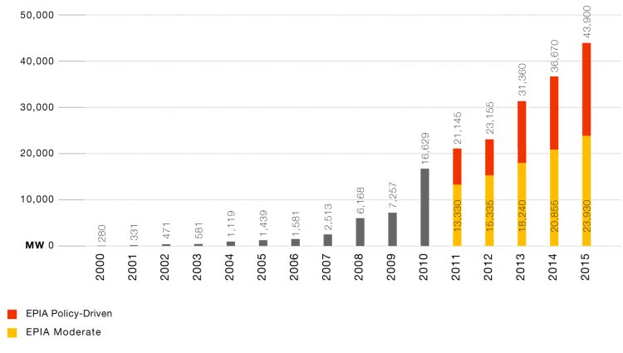
Market situation developments of PV solar power
2. New Types of Electric Generators: Market Opportunities
10GW = 25.000M€ investment !
Market Scenario for new PV Installations worldwide until 2015
(source: European Photovoltaic Industry Association (EPIA), 2015 – Global Market Outlook for Photovoltaics until 2015)

Slide 17
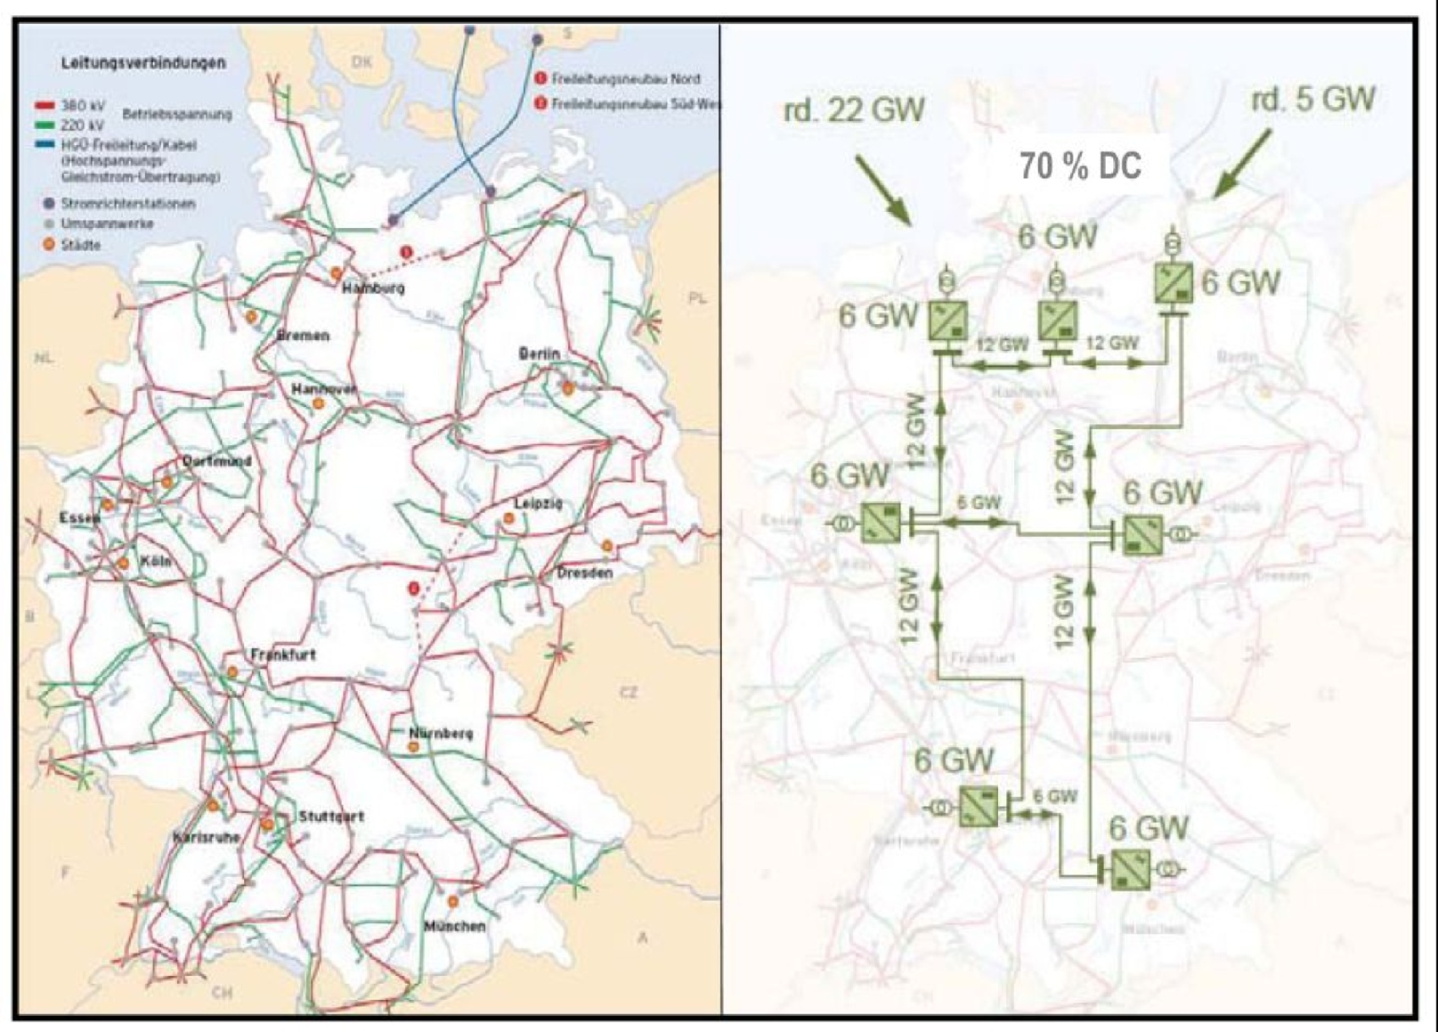
3. System Problems and Power Electronic Solutions: Transmission
Transmission grid can be completed with a HVDC overlay grid (source: VDE)

Slide 18
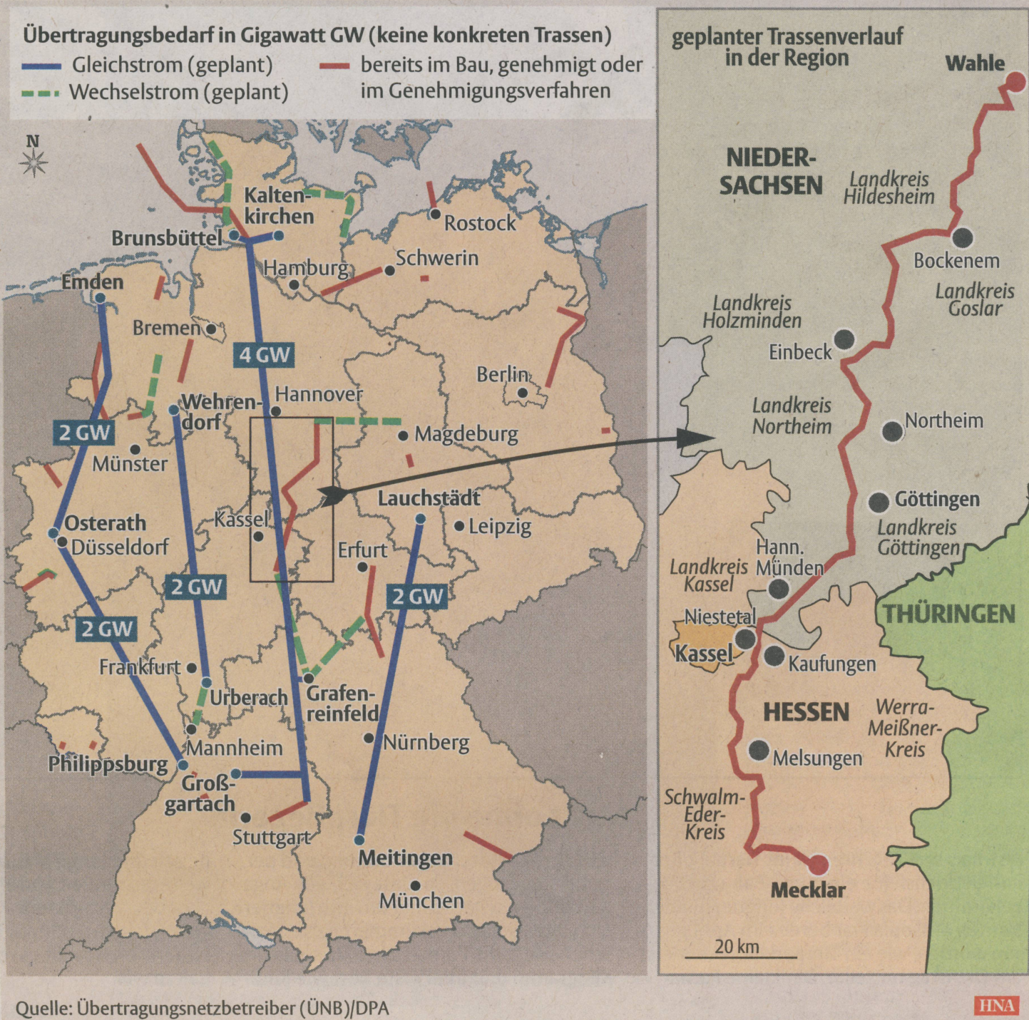
3. System Problems and Power Electronic Solutions: Transmission
Transmission needs within Germany
DC AC
under construction or planned
Example:
Local situation
at Kassel

Slide 19
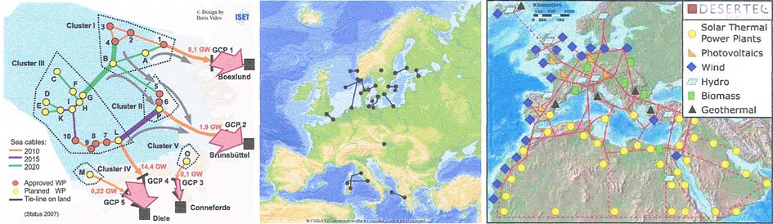
3. System Problems and Power Electronic Solutions: Transmission
HVDC: New Applications in Europe
a) planned offshore wind parks in the North Sea [Valov, Zacharias, ISET],
b) already existing sea cables for interconnecting grids in Europe [source: ABB],
c) proposed inter-continental grid extension for RE sources in North Africa and Europe
[source: DESERTEC Foundation]

Slide 20
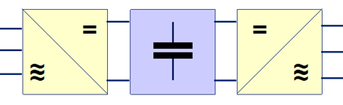
3. System Problems and Power Electronic Solutions: Transmission
Principle of HVDC Transmission System with
Voltage Source Performance and Capability for Grid Control
active Silicon area >15m²/GW !

Slide 21
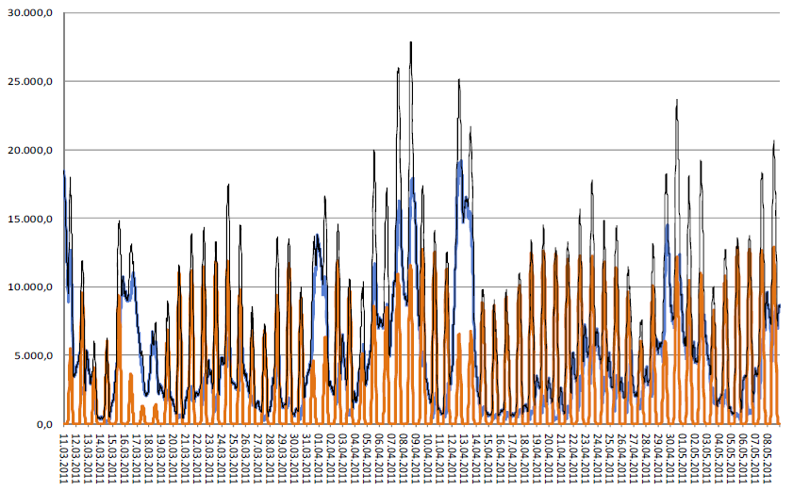

3. System Problems and Power Electronic Solutions:
Transmission Fluctuations
Wind
Solar
Total
MWh/h
Feed-in Wind and Solar Power in Germany accumulated in March-May 2011 (Source: TSO‘s; ÜNB)

Slide 22
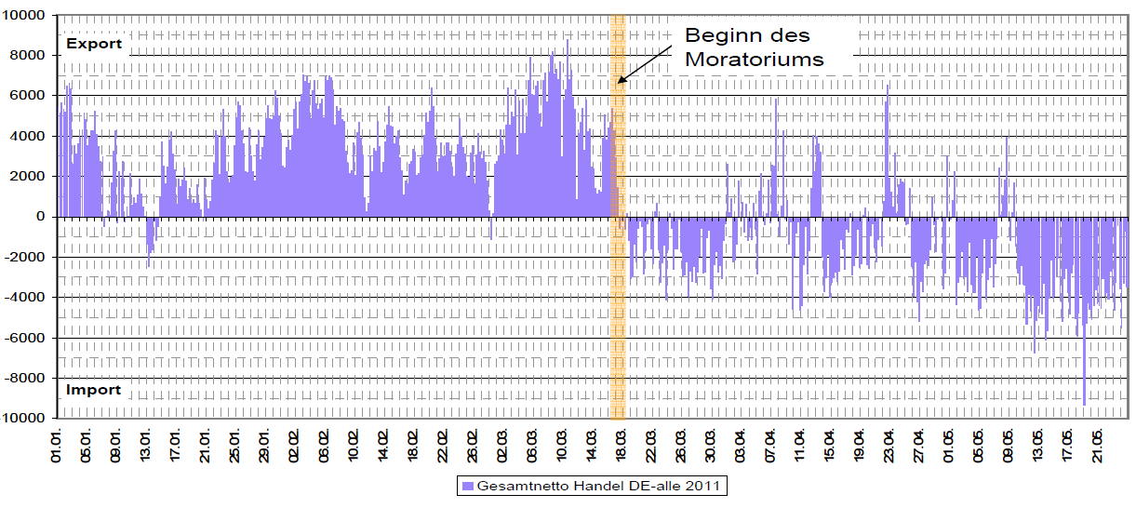
3. System Problems and Power Electronic Solutions:
Transmission Fluctuations
MWh/h
➔ Quicker change of power flow directions!
Total German Energy Trading 2011
Data: ENTSO-E, Diagram: BNetzA

Slide 23
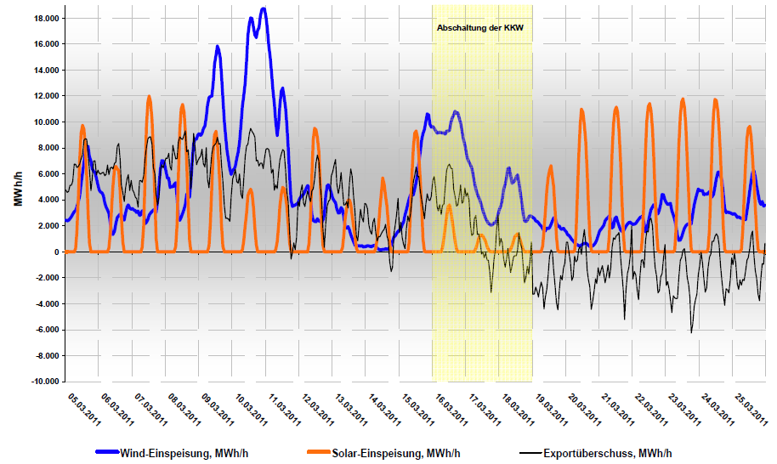
Feed in Solar & Wind Power in Comparison to Energy Export (+) and Import (-) in Spring 2011
Switch off of
nuclear power
➔ Quick Change of Power Flow
Data: Entso-E, EEX
Diagram: BNetzA
Wind power [MWh/h]
Solar power [MWh/h]
German power excess [MWh/h]

Slide 24
3. System Problems and Power Electronic Solutions:
Transmission Fluctuations
Solution Approaches:
Generation and Load Profile Prognosis
Demand Side Management*
Long Distance Energy Trade within Europe → Power Flow Control*
Energy Storage Implementation*
* Power Electronics is helpfull or necessary!

Slide 25
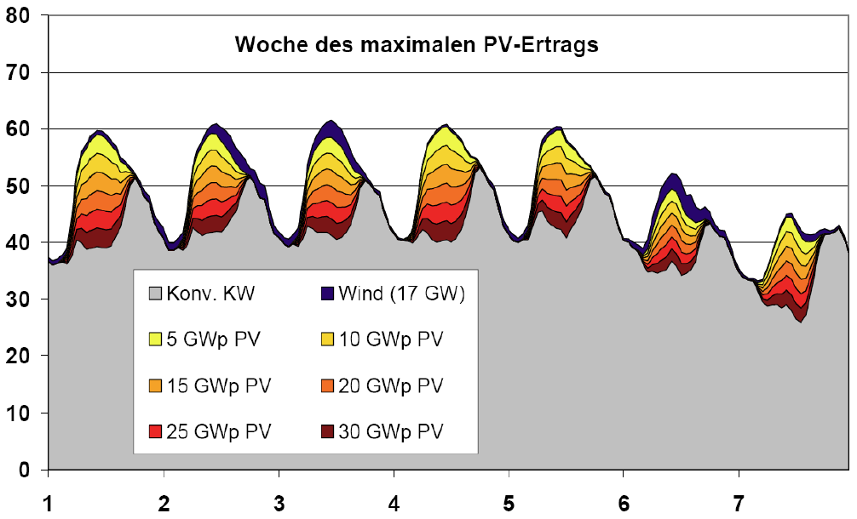
3. System Problems and Power Electronic Solutions:
Transmission Fluctuations
Week of the maximum PV energy yield /Germany
Power production & consumption [GW]
conv. power
in 2011
Wind 29,1GW
PV 24,8GW (BMU 2012)
Day of the week
(Study:Rolle der Solarstromerzeugung in zukünftigen Energieversorgungsstrukturen - Welche Wertigkeit hat Solarstrom?, requested by Federal Ministery BMU, May 2008, ISET e. V. Kassel, BMU 2012
Peak power shedding…No limits?

Slide 26
3. System Problems and Power Electronic Solutions:
Basic Problem: Voltage and Frequency Control of the Grid
Peak power shedding… No limits?
In principle : Yes!...
But we have already realized now the 50,2Hz problem:
PV solar low power systems switch immediatly off, if 50,2Hz is exceeded!
(This is due to regulations established, when PV power did not play any role in the grid)
What does this mean?

Slide 27
3. System Problems and Power Electronic Solutions:
Basic Problem: Voltage and Frequency Control of the Grid
(source: BMU 2012, e.on)
Solar PV power achieved a significant share of the installed power in the
German power system (total 118GW), but small sized systems (the majority)
disconnect from the grid automatically, if the grid frequency exceeds 50,2Hz

Slide 28
3. System Problems and Power Electronic Solutions:
Basic Problem: Voltage and Frequency Control of the Grid
(110/20kV near Braunschweig)
50,2Hz limit of PV inverters
ΔP=1GW ➔ Δf≈0,08Hz
(souce: S. Heier, University of Kassel)
The Italian blackout in 2003 would have caused a European blackout at today conditions!
(But this has been occurred in the dark morning)

Slide 29
3. System Problems and Power Electronic Solutions:
Basic Problem: Voltage and Frequency Control of the Grid
Consequences for all smaller systems:
Significant amount of PV systems must be refurbished by changing the switch off limits statistically in a wide band or continuous power reduction if frequency exceeds a certain limit
Future systems have to take part in grid frequency control
➔ More complex systems already at lower power level!
➔ Larger power (PV) installations have to follow the grid code for MV and HV systems already since 2001!

Slide 30
3. System Problems and Power Electronic Solutions:
Transmission Fluctuations
The renewable sources need backup sources indeed, but destroy (supported by law) the business cases of the existing fast reacting power plants like pumped storage power station or gas power plants
An increase to up to 200GWp of renewable sources (as being discussed at the moment) will destroy even the business cases of base (coal) power stations.
Load shifting opportunities exist but are overestimated by far.
Long distance transmission may discharge the problem.
➔ These problems cannot be solved by power electronic solutions, but only by (European – wide) market regulations!

Slide 31
3. System Problems and Power Electronic Solutions:
Basic Problem: Voltage and Frequency Control of the Grid
voltage, %
load shedding
reduction of delivered power
115
< 30 minutes
110
continuous operation
87,5
➔ at frequency < 47,5 Hz or > 51,5 Hz: undelayed trip
47,5 49 50,25 51,5
frequency, Hz
Introduction into basics of grid control: voltage and frequency control

Slide 32
3. System Problems and Power Electronic Solutions:
Basic Problem: Voltage and Frequency Control of the Grid
Power plants are controlled by droops:
Frequency droop
Voltage droop
> With frequency droop parameters
of each generator can be con-
trolled their share of active power
globally within the grid!
> Grid voltage can be controlled locally at the interconnection point by injection of reactive power

Slide 33
What is the problem about?
➔ Grid Voltage Control in Low and Medium Voltage Grids
3. System Problems and Power Electronic Solutions:
Basic Problem: Voltage and Frequency Control of the Grid
PV
transformer station
20
kV
0
HAS2
,
4
kV
line
HAS1
Trafo
P
P
3
~
~
P
Q
P
Q
load1
load
2
high solar power
at low load
PV
U
1
,
1
p
.
u
. =
253
V
additional injection of
reactive power
1
,
0
p
.
u
. =
230
V
length
0
,
9
p
.
u
. =
207
V
max. load (with voltage adjustment)
source: B. Engel/ SMA Solar Technology

Slide 34
3. System Problems and Power Electronic Solutions:
Basic Problem: Voltage and Frequency Control of the Grid
New control demands to low voltage distribution grids due to high density of distributed power generation
Important criteria: voltage tolerance according to DIN EN 50160 (230V +/-10%)
Voltage criteria is much more limiting the PV power to be connected to the low voltage grid than the line cross section for the current
Further explanations of the problem:

Slide 35
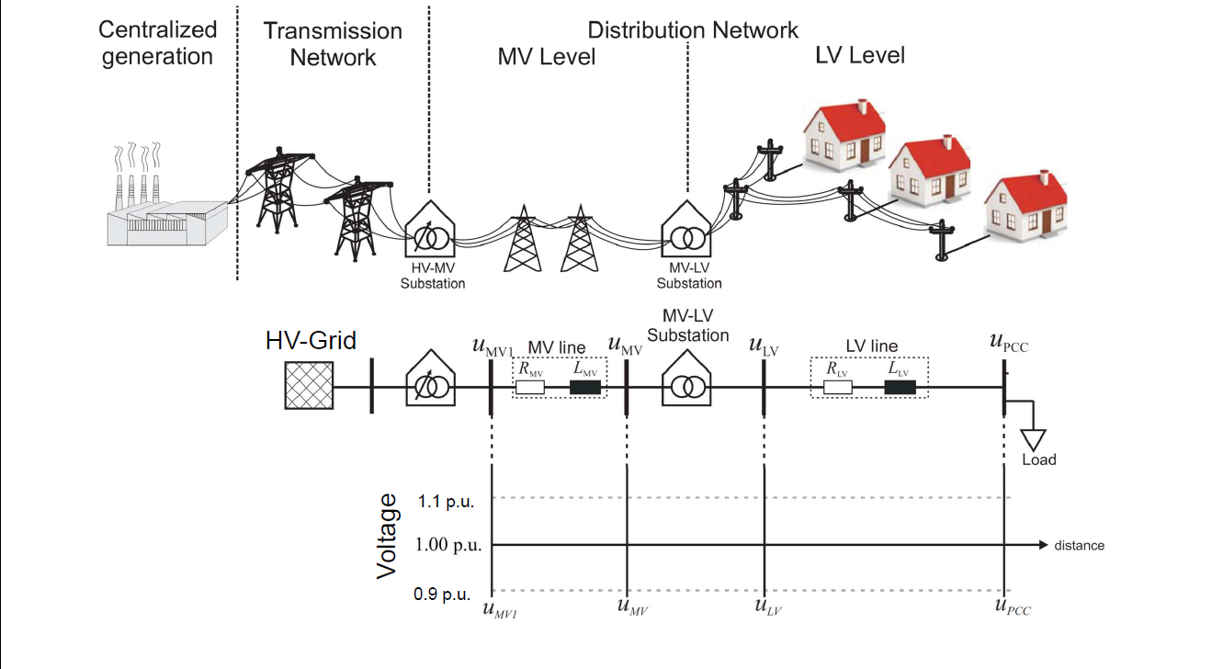
3. System Problems and Power Electronic Solutions:
Basic Problem: Voltage and Frequency Control of the Grid
J. P. da Costa et. al.: Uni Kassel, KDEE, 2011

Slide 36
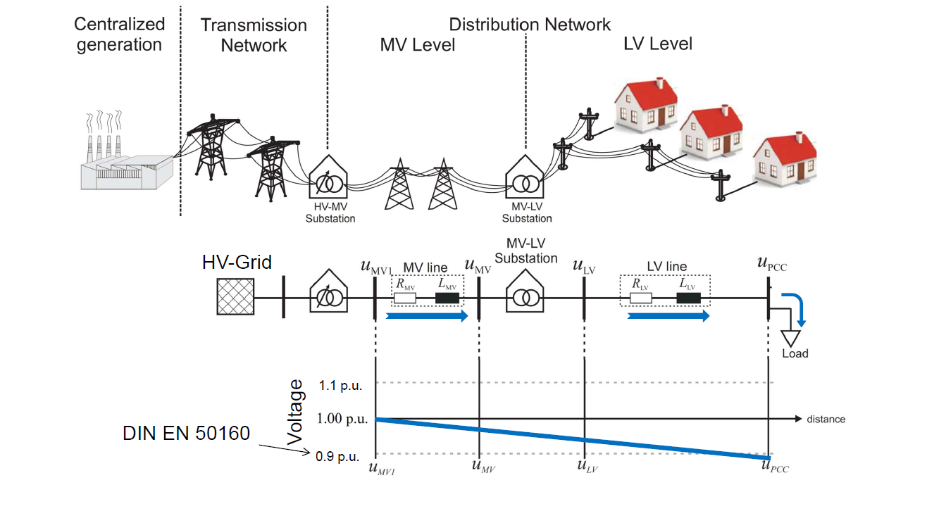
3. System Problems and Power Electronic Solutions
J. P. da Costa et. al.: Uni Kassel, KDEE, 2011
J- P- da Costa, Uni Kassel, KDEE

Slide 37
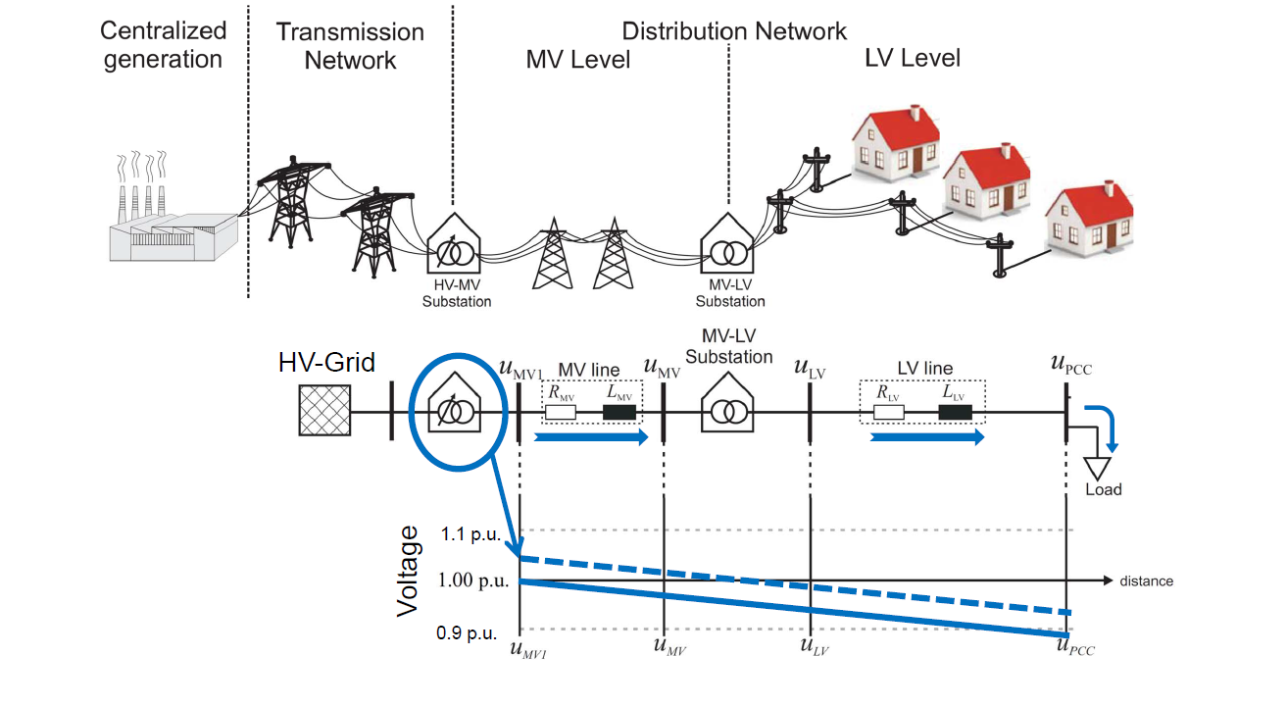
3. System Problems and Power Electronic Solutions
J. P. da Costa et. al.: Uni Kassel, KDEE, 2011
J- P- da Costa, Uni Kassel, KDEE

Slide 38
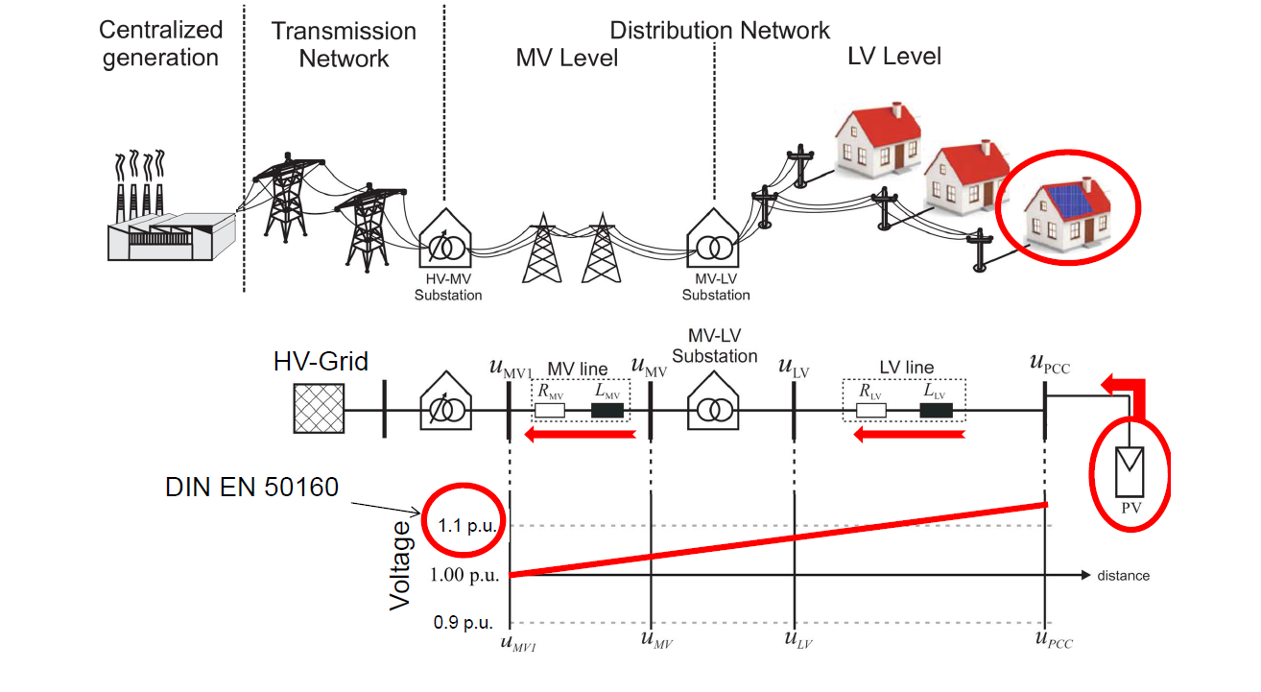
3. System Problems and Power Electronic Solutions
J. P. da Costa et. al.: Uni Kassel, KDEE, 2011
J- P- da Costa, Uni Kassel, KDEE

Slide 39
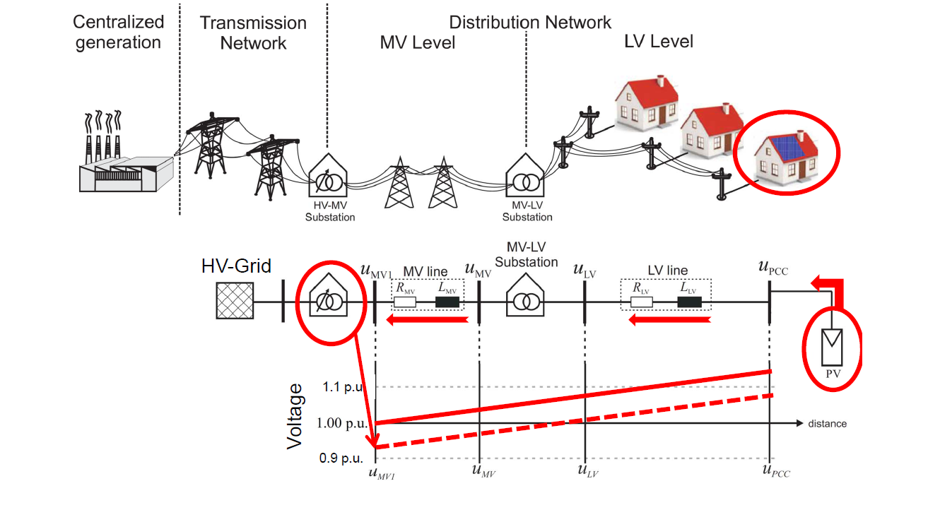
3. System Problems and Power Electronic Solutions
J. P. da Costa et. al.: Uni Kassel, KDEE, 2011
J- P- da Costa, Uni Kassel, KDEE

Slide 40
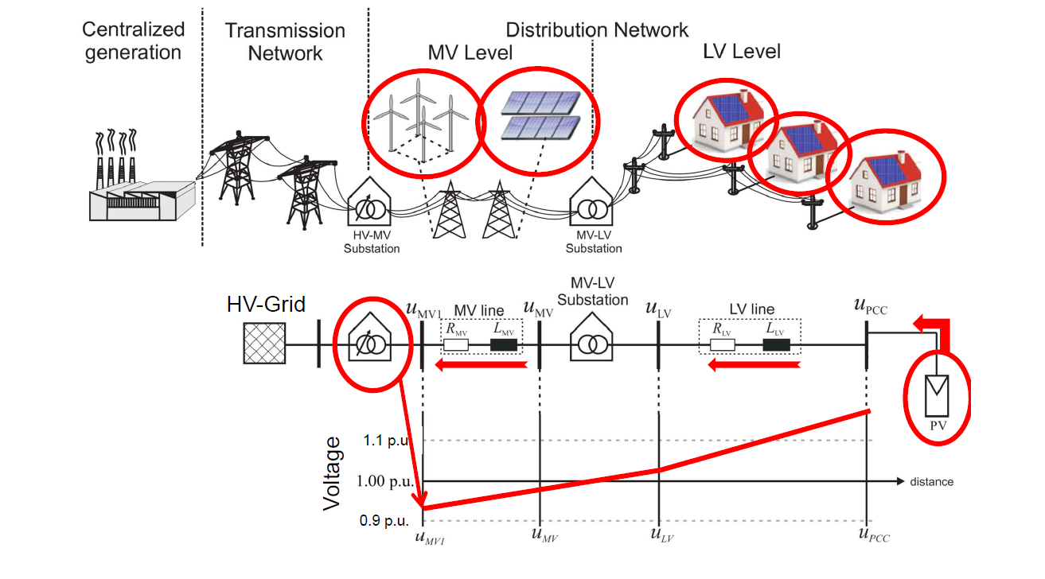
3. System Problems and Power Electronic Solutions
J. P. da Costa et. al.: Uni Kassel, KDEE, 2011
J- P- da Costa, Uni Kassel, KDEE

Slide 41


Power electroncis based voltage control in distribution grids
opens a new huge market for power electronics
3~400V
cable length [m]
Q, P
Increasing the hosting capacity of LV grids up to 200% with power electronics!
Intelligent unified power controlling substation (UPFC) in the LV grid
W. Kruschel, J.P. da Costa, P. Zacharias, D. Mende, T. Bülo.
Case Study: Use of Power Electronic Voltage Regulators in Low
Voltage Distribution Networks.. ECPE Workshop, Kassel, März 2013

Slide 42
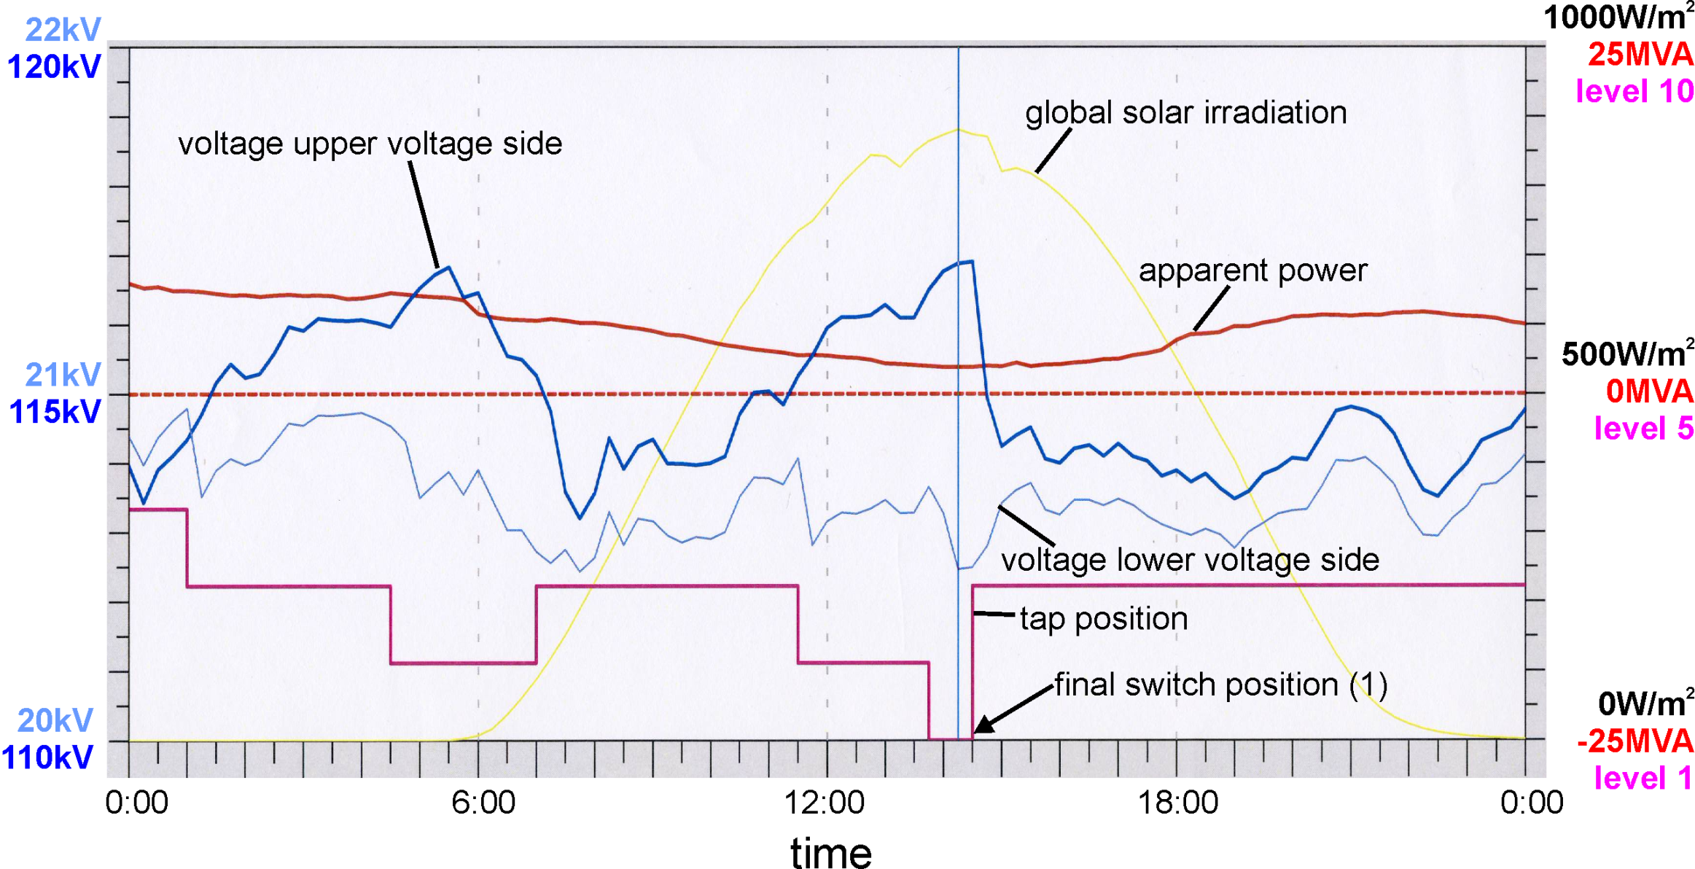
3. System Problems and Power Electronic Solutions
Measurements at a 110kV/20kV transformer at 26th May 2012 near Kassel
Source: diploma theses J. Busold; Uni Kassel 2012
Medium voltage distribution systems are influenced from higher voltage side (especially wind and excess of solar power) and have limited possibilities for reaction ➔ medium voltage control becomes important

Slide 43
General Problems in recent Electricity Networks
Feed in of distributed power sources
Visualisation of the voltage distribution in a medium voltage grid (green: close to the nominal voltage, red: close to the upper limit)
Source: master thesis J. Busold , Uni Kassel 2012

Slide 44
4. Useful Life Time and Reliability: Maximum Power Cycles of Bonds at IGBT Standard Modules
Number of cycles
Primary data: Application Notes eupec 2004

Slide 45
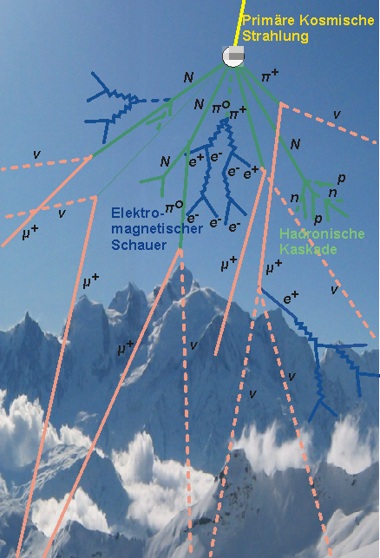
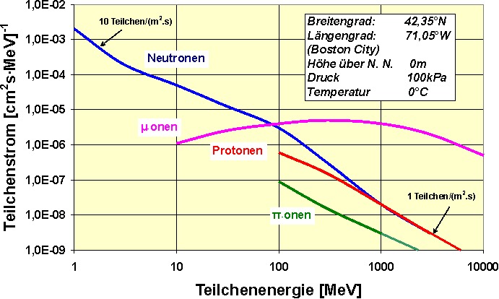
4. Useful Life Time and Reliability: Cosmic Particle Flow
Sources: J. F. Ziegler, “Terrestrial cosmic rays intensities,” IBM Journal of R & D,
Vol. 42, No. 1, pp. 117-140, 1998;
A. Astbury and D. Axen: Comparison of GEANT4 Simulation of Atmospheric Cosmic Rays with Measured Terrestrial Muon and Neutron Spectra, TRI--PP--06--14, Nov 2006
Cosmic particle interaction in compa-rison to the Mont Blanc mountain, according to an idea of CERN

Slide 46
FIT rates caused by cosmic rays at semiconductors at sea level
(pn-Dioden, Schottky-Dioden, IGBTs; 600V...6500V)
4. Useful Life Time and Reliability: Cosmic Particle Flow
Sources of basic data: ABB Semiconductors, Infineon AG, Microsemi,
Soelkner, G. et al. in Materials Science Forum Vols. 556-557, (2007)

Slide 47
4. Useful Life Time and Reliability: Cosmic Particle Flow
Influence of lower chip area on fail rate
100%
90%
Silicon
IGBT
3Gen
80%
U_{d}
70%
active area :
Assuming the same
FIT rates for
Si and SiC
at 1200V class
4,5cm
2
60%
likelyhood to fail within 20 years
50%
Silicon Carbide
40%
VJFET
3Gen
U_{d}
30%
active area :
0,6cm
2
20%
10%
0%
0
100
200
300
400
500
600
700
800
900
1000
1100
1200
DC link voltage U
d
[V]

Slide 48
4. Useful Life Time and Reliability: Cosmic Particle Flow
Summary on the cosmic particle flow
Shielding of cosmic rays is realistically not possible
Malfunction is technology dependent (internal field strength profile)
Related to chip area, may calculated if failure rates are known
Si und SiC seem to perform comparably
Higher altitude of application or systems closer to the earth poles increase the problem
Rule: for longlife installations: U_{d} < ²/₃ U_{nom}!

Slide 49
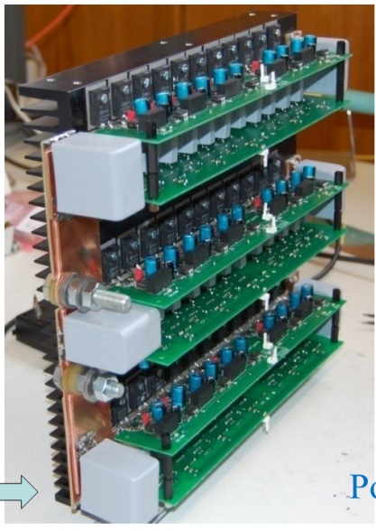
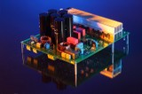
5. New Semiconductor Devices
At research level :
101% ?
In the Market:
KTH
Dez. 2011
99,7%
(Filter / devices in parallel?)
Sunny Tripower 20kW
Dez. 2011
99%
98%
Fraunhofer ISE
July 2009
99,03%
92%
ISET/University of Kassel
March 2008
98,8%

Slide 50
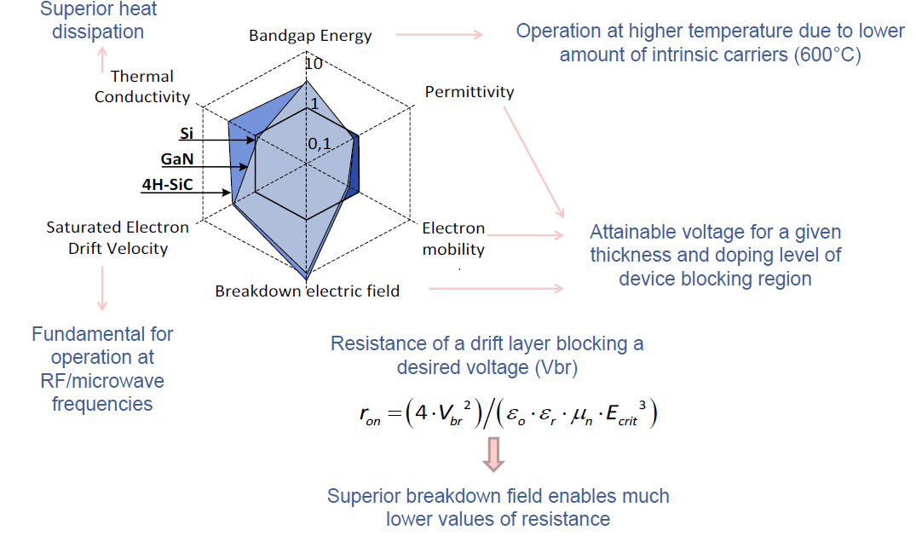
5. New Semiconductor Devices: Wide Band Gap Devices
Source: S. Araújo: Wide Band-Gap Power Devices in Power Conversion for Renewables, ECPE Workshop „Power Electronics in the
Electrical Network”, 12 – 13 March 2013, University of Kassel

Slide 51
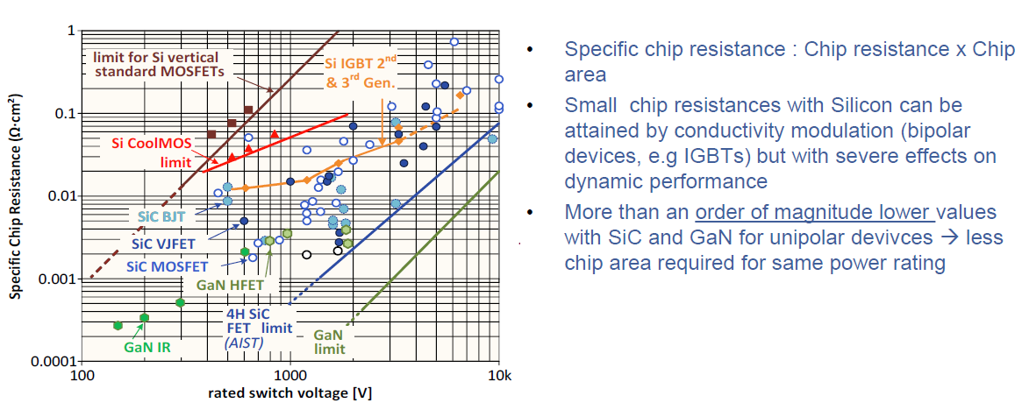
5. New Semiconductor Devices: Wide Band Gap Devices
Source: S. Araújo: Wide Band-Gap Power Devices in Power Conversion for Renewables, ECPE Workshop „Power Electronics in the
Electrical Network”, 12 – 13 March 2013, University of Kassel

Slide 52
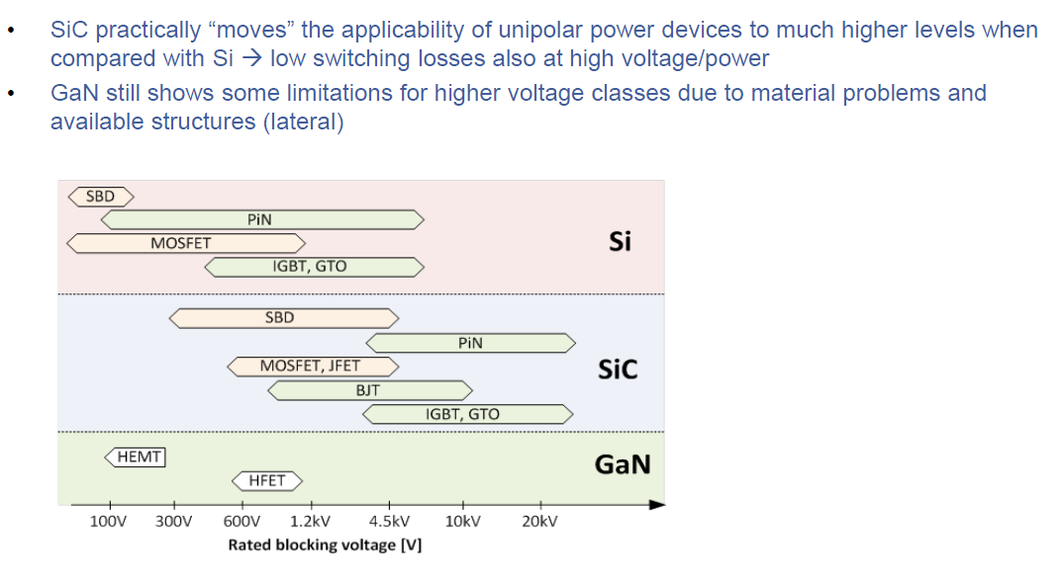
5. New Semiconductor Devices: Wide Band Gap Devices
Source: S. Araújo: Wide Band-Gap Power Devices in Power Conversion for Renewables, ECPE Workshop „Power Electronics in the
Electrical Network”, 12 – 13 March 2013, University of Kassel

Slide 53
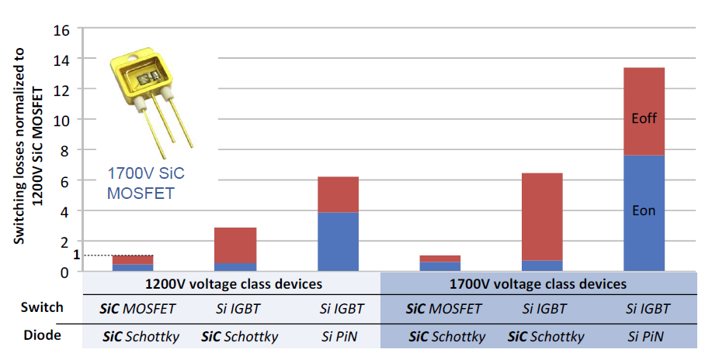
5. New Semiconductor Devices: Wide Band Gap Devices
Source: S. Araújo, PhD thesis, University of Kassel 2013

Slide 54
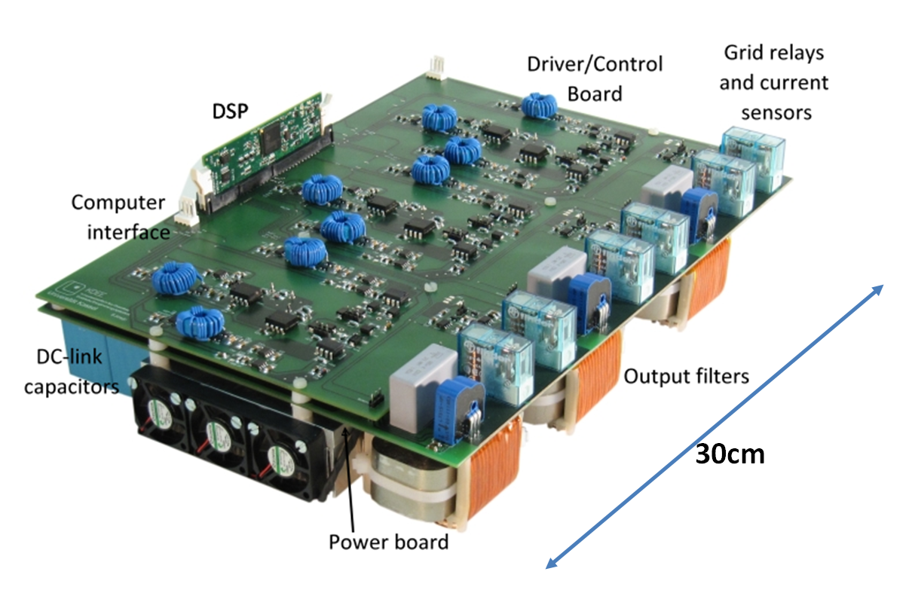
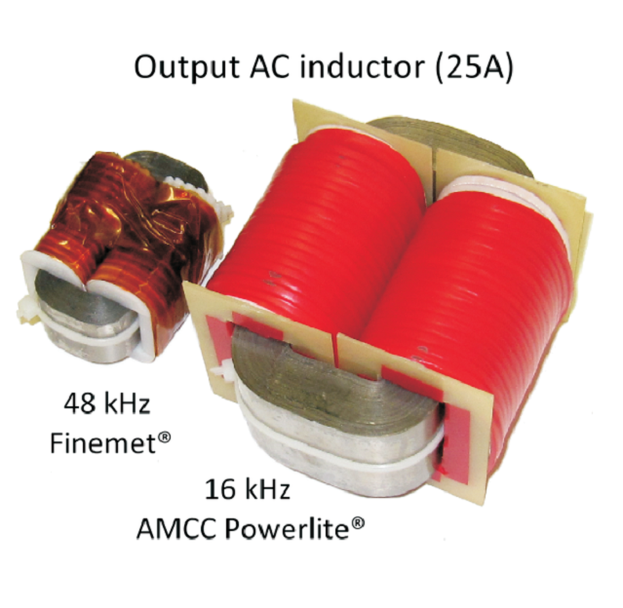
5. New Semiconductor Devices: Size reduction with SiC switches
First measurements indicate peak efficiency around 99% at 48kHz without overrating of semiconductor devices
Further increase of switching frequency to be investigated
Possible increase of power level (board already constructed for 11kW with possible parallel connection of two JFETs)
Araújo, S./ Uni-Kassel / Presented at PCIM Nuremberg 2011

Slide 55
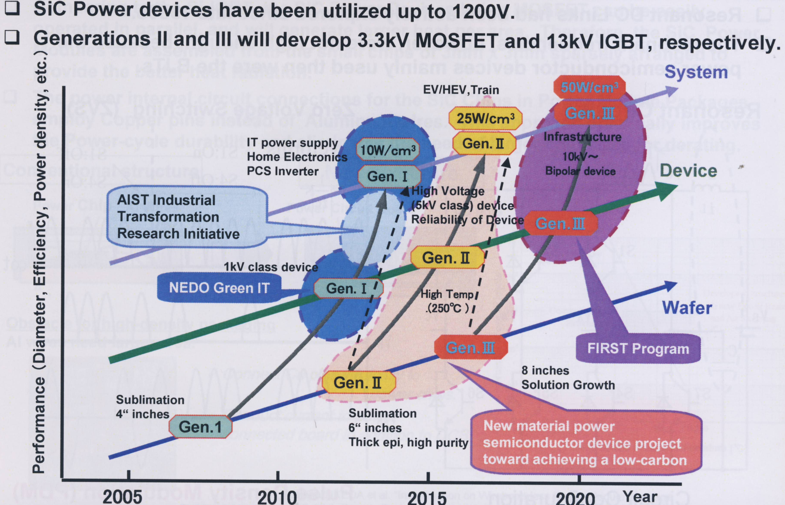
5. New Semiconductor Devices: Japanese Programs for SiC
Fuji Electric,
TIA Power Electronic Summer School, Tsukuba 2012

Slide 56
6. Zusammenfassung
Durch die Umgestaltung des Energieversorgungssystems spielt die Leistungselektronik eine immer größere Rolle in allen Systembereichen
Mit leistungselektronischen Konvertern hat man flexible Systemkomponenten zur Bereitstellung der elektrischen Energie, der flexiblen Steuerung der Energieströme und der Qualität des elektrischen Energie beim Verbraucher
Die hohen Lebensdauererwartungen von 20-50 Jahren stellen an die Halbleiterbauelemente hohe Erwartungen, die durch neue Halbleiter mit hohem Bandabstand erfüllt werden können

Slide 57
Thank you for your attention!
Vielen Dank für Ihre Aufmerksamkeit!
Please visit us at:
Besuchen Sie uns auf: www.kdee.uni-kassel.de

