Slide 1

Kernenergie – Die sichere Entsorgung und Endlagerung der nuklearen Abfälle
D. Bosbach
21. Oktober 2016 │ Arbeitskreis Energie (DPG), Bad Honnef

Slide 2
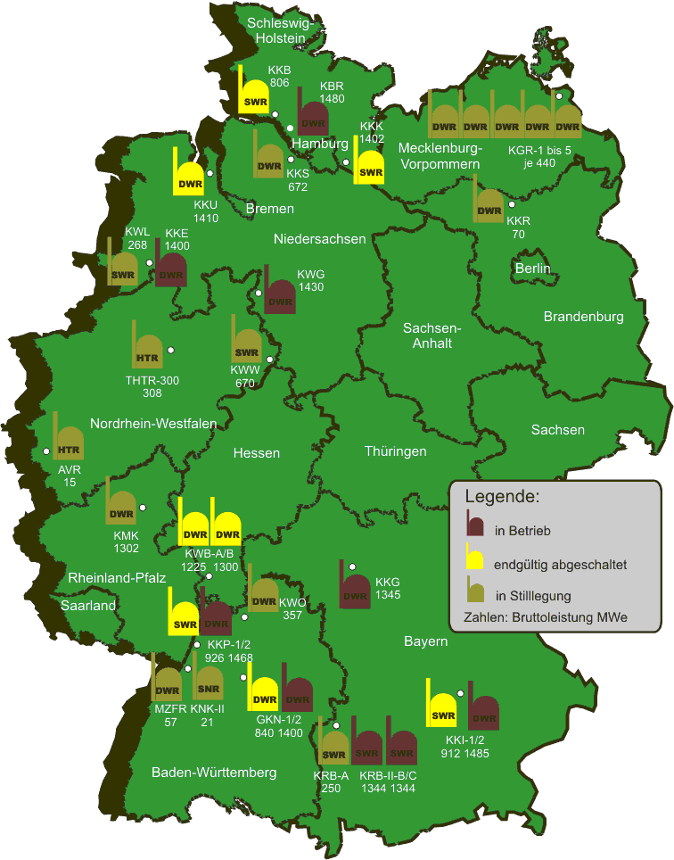
Nuclear Energy in Germany
Electricity production by nuclear energy will be terminated by 2022 (Atomic Energy Act, August 2011).
Decommissioning of all nuclear power plants will take several decades.
The repository site selection act (July 2013) re-defines the site selection procedure for the high level waste repository.
Repository Konrad for low- and intermediate level waste will start operation in the next decade.

Slide 3
Decommissioning of nuclear facilities
In Germany …
  about 300,000 m³ LILW up to 2080
  repository Konrad for low- and intermediate level waste will start operation in the next decade
… and abroad
  EU: about 40 NPP will reach their envisaged life-time at about 2025 and …
  about 300 NPP world-wide by 2030
Moreover:
  decommissioning/dismantling of research reactors, research installations, reprocessing facilities, …
Caption:
In operation
operation terminated
in decommissioning
numbers: output (MWe)

Slide 4
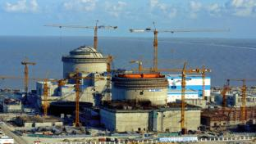
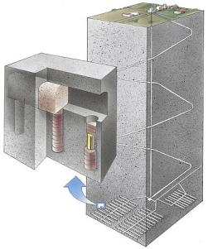
Nuclear Energy beyond Germany
On an international level, nuclear energy seems to have a long-term perspective with currently 68 new builds in various countries including neighbouring countries.
The first deep-geological repositories for high level waste in Europe will start operation in the early 2020s.

Slide 5
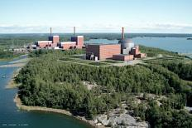
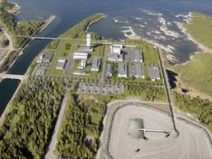
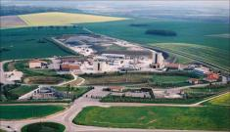

Geological Disposal seems to be the best option
OECD NEA RWMC collective statement, 2008
There is overwhelming scientific consensus world-wide that geological disposal is technically feasible
30+ years of R&D needed for the first license applications in Europe
Sweden 76: March 2011 (35 yrs)
operation 2029 (53 yrs)
Finland 78: Dec. 2012 (34 yrs)
operation 2022 (44 yrs)
France 70's: 2015-2017 (35-40 yrs)
operation 2025 (ca.50 yrs)
C.Davis, EC

Slide 6

Waste Directive 2011
States that each Member State (MS) is responsible for its policy on RWM
Need to include planning and implementation of disposal options
Recognizes that development of a disposal facility needs many decades
Radioactive Waste management (RWM) is based on state-of-the-art science and technology
Requires establish.t and implementation of national programmes, Art. 12
milestones & timeframes for implementation
Technical solutions for all steps including disposal
RD&D activities
Requires arrangements for expertise and skills, Art.8
"arrangements for education and training, as well as research and development activities in order to obtain, maintain and to further develop necessary expertise and skills."
Requires competent regulatory authorities for safety of Spent Fuel (SF) and RWM
Requires int.l Peer Reviews of nat.l Framework & prog. every 10 years

Slide 7
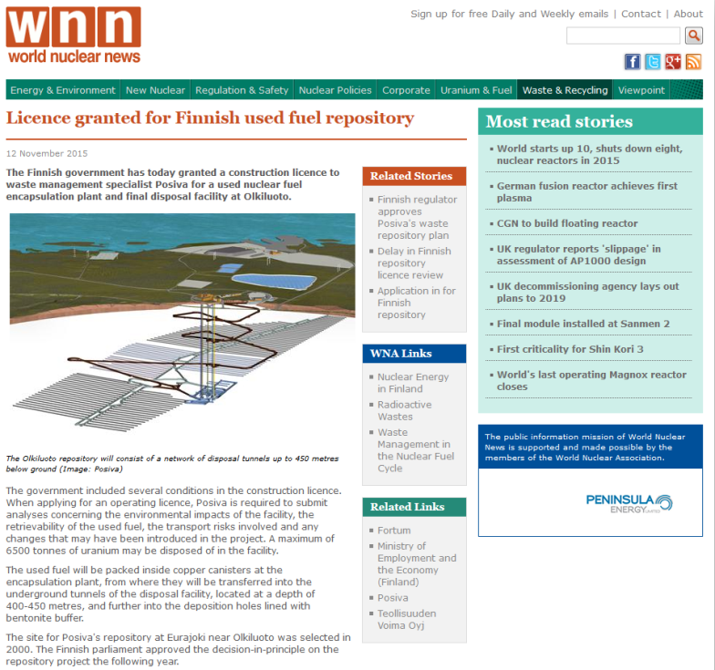

Slide 8
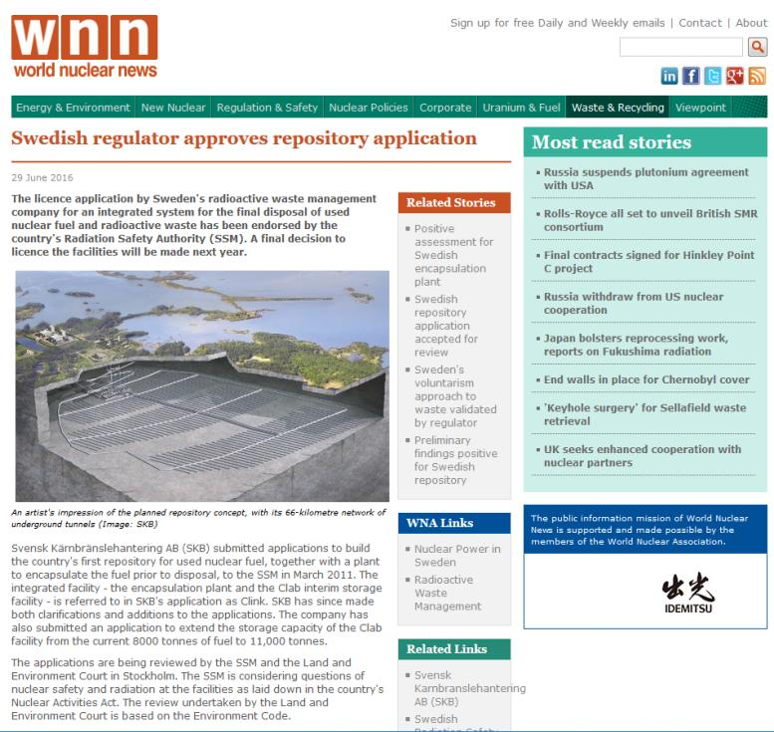

Slide 9
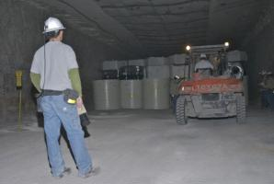
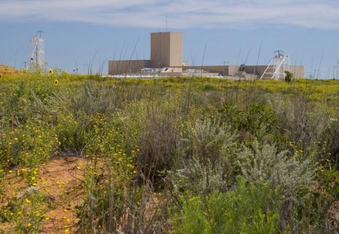
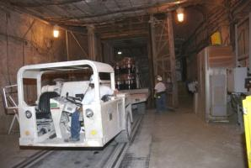
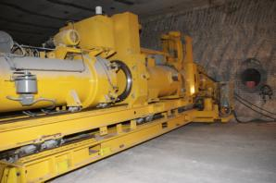
Waste Isolation Pilot Plant (WIPP)
Carlsbad, New Mexico (US Department of Energy)
Endlagerung von Transuranabfällen, die bei der Waffen-produktion angefallen sind (650m Tiefe, 180.000 m³ bis 2030).

Slide 10
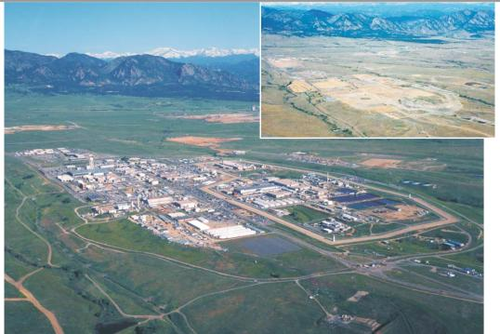
Cleanup of Rocky Flats Nuclear Weapons Plant
DOE
DOE 1995 estimate: $37 billion and 70 years
Clean up finished 31.12.2006: $7 billion and 10 years

Slide 11
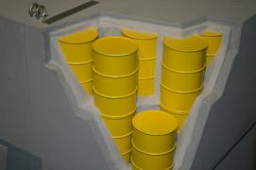
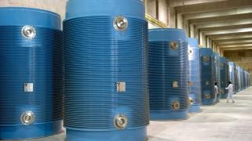
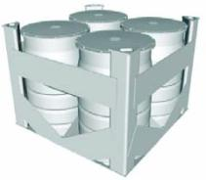
Radioactive wastes
Radioactive wastes:
  generated in all stages of the nuclear fuel cycle, but also in various industrial activities (incl. NORM), research and medicine
Wastes in the nuclear fuel cycle :
  uranium mining & processing: mine tailings, waste rocks, …
  enrichment & fuel fabrication: depleted uranium (if considered as waste), …
  nuclear energy generation: spent nuclear fuels containing fission products (e.g. ¹³⁷Cs, ¹³⁵Cs, ¹³¹I, ¹²⁹I, ⁹⁹Tc, ⁹⁰Sr, ⁷⁹Se, ...) and actinides (e.g. ²³⁹Pu, ²³⁹Np, ²⁴²Am, ...) due to neutron capture; activated structural materials; operational wastes (e.g. ion-exchange resins, wiping tissues, ...)
  reprocessing: vitrified wastes, secondary wastes
  decommissioning wastes: activated materials/metals, rubble, ...

Slide 12
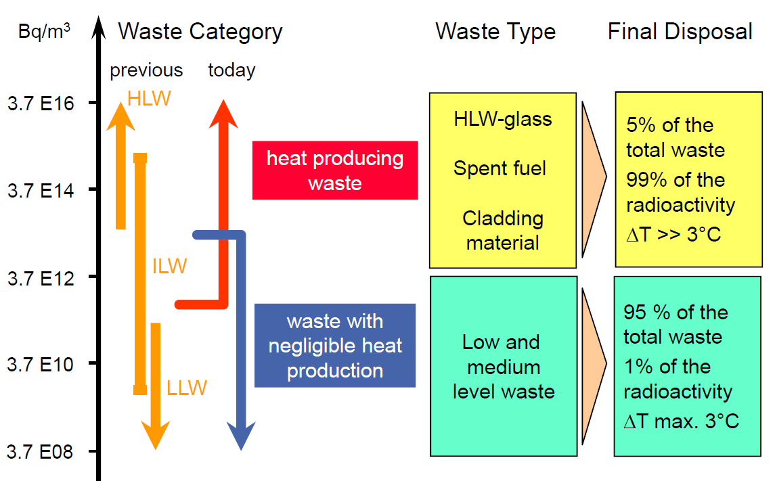
Categories of nuclear wastes
spent fuel
HLW-glass
cladding
material
5% of the total waste
99% of the radioactivity
ΔT >> 3 K
low and intermediate level waste
95% of the total waste
1% of the radioactivity
ΔT < 3 K

Slide 13
Spent / used nuclear fuel
²³⁵U (33 kg)
²³⁵U (8 kg)
Fission products & actinides
(49,26 Kg)
FP (35 kg)
3 a
Pu (9 kg)
²³⁶U (4,6 kg)
33 GWd/tU
Minor actinides
Np (0,5 kg)
Am (0,12 kg)
Cm (0,04 kg)
²³⁸U (967 kg)
²³⁸U (943 kg)
Nuclear fuel
SF / UNF

Slide 14
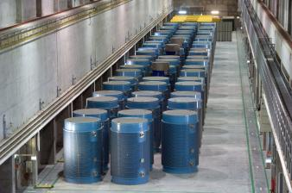
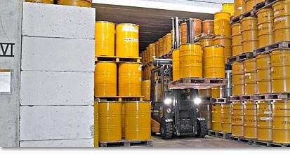
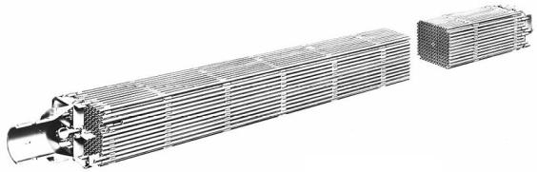
Nuclear waste in Germany
non-heat-generating wastes: (L-/ILW) | 304,000 m³ (until 2080)
heat-generating wastes: (HLW) | 28,100 m³
used nuclear fuel (until 2022): | 17,220 t_{HM}
reprocessed | 6,670 t_{HM}
LWR-fuel for direct disposal | 10,550 t_{HM}
HLW-glass (CSD-V) | 670 m³
MAW-glass (CSD-B) | 25 m³
compacted waste (CSD-C) | 740 m³
other wastes (e.g. HTRSF, RRSF) | 5,710 m³
[source: BfS 2015]

Slide 15
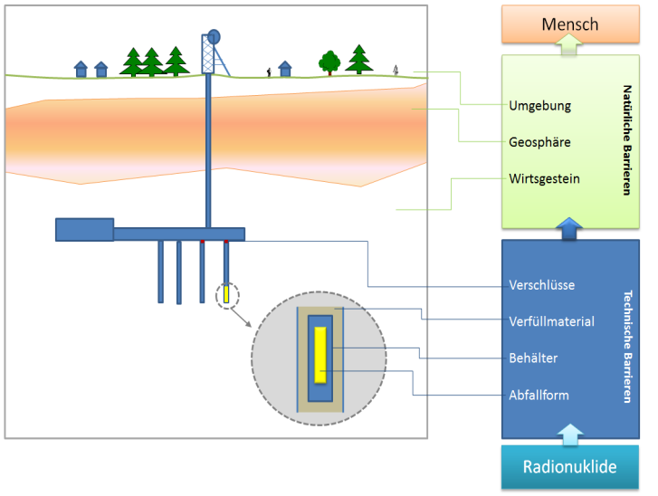
Disposal of nuclear waste in a deep geological formation
Multibarriensystem
Isolating rock zone

Slide 16

Why deep geological disposal of radioactive wastes?
COUNCIL DIRECTIVE 2011/70/EURATOM of 19 July 2011 establishing a Community framework for the responsible and
safe management of spent fuel and radioactive waste
Responsible and safe waste management required to avoid undue burdens for future generations
High level of safety required to protect workers and the general public against
the dangers arising from ionizing radiation
” It is broadly accepted at the technical level that, at this time,
deep geological disposal represents the safest and most sustainable option
as the end point of the management of high-level waste and spent fuel considered as waste.”

Slide 17
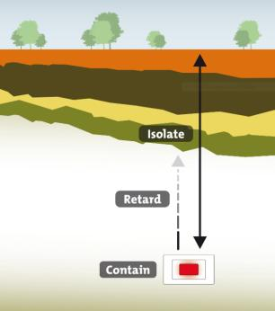
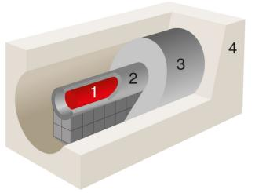
Safety principles of geological disposal
General protection objectives:
  protection of people and the environment against the dangers arising from ionizing radiation
Approach:
  isolation of waste from the biosphere and against inadvertent human intrusion
  concentration and containment
  (retardation)
Containment of waste by “defense in depth” multi-barrier system
Passive safety over geological time scales
First priority: long-term safety
1 waste form
2 waste container
3 engineered barrier
4 geological barrier

Slide 18
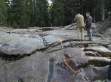
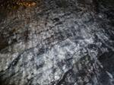
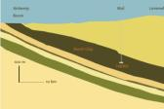
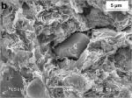
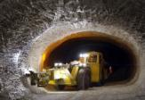
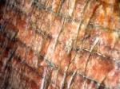
Host rocks for geological repositories
Crystalline rocks
Clays/Clay rocks
Salt
  mechanical stability
  thermal conductivity
  moderate radionuclide-retention capacity
  fractures
  advective transport
  low hydraulic conductivity (diffusional transport)
  high radionuclide-retention capacity
  self-sealing capacity
  low thermal resistance
  low mechanical stability
  low hydraulic conductivity
  plasticity (convergence)
  thermal conductivity / temperature resistance
  water soluble
  low radionuclide-retention capacity
Sweden, Finland, Czech Republic, Germany???
France, Switzerland, Belgium, Germany???
USA (TRU), Poland, The Netherlands, Germany???

Slide 19




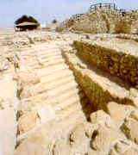
Long-term safety of nuclear waste disposal
The scientific & technical challenge is to demonstrate the safety over extremely long (geological) time scales – up to several 100,000 years.
Half-life Pu-239
25000
20000
15000
10000
5000
Years

Slide 20
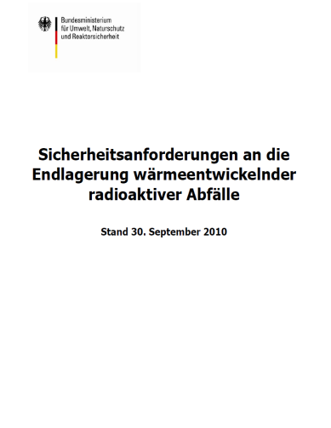
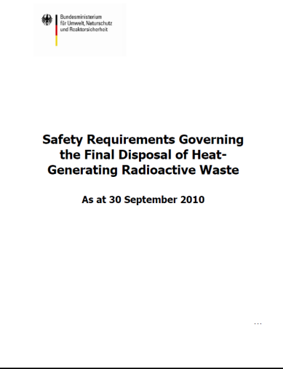
Safety requirements & criteria in Germany
Safety principles
  concentration and containment of radionuclides
  in the isolating rock zone (IRZ)
  release of radioactive substances from the
  final repository only negligibly increases risks
  associated with natural radiation
  no (planned) intervention or maintenance in
  the post-closure phase
  Comprehensive site specific safety analysis
  and safety assessment covering a period of
  one million years required
  Retrieval of waste must be possible
  during operational phase
  Managebility of containers for up to
  500 years must be guaranteed for recovery

Slide 21
Site selection for a HLW-repository in Germany
Legal framework: Standortauswahl-gesetz - StandAG of 23.07.2013:
  science-based, transparent approach
  stepwise, comparative selection of a site providing “best possible safety” for one million years
  blank map
  decision on site in 2031
  criteria & methods to be developed
  upfront by the commission „Lagerung hoch radioaktiver Abfallstoffe“
Criteria / requirements (AK End 2002)
  Exclusion criteria
  large-scale up-lift (> 1 mm/a)
  active faults
  seismicity
  Quaternary/expected volcanic activity
  young groundwater in IRZ
  Geoscientific requirements
  depth IRZ surface > n x 100 m
  thickness & size of IRZ
  low hydraulic conductivity of IRZ
  max. repository depth
  Criteria for consideration
  favourable hydrogeochemical
  conditions
  no/slow transport in groundwater in IRZ and repository
  feasibility of characterisation
  predictability of properties
Criteria to a large extent endorsed
by DAEF in 2014
Subject of report of the commission „Lagerung hoch radioaktiver Abfallstoffe“

Slide 22
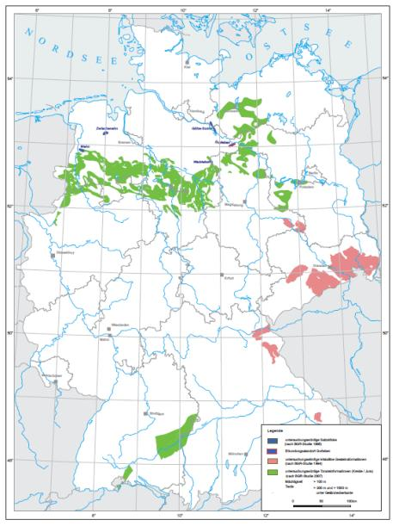
Potential regions for a HLW-repository in Germany
crystalline rocks
clays & clay rocks
salt deposits
[based on BGR 2007]

Slide 23

Next steps … (in Germany)
Bundesamt für kerntechnische Entsorgungssicherheit (BfE)
(… reguliert das Standortauswahlverfahren)
Bundesgesellschaft für Endlagerung mbH (BGE)
(… als „implementor“, Vorhabensträger)
Die „Endlagerkommission“ hat elf Kriterien festgelegt, die vor allem die geologischen Voraussetzungen, wie Stabilität und Wasserundurchlässigkeit, sowie das Verfahren für die Öffentlichkeitsbeteiligung bestimmen.
Vergleich verschiedener Endlagerstandorte (abgestuftes Verfahren).
Begleitende Sicherheitsanalysen unter Berücksichtigung des Endlagerkonzeptes.

Slide 24

DBE TECHNOLOGY GmbH, Forschungszentrum Jülich GmbH, Gesellschaft für Anlagen- und Reaktorsicherheit (GRS) mbH, Helmholtz-Zentrum Dresden-Rossendorf (HZDR),IfG Institut für Gebirgsmechanik GmbH, Institut für Sicherheitstechnologie (ISTec) GmbH, Karlsruher Institut für Technologie (KIT), Öko-Institut e.V., Institut für Bergbau und Spezialtiefbau der Technischen Universität Bergakademie Freiberg, Institut für Endlagerforschung der Technischen Universität Clausthal.

Slide 25
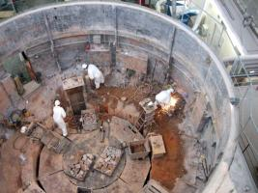
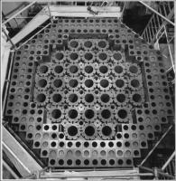
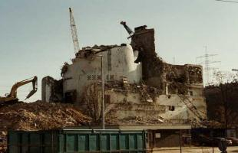
Decommissioning & waste management
Technologies for decommissioning and dismantling of nuclear facilities and the safe management of associated waste streams developed during recent decades
Current R&D focussing especially on optimisation regarding, e.g. radiation exposure of personal, economic aspects, clearance, etc.
However, some special (“problematic”) waste streams arising during decommissioning have not been in the focus of R&D activities in the past, i.e.
  safe, efficient, and cost effective processing methods not readily available
  technologies for the treatment of the waste types not yet established for routine waste management, and/or
  waste-type failed to meet criteria for acceptance for available processing technologies or waste acceptance criteria for disposal

Slide 26
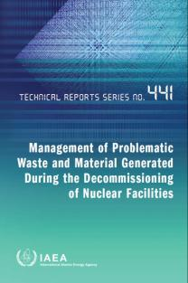
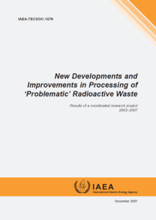
Problematic waste streams
irradiated graphite (i-graphite)
spent ion-exchange resins (SIER)
radioactive toxic metals, e.g.
  mercury
  cadmium
  beryllium
contaminated NAPL and decontamination fluids
asbestos & PCB containing wastes
mixed waste containing chemotoxic and/or hazardous constituents
(legacy wastes)
often comparatively small waste streams

Slide 27
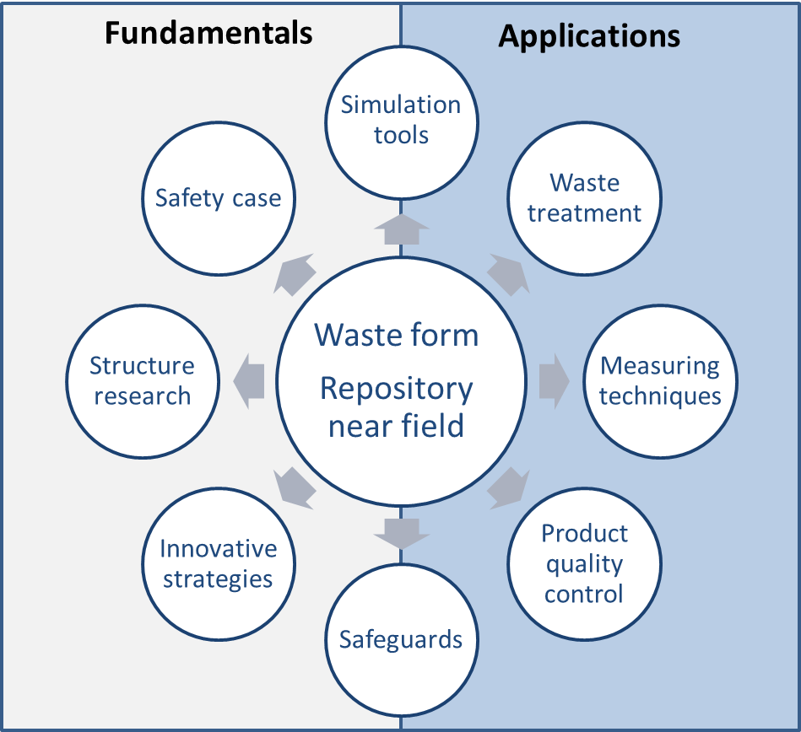
Materials science for waste management
molecular scale
nanoscale
microscale
macroscale

Slide 28
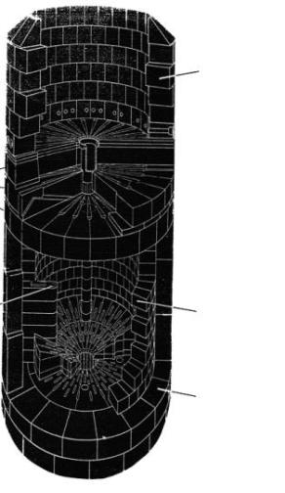
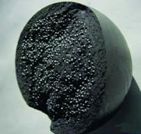
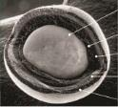
Irradiated reactor graphite (i-graphite)
Primarily graphite is used as a moderator
Carbon bricks
… but also as a structural component
  control rod channels
  coolant channels
  reflector bricks
  fuel compacts
i-graphite arisings:
Germany: ∼ 1000 Mg
Worldwide: > 250,000 Mg
Graphite segments
Carbon bricks
Variety of different types of reactor graphite with individual
structure, composition and history

Slide 29
Irradiated reactor graphite: issues
long-lived activation products (AP):
impurities(n,X)APs (¹⁴C, ³H, ³⁶Cl etc.)
Complex structure of reactor graphite depending on the fabrication technology
Individual impurity inventories result in unique inventory and distribution of APs
Unique radiation-induced structure and surface properties / reactivities
Unique RN release behavior in every irradiated graphite type affected by storage conditions
No standardized technical solutions for the safe management
of irradiated graphite available worldwide

Slide 30





R&D issues for i-graphite
Phenomenological investigations of i-graphite so far do not allow for
an understanding of i-graphite behaviour during treatment & disposal
Fundamental investigations of the properties of i-graphite required
to develop safe waste management solutions
R&D themes:
  chemical speciation, binding sites and partitioning of radionuclides
  mechanisms of radionuclide release (e.g. ¹⁴C, ³H, ³⁶Cl)
  theoretical understanding & modeling of i-graphite surface reactivity
  multi-scale modelling of graphite waste behaviour
R&D aims:
Characterization and understanding of i-graphite properties
Development of approaches for graphite waste minimization
Understanding of i-graphite behaviour during storage and disposal
CarboDISP

Slide 31
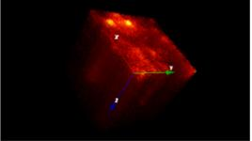
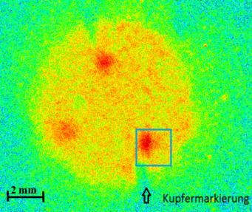
Radionuclide distribution in i-graphite
Distribution of APs “follows” their precursors – impurities
100 μm
TOF-SIMS depth profile of ³⁵Cl in reactor graphite
Autoradiographic images of hot-spots in reactor graphite
Inhomogeneous distribution of APs in irradiated graphite causes difficulties in an „up-scaling” of RN inventory from radioanalysis

Slide 32
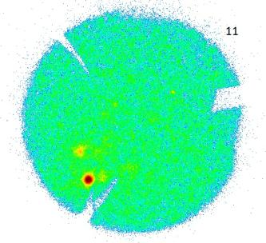

Location of ¹⁴C in i-graphite
EDX signal – carbon
∅=20mm
Autoradiography of hot-spots in reactor graphite
SEM image of a hot-spot
¹⁴N(n,p)¹⁴C (95%)
¹³C(n,γ)¹⁴C (≈5%)
¹⁷O(n,α)¹⁴C (<0.01%)
Accumulation of ¹⁴C on the pore surface, following its precursor ¹⁴N (e.g. adsorbed N₂)
Up-scaling of inventory and spatial distribution of RN in i-graphite required for optimization of decontamination and clearance

Slide 33
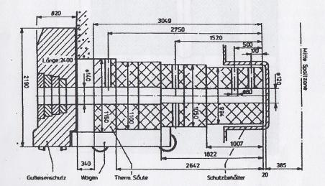
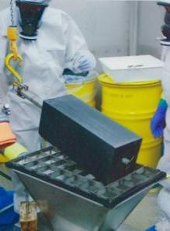
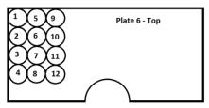
Sampling of i-graphite: an important issue
Thermal column RFR (c. 4 Mg)*
∅=20mm
*R. Knappik “Behandlung von Nukleargraphit im VKTA”, 2016
Knowledge of sample position and irradiation history (atmosphere,
neutron flux, irradiation & cooling time, etc.) essential

Slide 34
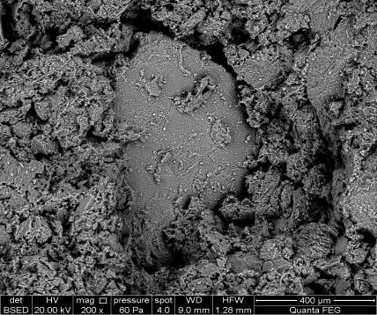
Treatment option: mechanical fractionation
Hypothesis: ¹⁴C is accumulated on the pore surface of the binder material
¹⁴N(n,p)¹⁴C (95%)
¹³C(n,γ)¹⁴C (≈5%)
¹⁷O(n,α)¹⁴C (<0.01%)
Porous pitch binder (ca. 30%)
1-0.5 mm
500-250 μm
250-100 μm
100-50 μm
<50 μm
Binder fraction
Filler fraction
crushing & fractionation
Crystalline filler particles (ca. 70%)
Treatment: Crushing and fractionation (e.g. sieving) of graphite
followed by characterization of structure and ¹⁴C distribution

Slide 35
Mechanical fractionation of i-graphite
¹⁴C activity distribution in different graphite fractions*
¹⁴C enriched in fine fraction – a promising way to reduce the
amount of graphitic wastes?
*L. Kuhne et al., Final report of BMBF project CarboDisp, 2015

Slide 36
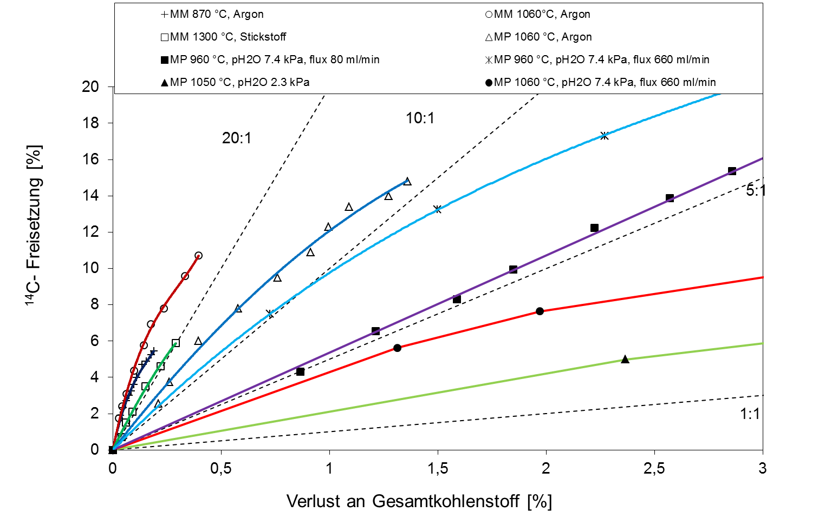

Thermal treatment of i-graphite
¹⁴C release, [%]
Selectivity of treatment:
C_{tot} mass loss, [%]
$$\frac{wt(14C)}{wt(Ctot)}>1$$
HT treatment in inert atmosphere improves selectivity of ¹⁴C separation

Slide 37


Storage and disposal of i-graphite
Kinetics of RN release and RN speciation: ¹⁴C as example
Corrosion (O₂, H₂O)
¹⁴CO₂, ¹⁴C_{org}/¹⁴CO
¹⁴CO₂, ¹⁴C_{org}/¹⁴CO
i-graphite + APs
¹⁴CO₃²⁻,
¹⁴C_{org}?
¹⁴CO₃²⁻, ¹⁴C_{org}?
Interim storage
Final disposal
Evaluation of release behaviour of APs and mobility under conditions relevant to interim storage (short-term) and final disposal (long-term)

Slide 38





Conditioning of i-graphite
Conditioning with/without prior treatment
Potential conditioning matrices
  cement
  geopolymer cements
  impermeable glass/graphite matrices
Evaluation of long-term behaviour of conditioned i-graphite under conditions relevant to geological disposal

Slide 39

Future perspectives: use of model materials
Lack of understanding of AP distribution and speciation
No unique model on release behaviour of APs
Unique structures & reactivities of every i-graphite type
n/γ
AP speciation and localization
Graphite
i-Graphite
AP release mechanisms
He
He
HOPG
Controlled conditions
Approach: use of model materials (HOPG, coke, binder) for separation of individual effects
  Experiments with simplified model systems/materials to interpret
  and predict the behaviour of i-graphite

Slide 40



Management of mercury from nuclear facilities
Various (historic) applications for mercury (Hg) in nuclear facilities
  coolant for early experimental fast reactors
  shielding in prototype reactors (e.g. PFR, DFR; UK)
  target material in accelerators
  window seals in hot cell facilities
  catalyst in isotope separation and uranium metal dissolution
Issues:
  radiological characterisation
  chemotoxic hazards / waste acceptance criteria
  decontamination / re-use
  immobilisation
Hg

Slide 41

Management of radioactive Hg @ FZJ
450 kg of contaminated Hg, collected during decommissioning of FZJ hot-cells
Unknown inventory (fission products, actinides, etc.)
Surface dose rate ≤ 1mSv/h
No authorization for mercury storage at FZJ interim storage
Disposal limit at KONRAD: 43 kg Hg
Up-coming project - PROcess of radioactive MErcury Treatment and Handling for Elimination Under Safety-Standards
PROMETHEUS – a joint BMBF-project on characterization, decontamination and clearance of radioactive mercury

Slide 42
Objectives & tasks of PROMETHEUS
PROMETHEUS (2016-2018):
Radiological characterization (α,β,γ) / nuclide vectors / scaling factors
RN-speciation in contaminated mercury collected at FZJ
Characterization of chemical composition of contaminated Hg (e.g. speciation, inactive additives, etc.)
Optimization of existing decontamination techniques: vacuum distillation,
Hg conversion, membrane extraction, electrochemical, etc.
Immobilisation of radioactive residues after processing
Development and optimisation of β/γ-counting technique for clearance of Hg

Slide 43

Management of irradiated beryllium
Be (or BeO) employed as neutron reflector and
moderator in research reactors
Issues
  activation during operation
  contamination possible depending on cladding
  highly chemotoxic
  incompatible with cementitious waste forms
⁹Be(n,γ)¹⁰Be
β⁻
⁹Be
1.38e+6 a
⁹Be(n,α)⁶He
β⁻
⁶Li(n,α)³H
0.807 s
⁹Be(n,2n)⁸Be
β⁻
2⁴He
7e-17 s
Impurities(n,X)APs (¹⁴C, ⁶⁰Co)
Irradiated Be in Germany
Institution | Amount of Be
GKSS Geesthacht (FRG-1) | 681.2 kg
HMI Berlin (BER-II) | 1582.6 kg
TU Munich (FRM-I) | 168.0 kg
HZDR Rossendorf (RFR) | 329.0 kg
Be
Disposal limit in KONRAD: 24.5 kg Be
Safe management solutions for
irradiated beryllium missing to date

Slide 44
Research perspectives for irradiated Be
Development of management strategies for irradiated beryllium
  Radiological characterization of irradiated Be
  Nuclide vectors & scaling factors (as function of irradiation history and material composition)
  Evaluation of decontamination techniques aiming at clearance of decontaminated beryllium and reduction of waste volumes
  Development of encapsulation materials
  Material behaviour under disposal conditions
  Alternative applications for re-use of decontaminated low-active Be
  Identification of optimal conditions for storage and disposal
  Requirements for safe handling of irradiated Be

Slide 45



R&D for non-destructive analyses of wastes
Purpose:
  compliance of waste packages with specifications and
  acceptance criteria for interim storage and final disposal
  inventories of radionuclides and chemotoxic elements
  heterogeneity of waste packages
  identification of shielding structures in waste packages
  accurate and reliable characterisation of waste packages
  at industrial scale
  characterisation of legacy wastes
Development/application of innovative passive and active
non-destructive techniques assisted by modern computational simulation tools, e.g.
  Segmented Gamma Scanning (SGS)
  Instrumental Neutron Activation Analysis
  P&DGNAA
  Fast Neutron Imaging
  Digital Radiography (DR)
  Transmission-Emission Computer Tomography

Slide 46




Radiography / Computer Tomography (TCT/ECT)
DR of a 200 L drum with 4 pellets
Counting time 85 min
Characterization of 200-L waste drums with respect to waste heterogeneity (density/activity)
  200 GBq Co-60 source in DU shielding
  collimation: tungsten, fan-beam, 8 mm × 300 mm
  3 HPGe-detectors for ECT & plastic scintillation-detectors with fan beam collimation
  imaging with Algebraic Reconstruction Technique (ART)
  resolution:
    density 3 … 5 %
    activity: 20 … 30 % for volume sources
TCT of a drum segment (concrete, metals)
Counting time 60 min
ECT for Co-60 in a drum segment
Counting time 12.5 h

Slide 47



Segmented-Gamma-Scanning (SGS)
Radiological characterization and quantification of gamma-emitting isotopes in 200-L waste drums
  collimated HPGe-Detector for gamma-ray measurement
  20 Segments (Δh = 4 cm) / 12 sectors (Δθ = 30°) –
  counting time 1 h per drum
  calibration based on homogeneous activity and density distribution
  radionuclide activity calculated from the sum-spectrum
  count rate distribution give qualitative information on waste heterogeneity (hot-spots)
R&D:
Improvement of reliability and accuracy of activity determination of radioactive waste drums with non-uniform isotope and matrix distribution including the presence of internal shielding structures
Cs-137 Count rate (662 keV)
Drum height
Rotation angle

Slide 48


Non-radioactive substances in nuclear wastes
MEDINA:
Multi-Element Detection based on INstrumental Activation Analysis
Assay of chemotoxic elements in 200-L waste drums
  Development
  concept and set-up
  parameterization (neutron flux, detector efficiency)
  influence of activity (Cs-137 and Co-60)
  algorithms for quantification
  validation
  analysis time 1 to 4 hours
  accuracy: 7±4 % (homog.); 14±7 % (inhomog.)
  R&D:
  Improved identification and quantification of chemotoxic elements in mixed wastes
1 T Crane
6.5 T Graphite
Reflector/Moderator
14 MeV Neutron Generator
HPGe-detector
Turntable inside the chamber

Slide 49


Slide 50







Forschungszentrum Jülich GmbH
(FZJ)
Materials science aspects of Nuclear Waste Management
Helmholtz – Zentrum Dresden – Rossendorf (HZDR)
Radionuclides in ecosystems
Karlsruher Institut für Technologie (KIT)
Aquatic geochemistry of actinides and fission products

Slide 51









Tiefengeologische Endlagerung ist die beste Option
In Deutschland: Endlager Konrad ab Mitte 20er Jahre, Endlager für hochradioaktive Abfälle gegen Ende des Jahrhunderts
Endlagerung in einigen EU Mitgliedsstaaten bereits weit fortgeschritten – erstes Endlager für hochradioaktive Abfälle Anfang der 20er Jahre (in Finnland)
Wissenschaftliche Basis und Begleitung - langfristig bis zum Verschluss des Endlagers erforderlich

