Slide 1
Interplay between energy and mobility: energy carrier for the mobility of the future
Thomas Hamacher
Lehrstuhl für Erneuerbare und Nachhaltige Energiesysteme Technische Universität München

Slide 2
A major step ahead of us
Content
Energy and mobility
Electricity or hydrogen: a first answer.
The real revolution: autonomous driving
And why autonomous cars will pave the way for electric cars
Conclusion and outlook

Slide 3
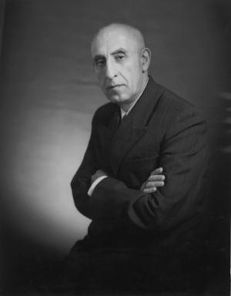
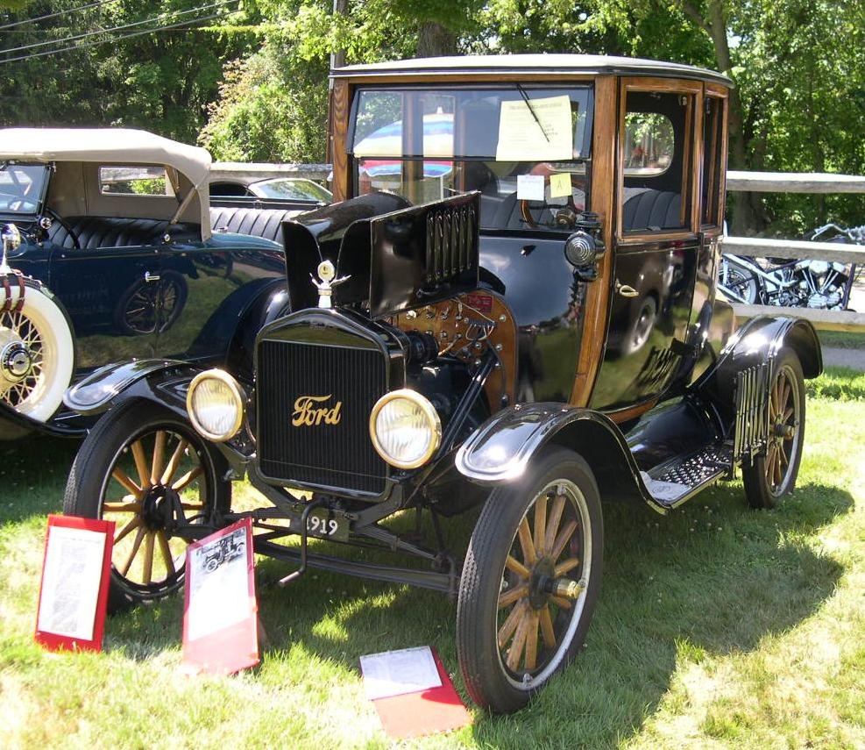
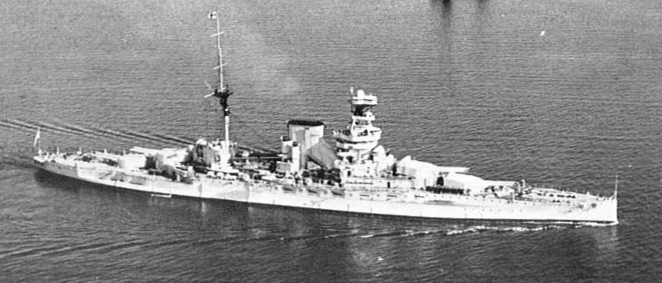
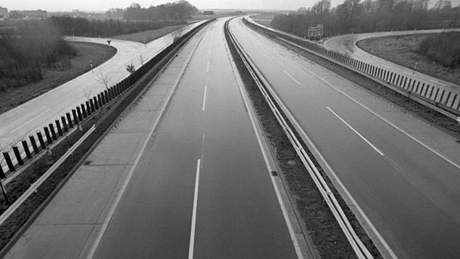
Internal Combustion Engine and Oil
Oil was the dominating energy carrier of the 21st century, especially of the second half.
Source: Wikipedia, SWR

Slide 4
A major step ahead of us
Content
Energy and mobility
Electricity or hydrogen: a first answer.
The real revolution: autonomous driving
And why autonomous cars will pave the way for electric cars
Conclusion and outlook

Slide 5
The competitors
Source: Felgenhauer, 2016

Slide 6
ICE versus BEV versus FCEV
Source: Felgenhauer, 2016

Slide 7
A system comparison
Source: Felgenhauer, 2016

Slide 8
The energy system overview
Source: Felgenhauer, 2016

Slide 9
The energy system: demand
Source: Felgenhauer, 2016

Slide 10
Solar Power
Source: Felgenhauer, 2016

Slide 11
Results: Overall Electricity Consumptions
Source: Felgenhauer, 2016

Slide 12
Results: Electricity Supply
Source: Felgenhauer, 2016

Slide 13
Results: Cost
Source: Felgenhauer, 2016

Slide 14
Results: Cost
Source: Felgenhauer, 2016

Slide 15
Results: Overall CO2-Emission

Slide 16
Results: CO2-Abatment cost
Source: Felgenhauer, 2016

Slide 17
A major step ahead of us
Content
Energy and mobility
Electricity or hydrogen: a first answer.
The real revolution: autonomous driving
And why autonomous cars will pave the way for electric cars
Conclusion and outlook

Slide 18
Autonomous Driving
Source: IFMO

Slide 19
Energy consumption and autonomous cars

Slide 20
Cost of autonomous cars: a case study Ann Arbor
Burns et al., Transforming personal
Mobility, 2013

Slide 21
A major step ahead of us
Content
Energy and mobility
Electricity or hydrogen: a first answer.
The real revolution: autonomous driving
And why autonomous cars will pave the way for electric cars
Conclusion and outlook

Slide 22
Autonomous cars
Long distance commuters
Robo-Taxi-Fleet

Slide 23
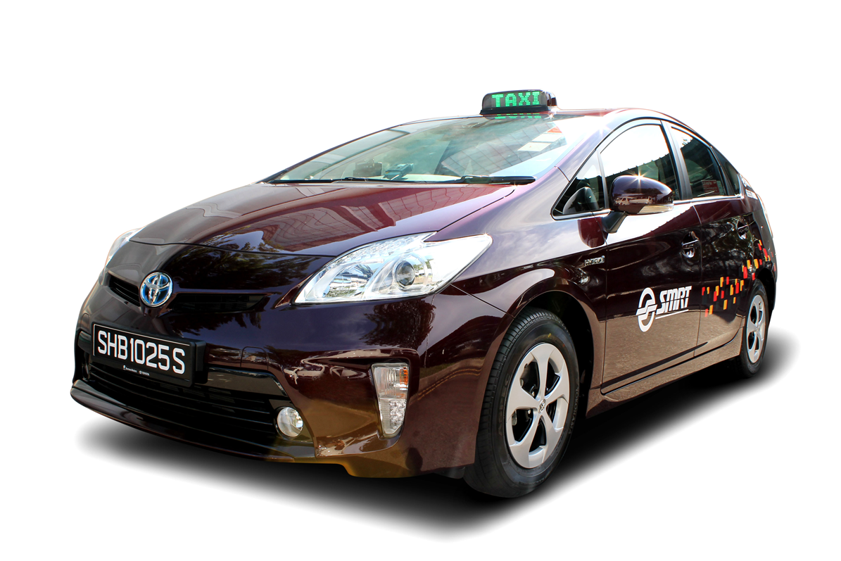
Analysis of Taxi fleet in Singapore
A good example for future autonomous
robo-taxis are
taxi fleets in busy cities like Singapore with daily
mileages of up to 500 km per car and day.
In a close collaboration between the taxi
company SMRT in Singapore and
TUM-CREATE an analysis showed
that with the new generation of BEVs
the a competitive operation of taxis is
possible, if charging stations are installed at
certain points in the city.

Slide 24
What will happen if we have electric robo-taxis as least cost option?
Reduced car ownership in cities (trend today)
Only electrical robo-taxis allowed in city centers (Umweltzonen)
Fast connection to public transport, airports, …
This will certainly pose a major challenge to existing public transport infrastructure and it will be a major question both can coexist in an optimal way.
As shown in Singapore electric taxis can supply most of the service. In case of autonomous cars even much easier.

Slide 25
What will happen if we have electric robo-taxis as least cost option?
Reduced car ownership in cities (trend today)
Only electrical robo-taxis allowed in city centers (Umweltzonen)
Fast connection to public transport, airports, …
This will certainly pose a major challenge to existing public transport infrastructure and it will be a major question both can coexist in an optimal way.
As shown in Singapore electric taxis can supply most of the service. In case of autonomous cars even much easier.

Slide 26
What happens if long distance travel becomes more convenient?
Imagine: 100 km from home to office, 1:15 driving time
8:00 in the morning, start working in the car, car connected via 5G to all databases and so forth in the office
9:15 start working in the office
15:30 start trip back
16:45 stop working when you arrive at home
Energy demand 2*15 kWh = 30 kWh, would cost 9 € today
The car can charge autonomous in special charging centers (flexible demand).
Children drive to school, music school, sport with robo-taxis and so on …
=> Settlement structures explode like many housing bubbles ….
Science fiction or possible mid-term future?

Slide 27
A major step ahead of us
Content
Energy and mobility
Electricity or hydrogen: a first answer.
The real revolution: autonomous driving
And why autonomous cars will pave the way for electric cars
Conclusion and outlook

Slide 28
Conclusion and outlook
BEV show clear advantageous regarding cost and PE-demand compared to FCEV, at least in a limited model environment.
Future developments in the mobility sector – especially autonomous driving – open completely new options which require a rethinking of the model.

