Slide 2


Energy Transition: Not Without Chemistry
Robert Schlögl
Fritz-Haber-Institut Berlin
MPI Chemical Energy Conversion, Mülheim

Slide 3

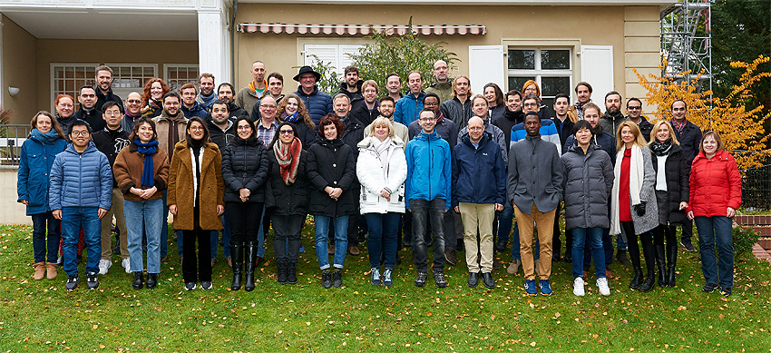
Acknowledgements
D. Teschner, R. Mom, L. Falling, T. Jones,
M. Greiner, S. Heumann, A. Knop-Gericke, Th. Lunkenbein, H. Ruland, K. Skorupska, A. Trunschke

Slide 4
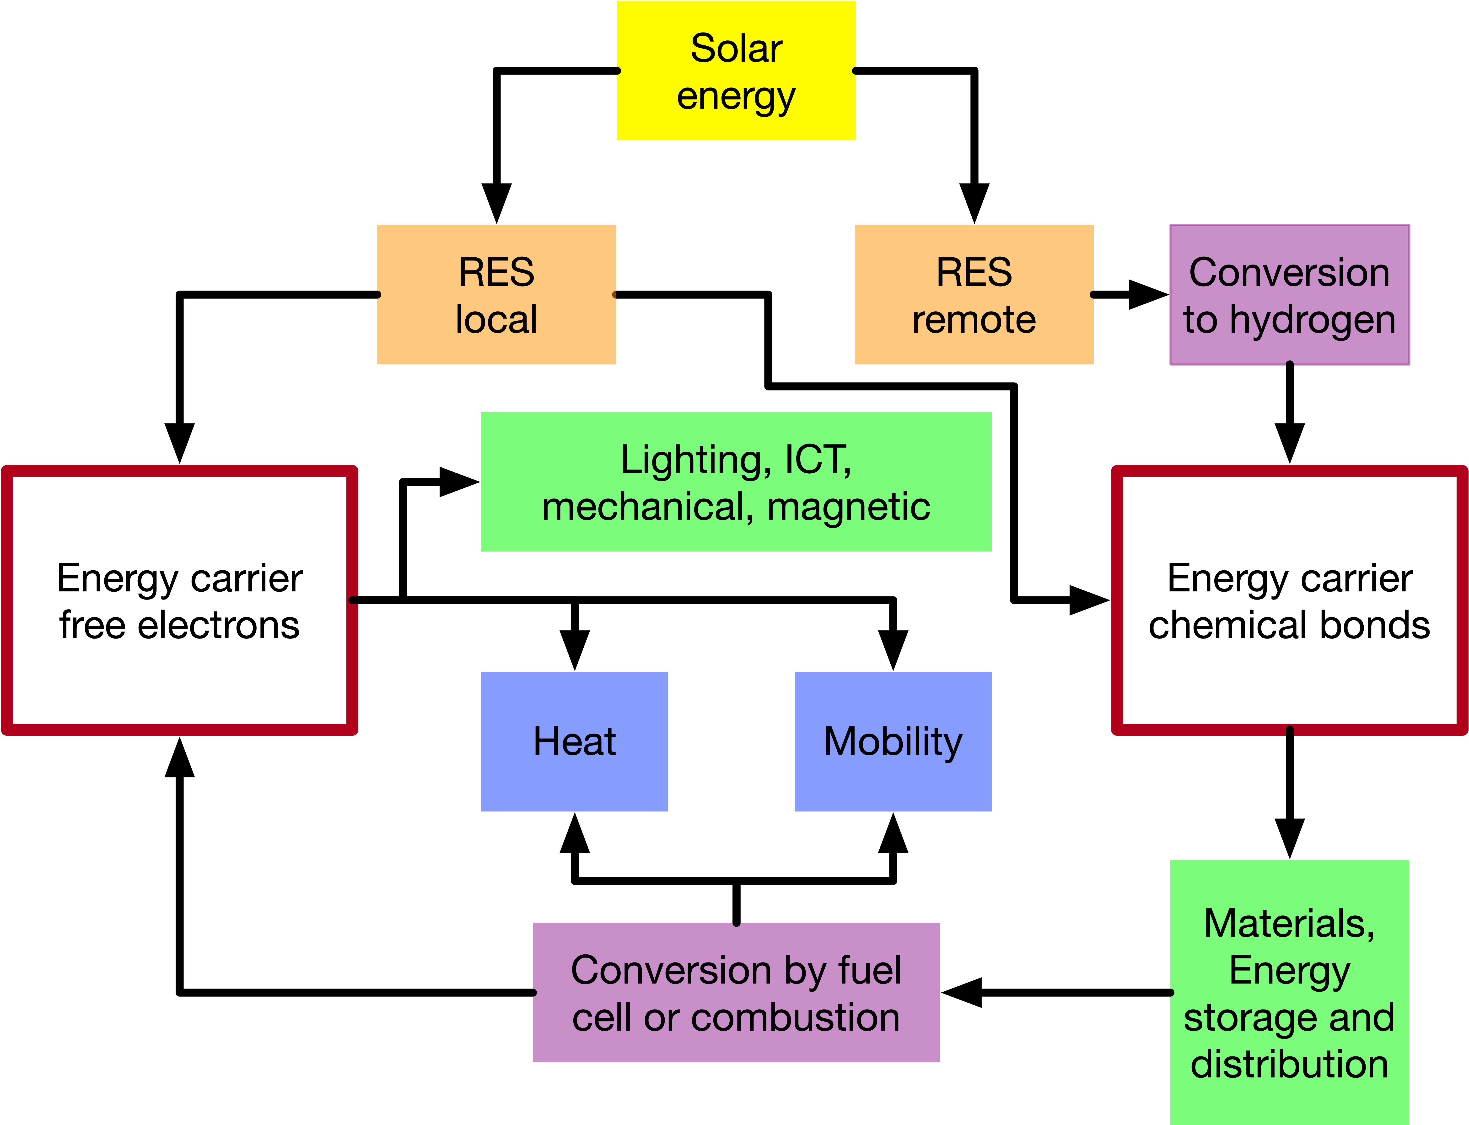
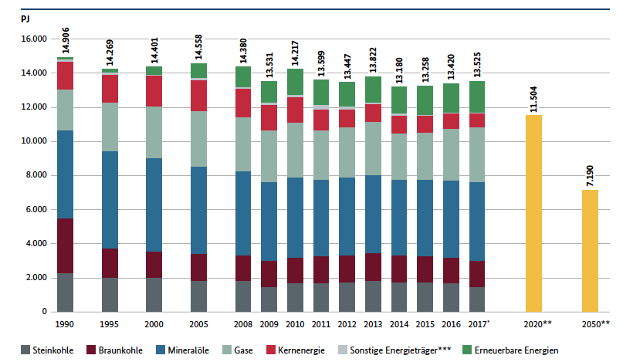
“Energiewende 1.0”
It is anticipated that RES is only available locally (within reach of electrical grids).
It is largely assumed that energy is only electrical; all non-electrical energy system nodes should disappear.
It is assumed that RES is limited and thus valuable: energy scarcity is essential consequence with multiple “exits”.
Fragmentation into applications has destroyed the systemic responsibility for energy supply; no coherent transition to targets.
Source
UBA 2017, BMWI

Slide 5

2017
In TWh
488
3117
Source:
Wallhere.com
Zahlen: EU country data sheets 2020

Slide 6
Volatility: one reason for hydrogen in the system
The German power system with sometimes up to 50% RES contribution can only be stabilized by massive ex-and imports.
This works due to different power sector structures of the neighbours.
Fragile situation for the future:
Molecular fuels are critically needed.
Struktur des Stromverbrauches August 2020.
Quelle Fraunhofer ISE

Slide 7
Energiewende 2.0: Closed material cycle: carbon
Energy systems cannot be decarbonized.
They can be defossilized.
A technical carbon cycle in analogy to the natural carbon cycle will be needed.
put the sunshine in the tank

Slide 8
Pure hydrogen as energy carrier?
Pro:
  Emission-free (green form).
  Maximal energy efficient.
  Technology for synthesis distribution and use exists.
Con:
  Unfavourable energy density.
  Bulk transport critical.
  Complete novel infrastructure needed (path dependence).

Slide 9
Where hydrogen comes from?
Multiple sources for hydrogen.
Sustainable for long term is only water splitting (like in nature).
Biomass in sustainable ways is of limited volume.
Fossil methane is not sustainable (solid carbon storage?).
All non-water sources are ok as bridge technologies to support transition from fossil to green fuels.

Slide 10
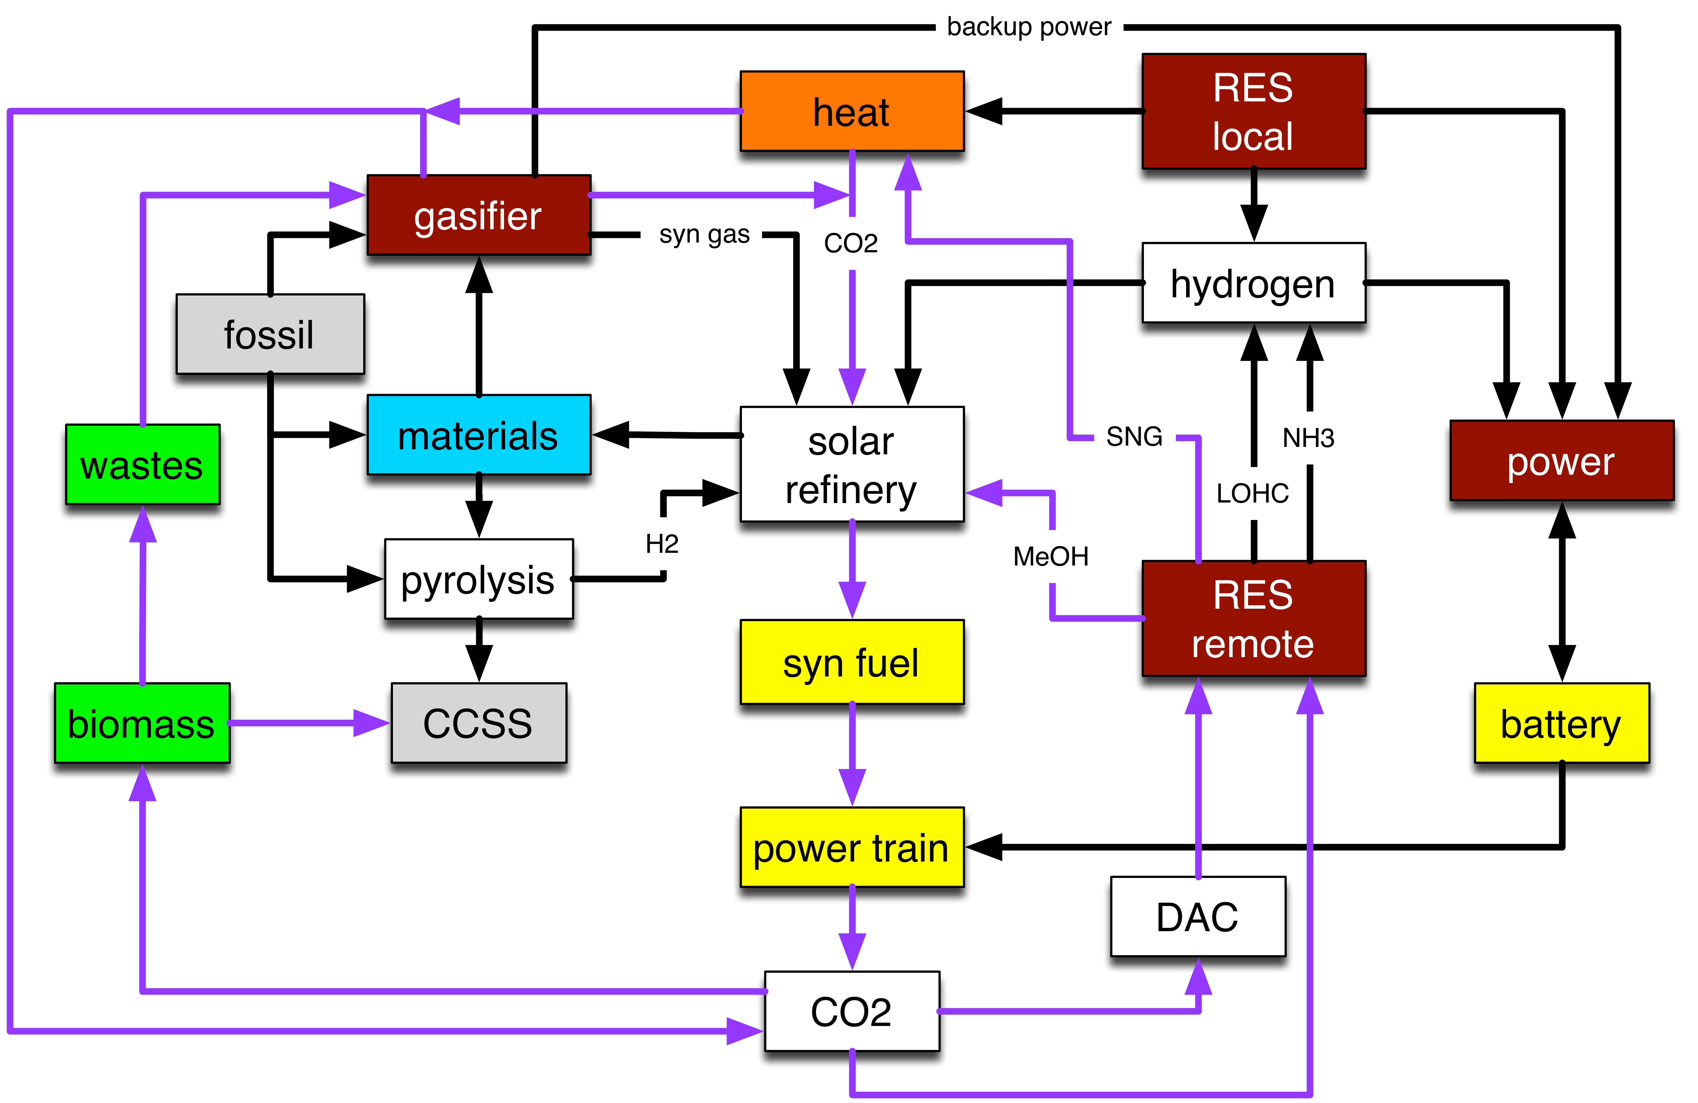
Chemical options for a carbon cycle
Concepts of future energy systems are built on hydrogen as only “chemical”
Systemic analysis shows that multiple advantages arise from also taking derivatives into considerations.

Slide 11
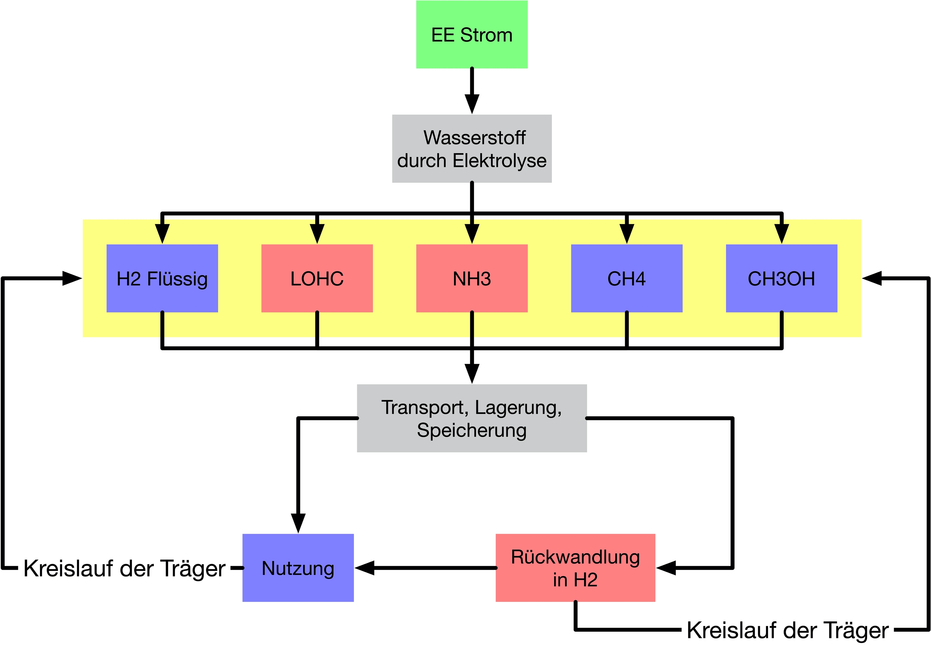
Systematics of hydrogen use
We need import of bulk amounts.
German capacity possibly 10% of demand.
Small scale introduction freezes too high domestic prizes (EE cost and market design).
Consider role of derivatives and transport forms and as e-fuels.

Slide 12
The thermodynamic crime: committed by nature
Storage molecule | Energy required for synthesis ex CO₂ (kJ/mol) | Reaction enthalpy (kJ/mol) | Stored enthalpy (kJ/mol) | Loss of primary RES (%)
methane | 1521 | 638 | 883 | 42
methanol | 1239 | 521 | 718 | 42
ethanol | 2478 | 1123 | 1355 | 45
butane | 4155 | 1275 | 2880 | 31
It is not the intention of CCU to remove CO₂: way too costly in energy: Close the carbon loop!
The synthesis of storage molecules in a carbon cycle requires large amounts of green energy.
Only a fraction is stored in the molecule ready for release upon combustion.
The reaction enthalpy can be used for the synthesis (heat integration).
A massive loss is the formation of reaction water.

Slide 13
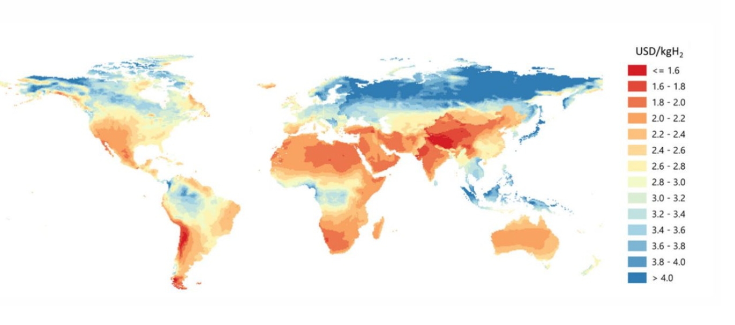
Where from will we get sufficient hydrogen?
The cost of hydrogen critically depend upon the (political) cost of electricity.
The annual availability is critical (more than 6000 h/a).
Transport of hydrogen through derivatives (e-fuels) is a negligible contribution.
Quelle:
IEA 2019

Slide 14
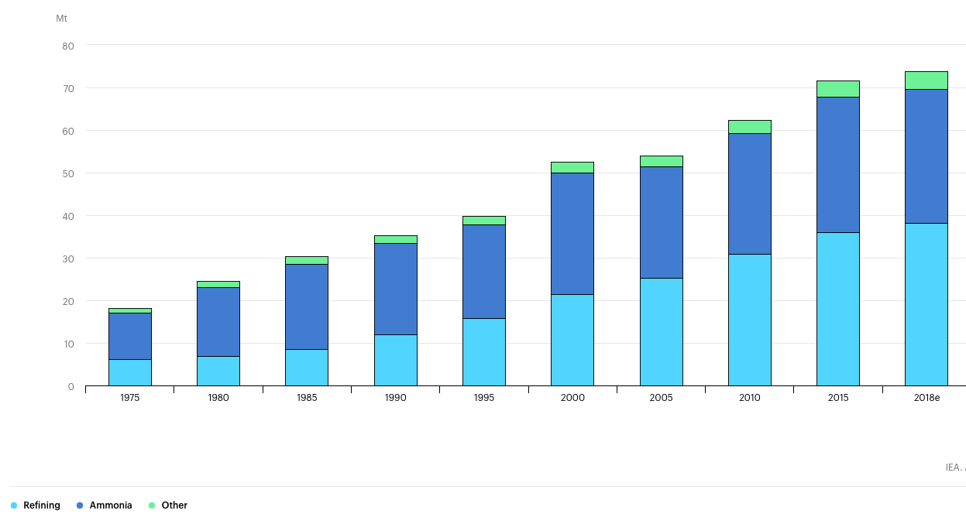
Global use of hydrogen today
The present users of hydrogen are petrochemical industry and fertilizer production. Multiple chemical applications give small addition.
Priority for green hydrogen for the main present users.
Energy import and storage will grow the amount by 2 orders of magnitude.
Quelle:
IEA 2019

Slide 15
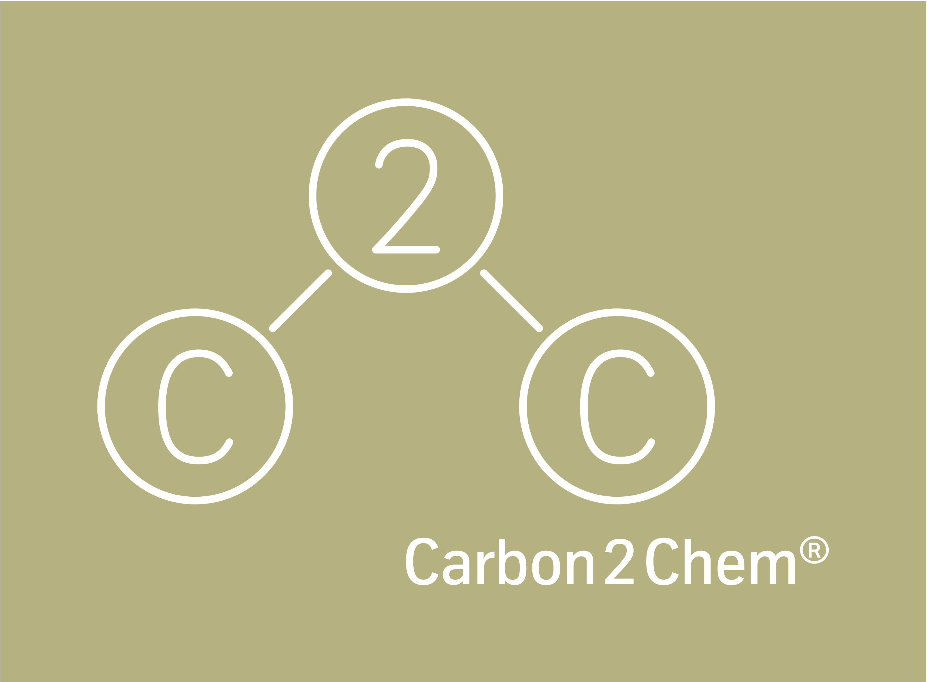
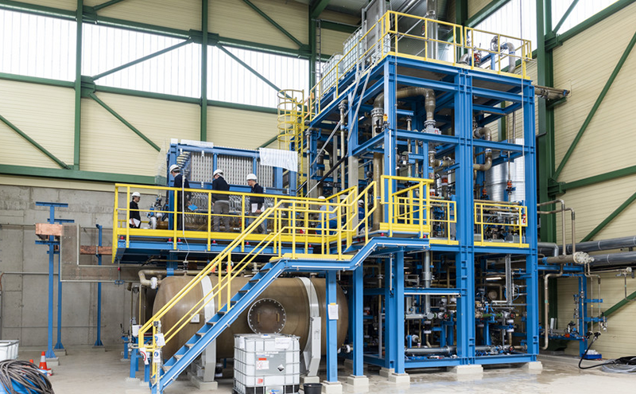
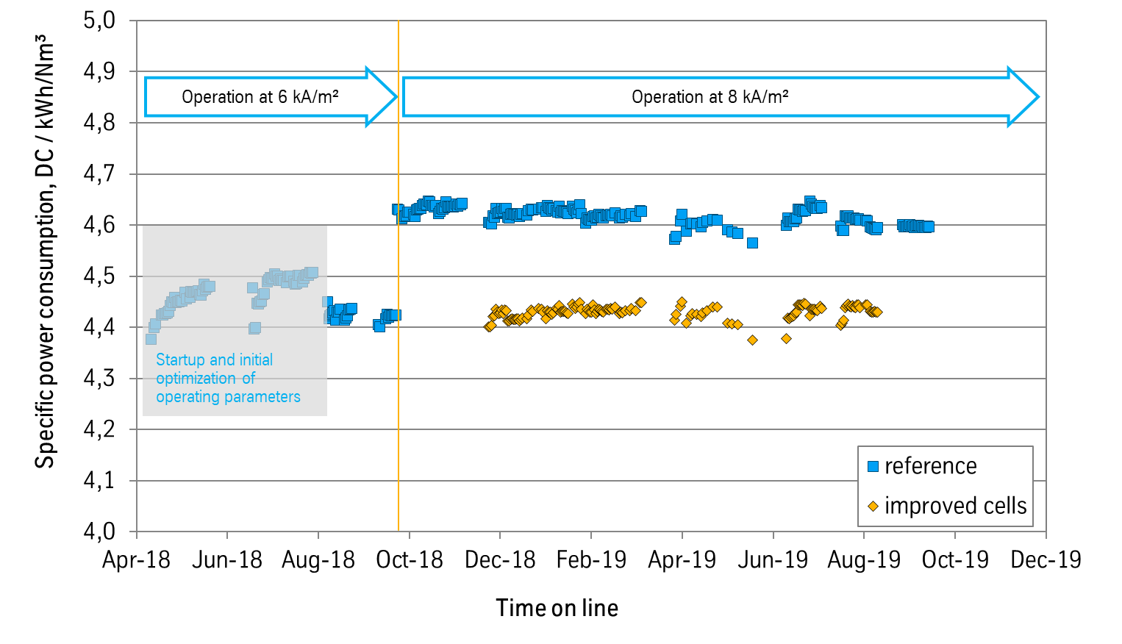
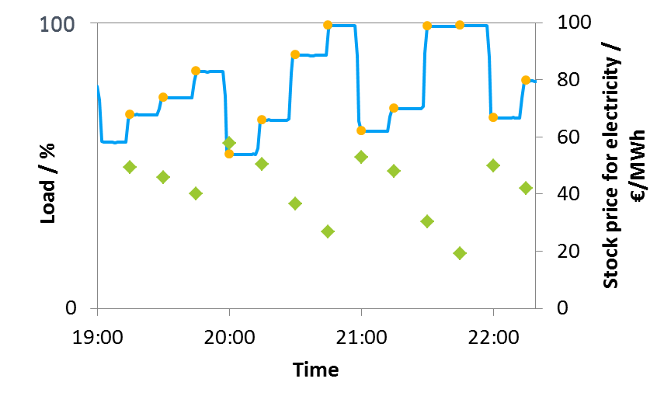
Hydrogen from water
The technology of water splitting is mature (alkaline/PEM (?)).
Stability and dynamic operation are still critical issues.
Production technology needs critical improvement (reduction of cost to below 500 €/kW).
At a electricity cost of ca. 3 ct. the resulting hydrogen reaches cost of fossil hydrogen.
actual load
calculated load setpoint
electricity stock price

Slide 16
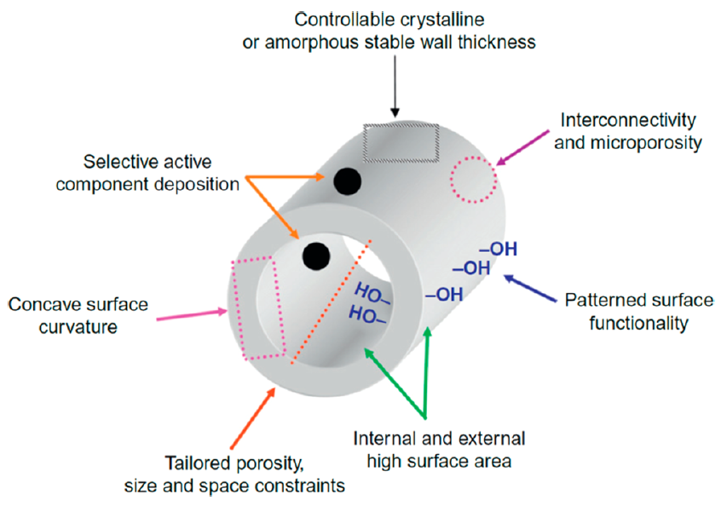
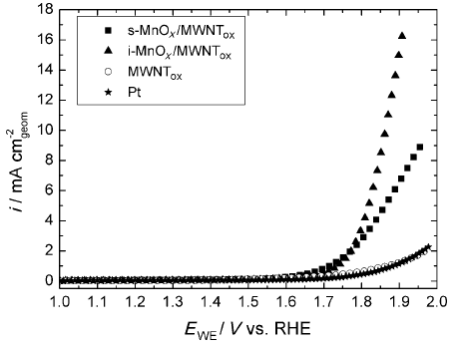
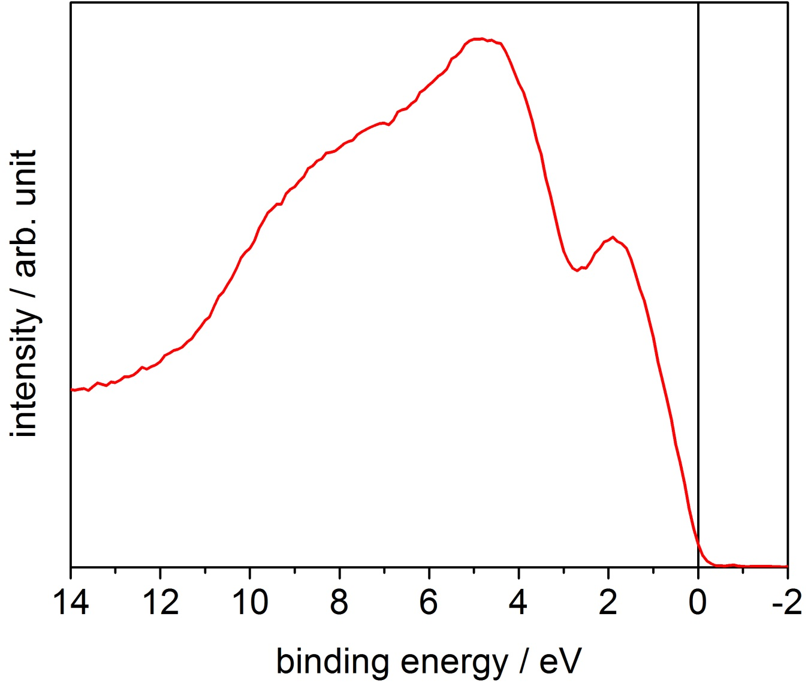
Science directions
Most researchers look for optimized catalytic function of nanostructures catalysing what?
Often it is ignored that electrocatalysis requires both transport of ions and of electrons with equal effects on performance (insulating oxides?).
Elemental metals are poor OER catalysts as they cannot bind water well.
Metallic oxides with their aqueous termination layers are the best systems.
Tüysüz, H.; Schüth, F. Adv. Catal. 2012, 55, 127−239

Slide 17
PEM: where are the losses?
The “overpotential” in a technical MEA was analysed.
The catalyst gives a stable contribution to the total overpotential.
Its degradation with 40 mV/d in static operation is inacceptable.
Dynamic operation improves this by an order of magnitude.
This indicates material dynamics and calls for in-depth analysis.
With MPI Magdeburg
K. Sundmacher and team

Slide 18
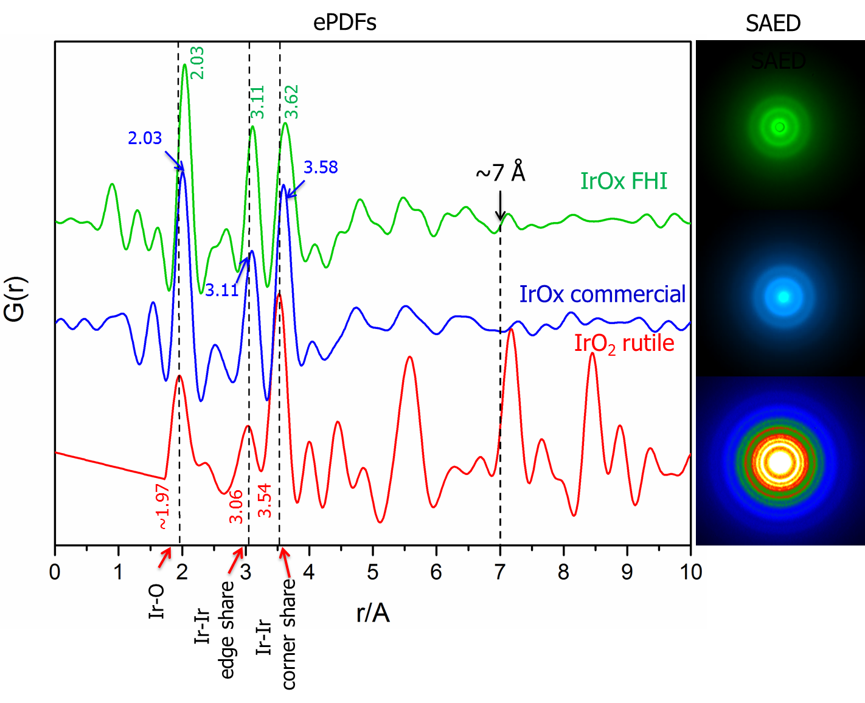
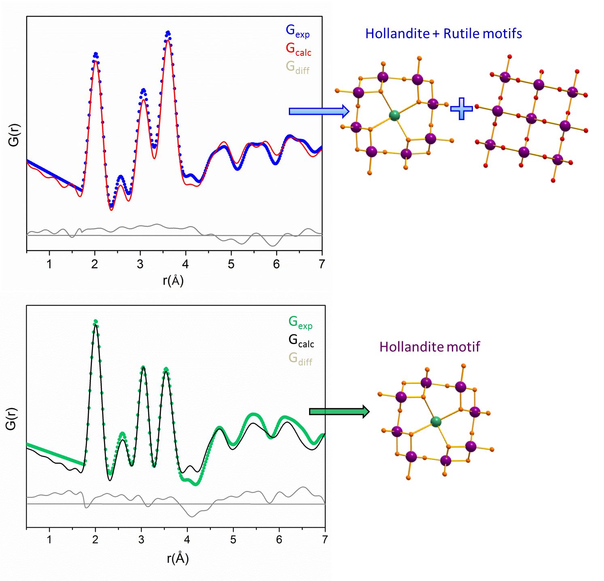
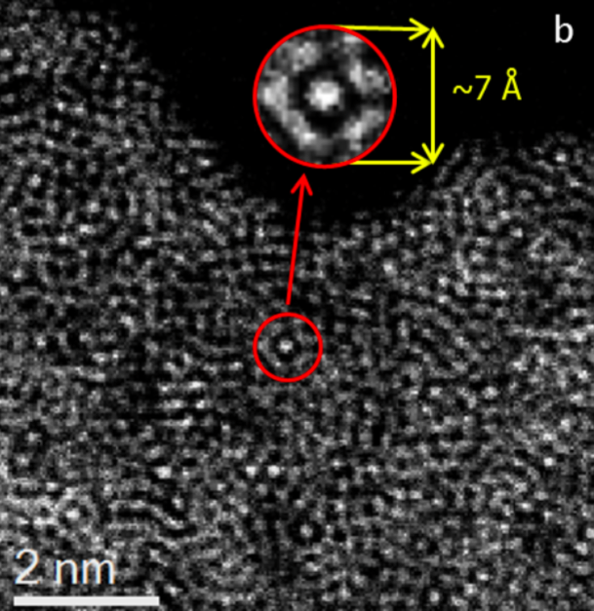
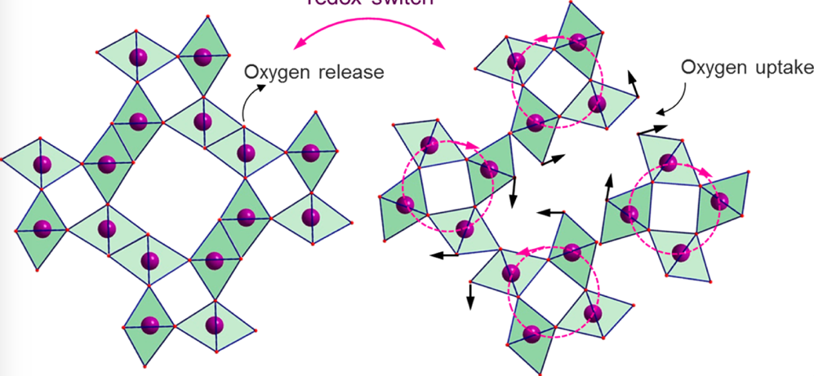
Structure local: dynamics
HAADF
IrO₂
IrO_{x}-commercial
The loose structure enables non-concerted structural mobility to allow for dynamical approximation of O⁻¹ vs OH as critical step in the O-O bond formation.
IrO_{x}-FHI

Slide 19
The most active form of “IrO₂”
With B. Lotsch and team
The active form of Ir-oxyhydroxide is synthesized from layered precursors by ion exchange of alkali vs protons.
Such a process can also occur in operando during OER; deprotonation equals oxidation of the lattice.

Slide 20
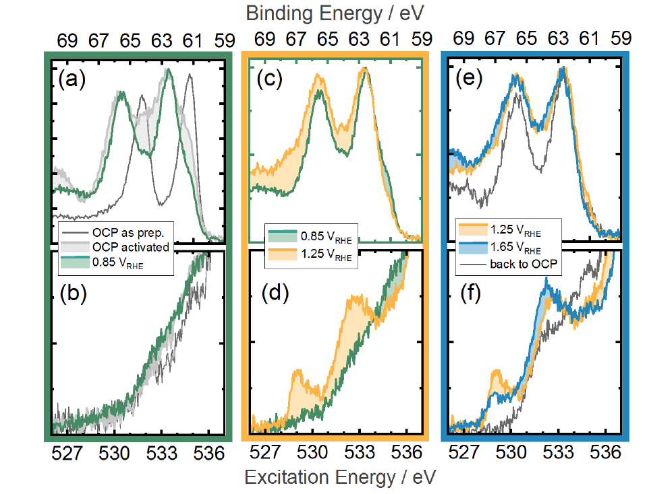
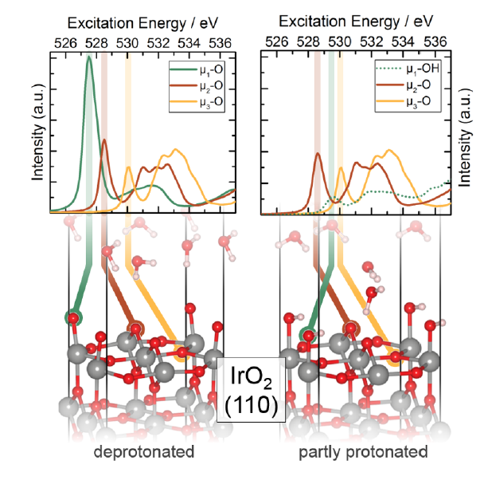
Spectroscopic identification of reactive oxygen
IrOOH as active phase in water splitting.
Active form is terminal single coordinated oxygen as O-1 in water.

Slide 21
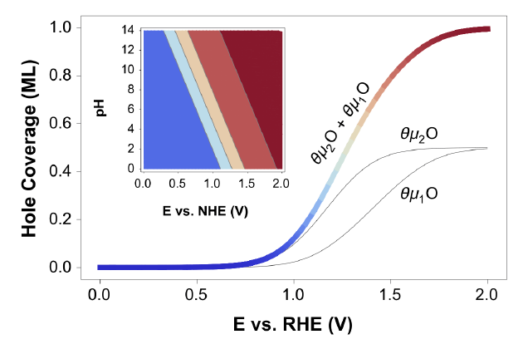
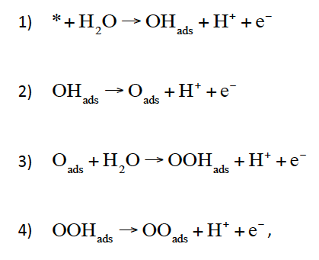
Operando Experiment in water
Time-resolved operando spectroscopy and theory of reactive species.
The formation of oxyl precedes the OER reactivity: an electro-catalyst and not an electro-chemical reaction as implied in the generalised (Norskov) mechanism.

Slide 22
Conclusions science
Water electrolysis is a mature science and semi mature technology.
Multiple mechanisms of water splitting co-exist (no dispute needed).
Process is electro-catalytic not electrochemical (catalyst is needed!).
Dynamics of electrodes and nanostructuring (enables activation).
Dynamical operation possible to compensate EE volatility.
Scalability and production demand material development not “overpotential”.
Production technology of electrolysers (“Volkselektrolyseur”) is the single most critical development needed; avoid useless fight PEM vs alkaline!
Transport processes for hydrogen derivatives need research and development.
Here too scalability in process and materials is critical.

Slide 23
Conclusions Politics
Hydrogen is not a slight addition (5 GW) to the local EE system .
It is the critical enabler making energy transitions feasible: think big!!
Large volumes and rapid temporal evolution of market penetration well within the coming decade are critical for keeping cost options open.
Infrastructure and regulations must co-evolve with generation capacity; enable novel technologies and market formation by flexible and transparent regulations: No micromanagement by politics!!
Large and technology-ready allocations need priority as first users.
Development and research into additional applications (steel) needs to be pushed with the conditions of techno-economic scalability.
The hydrogen economy is a European issue with global implications; abstain from “national” solutions!

Slide 24

Albert Einstein
There is no fundamental law requiring simplicity in natural processes
We cannot solve our problems with the same thinking we used when we created them
Thank You

