Slide 1

balancing the fight against climate change WITH energy security
Dr Colette Lewiner
In collaboration with:
24th Edition | 2022

Slide 2

AGENDA
1
Energy crises
2
Technologies update
3
Have we lost sight on Climate change?
World Energy
Markets
Observatory
4
Conclusions and Recommendations
24th Edition | 2022

Slide 3
Energy crisEs

Slide 4

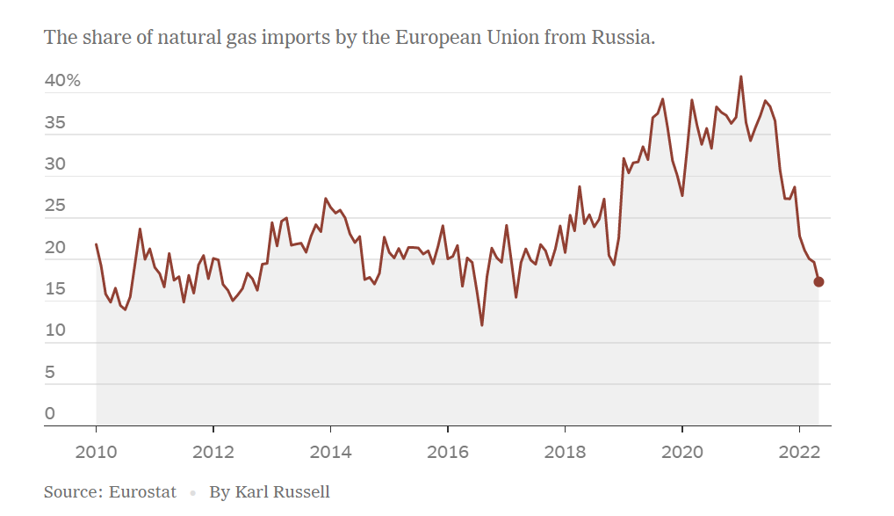

How did we get there?
Nuclear plant closures in Europe; mainly in Germany, and the two reactors in Fessenheim (France)
Climate change leading to a shift from coal to gas
“Gas is King”
Increasing gas consumption and, in Europe, dependency on Russian gas
Notes:
Graphe issu du New York Times
https://www.nytimes.com/2022/09/07/business/russia-gas-europe.html

Slide 5
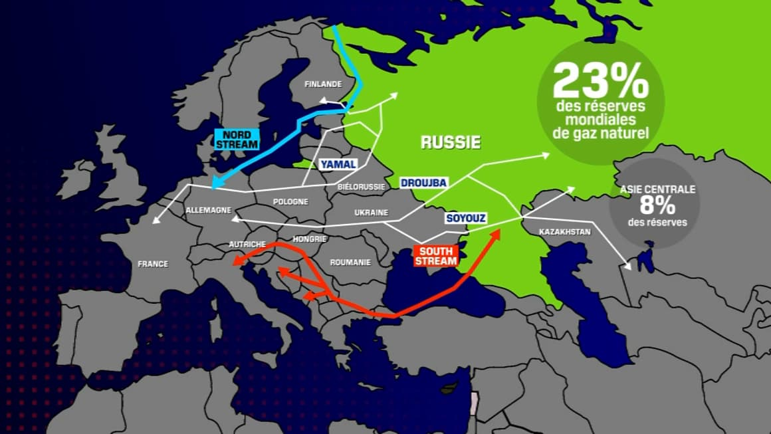
Russian pipelines supplying Europe
23% of the world's natural gas reserves
FINLAND
NORTH STREAM
RUSSIA
YAMAL
Central Asia
8% of reserves
BELARUS
DROUJBA
GERMANY
POLAND
UKRAINE
SOYOUZ
HUNGARY
KAZAKHSTAN
AUSTRIA
SOUTH STREAM
FRANCE
ROMANIA

Slide 6
ENERGY is also A driver of the Ukraine invasion
Ukraine has strategic position for the Russian gas export to Europe (Brotherhood pipeline from Russia to Germany through Ukraine)
Donbas and Crimea have important energy resources (coal, gas, oil)¹
The largest nuclear plant in Europe is in the war zone
Main gas, coal and oil fields in Ukraine²
Donbas
6th largest coal country in the world¹
9 Btoe of hydrocarbon reserves¹
Natural gas reserves are estimated at 5.4 tcm¹
Nuclear operator
Zaporizhia Nuclear Power Plant
Marioupol
Crimea
Source: ¹ Energy security, IEA; ² Ukraine At Risk: An Oil and Gas Perspective, Energy Consulting Group
Notes:
EU:
Security of supply endangered
Very sharp rise in energy prices
Trying to reduce its dependence on Russian gas
Russia:
A lever on European energy dependence
A lever on energy prices
A nuclear threat from the Zaporijja nuclear power plant
Ukraine:
6th largest coal country in the world¹
9 Btoe of hydrocarbon reserves¹
Natural gas reserves are estimated at 5.4 tcm¹
Nuclear operator
Oil fields : http://www.energy-cg.com/UkraineAtRisk.html

Slide 7
4 SUCCESSIVE CRISES
Forecasts
GDP evolution
-3.3%
+6.5%
+3.2 %
(G20)
(G20)
(Worldwide)
Energy
demand
-3.5%
+5%
Non available
GHG
emissions
-6%
+6%
+0,9%
  Price booming
  Economy Slow down
2020
2021
2022
  ECONOMIC RECOVERY
  COVID-19 and lockdowns
  Invasion of Ukraine by Russia
Sources: Enerdata, IMF and Refinitiv
Notes:
2022 will be a year with significant GDP growth durint H1, then slowdon in H2. Perhaps to be shown in the table.
Source FMI
https://www.imf.org/fr/Publications/WEO/Issues/2022/07/26/world-economic-outlook-update-july-2022

Slide 8
price evolution during the crises
  COVID-19 and lockdowns
  Price booming
  Invasion of Ukraine by Russia
  2020 - Very low commodities prices during lockdowns
End 2021
Summer 2022
~ €180 /MWh
~$300/
MWh
$400
/t
€3.5/MWh in May 2020¹
Gas
Coal
~ $80
/bl
~ $120
/bl
WTI under $0/bl in April 2020 (Henry hub)
Oil
€257/MWh spot price in France
~ €590/MWh
~ €23/MWh in Germany (H1 2020)²
Electricity
Source: ¹EUI, Some reflections on current gas market price trends; ²Chinmoy Chakraborty, LinkedIn, Key facts & figures of major Utilities;
Notes:
2022 will be a year with significant GDP growth durint H1, then slowdon in H2. Perhaps to be shown in the table.
Source FMI
https://www.imf.org/fr/Publications/WEO/Issues/2022/07/26/world-economic-outlook-update-july-2022

Slide 9


CRISES IMPACT ON ENERGY PLAYERS Finance
  Invasion of Ukraine by Russia
  COVID-19 and lockdowns
  Price
  booming
  Recession?
2020
2021
2022
H1 2022
$81 billion profits²
$200 billion profits in 2022²
Large Oil Firms
$76 billion losses¹
average of -9.7% revenues in Europe³
average of +70% revenues in Europe
/
European utilities
OTHER PLAYERS
Some European energy retailers failing
Renewables M&A market was bullish
an average of +21,7% EBITDA in Europe
average of +19.6% EBITDA in Europe
-115% EBITDA
-74.8% EBITDA
Source: Les Echos 6-7 January 2023
Notes:
Sources 2020
In fact, in 2020 the five integrated supermajors (i.e., “Big Oil”) – ExxonMobil, BP, Shell, Chevron, and Total – lost $76 billion.
https://www.forbes.com/sites/rrapier/2022/04/24/if-oil-companies-control-prices-why-do-they-ever-lose-money/?sh=390bce92cf9d
Pour les Oil majors 2021 et 2022 → données Statista
https://www.statista.com/statistics/1326419/quarterly-net-profit-of-leading-world-oil-companies/

Slide 10
HOW TO MANAGE EUROPEAN ENERGY security of SUPPLY WITHOUT RUSSIAN FOSSIL ENERGIES?
Short term
Middle term
Long term
Not closing Groningen gas field
Don’t close nuclear plants (Germany, Belgium)
Invest in re-gas facilities
Implement an electricity market reform
Accelerate R&D in energy technologies
Invest in nuclear plants
Buy as much LNG as possible
Invest in gas infrastructures
Accelerate the deployment of renewables
Diversifying EU gas supply
Create favorable financing conditions for long term green energy projects
Energy conservation
Level of solution implementation
Notes:
Sources:
-Groningen: https://www.government.nl/latest/news/2022/06/20/groningen-gas-field-on-the-back-burner-in-october
Nuclear plants: https://www.dw.com/en/germany-considers-u-turn-on-nuclear-phaseout/a-62699645#:~:text=The%20phaseout%20has%20been%20planned,using%20nuclear%20power%20by%202022. + Edito: Belgique ok mais Allemagne on ne sait pas encore
Invest in gaz facilities: https://www.euractiv.com/section/energy/news/europe-urged-to-invest-in-lng-infrastructure-as-winter-gas-crisis-looms/+ EDITO→ rien de trouvé sur les investissements dans de nouveaux pipelines en Europe
Implement an electricity market reform → EDITO
Diversifying EU gas supplying → EDITO
Invest in nuclear plants → EDITO
Create favorable financing conditions for long term green energy projects → EDITO (investissements insuffisants de la part de la France) mais est-ce que les 26 milliards européens sont suffisants ?
Accelerate R&D in energy technologies → pas d’accélération les années précédentes mais pas les chiffres de 2021 → en cours de recherche côté Debarghya

Slide 11
Retail market consolidation as many retailers have gone bankrupt
Departures and bankruptcies of energy retailers (End 2021)
To gain market share, some retailers agreed to low gas or electricity prices,
With no anticipated supplies they had to buy at very high prices to resell at low prices
Incumbents are the suppliers of last resort
Bankruptcies are continuing notably in France
Source: Arthur D. Little and Energy Outlook: European utilities driven by higher tariffs and investment, ING
Notes:
Article intéressant
https://balkangreenenergynews.com/european-energy-crisis-and-how-history-repeats-itself-losses-are-borne-by-consumers-while-profits-are-retained-by-utilities/
Source du graphe
https://www.adlittle.com/en/insights/viewpoints/energy-retailers%E2%80%99-business-model
Chiffre de la France
https://think.ing.com/articles/european-utilities-driven-by-higher-tariffs-and-investment

Slide 12
Technologies update

Slide 13
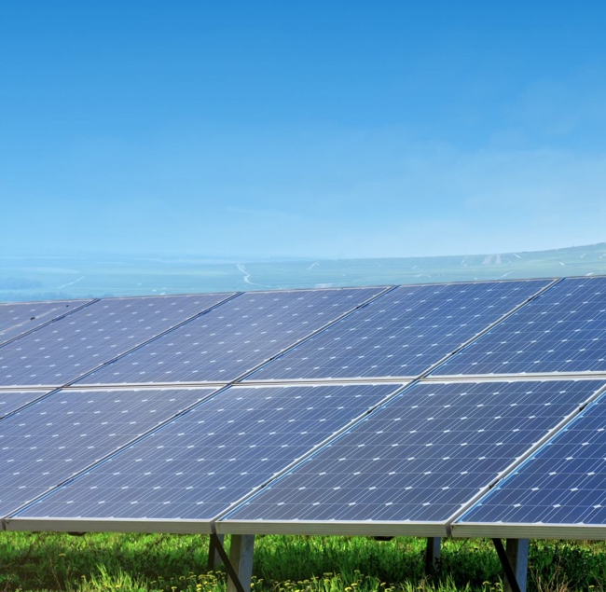

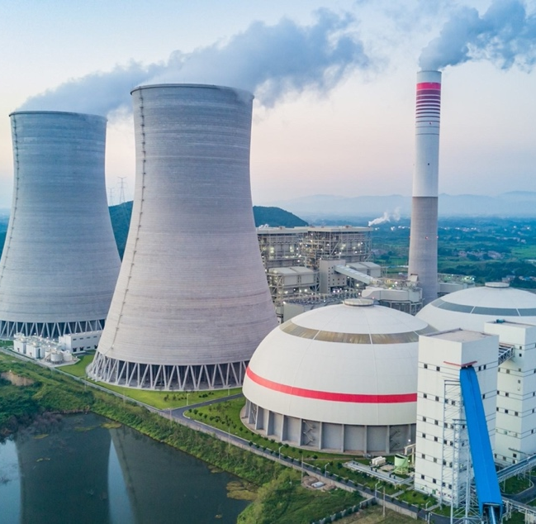
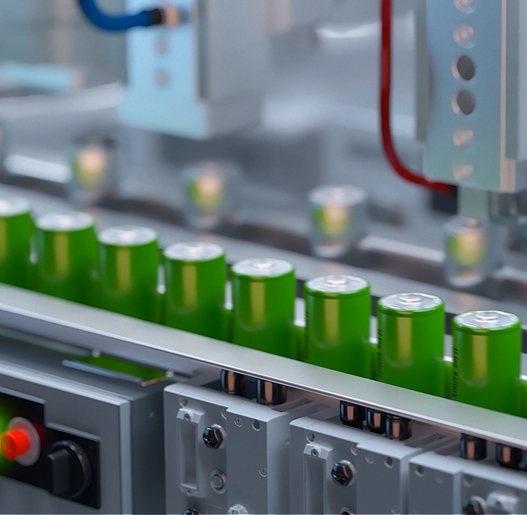
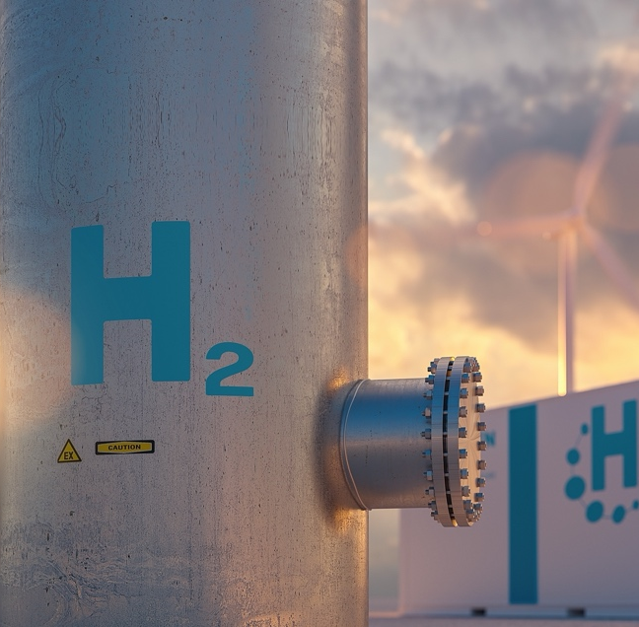
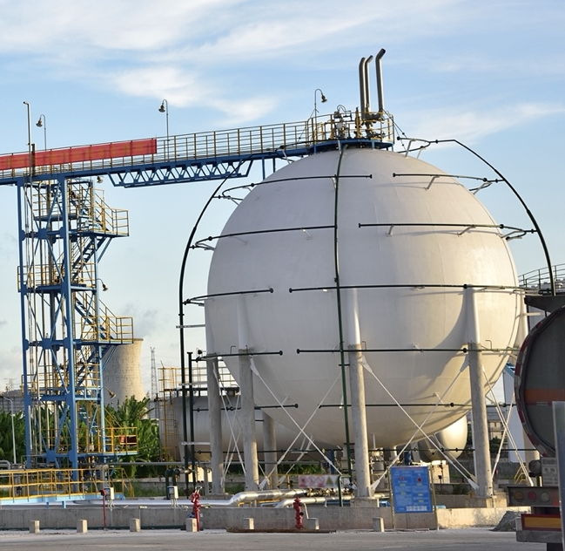
Progress in Low Carbon Technologies
SOLAR
WIND
NUCLEAR
BATTERIES / GIGAFACTORIES
HYDROGEN
CCUS
Notes:
2022 will be a year with significant GDP growth durint H1, then slowdon in H2. Perhaps to be shown in the table.

Slide 14
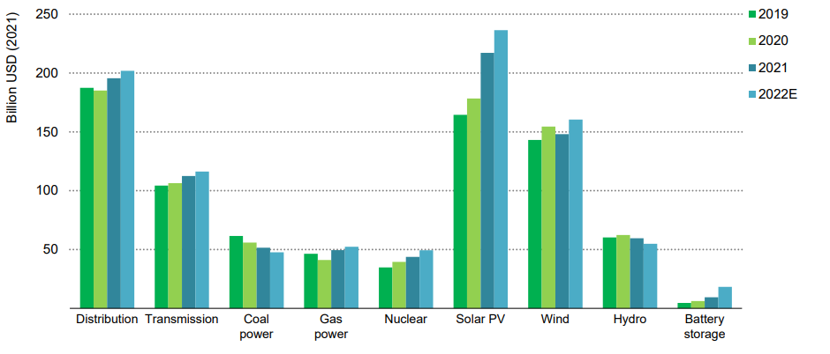
Power sector INVESTMENTS: investment in grids is critical for energy transition
Global annual investment in the power sector by technology, 2019-2022E
Investments in coal and gas almost equal to those in nuclear
Notes: Gas-fired generation investment includes both large-scale plants and small-scale generating sets and engines; hydropower includes pumped-hydro storage.
Source: IEA analysis based on calculations from IRENA (2022) and Platts (2022)
Notes:
Source
https://iea.blob.core.windows.net/assets/b0beda65-8a1d-46ae-87a2-f95947ec2714/WorldEnergyInvestment2022.pdf

Slide 15
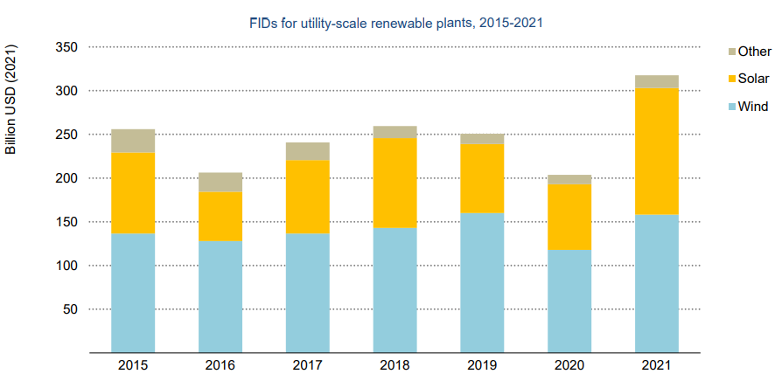
Renewables investments have increased but are Below objectives
FIDs for utility-scale renewables hit new records in 2021, with a large jump in solar projects
Solar energy investments are growing faster than wind energy investments and have reached parity by 2021
In 2021, China implemented more renewable capacities than Europe + USA
Offshore wind growth is higher than onshore wind growth
Notes: Excludes large hydropower. Other includes biomass, waste-to-energy, geothermal, small hydro and marine
Source: IEA calculations based on Clean Energy Pipeline (2022)

Slide 16
93 GW of wind and 133 GW of solar installed in 2021 despite a decline in Chinese wind
Global added renewables capacity in 2020 and 2021
+6%
-16%
-35%
+18%
+16%
Source: IRENA (2022), Renewable Energy Statistics 2022, The International Renewable Energy Agency, Abu Dhabi
Notes:
Source intéressante pour expliquer la baisse de l’éolien : https://www.enerdata.net/publications/daily-energy-news/global-wind-capacities-increased-94-gw-2021-837-gw.html
Source des chiffres
https://www.bp.com/content/dam/bp/business-sites/en/global/corporate/pdfs/energy-economics/statistical-review/bp-stats-review-2022-full-report.pdf

Slide 17
Advances in wind technologies
Increase in turbine capacity
(up to 14 MW per turbine)
Noise reduction
Improvements in blade design
Total capacity
825 GW in 2021
Floating offshore wind: currently 84MW, a prediction of 264 GW by 2050¹
Improvements in recycling
Better monitoring thanks to AI
Source: ¹Floating offshore wind: the next five years, DNV
Notes:
Siemens Gamesa a commercialisé la 1ère pale 100% recyclable en septembre 2021 (RecyclableBlade)
Source
https://www.offshorewind.biz/2021/11/12/worlds-largest-most-powerful-wind-turbine-stands-complete/

Slide 18
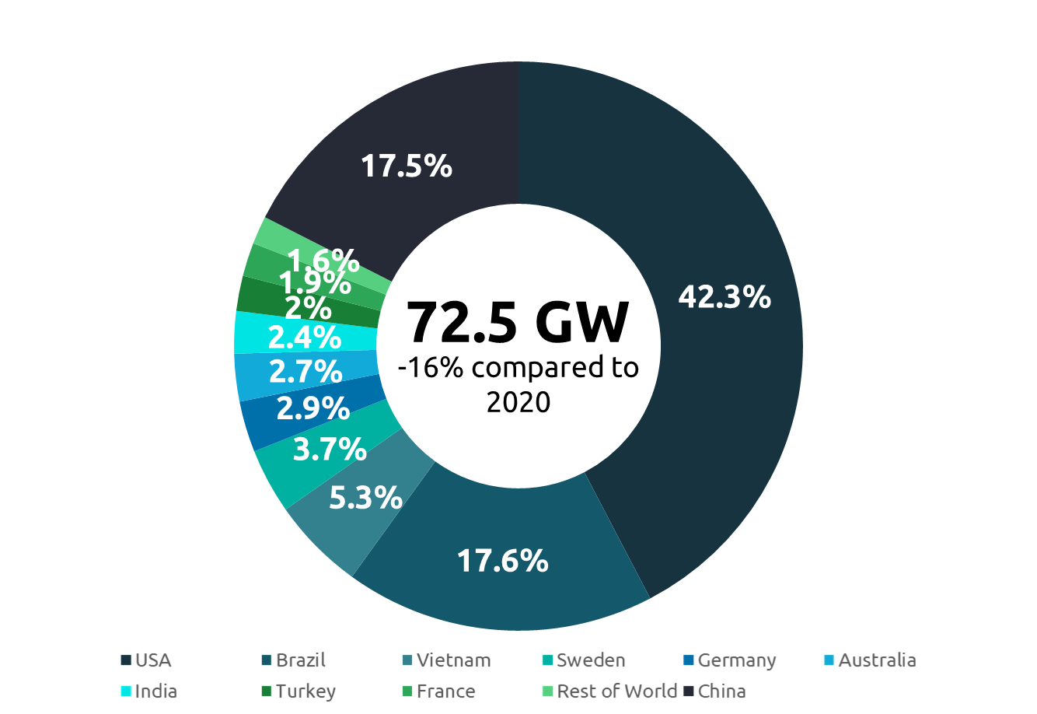
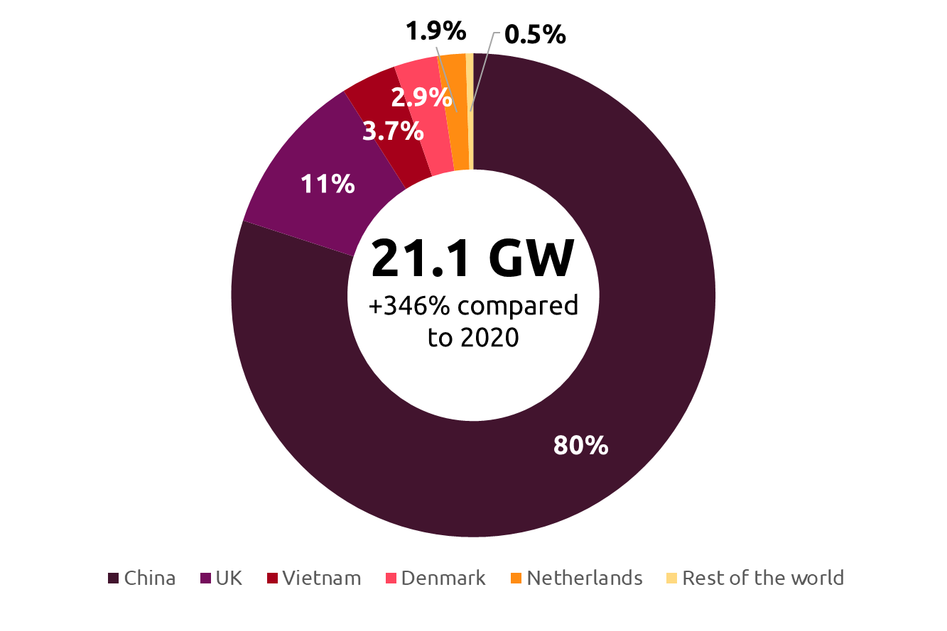
a slowdown in onshore installations but a significant increase in offshore installations
Offshore wind
New wind Installations in 2021
Onshore wind
Source: ¹Global Wind Offshore Energy Council (GWEC) report 2022
²Global Energy Review 2021: IEA
Notes:
Offshore is developing faster than onshore because it is less affected by the difficulties of local acceptance of projects
Wind onshore, together solar PV, are the lowest-cost options for new electricity generation in most of cases and world places
Profitability was hampered by supply chain disruptions, increased raw material costs, logistical difficulties, cost inflation, and the post COVID recovery
2020: + 6.1GW offshore +86.9GW onshore

Slide 19
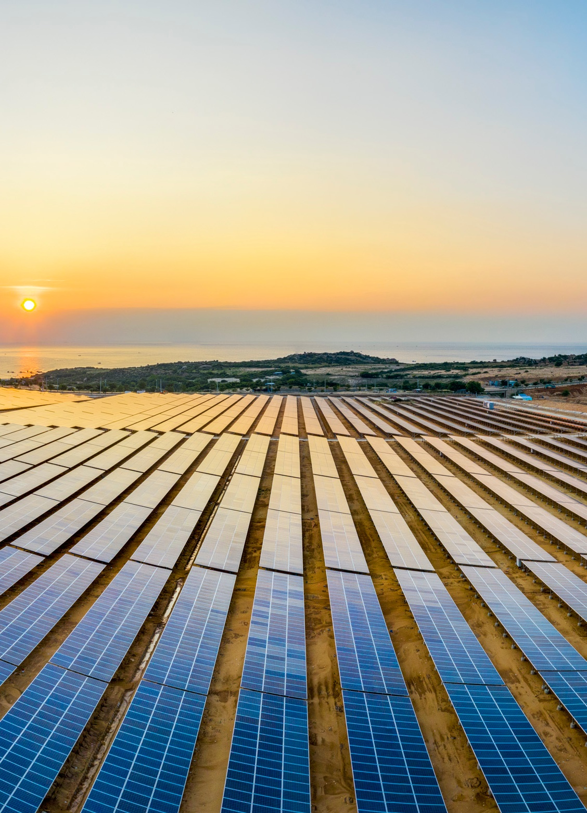
Advances in PV solar technologies
Research on new materials with higher conversion efficiencies
Over 25%
15-20%
compared to
Halide perovskites
Commercial PV cells
Sun trackers to increase the performance
(at least +20%)
Bifacial cells
Total capacity
843 GW in 2021
Floating solar: 2 GW capacity by the end of 2019, estimated 62GW by 2030
Solar cell recycling technologies to recover silicon are progressing
Development of reverse solar panels, that can generate electricity at night
Notes:
BSF (Back Surface Field) has been used as a way to increase solar cell performance by reduction of the surface recombination velocity (SRV).
Printing a full aluminum layer on the rear of the cell, with ensuing alloying through firing, produces a BSF and improves the cell bulk.
A "back surface field" (BSF) consists of a higher doped region at the rear surface of the solar cell. The interface between the high and low doped region behaves like a p-n junction. An electric field forms at the interface, which introduces a barrier to minority carrier flow to the rear surface.
https://www.pveducation.org/es/fotovoltaica/design-of-silicon-cells/surface-recombination

Slide 20
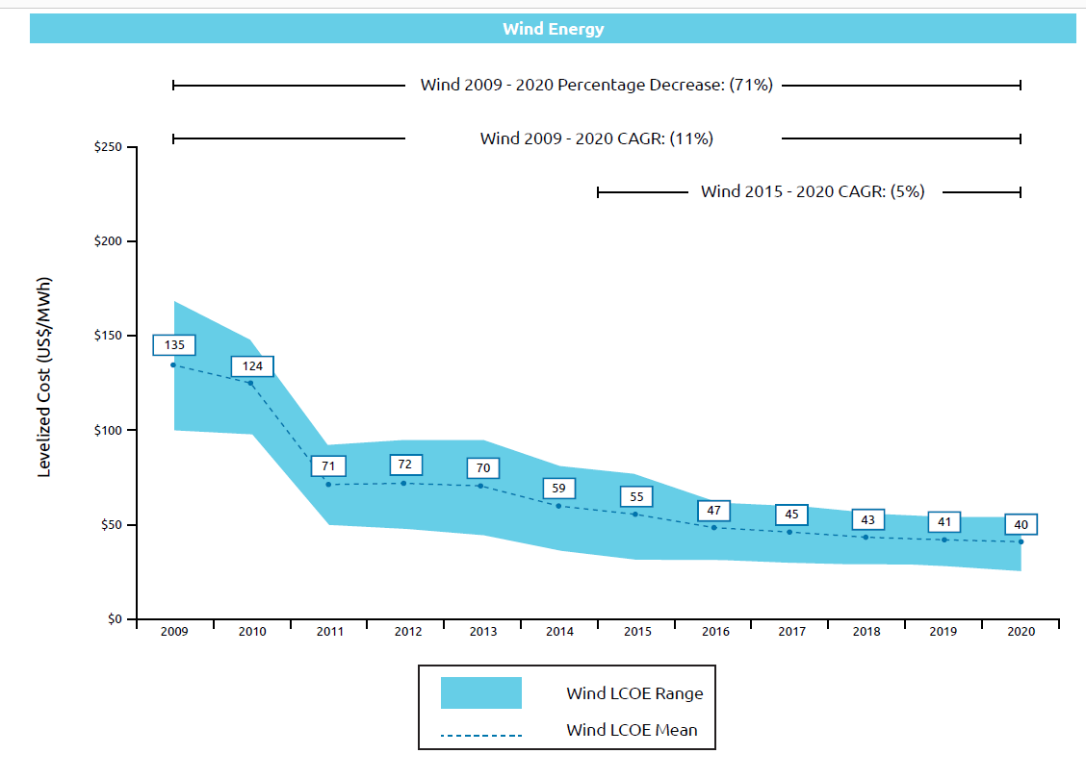
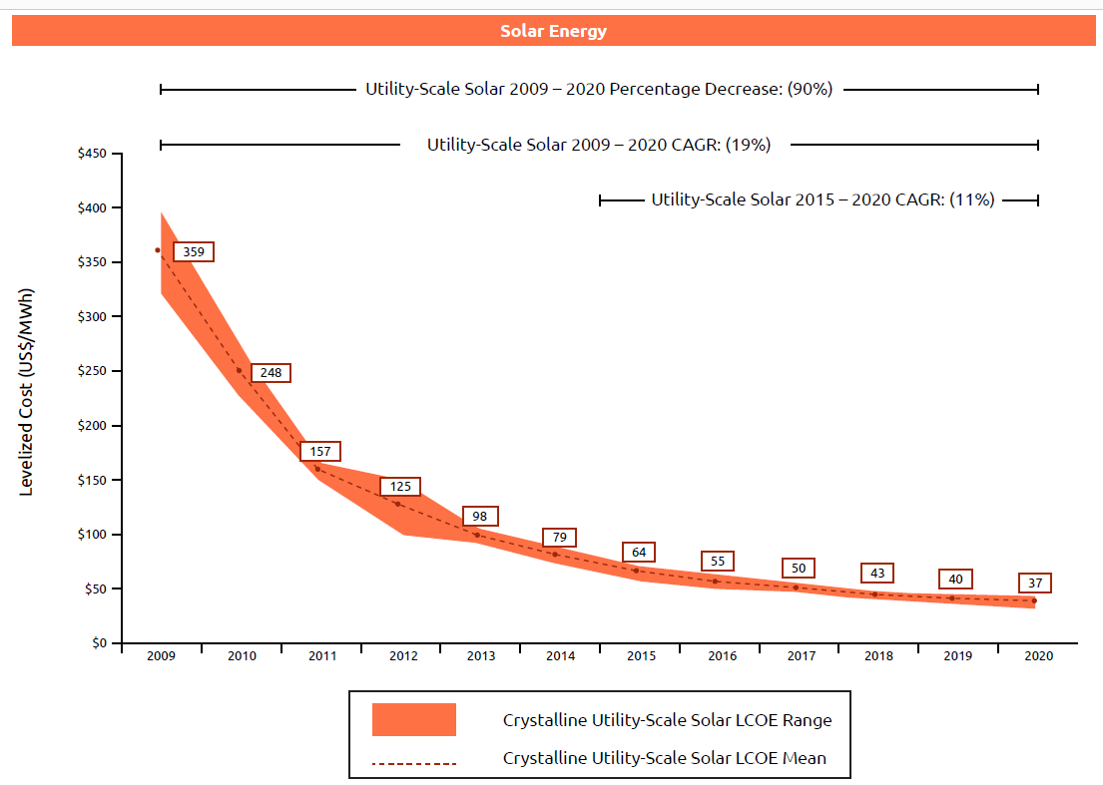
A rise in wind and solar COSTS after 10 years of decrease
Renewable costs should increase from 2021 to 2022 up to 25%
US historical Alternative Energy LCOE Declines, 2009-2020 (US$/MWh)
Wind Energy
Solar Energy
Cost of capital: 70-80%
Cost of capital: 80-90%
2021
H1 2022
Cost of capital
Cost of raw materials increase
Increase in freight rates
Solar PV and wind installations costs increase
Source: IEA, Lazard - Levelized Cost of Energy, Version 14.0 (October 2020)

Slide 21
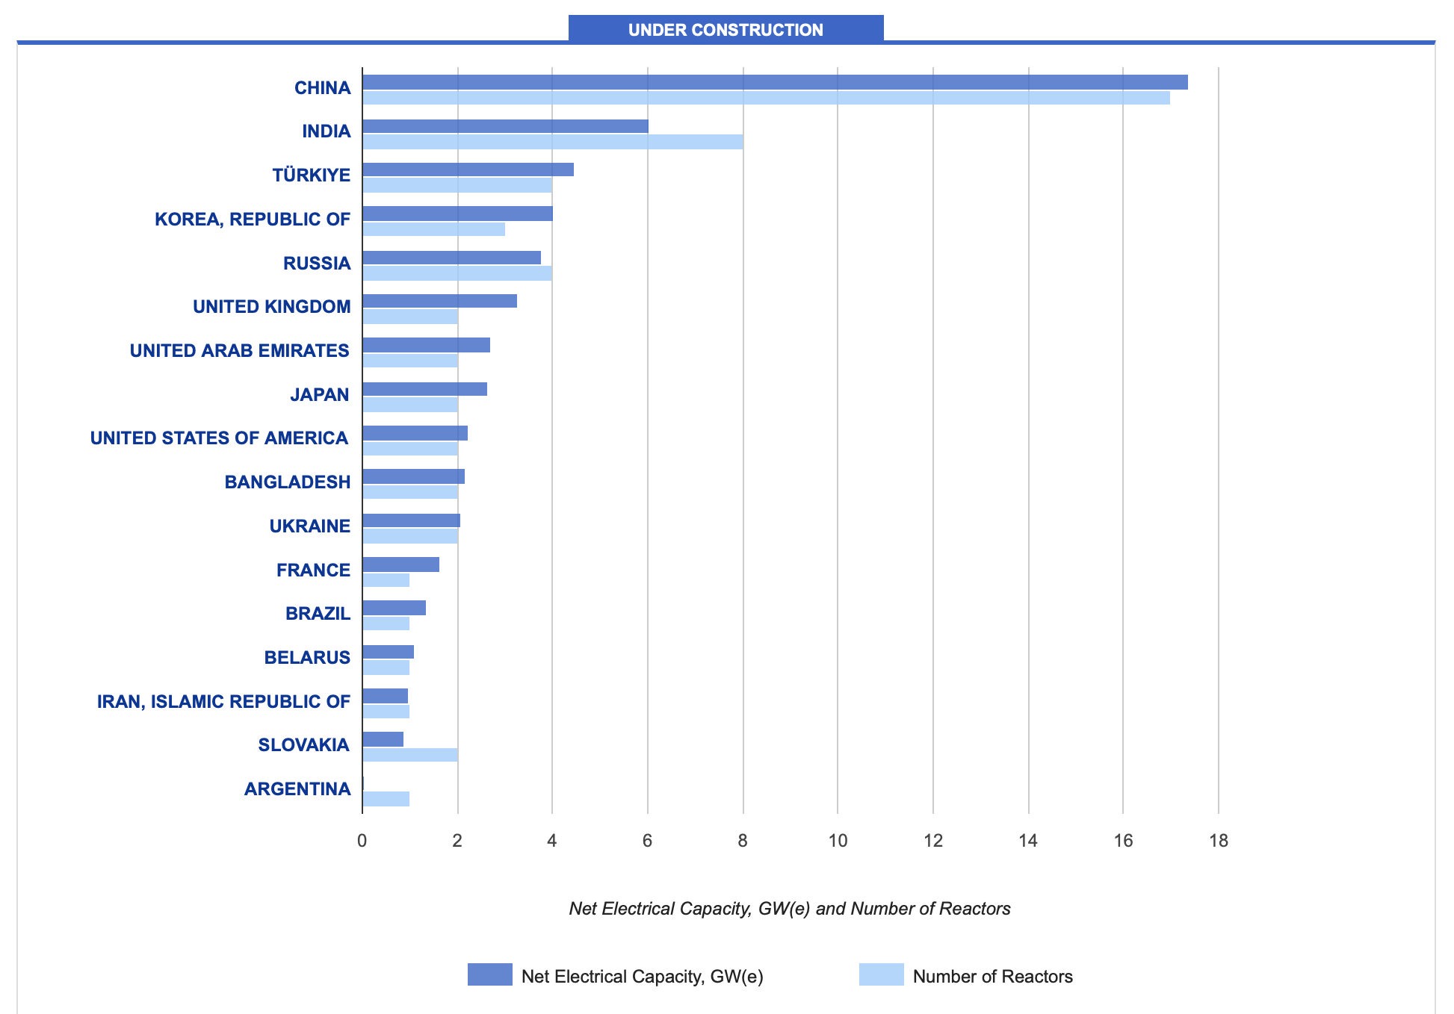
NUCLEAR RENAISSANCE
Reactors under construction
The role of nuclear in the fight against climate change Is recognized worldwide and recently in Europe (European “taxonomy delegated act”)
The number of new nuclear projects is increasing while Utilities are extending their existing reactors’ operating lifetime
In Europe many countries are announcing new nuclear plant construction (Poland, Czech Republic, NL, Sweden, Finland, Hungary, Romania , Bulgaria, France, UK)
IEA perspective: world will be falling short. Expectations to 2050 (+400GW)
Source: IAEA PRIS (Power Reactor Information System) Database
Notes:
According to IEA, nuclear energy production must double by 2050 to meet the Net Zero Carbon objectives,
Préciser que la guerre en Ukraine et les tensions générées autour de la centrale de Zaporijja montrent les limites du nucléaire

Slide 22
NUCLEAR RENAISSANCE
3rd generation reactors
SMR
Fusion
6
4
50
2025
New reactors connected to the network in 2021(+5.2 GW)¹
SMRs in advanced stages of construction
SMR designs and concepts
ITER construction progressing, first reaction expected by 2025
Improved security
Less nuclear waste
More manageable investment
More advanced safety features
Fusion by laser: Lawrence Livermoore Laboratory announced in December 2022, the first controlled fusion experiment to reach energy breakeven.
Emergence of many start-ups in the nuclear sector
Large delays and cost increase
Design complexity
Costs per MWh could be higher than large reactors
More waste than large reactors²
Loss of skills
Sources: ¹Nuclear Power Reactors in the World, IAEA
² Small nuclear power projects may have big waste problems, Reuters, 01/06/2022
³ China’s Artificial Sun Just Broke a Record for Longest Sustained Nuclear Fusion, Smithsonian magazine, 10/01/2022
Notes:
According to IEA, nuclear energy production must double by 2050 to meet the Net Zero Carbon objectives,
There are currently four SMRs in advanced stages of construction in Argentina, China, and Russia
3rd generation reactors: The project owners and their subcontractors’ unpreparedness
SMR: 1.7 times more waste per electricity output unit than large reactors²
Sources:
https://www.lindependant.fr/2022/09/20/fusion-nucleaire-annonce-surprise-de-la-chine-le-pays-sera-t-il-le-premier-a-maitriser-lenergie-du-soleil-10555983.php
https://www-pub.iaea.org/MTCD/Publications/PDF/RDS-2-42_web.pdf
Fusion
Avancées dans la fusion par laser en 2021 mais en 2022 les américains du NIF on avoué ne pas avoir réussi à répliquer leur expérimentation
https://www.nature.com/articles/d41586-022-02022-1

Slide 23
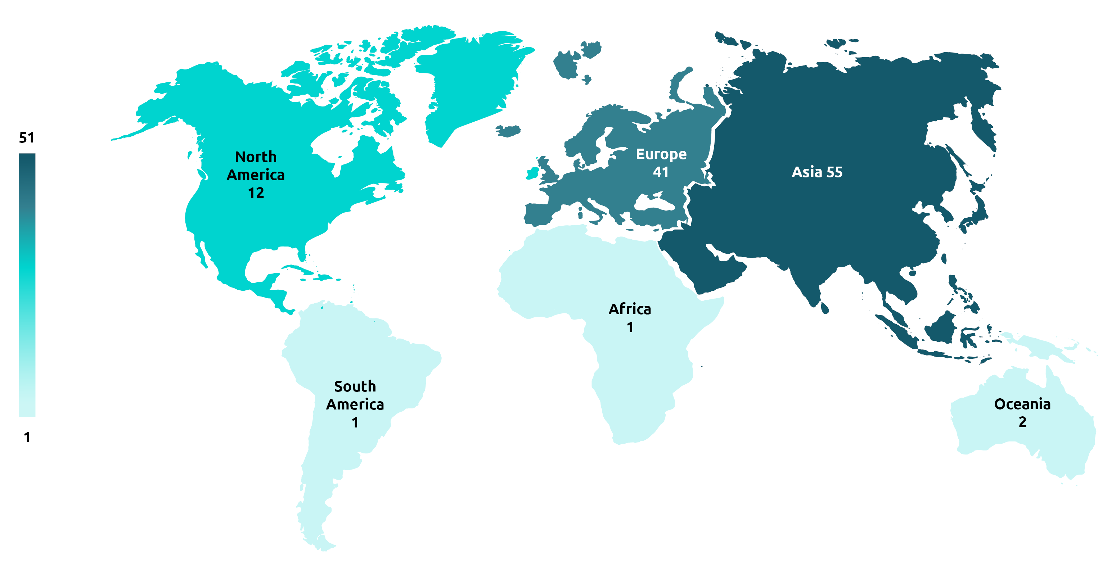
An increase in the demand for batteries requiring the development of gigafactories
A very strong increase in the demand for batteries, especially for electric vehicles
Li-ion is the dominant technology and will stay for eV batteries
112
55
Gigafactories around the world (both operational and ongoing projects)
35%
Of gigafactories are in China (40 gigafactories)
Europe wants to regain sovereignty with the European Battery Alliance
Source: World map of gigafactories, CIC energiGune
Notes:
Source des chiffres clés
https://www.pv-magazine.com/magazine-archive/on-a-mission/

Slide 24
Li-ion batteries dominate the market, but new batteries with lower critical metal requirements are being developed
Li-ion batteries for mobility
Larger plants and optimizing production methods:
Energy density increase
Cost decrease
Non-optimal batteries regarding safety and resource-utilization
Solid-state Li-ion batteries
for mobility
Stationary Sodium-ion batteries
Stationary redox vanadium batteries
Resistant to self-ignition
Higher-power and longer life-cycles
Higher lifetimes
Improve the design flexibility and volumetric density
Lower cost
Lower environmental impact

Slide 25
Forecast of lithium required with current technologies
Projection of worldwide lithium demand from 2019 to 2030
(in 1,000 metric tons of lithium carbonate equivalent)
To achieve EV sales forecast, lithium supplies will need to double from 2021 levels to reach 0.2 Mt in 2025 (17 million EV sales) and rise to 0.5 Mt by 2030 (39 million EV sales)
In absence of recycling, low carbon technologies will require massive amounts of critical resources
Do not trade European Russian gas dependency against China critical mineral resources and equipment dependency
* Starting from the indicated year, figures are forecasts based on the evolution of electric vehicles
Circular economy is a must
Source: Statista
Notes:
Source
https://www.statista.com/statistics/452025/projected-total-demand-for-lithium-globally/

Slide 26


coal usage is increasing: 2022 will be a record year in coal consumption
High gas prices make coal plants competitive
Re-opening coal plants in Europe
Text
Main reasons for coal revival
Reopen 10GW of fossil fuel plants
China increasing its domestic coal mining by 300 million tons in 3 years
Coal is still used as a domestic resource
Notes:
Source chiffre Chine : https://www.bloomberg.com/news/articles/2022-03-14/china-seeks-to-cut-coal-import-reliance-with-mining-boom?leadSource=uverify%20wall

Slide 27


CO₂ Capture is badly needed
CCUS
2021
2030 IEA objectives
Projects examples leading to a productivity increase
Plans to build a $100 billion platform to capture CO₂ emissions along the US Gulf Coast.
over 40 MtCO₂
1.6 GtCO₂¹
€1.8 billion for the Longship project, which should enable the storage of 1.5 million tCO₂ per year from mid-2024
Net Zero by 2050
< 3 MtCO₂
average, capture capacity added worldwide annually since 2010
Present projects affording short to achieve 2050 objectives
What about direct air capture?
Source: ¹Carbon capture in 2021: Off and running or another false start?, IEA

Slide 28
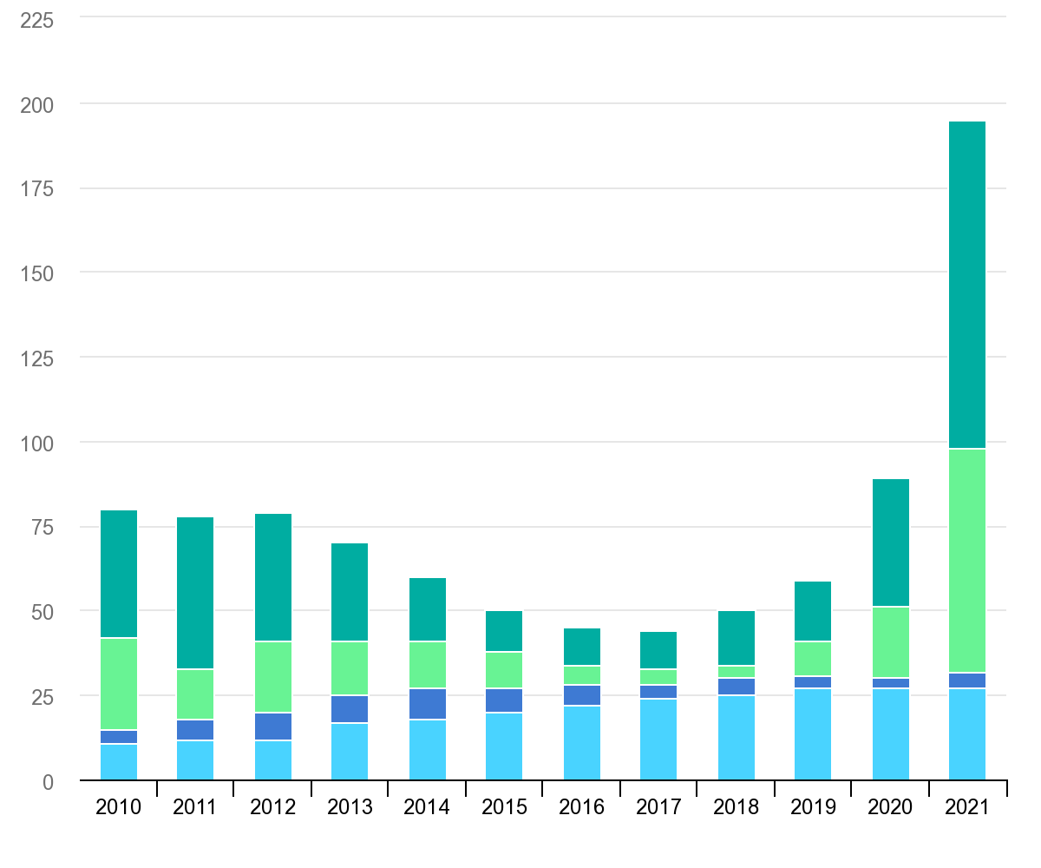
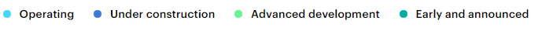
Ccus projects ARE Becoming more competitive with carbon price increase
Global pipeline of commercial CCUS facilities operating and in development (2010-2021)
Acceleration of states support
Recent involvement of major oil operators in achieving net zero
U.S. is the most supportive region of CCUS
The levelized average cost of CCUS per tCO₂ is expected to decrease by 2050. Today it is more costly than the European ETS (around €90/tCO₂ by mid-2022)
Number of facilities
Source: IEA analysis and tracking; Global CCS Institute CCS Facilities Database
Notes:
Schéma
https://www.iea.org/fuels-and-technologies/carbon-capture-utilisation-and-storage

Slide 29
Governments’ support, green hydrogen Production objectives are very ambitious
To meet the Paris agreement goals
End 2021
Green hydrogen
0,04%
$3-8/kg
15%
2%
of world energy demand
by 2050²
of world energy demand
Blue hydrogen
0,7%
$1-2/kg
0.04%
35%
of hydrogen production is green¹
of hydrogen production would need to be green by 2030²
Grey hydrogen
>99%
$0.5-1.7/kg
0.7%
35%
of hydrogen production is blue¹
would need to be blue by 2030²
Lack of green energy
H₂ transportation is complex
Renewable costs no longer decreasing
Difficulty to achieve these objectives
Source: ¹ Global hydrogen review 2022, IEA
² Net Zero by 2050: A Roadmap for the Global Energy Sector, IEA
Cost range: Global Hydrogen Review 2021, IEA
Notes:
Global hydrogen use expands from less than 90 Mt in 2020 to more than 200 Mt in 2030; the proportion of low‐carbon hydrogen rises from 10% in 2020 to 70% in 2030 (Figure 2.19). Around half of low‐carbon hydrogen produced globally in 2030 comes from electrolysis and the remainder from coal and natural gas with CCUS, although this ratio varies substantially between regions. Hydrogen is also blended with natural gas in gas networks: the global average blend in 2030 includes 15% of hydrogen in volumetric terms, reducing CO2 emissions from gas consumption by around 6%.
Source 1 (p.71)
https://iea.blob.core.windows.net/assets/c5bc75b1-9e4d-460d-9056-6e8e626a11c4/GlobalHydrogenReview2022.pdf
Source 2
https://iea.blob.core.windows.net/assets/deebef5d-0c34-4539-9d0c-10b13d840027/NetZeroby2050-ARoadmapfortheGlobalEnergySector_CORR.pdf

Slide 30
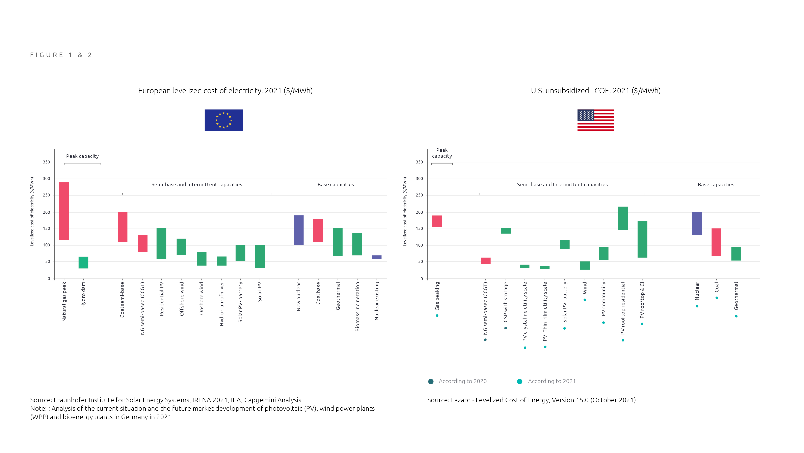
LCOE Comparison - Renewable Energy versus Marginal Cost of Selected Existing Conventional Generation
European LCOE , 2021 ($/MWh)¹
US unsubsidized LCOE , 2021 ($/MWh)²
Note: Analysis of the current situation and the future market development of photovoltaic (PV), wind power plants (WPP) and bioenergy plants in Germany in 2021
Source: ¹Fraunhofer Institute for solar energy systems, IRENA 2021, IEA, Capgemini analysis; ²LAZARD, Levelized Cost of Energy, 2021; Lazard, Levelized cost of energy, version 15.0 (October 2021)
Notes:
Note: Unless otherwise noted, the assumptions used in this sensitivity correspond to those used in the global, unsubsidized analysis as presented on the page titled “Levelized Cost of Energy
Comparison—Unsubsidized Analysis”.
(1) Represents the marginal cost of operating fully depreciated gas combined cycle, coal and nuclear facilities, inclusive of decommissioning costs for nuclear facilities. Analysis assumes that the salvage value for a decommissioned gas combined cycle or coal asset is equivalent to its decommissioning and site restoration costs. Inputs are derived from a benchmark of operating gas combined cycle, coal and nuclear assets across the U.S. Capacity factors, fuel, variable and fixed operating expenses are based on upper and lower quartile estimates derived from Lazard’s research.

Slide 31
Have wE LOst SIGHT OF CLIMATE CHANGE?

Slide 32
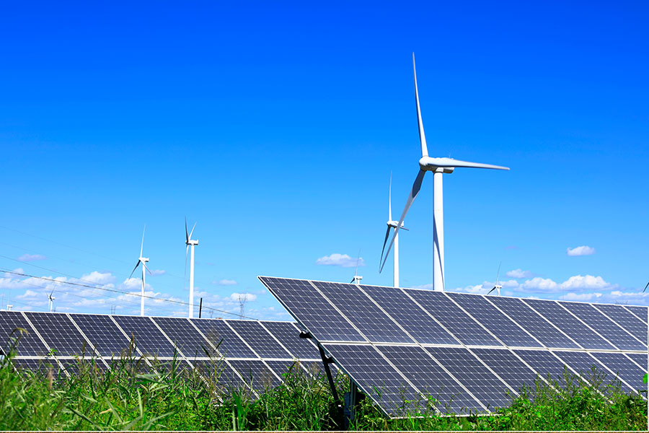


Access to energy AT an affordable price, must be possible for everybody
ENSURE SECURITY OF ENERGY SUPPLIES
FIGHT AGAINST CLIMATE CHANGE
SUPPLY
OF RAW MATERIALS
Coal usage is increasing
Pre-crisis, climate pledges led to a global temperature rise of 2.7°C by 2100
Wind, solar and batteries are requiring massive critical resources
Development of renewables
Corporations and Western Governments continue their fight against climate change
Circular economy is a must
The crisis is threatening the already fragile climate change-related commitments

Slide 33




Europe action’S against climate change ARE accelerated by the Russian invasion of Ukraine
2021: Fit for 55
2023: Reaction to IRA
Reduce EU’s GHG emissions by at least 55% by 2030 to achieve climate neutrality in 2050
  Announcement to end the EU's dependence on Russian gas by 2027 and to accelerate the green transition
  €210 bn investments
  Non paper on Electricity Market Reform:
  CfD mechanism for intramarginal generation
  PPA are encouraged
  More Storage and Demand response
13 measures including
Establishment of a carbon tax at the borders of the EU(adopted)
Mar
Apr
May
Jun
Jul
Aug
Sep
  “Green Deal Industrial Plan” to boost EU clean tech, industrial innovation & sovereignty.
  Key pillars:
  Regulatory
  Financing,
  Skills and Trade
  Agreement to phase out the EU's dependence on Russian fossil fuels
  Gas storage regulation
  Agreement to reduce natural gas demand by 15% this winter
The strengthening of the European carbon market
The end of thermal cars sales by 2035

Slide 34
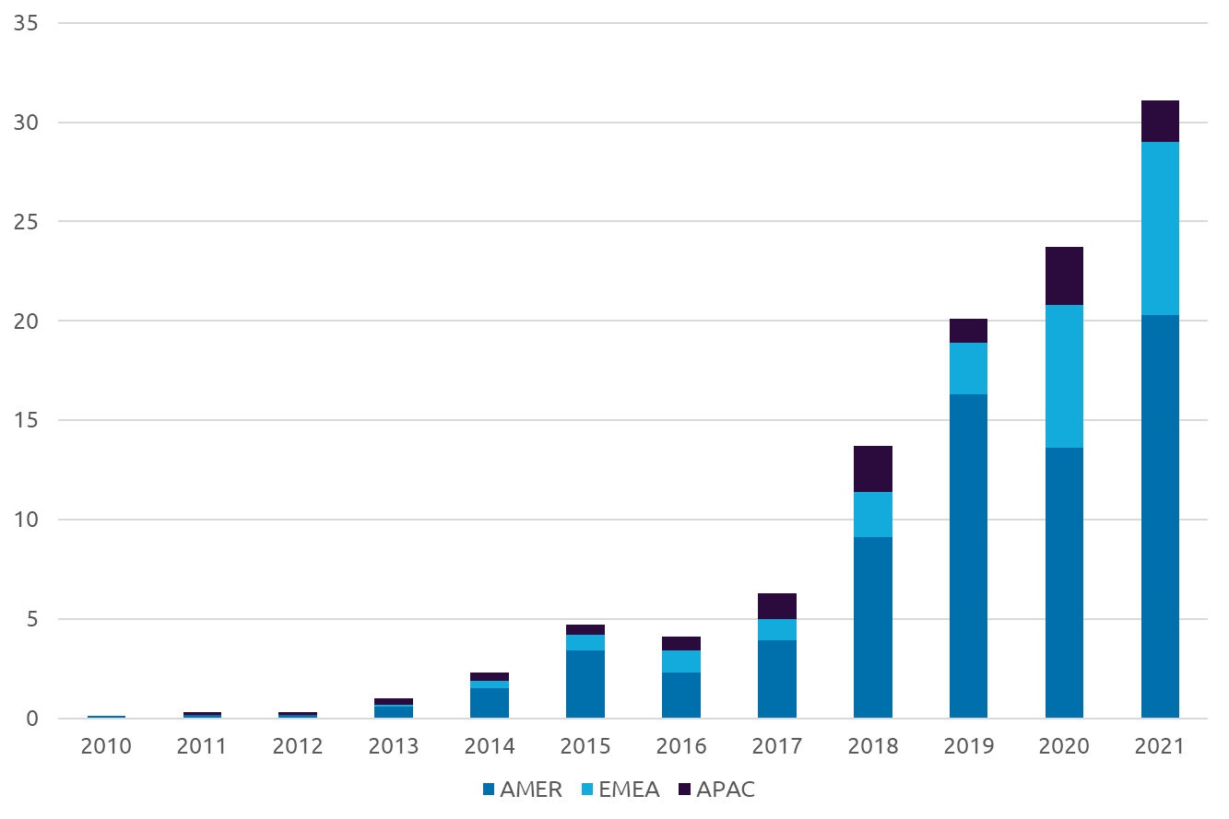
high electricity prices and net zero carbon objectives are pushing PPA demand up
Corporate PPA (in GW) from 2010 to 2021
Corporate PPA market: +24% between 2020 and 2021
European PPA additions record: +8.7 GW in 2021
ICTs and GAFAM continue to dominate the PPA market
With spot electricity increase, more Companies are switching to PPA to get predictable prices
Source: BNEF

Slide 35
Bold us decisions to accelerate its energy transition and reduce its ghgs emissions
2021
2022
Bipartisan Infrastructure Bill
Inflation Reduction Act
$1.2 trillion
$65 billion
>360 billion
40%
infrastructure bill for grid projects and climate resilience
for upgrading the national power infrastructure
in energy and climate change programs .
reduction in carbon emissions by 2030 according to Senate Democrats
The IRA provides significant tax breaks to encourage
the localization of equipment manufacturing plants in the US.
Notes:
Amount IRA : https://time.com/6204582/inflation-reduction-act-climate-change/

Slide 36
Conclusions and Recommendations

Slide 37

Conclusions & recommendations
In recent years, ensuring energy supplies has been neglected. This could result in gas & electricity shortages next winters, notably in Europe.
Energy sobriety is a critical immediate measure for Europe to avoid disruptions in supply.
The use of coal is more sustained than what is desired . Developing competitive CCUS is key to eliminate CO₂ emissions from coal and gas fired power plants.
In the short term, the energy crisis could delay GHG emissions reduction.
In the medium term, the carbon free energies development (renewables and nuclear) will benefit from the current energy crisis.
As renewable energies development is late compared to its targets, it will be difficult to reach green hydrogen objectives. Green hydrogen should be reserved for industrial processes that cannot be abated with electricity.
H₂

Slide 38
Conclusions & recommendations
Acceleration in the deployment of renewables ,however metal recycling is a must.
Long-term remuneration systems for nuclear electricity should be implemented to encourage investments in this industry.
Europe must not exchange a dependence on Russian gas with a dependence on certain energy transition key components, particularly vis-à-vis China.
A balance must be found between energy security of supply, the fight against climate change and energy affordability
Governments should invest more in education, research, and innovation.
Citizens, media and politicians should all receive basic knowledge to understand energy challenges.

Slide 39
THANK YOU
In collaboration with:
WEMO 24th edition
Download your copy @:
www.capgemini.com/wemo
Scan now to
download this
year’s report.
24th Edition | 2022

