Slide 1
Seasonal energy storage for the circular economy of the future with high energy density
Items of today
European Energy Research
2050 Storage Demand
Aluminium as Storage Medium
Storage System Costs
StoRIES Project
Holger Ihssen
Helmholtz / KIT
Brussels Helmholtz Office

Slide 2
European Energy
Research
1

Slide 3
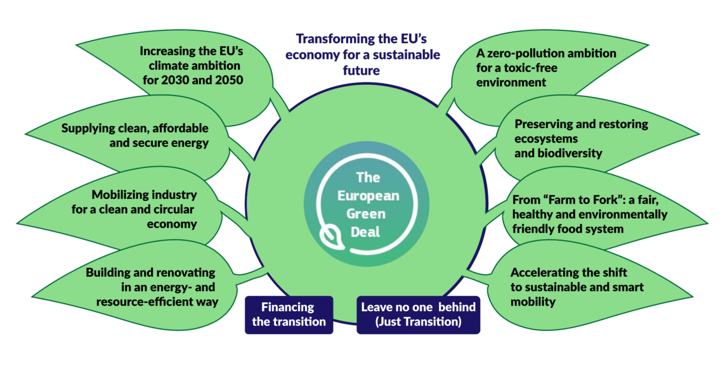



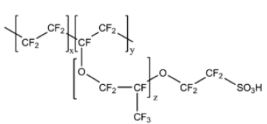

Policy and Energy Storage
Per-and Polyfluoroalkyl Substances (PFAS)
Circular economy
Society
Energy Storage
System Scale Up

Slide 4
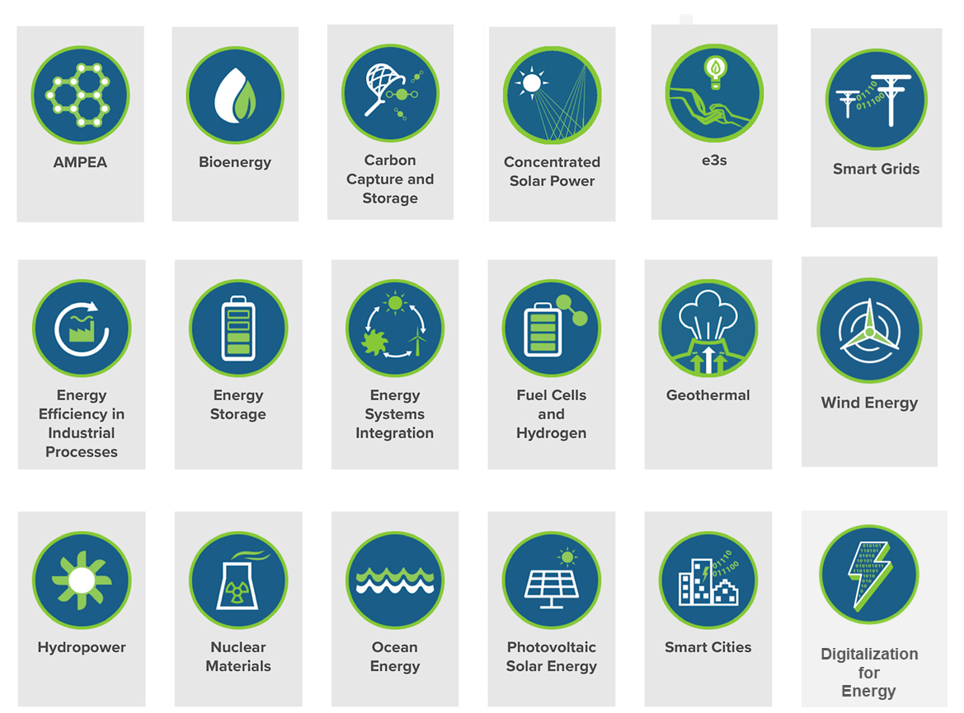
European Energy Research Alliance (EERA)
EERA in a nutshell: The European Energy Research Alliance is a membership-based, non-profit association, constituting the largest low-carbon energy research community in Europe and a key player in the European Union's Strategic Energy Technology (SET) Plan. It was established in 2008 by leading research institutes to expand and optimise EU energy research capabilities. Today it brings together more than 250 organisations from 30 countries.
18 Joint Programmes
www.eera-set.eu

Slide 5



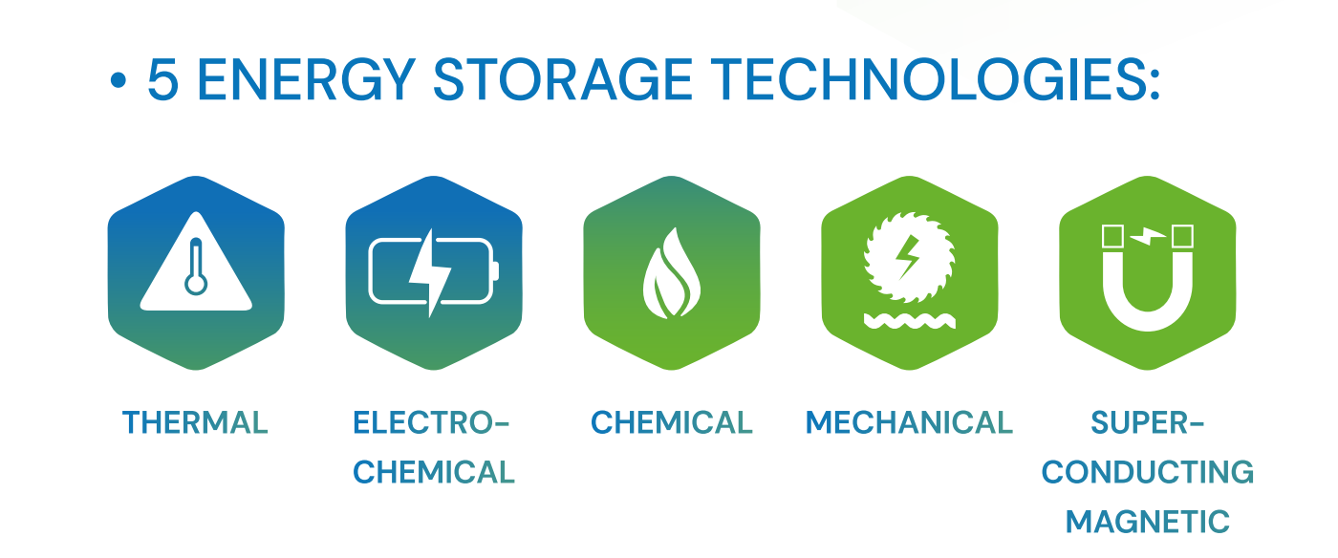
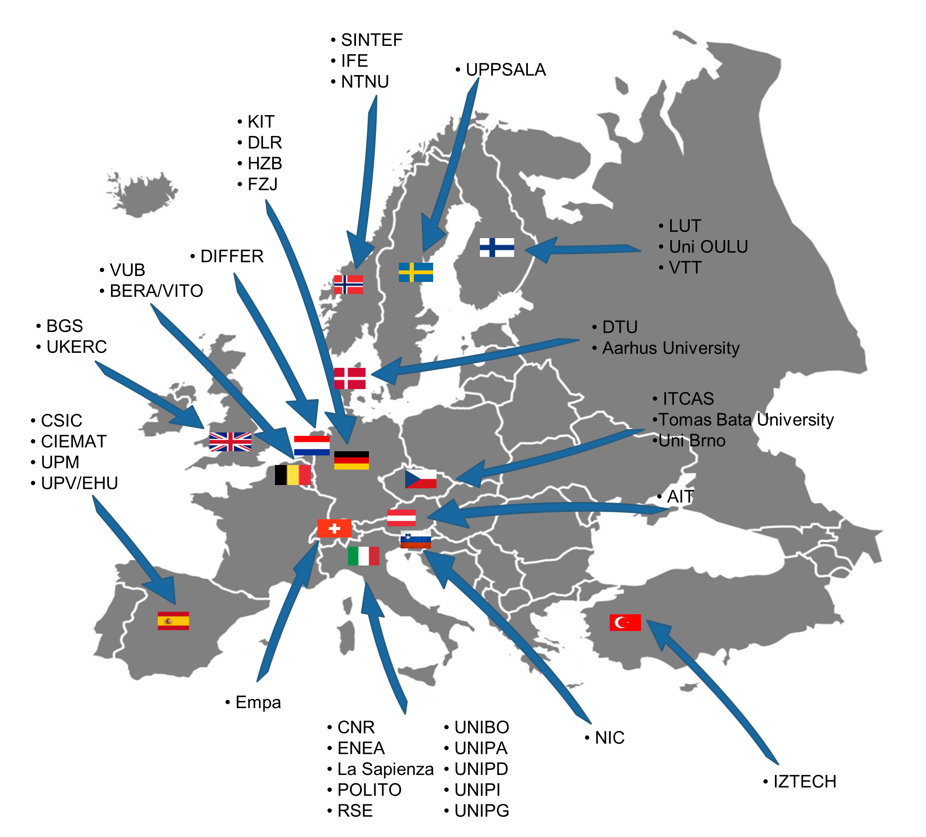
EERA Joint Programme on Energy Storage
www.eera-energystorage.eu
Coordinator:
Dr. Myriam E. Gil Bardají
VISION
Accelerating the European energy storage research to achieve a renewable-based carbon neutral Europa by 2050.
NUMBERS and FIGURES
Launch: 2011
Members: 40 RTOs
and universities
Countries involved: 15
Energy storage areas: 5
MAIN ACTIVITIES
Mobility Scheme
Online PhD Days
JP ES Award
Policy and Technical Workshops
White Papers
Technology Roadmaps
Industry Advisory Board
https://www.eera-energystorage.eu/

Slide 6
2050 Storage Demand
2

Slide 7
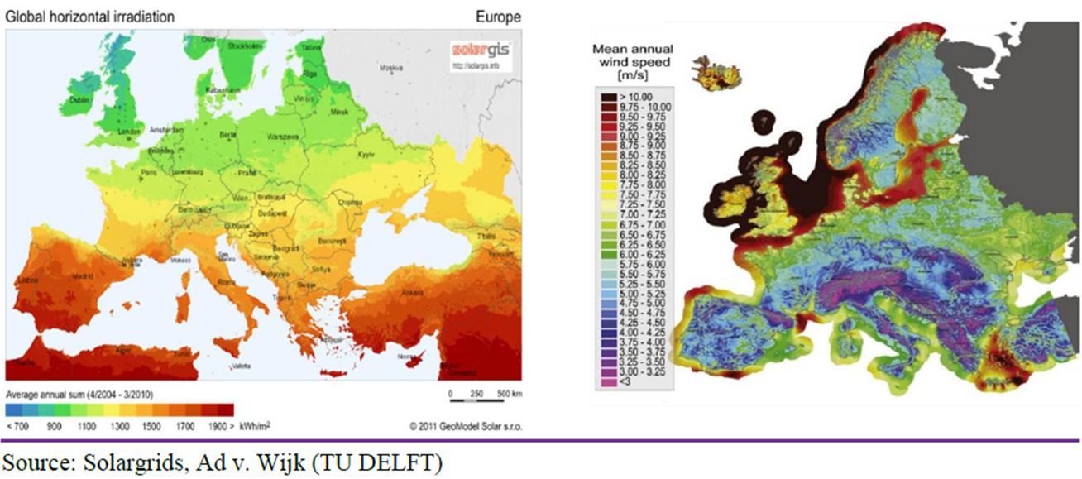
Renewables in Europe

Slide 8
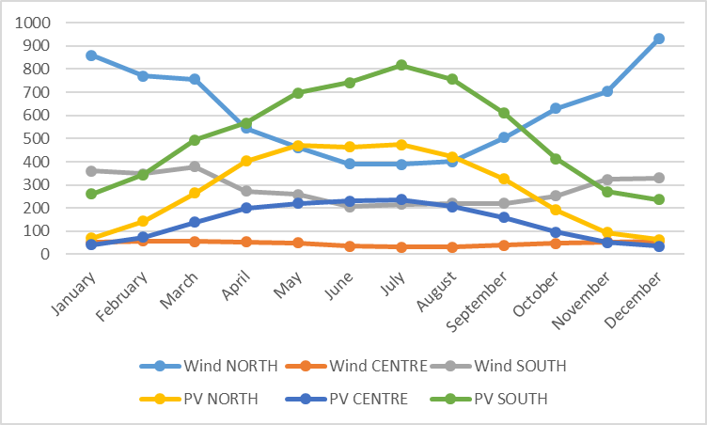
Why energy storage is needed?
Long-term energy storage demand for energy independence
Assumptions:
21399.2 TWh European primary energy consumption (2018)
Elaboration over 2015-2020 generation data (ENTSO-E)
36% Energy Storage cycle efficiency
5.8% POWER GRID LOSSES
 |  | NORTH | CENTRE | SOUTH
45% ³ | PV | 0,3 | 0,15 | 0,55
45% ³ | wind | 0,65 | 0,05 | 0,3
Generation profiles (TWh)
Total generation vs surplus/lack (TWh)
1266 TWh long-term energy storage capacity need
Source:
¹ https://yearbook.enerdata.net/total-energy/world-consumption-statistics.html
² https://download.terna.it/terna/1-DATI%20GENERALI_8d9cece053250fa.pdf
³ https://op.europa.eu/en/publication-detail/-/publication/94aab140-8378-11ea-bf12-01aa75ed71a1/language-en

Slide 9
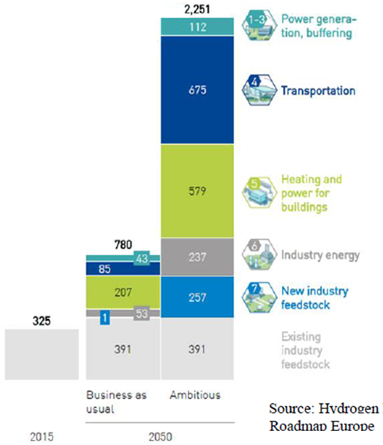
Green Deal Policy Specification
Hydrogen demand in TWh
generation power in 2050
under various scenarios
A generation of 2250 TWh is needed for ~50 M tons hydrogen
In the ambious scenarios hydrogen will be a key vector
for the society and the industry
112 TWh are needed for buffering the electric grid
Hydrogen storage will key for the society.
For how long ? One month ? => (50/12) ~ 4.2 M tons H2
There is no issue with seasonal power buffering,
if we can store hydrogen in sufficient amounts.
Notes:
Across sectors, we see the potential for generating approximately 2,250 terawatt hours (TWh) of hydrogen in Europe in 2050, representing roughly
a quarter of the EU’s total energy demand . This amount would fuel about 42 million large cars, 1.7 million trucks, approximately a quarter of a million buses, and more than 5,500 trains. It would heat more than the equivalent of 52 million households
(about 465 TWh) and provide as much as 10% of building power demand. In industry, approximately 160 TWh of
hydrogen would produce high-grade heat and another 140 TWh would replace coal in steelmaking processes
in the form of direct reduced iron (DRI). 120 TWh of hydrogen combined with captured carbon or carbon
from biomass would also produce synthetic feedstock for 40 Mt of chemicals in 2050.

Slide 10
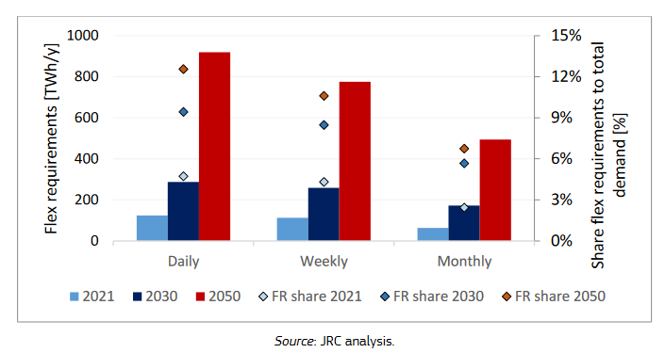
Energy Storage
Today’s flexibility requirements – in 2021, 11% of the total electricity demand in EU
– will grow to 24% in 2030 and to 30% in 2050.
This translate into
(500 / 6)
~ 83 TWh/month
in winter period
And ~ 250 TWh
for 3 month
seasonal storage

Slide 11
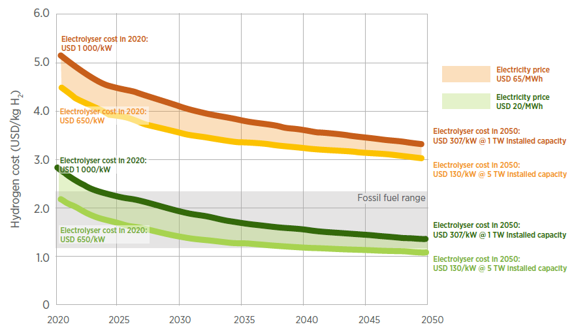
Cost of Green Hydrogen Production Deployment
1.5 – 3.5 $ / kg H2
in 2030
IRENA report: Green Hydrogen Cost Reduction 2020

Slide 12
Reference Scenario : Costs for Hydrogen Stored in 2030
Effective costs of a conventional hydrogen storage system*
Low : 0.2 €/ kg (salt cavern) 1.8 €/kg (gas field) high: 4.5 €/kg (LOHC)
Costs for standard hydrogen production plus storage
results in 1.7 – 8 € /kg hydrogen.
PEM electrolysers still need critical raw materials (iridium, platinium, etc)
and PFAS. The avoidance may reduce the efficiency and generate higher cost.
In economy terms alkaline water electrolysis is seen to be worse,
but could be easier to scale up.
Issue to scale up: Today ~140 MW electrolysers are operational.
Repower EU target is 140 GW !
* DIHK Faktenpapier Juni 2020
Notes:
In 2021, water electrolysis accounted for only around 0.1% of global hydrogen production.

Slide 13
Reactive Metals as
Energy Storage Medium
3

Slide 14
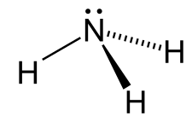

Short Discussion on Long-term Storage Media
Fe : Complex reduction process, still premature.
Ammonia : Needs cooling, that will drop efficiencies for seasonal application. Main use as fertilizer!
Flow batteries: Vanadium is a rare material and the energy density is extremly low (10-20 Wh/kg).
Pumped hydro : Capacity is limited 220 GWh in Europe (Set-Plan); Society might have objections!
Bio materials: Have capacities of about 1000 TWh.
Liquid air energy storage: Good for daily storage.
Hydrogen: Critical raw materials, PFAS, scale up for now,
Large scale storage and use of hydrogen is not proven, yet
Aluminium: May be .. , reduction process is available in industrial scale!
To be discussed.

Slide 15
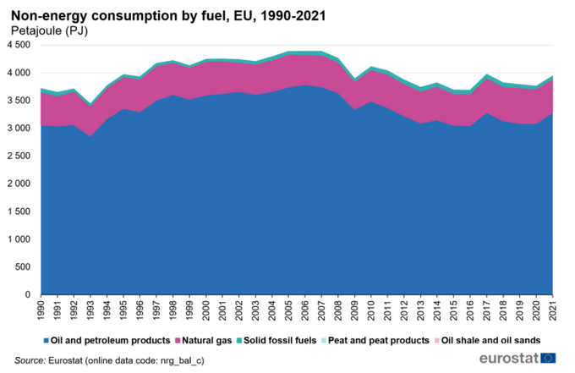
How can We Replace Materials from Non-Energy Consumption ?
4 PJ ~ 3.6 PJ = 1 TWh

Slide 16
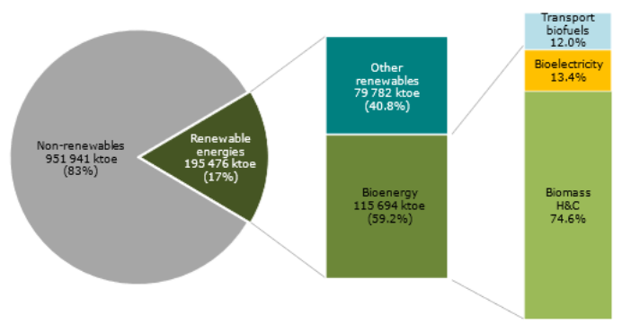
Biomass
Taken from the „National renewable action plan“ (NREAP)
100000 toe ~ 1 TWh
Non-energy consumption by fuel (ca. 1000 TWh) could be covered by bio-mass in the future.

Slide 17
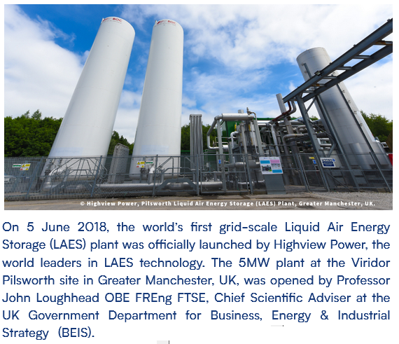
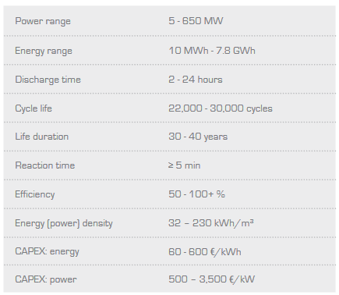
Potential Hybrid Energy System
Seasonal storage should have
long term high efficiencies
Could be combined with a geothermal
heat source reducing the loses and
costs

Slide 18



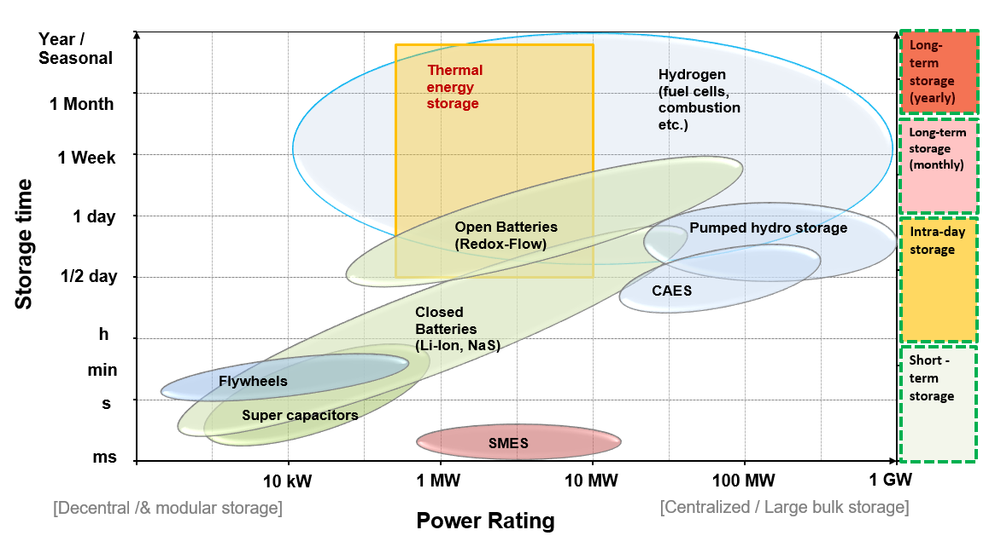

Reactive metals (and Al) vs. Energy Storage Needs
Total energy:
1200 TWh
Total energy:
29 TWh
Barelli, L.; et al.. Reactive Metals as Energy Storage and Carrier Media: Use of Aluminum for Power Generation in Fuel Cell-Based Power Energy technology, 8 (9), Art. Nr.: 2000233. doi:10.1002/ente.202000233
in Orientation to Taylor, Peter; et al.l (2012). Pathways for Energy Storage in the UK. Centre for Low Carbon Futures, York.
Baumann, M.; et al. A review of multi-criteria decision making approaches for evaluating energy storage systems for grid applications. 2019. Renewable & sustainable energy reviews, 107, 516–534. doi:10.1016/j.rser.2019.02.016

Slide 19
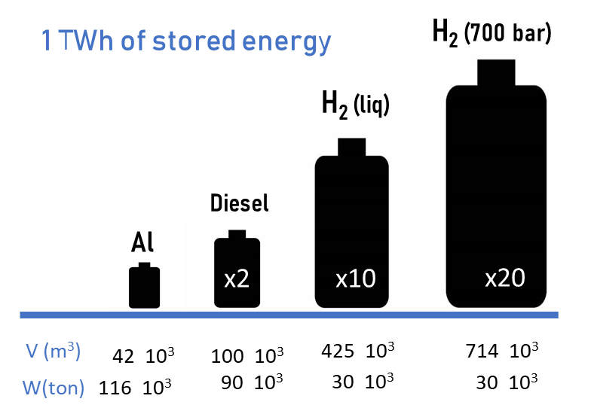
Energy carriers for long-term energy storage
Reactive metals (e.g., aluminium) enable easy, low cost, “perennial” storage
Al | Reactive metals
 | Constraint #1 : High reactivity Competitive energy density
 | Constraint #2 : No critical material
 | Constraint #3 : CO2 emission free reduction
 | Constraint #4 : No toxicity or hazard risk No PFAS
 | Constraint #5 : Local availability & Transportability
 | Constraint #6 : Recyclability
P. Julien, J. M. Bergthorson, Sustainable Energy Fuels (2017) 1, 615.
D. J. Durbin and C. Malardier-Jugroot, Int. J. Hydrogen Energy (2013) 38, 14595–14617.
Notes:
Li batteries : 0.3 kWh/kg // Fe :

Slide 20
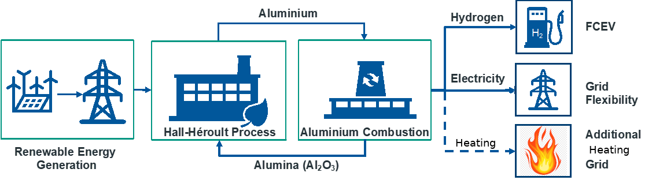

Aluminium as Driver of a Circular Storage System for
Hydrogen, Power and Heat
Thermodynamic conversion
1 kg of Al produces:
4.2 kWh heat
0.11 kg H₂
1.9 kg Al₂O₃ (to be recycled in the Al production)
Wet combustion
2Al(s)+3 H₂O(g)→ Al₂O₃(s)+3H₂ (g) -815.4 kJ/mol
Al₂O₃ reduction to Al through carbon-free Hall-Héroult process
circular approach
recyclable energy carrier
Barelli, L.; et al..
H. Ersoy, M. Baumann, L. Barelli, A. Ottaviano, L. Trombetti, M. Weil, S. Passerini, Adv. Mater. Technol. 2022, 7, 2101400.

Slide 21
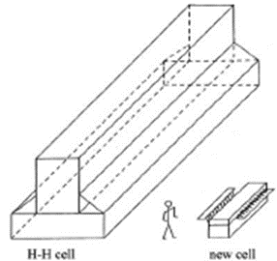
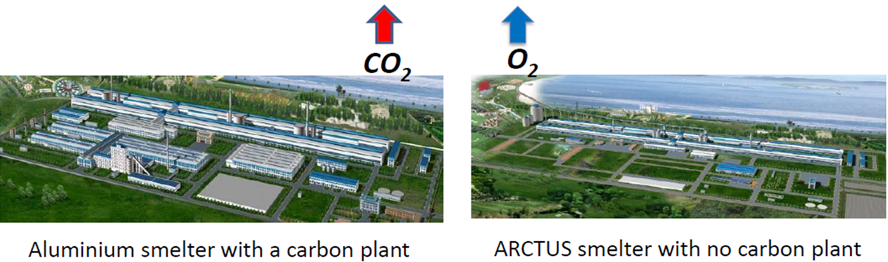
Carbon Free Hall-Héroult Process
Zero CO2 emission, only O2
No perfluorochemicals (PFCs) emitted
The capacity of the new
electrolyser is about
1 tonne of aluminium
per day at a current
of 140,000 A.
20 % less energy and flexible power
50 % less space, see figures
40 % less investments
15-30 % less operational costs
Presentation by: Eng. Jon Hjaltalin Magnusson, M.Sc.EE., CEO
Arctus Aluminium Ltd., Reykjavik, Iceland // jhm@arctus.is
Notes:
PFCs are produced when fluorine from a salt used in electrolysis combines with the carbon in the anodes. The PFCs produced during electrolysis are extremely potent greenhouse gases, with a global warming potential of 6,500 and 9,200 times the strength of CO2, respectively. In 2021, Century Aluminum’s Sebree plant in Kentucky emitted 24 tons of PFCs, equivalent to the emissions of 40,000 cars.
Inert anodes may reduce local air pollution. In addition to the climate benefits that they offer, inert anodes also present an opportunity to decrease sulfur dioxide (SO2) pollution. Carbon anodes are produced by baking coke and coal tar pitch, which both contain sulfur. SO2 is produced during smelting when oxygen in the air reacts with sulfur in the carbon anodes. This reaction does not occur when using inert anodes, removing SO2
emissions from the smelting process.
Despite the climate and health benefits of inert anodes, one criticism of the technology is its potential impact on the electrical grid. The theoretical minimum electricity requirement for smelting with a carbon anode is 5.99kWh/kg Al, while for inert anodes, it is 9.03 kWh/kg Al. The higher theoretical energy usage is valid reason for concern about grid reliability and the ability to meet demand. This concern is especially relevant as policymakers work to decarbonize the electrical grid while simultaneously electrifying sectors like transportation and buildings.
However, there is research suggesting that the actual, nontheoretical energy requirements for inert anodes will be equal to or lower than traditional aluminum production processes. Use of inert anodes allows for a lower anode overvoltage (the extra energy needed to force a reaction), which ultimately reduces energy demand during electrolysis. Additionally, the distances between the anode and cathode can be reduced when inert anodes are combined with wetted cathodes, which can lower the energy requirement of the smelting reaction.

Slide 22
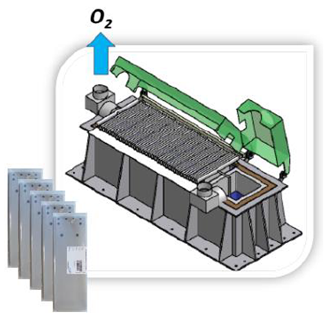
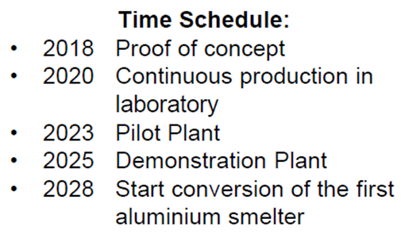
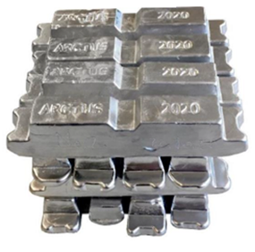
Carbon Free Hall-Héroult Process - Products
Products:
Production cells with vertical inert
metallic anodes, ceramic cathodes
and control systems for aluminium
production.
The business and market potential has
estimated sales in 2030-2040 in Europe
of process cells, etc. for conversion of
8 old smelters: Estimated total revenues
in the period 2030 –2040: €4,5 billion.
Overall 19 smelters are operational in Europe.
99.7 % pure aluminium
Notes:
PFCs are produced when fluorine from a salt used in electrolysis combines with the carbon in the anodes. The PFCs produced during electrolysis are extremely potent greenhouse gases, with a global warming potential of 6,500 and 9,200 times the strength of CO2, respectively. In 2021, Century Aluminum’s Sebree plant in Kentucky emitted 24 tons of PFCs, equivalent to the emissions of 40,000 cars.
Inert anodes may reduce local air pollution. In addition to the climate benefits that they offer, inert anodes also present an opportunity to decrease sulfur dioxide (SO2) pollution. Carbon anodes are produced by baking coke and coal tar pitch, which both contain sulfur. SO2 is produced during smelting when oxygen in the air reacts with sulfur in the carbon anodes. This reaction does not occur when using inert anodes, removing SO2
emissions from the smelting process.
Despite the climate and health benefits of inert anodes, one criticism of the technology is its potential impact on the electrical grid. The theoretical minimum electricity requirement for smelting with a carbon anode is 5.99kWh/kg Al, while for inert anodes, it is 9.03 kWh/kg Al. The higher theoretical energy usage is valid reason for concern about grid reliability and the ability to meet demand. This concern is especially relevant as policymakers work to decarbonize the electrical grid while simultaneously electrifying sectors like transportation and buildings.
However, there is research suggesting that the actual, nontheoretical energy requirements for inert anodes will be equal to or lower than traditional aluminum production processes. Use of inert anodes allows for a lower anode overvoltage (the extra energy needed to force a reaction), which ultimately reduces energy demand during electrolysis. Additionally, the distances between the anode and cathode can be reduced when inert anodes are combined with wetted cathodes, which can lower the energy requirement of the smelting reaction.

Slide 23
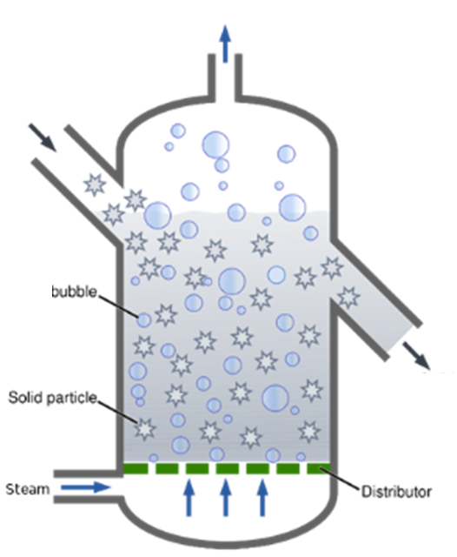
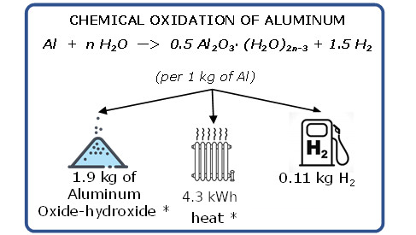


Aluminium Combustion Technology
THERMODYNAMIC CONVERSION
(wet combustion)
Overheated steam
Hydrogen
Fluidized bed
Al powder
H2 bubble
Stored energy is converted into H₂ and heat
Heat is transformed into electricity via gas turbine.
Steam
Al₂O₃
Is a simple combustion process !

Slide 24
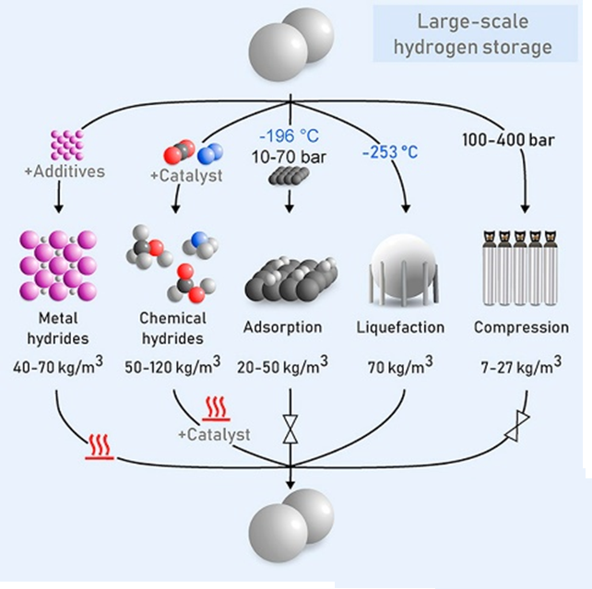

Hydrogen Storage Media Performance
Aluminium

Slide 25
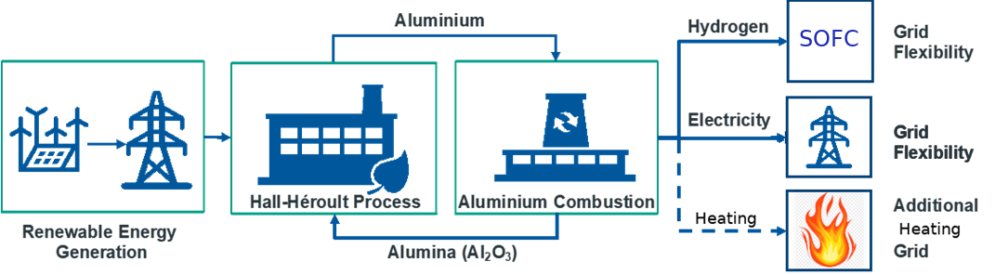
Business Case: Power Only
Hydrogen is converted into power via a Solid Oxide Fuel Cell !
Al₂O₃ reduction to Al through carbon-free Hall-Héroult process
Barelli, L.; et al..
H. Ersoy, M. Baumann, L. Barelli, A. Ottaviano, L. Trombetti, M. Weil, S. Passerini, Adv. Mater. Technol. 2022, 7, 2101400.

Slide 26
Round Trip Efficiency
Volumetric energy density and implemented technologies of
Power-to-Power applications based on different energy carriers
Energy Carrier | Conversion Technology | Round Trip Efficiency (RTE) | Energy Density [kWh/L]
Al | Aluminium Wet – Combustion (ST,GT, & SOFC) | 35.6 % | 23.5
H₂ | PEM Electrolyzer – PEM Fuel Cell (PEMFC) Reversible – Solid Oxide Cell | 30% (H₂@200 bar) 48% (H₂@70 bar) | 0.53 0.2
Methanol / DME | Solid Oxide Electrolizer (SOE) / H₂ to methanol-DME / Solid Oxide Fuel Cell (SOFC) | 36% (26.5%) | 5.5
Gasoline | SOE/ H₂ to gasoline/SOFC | 27% (20%) | 8.8
LNG | SOE/TSA dehydration, H₂ and CO₂ membrane separation/SOFC | 28% (23%) | 5.8
The RTE values in brackets include the thermal (1750 kWh/tCO₂) and electric (250 kWh/tCO₂) specific consumptions for CO₂ direct air capture for low-temperature solid sorbent technologies

Slide 27

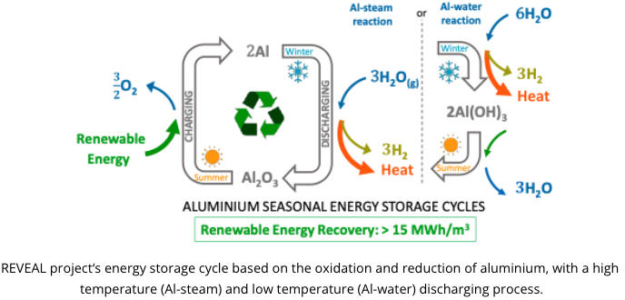






REVEAL Project
at ~280 degrees C
Results are excellent
Batch operating system
Not suitable for continuous operation of energy-conversion devices such as turbines and fuel cells.
Energy density is lower than by producing alumina

Slide 28
Storage System Cost
4

Slide 29
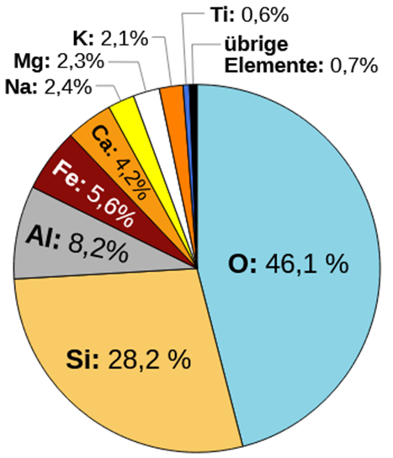
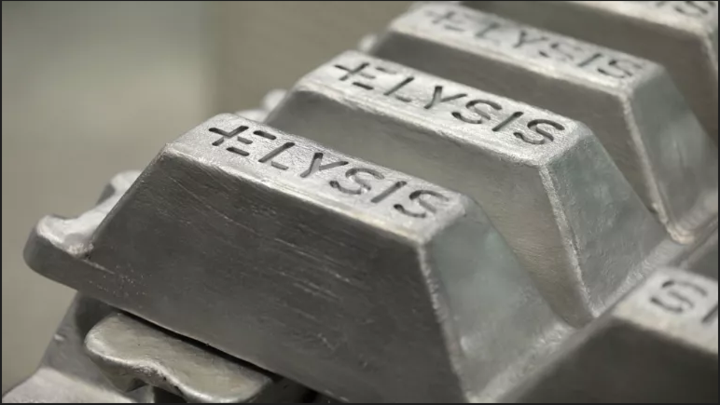
European View on an
Aluminium Storage System
Aluminium production in 2022 :
World total : 69 M tons
Europe : 7 M tons
Aluminium demand in Europe :
2022 : 9 M tons
2050 : 18 M tons expected
Aluminum is the third most
abundant element in the
earth's crust!
43 M tons of aluminum is needed to store the power for 112 TWh.
Scale up of the European aluminium smelter industry by a factor of three to six
over 25 years would do it.
And Europe needs an increase of 22% „fresh“ aluminium production.
43 M tons aluminium would provide 4,7 M tons hydrogen storage.
This is a reserve for 34 days.

Slide 30
Private Cost Assessment
The March 2010 commodity price for aluminum is $2.21 per kg. Al₂O₃ At this price, hydrogen from an aluminum-water hydrogen generation approach would cost approximately $20 per kg H2. Even assuming high volume production, the DOE target range for hydrogen cost of $2-3 per kg H2 would not be met.
Today generation of hydrogen by wet combustion results in price of 12 -14 €/ kg
Inert aluminium smelting technology will reduce the price to 8-10 €/ kg of hydrogen.
Aluminium is a hybrid storage medium. There is still heat and power left.
Seasonal storage will be actived, when power is rare and the price of electricity is high.
Revenues will reduce the hydrogen price further to may be 5-9 €/ kg.

Slide 31
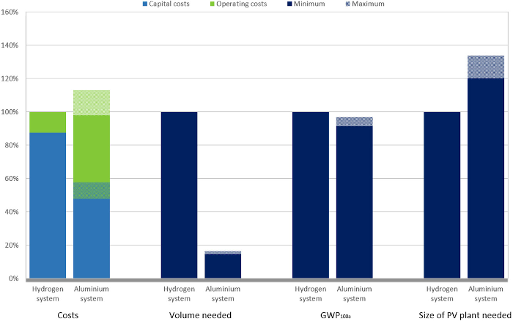
Aluminium Redox Cycle vs Pressurized Hydrogen
https://www.sciencedirect.com/science/article/pii/S2666352X22000413
Based on 280 C Aluminium wet combustion

Slide 32
Remarks
Cost calculations are based on todays market framework and are rough estimations.
Aluminum could be the medium for daily, weekly or seasonal storage solution.
Aluminium could be the medium for local or central energy solutions. Turbines from coal or gas power stations could still be used !
The ambitious scenario of the EU assumes an overall energy drop by a factor of 1.5 – 2
EU Green Deal scenario is most likely are not realistic.
If the energy consumptions is not dropping and Europe still needs 1200TWh seasonal storage capacities in 2050, then this is a challenge.
Aluminium production from bauxite has an environmental issue. Using aluminium in a circular economy is a clean process.

Slide 33
StoRIES project
H2020 project
5

Slide 34


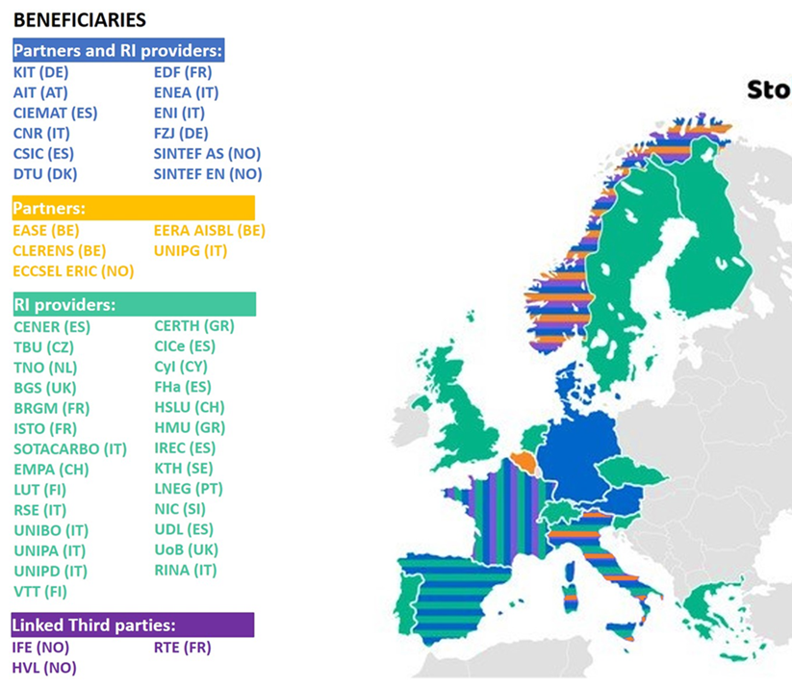
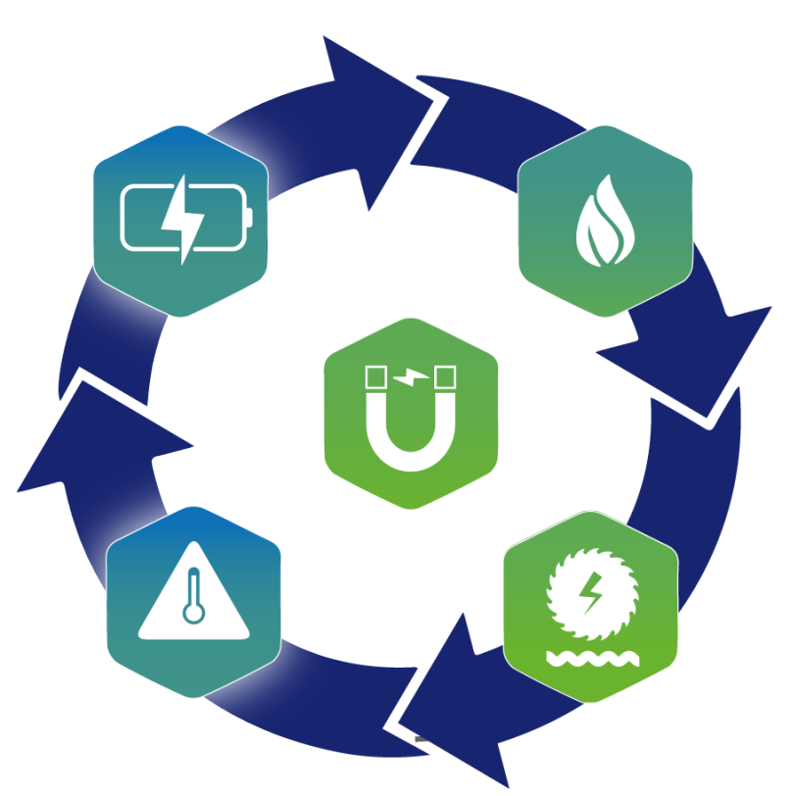
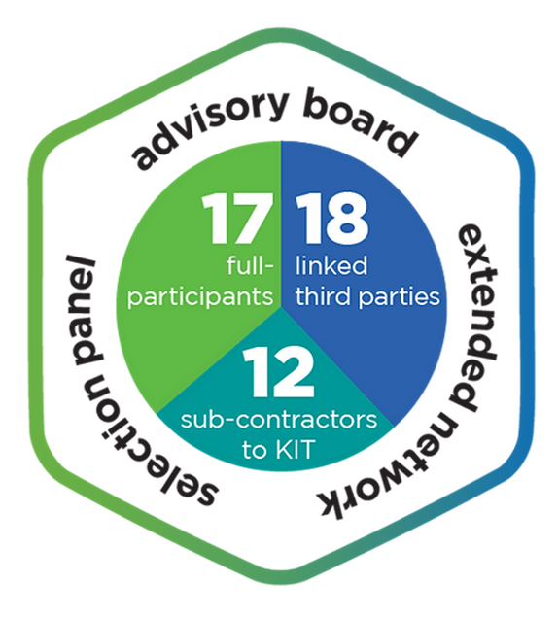

Storage Research Infrastructure Eco-System
34
Coordinator:
Prof. Stefano Passerini
ECO-SYSTEM
Key Research Priority: Hybridization of ES
NUMBERS and FIGURES
Duration: 2021-2025
Budget: 7 Mio €
Beneficiaries: 47
Infrastructures: 64
Countries involved: 17
MAIN OBJECTIVES
Foster a European eco-system of industry and research organisations on hybrid energy storage technologies
Provide access to world-class materials and energy storage related research infrastructures
This project has received funding from the European Union’s Horizon 2020 research and innovation program under Grant Agreement no. 101036910

Slide 35
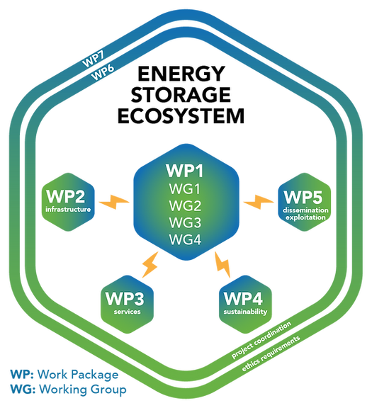
Main Outcomes
White Paper on ‘Open Data in the ES community’
6 Transnational Access (TNA) calls
Materials Acceleration Platform for ES (MAPs)
Roadmap for Hybrid Energy Storage Solutions
Strategic Research and Innovation Agenda (SRIA)
5 International Mobility Calls
Master programme
Mentoring Programme
3 Summer schools
Sustainable ES Workshop Series
White paper on ‘Sustainable hybrid ES for the European CET’
This project has received funding from the European Union’s Horizon 2020 research and innovation program under Grant Agreement no. 101036910
www.storiesproject.eu

Slide 36










Thank You Very Much For Your Attention
eera-jpes@b3.kit.edu
EERA JP-ES Energy Storage
@EERA_JPES
eera-energystorage.eu
Many Thanks for Supporting this Presentation
Myriam Gil Bardají
EERA Joint Programme coordinator
Stefano Passerini
Project coordinator
Linda Barelli
University of Perugia

Slide 37
Some Extra Slides

Slide 38
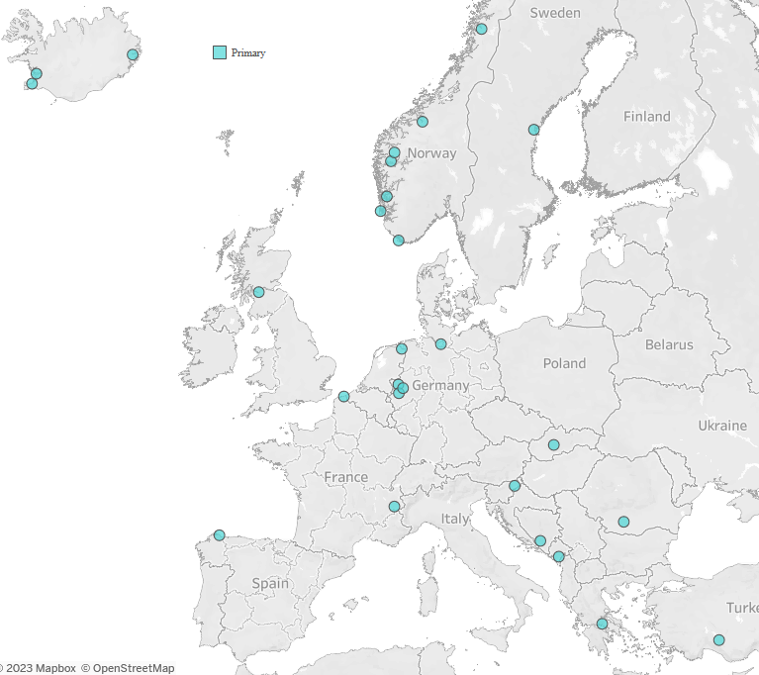
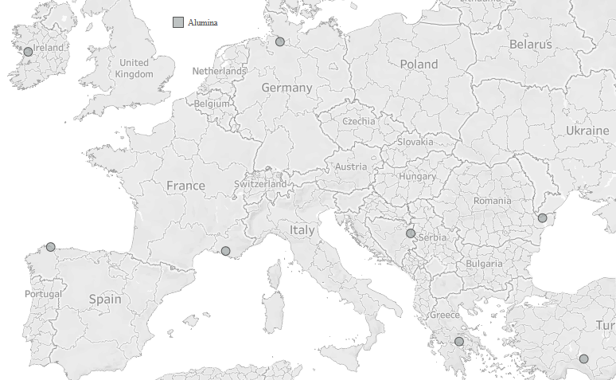
Primary and Alumina
Production Facilities
Primary
Alumina

Slide 39
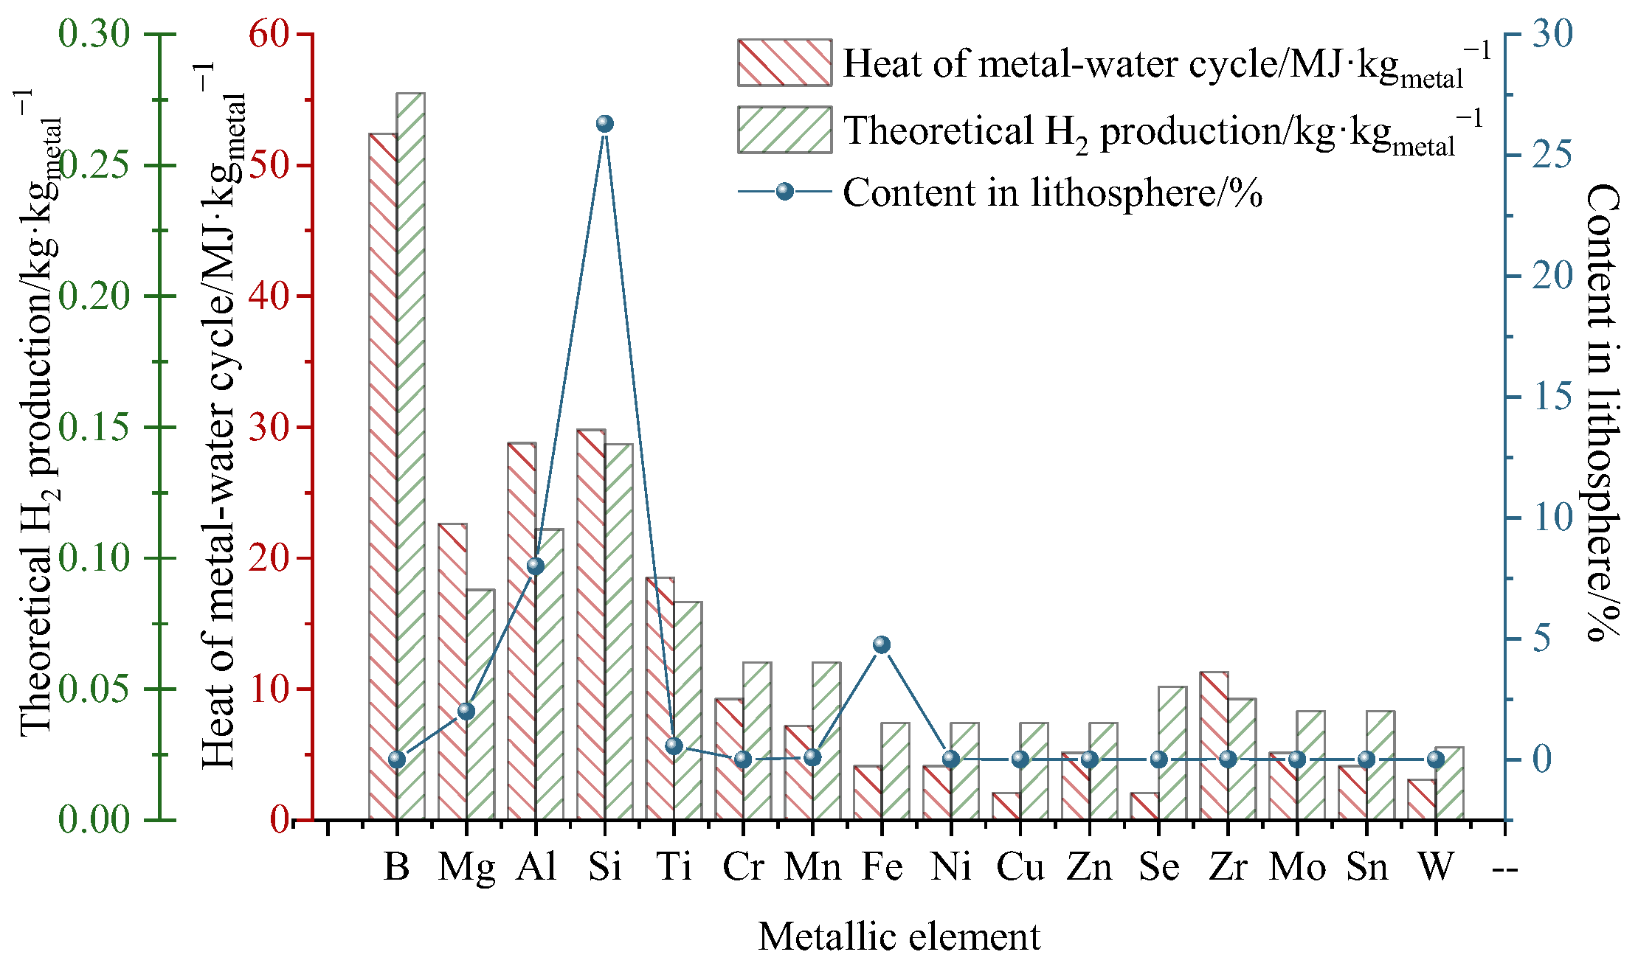

Slide 40
Work on inert anodes – at SINTEF and globally
There are currently many research groups working on inert anodes.
The Russian company RUSAL is currently operating with pilot cells based
on the use of metal anodes. A Chinese company has pilot cells using
cermet anodes (made of a mixture of a metal and ceramic material).
Elysis is a relatively new consortium made up of the companies Alcoa,
Rio Tinto, Apple and the Canadian authorities. Elysis is planning to
spend more than a billion kroner on the development of cell technology
based on the use of inert anodes, and are claiming that they will have
a commercial process in place in 2024.
In Europe, Arctus Metals in Iceland is conducting R&D into inert anodes.

Slide 41
industrial production of primary aluminium in Hall-Héroult electrolysis cells, where alumina (Al₂O₃) is dissolved in a molten fluoride-containing electrolyte consisting mainly of cryolite (Na₃AlF₆) at about 960 °C.

