Slide 1
Pumped storage hydropower in former surface mining pits
791. WE-Heraeus-Seminar
The Physical, Chemical and Technological Aspects of the Fundamental Transition in Energy Supply from Fossil to Renewable Sources – Key Aspect: Energy Storage
Bad Honnef, 21 June 2023

Slide 2
Pumped storage hydropower overview

Slide 3
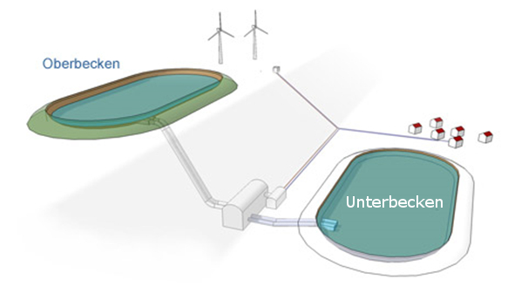
General functionality of pumped storage hydropower plants
Upper reservoir
Lower reservoir
Powerhouse
Waterway, including surge tank
Grid connection
Upper reservoir
Grid
Waterway
Lower reservoir
Powerhouse
Energy storage: Increase of the potential energy of the water by pumping the water from the lower reservoir to the upper reservoir
Energy recovery: Reconversion of the stored potential energy to electrical energy by turbination of the water from the upper reservoir to the the lower reservoir
Quelle der Abbildung: http://www.psw.at
3

Slide 4
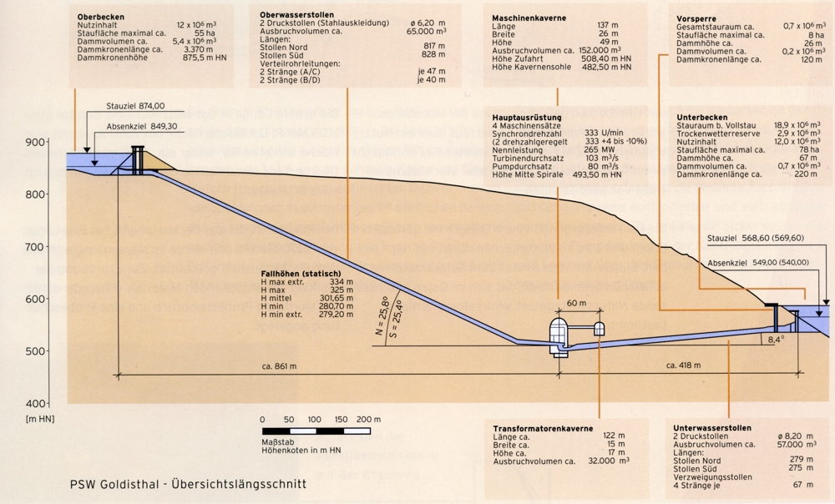
General functionality of pumped storage hydropower plants
Scheme of the pumped storage hydropower plant Goldisthal (installed capacity 1.060 MW)
4

Slide 5
General functionality of pumped storage hydropower plants
Optimal site conditions:
Big geodetic head between upper and lower reservoir
Short horizontal distance between upper and lower reservoir
Existing natural watercourse (for compensation of losses by evaporation and infiltration)
Direct proportionality between capacity (P) and head (H) respectively discharge (Q)
with:
P = Installed capacity (W, kW, MW)
Q = Turbine / pump discharge (m³/s)
H = Head (m)
$η=$ Total efficiency factor (-)
$ρ=$ Density of water (kg/m³)
g = Gravity acceleration (9,81 m/s²)
$$P= η ×ρ × Q × H × g$$

Slide 6
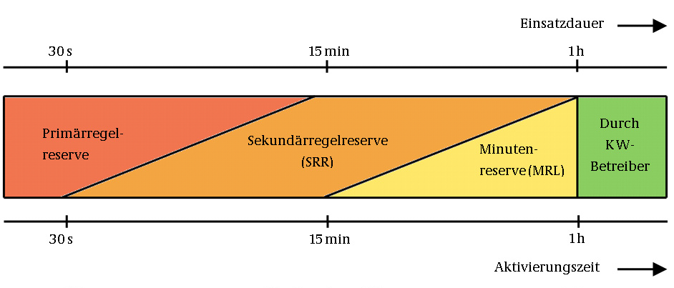
Relevance and principal tasks of pumped storage plants for grid
Daily and weekly storage for compensation of demand deviations
Control energy for frequency regulation (Primary, secondary, tertiary control –minute reserve) for load balance and in case of forecast deviations
Blind power control (Phase shifter operation – no-load operation)
Black start ability (e. g. after a power failure)
Timeline for the three types of control energy, source: Bundesnetzagentur

Slide 7
Pumped storage hydropower – Overview Germany
Nr | Pumped storage plant | Region | Installed Capacity (MW) | Storage Capacity (MWh) | Year
1 | Goldisthal | Thuringia | 1.060 | 8.480 | 2003
2 | Markersbach | Saxony | 1.050 | 4.018 | 1979
3 | Schluchsee (Wehrkraftwerk) | Baden-Württemberg | 980 | 6.073 | 1975
4 | Waldeck II | Hesse | 480 | 3.428 | 1975
5 | Schluchsee (Kaverne) | Baden-Württemberg | 370 | 2.064 | 1967
6 | Hohenwarte II | Thuringia | 320 | 2.087 | 1966
7 | Erzhausen | Lower Saxony | 220 | 1.110 | 1964
8 | Schluchsee (Kraftwerk Witznau) | Baden-Württemberg | 220 | 626 | 1950
9 | Happburg | Bavaria | 160 | 900 | 1958
10 | Schluchsee Kraftwerk Waldshut | Baden-Württemberg | 160 | 402 | 2011
10 Largest PSP in Germany, Source: Wikipedia

Slide 8
Pumped storage hydropower – Overview Germany
approx. 30 existing pumped storage hydropower plants in Germany
Total installed capacity approx. 7 GW
total storage capacity approx. 40 GWh
Energy generation per year approx. 4.000 GWh
Energy storage per year approx. 5.800 GWh
Currently, only a few pumped storage projects in progress (e.g. PSP Forbach by EnBW: in pre-construction phase) due to low economic viability.

Slide 9
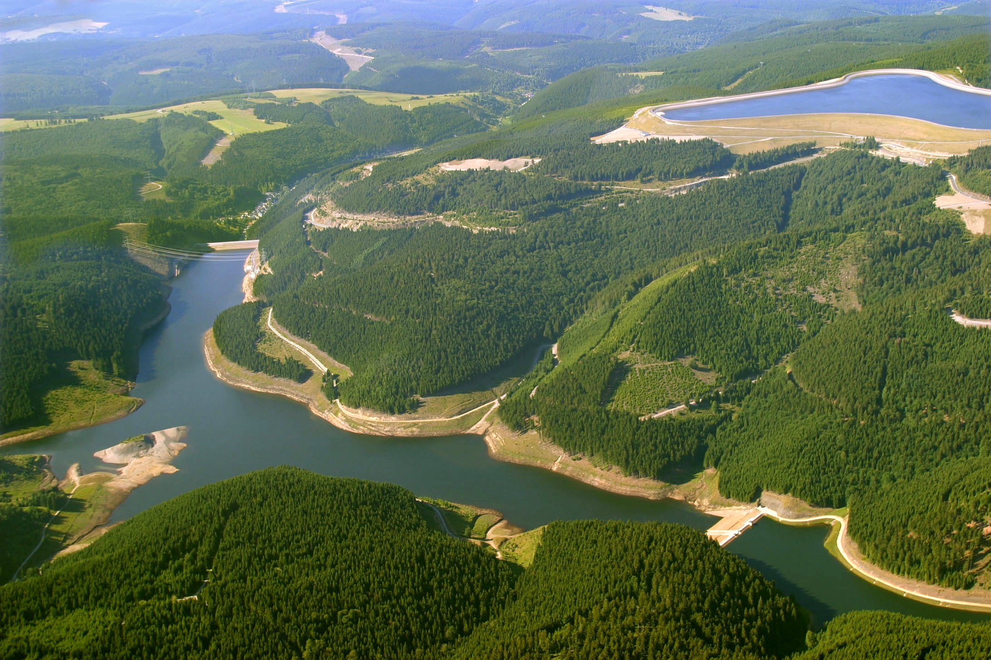
Pumped storage hydropower plant Goldisthal
Pumped storage hydropower plant Goldisthal with upper and lower reservoir

Slide 10
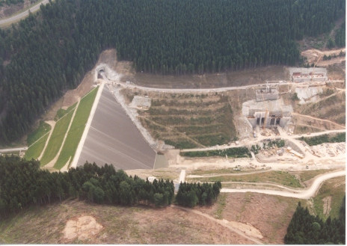
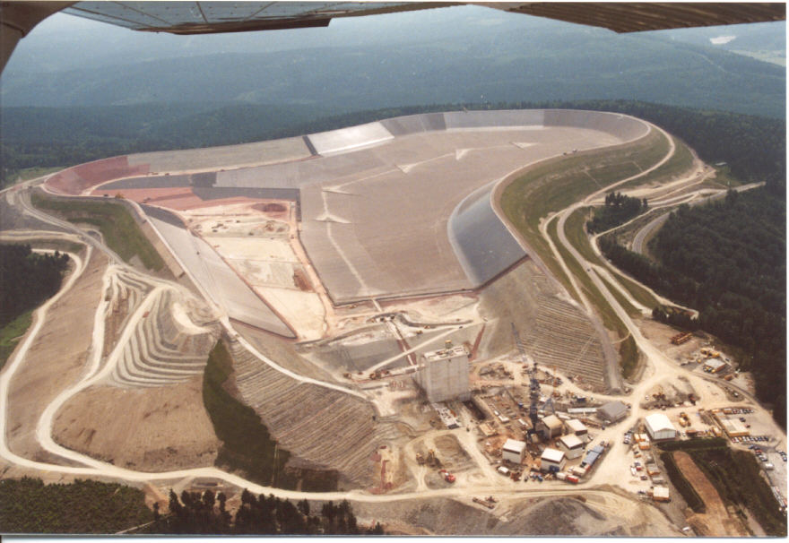
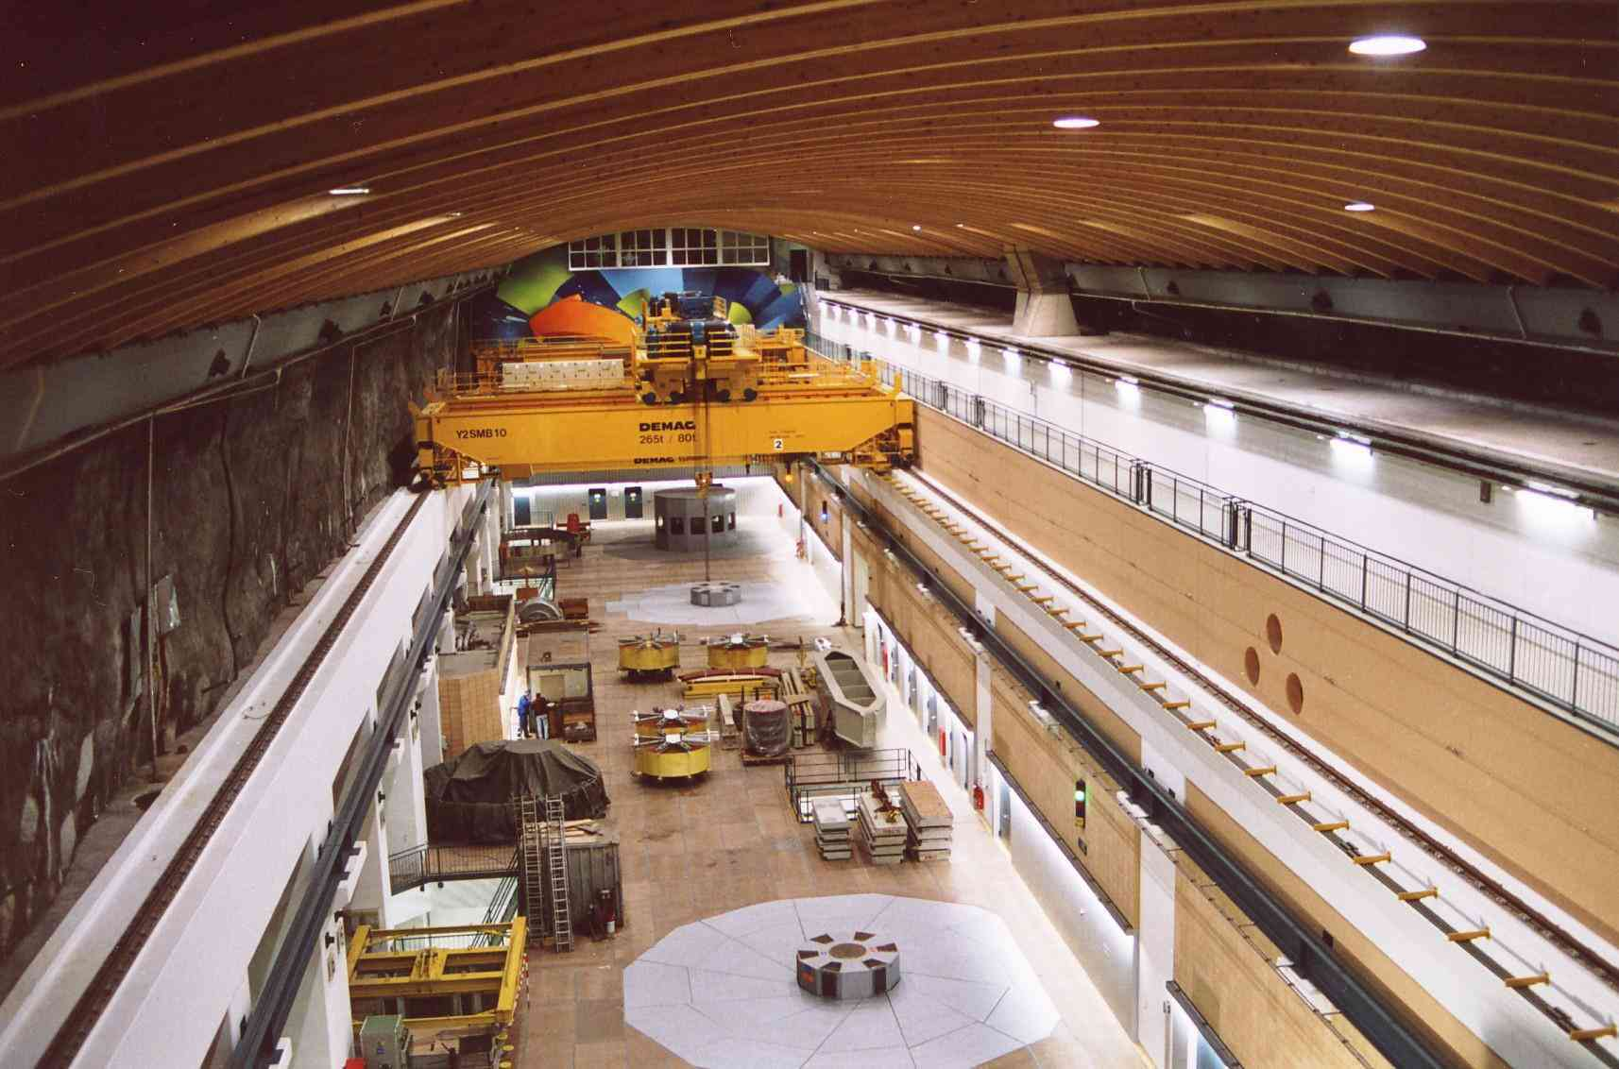
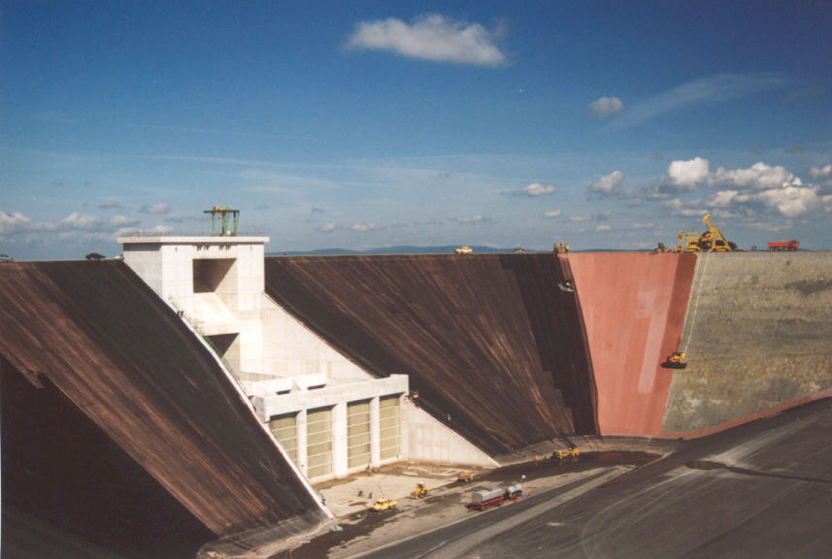
Pumped storage hydropower plant Goldisthal
Construction of lower reservoir
Construction of upper reservoir
Powerhouse cavern
Inlet structure upper reservoir

Slide 11
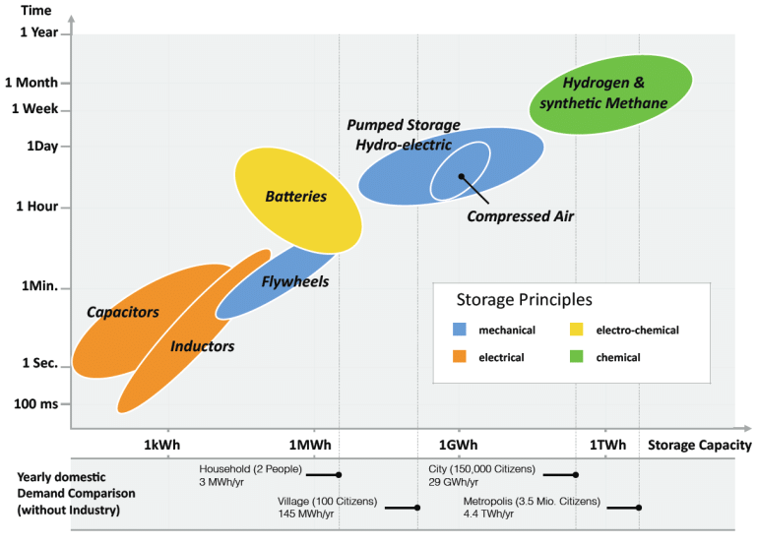
Comparison of storage technologies
Storage technologies in comparison (source: M. Sterner, Energiespeicher, 2014)

Slide 12
Storage technologies –Technical and economic parameter
 | Pumped storage | Batteries | Capacitors | Hydrogen | Compressed air
Reaction time | Min. | Millisec. | Millisec. | specific | Min.
Storage capacity* | 100 MWh – 100 GWh | up to 50 MWh | up to 100 kWh | 10GWh bis 10TWh | 1 GWh
Installed capacity in MW | >1.000 | 27 | 0,1 | 0,2 | 290
Costs in €/kW | 800 -1.500* | 1.200-2.000 | very high | 2.500 | 600
Black start ability | Yes | potentially | potentially | not specified | ja
Phase shifter operation | Yes | yes | yes | No | No
Balancing power | Yes | limited | No | No | no
Reactive power | Yes | No | no | No | limited
Efficiency factor | 70-80% | 80-95% | 80-95% | 30-40% | 50%
Number of cycles | unlimited | <10.000 | >1.000.000 | not specified | unlimited
Source: DENA 2010, Wikipedia „Energiespeicher“, LBS 2010, DBACB 2010, AEE 2011, GE 2012
* Tractebel Hydroprojekt GmbH

Slide 13
Pumped storage hydropower in the Rhenish mining area

Slide 14
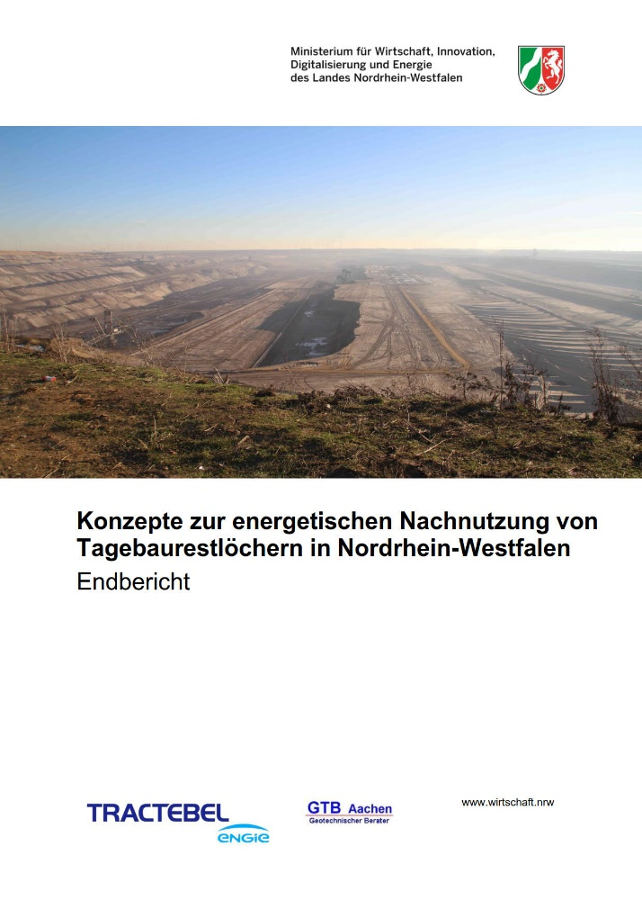
Study about pumped storage energy in the Rhenish Mining Area
“Concepts for the energetic reuse of former mining pits in North-Rhine Westphalia”, Tractebel Hydroprojekt GmbH from November 2019, assigned by the Ministry of Economic Affairs, Industry, Climate Action and Energy of the State of North Rhine-Westphalia
Investigation about possibilities of pumped storage plants for the energetic future use of former coal mining pits after the coal exit
Evaluation of Basic data (geotechnics, hydrology, environment, regional planning)
Investigation of various pumped storage concepts
Identification and evaluation of possible locations
Study Title, Tractebel Hydroprojekt GmbH, 2019
Download: Publikationen | Wirtschaft NRW

Slide 15
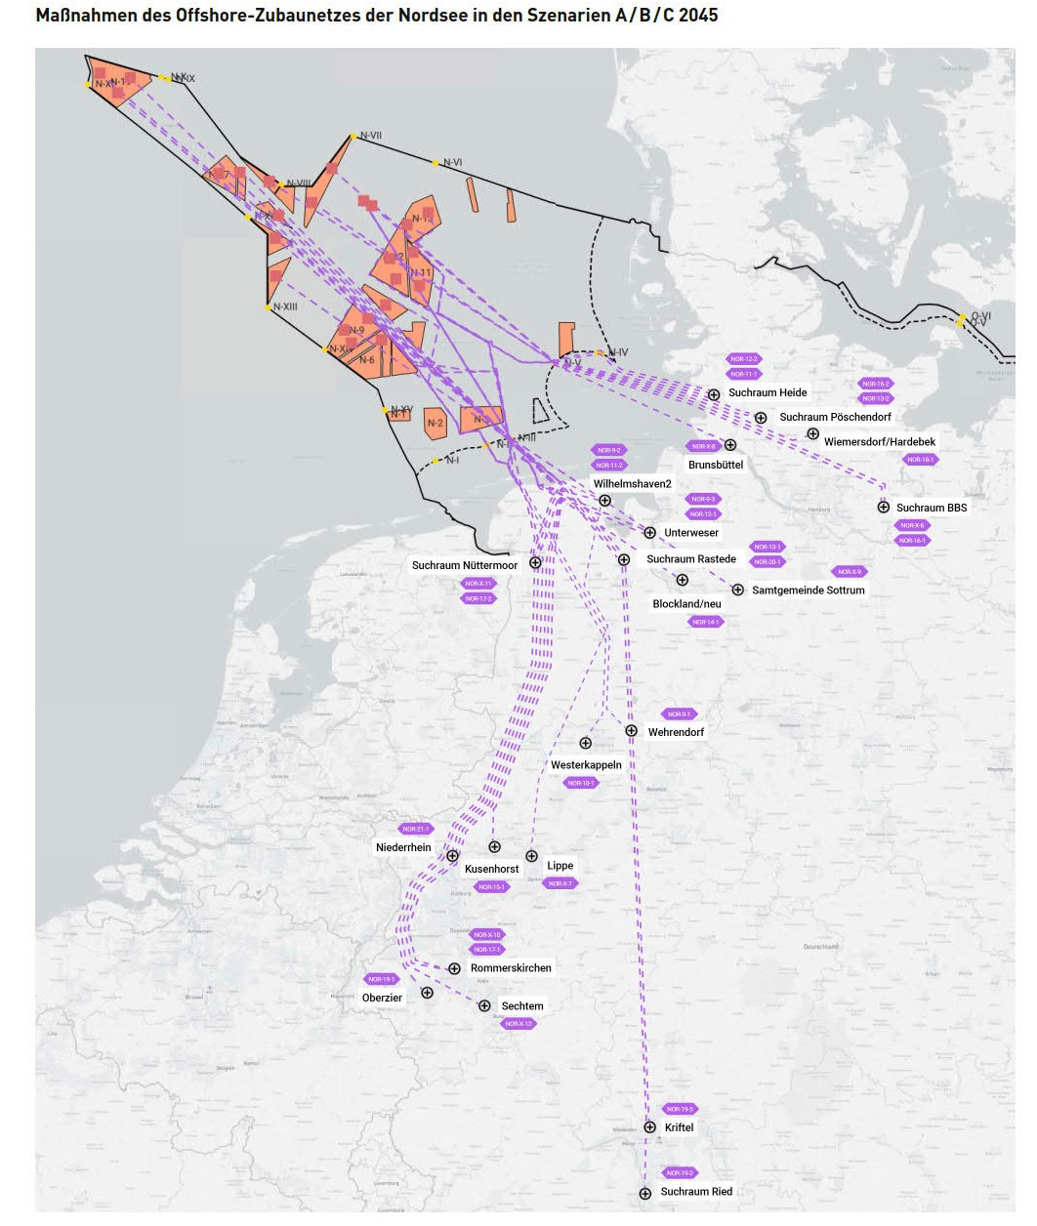
Grid development plan
Planned main grid line from the North Sea and North-Rhine Westphalia
Good condition for feed in of wind energy from the offshore wind parks to the storage plants in the Rhenish mining area
Rhenish Mining Area
Source: Bundesnetzagentur, Netzentwicklungsplan 2037/2045, Version 2023

Slide 16
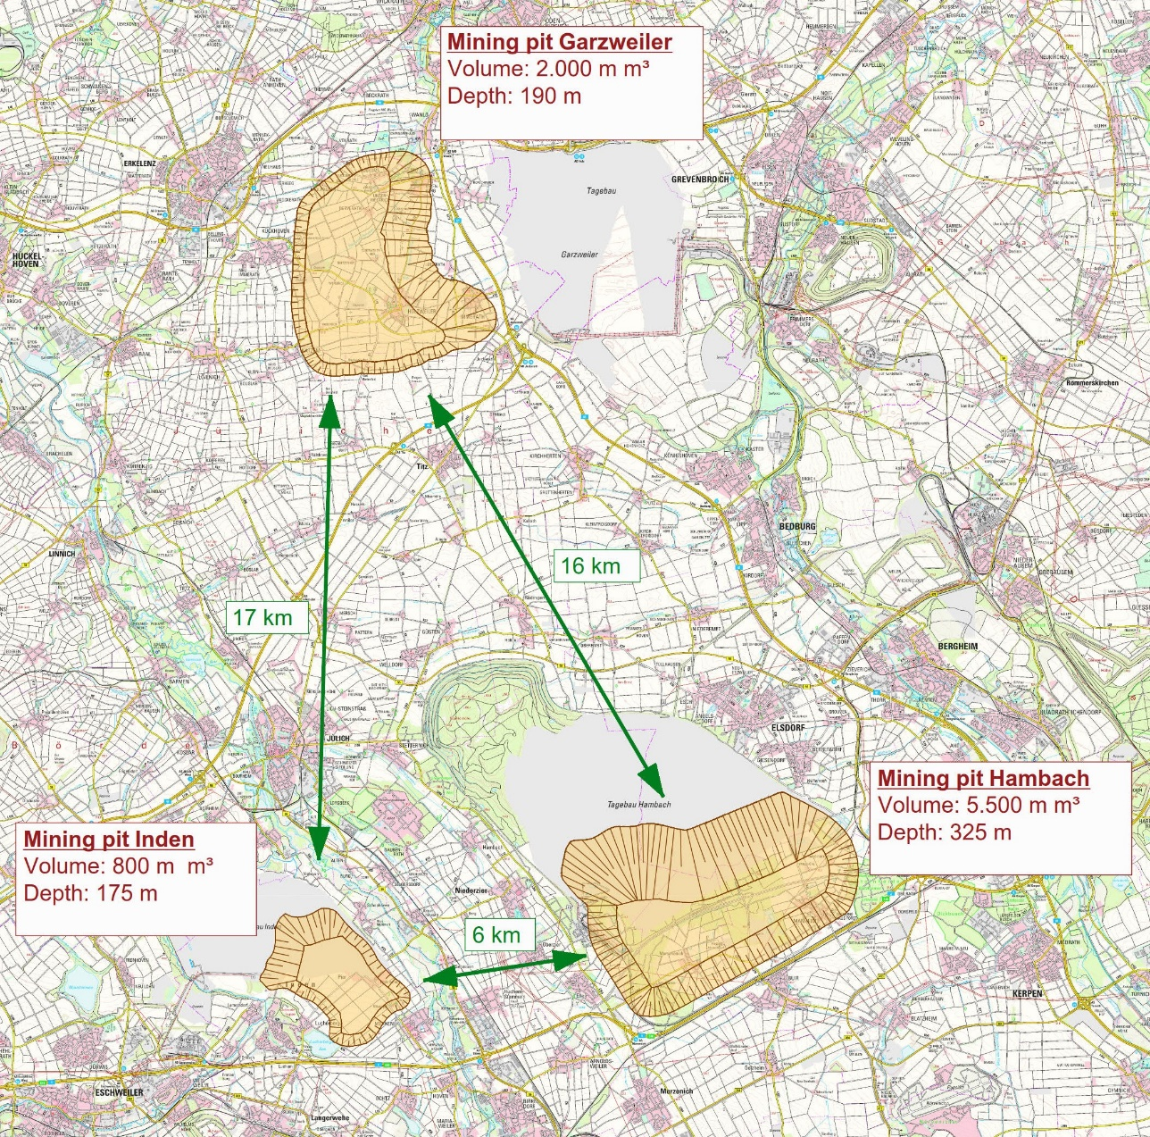
Pumped storage in the Rhenish Mining Area - Overview
Surface mining pits Garzweiler, Hambach and Inden
Big storage volumes and depths offer best conditions for pumped storage hydropower
Coal exit in the year 2030 (according to “Reviervertrag 2.0” from May 2022)
Regional Planning: Mining pits will be filled with water after coal exit (Residual lakes); estimated filling time: 20 to 40 years
Overview Rhenish District

Slide 17
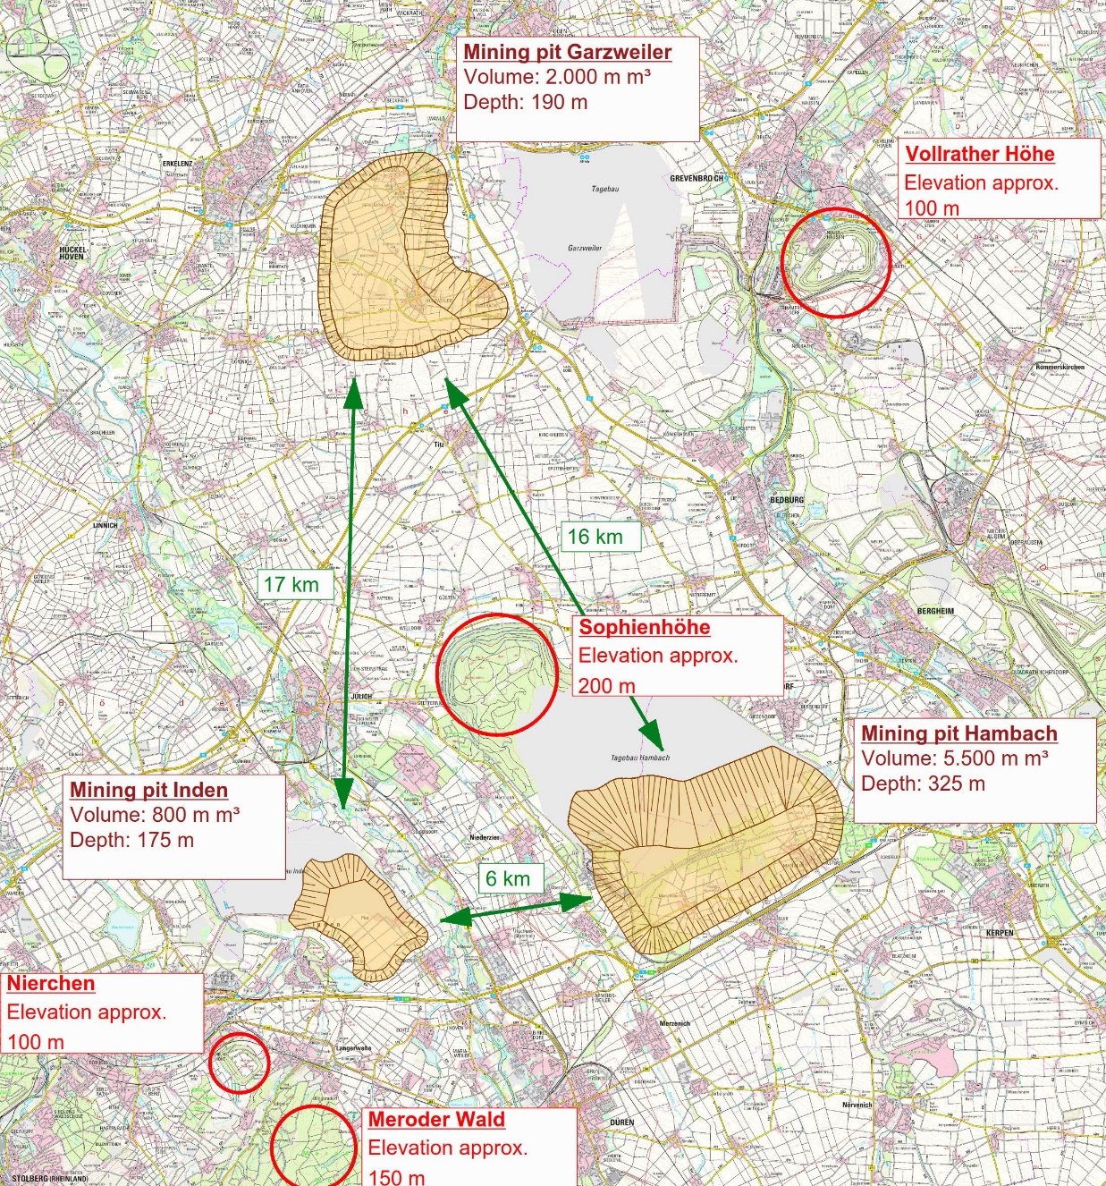
Pumped storage in the Rhenish Mining Area - Overview
Consideration of existing elevations (mine dumps or natural) as possible locations for upper reservoirs
Overview Rhenish Mining Area with elevations

Slide 18
Pumped storage in the Rhenish Mining Area – Project sizing
Operation Water Volume (decisive for installed capacity, storage capacity and duration):
Huge Water Volumes in the mining pits (from 800 to 5.500 m. m³)
selected for the study: 10 m. m³ (equivalent to a water body of D = 700 m and a depth of 30 m)
(big value in comparison to other pumped storage plants in Germany)
Number of full load hours (dependent on intention of the pumped storage plant):
Short full load period (e. g. 4 to 6 h): Generation of high capacities, compensation of daily peaks, application in case of small operation water volumes
Long full load periods (bigger than 8 h): for long-term storages (e.g. storage of wind and solar energy) and less capacities, application in case of huge operation water volumes
selected for the study: 12 full load hours

Slide 19
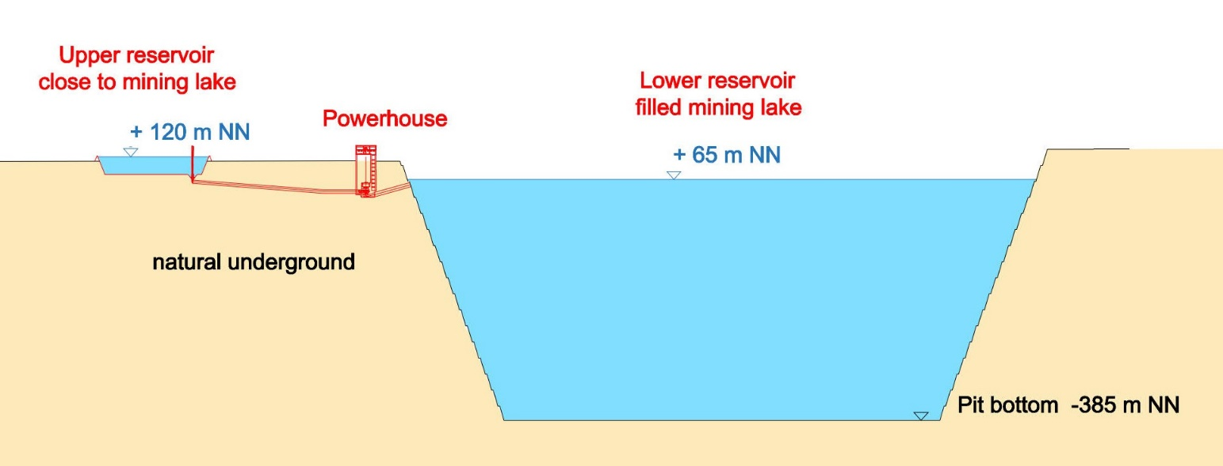
Pumped storage concept 1 – filled pits as lower reservoir
Filled mining lake as lower reservoir
Upper reservoir close to mining lake
+ Short distances
+ No draining necessary
+ favorable geotechnical conditions (construction in natural underground)
- - Very low heads
- Late start of operation: Mining lake has to be filled at first

Slide 20
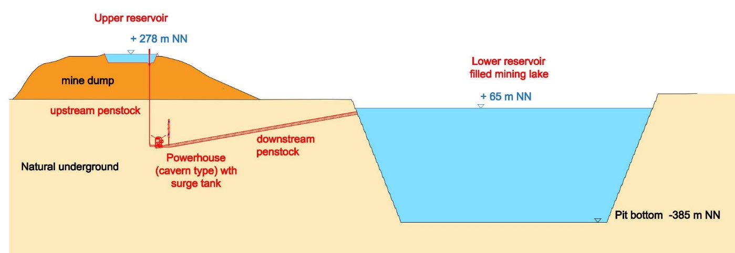
Pumped storage concept 2 – filled pits as lower reservoir
Filled mining lake as lower reservoir
Upper reservoir on elevation (e.g. on mine dump)
+ No draining necessary
o Low to middle heads
- Bigger distances between upper and lower reservoir
- maybe unfavorable geotechnical conditions (upper reservoir on dumped material; settling risk)
- Late start of operation: Mining lake has to be filled at first

Slide 21
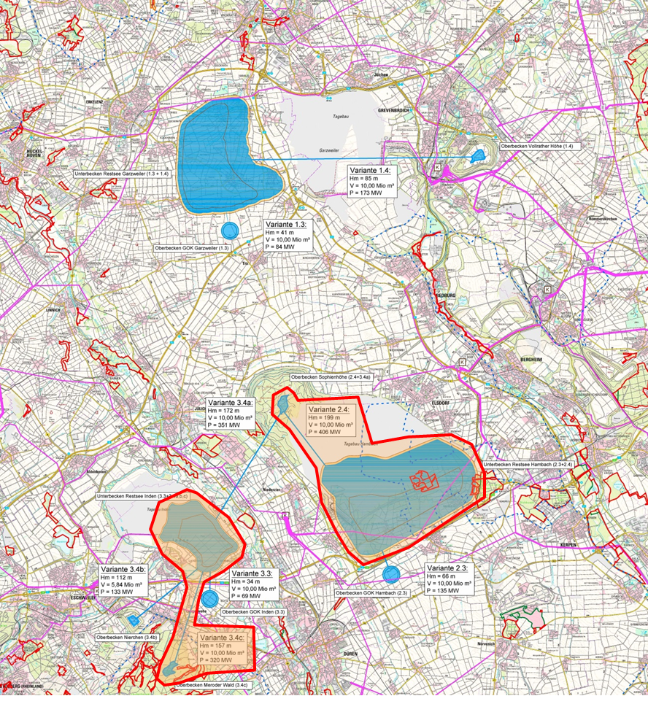
Pumped storage concepts 1 and 2 – filled pits as lower reservoir
Pumped storage concepts with filled former mining pits as lower reservoir:
Average geodetic heads: 30 m - 200 m
Installed capacities: 50 MW - 400 MW (for 10 m. m³ storage volume and 12 h full load operation)
Storage capacities: 600 - 5.000 MWh (every 12h - cycle)
Pumped storage concepts with filled former mining lakes
UR: Dump Sophienhöhe – LR: Residual lake Hambach
UR: Elevation Meroder Wald – LR: Residual lake Inden

Slide 22
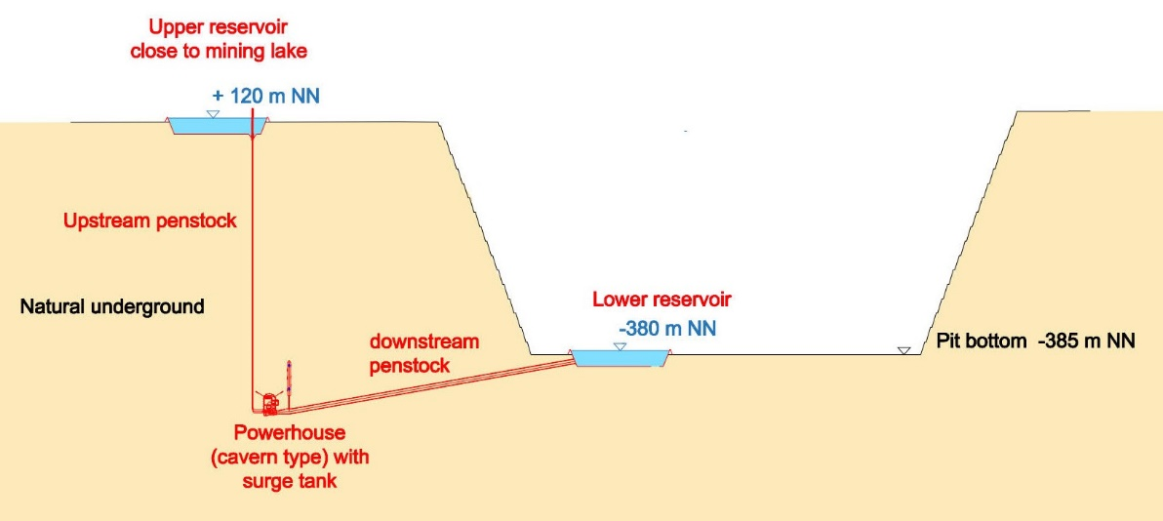
Pumped storage concept 3 – Lower reservoir on pit bottom
Lower reservoir on the bottom of the open mining pit
Upper reservoir close to the mining pit or on elevation (e.g. on mine dump)
++ Big / very big heads
+ Early start of operation possible
- - Permanent draining necessary around the pit
- - No utilization of the former mining pit as a lake (contradiction to regional planning)

Slide 23
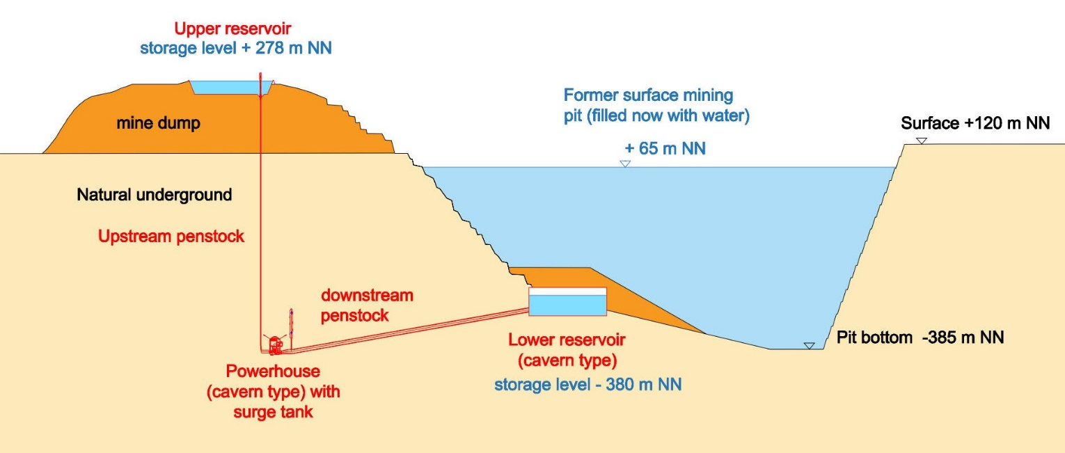
Pumped storage concept 4 – Lower reservoir on the bottom of filled pit
Lower reservoir as closed cavern on the bottom of the filled mining pit
Upper reservoir close to the mining pit or on elevation (e.g. on mine dump)
++ Big / very big heads
++ Early start of operation
+ No draining necessary
- Huge technical challenge
- reduced operational water volume (due construction constraints for cavern type storage)

Slide 24
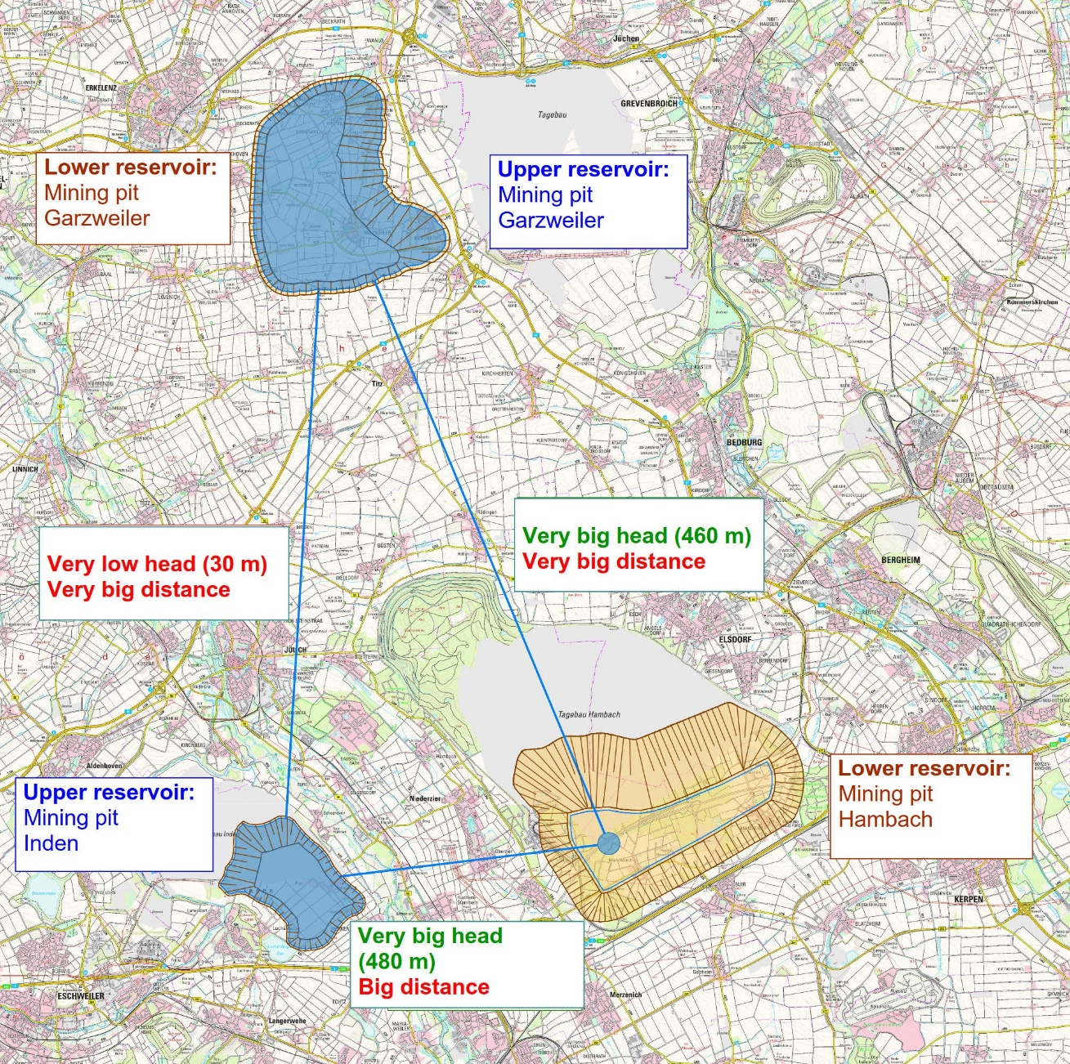
Pumped storage concept 5 – Connection of the mining pits
++ Big water volumes ideal for long term storage
+ Big head if deep cavern type storage is installed in the Hambach pit (with lake Inden as upper reservoir)
- - Big / very big distances
- Low / very low heads in case of filled pits used as lower resp. upper reservoir
Pumped storage with combination of mining pits

Slide 25
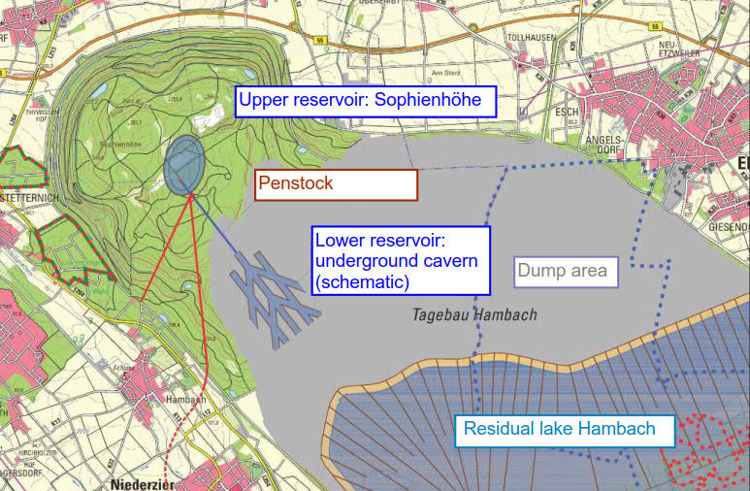
Pumped storage concepts 4 and 5 – storage on pit bottom
Pumped storage concepts with closed cavern type water storages at the bottom of the pit as lower reservoir:
Average geodetic heads: 220 m - 650 m
Installed capacities: 400 MW - 1.300 MW (for 10 m. m³ storage volume and 12 h full load operation)
Storage capacities: 5.000 - 16.000 MWh (every 12h - cycle)
Pumped storage concept: Sophienhöhe – cavern storage Hambach

Slide 26
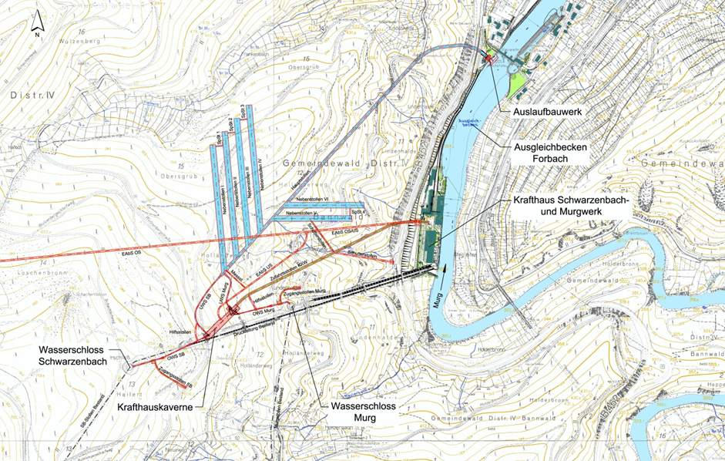
PSP Forbach - Example of an underground water storage (tunnel system)
Overview PSP Forbach

Slide 27
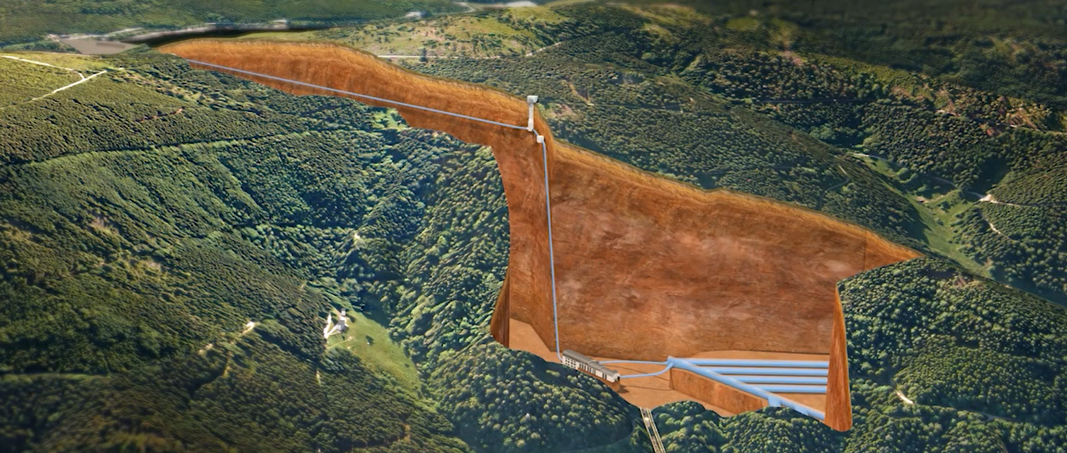
PSP Forbach - Example of an underground water storage (tunnel system)
Surge tank
Upper reservoir
Upstream penstock
Lower reservoir
Powerhouse
PSP Forbach – Project visualization (source: www.enbw.com)

Slide 28
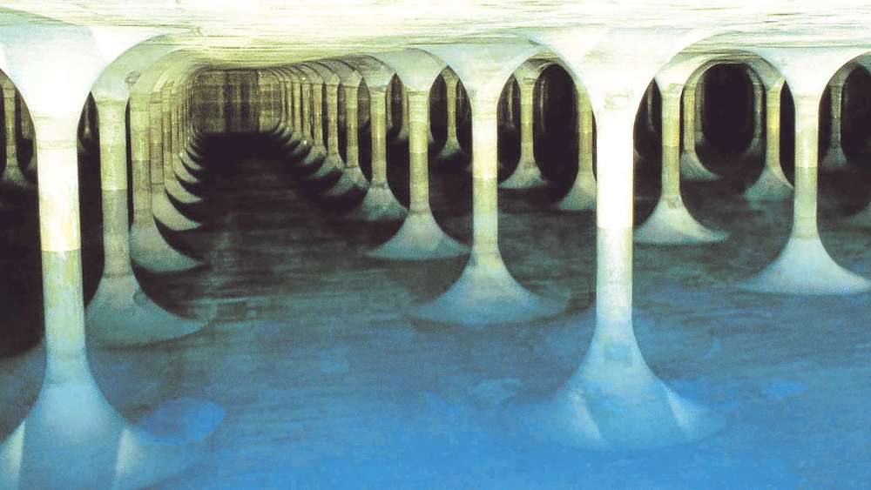
Underground storage as hall
Underground drinking water storage Munich
Source: Stadtwerke München GmbH

Slide 29
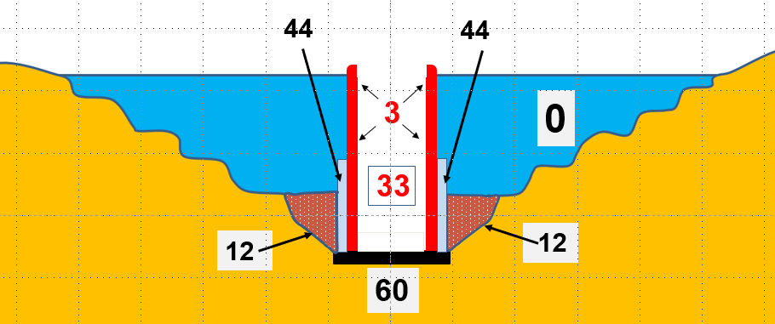
Alternative pumped storage concepts – Ring wall system
Source: DE 10 2020 004 099.9 („SeeEi4“), Bild 2
Upper reservoir (0): Residual lake (e.g. Hambach)
Lower reservoir (33): Separated from the lake by a steel-concrete ring wall (3)
Power equipment: Incorporated at the bottom of the ring walls near the bottom slab (60) (pump turbines)
Penstock and access system (44)
Stabilization by earth material (12)

Slide 30
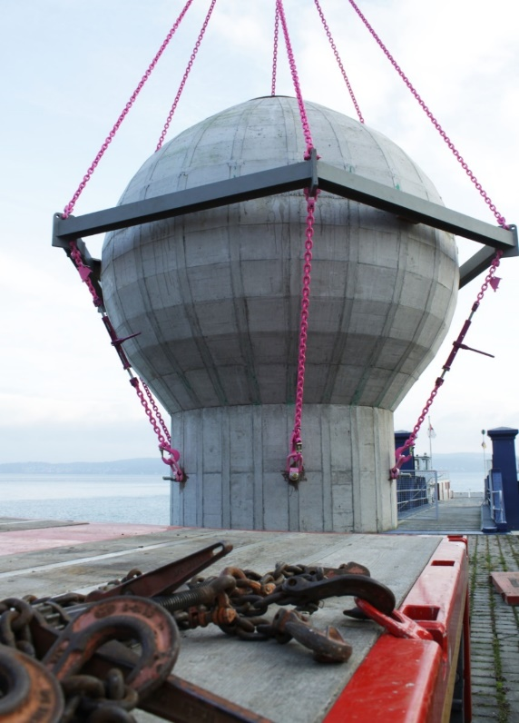
Alternative pumped storage concepts – Concrete balls
Source: Pumped storage concept StEnSEA, Fraunhofer Institut IWES (Kassel)

Slide 31
Pumped storage in the Rhenish mining area - Outlook
Detailed investigation of the technical feasibility of the storage type in the area of the mining pit Hambach (alternatively also in Garzweiler and Inden):
Geotechnical and structural feasibility
Determination of a feasible depth (technically and economically)
Determination of most adequate construction type (tunnel system, hall system, concrete balls, comb system, ring wall etc.)
Investigation on material management
Determination of a feasible size of the PSP (operation water volume, storage capacity, installed capacity)

Slide 32
Pumped storage in the Rhenish mining area - Outlook
Further detailed investigations about
mechanical equipment (development of tailor-made solutions for these specific conditions)
Possible locations for the upper reservoirs in concordance with the targets of the regional infrastructure planning
Logistics and infrastructure (access, energy transmission, emergency, etc.)
Concordance with environmental and social aspects
Design work has to be started soon, as the coal exit is in 2030!

Slide 33
THANK YOU FOR YOUR ATTENTION !
Dipl.-Ing. Matthias Feldmann
Tractebel Hydroprojekt GmbH
matthias.feldmann@tractebel.engie.com
T: +49 89 381907-76
M: +49 171 679 2029

