Slide 1

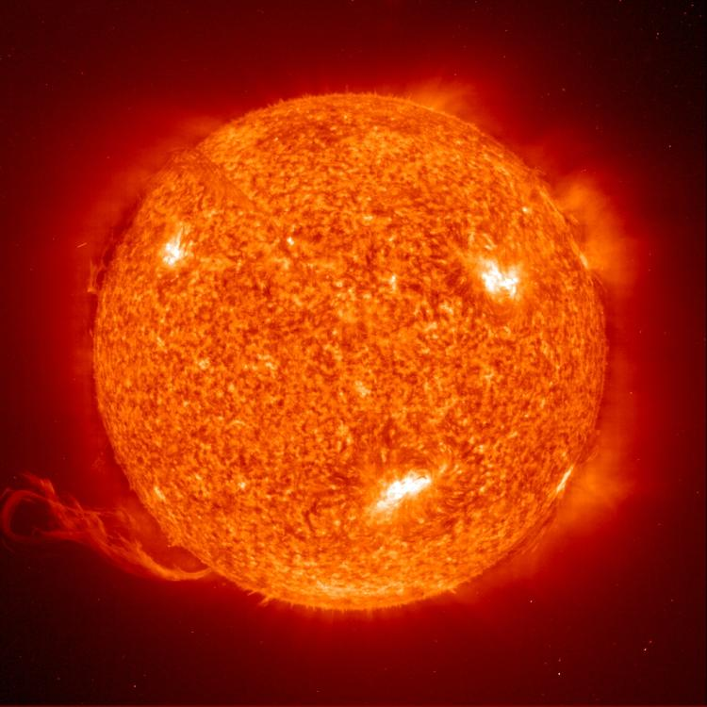
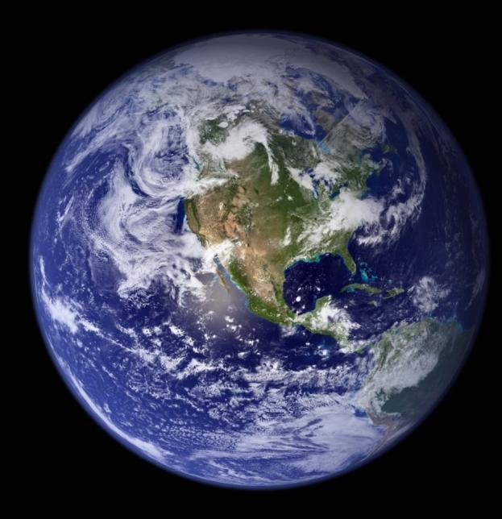
Aufwindkraftwerk /
Das Aufwindkraftwerk / The Solar Updraft Tower
Functional Principle, Prototype, Perspectives
DPG Jahrestagung Dresden, 16.3.2011

Slide 2
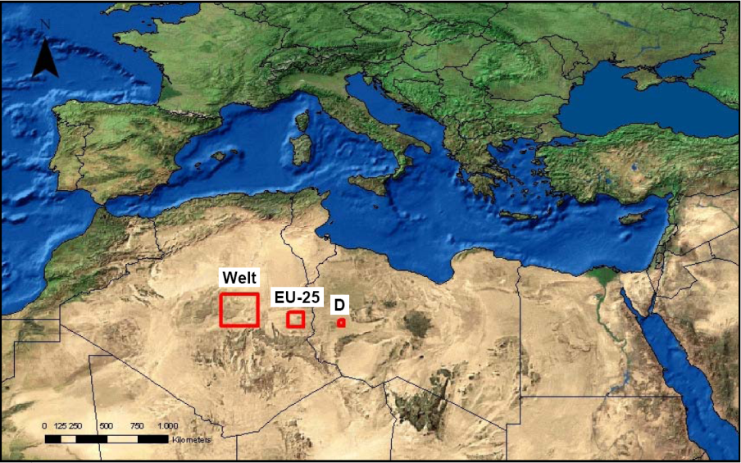
Area required to supply all electricity using solar power plants (Source: DLR)

Slide 3
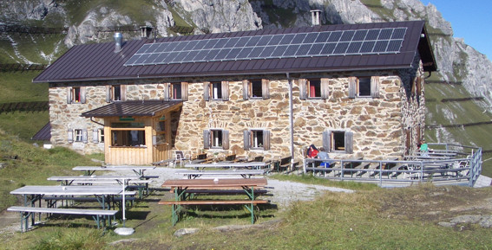
Starkenburger Hütte, Stubaier Alpen

Slide 4
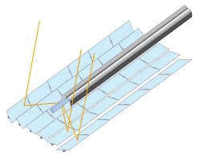
Classification of solar thermal electric (STE) power plants
solar thermal electricity generation
Point Focusing
Dish/Stirling
Power Tower (CRS)
Line Focusing
Parabolic Trough
Linear Fresnel
Non-Concentrating
Solar Updraft Tower (SUT)

Slide 5
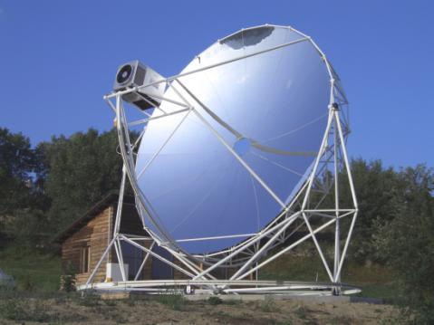
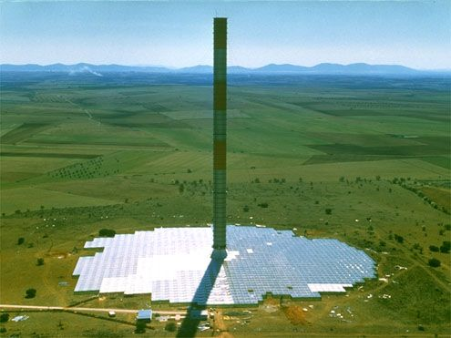
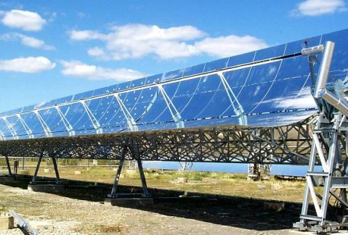
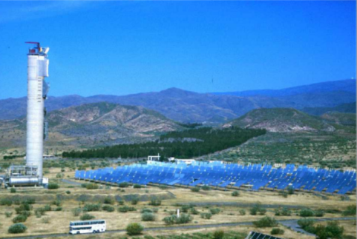
Dish/Stirling
Solar Updraft Tower
Parabolic Trough Power Plant
Power Tower

Slide 6
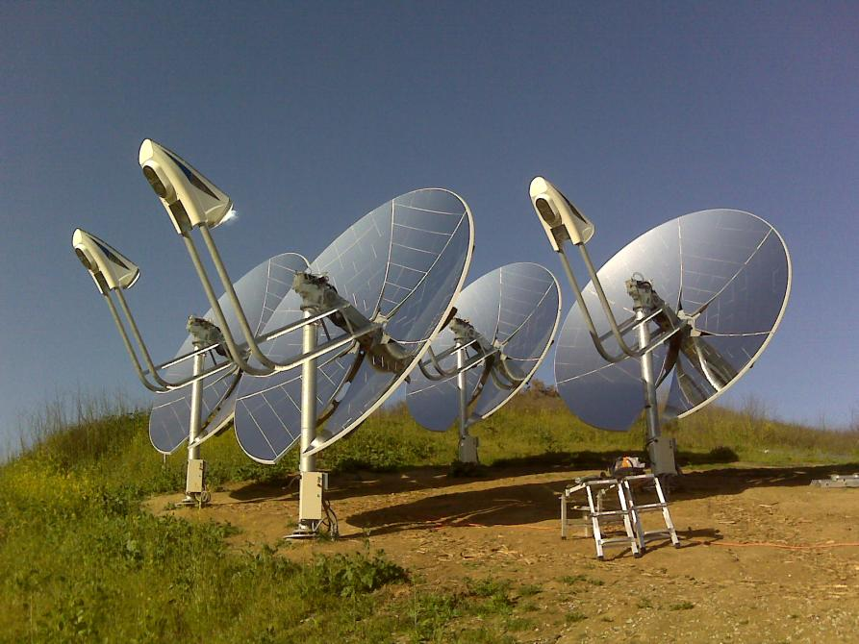
INFINIA Corp 3 kW Commercial Test Units in operation

Slide 7
PS10 / PS20 Seville/Spain (Source: Abengoa)

Slide 8
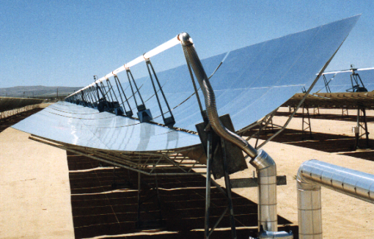
Parabolic Trough Collector Principle
Absorber Tube
Absorberrohr
Reflector
Reflektor
Solar Field Piping
Solarfeld-Verrohrung

Slide 9
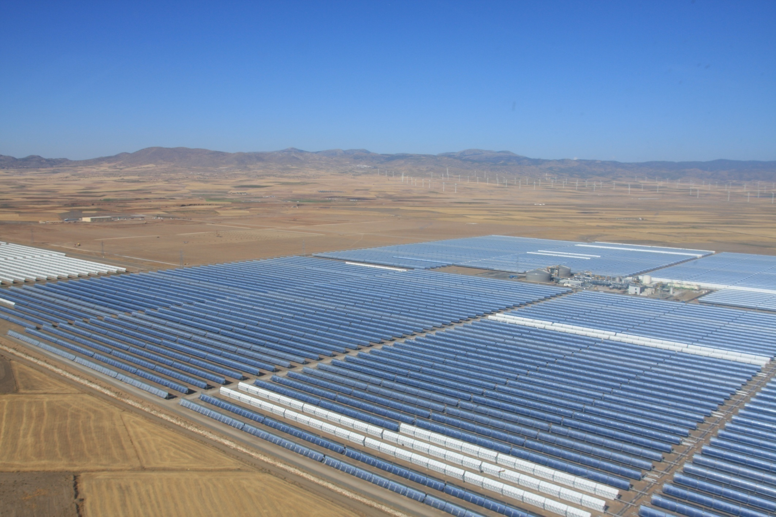
Andasol: 50 MW Parabolic Trough Power Plant in Spain

Slide 10
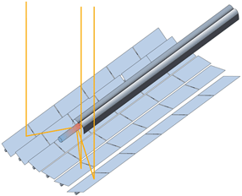
Linear Fresnel Collector: Principle

Slide 11
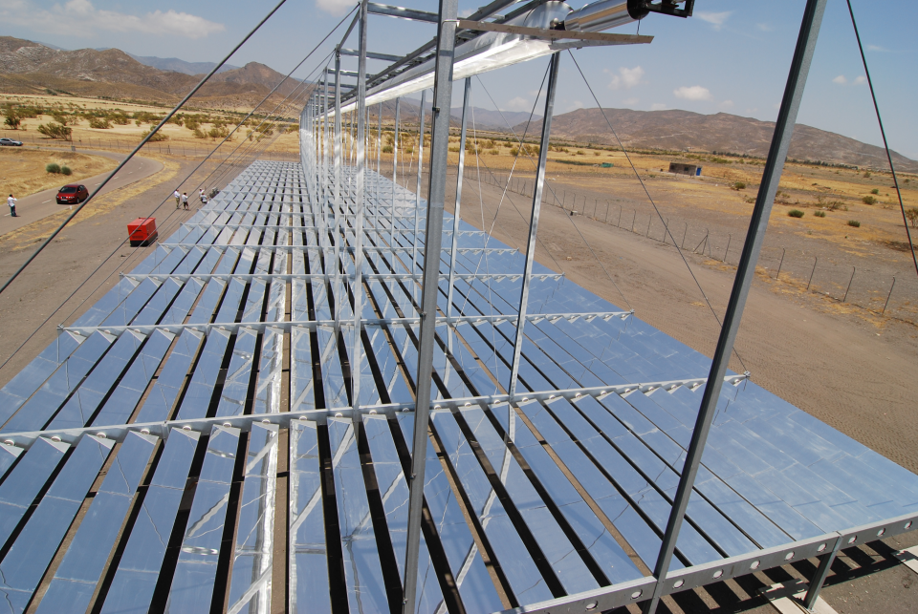
Linear Fresnel Collector Example: MAN-Ferrostaal Collector at PSA

Slide 12
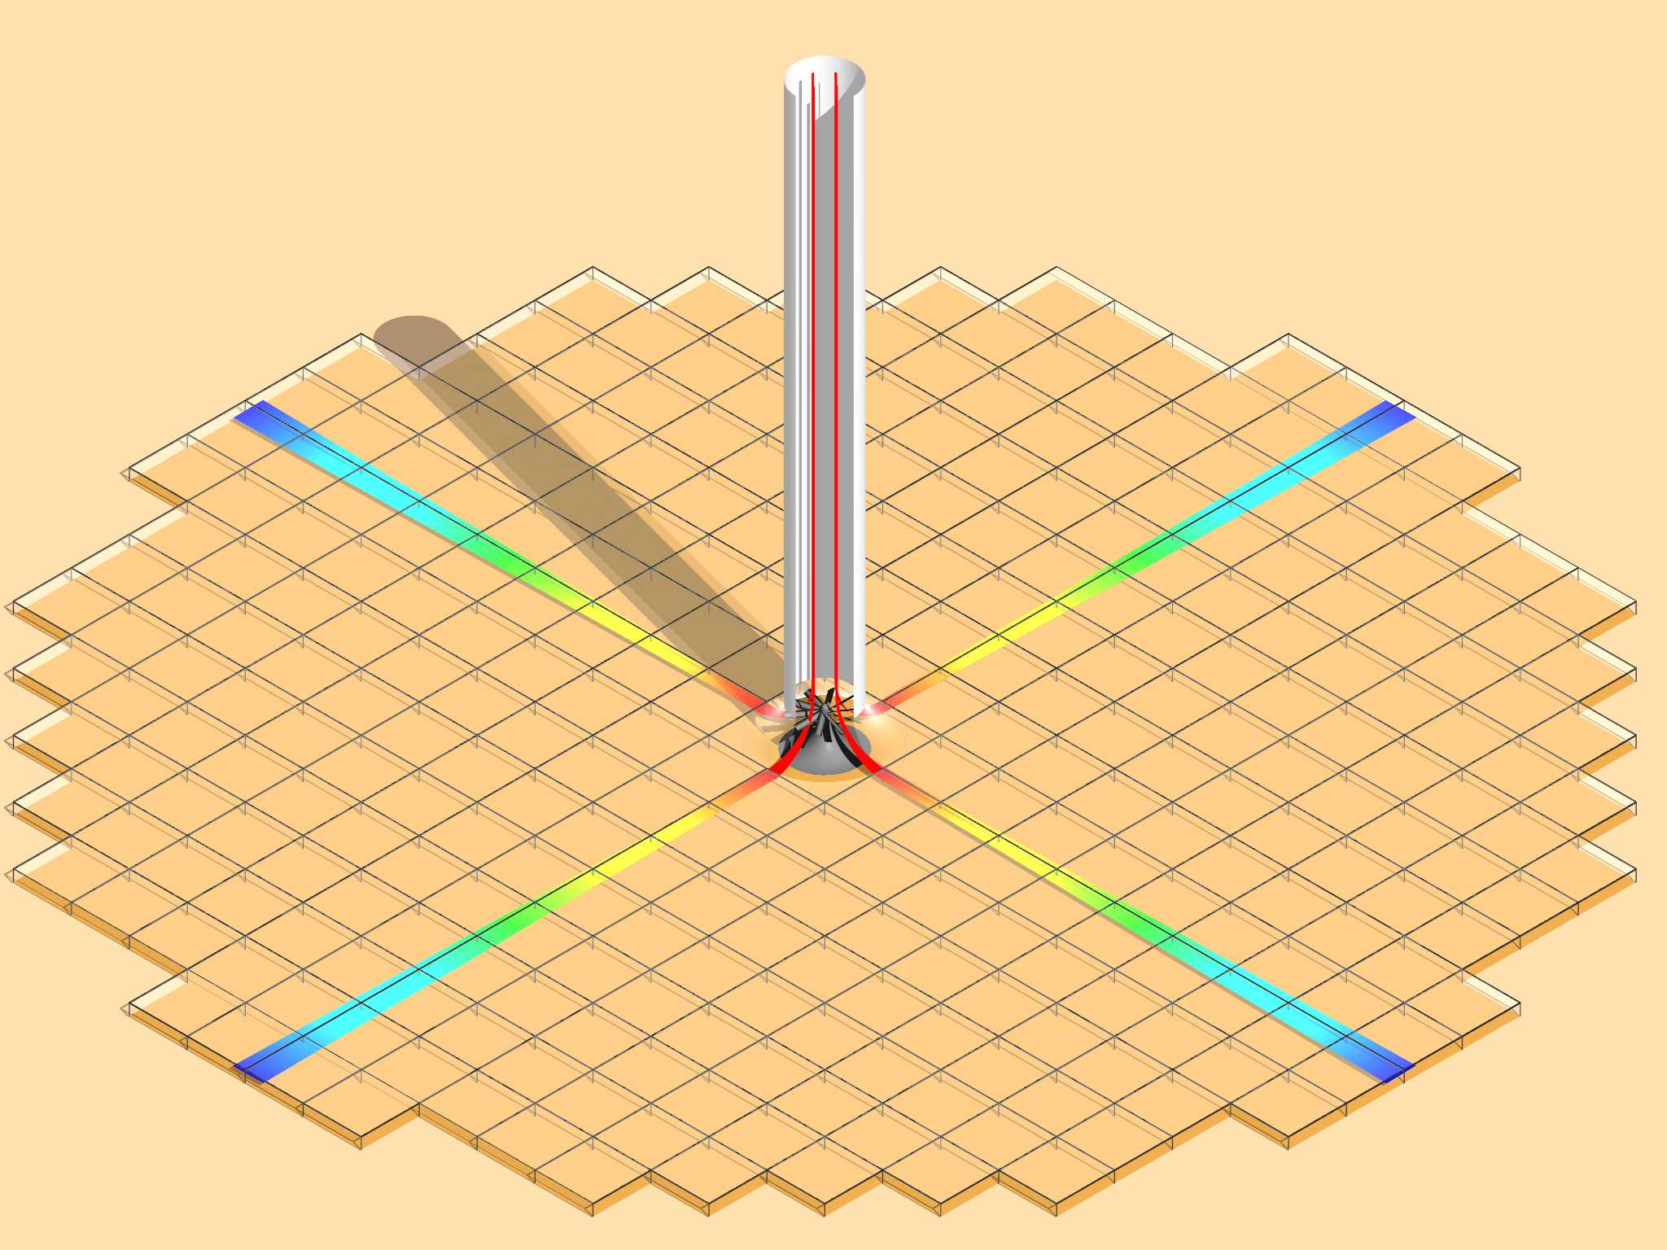
Solar Updraft Tower Functional Principle
tower exit: warm air
hot air
relatively cool ambient air
solar radiation
= temperature difference:
density difference
pressure difference
up-draught
collector entry:
ambient air
greenhouse effect
ground functions as natural thermal storage

Slide 13
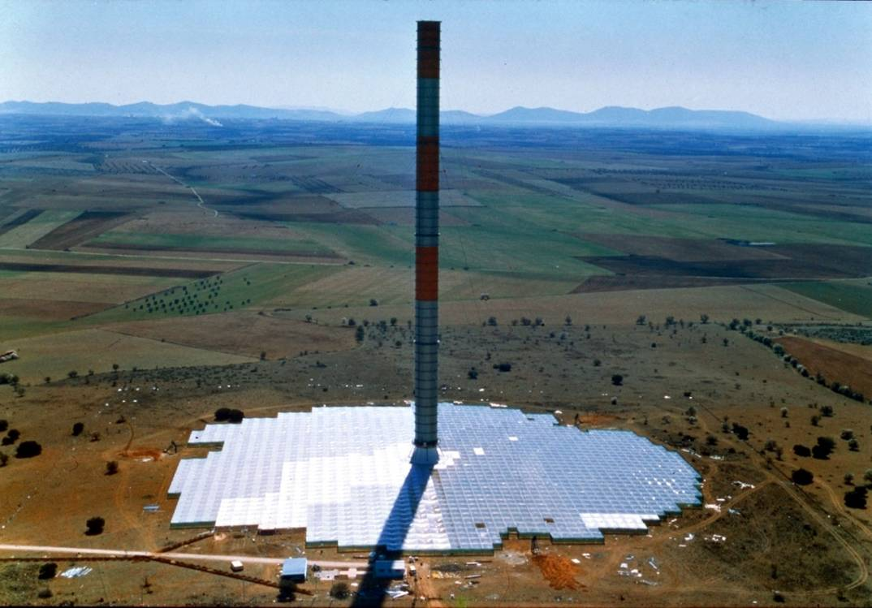
Prototype Manzanares, 1982, Castilla - La Mancha
Notes:
Projektnummer: 1980 1006
ID: 82
Unterkategorie: 52
Titel deutsch: Aufwindkraftwerk Demonstrationsanlage
Titel englisch: Solar Chimney Manzanares
Titel spanisch: Chimenea solar de experimentación
Ort: Manzanares, Spanien
Land: Spain
Unser Auftrag: Grundlagenerforschung: Planung, Bau, Betrieb und Auswertung
Bauherr: supported by: Bundesministerium für Forschung und Technologie, Bonn
Architekt:
Zusammenarbeit: Maurer Söhne, München
Balcke-Dürr, Ratingen
Siemens Interatom, Bergisch Gladbach
Fertigstellung: 1989
Daten:

Slide 14
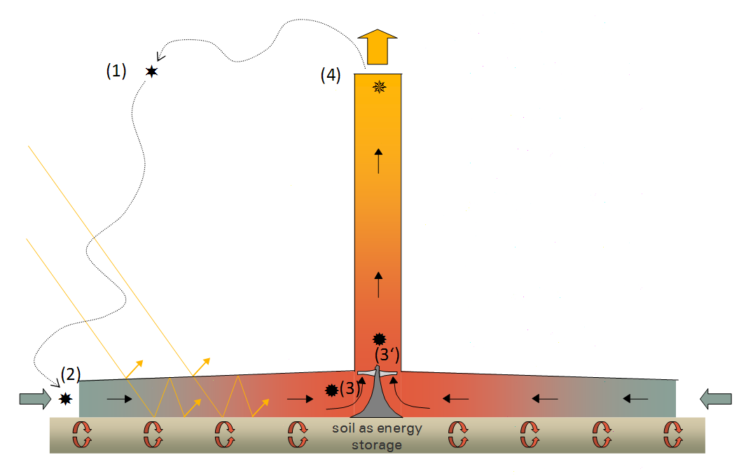
Air ‚Parcel‘ going through Thermodynamic Cycle

Slide 15
Ideal Thermodynamic Cycle
collector exit = turbine entry
Q_{collector}
3
T
ΔΤ _{turbine}
3‘
collector entry
2
4
tower exit
p @ ground level
1 - 2: polytropic compression in atmosphere
1‘ - 2: compression in atmosphere (dry adiabatic lapse rate)
p₁ = p₄
1‘
1
p @ tower exit height
2 - 3: isobaric heating of air in the collector
Δz = tower height
3 - 3‘: expansion in turbine and
3 - 4 isentropic lifting of air in chimney
s
4 - 1: isobaric cooling of chimney exit air to ambient temperature at chimney height

Slide 16
Thermodynamic Cycle incl. Losses
collector exit = turbine entry
3
T
Q_{collector}
3_{te}
turbine
ΔΤ _{turbine}
3‘
tower
p₂ = p₃
collector entry
kinetic exit loss
2
4
tower exit
p @ ground level
1 - 2: polytropic compression in atmosphere
1‘ - 2: compression in atmosphere (dry adiabatic lapse rate)
p₁ = p₄
1‘
1
p @ tower exit height
2 - 3: isobaric heating of air in the collector
Δz = tower height
s
3 - 3‘: expansion in turbine and
3 - 4 isentropic lifting of air in chimney
4 - 1: isobaric cooling of chimney exit air to ambient temperature at chimney height

Slide 17

Collector: Energy Balance
Atmospheric Air
G_{D}
G_{B}
Q_{radiation}
G_{D, reflected}
Q _{convection}
G_{B, reflected, glazing}
>
T_{glass, outside}
>
Glazing
>
T_{glass, inside}
>
G_{B, transmitted}
T_{air}+dT_{air}
>
>
T_{air}
G_{D, transmitted}
h_{air}
Collector Air
h_{air}+dh_{air}
G_{D, reflected, ground}
G_{B, transmitted}
Q _{ground storage}
>
G_{B, reflected, ground}
T_{ground,} _{surface}
Ground
G_{B, ground storage}
T_{ground}

Slide 18
Storage Principle 1/2
Collector Roof
from air
into air
into soil
soil
soil
Day
Night

Slide 19
Collector Roof
into air
into soil &
Into water tubes
into air
soil
water-filled tubes
soil
Day
Night
Storage Principle 2/2

Slide 20
relative Power (%)
100
80
60
Water height
20 cm
40
Water height
10 cm
20
soil-storage
only
0
0:00
3:00
6:00
9:00
12:00
15:00
18:00
21:00
0:00
Time of Day (h)

Slide 21
Tower
ambient atmosphere (depends on site and weather conditions, approx. 0.6 to 1 K/100m)
air column inside chimney
(DALR, i.e. ~1K/100m)
atmosphere
height z above ground level
driving pressure difference
ΔT
Δρ
Δ p
air temperature
ground

Slide 22
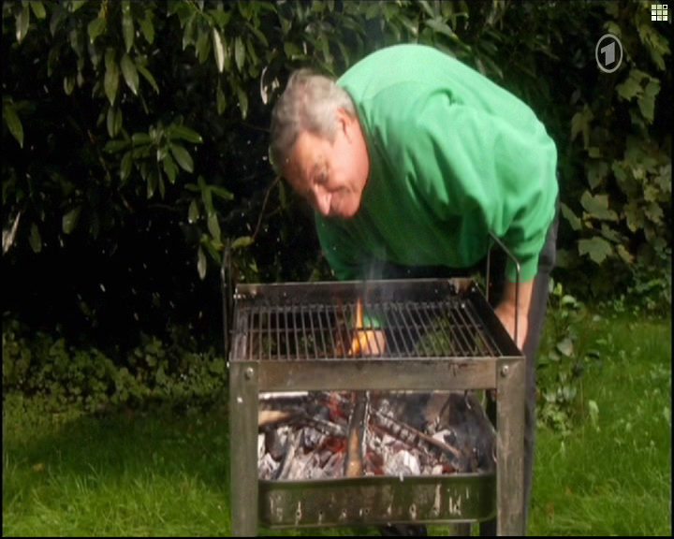
Chimney effect

Slide 23
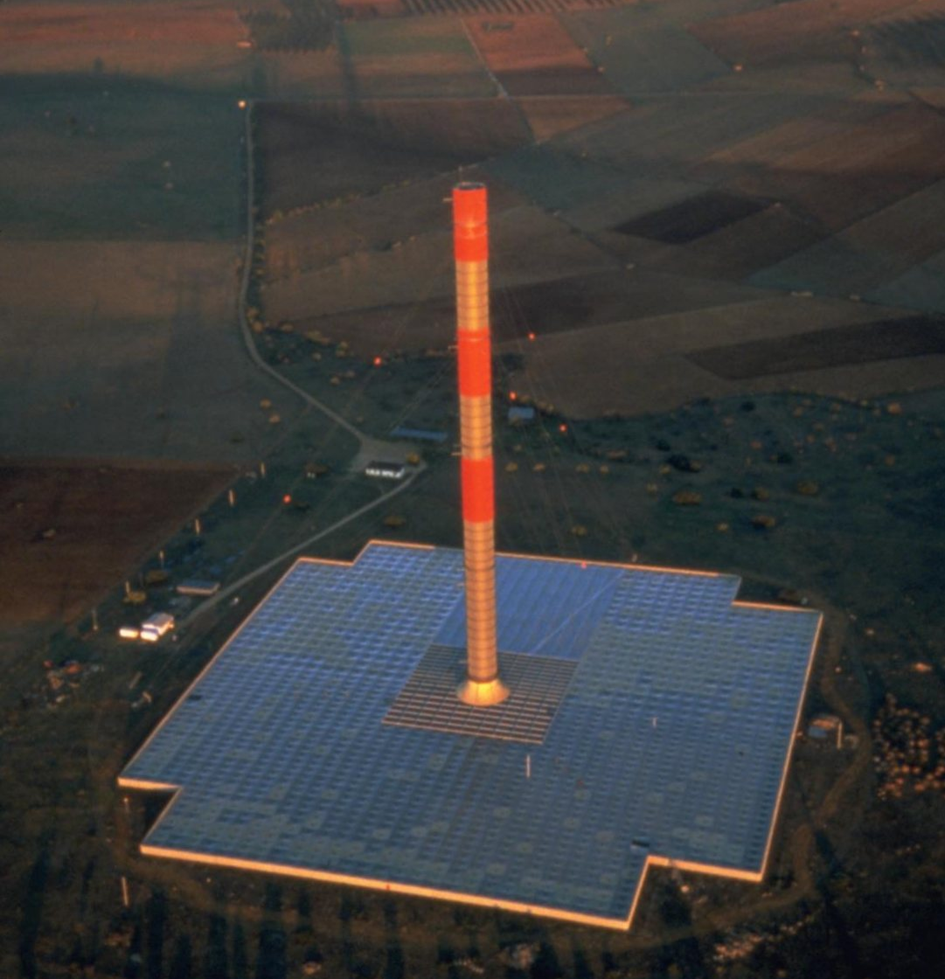
Prototype Manzanares, 1982, Castilla - La Mancha
Notes:
Projektnummer: 1980 1006
ID: 82
Unterkategorie: 52
Titel deutsch: Aufwindkraftwerk Demonstrationsanlage
Titel englisch: Solar Chimney Manzanares
Titel spanisch: Chimenea solar de experimentación
Ort: Manzanares, Spanien
Land: Spain
Unser Auftrag: Grundlagenerforschung: Planung, Bau, Betrieb und Auswertung
Bauherr: supported by: Bundesministerium für Forschung und Technologie, Bonn
Architekt:
Zusammenarbeit: Maurer Söhne, München
Balcke-Dürr, Ratingen
Siemens Interatom, Bergisch Gladbach
Fertigstellung: 1989
Daten:

Slide 24
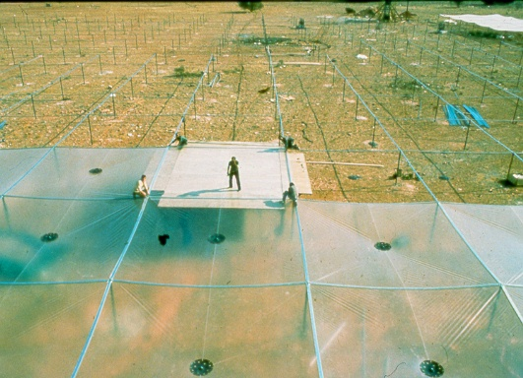
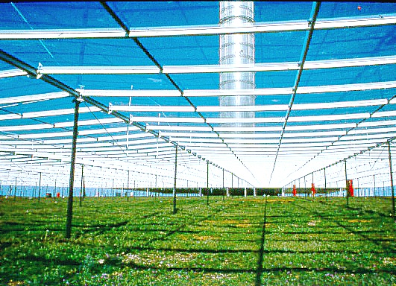
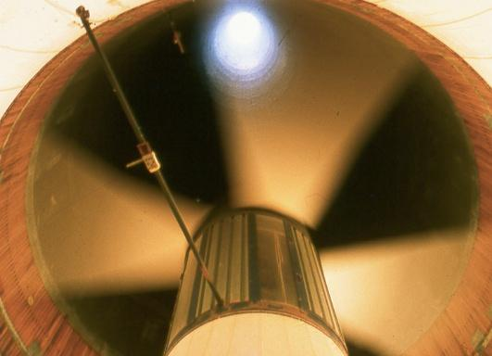
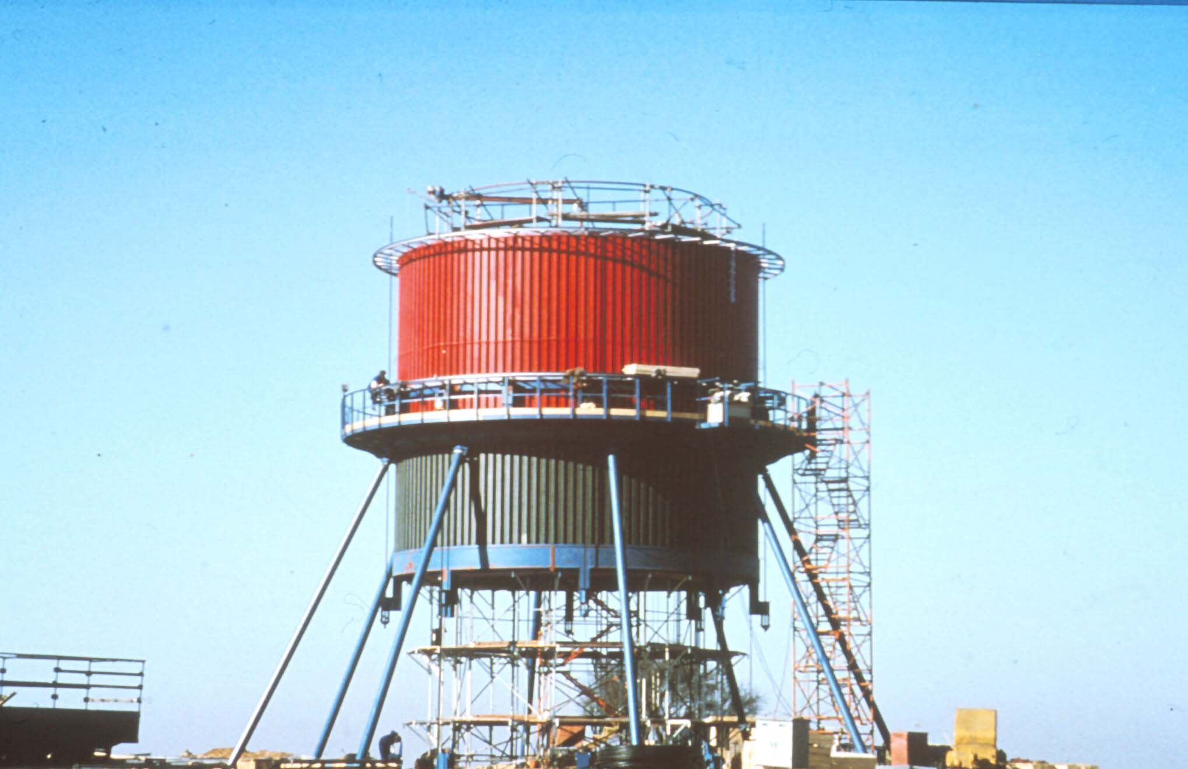

Components Prototype Manzanares

Slide 25
Collector Design Options
Schlaich Bergermann
Solar GmbH
Notes:
SBP have designed several collector types so that for each respective site and also for each position in the colletor the best suitable collector design is available.
4 types are shown schematically on the slide, suitable for hard claddings like glass or plastic sheets (top) or plastic membranes (bottom).

Slide 26
Wind force on a cylinder
Schlaich Bergermann
Solar GmbH
C = + 1.00
p
C = - 0.45
p
wind direction
pressure
C = - 1.5
p
suction
Notes:
On the slide a cylinder (=the tower) is shown from the top. Natural wind is flowing around the tower, the resulting pressure distribution can be seen on the slide. This combination of pressure on the front and suction on both sides leads to ovalization, which might damage the concrete of the tower. In order to avoid extreme wall thicknesses, SBP invented another solution which makes the construction of economical large concrete (Solar) towers possible – the spoked wheel (see next slide).

Slide 27
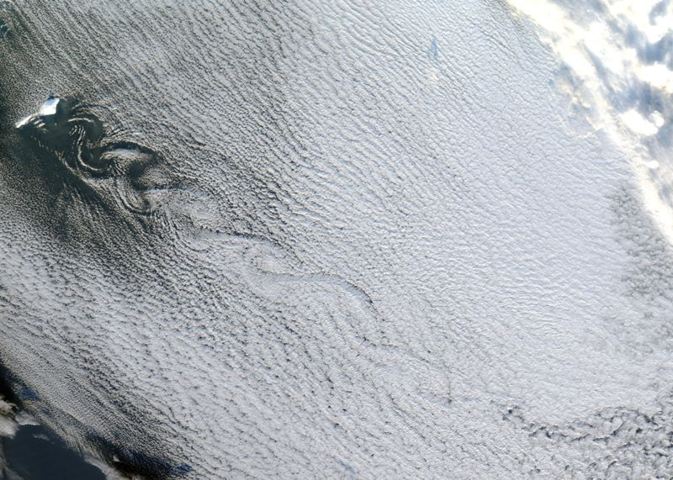

Satellite view of Jan Mayen island with a Von Kármán vortex street shown by cloud vortices, Greenland (on the left top side) and Norway (on the right bottom side)
Source: Image courtesy of MODIS Rapid Response Project at NASA/GSFC
Animation: Cesareo de La Rosa Siqueira

Slide 28
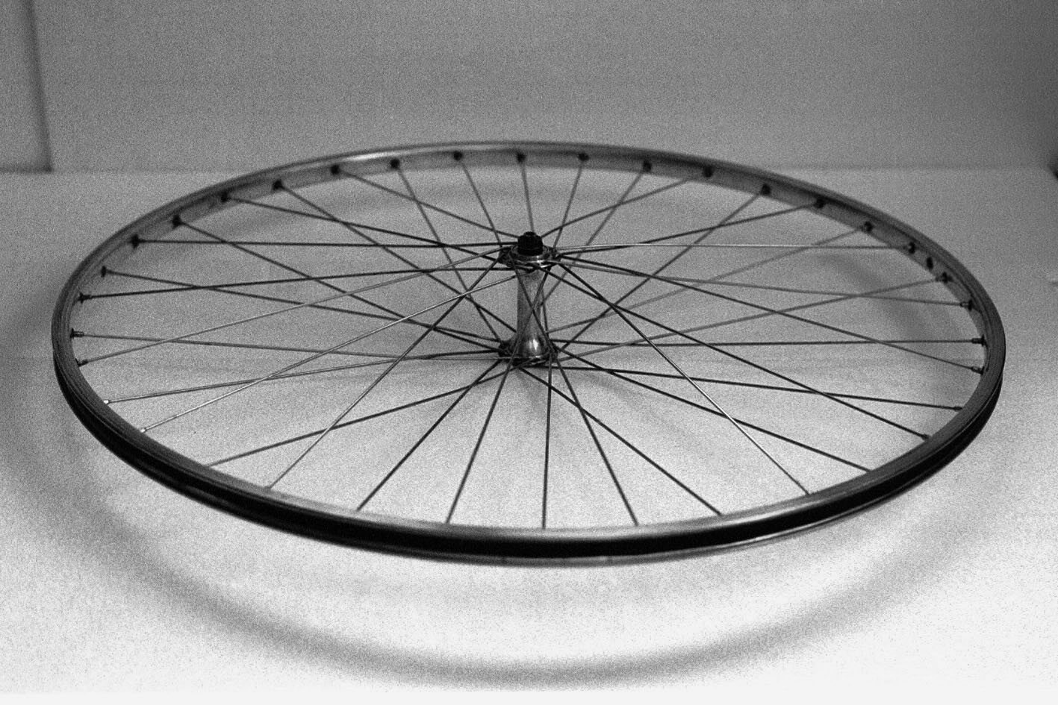
Speichenrad / Spoked Wheel
Notes:
Das Prinzip der Vorspannung finden wir aber auch bei den Speichenrädern wieder.
Dank Vorspannung „druckfest“
Nur deshalb funktionieren unsere Fahrräder.

Slide 29
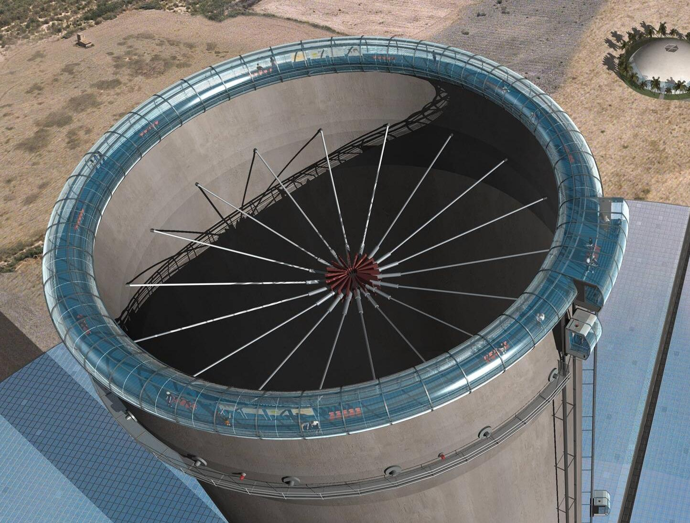
Notes:
2) The Tower Tube
The SUT tower tube is a simple reinforced concrete tube, stiffened by spoked wheels at several levels.
Additional Information:
Spoked wheel to stiffen tower cross section.
Detailed statical/structural research showed that it is appropriate to stiffen the updraft tower at several levels with cables arranged like spoked wheels

Slide 30
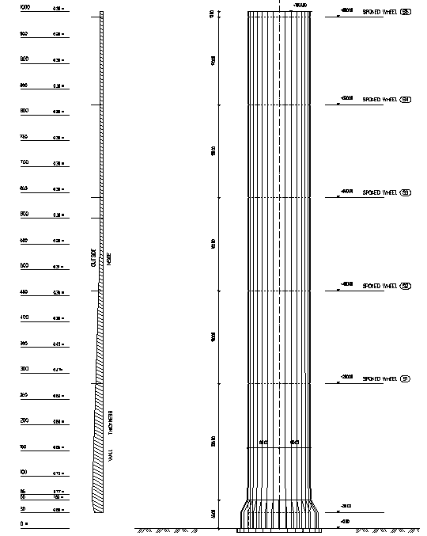
120
Schlaich Bergermann
Solar GmbH
Tower Dimensions
1000 0.30m
170
180
outside
intside
550 0.30m
180
500 0.31m
180
300 0.47m
225
55 1.80m
30 0.80m
55
Notes:
...resulting tower dimensions

Slide 31
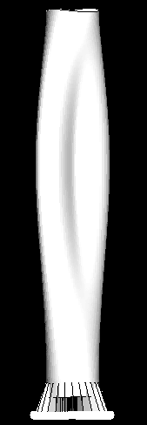
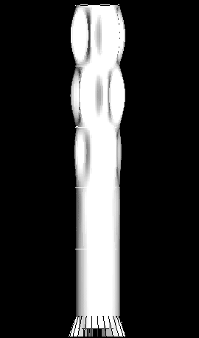
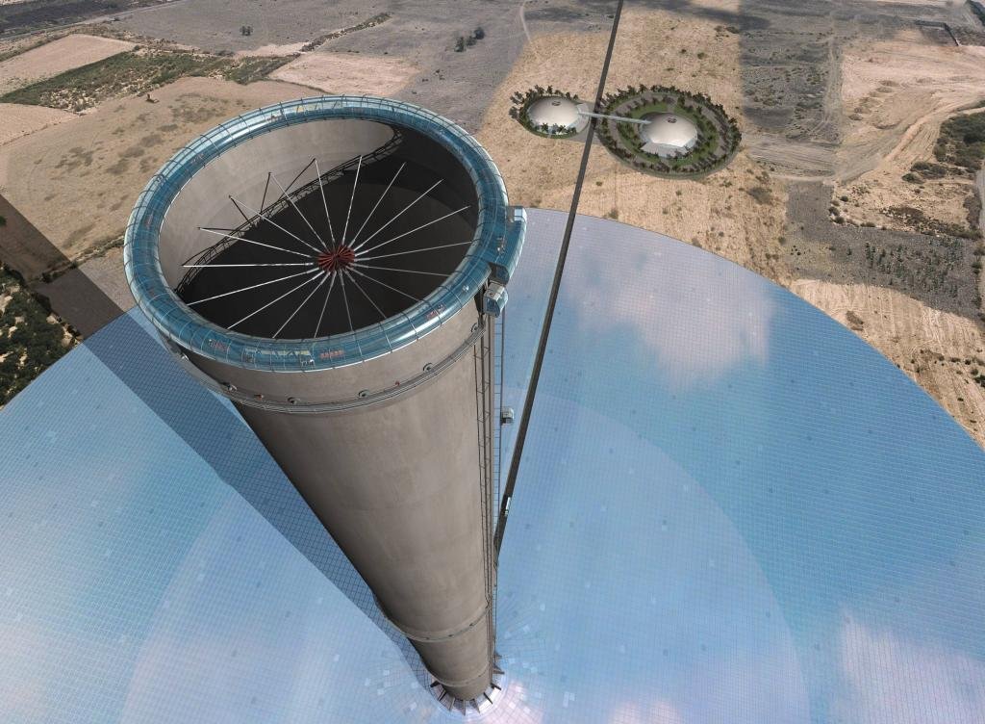
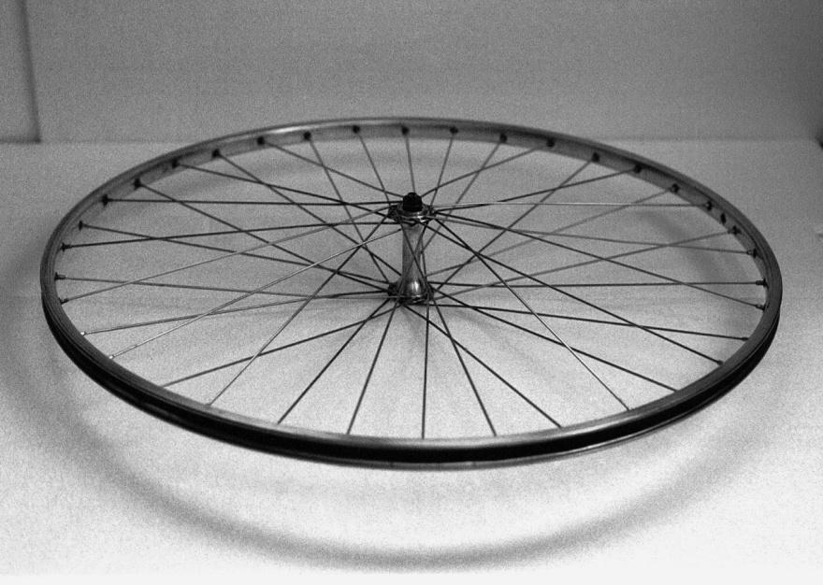

Slide 32
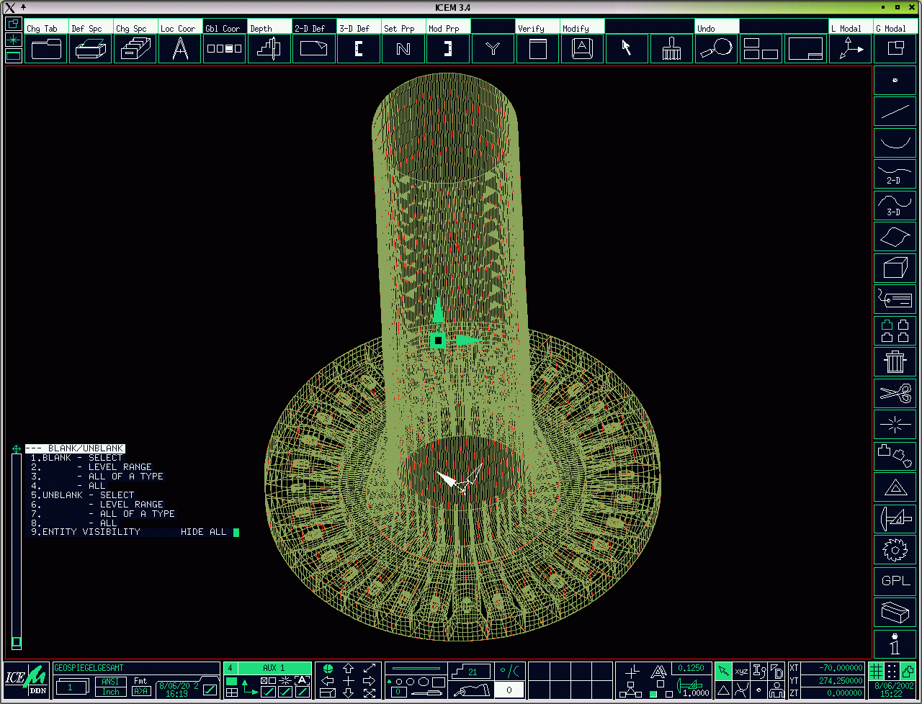
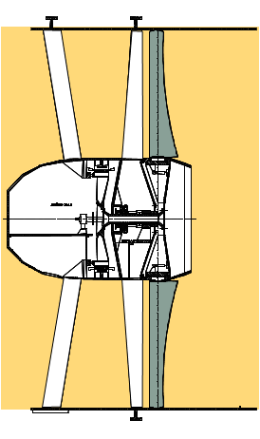
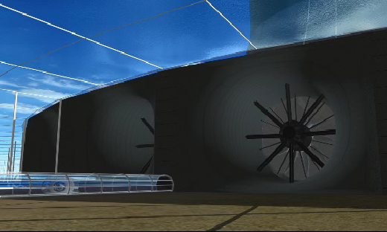
Turbines
air flow
Notes:
3) Turbine(s)
Top: Computer Fluid Dynamic Model for Tower bottom area with horizontal axis turbines arranged around the tower base.
Lower left: Schematic cross section of turbine
Lower right: Artist’s impression of horizontal axis terbines at tower base.
Generally:
Using turbines, mechanical output in the form of rotational energy can be derived from the air current in the tower. Turbines in a solar tower do not work with staged velocity like free-running wind energy converters, but as shrouded pressure-staged wind turbo generators, in which, similarly to a hydroelectric power station, static pressure is converted to rotational energy using cased turbines. The specific power output (power per area swept by the rotor) of shrouded pressure-staged turbines in the solar tower is roughly one order of magnitude higher than that of a velocity staged wind turbine. Air speed before and after the turbine is about the same. The output achieved is proportional to the product of volume flow per time unit and the pressure differential over the turbine. With a view to maximum energy yield, the aim of the turbine control system is to maximize this product under all operating conditions.

Slide 33
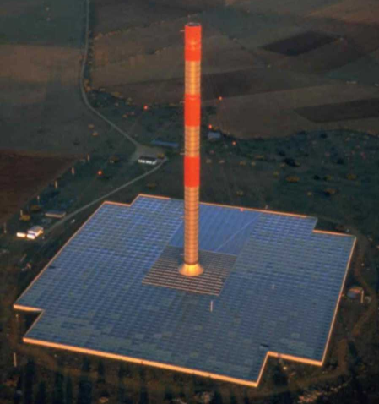
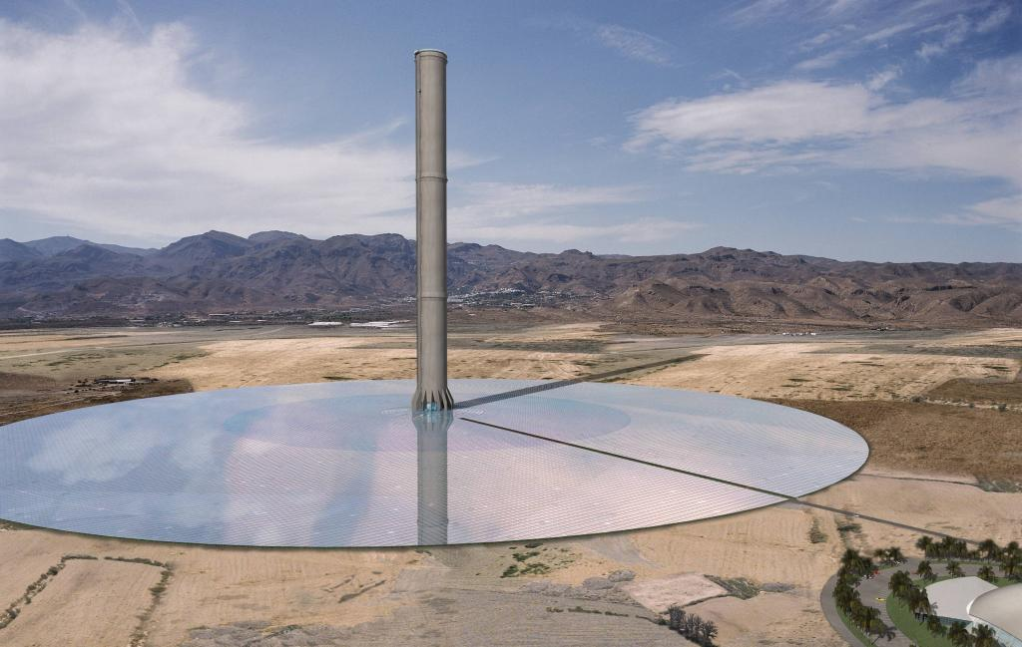

Prototype Manzanares - 30 MW System
Notes:
Die rechnerische Stromerzeugung bei 2060 kWh/m2/year beträgt 78 GWh ohne Speicher, 2950 m Kollektordurchmesser ➔ Kollektor minimal vergrößern auf 3000m ➔ Strombedarf von rund 80 GWH komplett gedeckt.

Slide 34
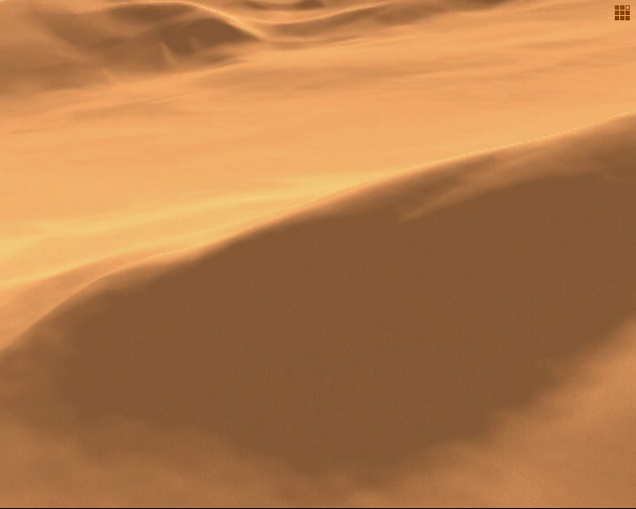
Video Animation

Slide 35
Thank you!
g.weinrebe@sbp.de

Slide 36
Comparison, as of October 2010
 | Dish/Stirling | Power Tower | Parabolic Trough | Linear Fresnel | Solar Updraft Tower
Erprobte Technologie | Nein | Nein | Ja | Nein | Nein
Optische Effizienz | Hoch | Hoch | Hoch | Mittel | Hoch
Thermische Effizienz | Hoch | (Potentiel) Hoch | Mittel (Hoch) | Mittel | Niedrig
Landbedarf (m² / kW_{installed}) | Niedrig | Mittel | Mittel | Niedrig | Hoch
Kapazitäts-bereich (Einzelsystem) | ≤ 50 kW | ≤ 100 MW | ≤ 250 MW | ≤ 250 MW | ≤ 250 MW
Wasser-verbrauch | ~ keiner | 3…4 l/kWh | 3…4 l/kWh | 3…4 l/kWh | ~keiner
LEC | (Hoch) Mittel | Mittel | Mittel | Mittel | Niedrig

Slide 37
1200
12
1000
Treibhausgasemissionen
10
Energierückgewinnungszeit
800
8
6,7
600
6
Treibhausgasemissionen in g/kWh
Energierückgewinnungszeit
400
4
3,0
200
2
0,6
1,0
0,7
0,7
0,7
0
0
Steinkohlekraftwerk
Windturbine, 5.5m/s
Aufwindkraftwerk
Braunkohlekraftwerk
PV-Dachsystem, 5 MW
Turmkraftwerk
Kombikraftwerk
Laufwasserkraftwerk
10 kW SBP Dish/Stirling -System
Parabolrinnenkraftwerk (SEGS)

Slide 38
Durchschnittliche Stromkosten
 | Gegenwärtig^{A} | Mittel- bis langfristig^{B}
Dish/Stirling | 0.18 € / kWh | 0.13...0.16 €/kWh
Turmkraftwerk | 0.13 € / kWh | 0.05 €/kWh
Parabolrinnenkraftwerk | 0.12 € / kWh | 0.04...0.06 €/kWh
Aufwindkraftwerk | 0.07 € / kWh | n/a
^{A} Source: Kaltschmitt, Wiese, Streicher (Edts.): ‚Renewable Energy‘, Springer, Berlin, 2007
Annahmen: Abschreibungsdauer 25 Jahre, Zinssatz 4.5 %,
2700 kWh/m²/a DNI, 2300 kWh/m²/a global Sonneneinstrahlung
^{B} Source: DoE-Studien

Slide 39
Flächenbedarf
Dish/Stirling | 20...35 m²/kW
Turmkraftwerk | 10...25 m²/kW
Parabolrinnenkraftwerk | 15...30 m²/kW
Aufwindkraftwerk | ~ 200 m²/kW

