Slide 1
Analysis of the electric energy storage in different renewable energy scenarios
Wayne Götz, Tobias Tröndle, Ulrich Platt und Werner Aeschbach-Hertig
University of Heidelberg
DPG Frühjahrstagung – Dresden | 4. März 2013

Slide 2

Global Energy Supply Model
Input:
energy production mix
overcapacity
load management
electromobility
Restrictions:
resolution of area: 2.5° (MERRA)
resolution of time: 1h
perfect electricity grid
storage efficiency: 81%
demand curve (Germany 2008)
10 types of energy producers
MEET*
Output:
timeseries
storage capacity
installed capacity of energy production
…
*Meteorological based Energy Equilibrium Testing
Notes:
Kurze Vorstellung was das Modell kann

Slide 3
demand in Europe analysis of frequencies
FFT demand
demand
= 1 year
365 (24h)
|Y(f)|
demand
≈ 1 week
frequency [year⁻¹]
Database: 2010_mix

Slide 4
photovoltaics in Europe
analysis of frequencies
FFT PV
supply
365 (24h)
= 1 year
|Y(f)|
≈ 1 week
supply
frequency [year⁻¹]
Database: 2010_mix

Slide 5
wind onshore in Europe
analysis of frequencies
FFT wind onshore
supply
= 1 year
365 (24h)
|Y(f)|
supply
≈ 2 weeks
frequency [year⁻¹]
Database: 2010_65on_35off

Slide 6
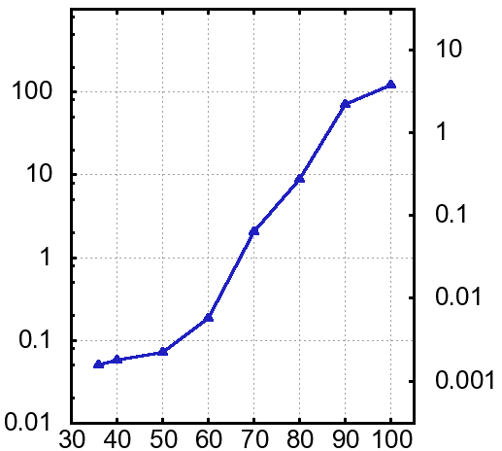
renewables and their consequences on storages
need of energy storage for Europe*
influence of the energy mix
on storage
need of storage
increases
strongly
best energy
mix for Europe
60% sun & 40% wind
storage capacity [TWh]
storage capacity
[% of annual electricity demand]
storage
[% of power demand]
mix of energy
% of installed renewables
*Tröndle, T., Platt, U., Aeschbach-Hertig, W. and Pfeilsticker, K. (2012), Erneuerbare Energie für Europa.
Physik in unserer Zeit, 43: 300–306.
Notes:
Ab einem best. Anteil an EE

Slide 7
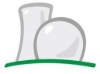




tranferscenarios
name wind onshore wind offshore photovoltaics wave power hydro power CSP power bio power nuclear power coal power gas power | 2010_mix45 20% 30% 5% 5% 5% 10% 10% 15% | 2010_mix35 26% 39% 5% 5% 5% 10% 15% | 2010_mix20 30% 45% 5% 5% 5% 10% | 2010_mix10 34% 51% 5% 5% 5%
renewables
45% controllable
35% controllable
20% controllable
10% controllable

Slide 8

scenarios
name wind onshore wind offshore photovoltaics wave power hydro power CSP power bio power nuclear power coal power gas power | 2010_100sun 100% | 2010_65on_35off 65% 35% | 2010_60_40 40% 60%
renewables
0% controllable
0% controllable
0% controllable

Slide 9
2010_60_40 in Europe
FFT Storage
Amount of total accumulated stored energy:
Storage: 8.29 ∙ 10¹¹ kWh
Storage (>24h): 3.17 ∙ 10¹¹ kWh
Storage (<24h): 7.72 ∙ 10¹¹ kWh
365 (24h)
max = 1.0 ∙ 10¹¹
storage
[% of power demand]
storage
[% of power demand]
max = 3.4 ∙ 10⁹
*Percentage of total energy consumption

Slide 10
overview of installed storage capacity in different scenarios
in the 2010_60_40 scenario the installed storage (>24h) capacity is ≈ 30 times higher than the installed storage (<24h) capacity

Slide 11
overview of the quantity of cycles the storages are used
in a 100% renewable energy scenario the storage (>24h) is used only once a year and the
storage (<24h) is used up to ≈ 2/3 days a year

Slide 12
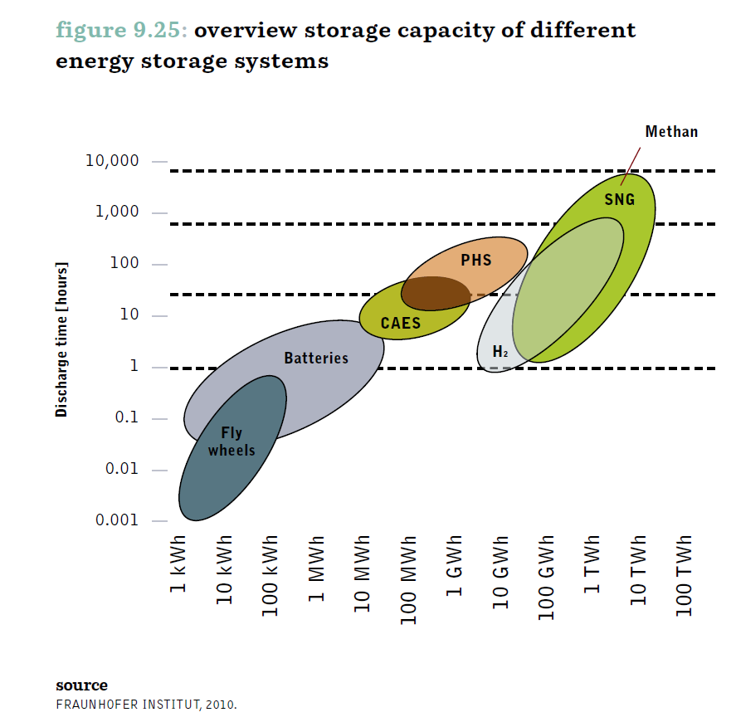
storage technologies
overview storage capacity of different energy storage systems*
1a
storage technologies | energy density (kWh/m³)
Hydrogen | 3 (Atmospheric pressure); 530 (20 MPa); 1400 (70 MPa)
Compressed Air Storage | 3 (Δp =2 MPa); 12 (Δp =8.5 MPa)
Pumped-storage Hydeoelectricity | 0.82 (300m drop height)
1m
24h
discharge time [h]
1h
*Energy [R]evolution, Greenpeace, June 2012, 259

Slide 13
summary and outlook
summary
installed long-term storage (>24h) capacity can be around 30 times higher than short-term installed storage (<24h) capacity
short-term storage will be used up to 2/3 days and the long-term storage from 1 to 3 times a year
outlook
analysis and optimization of the separation of storage in short-term and long-term
analysis of the transfer process into a 100% renewable scenario
analysis of the variation of storage from 2000 – 2010

Slide 14
thank you very much
for
your attention

