Slide 1
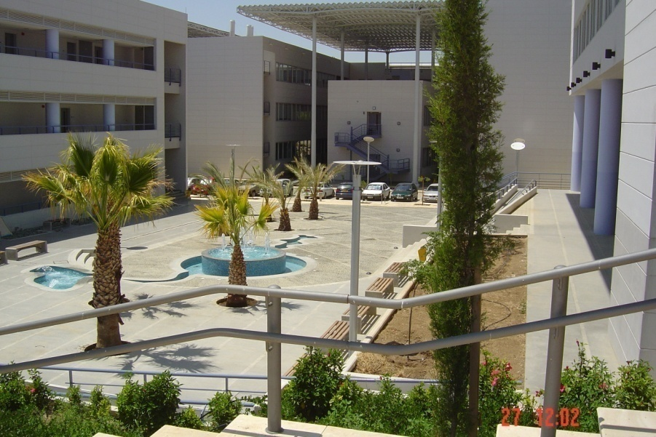
Energy-level & electronic-coupling fluctuation control of biomolecular and small-molecule charge transfer reactions
Spiros S. Skourtis
Department of Physics, University of Cyprus Nicosia Cyprus
DPG Annual & Spring Meeting 2014, Symposium on Rare Events:
Optimal solutions and Challenges – from Charge Transfer Reactions to Supervolcanoes
March , 2014, Berlin
Humboldt University

Slide 2
Biomolecular & molecular Electron Transfer (ET) reactions
Ubiquitous in physical-chemical & biological processes
Bio/Chem: all oxidation/reduction reactions,
bioenergetics, signalling, disease
Devices: molecular electronics, molecular photovoltaics, biosensors
Why interesting at the fundamental level
ET processes controlled by rare events
ET through dynamic & responsive molecular media
Biomolecular ET systems are often “designed” to do the job

Slide 3
In biological electron transport processes there are design principles at all scales: molecular-assembly & cellular to single molecule

Slide 4
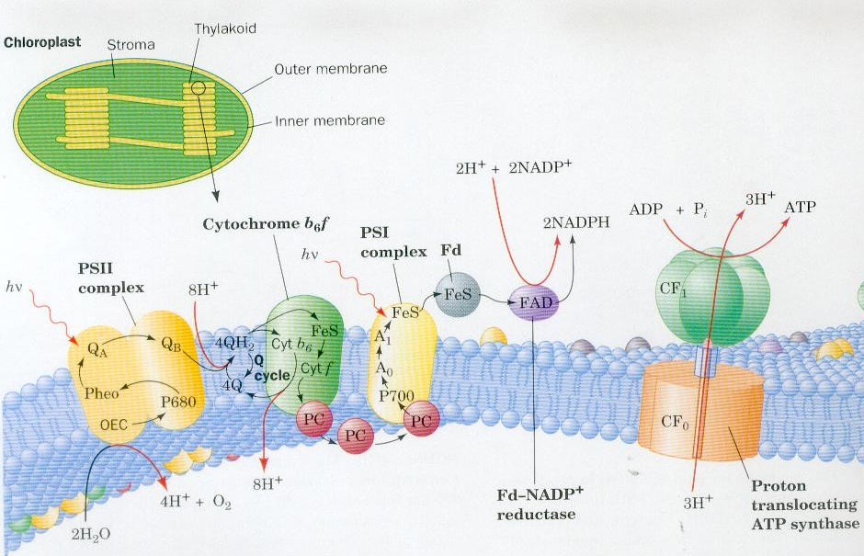
Most famous example: Photosynthesis
At “macroscopic” molecular assembly level
Voet
Biochemistry
Assembly designed to couple
exciton transfer to electron transfer to proton transfer

Slide 5
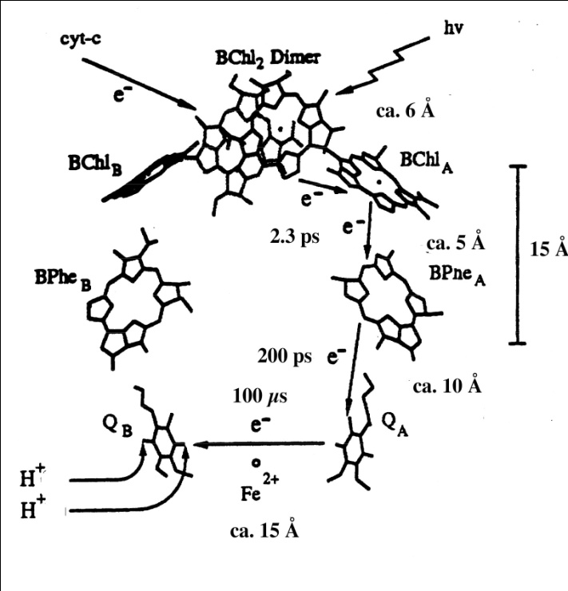
At single molecule level
Reaction center is designed to
directionally transfer 1elec. per photon absorbed
The initial ET reaction is fast
to avoid fluorescence & loss of photon energy to heat
fluoresence time: 10⁻⁸ sec,
Initial ET time: 10⁻¹² sec
The electron transport is in one direction
& along specific pathways

Slide 6
Some features of biological ET
Often long distance & very-long distance ET:
The electron transfers from an initial
localized donor (D) state to a final
localized acceptor (A) state through
intervening molecular matrix (bridge).
D-A distance for single-step (tunneling) ET
up to ~ 10 Å,
for multistep hopping ET
~ 100 nm (bacterial nanowires)
~10Å
D
e
A
Bridge:
(protein or DNA)
_{solvent}
Bridge:
Protein and/or DNA and/or other organics,
hundreds of atoms between each D-A pair.
D
e
A
protein
protein
or DNA
_{solvent}
Donor (acceptor) moieties:
metals atoms, small organic molecules,
aminoacids, DNA bases
MAIN EXP. OBSERVABLE: ET rate
biological rates: (psec)⁻¹ or slower

Slide 7
Mechanisms of biomolecular ET
fully coherent:
“Deep” tunneling to resonant tunneling
(describable by Schr. Eq.)
to
fully incoherent:
thermally-activated hopping
(describable by rate equations)

Slide 8
Electron Transport & Transfer pathways
Larger scale incoherent elec. transport pathways (kinetic networks)
Solvent
Protein
D₁
A₁(D₂)
k^{forw}
k^{back}
A₂(D₃)
A₃
D₂
A₂
Smaller scale coherent elec. transfer pathways (coupling networks)

Slide 9
Long-distance single-step tunneling ET reactions (“nonadiabatic”)
D_{i}
protein
A_{i}
Often involve metal atoms as D & A
Weak D-A electronic coupling (D-A tunneling matrix element)

Slide 10
ET rate is controlled by rare events:
D and A energy-level fluctuations
to D-A resonance
D-A electronic coupling fluctuations

Slide 11
Qualitative picture of nonadiabatic ET reactions mediated by tunneling
Energy of ET molecule + solvent
excluding kinetic energy of atoms
Thermal fluctuations of molecule+solvent
induce D-A resonance
ET by tunneling takes place at
D-A resonance
ET RATE:
Collective system (Reaction) coord. R
Assume classical motion.
Tunneling matrix element (coupling)
between D and A
Boltzmann factor
for activation to
resonance conformation
Crossing point
(resonance)

Slide 12
Coherent “deep” tunneling
Pot. energy felt by e⁻
V₀
E_{tun}
-e
Donor-Acceptor tunneling matrix element :
D
A
B₁
B₂
BRIDGE
ATOMS

Slide 13
Questions of interest How does the ET rate depend on:
The structure of the ET molecule
The dynamics of the ET molecule
The nature of the initial D state
ET CONTROL
(artificial biomimetic systems: devices)

Slide 14
Dependence of ET rate on biomolecular structure

Slide 15
Protein structure (AA sequences & folds & cofactors)
Central dogma of molecular biology:
structure determines function
Protein Data Bank @ http://www.pdb.org/

Slide 16
Structural control parameters
for the rare event of
D-A resonance

Slide 17
Rudy Marcus
Nobel prize in Chemistry (1992)
_{Energy}
Crossing point (region)
_{R}
“Driving force of reaction or free energy of reaction” :
“Reorganization energy of reaction”
and/or:

Slide 18
control
control
activated
activationless

Slide 19
Experimental evidence
Arrhenius temperature dependence of rate
Reaction free energy dependence of rate at a given D-A distance
Solvent (dielectric medium) dependence of rate

Slide 20
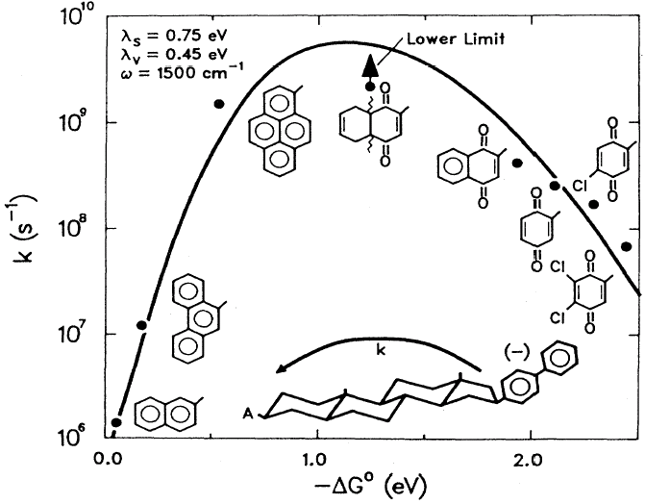
Closs & Miller
Science (1988)
Normal region:
Activationless region:
Inverted region:

Slide 21
Structural control parameters
for D-A electronic coupling

Slide 22
Through-space versus through-bond tunneling jumps in tunneling pathways
THROUGH-BRIDGE PROPAGATION
S.S. Skourtis and D.N. Beratan Adv. Chem. Phys. 106, 377 (1999)

Slide 23
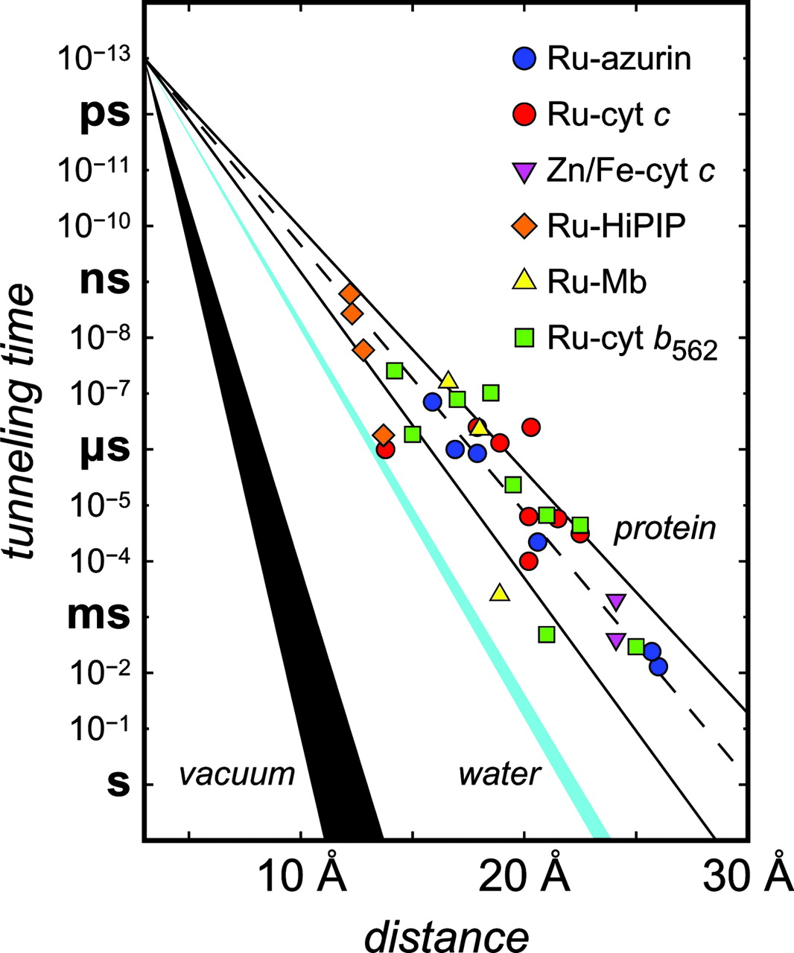
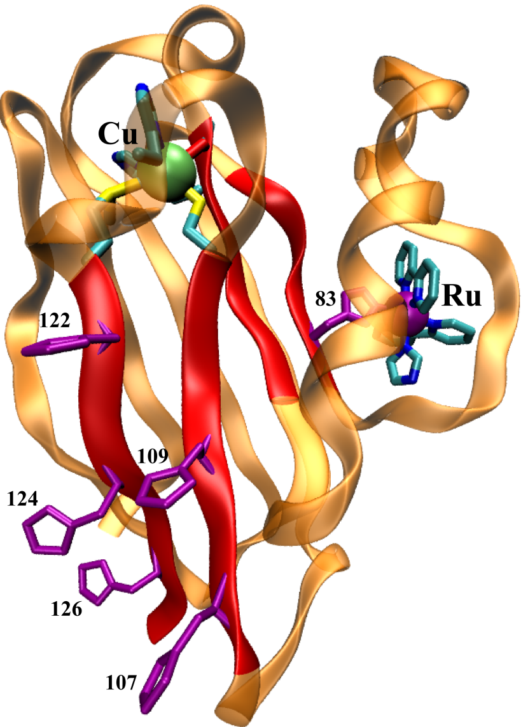
Exps. on protein ET systems with metal D & A
(large rate scatter)
Activationless rates
β- sheet
Gray H. B., Winkler J. R. PNAS 2005;102:3534-3539
Copyright © 2005, The National Academy of Sciences
Notes:
Tunneling timetable for intraprotein ET in Ru-modified azurin (blue circles), cyt c (red circles), myoglobin (yellow triangles), cyt b562 (green squares), HiPIP (orange diamonds), and for interprotein ET Fe:Zn-cyt c crystals (fuchsia triangles). The solid lines illustrate the tunneling-pathway predictions for coupling along β-strands (β = 1.0 Å-1) and α-helices (β = 1.3 Å-1); the dashed line illustrates a 1.1-Å-1 distance decay. Distance decay for electron tunneling through water is shown as a cyan wedge. Estimated distance dependence for tunneling through vacuum is shown as the black wedge.

Slide 24
Dependence of electron tunneling on biomolecular motion

Slide 25
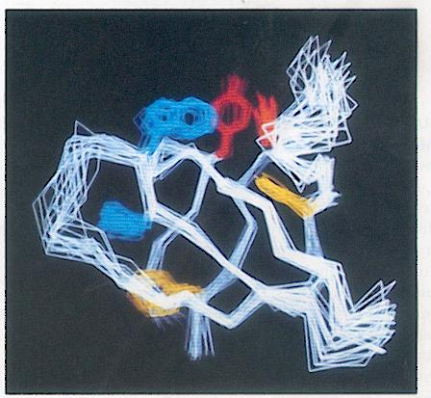
A protein fluctuates around its average structure
Rich spectrum of fluctuations relevant to ET:
Time scales of structural fluctuations: tens of fsec to μsec/msec
Sizes of structural fluctuations: a few to tens of Angstroms

Slide 26
Fluctuating barrier tunneling
Fluctuating barrier/tunneling matrix element: T_{DA}(t) → rare flucs to large T_{DA}
Pot. energy felt by e⁻
-e
D
A
B₁
B₂
BRIDGE
ATOMS

Slide 27
Expected coupling fluctuation effects on molecular ET
Temperature dependence of T_{DA}
(modifies temperature dependence of overall rate)
Modification of free energy gap dependence
Inelastic tunneling
Gating

Slide 28
ET rate for a fluctuating tunneling matrix element
(slow & large fluctuation regime)
High-temp, & elastic tunneling limits
_{Energy}
Average of T_{DA}² over diff. molecular conformations
Crossing point (region)
FC factor
_{Collective system coord}
rms fluctuation in the D-A energy gap: U_{A}-U_{D}

Slide 29
Magnitude of T_{DA} fluctuations compared to average
Small T_{DA} fluctuations
Large T_{DA} fluctuations
Rate may be determined by rare flucs that give large couplings

Slide 30
Checking importance of coupling fluctuations
on ET rates
MD simulations coupled to electronic structure comps

Slide 31
Run MD of system / Save MD snapshots of molecule
Compute electronic structure for each snapshot
Compute E_{D} , E_{A} , T_{DA}
Compute averages and moments of T_{DA ,} E_{A} - E_{D}
from MD trajectory
Compute ET rates
(interpret in terms molecular structure and dynamics)

Slide 32
T_{DA} fluctuation effects in the ET protein azurin
S.S. Skourtis, I. Balabin, T. Kawatsu, and D.N. Beratan Proc. Natl. Acad. Sci. USA 102, 3552 (2005)
LARGE FLUC

Slide 33
Coupling fluctuations increase with DA distance
I. Balabin, D.N. Beratan and S.S. Skourtis Phys. Rev. Lett. 101, 158102 (2008)
Critical distance R_{c}
R_{DA} < R_{c}
R_{DA} > R_{c}
Water-mediated tunneling R_{c} = 2-3 Angstroms
Protein-mediated tunneling R_{c} = 6-7 Angstroms

Slide 34
SUMMARY
Some conclusions
The large coupling-fluctuation regime is very common in biological (and even small molecule) ET systems.
In this regime interpreting ET coupling in terms of average protein (molecular) structure may not give the correct physical picture:
Non equilibrium conformations can provide most of the coupling
Sufficient MD sampling necessary
< T_{DA} ² > >> < T_{DA} >²

Slide 35
Control
in
ET molecular “devices”
Control of energy level and electronic coupling fluctuations
- Control via initial donor state preparation
-Control coupling pathway topology

Slide 36
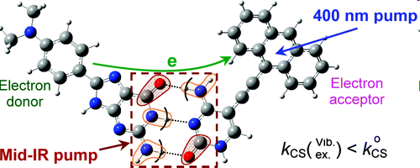
Manipulate ET by IR excitation of mol.vibrations
S.S. Skourtis, D.H. Waldeck and D.N. Beratan JPC B 108, 15511-15518 (2004)
S.S. Skourtis and D.N. Beratan AIP Proceedings Vol. 2, Part B, 809-812 (2007)
D. Xiao, S.S. Skourtis, I. Rubtsov, D.N. Beratan, Nano Lett., 9 (5), 1818–1823 (2009)
Z. Lin, et. al. J.Am. Chem. Soc., 131: 18060-62 (2009)
H. Carias , D.N. Beratan, S.S. Skourtis JPC B., 115 (18), 5510-5518 (2011)
400 nm
mid-IR
Vis
τ
T
time
3-5% decrease in ET rate

Slide 37
Some challenging future directions
Single molecule transport & transfer
Photon and electron counting statistics to reveal fluctuation –dynamics effects
IR driving of ET
Driving of rare activation events
Computation
Long time MD and reliable sampling of resonance region
For large coupling flucs the DA resonance region is altered

Slide 38
Reviews
S.S. Skourtis
Probing protein electron transfer mechanisms from the molecular to the cellular length scales
Biopolymers (Peptide Science) 100, 1 pp 82–92 (2012)
S.S. Skourtis, D.H. Waldeck, and D.N. Beratan
Fluctuations in biological and bioinspired electron-transfer reactions
Annu. Rev. Phys. Chem., 61, pp 461–485 (2010)
D. N. Beratan, S.S. Skourtis, Ilya A. Balabin, Alexander Balaeff, Shahar Keinan, Ravindra Venkatramani, and Dequan Xiao
Steering electrons on moving pathways
Acc. Chem. Res., 42, pp 1669–1678 (2009)
S.S. Skourtis, J. Lin, and D.N. Beratan
The effects of bridge motion on electron transfer reactions mediated by tunneling
Modern methods for Theoretical Physical Chemistry of Biopolymers,
E. B. Starikov, S. Tanaka, and J. P. Lewis, editors, Elsevier, pp. 357-379 (2006)

Slide 39
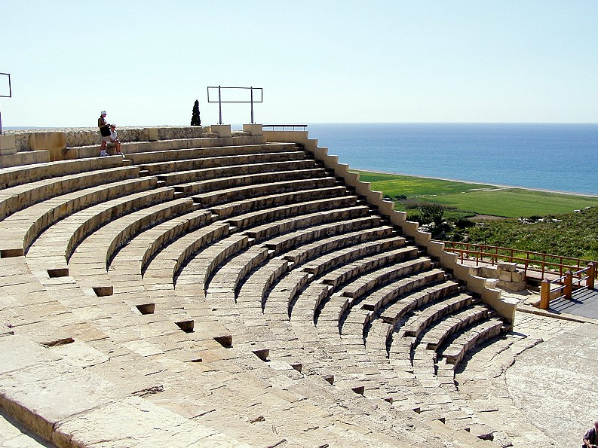
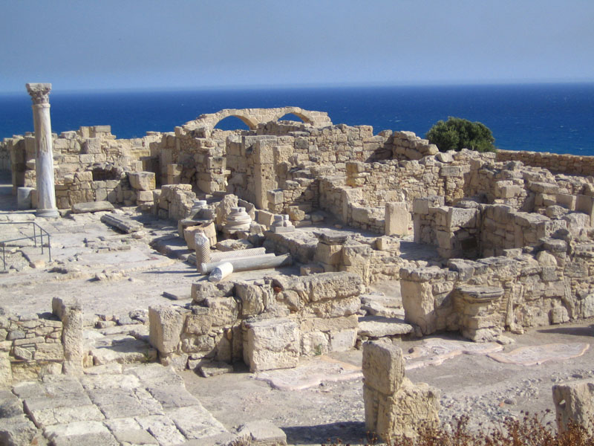
Funding
Cyprus Research Promotion Foundation
Leventis Foundation
University of Cyprus
EU: FP7
USA: DOE, NIH, NSF, Duke Univ. Theory Initiative, UNC EFRC

