Slide 1
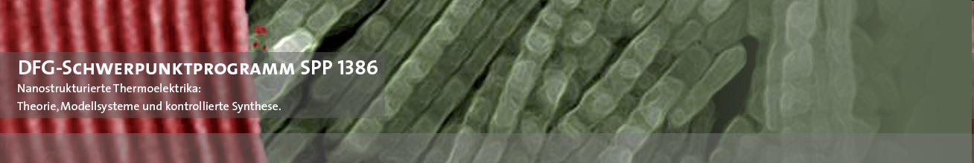
Energiewandlung mittels Nanostrukturierte Thermoelektrika
Prof. Dr. Kornelius Nielsch
Institute for Metallic Materials (IMW), IFW Dresden

Slide 2

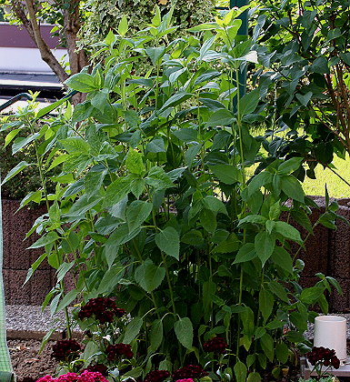
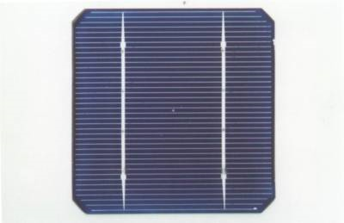
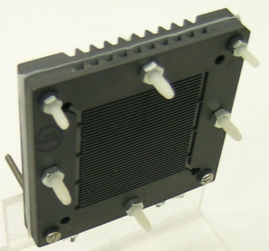
Licht
Photosynthese
Photovoltaik
Brennstoffzelle
Elektrizität
Brennstoff
Thermoelektrik
Verbrennung
Generator
Wärme
Mechanik
Wärmekraft-
maschinen
Konventionelle Stromerzeugung: 90% der Stromgewinnung
SPP 1386
MPI-MSP Halle

Slide 3
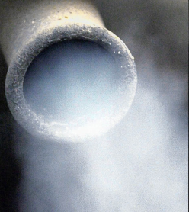

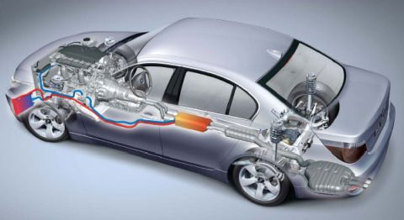
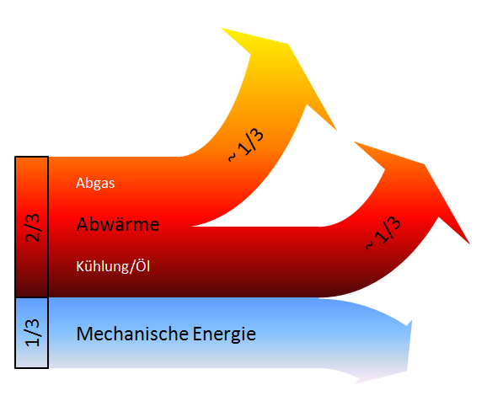
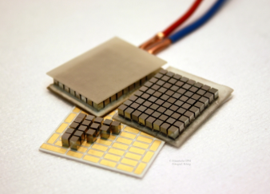

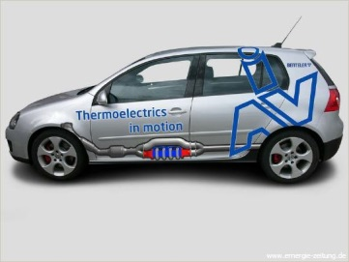
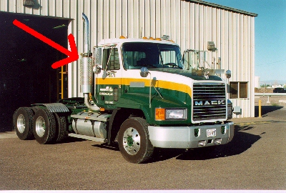
Stromerzeugung aus Wärme im Auto
Viel Wärme aus dem Auspuff
Thermoelektrischer
Generator im KFZ
Energierückgewinnung
durch Thermoelektrik
Quelle: BMW AG
Quelle: IAV GmbH
Nur ~ 1/3 der Gesamtenergie steht dem KFZ zum direkten Antrieb zur Verfügung
SPP 1386

Slide 4
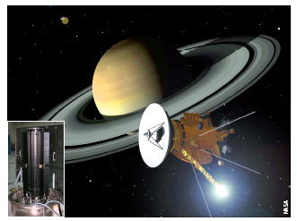
Cassini-Sonde
Die Cassini-
Sonde bezieht ihre
Energie aus der
Zerfallswärme von
Plutonium, die
thermoelektrische
Konverter (Inset)
in Strom umwandeln.

Slide 5
Thermoelectric Applications
SPP 1386

Slide 6

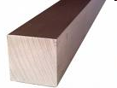

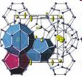
Thermoelectric Efficiency: ZT
S² σ
ZT = T ~ 0,5-1
κ
Diamond
Therm. Conductivity (κ)
Metal
High Output Potentials: Seebeck coefficient
Low Thermal Conductivity
High Electric Conductivity
Thermoelectrics
Glass
Elect. Conductivity (σ)

Slide 7
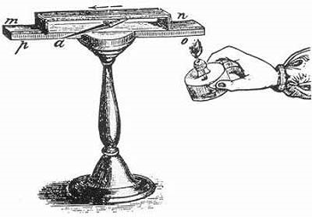
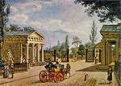
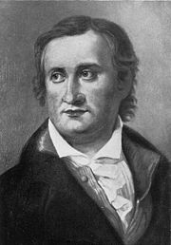
Historischer Hintergrund: Thermoelektrik
- TE Nanostrukturen ZT = 2-3
2000
- Theorie zu TE Nanostrukturen
1990
1960
- Kühlung mit Bi₂Te₃
Seebeck-Effekt
1940
- PbS-Generatoren
Berlin 1821
Thomas Johann Seebeck
1840
- Peltier-Effekt
- Ohm‘sche Gesetz
- Seebeck-Effekt
1820
SPP 1386

Slide 8
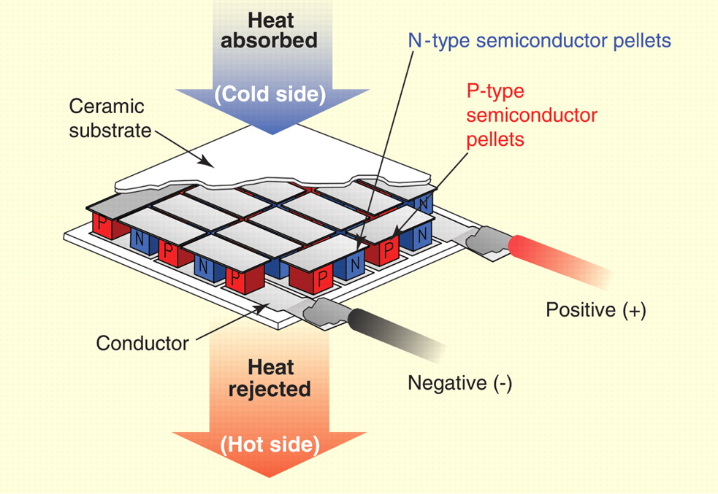
Functionality of Thermoelectric Modules
Price: 2 to 15 U$
Heat emission
Continuous current
Ca. 90% of moduls based on Bi₂Te₃
Handcrafted manufacturing

Slide 9
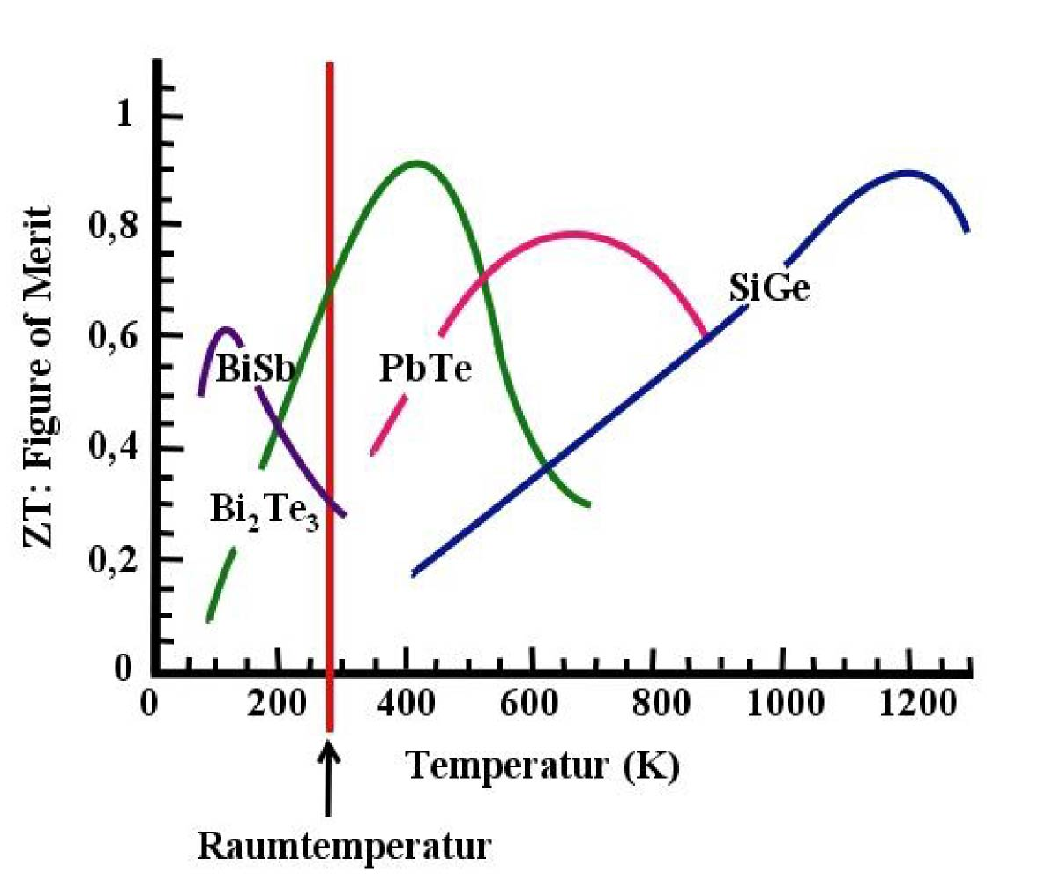
Important Thermoelectric Materials
Temperature (K)
Room Temperature

Slide 10

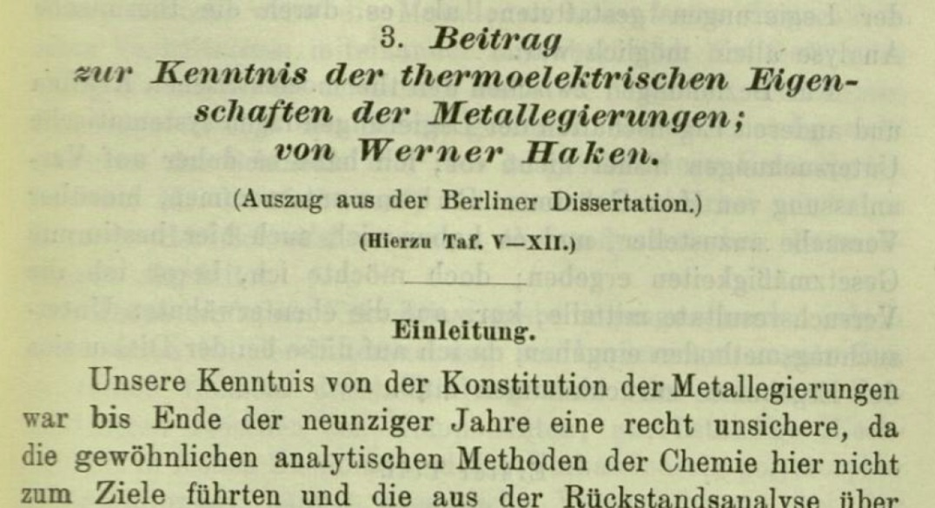
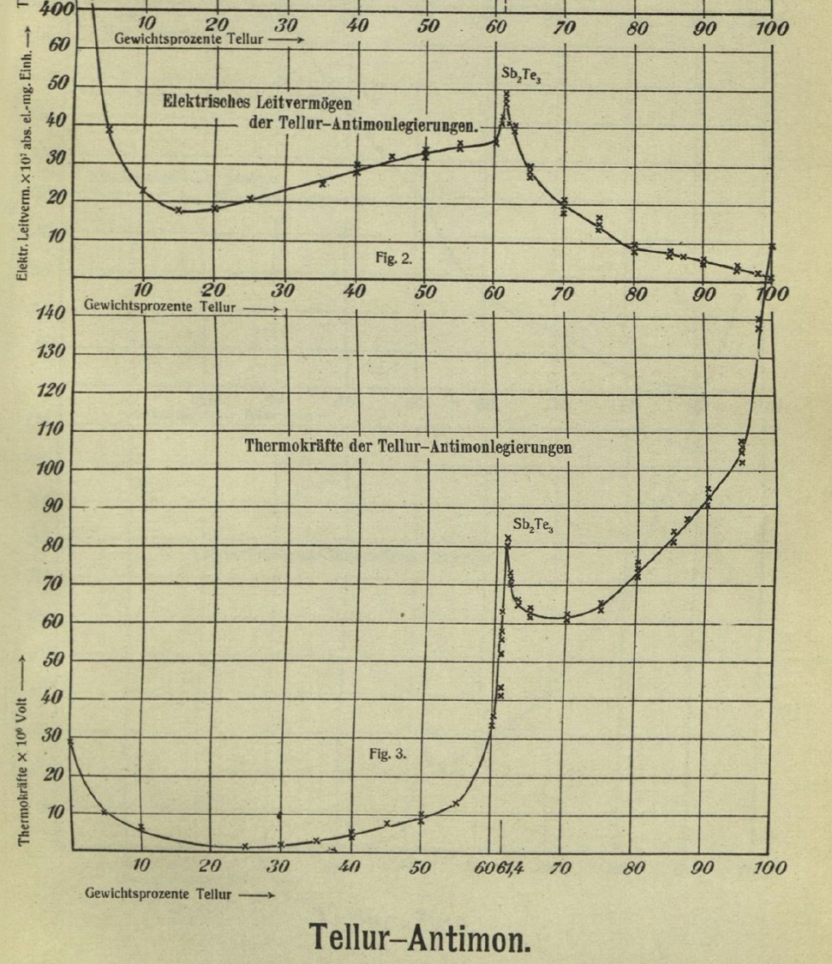
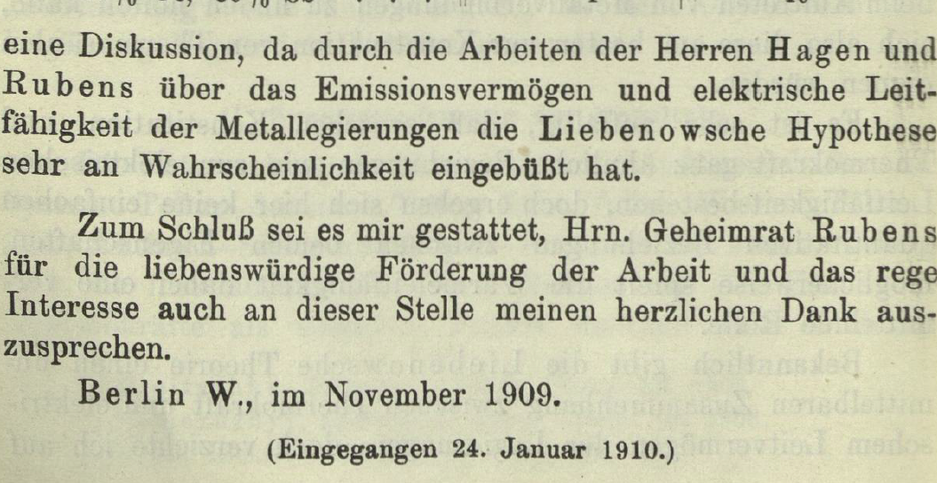

Slide 11
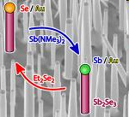
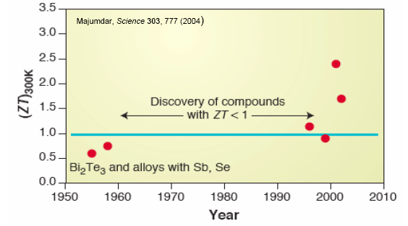
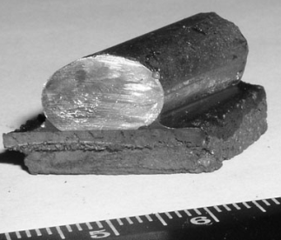

Thermoelectric Materials of the 20th Century
year

Slide 12
Design Challenges
S² σ
ZT = ---------- T
κ
κ = κ_{e} + κ_{PH}

Slide 13
Promising approaches to higher ZT

Slide 14
Overview of Thermoeletric Materials
Notes:
14

Slide 15
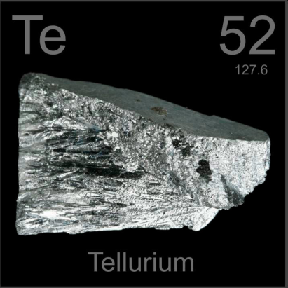
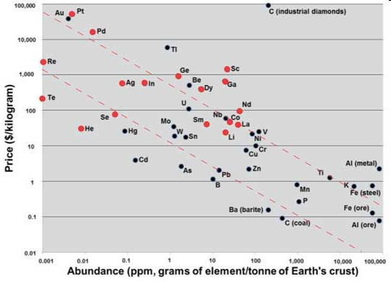
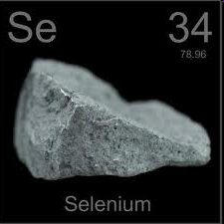
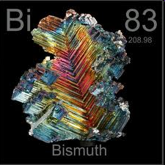
Seltene Elemente für die Thermoelektrik
Bi

Slide 16
Thermoelectric Materials

Slide 17
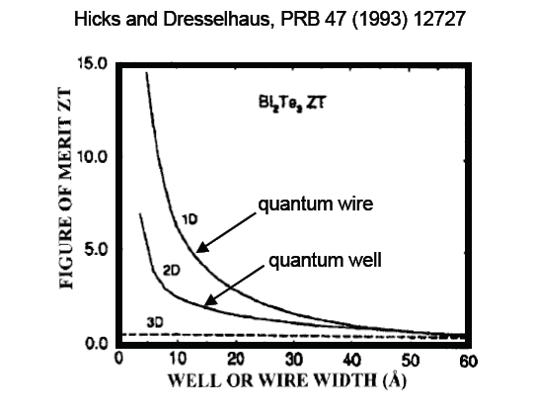
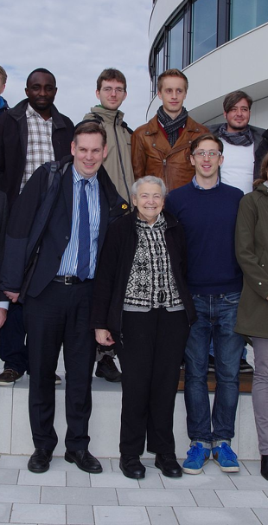
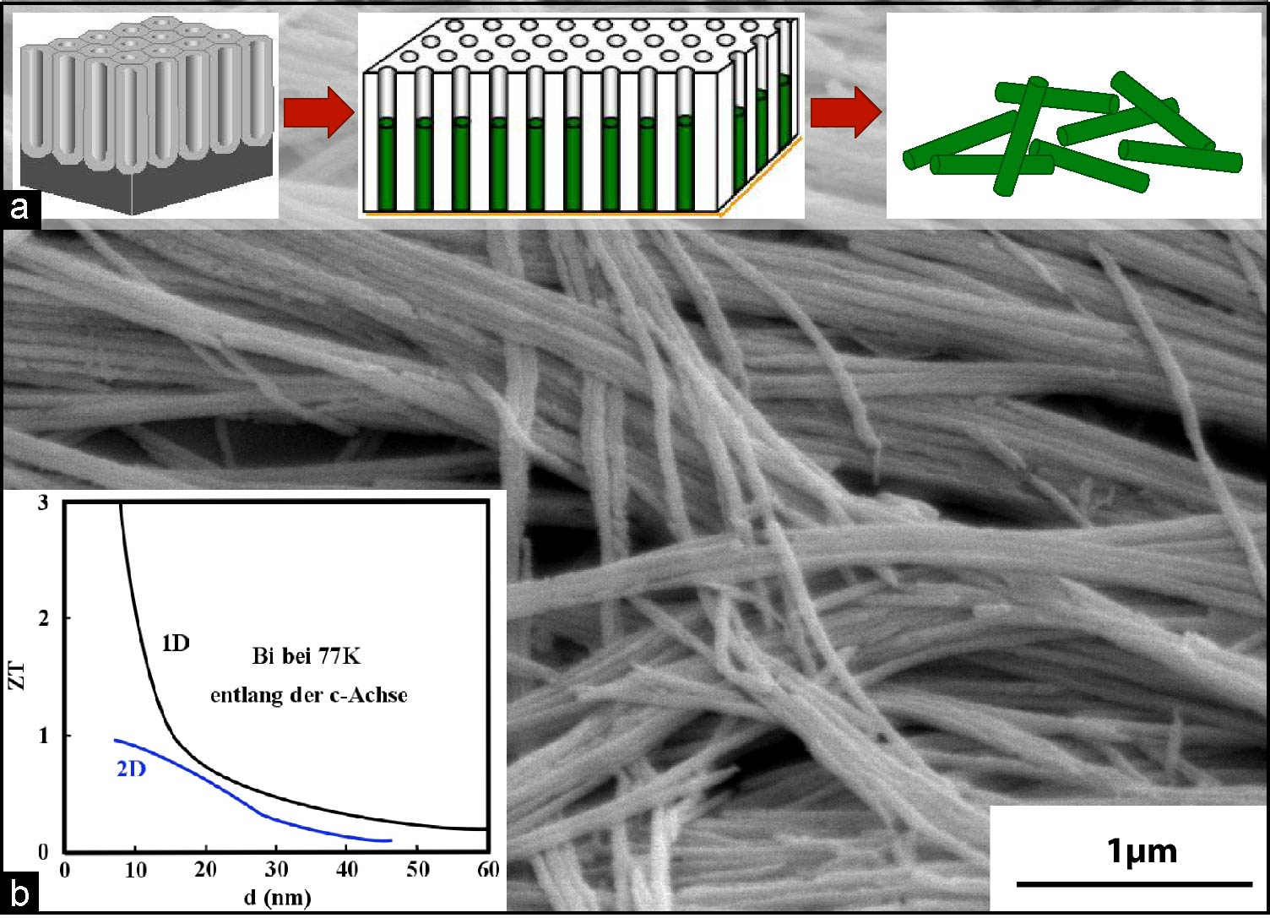
Predictions for Confined Structures
Hamburg, Jan 2013
Does not include deleterious interface or barrier effects
ZT enhanced by degeneracy: multiple carrier pockets in k-space

Slide 18
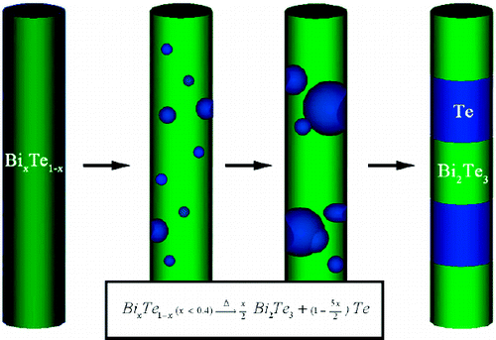
Template-based Synthesized of TE Nanowires
Large-Area Bi₂Te₃ Nanowire Arrays into Porous Anodic Alumina Templates
M. S. Sander, A. L. Prieto, R. Gronsky, T. Sands, A. M. Stacy,
Adv. Mater. 14, 665 (2002).
Bi₂Te₃/Te Multiple Heterostructure Nanowire Arrays by Confined Precipitation
W. Wang, X. Lu, T. Zhang, W. Jiang, X. Li,
J. Am. Chem. Soc. 129, 6702 (2007).

Slide 19
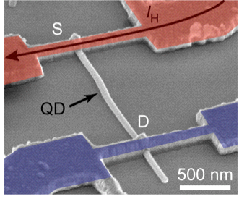
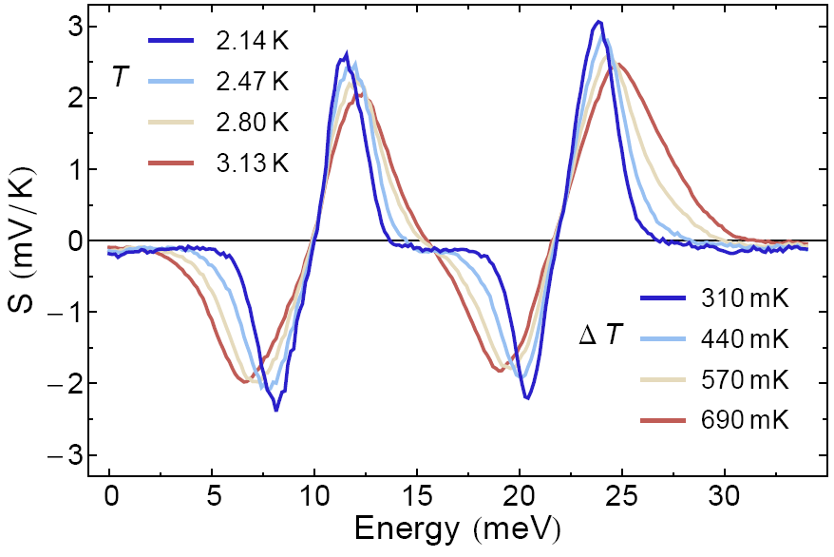
Single Electron Transistor: Thermopower Measurements of InAs Nanowire with embedded Quantum Dot
E.A. Hoffmann, H. Linke et al., Nano Lett. 9, 779 (2009)

Slide 20
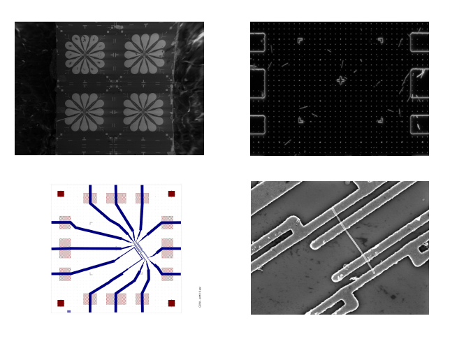
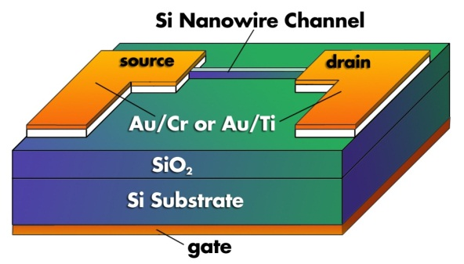
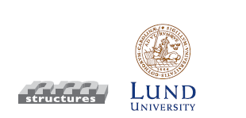
Power-Factor Measurements of Backgate-tuned InAs Nanowire
Vapor-Liquid-Solid Growth of InAs Nanowires
Seebeck Characterization Setup with InAs Nanowire
In collaboration:
H. Linke and K. Nielsch et al., Nano Letters 13, 4080 (2013).
Notes:
Measurement of Seebeck Coefficient and elektrical Conductivitiy under the influence of electrical fields
MOSFET-Setup
Tuning the Fermi-Level by E-Field
Quantized conductivity,
Quantendot-like behaviour
Very high power-factor

Slide 21
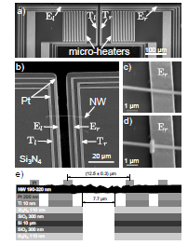
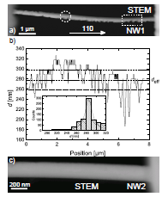
Thermoelectric Properties of an Individual Bi_{0.39}Te_{0.61} Nanowire
ZT_{NW1} = 0.08 and ZT_{NW2} = 0.07
D. Kojda, et al, Sem. Sci. Tech. (2014).

Slide 22
TE two channel-model for Bi₂Te₃ put to the test.
Experimental survey for Bi₂Te₃ from micro- to nanostructures
S / V ratio
bulk
nanostructure
TI two channel-model represents experiments for Bi₂Te₃ very well.
Notes:
How does the two channel model for Bi₂Te₃ compare to experiments?
So it seems the model works fine for how Bi₂Te₃ we also applied the model to Sb2Te3 and BI2Se3

Slide 23
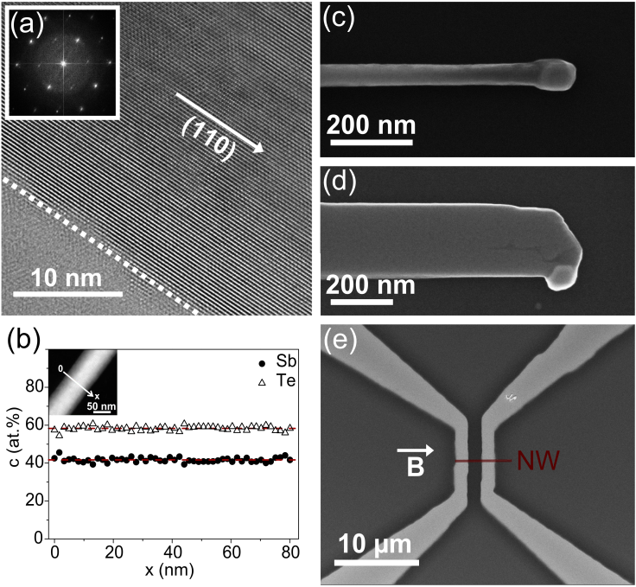
Electrical Transport of Sb₂Te₃-Nanowires under Magnetic Fields
R _{Bulk}
R _{Surface}
Bulk
Surface

Slide 24
Electric field-dependent Shubnikov-de Haas spectra of a Bi₂Te₃ nanowire
2D and 1D Transport in Cylindrical NWs under Transverse Magnetic fields
Landau Levels
Linear dispersion relation is observed by transport measurements
Oscillations cannot be explained
by 2D surface or 3D bulk states
J. Gooth et al., APL. 104, 243115 (2014)
S. Baessler et al , APL. 107, 181602 (2015)

Slide 25
Electric field-dependent Shubnikov-de Haas spectra of a Bi₂Te₃ nanowire
2D and 1D Transport in Cylindrical NWs under Transverse Magnetic fields
Landau Levels
The linear dispersion relation is observed by transport measurements
Oscillations cannot be explained
by 2D surface or 3D bulk states
J. Gooth et al., APL. 104, 243115 (2014)
S. Baessler et al , APL. 107, 181602 (2015)

Slide 26
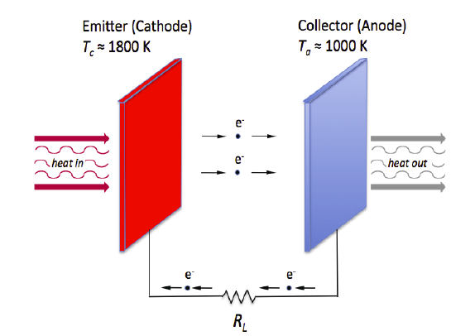
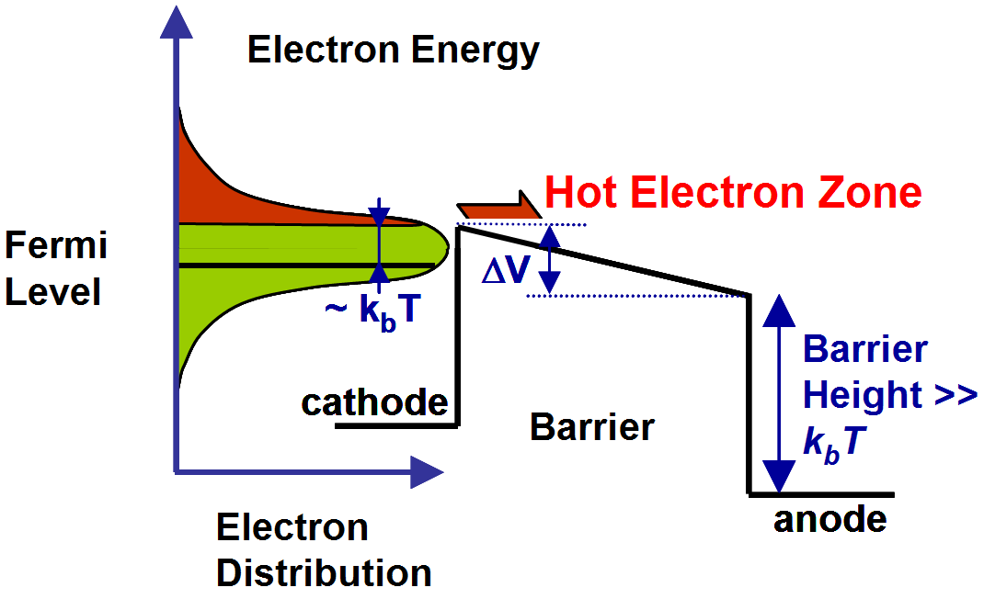
Thermionic Energy Converters: Principles
Vacuum based Thermionic Device
Solid State Thermionic Device
Metal
Vacuum
Metal
Metal
Semi-conductor
Metal
Basic Concept: W. Schlichter, Germany, 1915
Lab demonstration (cesium vapor diode):
M. Y. Gurtovoy and G. I. Kovalenko, USSR, 1941
Pioneers: G.D. Mahan and A. Shakouri, USA, 1994/1997
Notes:
Erklärung Thermionic
Glühemission von Elektronen ins Vakuum
Versuchsapperaturen mit 10% Effizienz
Anwendung auf Satelliten
Einige Aktivität in jüngster Zeit mit MEMS-Strukturen
Neue Ideen Photonunterstützte Thermoemission
Gegenkonzept: Thermionic auf Basis von Festkörperen
Realisierung mit III-V-Halbleritern und Festkörpern
Große experimentelle Herausforderung beim Wachstum

Slide 27
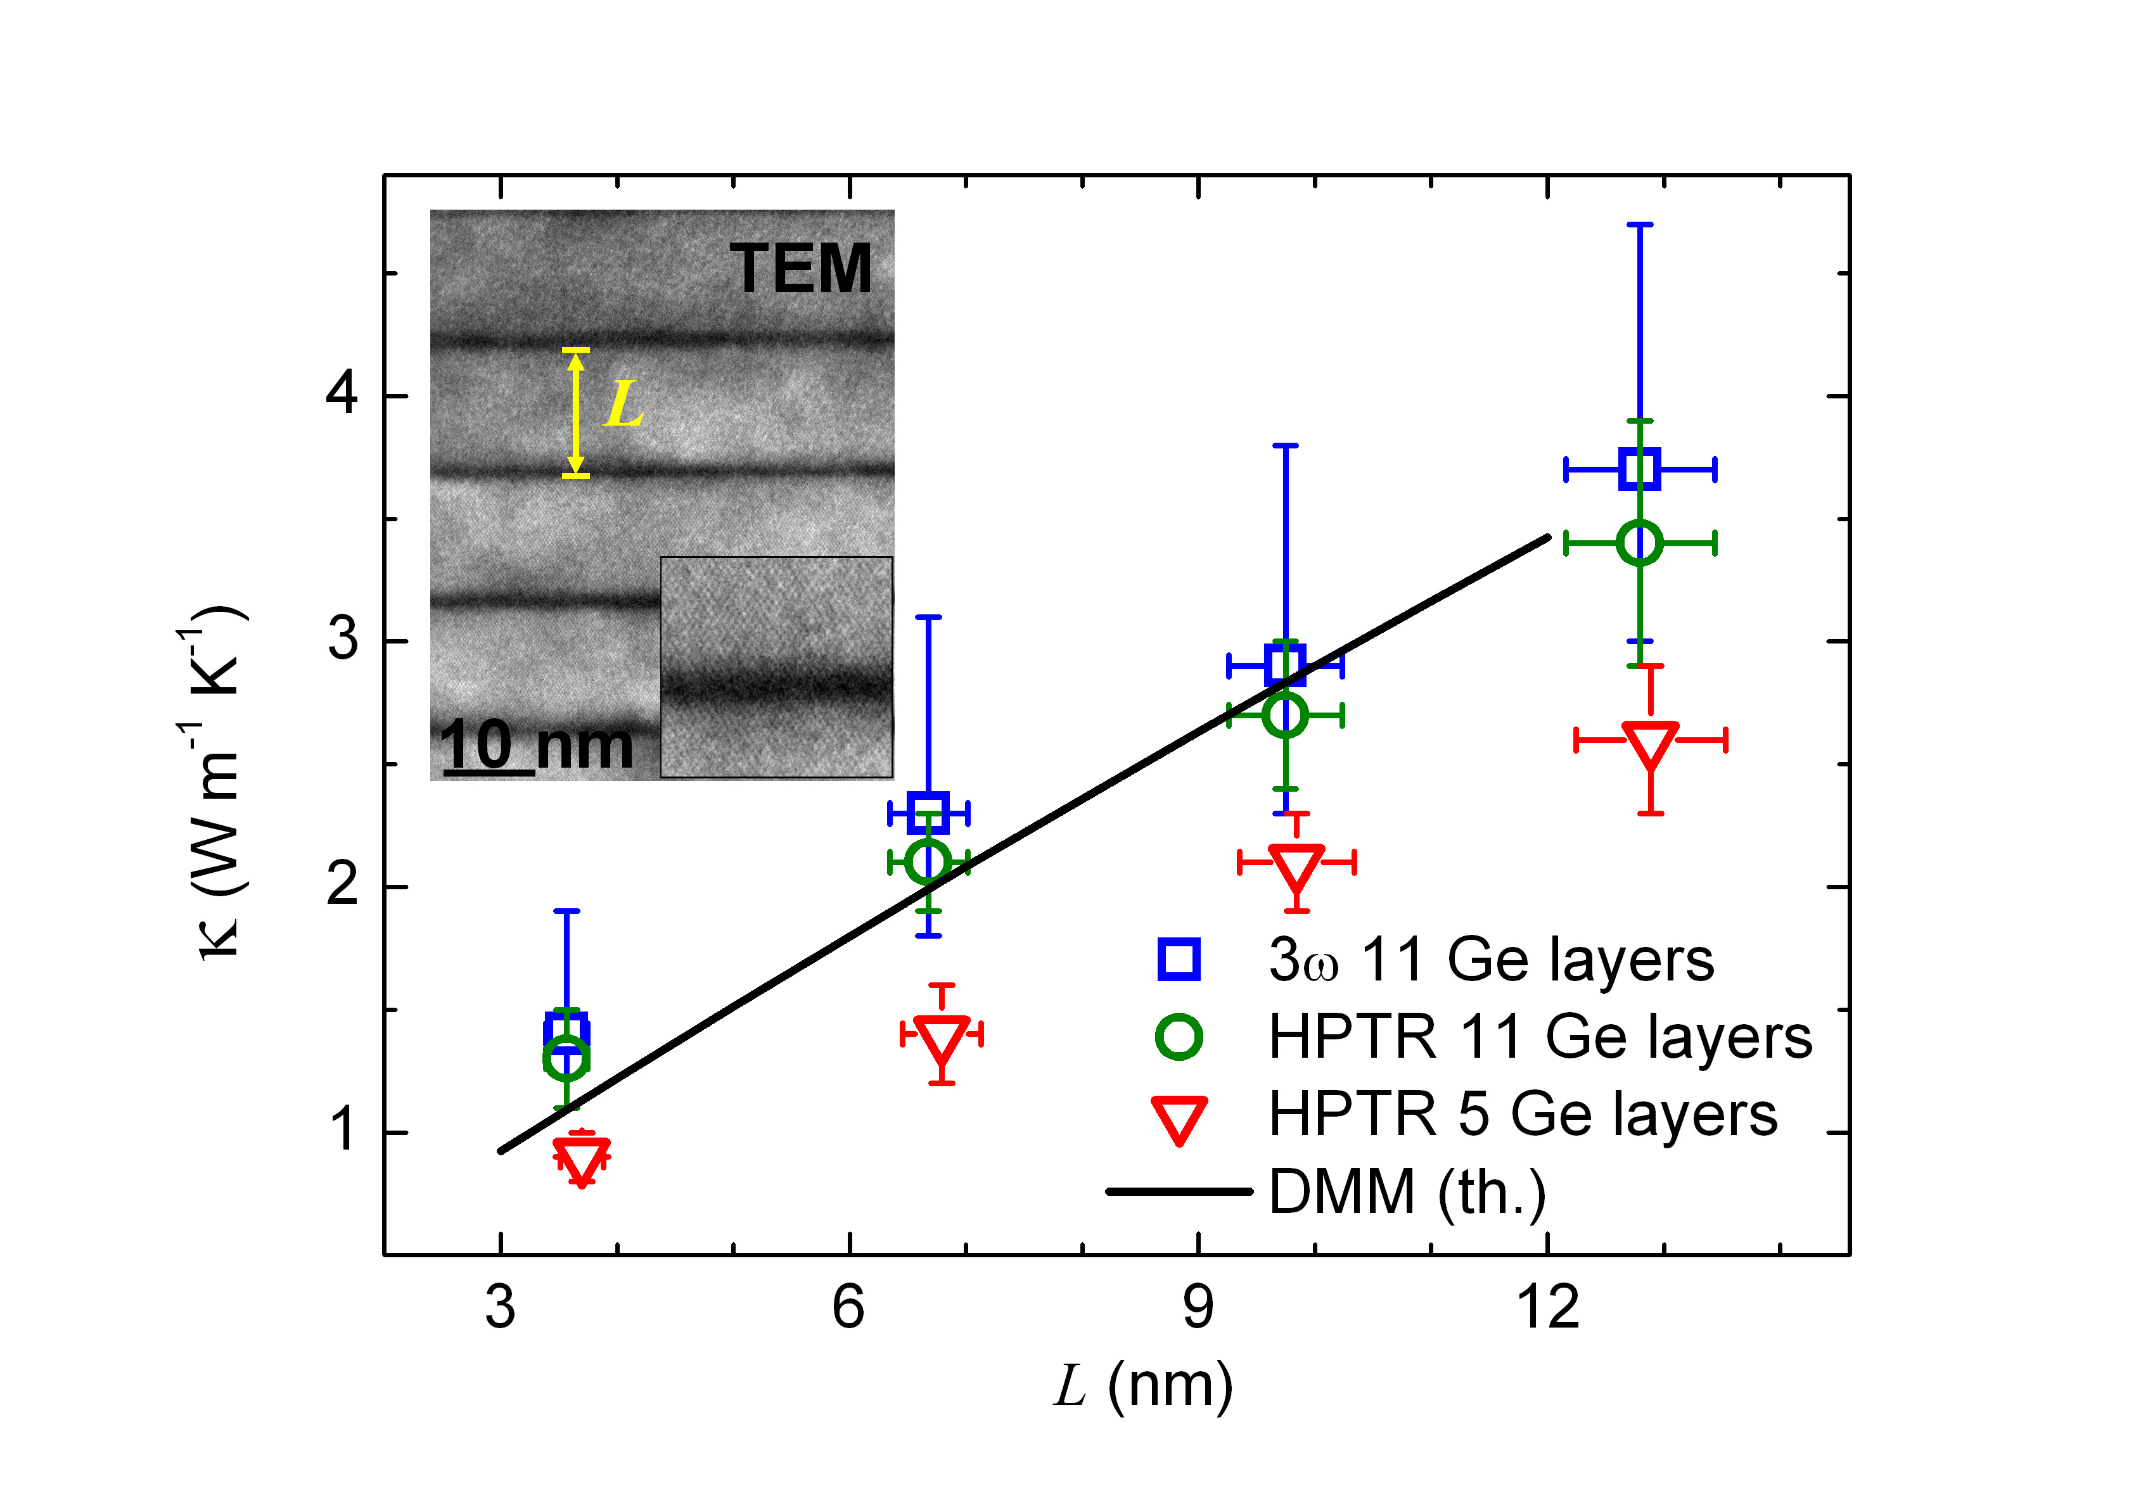
Thermal Conductivity of Epitaxial Ge/Si Nanodot Multilayers
IIN (IFW)
A. Rastelli & O. G. Schmidt
G. Pernot et al., Nature Mater. 9, 491-495 (2010).

Slide 28
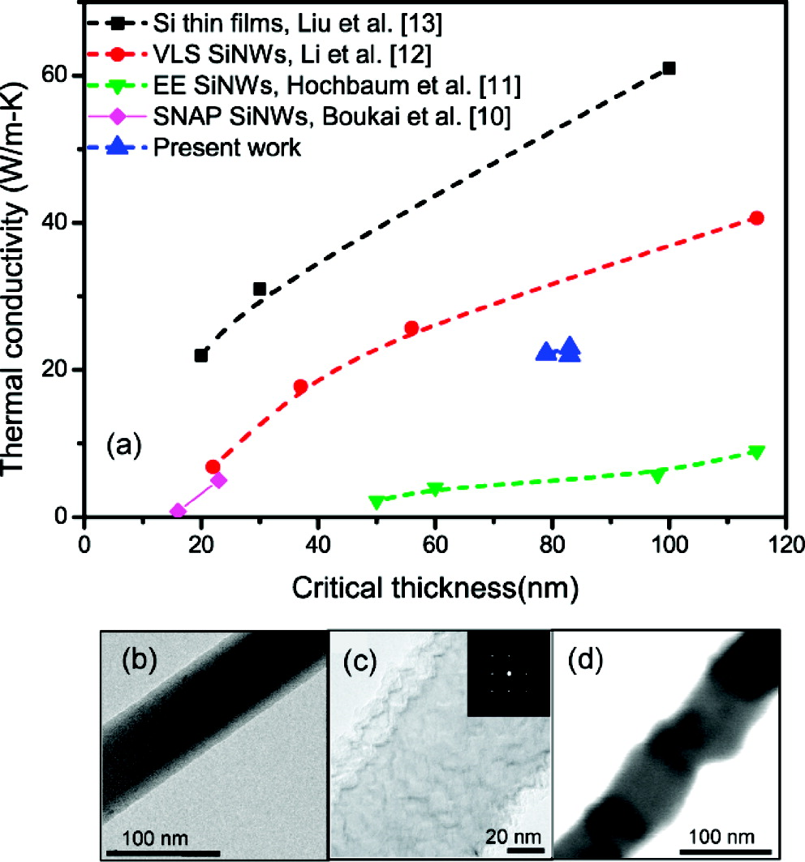
Comparison of Silicon Nanowires: Thermal Conductivity
Top Down: Electrochemical Etched Silicon Nanowires
Si thin films [Si13]
VLS Si NWs [Si12]
EE Si NWs [Si11]
SNAP Si NWs [Si10]
Integrated Si NWs [Si9]
A. Majumdar et al., Nano Lett. 10, 4341 (2010).

Slide 29
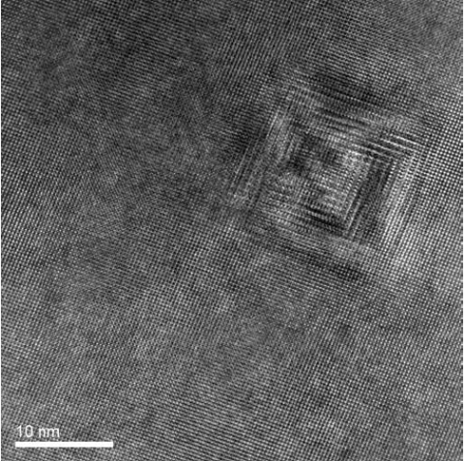
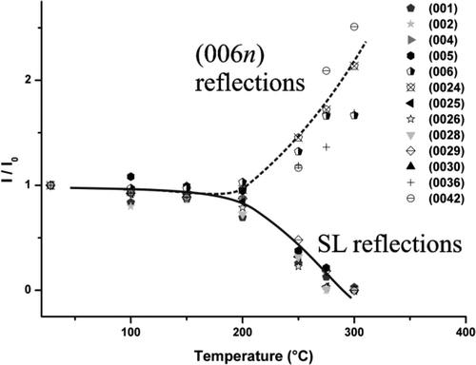
Thermoelectric Nanostructures (ZT >1)
ZT~3.5 @ 575 K
quantum dot superlattice (MBE)
n-type, PbSeTe/PbTe
[Harman, MIT-LL, J. Elec.Mat. 2000]
ZT~1.2 @ 350 K Nanowire p-type, Si
[Heath, Caltech, 2008]
ZT~2.2 @ 800 K
bulk – ‘natural’ nanodots
n-type, AgSbTe₂-PbTe (‘LAST’)
[Kanatzidis, Northwestern, 2004]
ZT~1.4 @ 373 K
bulk – fine grain
p-type, (Bi,Sb)₂Te₃
[15 authors, BC/MIT/GMZ Energy/Nanjing
University, 2008]
ZT~2.4 @ 300 K
superlattice (CVD)
p-type, Bi₂Te₃/Sb₂Te₃,
[Venkatasubramanian, RTI/Nextreme, 2001]
ZT~0.6 @ 300 K
nanowire
p-type, Si
[Yang/Majumdar, Berkeley, 2008]
State of the Arte for Devices: ZT < 1

Slide 30

Synthesis of Nanograined Bulk-Materials

Slide 31
Overview: Nanograined TE Bulk Materials
K. Nielsch et al., Adv. Energy Mater. 1, 713 (2011).

Slide 32
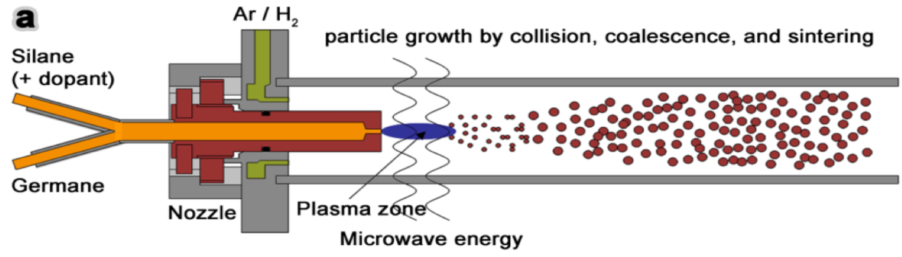
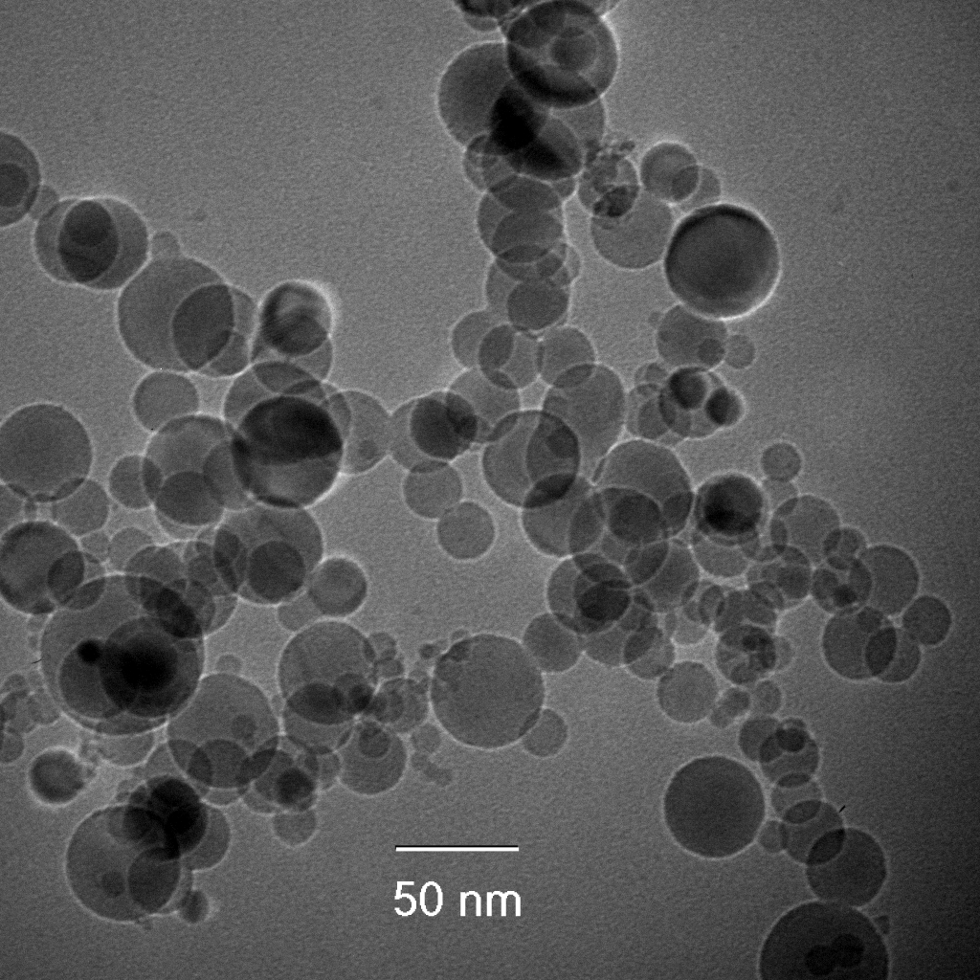
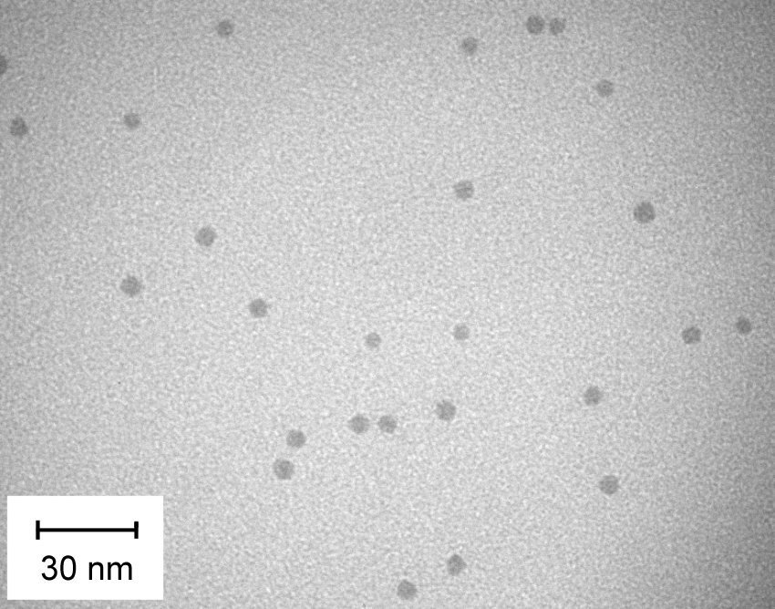
Nanopowder synthesis from the gas phase
Atmospheric pressure;
High cooling rate
Reduced pressure;
High cooling rate
Atmospheric pressure;
Low cooling rate
J. Phys. D: Appl. Phys. 48, 314010 (2015).
J. Phys. D: Appl. Phys. 44, 174034 (2011).
Synthesis: Group of H. Wiggers, University of Duisburg-Essen

Slide 33
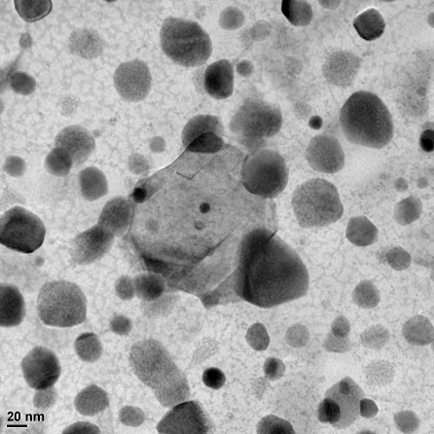
Si + WSi₂ nanocomposites
Si + 5 % W
50 nm
1 µm
J. Phys. D: Appl. Phys. 48, 314010 (2015).
TEM by Mathis Müller and Hans-Joachim Kleebe, TU Darmstadt

Slide 34


www.spp1386thermoelectrics.de/
Berlin, Oct 2010

Slide 35

German Priority Program SPP 1386 on Nanostructured Thermoelectrics
May 2007 Overview Publication in Physik Journal
Sep 2007 Planning Meeting in Fulda
Nov. 15 Submission for the Founding Proposal
Apr. 2008 Positive Announcement about SPP 1386
Jul 2008 Network Meeting in Hamburg (80 Part.)
Sep. 22 Submission of 35 Proposals
Dec 2008 Selection of the Projects
Apr. 2009 Start of the individual Projects (18)
2009 to 2012 First Funding Period
2012 to 2015 Second Funding Period

Slide 36


Funding from the German Ministry of Education and Science (BMBF) via the Material Development Program (WING)
Funding Focus
(z.B. Thermopower)
10 funded Projects (ca. 27 Mio. €)
Idea
Basic
Research
WING Projects
with Industry
Product-
development
Market
Entry
  5 Research Consortia
  17 Research Center involved, 5,5 Mio. €
Materials for Tomorrow:
Scientific Pre-Project

Slide 37






Motivation: Electrochemical Synthesis of TE Films and Nanostructures
Miniaturized TE Devices
Sb₂Te₃ ; (Bi_{1-x}Sb_{x})₂Te₃
Flexible TE Devices
Notes:
Kostengünstig zu Sputter-Technik
Electrochemie kann wesentliche Verbindungen erzeugen
Wässerige Lösungen
Zwei Konzepte

Slide 38

Thematische Schwerpunkte in ThermoPower
Materialentwicklung für Temperaturbereich von 200°C – 1000°C
  Ressourcenverfügbarkeit
  Industrielle Herstellbarkeit
  Wirtschaftlichkeit
  Umweltverträglichkeit (Bismut-, Bleitellurid)
Systementwicklung
  maßgeschneiderte Aufbau- und
  Verbindungstechnik
  komplettes thermoelektrisches System
  Demonstrator
Begleitende Maßnahme
  Standardisierung von thermoelektrischen Referenzproben
  Etablierung von validierten thermoelektrischen Meßmethoden
Quelle: IAV GmbH

Slide 39
Funding from the German Ministry of Education and Science (BMBF) via the Material Development Program (WING)
Funding Focus
(z.B. Thermopower)
10 funded Projects (ca. 27 Mio. €)
Idea
Basic
Research
WING Projects
with Industry
Product-
development
Market
Entry
  5 Research Consortia
  17 Research Center involved, 5,5 Mio. €
Materials for Tomorrow:
Scientific Pre-Project

Slide 40


Slide 41




The Great Vision for Thermoelectric: Waste Heat Recovery

Slide 42

The Great Vision for Thermoelectric: Waste Heat Recovery

Slide 43



Thermoelectric Society of Japan: Academic Roadmap for TE Applications
research
prototype
demonstration
application
2011
2030
2040
Solar heat
Solar heat
Geotherm.
Hot spa
FC
Factory Biomass
Ship Therm. plant
Furnace
FC.
Geotherm.
Co-gene
Ship
Industry
Ship・Factory
Small gene.
Furnace
Furnace
Incin.
Power/unit (W)
LNG
Co-gen.
Airplane
LNG
Air plane
Power/unit (W)
LNG
Hot spa
Raw sludge
Space
Car
Power/unit (W)
Biomass
Therm. plant
Co-gen.
Car
Electrics
Electronics
Energy
harvesting
Small generator
Car
Electrics
Electronics
Energy harvesting
Mosquito trap
Candle radio
Charge pan
Energy
harvesting
Watch
Temperature (K)
Temperature (K)
Temperature (K)
Cost
$/Wh
Scale
ΔT
η=7%
η=15%
η=20%
η>30%
K
W
800
0.0001
10⁶
Thermoelectric
Power plant
Micro-grid
co-generation
400
0.001
10³
Thermal plant
（Low tem. wast）
Thermoelectric
car
Biomass
Industry
0.01
Incinerator
Solar heat
200
1
Geotherm.
Stove/Fireplace
Waste heat from engine
(Car, Co-generation)
100
0.1
Module efficiency (%)
10⁻³
10
1
10⁻⁶
Energy harvesting
ΔT @ T_{c} = 300K (K)
2010
2020
Year
2030
2040

Slide 44
www.spp1386thermoelectrics.de/
Berlin, Oct 2010

Slide 45
Ausblick zur Thermoelektrik in Deutschland
Landungs- , Wärme und Stofftransport an thermoelektrischen Grenzflächen
Ressourcenschonende TE Materialien, z.B. Substitution von Bi₂Te₃ und Kontakte
Skalierbare Materialsynthese und innovative Ansätze zum Modulaufbau
Material- und Modulentwicklung jenseits von ZT-Optimierung
Systemintegration und Wärmemanagement
Eine Initiative zur Anwendungsorientierten Grundlagenforschung
Festkörperphysik und Festkörperchemie
Materialwissenschaften und Festkörperphysik
Verfahrens- und Fertigungstechnik
Ganzheitlich
Mikrosystemtechnik, Elektrotechnik und Mikroelektronik

Slide 46
Material- und Modulentwicklung jenseits von ZT-Optimierung

Slide 47


Academic Roadmap for Efficient Thermoelectric Materials
The 3rd
Creation of High Efficient Materials of Low Impact on Environment, Rich Resources, Low Cost, High Stability
The 2nd
Advanced Manipulation at Atomic and Molecular Levels, Extend from Thin Films and Superlattices to Bulk Materials
The 1st
Thin Films and Superlattices, Present Materials Systems
Nanowire Superlattices
3rd Generation
Thin Films and Superlattices: ZT ≥ 5
Bulk Materials: ZT ≥ 3
Quantum Mechanical Effects
Nano Structure and Texture control
Fusion of Molecular Technologies
Phonon Scattering and Blocking Effects
Nano Interface Control
Energy Filtering Effect
Self-Assembly
2nd Generation
Thin Films and Superlattices: ZT=3〜5
Bulk Materials: ZT=2〜3
Spin Seebeck Effect
Molecular Sheets and Wires
Resonance Level Effects
Artificial Crystals by Advanced Design of
Electronic Properties and Synthesis Technologies
1st Generation
Thin Films and Superlattices: ZT=2〜3
Bulk Materials: ZT=1〜2
Crystals without Thermal Conduction
by Confinement of Phonons
Self-Assenbly Bulk Materials
Efficiency of Thermoelectric Materials
Nanostructure Built in Materials
Complex
Synergy Effect
Bi₂Te₃Alternative Materials
Control of Network Structures
Bi₂Te₃ System
PbTe System
Organic and Inorganic Hybrids
Realization of Thermal Diode
Skutterudites
Silicides
Strongly Correlated Electrons
New Findings of Condensed
System Physics
（From Fermion to Boson）
Clathrates
Oxides
Electronic Structure and States
Engineering
Heusler Alloys
Cluster Solids
Nano Space Engineering
Explanation of Non-Steady State Behaviors and their Application
Chalcopyrites and
Zinc blende Compounds
Organic Systems
Control of Lattice Defects
New Findings from Transport Mechanism of Organic Materials
PGEC
Control of Anisotropy
Molecular Design
Control of Carriers
Improvement in Heat and Oxidation Resistance, Thermal Stability, Chemical Stability, Thermal and Mechanical Properties
Rattling Effect
Materials Design
by Computation Science
Technology of Nanostructure
Manipulation and Synthesis
New Principles and Concepts
２０２０
２０３０
２０４０
Notes:
47

