Slide 1




Roadmap and roadblocks for multi-junction device technology based on metal halide perovskites
DPG Jahrestagung, 27th March 2017, Münster, Germany
Eva Unger^{1,2}
¹ Ass. Prof. Dep. of Chemistry and NanoLund, Lund University, Sweden
² Young Investigator Group Hybrid Materials Formation and Scaling,
Helmholtz-Zentrum Berlin, Germany

Slide 2
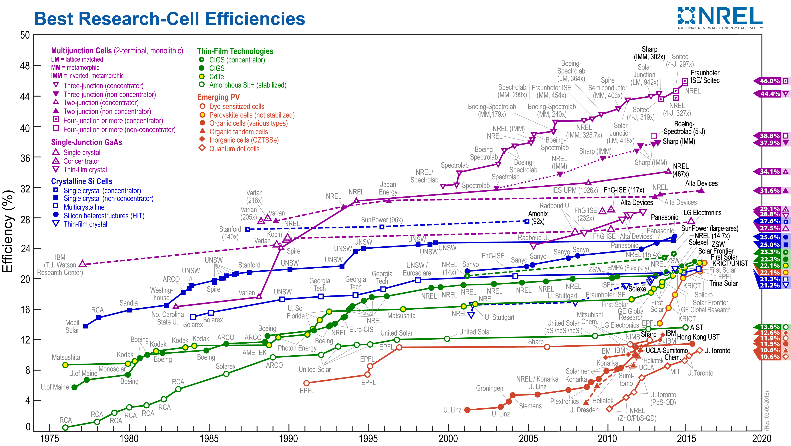
The Hall of Fame for the PV researcher
http://www.nrel.gov/ncpv/images/efficiency_chart.jpg

Slide 3
The Hall of Fame for the PV researcher
http://www.nrel.gov/ncpv/images/efficiency_chart.jpg

Slide 4
Perovskite solar cell influenced by many different technologies
Low-cost
Multi-junctions?
40
Multi-junction devices
30
Silicon Photovoltaics
Efficient (22 % on small area)
Scalable?
Stable?
Eco-compatible?
Efficiency (%)
20
CIGS
Thin film devices
CdTe
Perovskites
DSC
10
Excitonic devices
OPV
QDs
0
2000
2005
2010
2015
2020
2025
Time
Unger, Curr. Op. Sus. Chem. (accepted, 2017)

Slide 5
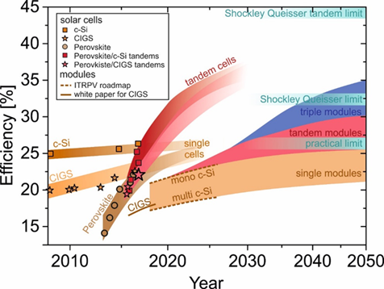
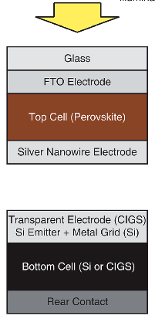




Hybrid tandem solar cells: Examples
4-terminal
(Bailie 2014)
Perovskite-CIGS Tandem Efficiency 18.6 %
Area: 0.39 cm²
S. Albrecht & B. Rech, Nat. Energy 2017 Bailey et al., En. Env. Sci. (2015)

Slide 6
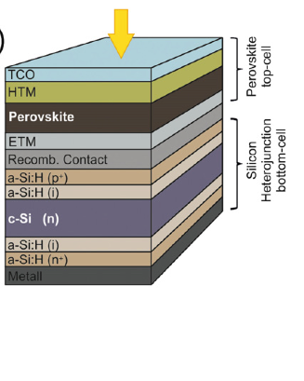

Hybrid tandem solar cells: Examples
2-terminal monolithic (Albrecht 2015)
Perovskite-Si(HIT) Tandem Efficiency 18.1 %
Area: 0.16 cm²
S. Albrecht & B. Rech, Nat. Energy 2017 Albrecht et al., En. Env. Sci. (2015)

Slide 7
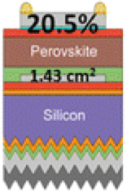
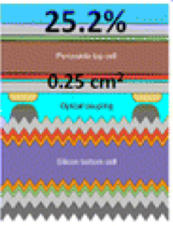
Hybrid tandem solar cells: Examples
Perovskite-Si(HIT) Tandem
(Werner 2015)
2-terminal monolithic Efficiency 20.5 %
Area: 1.43 cm²
4-terminal monolithic Efficiency 25.2 %
Area: 0.25 cm²
S. Albrecht & B. Rech, Nat. Energy 2017 Werner et al., ACS Energy Lett. (2016)

Slide 8
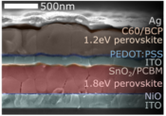
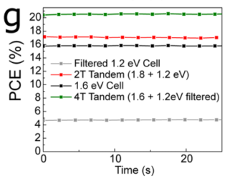
Hybrid tandem solar cells: Examples
Perovskite-Perovskite Tandem
(Eperon 2016)
2-terminal monolithic Efficiency 17 %, Area: 0.2 cm²
4-terminal stacked Efficiency 20.3 %, Area: 0.2 cm²
S. Albrecht & B. Rech, Nat. Energy 2017 Eperon et al., Science (2016)

Slide 9
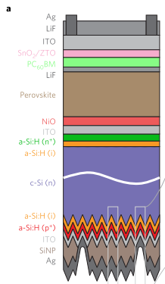
Hybrid tandem solar cells: Examples
2-terminal monolithic (Bush 2017)
Perovskite-Si Tandem Efficiency 23.6 %
Area: 1 cm²
S. Albrecht & B. Rech, Nat. Energy 2017 Bush et al., Nat. En. (2017)

Slide 10
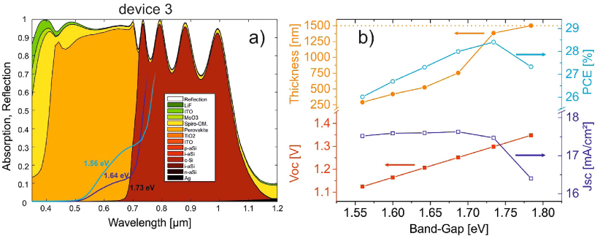
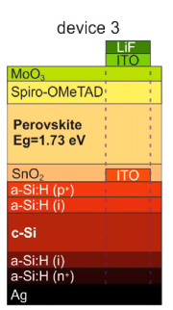
Light harvesting efficiency of absorber layer matters!
Numerical modelling of light harvested in device stack.
With MAPbI₃ (E_{g} = 1.58 eV): Efficiency of 26 % possible
29% with E_{g} = 1.73 eV & Absorber layer thickness > 1.2 μm
Albrecht et al., J. Opt. 18 (2016) 064012

Slide 11
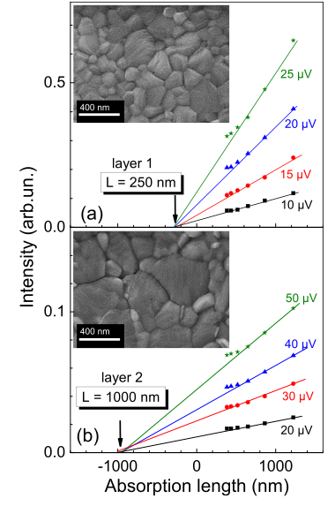
Is the Charge Carrier Diffusion Length long enough?
Diffusion length correlates with crystallite size
Recombination dominated
by surface recombination
Bulk Defects benign
“Defect tolerant material”
Optimization of growth conditions to achieve large grains with minimum bulk defects
Dittrich et al. Appl. Phys. Lett. 109, 073901 (2016)
Notes:
Both electrons and holes have been found to have high mobilities on the order of 10-30 cm² per Vs.

Slide 12
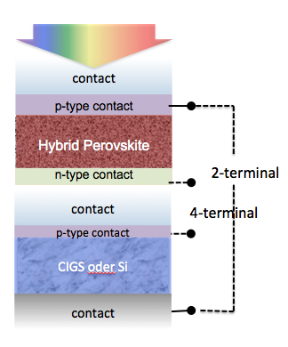
Back-of-the-envelope multi-junction performance estimation
Assumptions:
no parasitic absorption losses
bandgap tunability
100% IQE (E > E_{g})
FF of 0.8
qV_{OC} = E_{g} – 0.3 eV
1.75 eV
Analysis similar to Beiley et al., En. Env. Sci. 5 (11), 9173 (2012)

Slide 13
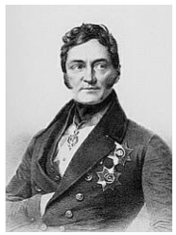
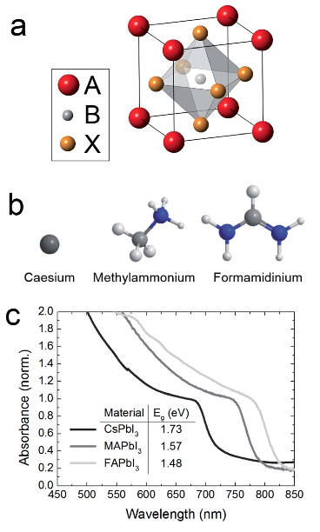
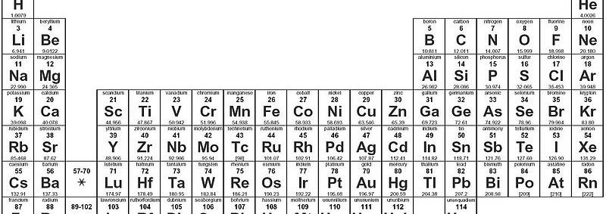
Pseudo-alkaline metal-halide perovskites
”Pseudo alkaline”
Organic cations
“Perovskite” crystal structure :
+1/+2
+2/+4
-1/-2
A B X₃
MA⁺
Si wafer
FA⁺
Lev Perovski (1839)
a₀
”Pseudo halides”
SCN⁻, CN⁻, CF₄⁻, …

Slide 14
Halide perovskites obey Goldschmidt tolerance factor
(whether stable perovskite structures can be expected)
Si wafer
Ionic radii
r_{Cs+} = 1.67 Å
r_{MA+} = 2.15 Å
r_{FA+} = 2.52 Å
r_{Pb2+} = 1.19 Å
r_{Sn2+} = 1.10 Å
r_{Cl-} = 1.81 Å
r_{Br-} = 1.96 Å
r_{I-} = 2.20 Å
a₀
Kieslich et al., Chem Sci. 2014, 5, 4712

Slide 15
Bandgap tunability
ABX₃ perovskite band gap can be tuned in broad range interesting for PV
Si wafer
a₀
Unger et al., Highlight paper to be published in J. Mater. Chem. A (2017)

Slide 16
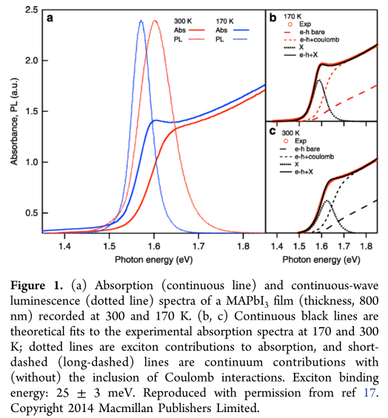
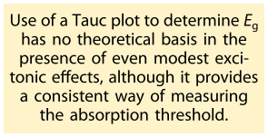
Absorption onset vs band gap
Green et al. J. Phys. Chem. Lett. (2015)
Saba et al. Acc. Chem. Res. (2016)

Slide 17
Bandgap tunability: Performance as a function of band gap
Unger et al., Highlight paper to be published in J. Mater. Chem. A (2017)

Slide 18
Bandgap tunability: Performance as a function of band gap
Progress in
materials
and device
engineering
Lower band
gap materials
?
Unger et al., Highlight paper to be published in J. Mater. Chem. A (2017)

Slide 19
Bandgap tunability: Short circuit current as a function of band gap
Unger et al., Highlight paper to be published in J. Mater. Chem. A (2017)

Slide 20
Photocurrent reaching predicted limit (no parasitic absorption losses)
Errors in area determination and/or not accounting for capacitive currents?
Unger et al., Highlight paper to be published in J. Mater. Chem. A (2017)

Slide 21
What is the reason for the drop in V_{OC} for E_{g} > 1.7 eV?
Unger et al., Highlight paper to be published in J. Mater. Chem. A (2017)

Slide 22
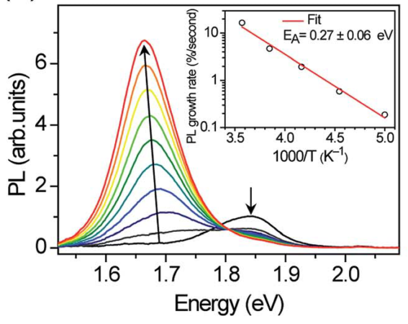
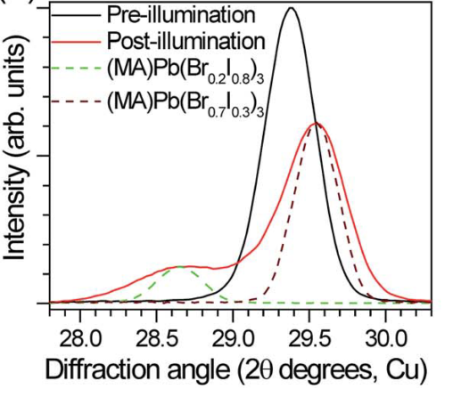
The ”Hoke”-Effect: Photo-induced phase segregation
Higher bandgap mixed Br/I perovskites MAPb(Br_{x}I_{1-x})₃:
Photo-induced phase segregation due to halide-ion migration.
Hoke et al., Chem. Sci. 6 (1), 613-617 (2014)

Slide 23
PL peak shifts upon illumination
Unger et al., Highlight paper to be published in J. Mater. Chem. A (2017)

Slide 24
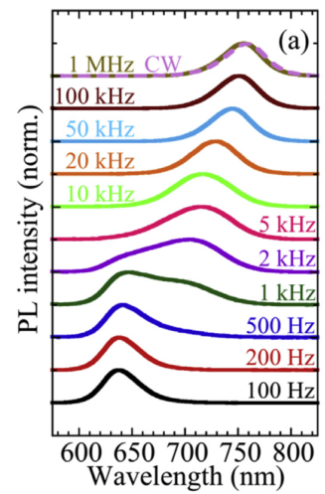
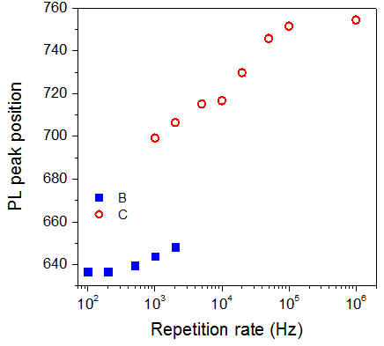
Origin for photo-induced phase segregation by ion diffusion
Phase segregation due to photo-induced polar state?
1 ms
100 μs
Low repetition rate (e.g. 1 pulse per 10 ms): NO shift in spectrum!
Yang et al. Org. Electr. 34, 79 (2016)

Slide 25
Low-energy sites introduced during preparation
Examples of samples prepared from equimolar solutions, spin-cast at 4000 rpm for 40 seconds.
Annealed at 100ºC for 15 min
UV/Vis measurements with integrating sphere equipped with in-sphere holder.
Unger et al. (manuscript in preparation), see also: Sadhanala et al., J. Phys. Chem. Lett. (2014)

Slide 26
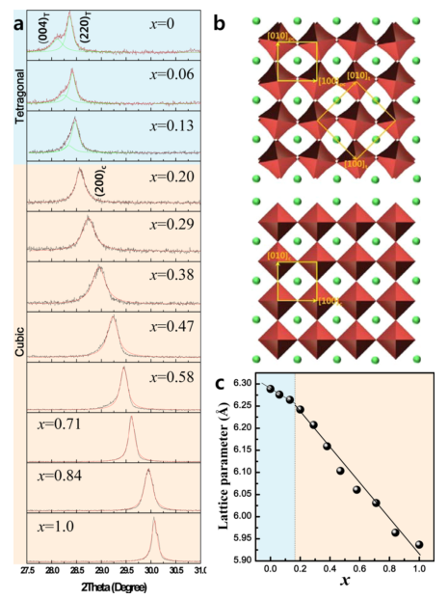
Stable phases coinciding with phase transition?
202_{t}
tetragonal
111_{c}
211_{t}
cubic
tetragonal to cubic transition
@ x ca. 0.17 (RT)
equivalent to E_{g} ca. 1.68 eV
(possibly the reason?)
Noh et al., Nano Lett. 2013, 13, 1764−1769, Sörell/Unger (experimental data)

Slide 27
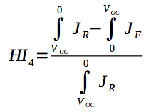

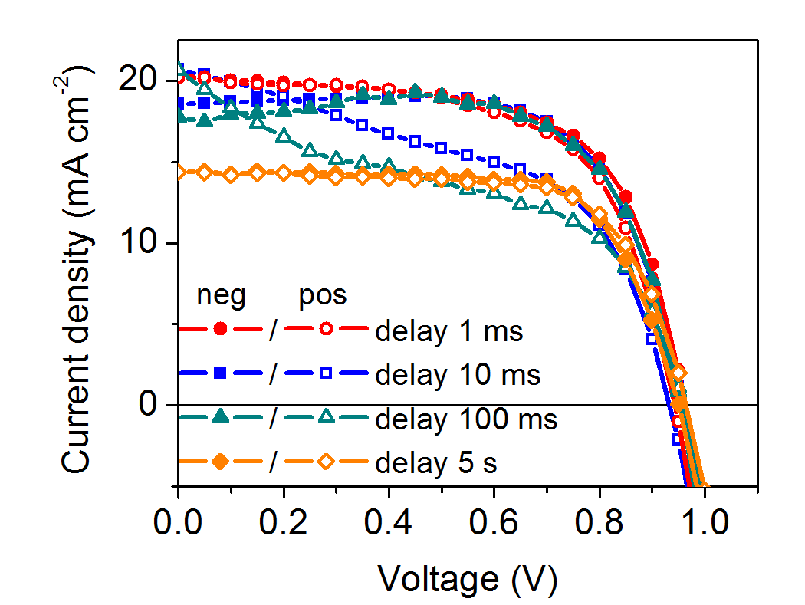
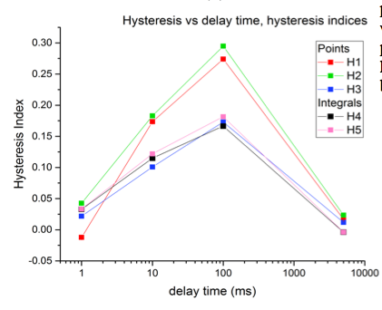
Photo-induced transient phenomena also cause hysteresis
12.3%
9.7%
Perovskite-based solar cells may exhibit congruency between forward and reverse scan for different scanning conditions at short and long delay times.
Unger et al., Energy Environ. Sci. (2014) & A. Czudek, Progress Report Nov 2016

Slide 28
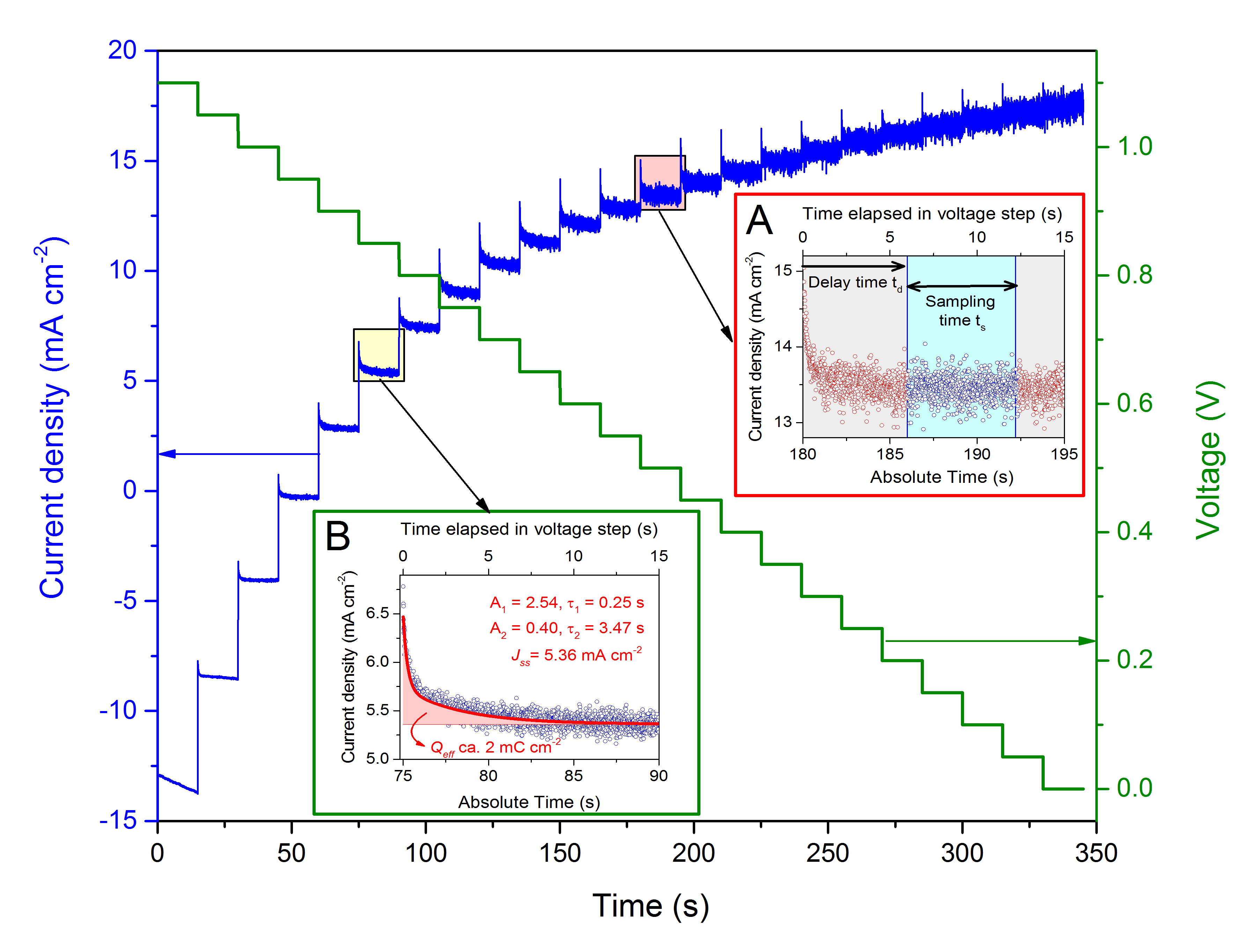
Photo-induced transient phenomena also cause hysteresis
Unger et al., Energy Environ. Sci. (2014) & Christoforo et al. Photonics (2015)

Slide 29
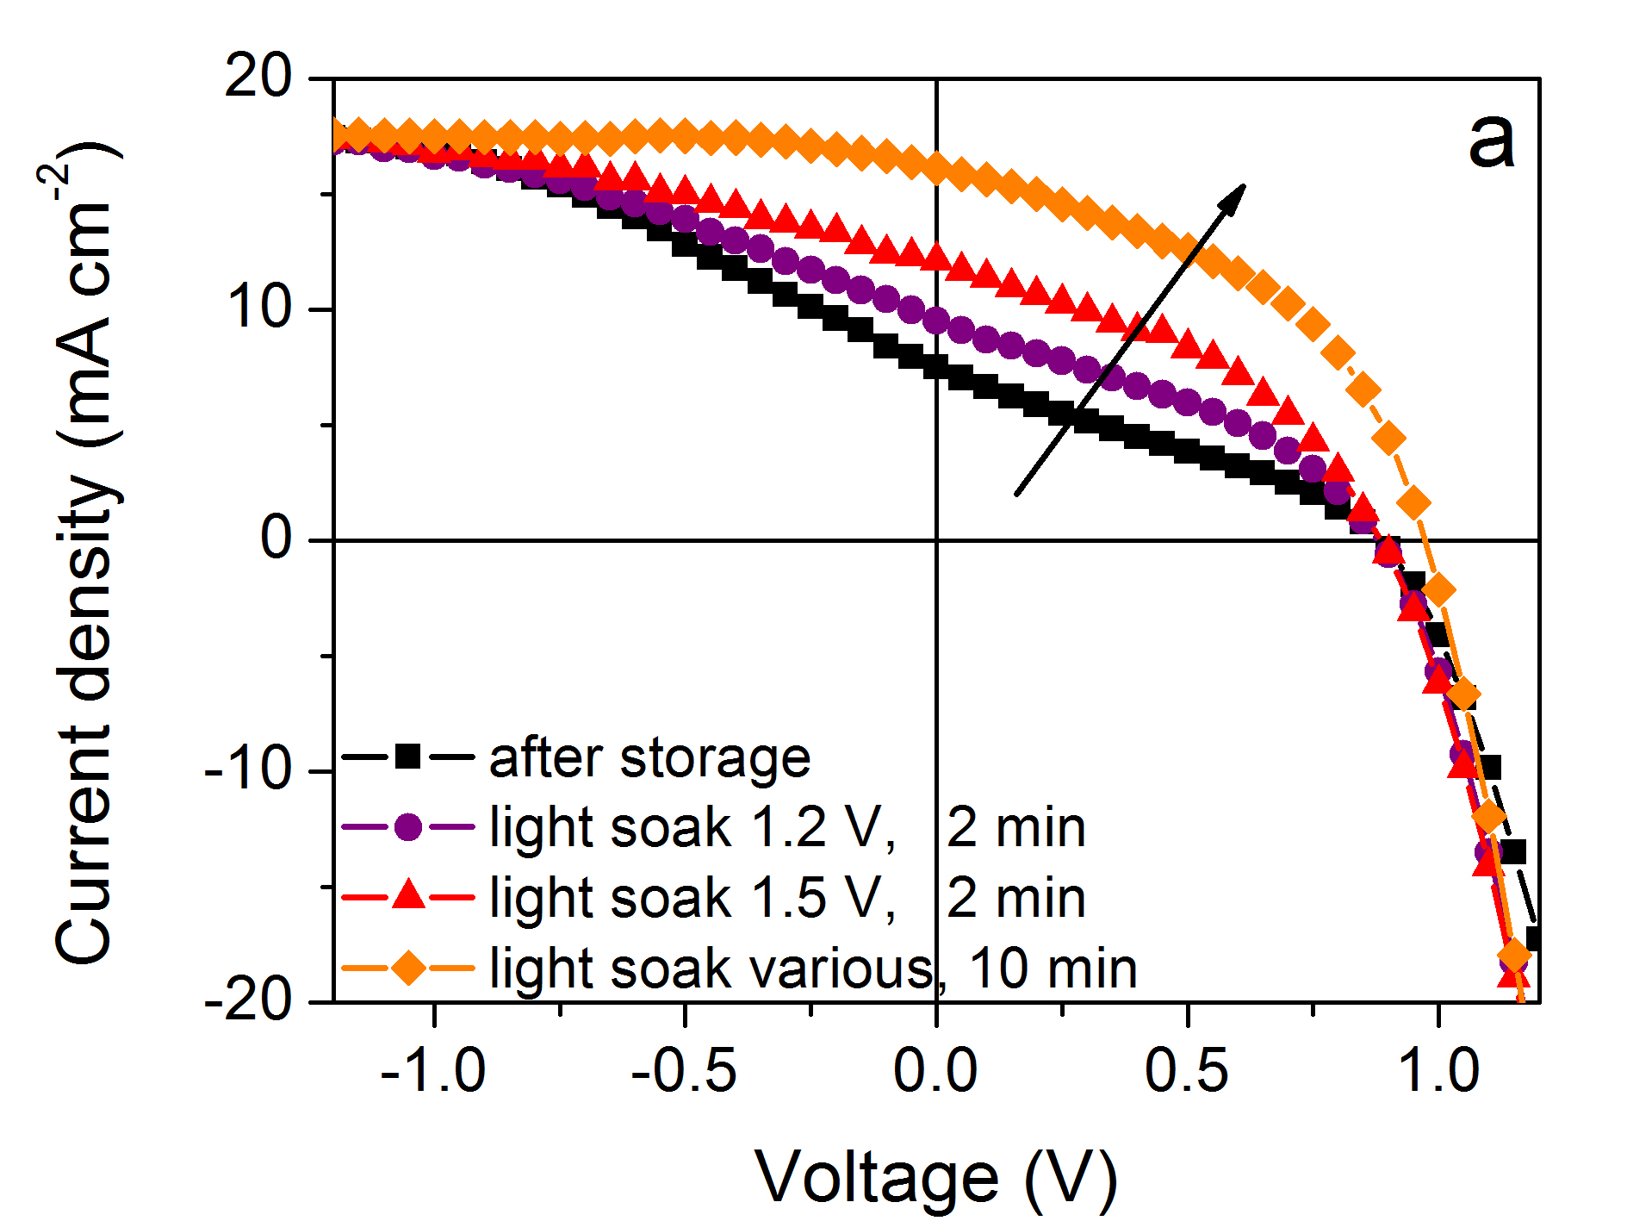
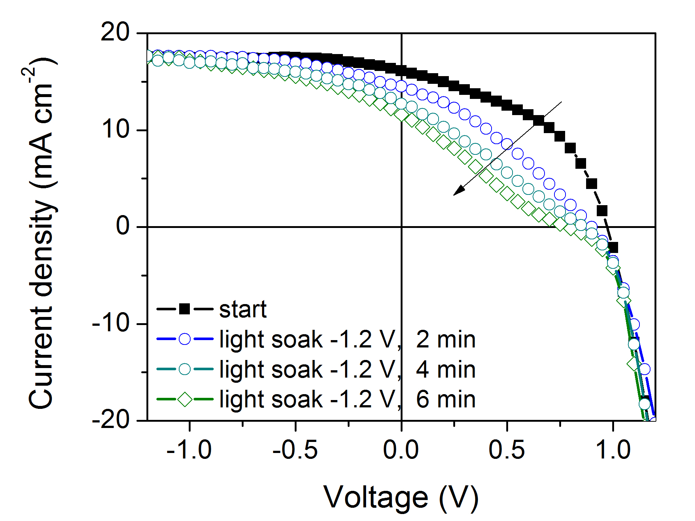
Photo-induced transient phenomena also cause hysteresis
s-shaped IV-curves may ”recover” after light soaking at forward bias
Indicates changes in electric field distribution at selective contacts.
forward bias light soak
reverse bias light soak
¹ Dualeh et al., ACS Nano 2013
Unger et al., Energy Environ. Sci. (2014)

Slide 30
Conclusions
Stable materials with bandgaps ca. 1.7 eV
GOOD NEWS FOR TANDEMS BASED ON Si
Photo-instability due to:
ionic inhomogeneity
improve synthetic methods
thermodynamic sink?
could form over time
Other alloy strategies to reach high band gaps

Slide 31







Acknowledgement
Marie Sklodowska Curie Actions,
Cofund, Project INCA 600398
Young Investigator Group starting February 2017
started Jan 2017

Slide 32



Overview:
David Sörell
(former MSc 2015)
M
”german
industrial collaborator”
Lund University
Chemical
Physics
Klara Suchan
(start Aug 2016)
D
open
D
P
open
Inks
I
Aboma Merdasa
(start Feb 2017)
YIG Hybrid Materials Formation and Scaling
P
Katrin Hirseland
(start Jan 2017)
Formation
D
open
P
Printing
M
Aniela Czudek
Band gap
tuning
Collaborators:
Institute Si-PV
T. Unold
T. Dittrich (SPV)
A. Abate (Stability)
S. Albrecht (Tandems)
M. Bär (PES)
D. Abou-Ras (EM)
D
Carolin
Rehermann
(start April 2017)
collaboration with WIS

Slide 33
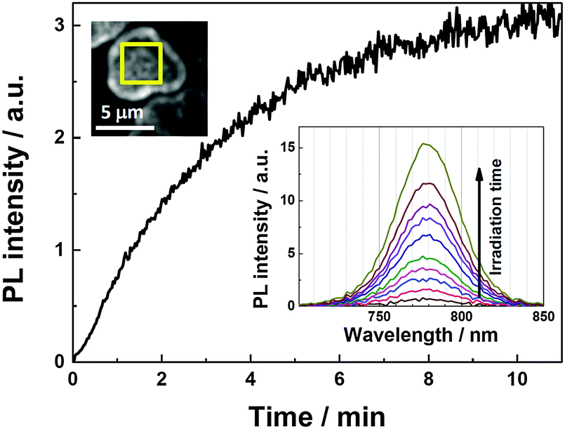
Other phenomena in ABX₃ perovskite upon light soaking
Photoluminescence enhancement in MAPbI₃ during light soaking.
Tian et al., Phys. Chem. Chem. Phys.,17, 24978 (2015)

Slide 34
Different growth mechanisms rationalize difference in ionic homogeneity

Slide 35
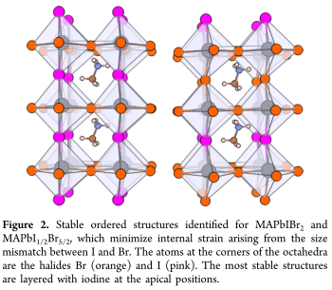
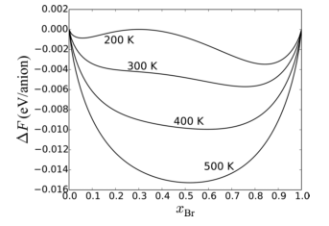
Hypothesis #2: Free Energy Minimum?
Brivio/Walsh suggest existance of local energetic minimum from theoretical calculations.
Possibly the reason. Are there preferential phases during growth?
Brivio et al., J. Phys. Chem Lett. 2016

Slide 36
Light drives to thermodynamically stable phase-segregated state?
Sörell/Unger (experimental data)

Slide 37
Light induced changes in X-ray diffractograms
low energy phase?
Sörell/Unger (experimental data)

Slide 38
Understanding Formation: MAPb(Br_{0.6}I_{0.4})₃
Br-rich
MAPb(Br_{x}I_{1-x})₃
phase
Heat drives ion homogenization
I-rich
MAPb(Br_{x}I_{1-x})₃
phase
Br-rich
MAPb(Br_{x}I_{1-x})₃
precursor?
Unger et al. (manuscript in preparation)

Slide 39
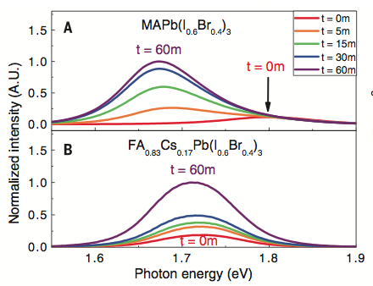
Photo-induced trap state formation in FA/Cs compounds
”Stable compounds” FA_{0.83}Cs_{0.17}Pb(I_{0.6}Br_{0.4})₃?
ca. 1.7 eV
additional data from McMeekin et al. Science 2016

Slide 40
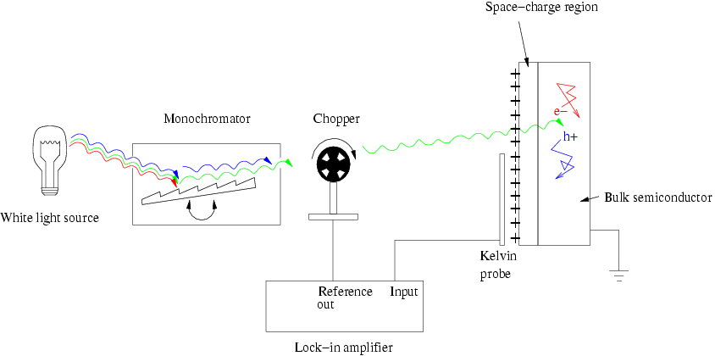
Surface photovoltage
SPV monitors the surface potential at a semiconductor surface due to generating electron-hole pairs as a response to illumination

