Slide 1
Fusion Research
Recent Progress and Perspectives
Tony Donné
Programme Manager EUROfusion
DPG | Münster | 27 March 2017

Slide 2
Contents
Introduction
  What is fusion?
  Why do we want it?
  How can we do it on Earth?
European Fusion Roadmap
  Overview
  8 missions (challenges)
Conclusion

Slide 3
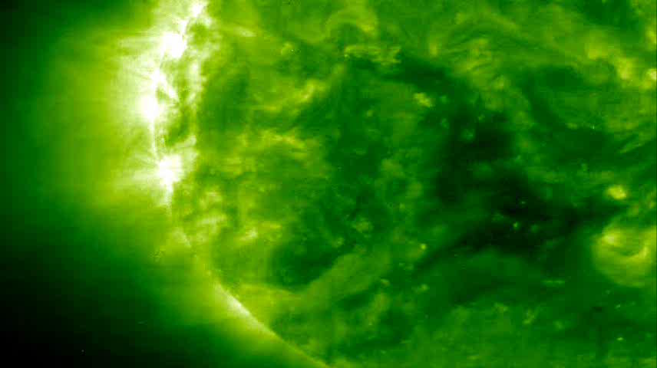
Fusion: the engine of the sun
Source: NASA
Notes:
3

Slide 4
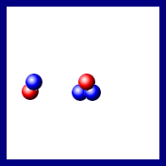
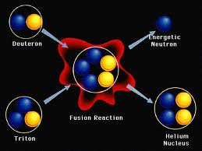
Nuclear Fusion
deuterium + tritium → helium + neutron

Slide 5
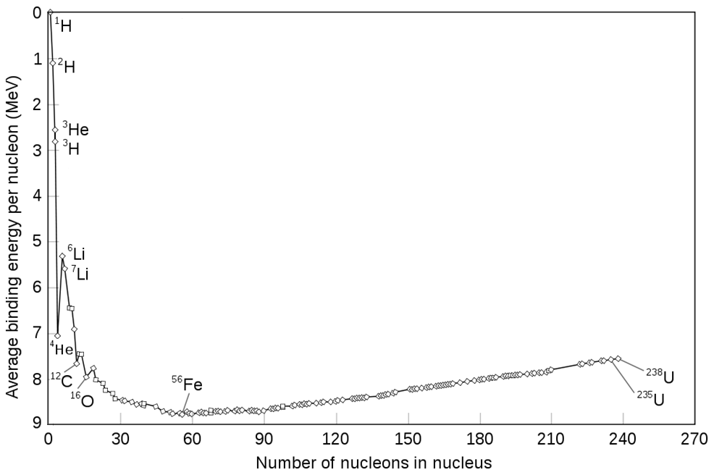
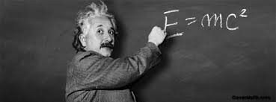
E = mc²
Fusion
Fission

Slide 6
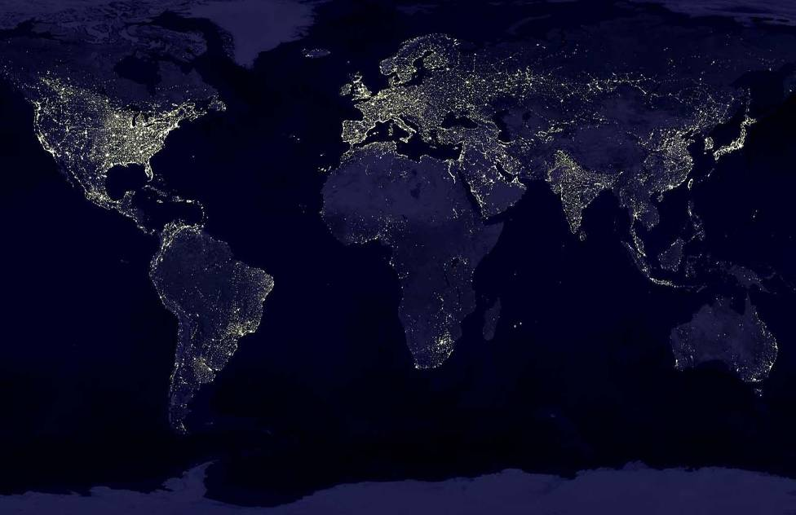
Europe, USA, Japan, China, Russia, S-Korea and India
want fusion:
No CO₂ release, clean, safe
Fuel abundantly available
No proliferation issues
But... Fusion is impossible
Source: NASA
NASA
Notes:
6
Energie is niet eerlijk verdeeld op de wereld. Dit is een nachtkaart van de wereld, meteen een kaart van energiegebruik.
Wat is het verschil tussen de lichte en de donkere gebieden? Juist! Alle verlichte gebieden zijn geindustrialiseerd en druk bevolkt.
Op de donkere plekken wonen ook enorm veel mensen – in China al drie keer zoveel als in West-Europa. Maar die mensen hebben per persoon veel minder energie tot hun beschikking. En je ziet: waar veel energie is, is het leven prettig. Natuurlijk willen we dat gelijktrekken, maar dat gaat niet zomaar.

Slide 7
Europe, USA, Japan, China, Russia, S-Korea and India
want fusion:
No CO₂ release, clean, safe
Fuel abundantly available
No proliferation issues
But... Fusion is difficult
Source: NASA
NASA
Notes:
7
Energie is niet eerlijk verdeeld op de wereld. Dit is een nachtkaart van de wereld, meteen een kaart van energiegebruik.
Wat is het verschil tussen de lichte en de donkere gebieden? Juist! Alle verlichte gebieden zijn geindustrialiseerd en druk bevolkt.
Op de donkere plekken wonen ook enorm veel mensen – in China al drie keer zoveel als in West-Europa. Maar die mensen hebben per persoon veel minder energie tot hun beschikking. En je ziet: waar veel energie is, is het leven prettig. Natuurlijk willen we dat gelijktrekken, maar dat gaat niet zomaar.

Slide 8
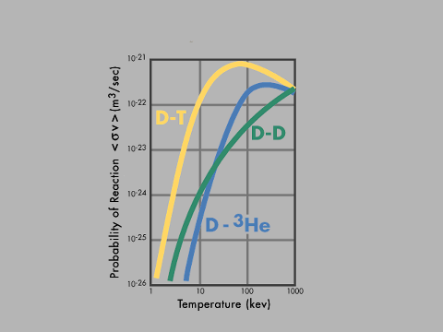
brandstof: waterstof
temperature: ~150 million°C
the D and T nuclei
that need to fuse
repel each other
Notes:
Uitweiden over hoge temperatuur.
Plasma! Inderdaad: zonnegas.
Op aarde: bliksem, noorderlicht
Demo’s.
Luchtplasma + magneet
Tol
Filamentenbol
TL buis

Slide 9
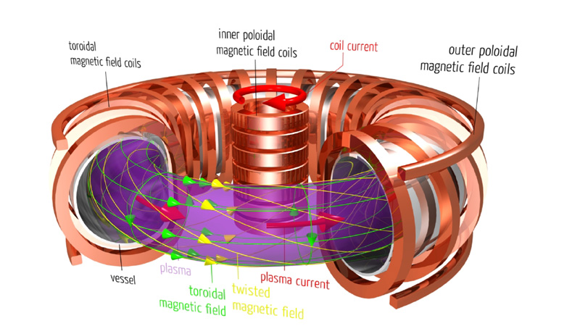
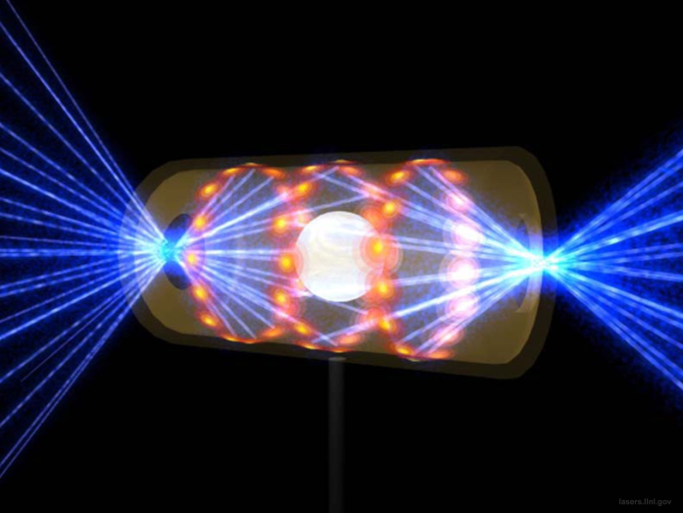
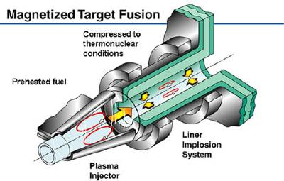
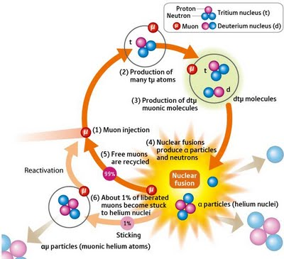

Forms of fusion
Magnetic Confinement
Inertial Confinement
Magnetised Plasma Compression
Con-fusion
Muon-catalysed

Slide 10
Magnetic Confinement Fusion - Tokamak
In the tokamak the hot plasma (=charged particles) is confined by a superposition of two fields:
the toroidal field generated by coils around the plasma vessel and
the poloidal field generated by running a current through the plasma.
The tokamak is operated like a transformer and is a pulsed device

Slide 11
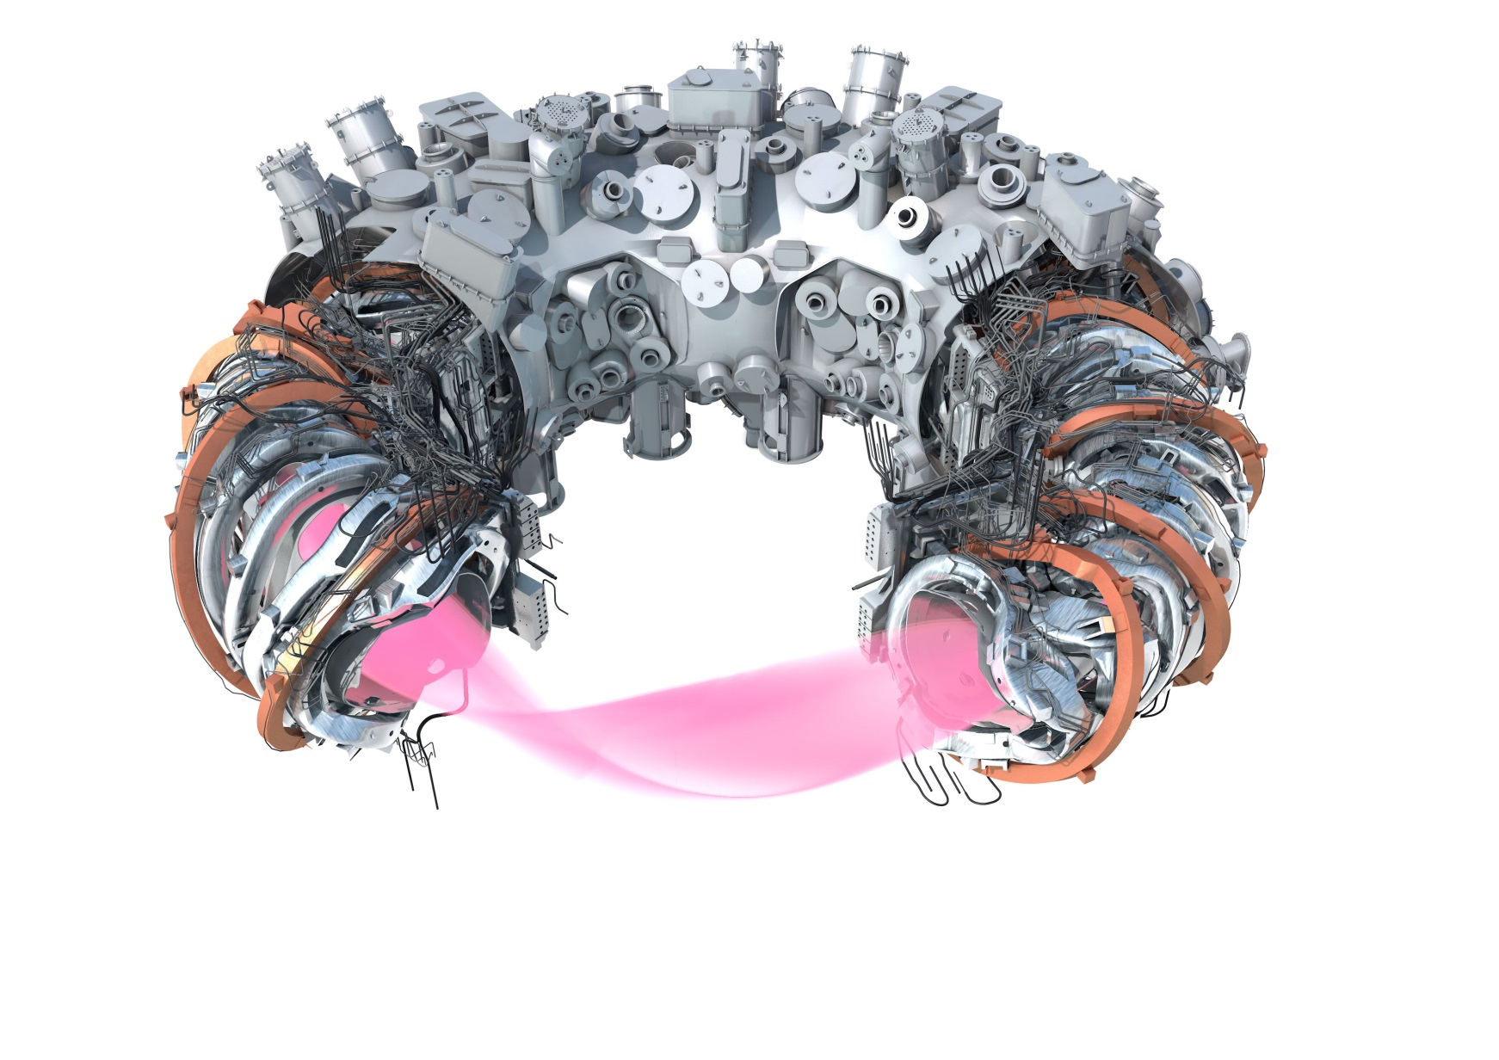
Magnetic Confinement Fusion - Stellarator
In the stellarator the hot plasma (=charged particles) is confined magnetic fields that are completely generated by external coils.
The stellarator is current-less and is in principle steady state. The plasma is also less prone to instabilities. Technically the stellarator is much more complicated than the tokamak.

Slide 12
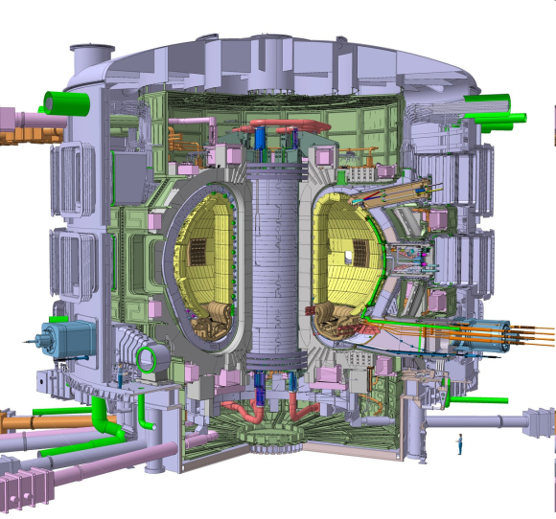
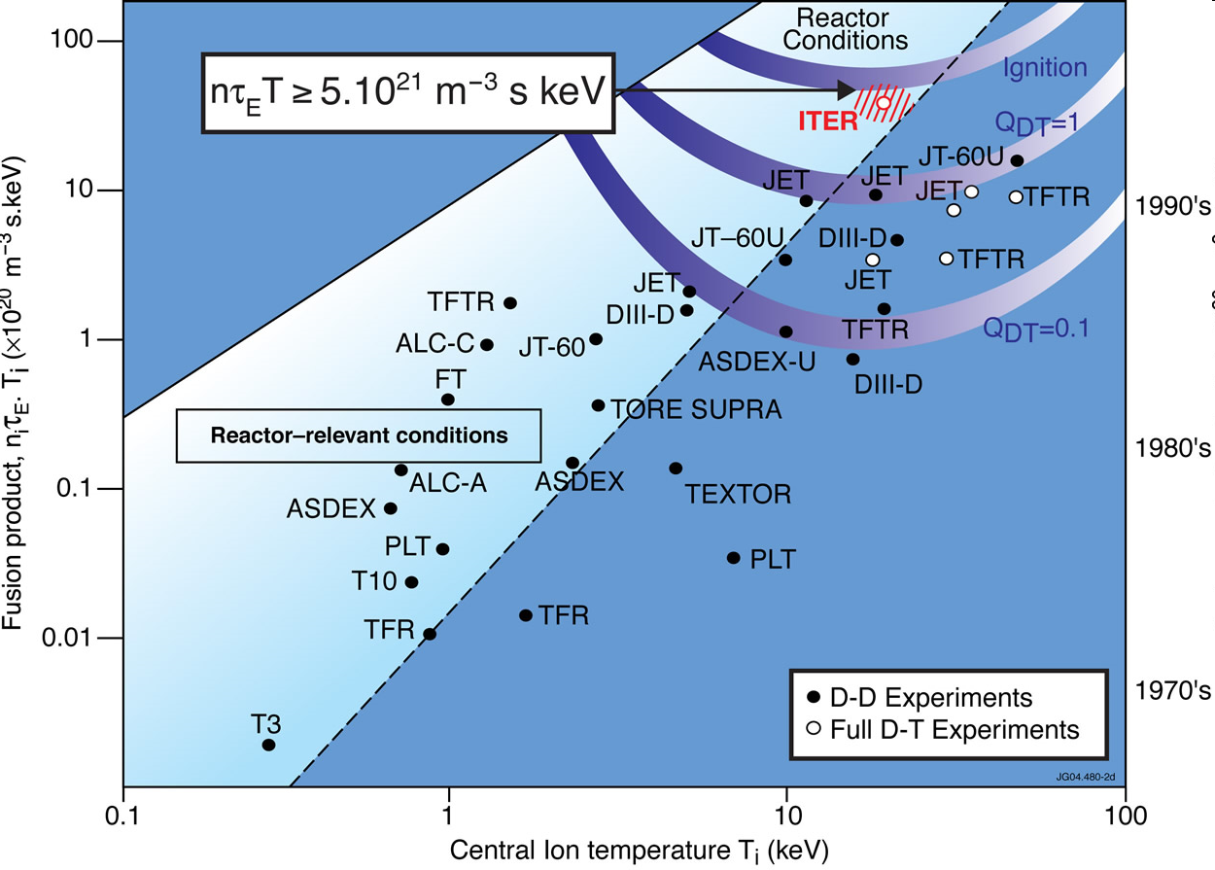
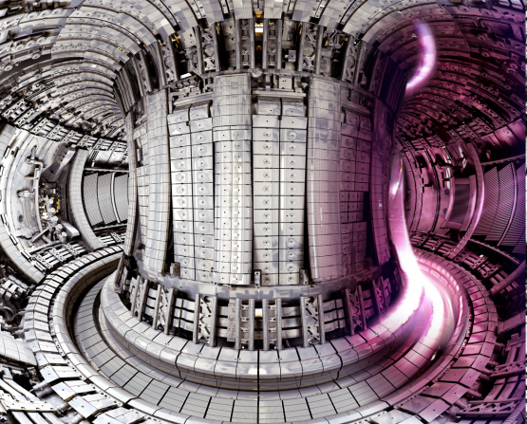
Progress in fusion
ITER
Nett power gain:
P_{fusion} = 10 × P_{in}
Demonstration of technical principles – new regime
JET (and other machines) Break-even:
P_{fusion} = P_{in}
Emphasis on understanding the science

Slide 13
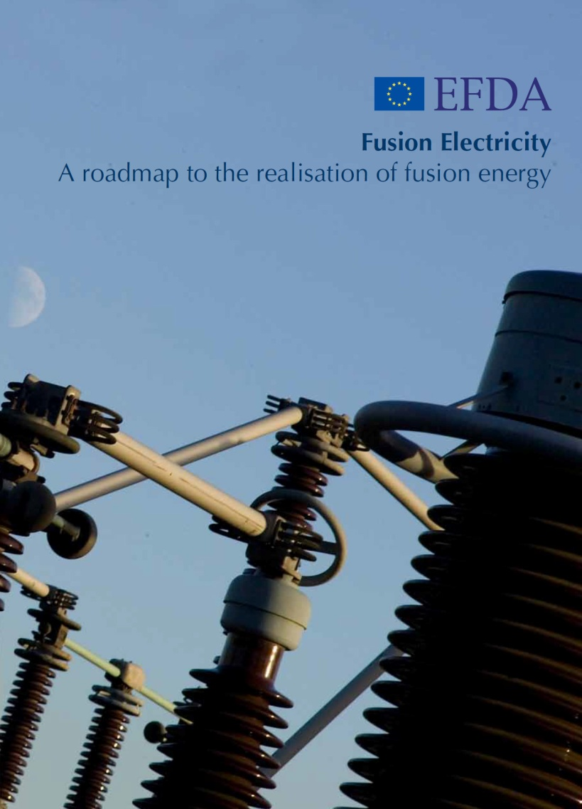
Fusion Roadmap
Mission statement
  Demonstrate fusion electricity production by the middle of the century
A key document
  Founded on technical assessment reports (existing and new)
  Provides coherent EU programme with clear goal and indicative dates
  Avoids open-ended R&D
Importance
  The ‚Bible‘ for EUROfusion (all work funded is fully aligned with Roadmap)

Slide 14
Fusion Roadmap
Eight important missions
  For each mission:
    overview present status
    list of unresolved and urgent issues
    research & development plan
    estimation of required resources
Three periods
  Short Term
  (Building ITER & Supporting Experiments)
  Medium Term
  (Exploiting ITER and Designing DEMO
  Long Term (Building and Exploiting DEMO)
Important to gradually intensify the involvement of industry
http://www.euro-fusion.org/

Slide 15
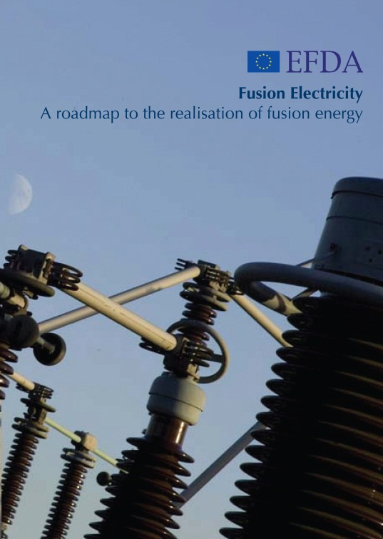
Eight missions
Plasma Regimes of Operation
Stellarator
Heat-Exhaust Systems
8
1
2
Competitive cost of Electricity
7
3
Neutron Resistant Materials
6
4
5
Integrated DEMO design and system development
Tritium Self-Sufficiency
Implementation of Intrinsic Safety Features of Fusion

Slide 16
Input from research on present facilities, analysis and modelling
High level milestone
Science & Technology Basis for first FPPs
ITER
First plasma
Full performance
Consistent
Concept
EU-DEMO
Commence
Construction
Electricity
Production
Pre conceptual design
Conceptual design
Engineering design
Target: third quarter of the century
Materials
DONES
IFMIF
Concept improvements and innovations → Lower cost
Back-up strategy: Stellarator
Stellarator viable
for an FPP?
Short term
Medium term
Long term

Slide 17
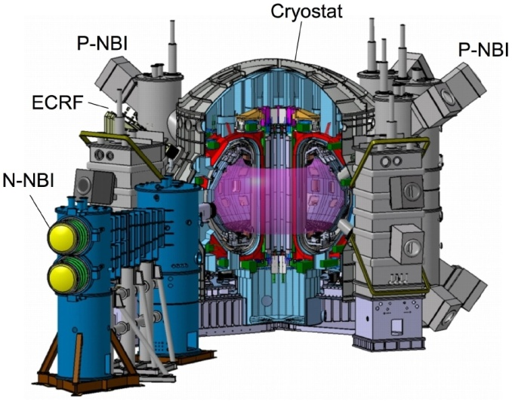
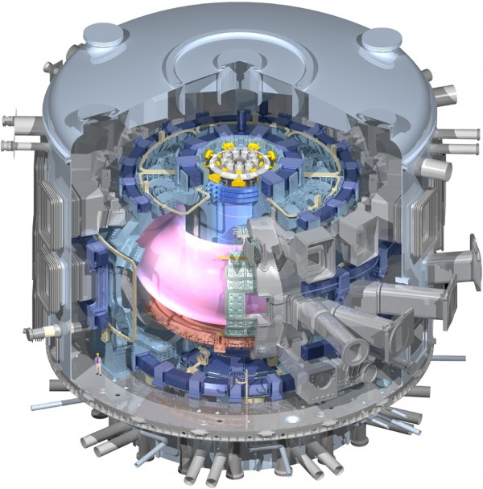
Mission 1: Plasma regimes of operation
Demonstrate and qualify regimes that meet the needs of ITER and DEMO
High fusion performance with metallic PFCs by improving transport and by controlling MHD instabilities.
Acceptable power depositions in the W divertor, radiate as much as possible power while keeping high performance
Develop integrated scenarios with controllers (MHD, detached divertor, dilution…)
Try to achieve steady state conditions
Preparation on existing devices: JET, Medium Sized Tokamaks, JT-60SA
+ other international collaborations

Slide 18
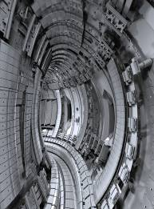
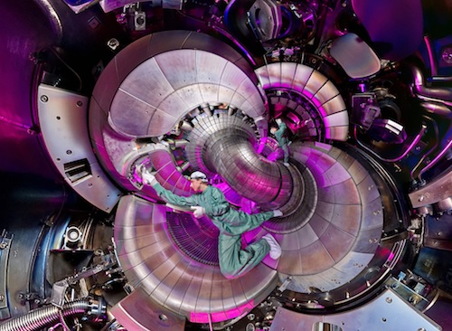
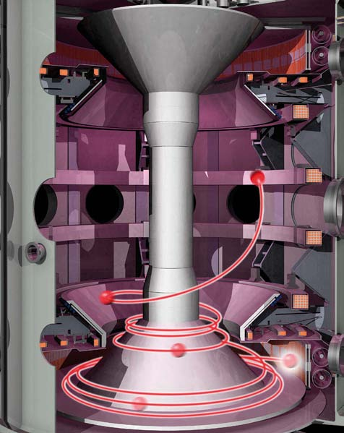
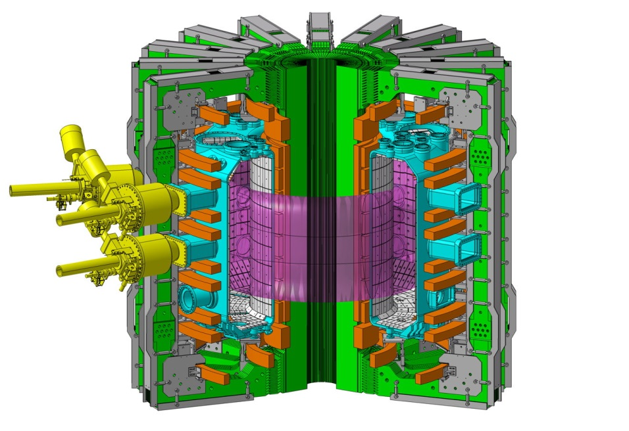

Mission 1: JET and Medium-Size Tokamaks
JET, UK
ASDEX Upgrade, Munich, DE
JT-60SA, JA
(Start in 2020)
TCV, CH
ITER
(Our target device)
MAST Upgrade, UK
(Start in 2017)

Slide 19


JET
Notes:
19

Slide 20
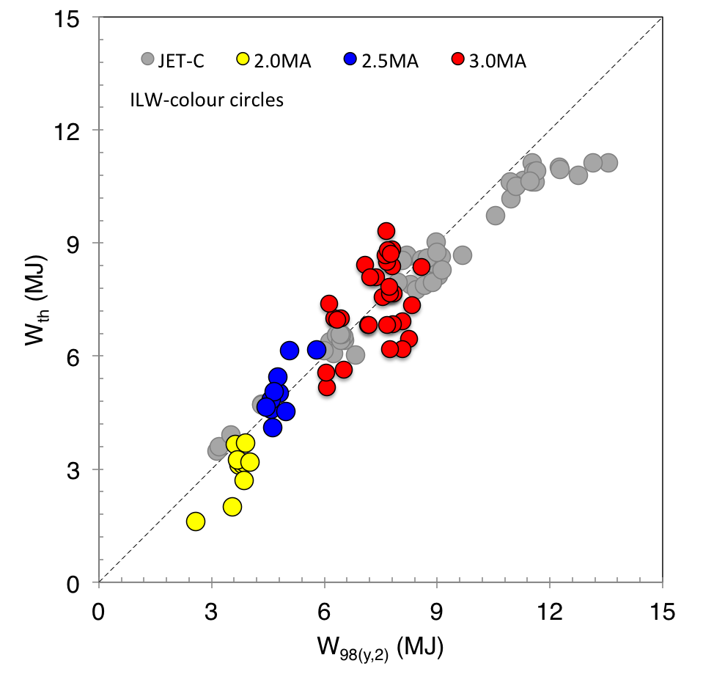
Latest progress:
ITER Baseline Operation at ~30MW 3MA/2.7T
3MA ILW
(2016)
2018/19
Objective
[Nunes 2016]

Slide 21
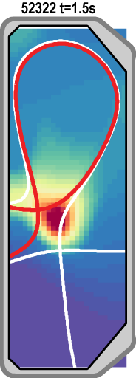
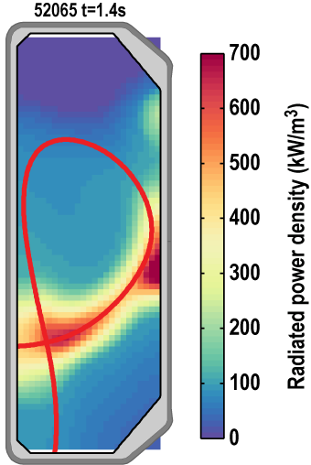
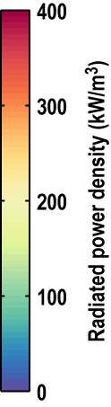

TCV Snowflake divertor experiments confirm predicted radiation trapping in N seeded discharges
Edge fluid modelling suggested N radiation will be trapped between primary and secondary X-point in SF⁻.
Radiation trapped away from core plasma.
Trapping observed in experiment.
SF⁻
LSN
T. Lunt, PPCF 2015
H. Reimerdes, IAEA FEC 2016
Notes:
Advanced divertor configurations may be needed to survive the heat loads on DEMO.
TCV has and MAST-U will have unique capabilities to study this worldwide.
Radiation is needed to reduce the power to the targets, but close to the plasma core can be detrimental.
3D edge fluid modelling predicted the trapping of impurities in between the primary and secondary X-point in a snowflake configuration with the secondary X-point in the low field side SOL (SF-).
This has now been validated experimentally.

Slide 22
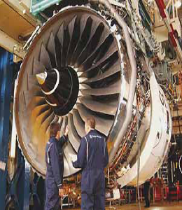
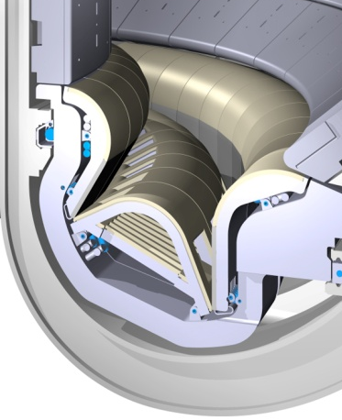
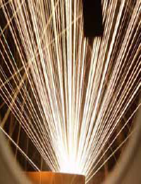
Mission 2: Materials one can lay on the sun
Rolls Royce Trent 900
ITER steady-state
ITER transients
~1 <10 85 2000
Power load [MW/m²]
HWR
Ariane 5/Vulcain 2
Re-entry vehicle

Slide 23
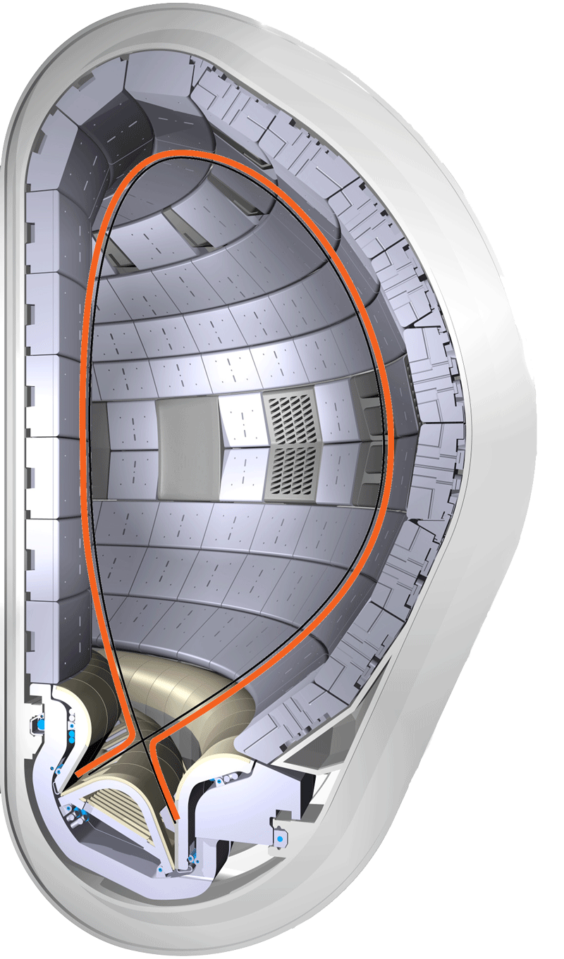

20mm
Scrape-off layer ~ 2 cm thick
Power density 1 GW/m²
Notes:
23

Slide 24
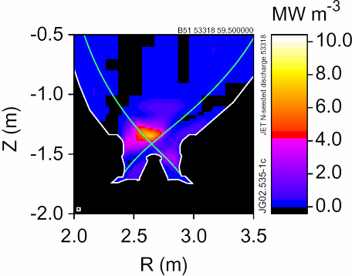
How to reduce the power loads of 1 GW/m²
Proper choice of the divertor geometry
Radiate >90% of the power away (uniform distribution)
Decouple (detach) the plasma from the divertor (T<10 eV)
JET
Notes:
24

Slide 25
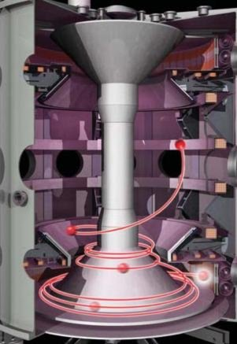
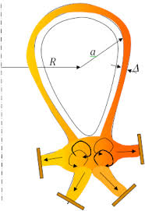


Heat Exhaust Research in Tokamaks
Research in alternative divertor solutions
(Super-X, snowflake, liquid metal divertors)
Research in order to understand detached divertor conditions

Slide 26
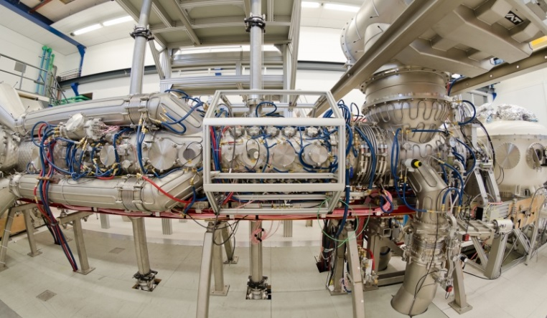
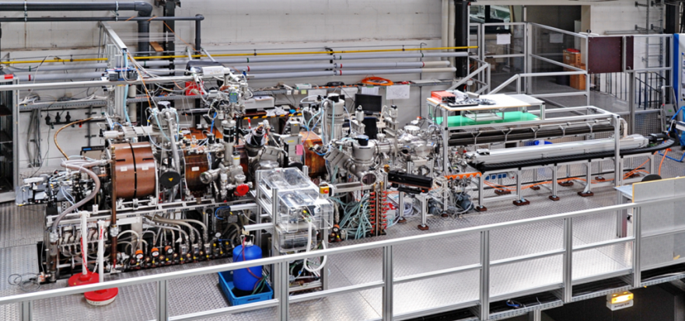
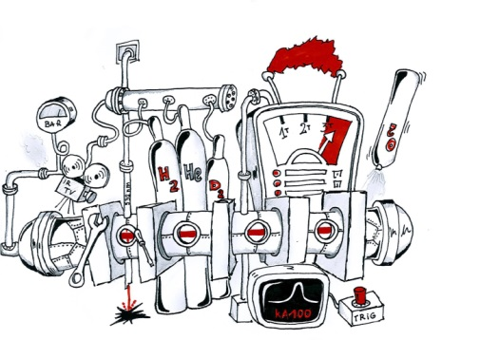


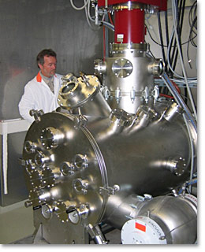
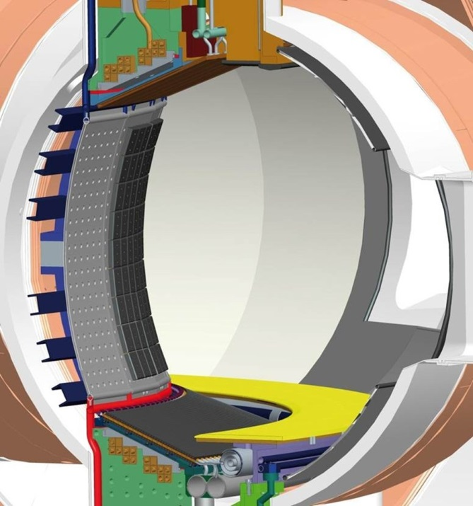

Studying Plasma Facing Components
Magnum-PSI
Pilot-PSI
PSI-2
JUDITH-1/2
WEST

Slide 27
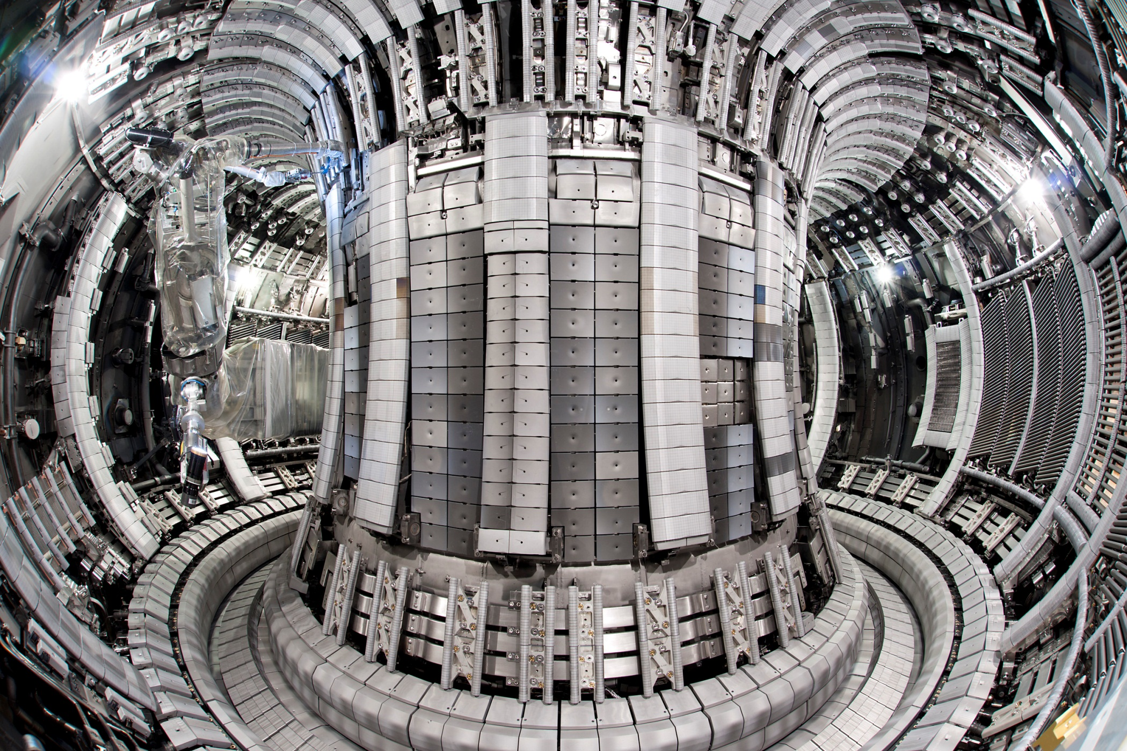
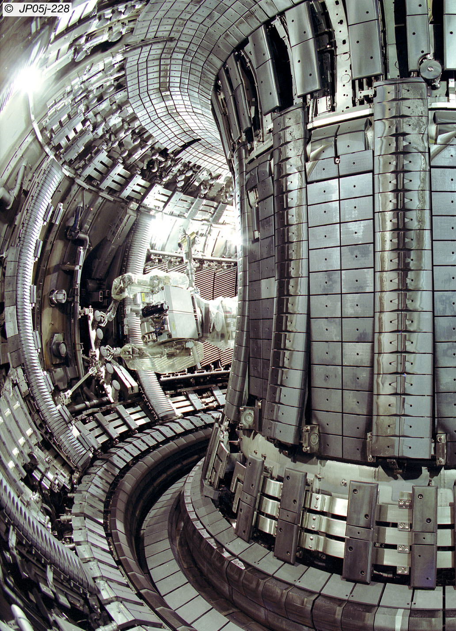
The Change of the JET Wall
JET-C
until October 2009
JET-ITER-Like Wall
since May 2011
Be
Be
Carbon
CFC
Be
on
Inconel
Be
on
Inconel
Carbon
CFC
W
W

Slide 28
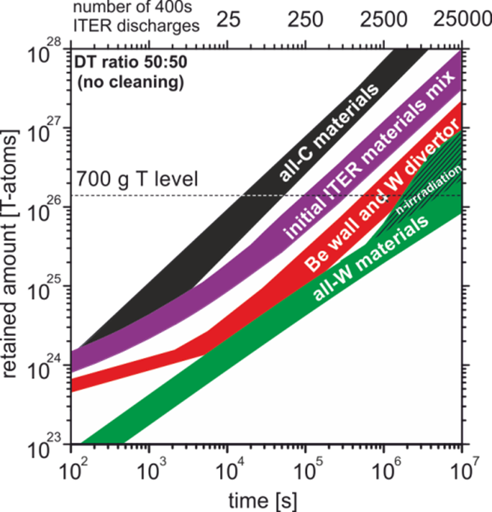
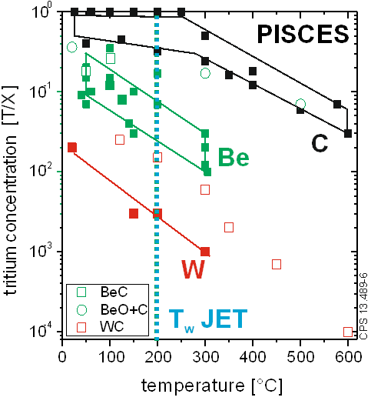
Why not Continue to Operate with a Carbon First Wall?
DT experiment in JET revealed unacceptable safety conditions for ITER or a reactor:
tritium retention of 20% due to co-deposition in divertor [P. Andrew. et al JNM 1999]
multistep transport of carbon to inaccessible/remote areas of the divertor => dust
S. Brezinsek et al.
NF 2013
J. Roth et al.
JNM 2009
Impossible to breed enough
T in a reactor with C walls
to compensate for loss in co-deposits!

Slide 29
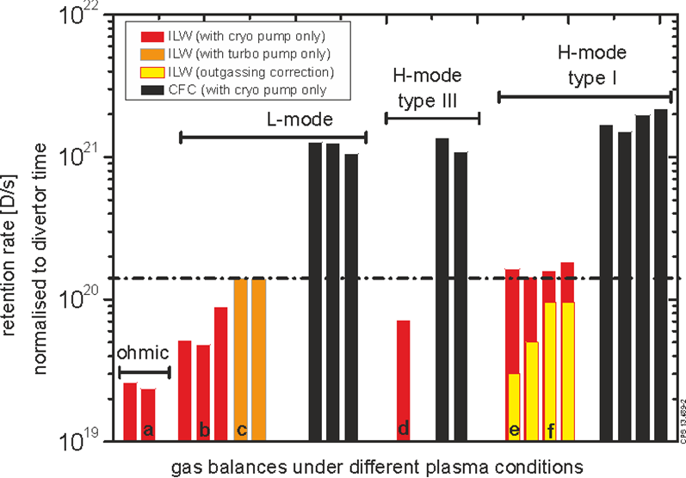
Fuel Retention in JET-ILW vs. JET-C
Strong reduction od retention rate by more than one order of magnitude with JET-ILW
The deposition pattern and the absolute value of the retention have been reproduced by WallDYN & ERO simulations, providing a benchmark for ITER predictions
S. Brezinsek NF 2013
K. Schmid NF 2015
Long-term retention mechanism:
implantation (1/3) and co-deposition (2/3)
deuterium outgassing important
Fuel retention limit in ITER
with Be+W walls:
3000-20000 discharges
Notes:
Key results on T retention

Slide 30
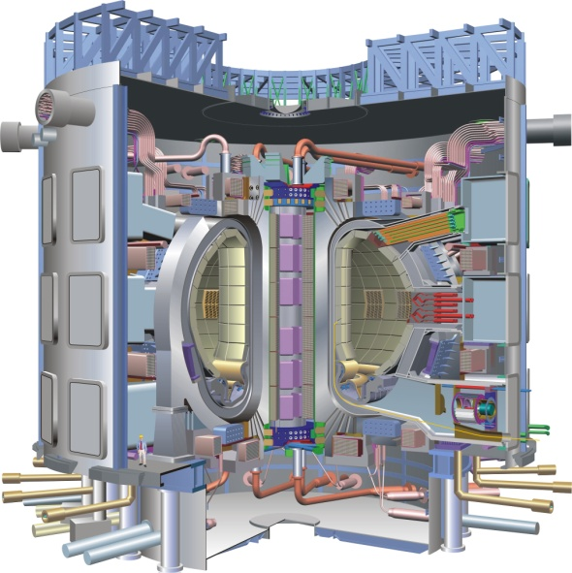
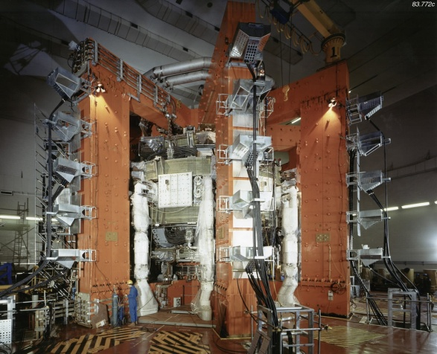
Mission 3: Materials for the fusion reactor
JET ITER DEMO
50 times higher ion fluxes
5000 times higher ion fluence
up to 5 times higher ion fluence
10⁴ times higher neutron fluence
100 times higher neutron fluence

Slide 31
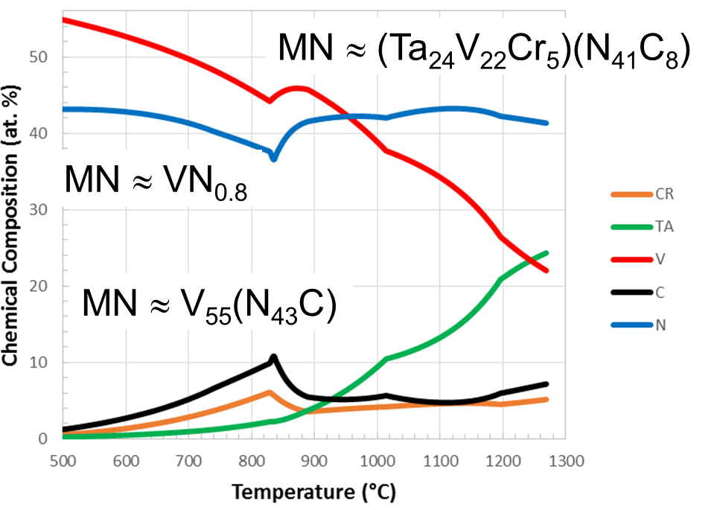
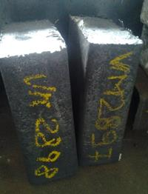
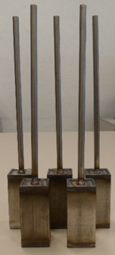
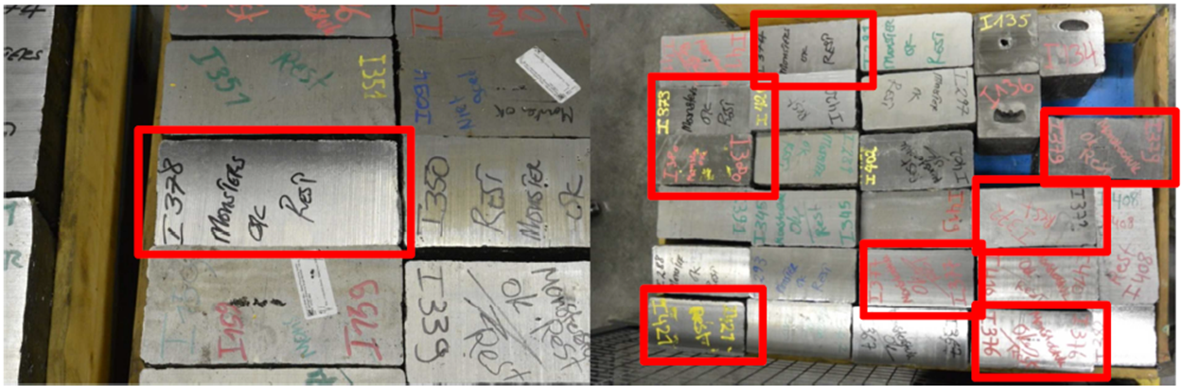
Advanced Steels: High Temp. Applications
Steel development based on thermodynamic calculations
→ low temperature steel: two 80 kg batches produced
high temperature steel: nine 80 kg batches produced, four 100 kg batches in production
alternative ODS steel production: 23 lab-scale batches produced (250 – 550 g each)
M. Rieth (KIT) and WPMAT Team

Slide 32



Advanced Steels: High Temp. Applications
Adjustment of EUROFER properties by varying heat treatment temperatures
  Austenitisation: 980 °C – 1150 °C
  Tempering: 700 °C – 760 °C
Very successful
Charpy Properties
Tensile Strength
Creep Strength
J. Henry, CEA
  13 new heats ready, 9 under investigation

Slide 33





Achievements – High Heat Flux Materials
Mass production of W parts
and W alloys development
W Alloys Development
S. Antusch, KIT
Monoblocks with various shapes
Langmuir probes for WEST
Samples for ASDEX Upgrade

Slide 34



Achievements – High Heat Flux Materials
Appl. 1: divertor heat sink
W-Cu laminated pipe
length up to 1000 mm
J. Reiser, KIT
Appl. 2: Interface
W
CuCrZr
Notes:
Pipes wrapped from foils to increase operation temperature

Slide 35





Achievements – High Heat Flux Materials
Cu-W(fiber) composite tubes
W-W(fiber) composite
ErO_{x}
ZrO_{x}
ErO_{x}/W
ZrO_{x}/W
J. Riesch, J.-H. You, IPP
J.W. Coenen, FZJ
Fracture Mechanics
V. Nikolic, ÖAW
A. v. Müller, J.-H. You, IPP
Notes:
Multi-layer braiding – woven W fibre ; stick in mold and then cast it with CuCrZr -> high reinforced Cy pipe for higher temperatures

Slide 36



IFMIF - International Fusion Materials Irradiation Facility
creep testing
Notes:
36

Slide 37


Mission 4: Tritium cycle & tritium self-sufficiency
Available T inventory
    ~112kg T/year for 500MWe reactor
    Efficient breeding & extraction
    DEMO MUST produce its own tritium

Slide 38

ITER Test Blanket Module
Plasma
Pb-17Li inlet
Tritium must be used at least 1000 × without being lossed
(each fusion reaction in the plasma must lead to creation of a new tritium atom in the blanket)
Pb-17Li outlet
First wall
Notes:
38

Slide 39






Breeding Blanket Design
The Breeding Blanket (BB) concept considered in PPPT have been adapted (e.g. HCPB and DCLL in the figure) at the current DEMO configuration.
Neutronics, thermo-hydraulics and structural-mechanics performance were evaluated. Issues were identified in TBR and coolant performances.
New design features have been evaluated and performances increased
HCPB BB
DCLL BB
L. Boccaccini (KIT) and WPBB Team

Slide 40
Mission 5: Safety
DEMO will be a full blown nuclear device
Safety is an extremely important issue and needs to be taken aboard already in the earliest design phases

Slide 41
Mission 6: Integrated DEMO Deisgn
Plasma Control
Plasma Heating
Fuelling
System-of-systems (SoS):
A set or arrangement of interdependent systems that are related or connected to provide a given capability.
The loss of any part of the system will degrade performance capabilities of the whole.
Optimising individual systems does not lead to overall optima.
Exhibits emergent behaviour not otherwise achievable by the Constituent Systems.
The complexity of dependencies between systems increases significantly once we move to their physical embodiments.
Site Services
Exhaust
Current Drive
Waste Mngmt
Vacuum
Plasma
Maintenance
Heat* Extraction
Plasma Confinement
Plasma Facing
PIS
1st Confinement
Tritium Breeding*
Shielding
Power* Generation
Cryocontrol
2nd Confinement

Slide 42
Costs of change to a system
[Source: INCOSE UK, Z3, Issue 3, March 2009]
Freezing of design options should be done in a very careful way – changing a design at too late a stage increases the costs

Slide 43





Mission 7: Lower the costs of fusion electricity
High temperature superconductors (HTS)
► Several HTS Tapes tested & irradiated
comparative approach led to survey technology
► Development of simulation models
Electro-mechanical
Electromagnetic
► Manufacture and tests of 2 cable concepts
Development of optimal samples design
2 samples manufacture
Good performances
at T=4.2 K &
high fields
RACC cable
CORCcable
L. Zani (CEA) and WPMAG Team

Slide 44



Mission 7: Lower the costs of fusion electricity
Remote Maintenance
MMS Transporter
Transport Casks
Revaluation of the in-vessel remote maintenance:
  Improve flexibility allows for more cooling systems and access for diagnostics H&CD.
  Independent blanket and divertor maintenance
  Improved maintenance durations
  Near vertical lifts for blankets increase robustness of remote handling equipment
  Includes a neutron shield plug
  Independent port closure plate
  No in-vessel mover
  ITER-like cask transportation
  Improved unplanned single blanket maintenance
MMS Blanket
Attachment
Neutron Shield
A. Loving (CCFE) and WPRM Team

Slide 45


Mission 7: Lower the costs of fusion electricity
Remote maintenance
75% of blanket and divertor cassette maintenance duration is attributed to removal and installation of services
Technology evaluation shows Laser to be favourable for in-bore cutting and welding
Laser welding trials using P91 as a substitute for Eurofer have been undertaken
Diffused laser has potential to provide extra heat input and can be used for post weld heat treatment
A. Loving (CCFE) and WPRM Team

Slide 46



Mission 8 : Bring the stellarator line to maturity
Bring stellarator to maturity as a possible long-term alternative to tokamaks, EU programme focuses on the Helical Axis Advanced Stellarator, HELIAS, line
For 2014-2020 : main priority scientific exploitation of the W7-X including theory development & modelling
Impact on the progress of the basic understanding of plasma physics in support of Mission 1 and 2 and in support of the ITER preparation

Slide 47



First Plasma in W7-X (Greifswald)
Experimental demonstration
of closed flux surfaces
Wendelstein 7-X
Max-Planck-Institut für Plasmaphysik
Greifswald (Germany)
First plasma in W7-X
© IPP
© M. Otte, IPP
Wendelstein 7-X
from assembly to operation
12.05.2014: Start of commissioning
16.07.2015: First flux surface measurements
09.12.2015: Operation permit granted
10.12.2015: First helium plasma
03.02.2016: First hydrogen plasma
< 10.03.2016: First experimental campaign
(W7-X Team = IPP, EUROfusion, US, Japan)
© IPP
HELIAS-type stellarator
N_{f}=5, R/a = 5.5m/0.53m
→ ~30 m³ plasma volume
50+20 superconducting coils (2.5T)
~8+7MW (ECRH, NBI) + ICRH (later upgrades)

Slide 48


Merkel-induced Hydrogen Plasma in W7-X
3.2.2016, 15:21:25.822 (local time)
… 60 s later
  First hydrogen plasma in Wendelstein 7-X
  total heating power: ~ 2 MW
  pulse lengths: ~ 250 ms
  T_{e} ~ 7 keV, T_{i} ~1.2 keV
  <n> ~ 2 x10¹⁹m⁻³
  a < 49 cm (V ~ 26 m³)
  (plasma touched the limiter)
Notes:
Note: the plasma volume depends on the magnetic cofniguration. In the limiter phase V is somewhat smaller than for the configurations to come later. The available heating power is > 4 MW; for the first hydrogen plasma about 2 MW were applied.

Slide 49



Some achievements by Mar. 10, 16
6s
© T. Szepesi et al.
4MW
Notes:
SCIENTIFIC SUCCESS INDICATED BY FIRST FINDINGS
Note: the plasma volume depends on the magnetic cofniguration. In the limiter phase V is somewhat smaller than for the configurations to come later. The available heating power is > 4 MW; for the first hydrogen plasma about 2 MW were applied.

Slide 50
Input from research on present facilities, analysis and modelling
High level milestone
Science & Technology Basis for first FPPs
ITER
First plasma
Full performance
Consistent
Concept
EU-DEMO
Commence
Construction
Electricity
Production
Pre conceptual design
Conceptual design
Engineering design
Target: third quarter of the century
Materials
DONES
IFMIF
Concept improvements and innovations → Lower cost
Back-up strategy: Stellarator
Stellarator viable
for an FPP?
Short term
Medium term
Long term

Slide 51
Take home message
Fusion is possible, challenging and fun
ITER is steadily going forward – first operation late 2025
DEMO pre-conceptual design is in full swing
First fusion electricity by the middle of the century
EUROfusion is coordinating the fusion research in Europe

Slide 52

The End
Notes:
...we doen dit om de wereld te redden. Zodat de volgende generaties net zoveel energie en kwaliteit van leven hebben als wij. Dus dit is niet het einde...dit is het begin!
Dank voor jullie aandacht!
[na - hopelijk ;-) - applaus]
Ik wil iedereen uitnodigen om folders en cds mee te nemen en meer te leren over fusie. Nog meer info vind je op fusie-energie.nl - en ik hoor graag jullie vragen

