Slide 1
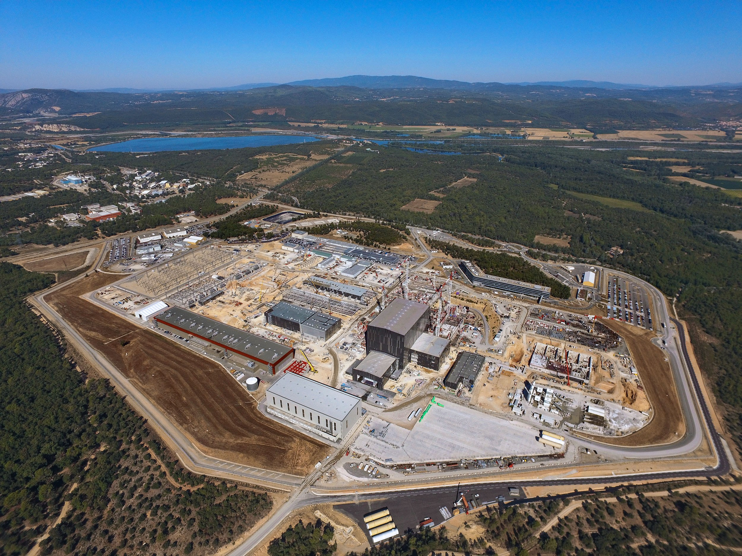
Progress in ITER Construction
and in the preparations for Operation
D.J. Campbell
On behalf of: ITER Organization, 13067 St Paul lez Durance, France
Acknowledgements: Staff of ITER Organization and Domestic Agencies
The views and opinions expressed herein do not necessarily reflect those of the ITER Organization.

Slide 2
What is ITER?
ITER is a major international collaboration in fusion energy research involving China, the EU (plus Switzerland), India, Japan, the Russian Federation, South Korea and the United States
The overall programmatic objective:
to demonstrate the scientific and technological feasibility of fusion energy for peaceful purposes
The principal goal:
to design, construct and operate a tokamak experiment at a scale which satisfies this objective
ITER is designed to confine a DT plasma in which α-particle heating dominates all other forms of plasma heatingg:
⇒ a burning plasma experiment

Slide 3
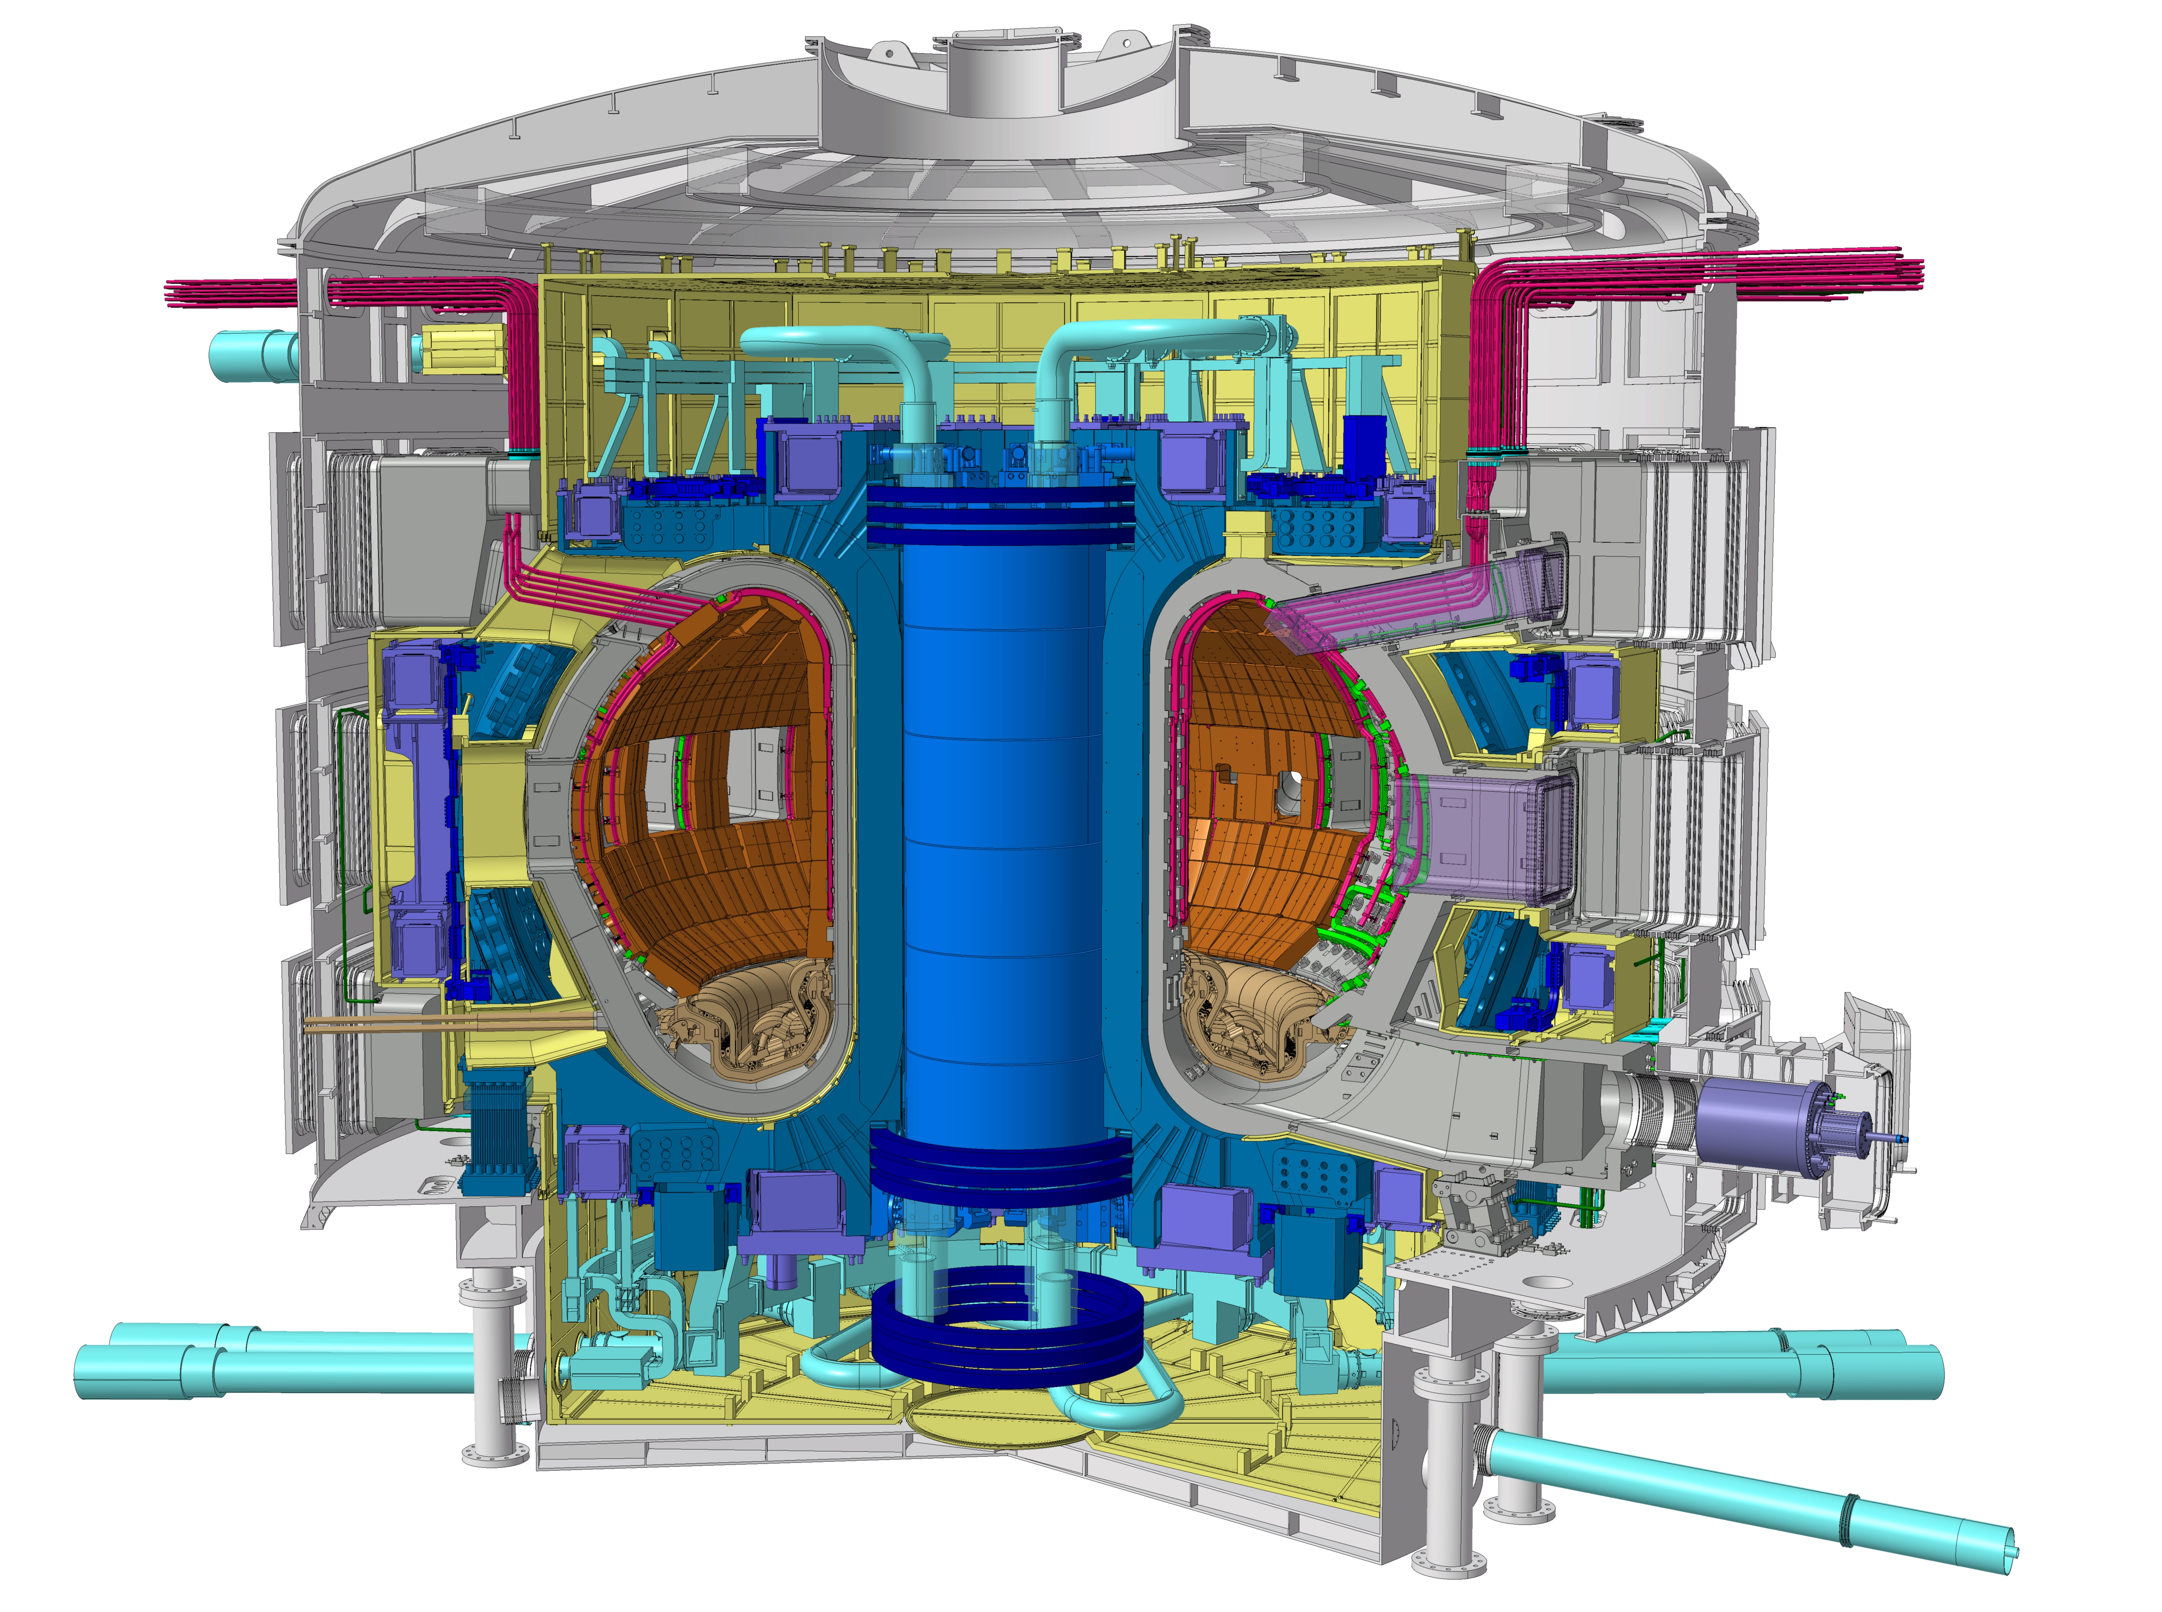
The ITER Mission
ITER Program Objective:
to demonstrate the scientific and technological feasibility of fusion energy for peaceful purposes
Key Technical Goals:
achieve extended burn of a DT plasma with dominant alpha-particle heating (Q ≥ 10, ~500 s)
develop steady-state fusion power production as ultimate goal
integrate and test all essential fusion power reactor technologies and components
demonstrate safety and environmental acceptability of fusion
ITER tokamak

Slide 4
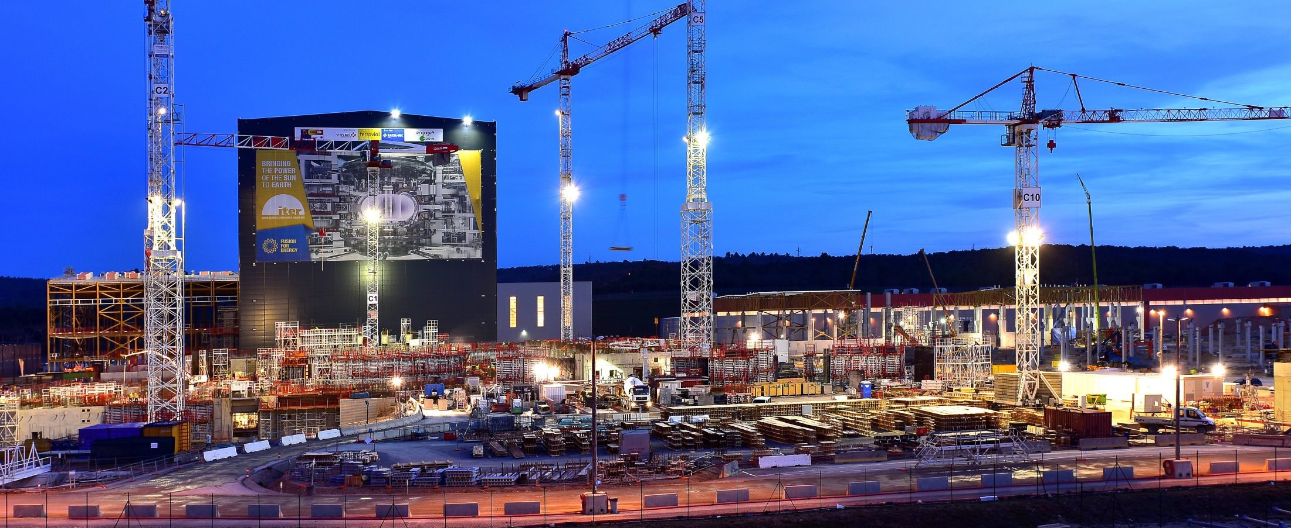
Synopsis
Fusion power production in ITER: the physics basis
ITER technology: progress in R&D and manufacturing of ITER components
ITER construction status
ITER operational planning

Slide 5
Fusion power production in ITER

Slide 6
Essential fusion reactions
T
He
+ 20% of Energy (3.5 MeV)
Fusion
D
n
+ 80% of Energy (14.1 MeV)
The D-T fusion reaction is the simplest to achieve under terrestrial conditions:
²D + ³T ⇒ ⁴He (3.5 MeV) + ¹n (14.1 MeV)
Two other important reactions for DT fusion:
¹n + ⁶Li ⇒ ⁴He + ³T + 4.8 MeV
¹n + ⁷Li ⇒ ³He + ³T + ¹n – 2.5 MeV
these reactions will allow a fusion reactor to breed tritium

Slide 7
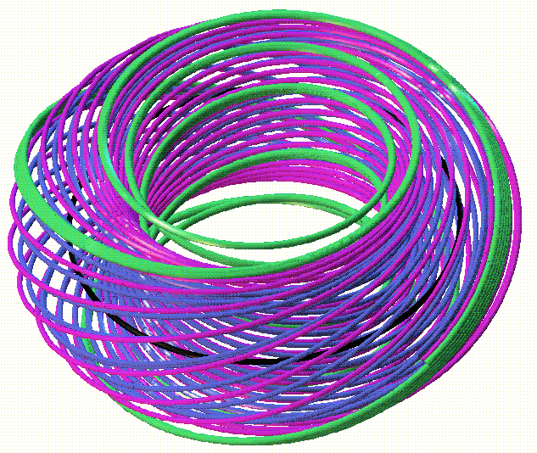
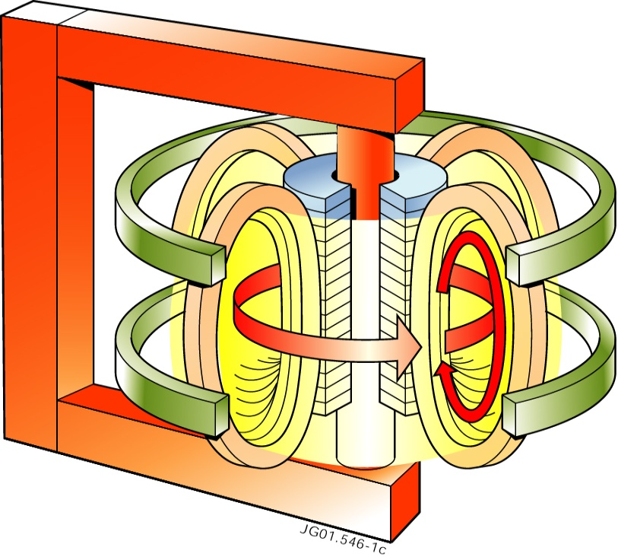
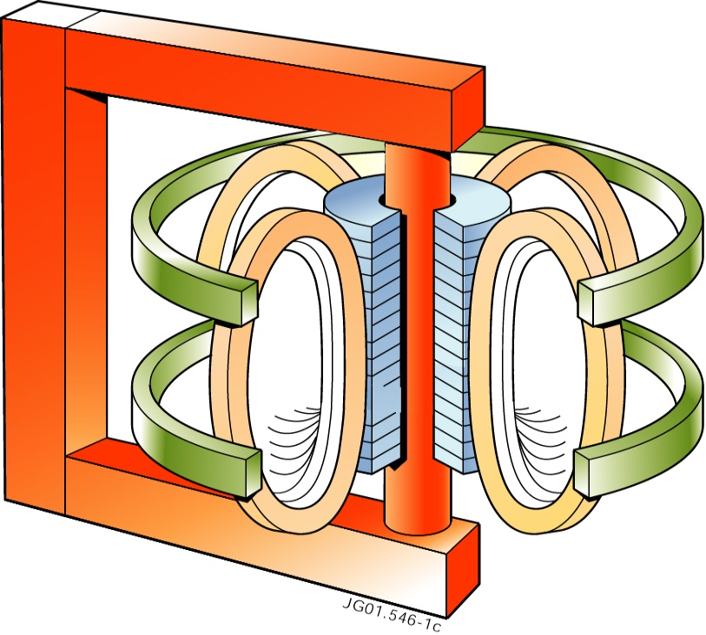
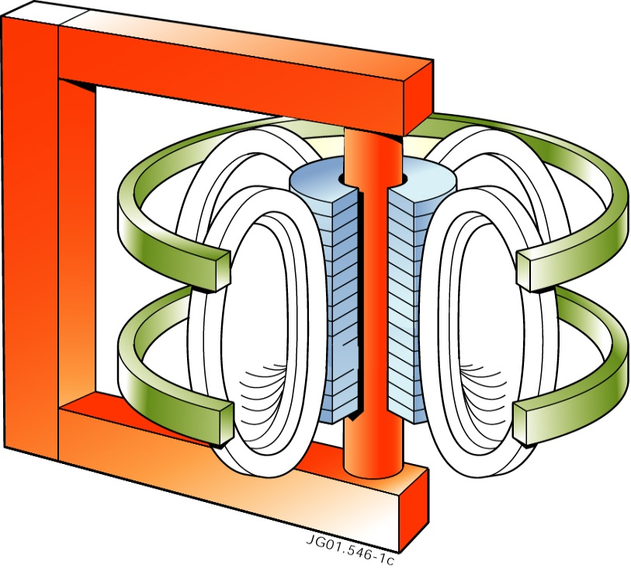
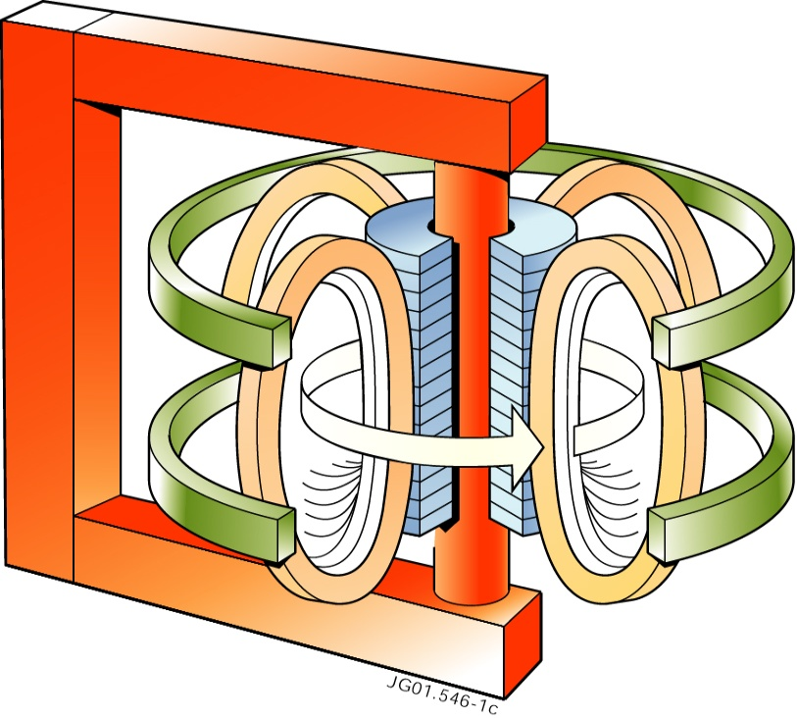
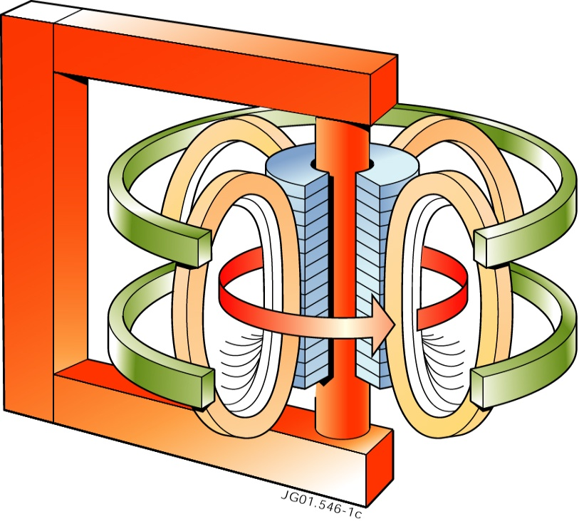
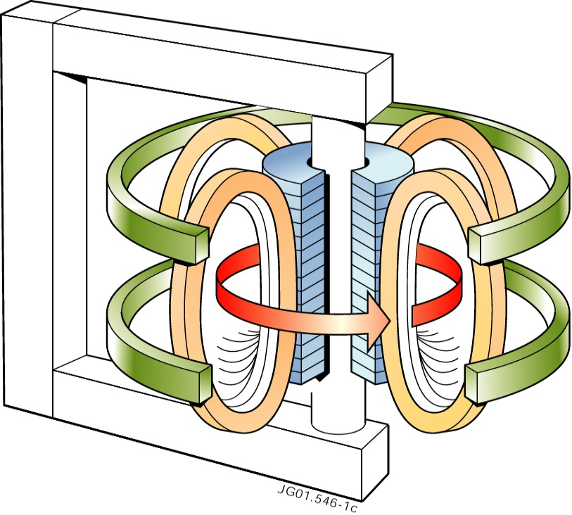
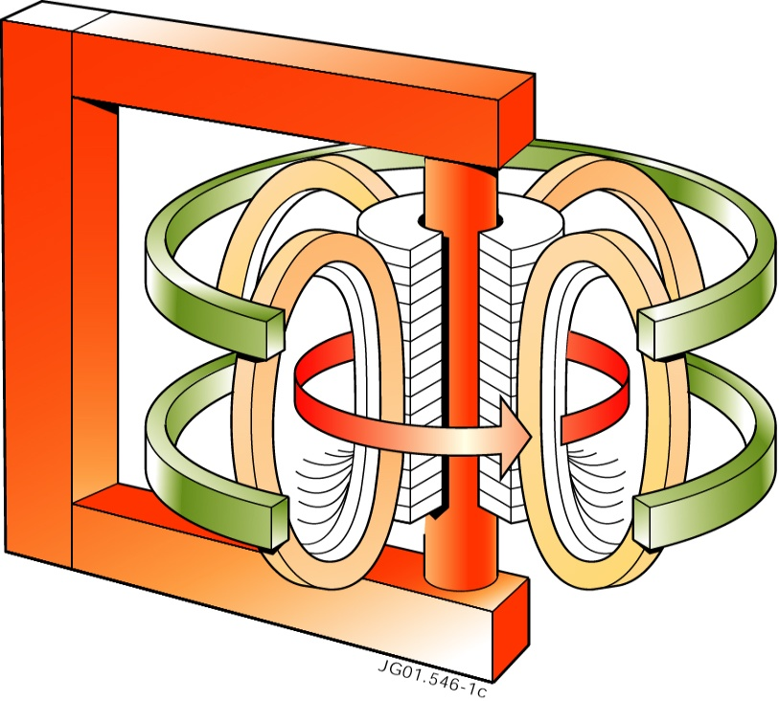
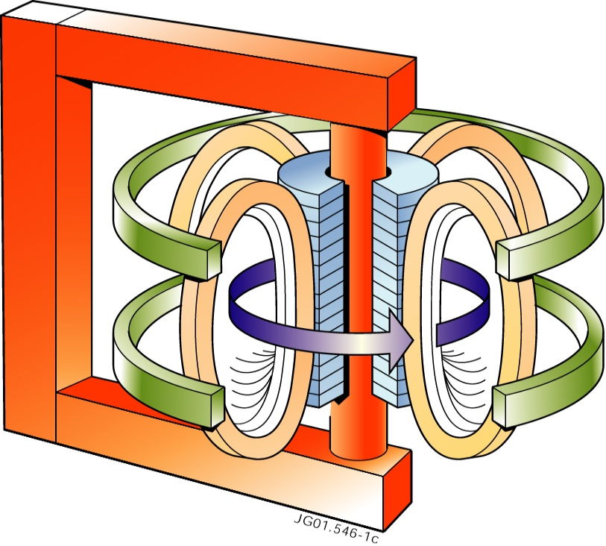
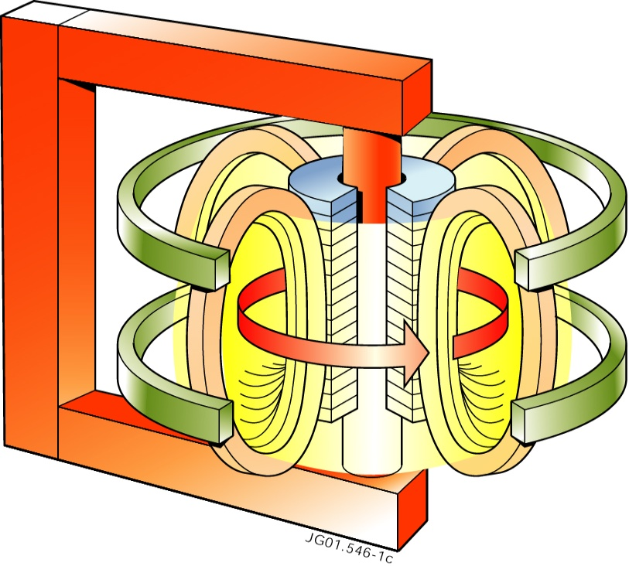
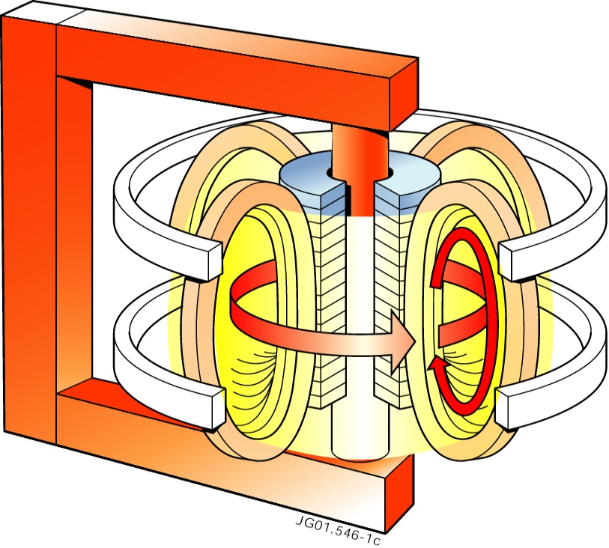
Plasma magnetic confinement in a Tokamak
Combination of toroidal and poloidal fields produces helical field for plasma confinement
The Tokamak:
External coils
to produce a toroidal magnetic field
Transformer
with primary winding
to produce a toroidal current
in the plasma
this plasma current creates a poloidal magnetic field
Finally, poloidal coils
to control the position and shape of the plasma

Slide 8
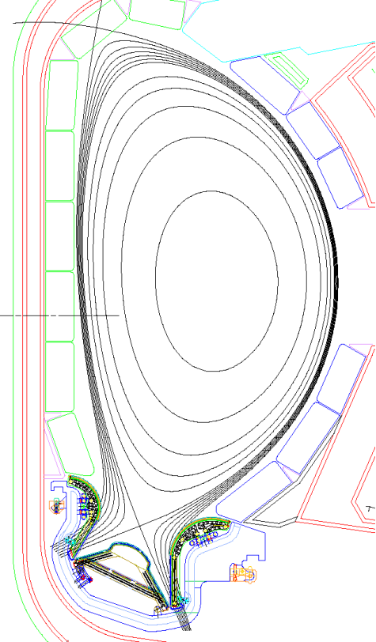
The Tokamak Plasma
Surfaces of constant poloidal magnetic flux, Ψ
pressure (p=nkT) is constant on magnetic surfaces
current lines lie within magnetic surfaces
magnetic field lines wind helically around torus within magnetic surfaces
Height b
R Major Radius
a Minor Radius
Last closed flux surface is denoted separatrix
outside separatrix magnetic field lines run into divertor, guiding most of heat and particles onto target plates

Slide 9
Plasma fusion performance
Temperature - T_{i}: 1-2 × 10⁸ K (10-20 keV) (~10 × temperature of sun’s core)
Density - n_{i}: 1 × 10²⁰ m⁻³ (~10⁻⁶ of atmospheric particle density)
Energy confinement time - τ_{E}: few seconds (∝ current × radius²) (plasma pulse duration ~1000s)
⇒ Present devices: Q ≤ 1
⇒ ITER: Q ≥ 10
⇒ ‘Controlled ignition’: Q ≥ 30
Fusion power amplification:

Slide 10
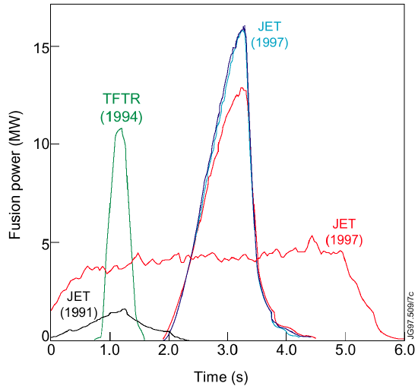
DT Fusion Power Production
During the 1990s experiments in JET (EU) and TFTR (US) initiated the study of DT fusion power production
In 1991, JET produced ~2 MW of fusion power with ~10% of tritium in deuterium
JET and TFTR subsequently produced DT fusion powers of >10 MW for ~1 s in 50:50 DT plasmas with Q<1
ITER is designed to produce DT fusion powers of ~500 MW for 300 – 500 s, with Q≥10

Slide 11
ITER Technology:
Progress in R&D and manufacturing of ITER components

Slide 12
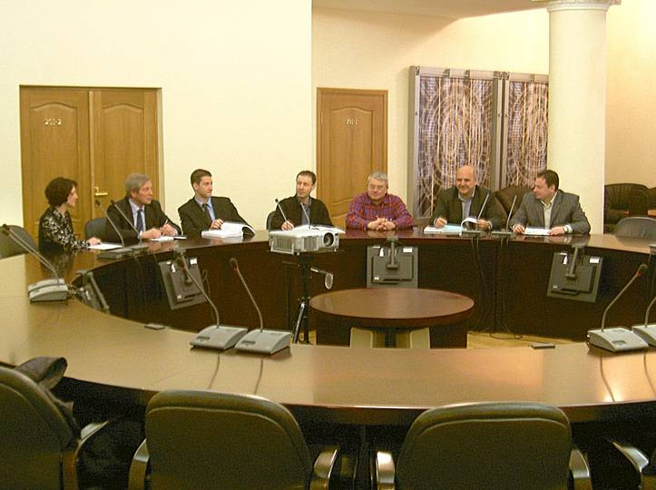
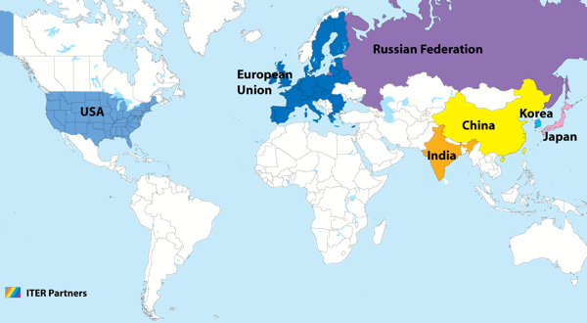
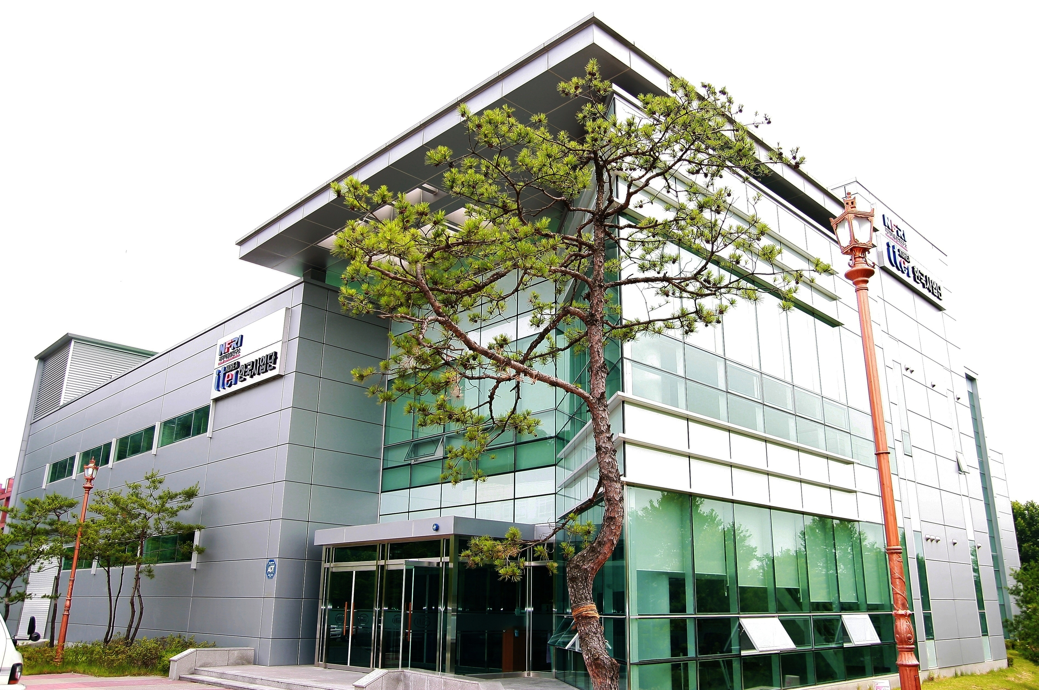
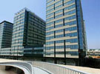
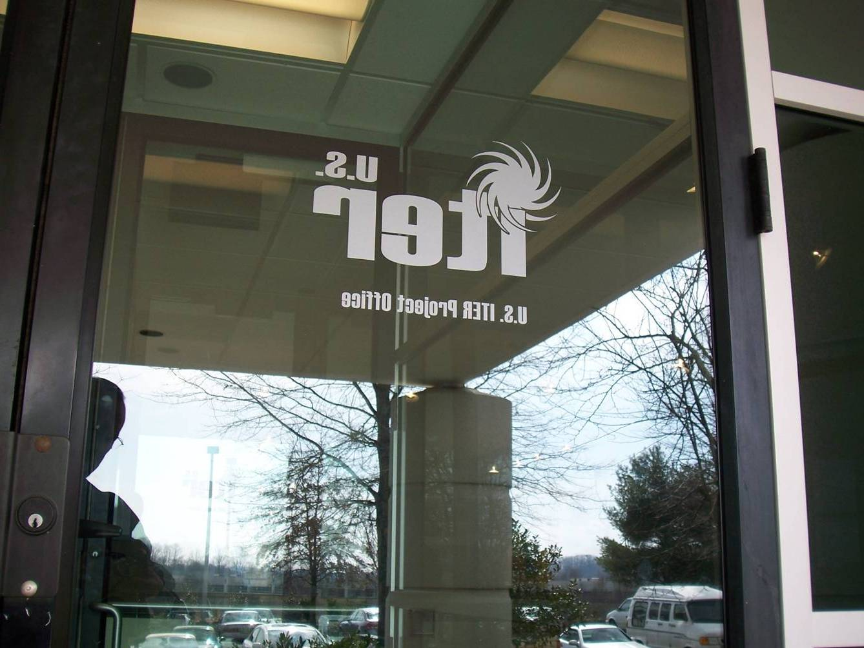
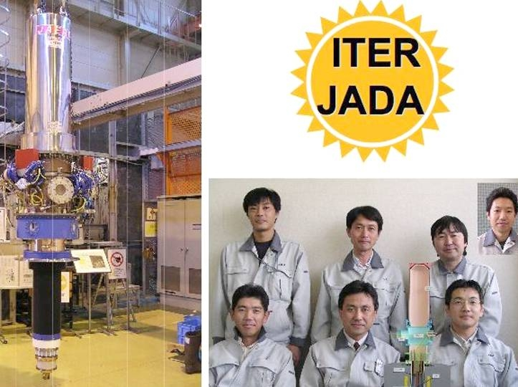
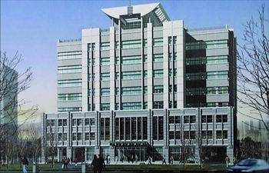
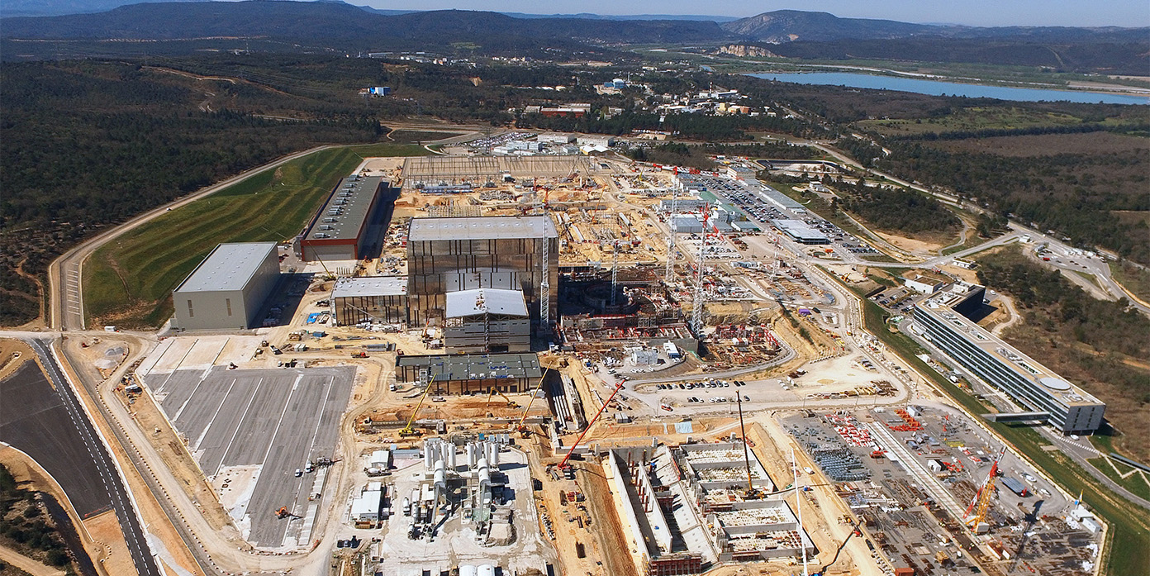
ITER – A Major International Collaboration
90% of ITER components are supplied “in-kind” by the Members through their Domestic Agencies
*
This approach necessitates the integration of ITER management, design and procurement activities across the globe
Notes:
12

Slide 13
ITER – Tokamak Core Components
d ~ 30 m
Central Solenoid (6) (Nb₃Sn)
Cryostat (SS)
Thermal Shield (SS)
Internal Coils
(Cu)
Poloidal Field Coils (6) (NbTi)
Toroidal Field Coils (18) (Nb₃Sn)
Shielding Blanket Modules (SS/ Be)
h ~ 29 m
Correction Coils (18)
(NbTi)
Vacuum Vessel (SS)
Divertor (SS/ W)

Slide 14
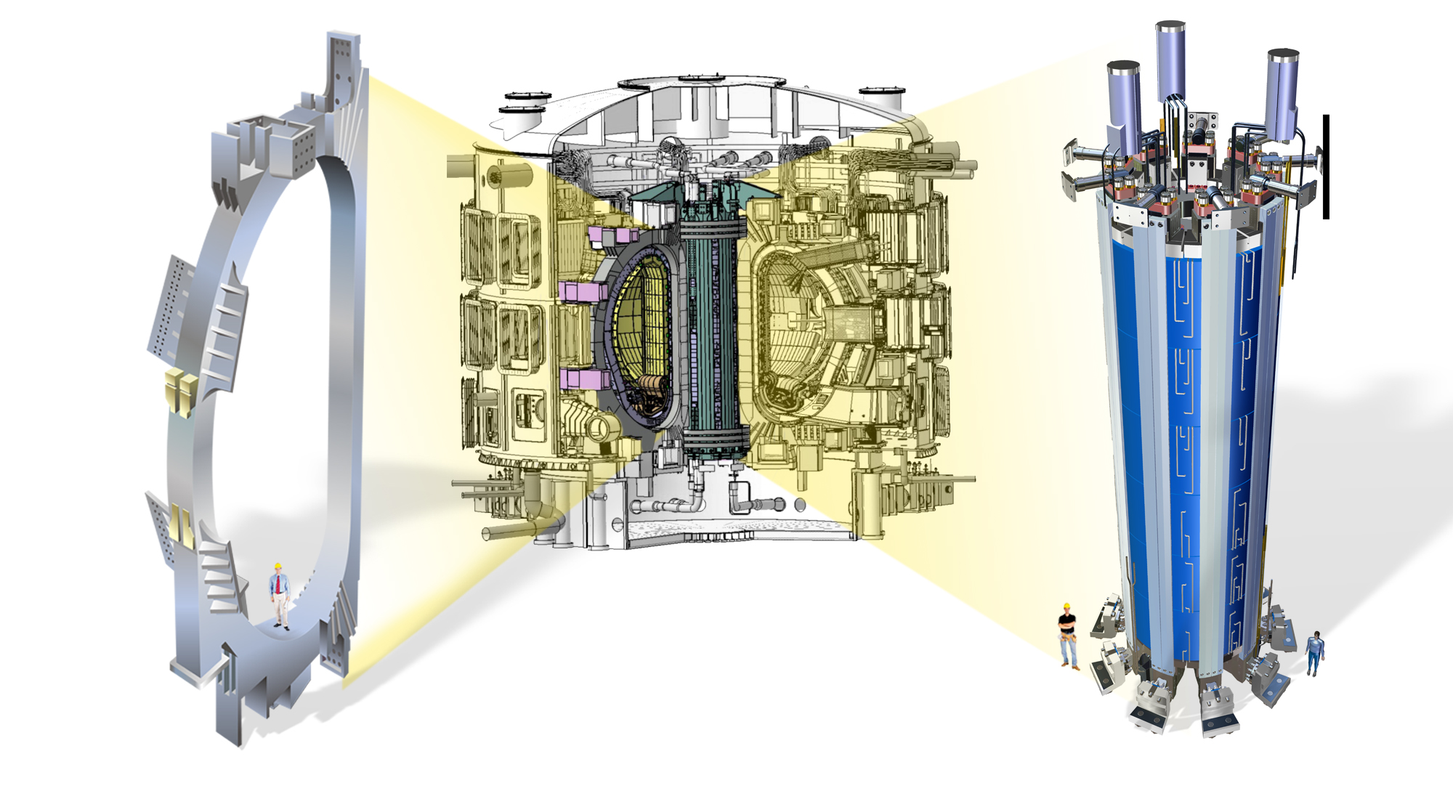
Magnets - Unprecedented Size and Performance
TF Coils (Nb₃Sn)
11.8 Tesla, 41 GJ
400 MN centering force
Central Solenoid (Nb₃Sn)
13 Tesla, 7 GJ
20 kV, 1.2 T/s

Slide 15
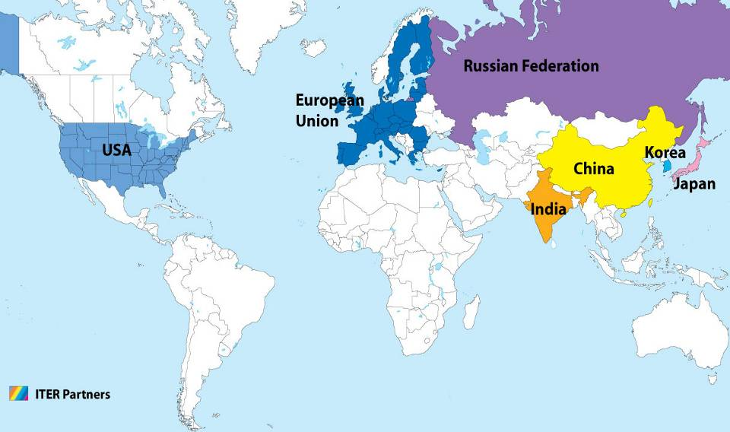
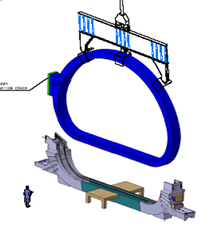
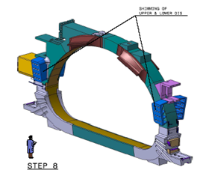
TF Coils – A Global Collaboration
TF Coil
TF coil cases
Conductor
Japan
Japan
China
Europe
South Korea
Japan
Russia
United States
Europe

Slide 16
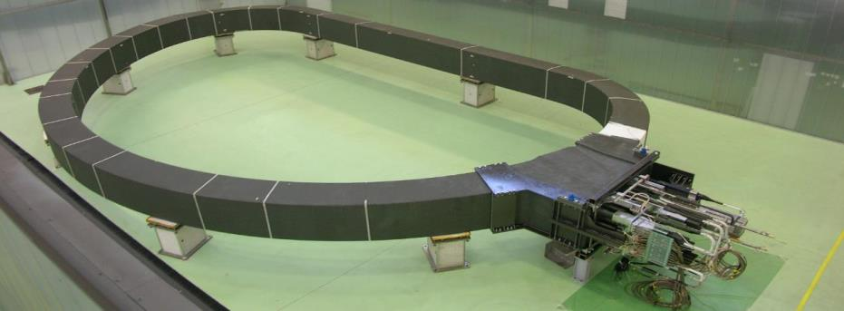
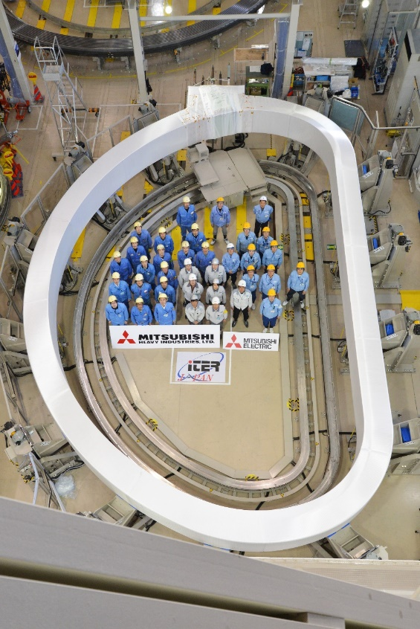
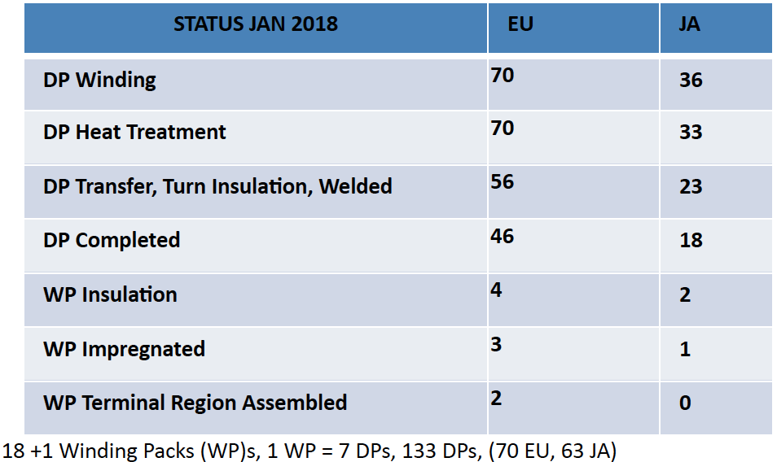
TF Coil Manufacturing
1st EU Winding Pack Final RT tests completion in April 2017
First JA TF Coil Winding Pack completed in January 2017
Winding of 80% of superconducting ‘Double Pancakes’ (DP) required for TF coils is complete

Slide 17
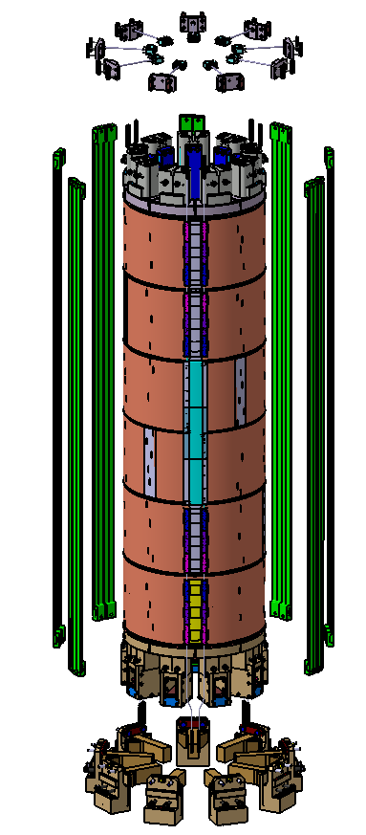
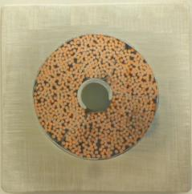
Central Solenoid
• In comparison to the TF coils, which are operated in a steady state, the CS and PF coils must drive inductively 30,000 x 15 MA plasma pulses with a burn duration of ~400 s
• During their life time, the CS coil modules will have to sustain severe and repeated electromagnetic (EM) cycles to high current and field conditions
Well beyond anything large Nb₃Sn coils have ever experienced
CS3U
CS2U
CS1U
CS1L
CS2L
CS3L
Note: CS conductors are to be procured in kind by Japan; they are 100% funded by EU (Broader Approach) and will be delivered to the USA for coil manufacture

Slide 18
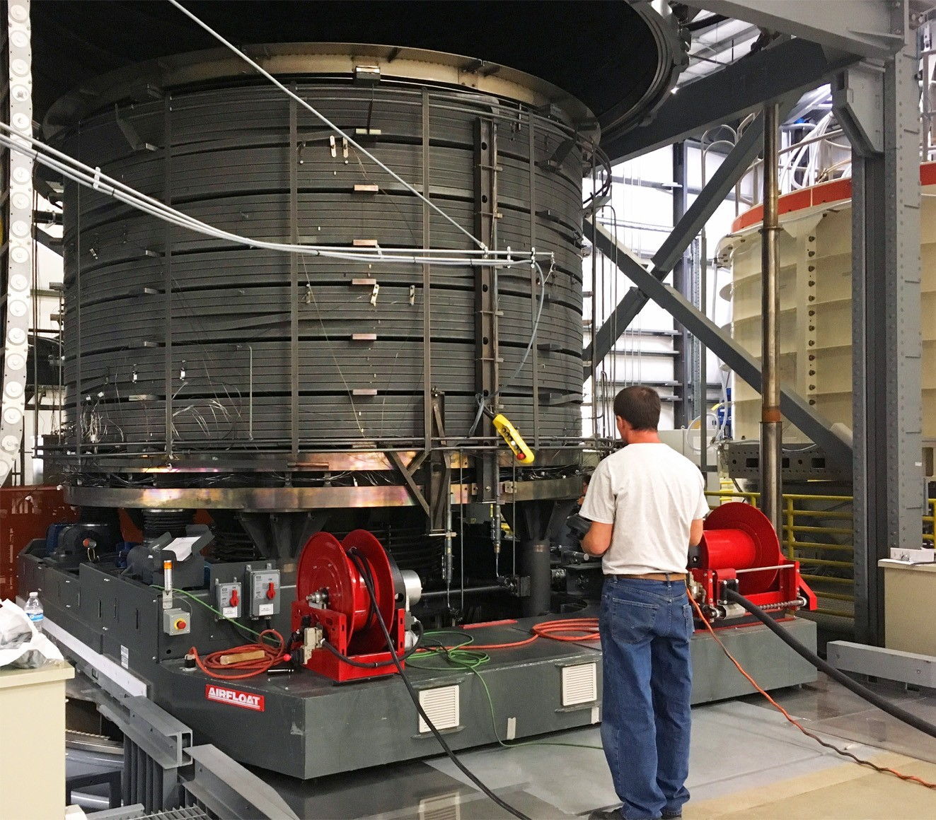
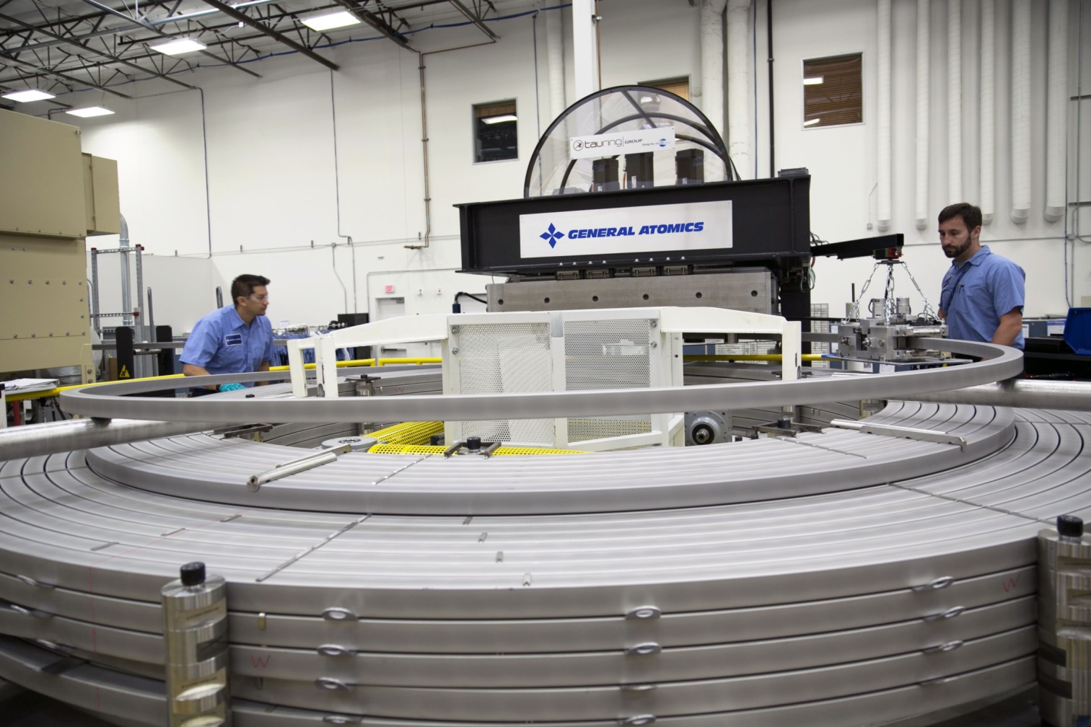
Central Solenoid Manufacturing
The 1000-ton Central Solenoid (CS), consisting of 6 modules, is being fabricated by the United States.
In April 2016, winding of the first CS module was completed.
Second and third CS modules complete and fourth module being wound
The first module for ITER's CS has successfully passed the heat treatment phase, which ultimately creates the CS's superconducting material.

Slide 19
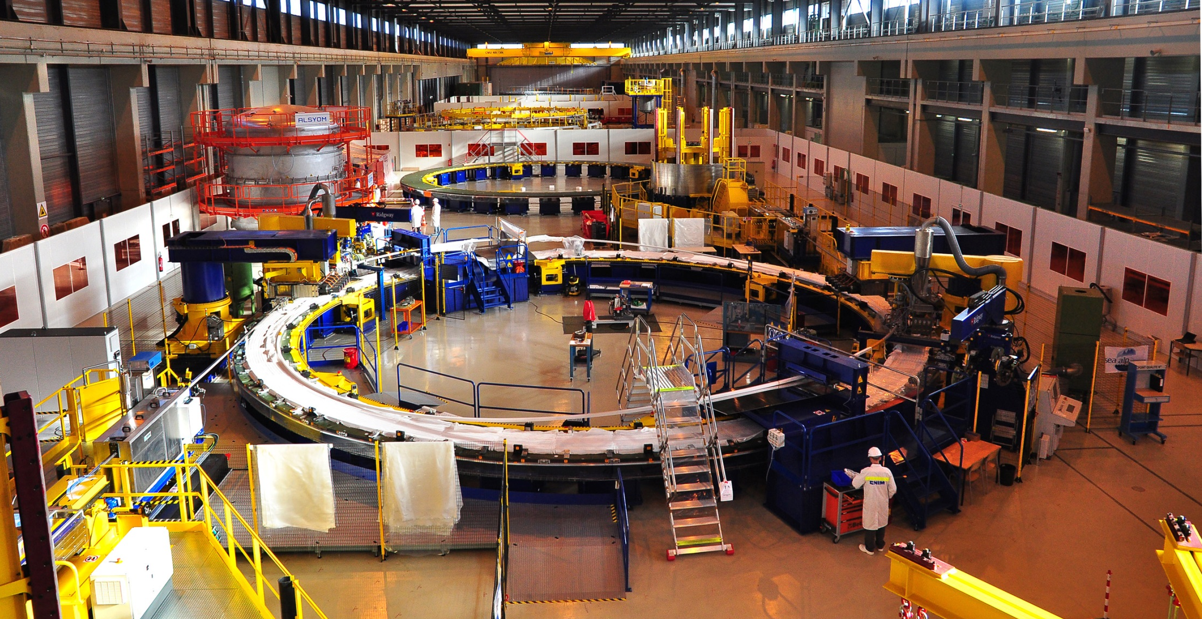
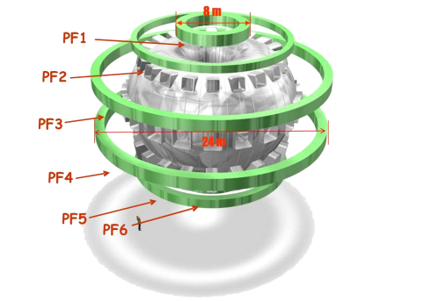
PF Coil Winding Facility (PF2 – PF5)
Too large to be transported by road, four of ITER’s six ring-shaped magnets (the poloidal field coils, 8 to 24 m in diameter, NbTi superconductor) will be assembled by Europe on-site in this 12,000 m² facility. The DPs for PF5 (17 m in diameter) are now being wound in the PF Coil Winding Building.

Slide 20
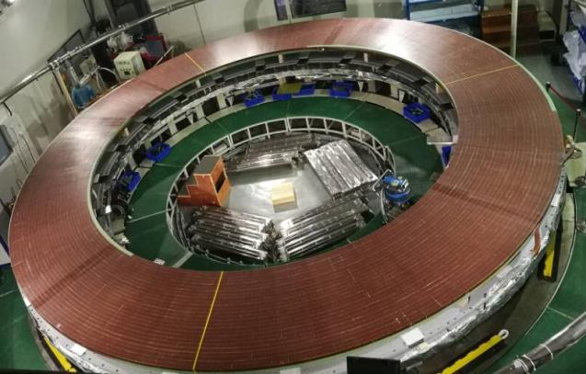
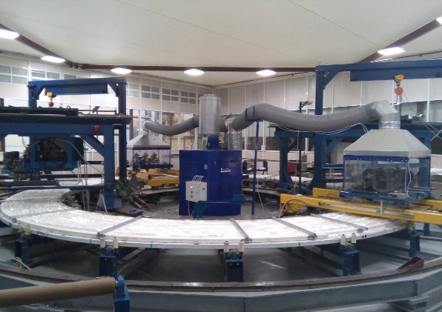
PF Coil #1, #6 Manufacturing
Winding of 3rd Double Pancake for PF1 underway in Russian Federation
The winding of 3 Double Pancakes for PF6 has been completed at ASIPP in Hefei. Nine double layers of conductor will be stacked to build the full coil, which is being built in China under contract with F4E (EU DA)

Slide 21
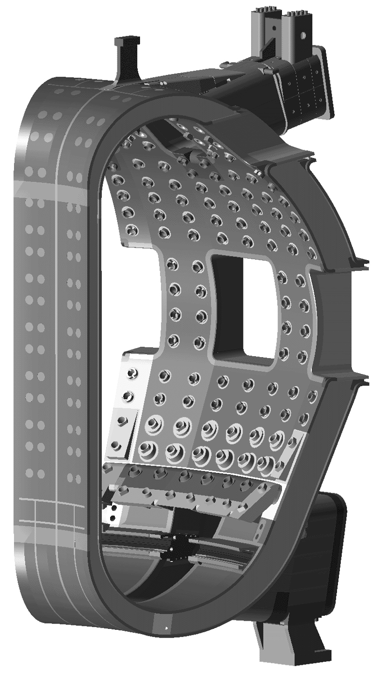
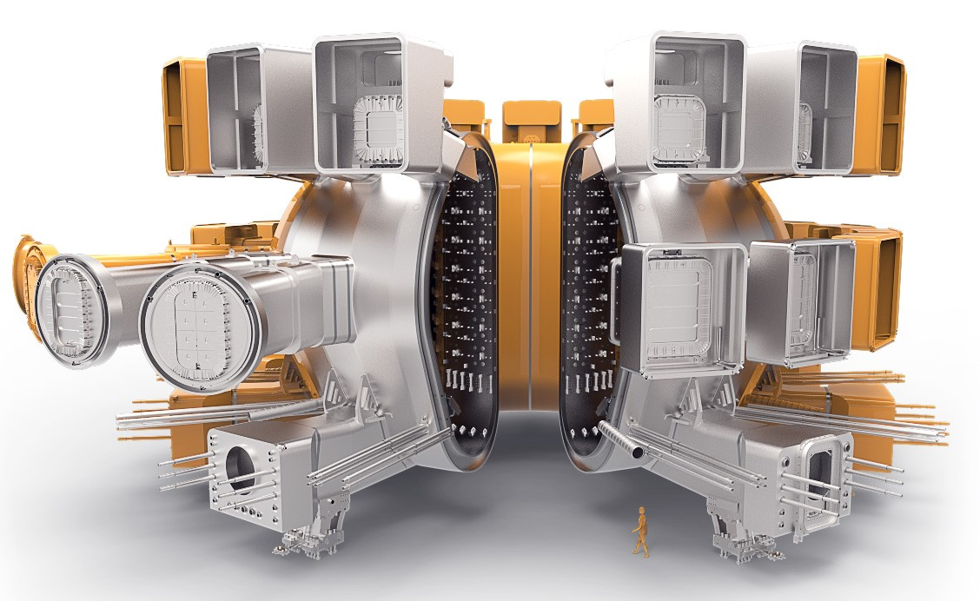
Vacuum Vessel
Vacuum Vessel is a double-walled stainless steel structure
19.4m outer diameter, 11.3m height, 5300 tonnes
provides primary tritium confinement barrier
Technically challenging due to large size, tight tolerances and nuclear safety aspects

Slide 22
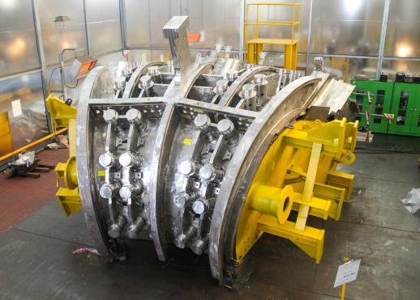
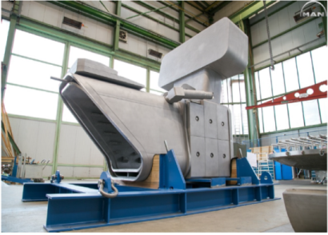
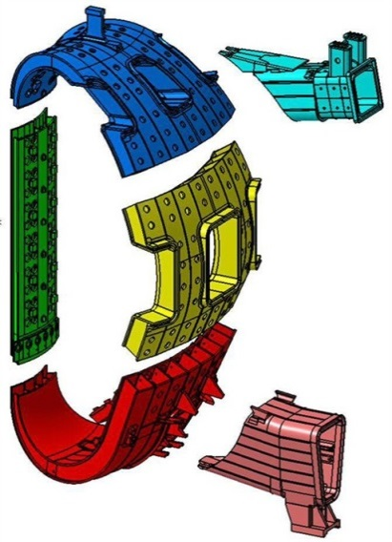
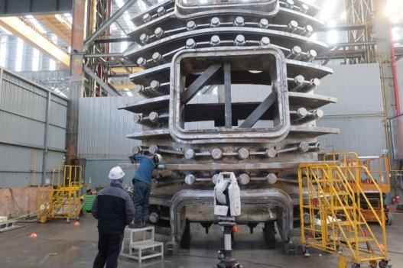
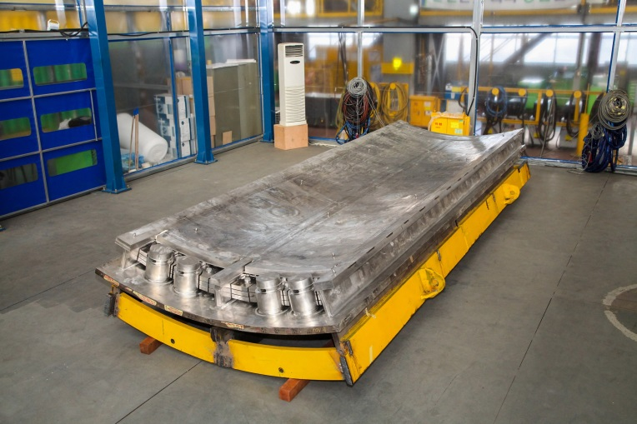
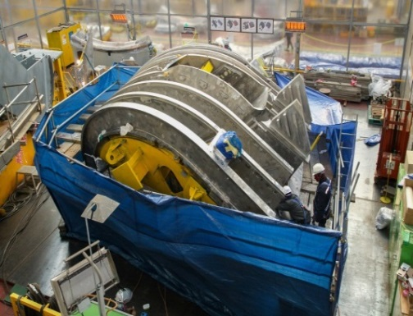
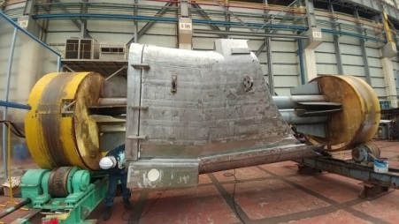
Vacuum Vessel Manufacturing
Upper Port
PS2
Delivered
from MDT (RF)
to HHI (KO)
PS3
PS1
PS4
Lower Port
Manufactured
by HHI (KO)
Completion of manufacturing
Manufacturing of the first Vacuum Vessel sector (#6) is ~80% complete in Korea

Slide 23
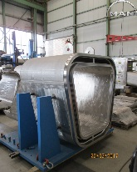
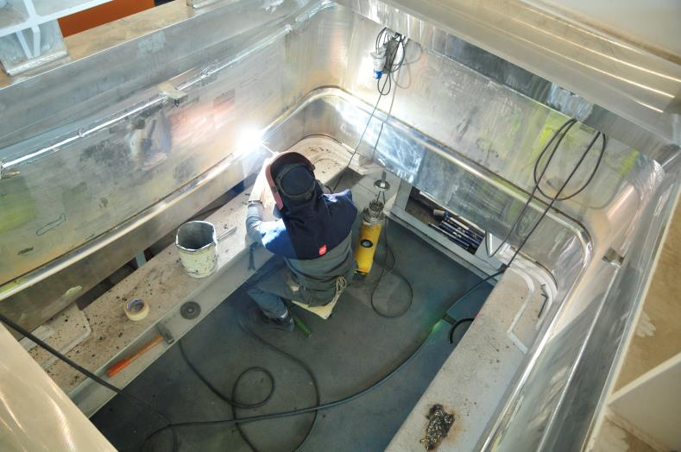
Vacuum Vessel Manufacturing
RF manufacturing port extensions
Manufacturing of first EU Vacuum Vessel sector (#5) is ~50% complete

Slide 24
Cryostat
Top Lid
Upper Cylinder
Lower Cylinder
Base Section
304L Stainless steel, 40 – 180 mm thick
Weight: ~3500 tonnes
Transfers loads to tokamak complex floor
Notes:
24

Slide 25
Cryostat Manufacturing
The 30 m x 29 m cryostat is being assembled and welded on-site from elements manufactured in India:
Welding operations for the base section (1,250 t) are complete (October 2016);
Welding of Cryostat lower cylinder (~10 m high) is underway on-site

Slide 26
Plasma Facing Components
Blanket first wall
~700 m² beryllium
Low Z – good plasma compatibility
Good oxygen getter
Good thermal conductivity
Beryllium
~150 m² tungsten
Low sputtering yield, high threshold
Highest melting point
Low fuel retention
Divertor
Tungsten

Slide 27
ITER Construction Status

Slide 28
Radiofrequency Heating
Assembly Hall
PF Coil winding facility
Cryoplant
Service Building
Cryostat workshop
Cooling water system
400 kV Switchyard
Magnet Power Conversion Bdgs.
Worksite Construction
progress
Tritium Building
Tokamak Building
Diagnostics Building

Slide 29
Tokamak Building
A north-south cutaway of the Tokamak Building, which is the major element of the Tokamak Complex, together with the Diagnostics Building and the Tritium Building

Slide 30
Tokamak Complex
Resting on 493 seismic pads, the reinforced concrete “B2” slab bears the 400,000-ton Tokamak Complex:
Diagnostic Building (right)
Tokamak Building (centre): with circular BioShield (~30 m internal diameter) visible
Tritium Building (left)

Slide 31
Tokamak Complex - Bioshield
The concrete Bioshield (30 m diameter) has risen to its maximum height – the equatorial and upper levels of port access openings can be clearly seen

Slide 32
Assembly
Hall
Before being integrated in the tokamak, the components will be prepared and pre-assembled in this 6,000 m², 60-metre high building. The Assembly Hall is equipped with a double overhead travelling crane with a total lifting capacity of 1,500 tons

Slide 33
Radiofrequency Heating
Adjacent to the Assembly Hall, the Radiofrequency Heating Building (right) and Cleaning Facility Building (foreground) are approaching completion

Slide 34
Cryoplant
It will be the largest single-platform cryoplant in the world. The ITER Cryoplant will distribute liquid helium (~4.2 K) and liquid nitrogen (77 K) to various machine components (superconducting magnets, thermal shield, cryopumps, etc.)

Slide 35
Cooling Water Systems
ITER power will be partly evacuated by cooling towers (procured by India). Work on the “hot” and “cold” basins’ foundations began in August 2016

Slide 36
Schedule - Major Assembly Milestones

Slide 37
ITER Operational Planning

Slide 38
Baseline Schedule - ‘Staged Approach’
During 2015 – 2016, the project has performed a ‘bottom-up’ analysis of the construction and operations schedule to develop a fully consistent programme towards plasma operation and fusion power production:
Schedule and IO-CT resource estimate to First Plasma consistent with Members’ budget constraints
4-stage operations programme developed towards fusion power production in DT, starting in late-2035
DT Operation
Stage I
Stage II
Stage III
Stage IV

Slide 39
Operations Planning - ITER Research Plan
PFPO-1
PFPO-2
FPO-1
FPO-1
FPO-2
FPO-3

Slide 40
Conclusions
The ITER device integrates many advanced technologies and is driving major fusion science and technology R&D programmes within the partners
The ITER project has now moved fully into the manufacturing and construction phase
on-site construction of the Tokamak Complex is advancing rapidly
Domestic Agencies have launched large scale manufacturing contracts for many major tokamak and plant components
extensive R&D and prototyping is ongoing in preparation for manufacture of auxiliary systems (H&CD, Diagnostics, Fuelling)
The revised baseline schedule foresees First Plasma in late-2025 and the transition to fusion power experiments in late-2035
a wide-ranging programme of physics R&D conducted in collaboration with the international fusion community is preparing for ITER operation
Successful exploitation of ITER will not only realize the limitless possibilities of fusion energy, but open new areas of fusion plasma and technology research, including tritium breeding

Slide 41
ITER is moving forward!
Thank-you for your attention

Slide 42
Backup Slides

Slide 43
ITER heating and current drive systems
NB
Neutral Beam - 1 MeV
33MW* +16.5MW#
Bulk current drive limited modulation
IC
Ion Cyclotron 40-55MHz
20MW* +20MW#
Sawtooth control modulation < 1 kHz
EC
Electron Cyclotron 170GHz
20MW* +20MW#
NTM/sawtooth control modulation up to 5 kHz
LH
Lower Hybrid ~5 GHz
0MW* +40MW#
Off-axis bulk current drive
*Baseline Power
#Possible Upgrade

Slide 44
Analyzing the plasma - ITER Diagnostics
VESSEL WALL
(Distributed Systems)
UPPER PORT
(12 used)
EQUATORIAL PORT
(8 used)
DIVERTOR CASSETTES
(16 used)
DIVERTOR PORT
(3 used)
About 50 large scale diagnostic systems are foreseen:
Diagnostics required for protection, control and physics studies
Measurements from DC to γ-rays, neutrons, α-particles, plasma species
Diagnostic Neutral Beam for active spectroscopy (CXRS, MSE ….)

Slide 45
Plasma Facing Components
Blanket/ First Wall
Beryllium
Tungsten
Be flat tiles, enhanced (4.7 MWm⁻²) and normal (2 MWm⁻²) power handling
440 blanket shield modules, ~1800 tons

Slide 46
Plasma Facing Components
W-monoblock vertical targets
54 divertor cassettes, ~500 tons
Total of ~292,000 monoblocks
Beryllium
Divertor
Tungsten

Slide 47
Tritium Plant
~100 g tritium required for a standard Q=10 pulse, but only <1% is actually burned:
tritium reprocessing required
7 Stories:
2 below grade
L = 80 m
W = 25 m
H = 35 m

Slide 48
Tritium Breeding - Test Blanket Modules
Tritium fuel cycle is a major challenge for all DT fusion devices ⇒ ITER will test concepts
6 modules with different designs, all ITER Members involved
n + ⁶Li → T + ⁴He + 4.8 MeV
n + ⁷Li → T + ⁴He + n - 2.5 MeV

Slide 49
Robotics and Remote Handling
Sector Sub-Assembly Tool (SSAT):
1st SSAT delivered by KO DA to ITER and being installed on=site
Divertor Cassette Remote Handling facility being tested in EU (Finland)
Due to the massive size of the ITER Tokamak components, as well as the intense neutron flux that will occur during operations, the ITER machine has required the development of cutting-edge robotics and remote handling tools, which will be used in both the assembly and operational phases

Slide 50
ITER Site Overview (~2025)
39 buildings and technical areas, 180 hectares
POWER SUPPLIES
TOKAMAK BUILDING
OFFICE BUILDING

Slide 51
Component transport
Component Transport
For heaviest components: vacuum vessel sectors, toroidal field coils, poloidal field coils 1/ 6 Road upgrades from south coast to Cadarache complete and paid for by regional funding (115 M€) ITER itinerary ~104 km by road + 32 km by barge

Slide 52
Component Transport
352 wheel test convoy carrying 800 ton load (33 m long, 9 m wide, 10 m high) trialled in September 2013 and March/April 2014
2 power generators developing 730 horse power
Journey lasts 4 nights
Crossing Etang de Berre (32 km)

Slide 53
ITER reference plasma scenarios
The set of DT reference scenarios in ITER is specified via illustrative cases in the Project Requirements:
⇒ Design Basis plasma scenarios

