Slide 1

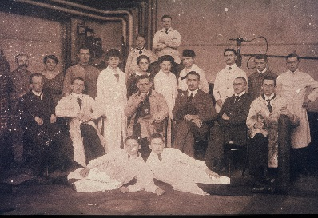
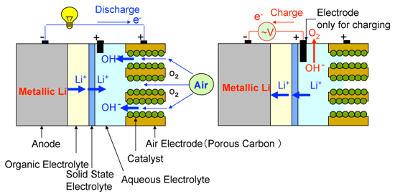
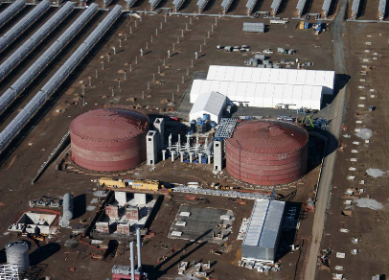
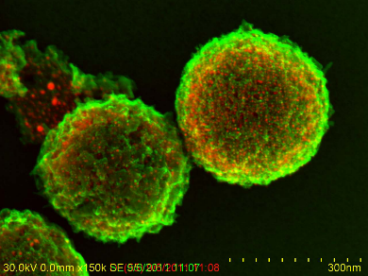

Chemical Energy Storage: a Key Element for a Sustainable Energy Future
Ferdi Schüth
Max-Planck-Institut für Kohlenforschung
Notes:
1

Slide 2
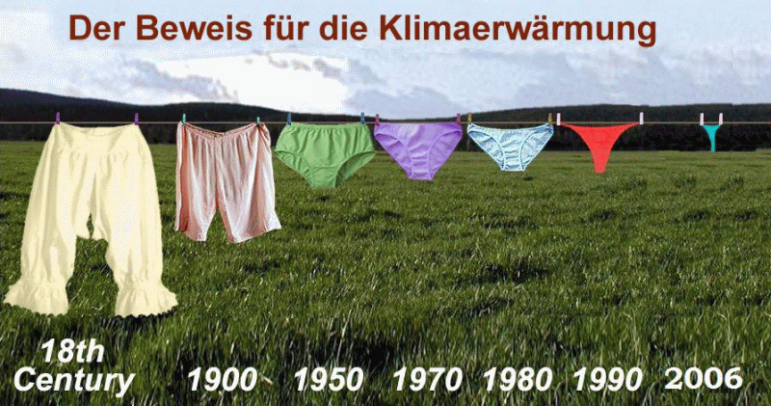
If it‘s not broken, don‘t fix it
- why change the system?
Multi-model averages of global surface warming for different scenarios
The META PICTURE
Climate Change 2014 – Mitigation of Climate Change, IPCC 5 Report WG 3, Cambridge 2014, p. 176

Slide 3
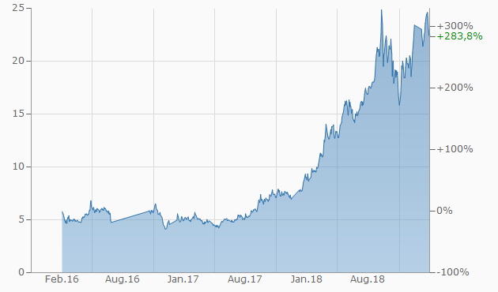
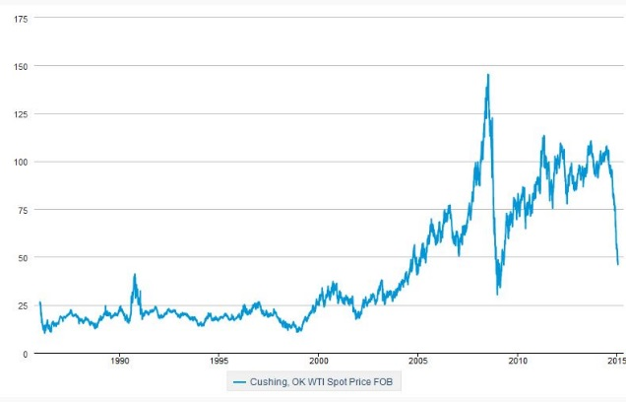
Changing boundary conditions…
CO₂ will have an increasing price
  Currently around 20 € in Europe
  Original target price 40 €
Increasing share of electricity in the
energy system
  Electromobility
  Improved insulation
  Renewables mostly electric
Strong fluctuations in oil prices
  Many reasons
  Production not easily increased
  at inelastic demand structure
Uncertain and rapidly changing
legislation
EJ
total primary energy electricity x 10
175
150
US$/bbl
125
100
75
50
25
0
1900 1995 2000 2005 2010 2015

Slide 4
Structure of the world energy consumption (2016)
586 EJ
International Energy Agency, Key World Energy Statistics 2018

Slide 5
Structure of the German energy consumption (2018)
12.9 EJ
Arbeitsgemeinschaft Energiebilanzen, Pressedienst 05/2018

Slide 6
CO₂ Emissions of fossil fuels
C + O₂ CO₂ real: hard coal around 95 t CO₂/TJ
lignite around 110 t CO₂/TJ
Efficiency hard coal power plant 38 %, 750-1100 g CO₂/kWh
lignite 35 %, 850-1200 g CO₂/kWh
(CH₂)_{x} + 1.5O₂ CO₂ + H₂O real: Gasoline around 73 t CO₂/TJ
Diesel Fuel around 74 t CO₂/TJ
CH₄ + 2O₂ CO₂ + 2H₂O real: around 56 t CO₂/TJ
Efficiency GuD bis 60%, 330-500 g CO₂/kWh
K. Juhrich, CO₂ Emission Factors for Fossil Fuels, Climate Change 28/2016

Slide 7

Far better: renewable energy
Sahara-day, sunshine
1000 J/s
= 1 kW
Sahara day&night
average,
10 % efficiency:
50 W/m²,
100 m² ≈ 5 kW
1 m
10 m
ca. 830 km
D
EU
world
700.000 km² desert area (Germany: 360.000 km²) is sufficient, to lift 7 billion people to EU-energy standard with respect to use of primary energy
Quelle: LBST

Slide 8
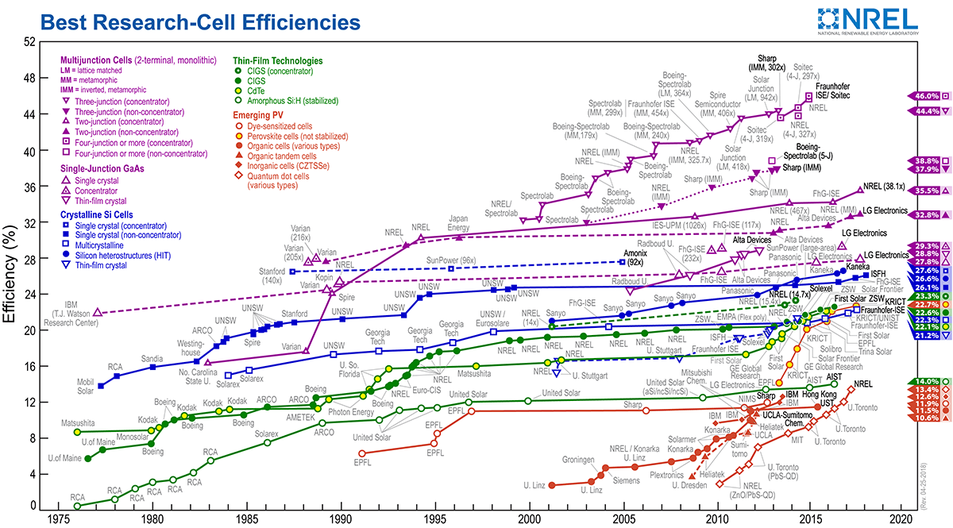
Just if you want to know efficiencies…
Commercial cells highest around 22 %, most 17-19% (module basis)
Total installed power in Germany about 46 GW (end 2018)

Slide 9
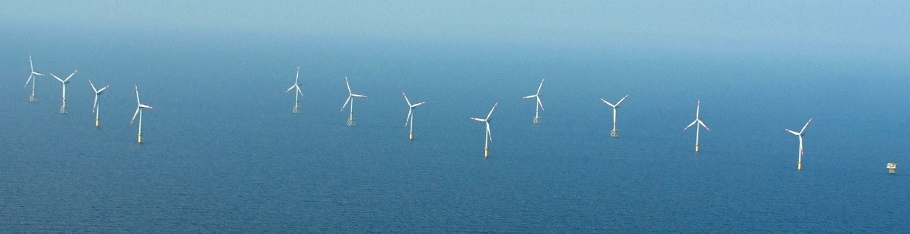
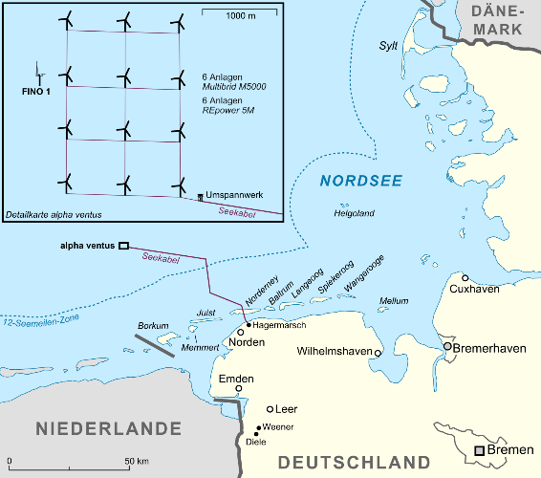
Wind power
Onshore: up to 7.5 MW, rotor diameter 127 m (Enercon E 126)
typical 2 – 5 MW
Offshore: alpha-ventus
  RePower 5 M
  5 MW
  126 m rotor diam.
  3.5– 30 m/s wind
  Multibrid M5000
  5 MW
  116 m rotor diam.
  3.5 – 25 m/s wind
Biggest 9.5 MW (164 m)
Martina Nolte, CC BY-SA 3.0
Lencer, CC BY-SA 3.0
Total installed power in Germany about 60 GW (end 2018)

Slide 10
Levelized cost of electricity
C. Kost et al., Fraunhofer ISE, March 2018

Slide 11
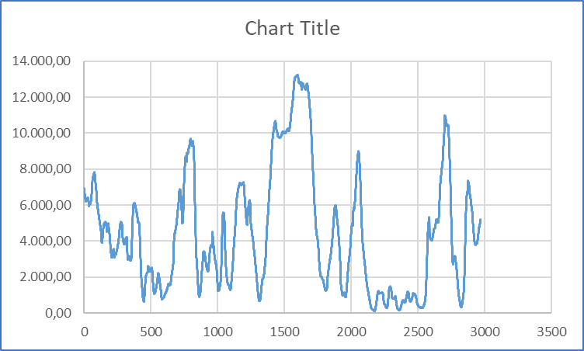
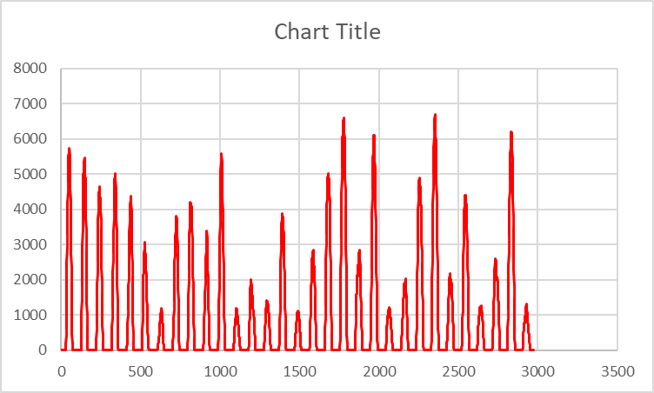
Wind and solar power 50 Hertz
March 2018
12
8
4
0
Solar power [GW] Wind power [GW]
6
4
2
0
March 1st March 15th March 31st
Drawn from data downloaded from 50 Hertz homepage

Slide 12
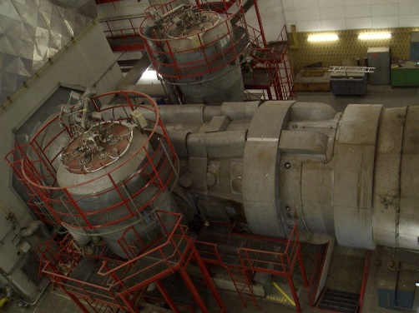
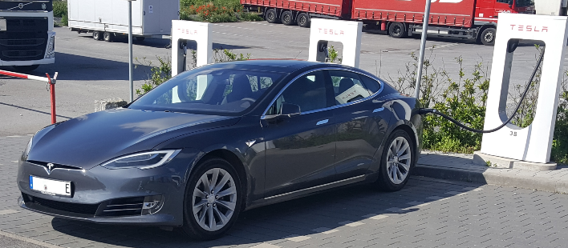

How to deal with fluctuating supply
(and demand)
Grid extension
Backup capacity
Demand side management
Storage
wdwd, CC BY-SA 3.0
Unimog404, CC BY-SA 4.0

Slide 13
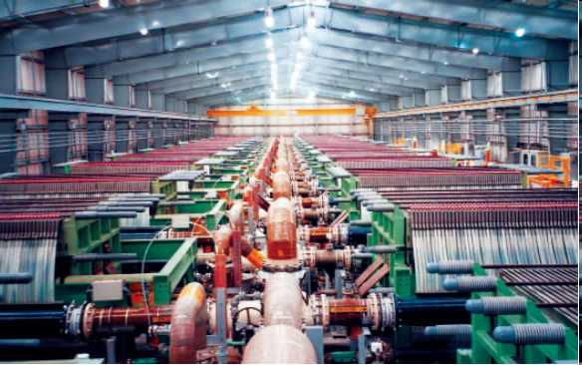
Big electricity consumers in chemical industry
Example: chlorine production in Germany (appr. 4 Mio. t) corresponds to one big power plant
Often not economical due to unfavorable split between capex and opex
Great example for non-oxygen anode reaction
Helpful: more electricity in the industry
http://www.bayertechnology.com/uploads/pics/chlorine_electrolysis_service2.jpg

Slide 14
Size and time scales of storage options
10⁸
Chemical compounds
grid scale
1 year
Engine
fuel
1 month
10⁶
Redox-Flow
(pumped) hydro
Li-ion
(traction)
Pb battery
Li-ion
(electronics)
CAES
1 day
NaS battery
typical time scale [s]
10⁴
1 hour
Flywheel
10²
capacitors
1
1 Wh
1 kWh
1 MWh
1 GWh
1 TWh
typical size scale

Slide 15
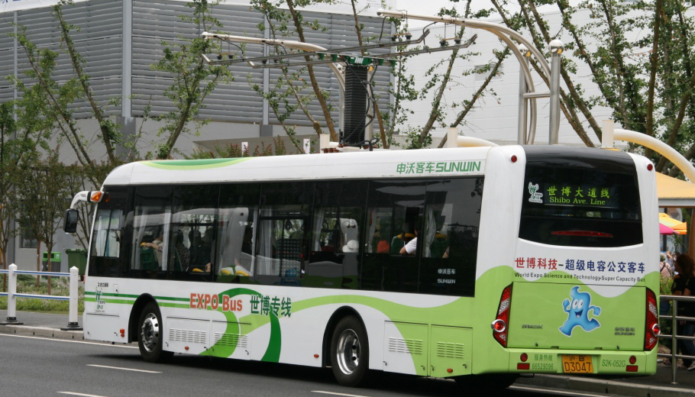
Alternative to batteries: supercapacitors
https://commons.wikimedia.org/wiki/File:Expo_2010_Electric_Bus.jpg#file

Slide 16
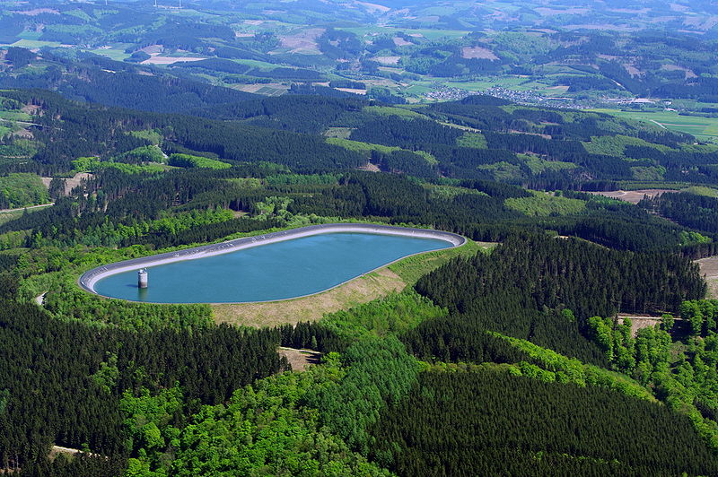
Current storage option: pumped hydro
Man kan die Krafft des Windes spahren und gleichsam in vorrath legen. Solches ist zu verstehen, wenn man damit waßer in die teiche bringet, welches darinne in vorrath gehalten und hernach zu gemeinem Nutzen des Bergwercks auf Künste und Puchwercke etc. despensieret werden kann.
G.W.Leibniz um 1680, Gesammelte Werke 1950, Bd. I.4, S. 43
E = m . g . h
Goldisthal: 12 Mio. m³, 350 m Fallhöhe
E = 1000 kg/m³ . 1.2.10⁷ m³ . 9.81 m s⁻² . 100 m = 41.2 TJ
0.00032 % des deutschen Gesamtenergiebedarfs (12.9 EJ)
Foto: Dr. G. Schmitz, CC BY-SA-3.0

Slide 17

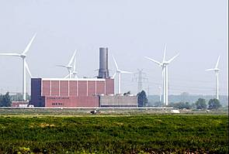
Compressed air energy storage (CAES)
©KBB Underground Technologies
©KBB Underground Technologies
Needs to be operated
adiabatically for high efficiency
A. Kampke, Energieperspektiven 01/2008, MPI für Plasmaphysik

Slide 18
Hydrogen by electrolysis
Alkaline PEM
Mature technology
Limited pressure capability
Moderate dynamic behavior
Technology still being developed
High pressure capability
From 5% to 300 % of nominal
power rating
M. Carmo et al., Intern.J.Hydrogen Ener. 38, 4901 (2013)
T. Smolinka et al., Fraunhofer ISE 2011

Slide 19

Storage in salt caverns
for instance: Clemens Dome (Texas) 580 000 m³, 100 bar, 0.01 % leak rate / a
F. Crotogino et al., Abstracts of 18th World Hydrogen Energy Conference 2010
Notes:
Speichern könnte man den Wasserstoff dann zentral in Kavernen in Salzdomen, wie sie heute schon in Raffinerieverbünden genutzt werden und für die Leckraten von 0.01 % pro Jahr angegeben werden

Slide 20
The hydrogen cost structure
Thermochemical cycles
electrolysis
biomass reforming/captive
Natural gas reforming/merchant
Natural gas reforming/captive
0 1 2 3 4 5
€/kg H₂
F. Schüth, in: R. Rinaldi (Ed.) Catalytic Hydrogenation for Biomass Valorization, RSC 2014

Slide 21
How expensive is storage in chemical compounds?
First step: water electrolysis
Thermodynamically: 33 kWh/kg H₂
Practically 45-55 kWh/kg H₂
Hydrogen cost industrial (from methane): 1 €/kg
However, recently bid was won at 2.34 $_{cent} / kWh for Saudi Arabia (in line with Fraunhofer ISE analysis)
Thus, producing chemicals in the Sahara/transport to Europe not completely unrealistic – but we need CO₂
If electricity cost exceeds 2 – 3 €_{cent} / kWh,
currently certainly not competitive

Slide 22
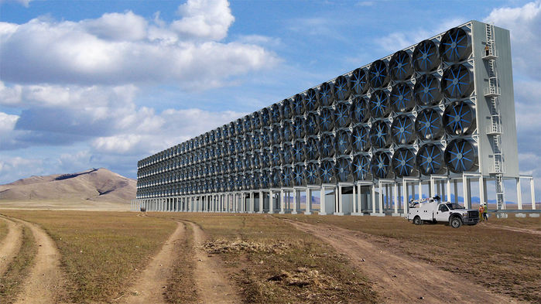
CO₂ capture from air
Rendering!!!
Absorption on liquid or solid bases, release, use
Cost estimates between 100 and 1000 $ / ton CO₂
D.W. Keith et al., Joule 2,1573 (2018)

Slide 23

Synthetic fuels via the Fischer-Tropsch process
Archiv MPI für Kohlenforschung

Slide 24
Production of Syngas
H₂O, (O₂)
CO + H₂
500 °C
„synthesis gas“
also coal, natural gas or
other sources of carbon
or: H₂ from electrolysis and CO from reverse water-gas shift:
CO₂ + H₂ CO + H₂O
Fischer-Tropsch: CO + 2 H₂ (CH₂)_{x} + H₂O
Pearl plant (Qatar): capacity about 12 Million tons of higher hydrocarbons
Other transport/storage molecules from syngas: DME, OME, MeOH

Slide 25

Fischer-Tropsch-Synthesis over metal catalysts

Slide 26
Size and time scales of storage options
10⁸
Chemical compounds
grid scale
1 year
Engine
fuel
1 month
10⁶
Redox-Flow
(pumped) hydro
Li-ion
(traction)
Pb battery
Li-ion
(electronics)
CAES
1 day
NaS battery
typical time scale [s]
10⁴
1 hour
Flywheel
10²
capacitors
1
1 Wh
1 kWh
1 MWh
1 GWh
1 TWh
typical size scale

Slide 27
Storage density of different energy carriers for transportation
400 kWh chemical energy
U. Eberle, M. Felderhoff, F. Schüth, Angew.Chem.Int.Ed. 48, 6608 (2009)

Slide 28
The alternative – or better synergy: battery cars
In the early days of automobility: competition between electric cars and internal
Combustion engine case with open ending
1899 1900-1917
Courtesy of Dr. U. Eberle
Adam Opel AG

Slide 29
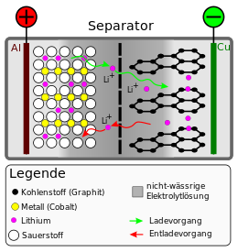
State-of-the-art: Li-Ionenbattery
11 wt.%
18 wt.%
46 wt.%
15 wt.%
2 wt..%
carbon
non-aqueous
electrolyte
metal (cobalt)
lithium
charging
oxygen
discharging
©Cepheiden
8 Gew.%: electrode additives, i.e. binders
Data from: M. Broussely, G. Archdale, J.Power Sources 136, 386 (2004)

Slide 30
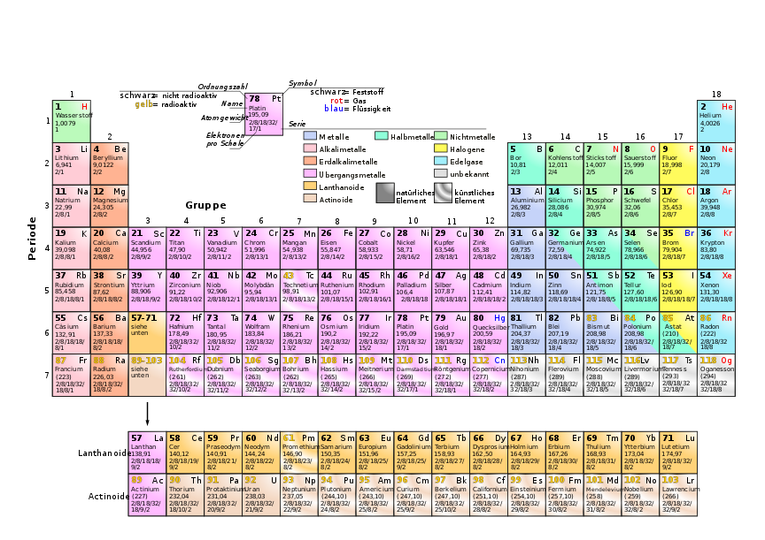
What can be expected?

Slide 31
What is the trajectory?
P. Bruce et al., Nature Mater. 11, 19 (2012)

Slide 32
How about the energy cost?
D. Larcher, J.M. Tarascon, Nature Chem. 7, 19 (2015)

Slide 33
Levelized cost of battery stored electricity
C. Kost et al., Fraunhofer ISE, March 2018

Slide 34
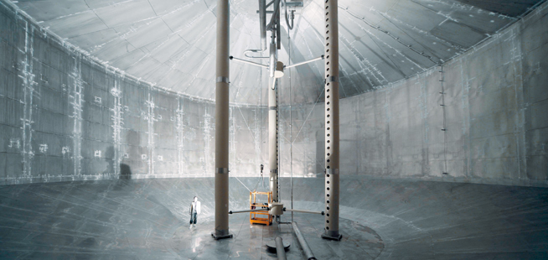

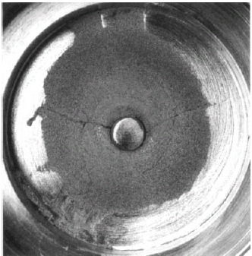
Why not even heat?
No energy conversion system cheaper than a water heater!
Why high exergy electricity to low exergy heat?
storage
© Ratiotherm
D. Laing et al., IRES III 2008,
24.-25.11.2008, Berlin
©solarmillenium
©Badenova

Slide 35
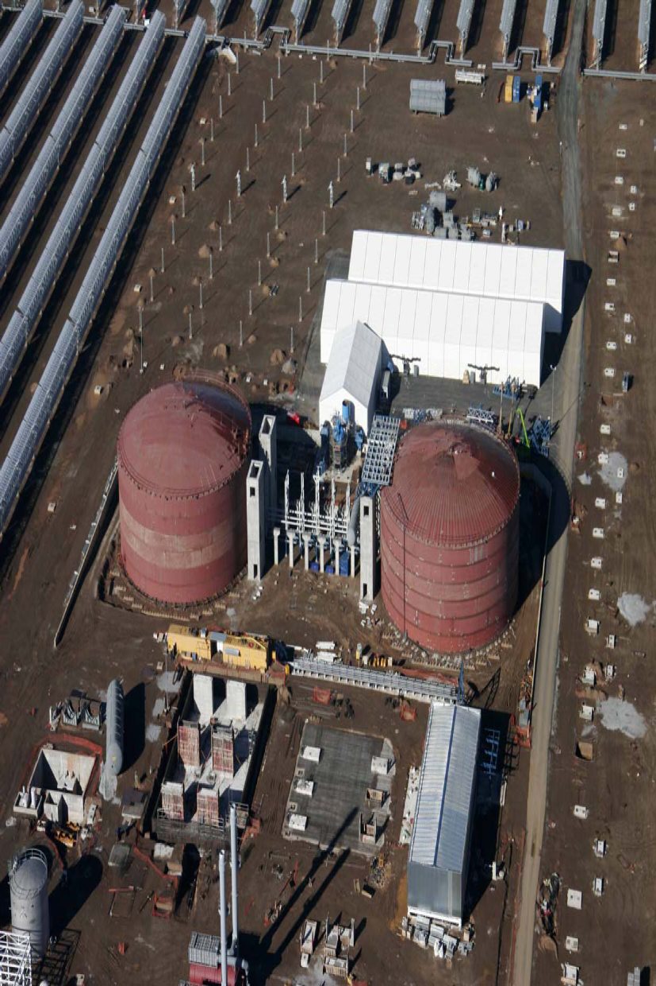
The biggest heat storage unit
©solarmillenium
Solar power plant Andasol I
27 500 t 60% NaNO₃/40% KNO₃ for heat storage between 386°C and 292°C
1010 MWh thermal, 7.5 h operation of 50 MW turbine

Slide 36
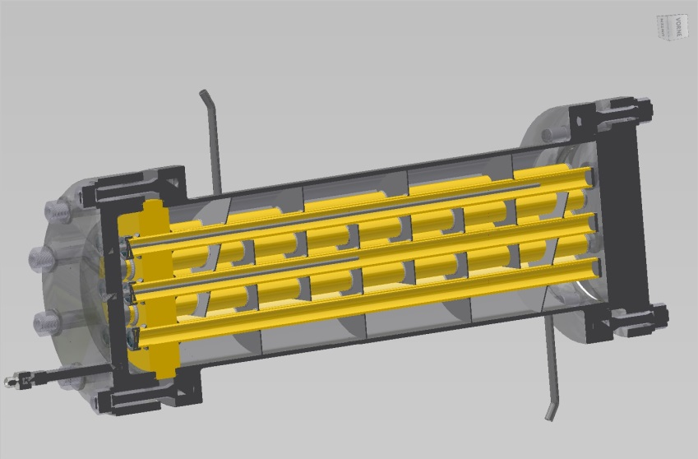
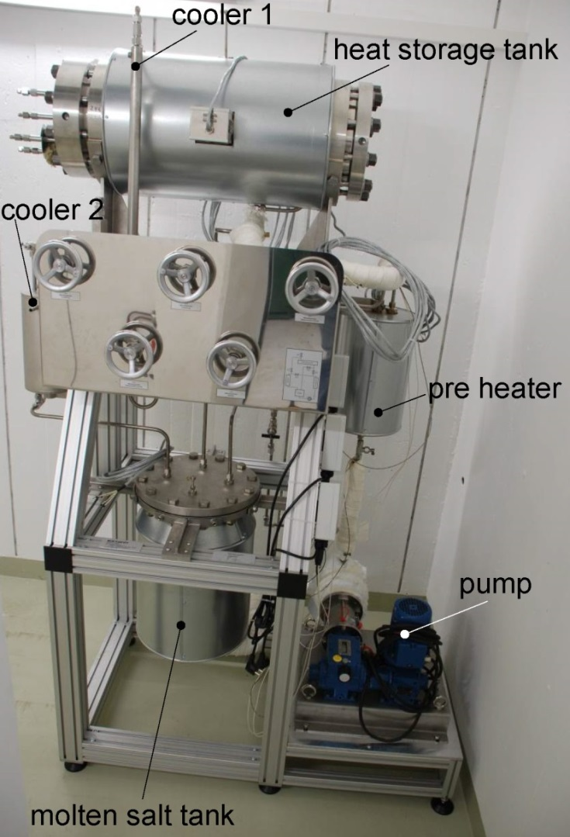
Thermochemical Heat Storage at 500 °C with
Mg₂FeH₆ (M. Felderhoff)
Molten salt exit
NaNO2:KNO3
2 Mg + Fe + 3 H₂
Mg₂FeH₆ + heat
H₂
Molten salt entry
  Mg₂FeH₆ Parameters:
    V_{2Mg-Fe}= 4.5 l
    ρ_{2Mg-Fe}= 1085 g/l
    m_{2Mg-Fe}= 4830 g
    x_{H2, real}= 5 %
    m_{H2}= 254 g
    m_{Mg2FeH6}= 5084 g
    Δ^{R}H= 77.2 kJ/mol H₂
    Q_{target=} 2.7 kWh

Slide 37
But we need business models
Storage (probably chemical) will be needed at large scale after 2040, but storage currently economically unattractive due to small price spread
E-fuels could bridge until full e-mobility, but currently much more expensive than conventional fuels
In addition, plants may produce only in transition period, which is not feasible at high capex
(International) Legislatory framework questionable
possibly retain some liquid fuel infrastructure, i.e. generate in sun-rich regions, transport to demand region

Slide 38
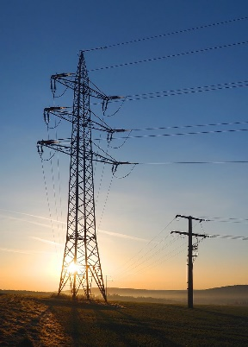

Take home
3. Relevante Mechanismen im Energiesystem
Our energy system is changing, and it will
become more electrical, with strongly
reduced CO₂ emissions
Fluctuating electricity supply needs to
be managed
Storage is one option
    Grid scale: probably only chemical storage
    Mobility: e-fuels, hydrogen, battery
    Heat: an underexplored option
Two „ceterum censeo“:
    the world is not just countries with a developed
    electricity grid
    Don‘t extrapolate linearly
Kreuzschnabel, CC BY-SA 3.0

Slide 39

A ceterum censeo…

