Slide 1
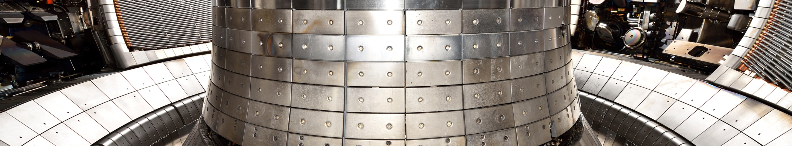
Nuclear fusion on the way to ITER and beyond
Thomas Pütterich
and the ASDEX Upgrade Team
AUG laser scan

Slide 2
Outline
Introduction to nuclear fusion with magnetic confinement
How does a tokamak fusion device work?
Critical open questions
  Future plans

Slide 3
Nuclear fusion with D-T
0.015% Deuterium in sea water
Deuterium
⁴Helium
3.5 MeV
Tritium does not occur naturally.
It decays with a half time of 12.3y.
14.1 MeV
Tritium
4.8 MeV
Neutron
⁴Helium
⁶Lithium
Lithium will be provided in the breeding blanket around the vacuum chamber

Slide 4
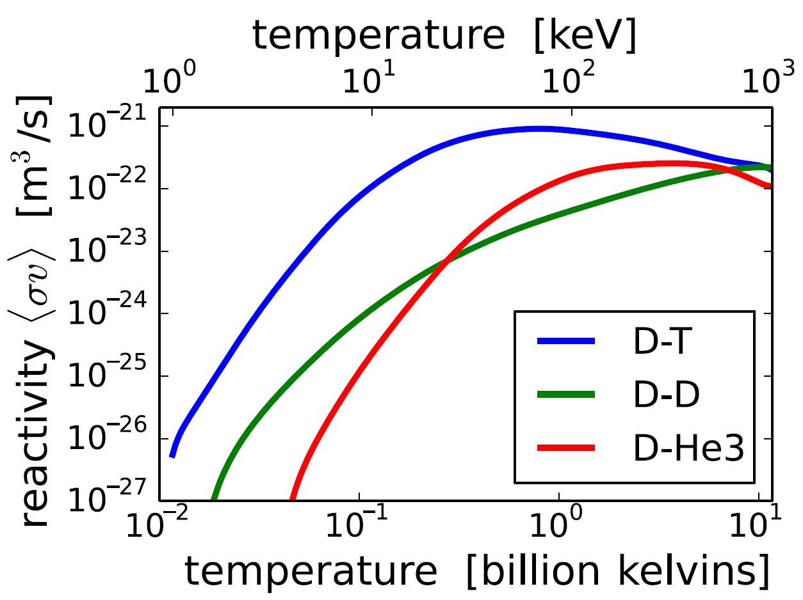
D-T fusion rate coefficients set temperature range
Ion temperature range: 10 - 30 keV
(100-300 Mio Kelvin)
Coulomb collisions orders of magnitude
more likely than fusion events → thermal plasma
Energy confinement time a few seconds:
density ~ 10²⁰ m⁻³
allowing fusion alphas (1/5 of power)
to compensate energy loss
Source: Wikipedia

Slide 5
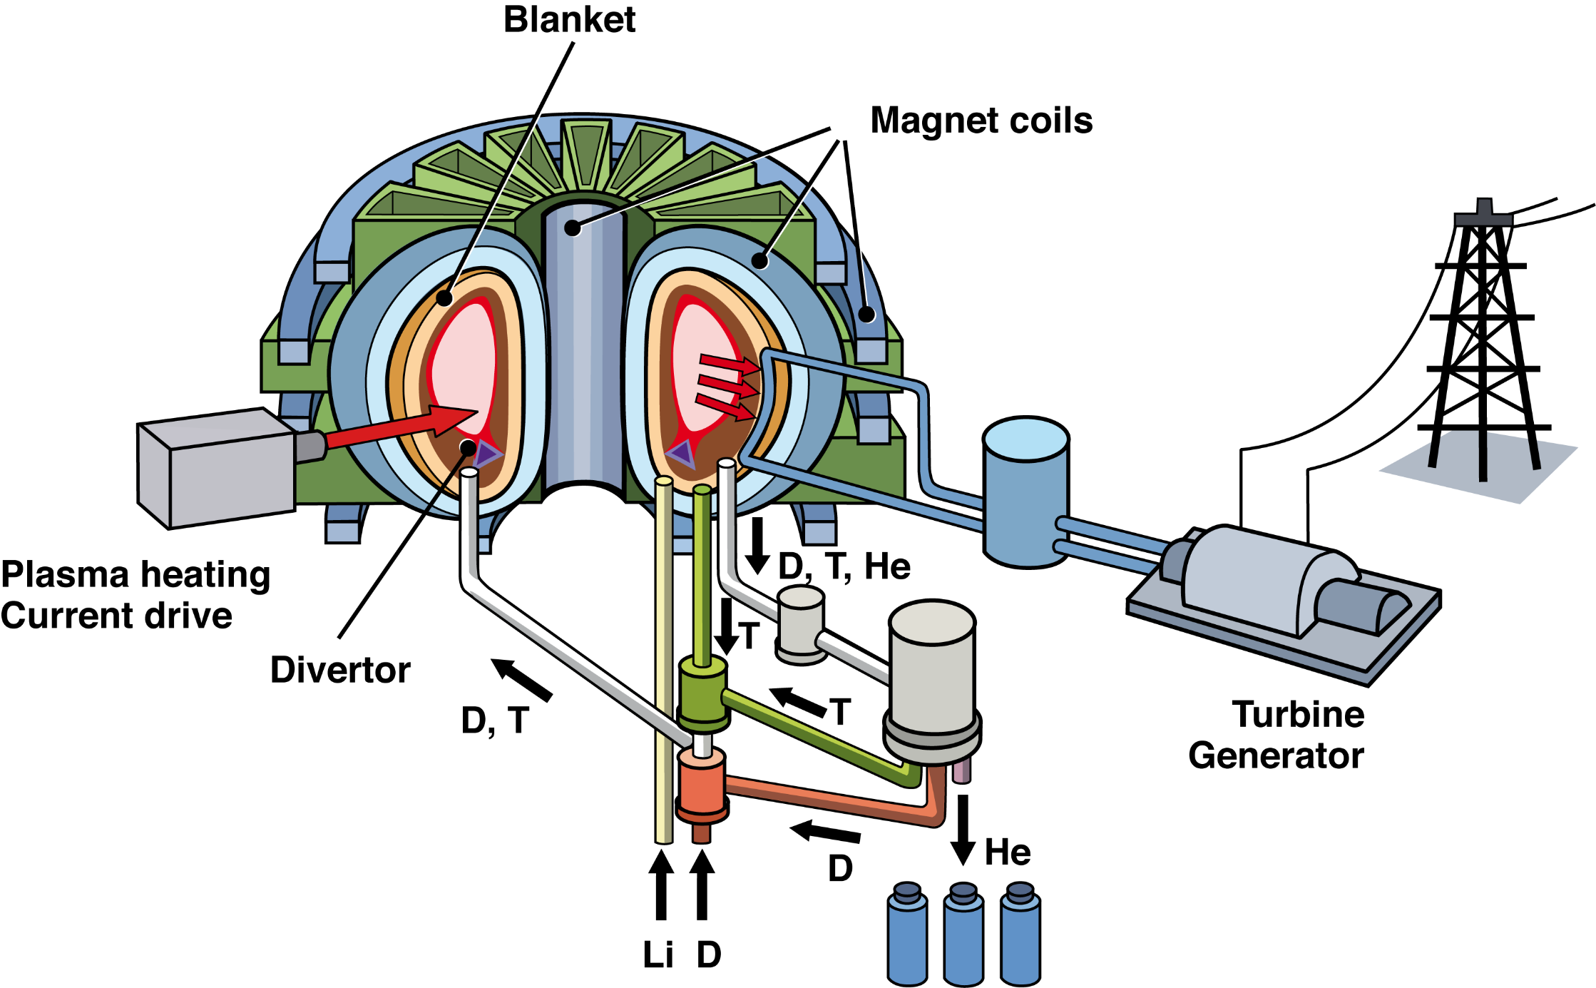
Reactor Schematics for Magnetic Confinement Fusion
Graphic: IPP, Karin Hirl
No long-lived waste
No chain-reaction
Base load electricity
No CO₂

Slide 6
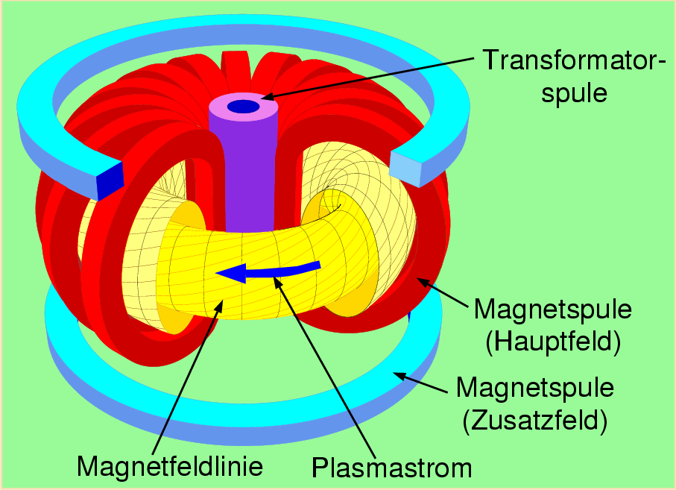
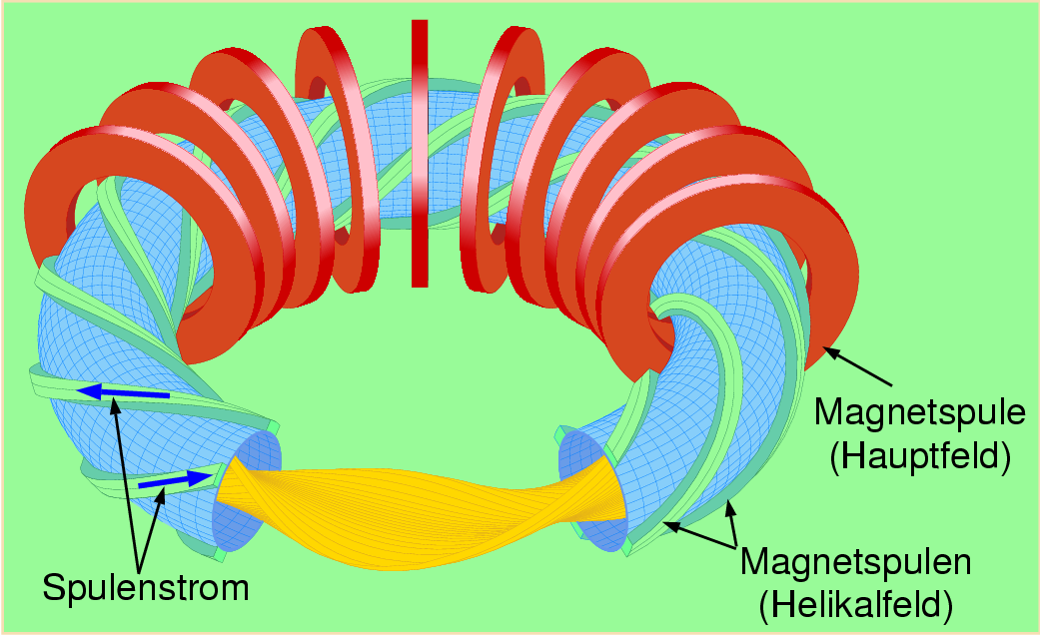
Two Lines of Experiment Types
Tokamaks (focus of this talk)
plasma current via transformer principle
Well developed concept => ITER
Stellarators
only external coils, no plasma current
one generation behind, but potentially the better solution for a reactor
central solenoid (transformer)
toroidal field coil
toroidal field coil
vertical field coil
helical field coil
coil current
magnetic field line
plasma current

Slide 7
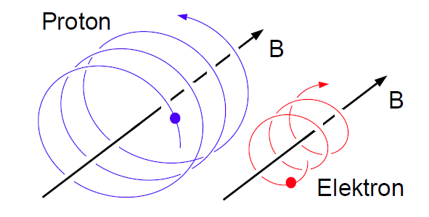
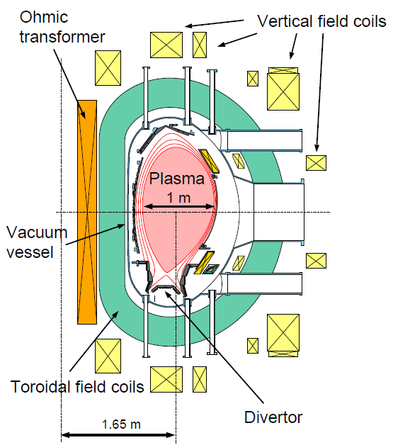
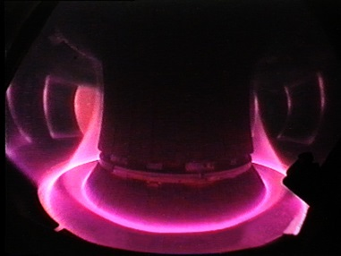
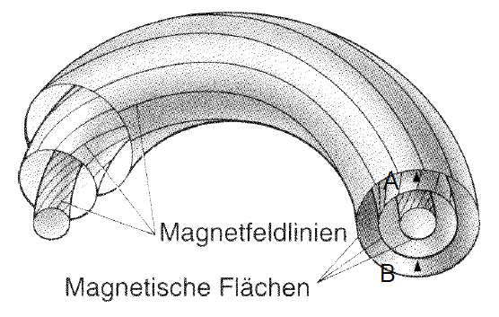
Magnetic container for charged particles
Charged particles bound
to magnetic field lines
ASDEX Upgrade (video camera)
Magnetic field lines
const. pressure
(and T) on flux surfaces
magnetic field lines
flux surfaces
ASDEX Upgrade

Slide 8
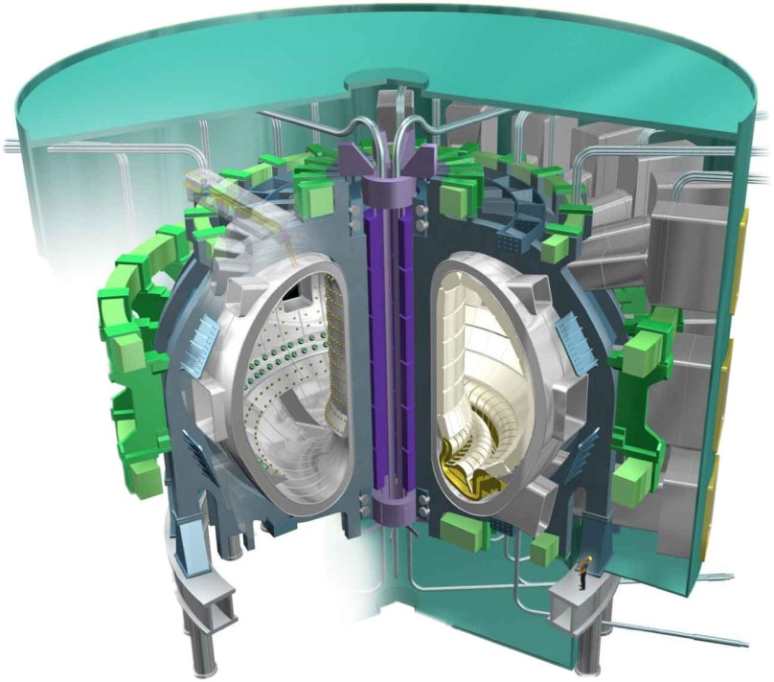
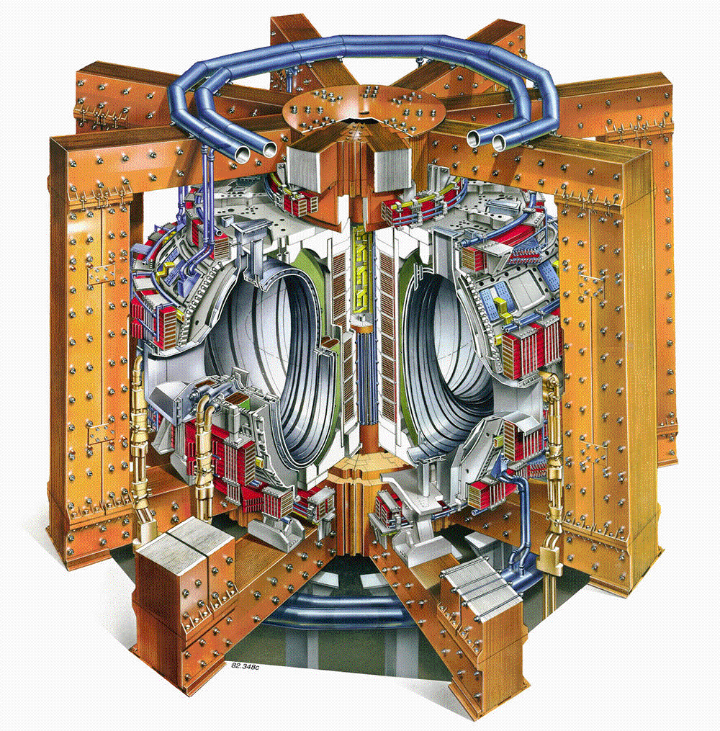
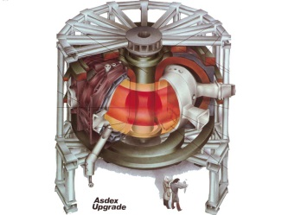
Step-ladder of tokamak experiments
ASDEX Upgrade
3.3 m
14 m³
1.5 MW
(D-T equivalent)
JET
6 m
80 m³
~ 16 MW_{th}
(D-T)
ITER
12 m
800 m³
~ 500 MW_{th}
(D-T)
diameter
plasma volume
fusion power
Coil and divertor configuration very similar between ASDEX Upgrade and ITER & W as prominent wall material

Slide 9
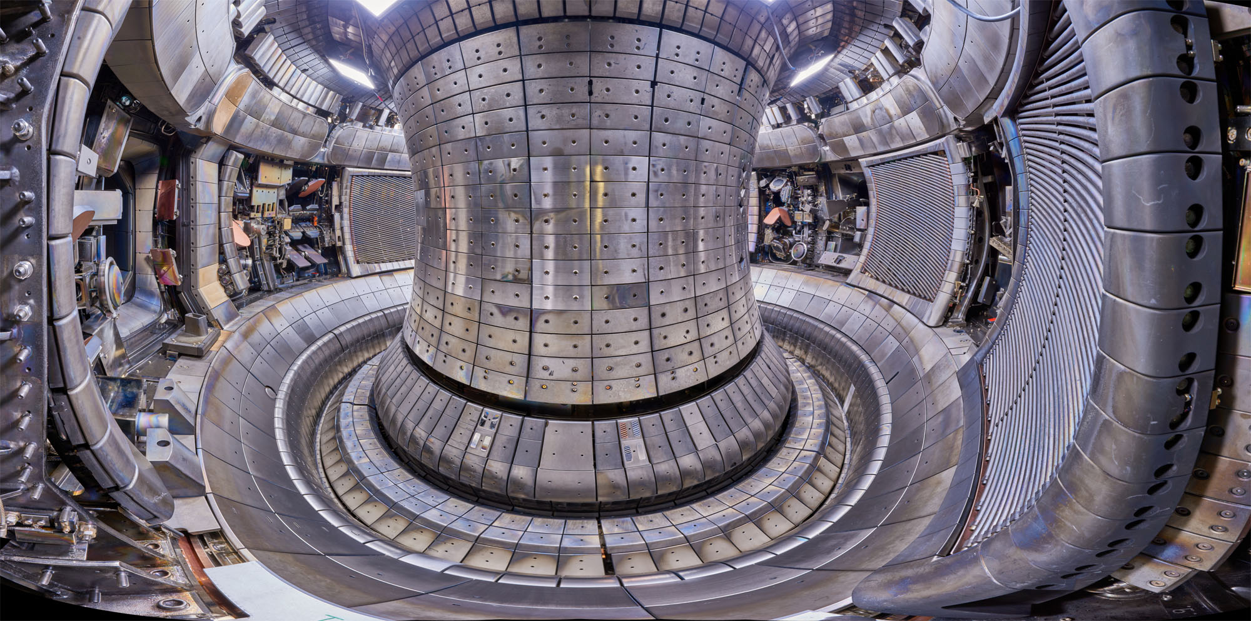
A view into the ASDEX Upgrade torus after 30 years of operation
first wall made from W since 2007

Slide 10
Open problems in tokamak research
Power exhaust
Avoidance of transients (edge localised modes, disruptions)
Stationary tokamak operation
Predicting the plasma properties
Individual solutions for 1-4 available, but integration into 1 reactor scenario challenging

Slide 11
Open problems in tokamak research
Power exhaust
Avoidance of transients (edge localised modes, disruptions)
Stationary tokamak operation
Predicting the plasma properties
Individual solutions for 1-4 available, but integration into 1 reactor scenario challenging

Slide 12
Power balance in ITER
fusion amplification factor =10
400 MW leave as neutrons
converted to heat in the blanket
100 MW heat plasma (α particles)
50 MW additional heating for control
150 MW have to be transmitted to cooling system:
50 MW core radiation, 100 MW to divertor
50 MW
500 MW
divertor radiation
Power exhaust can be developed and tested in smaller device ASDEX Upgrade:
power/radius good scaling parameter for similar edge plasma parameters:

Slide 13
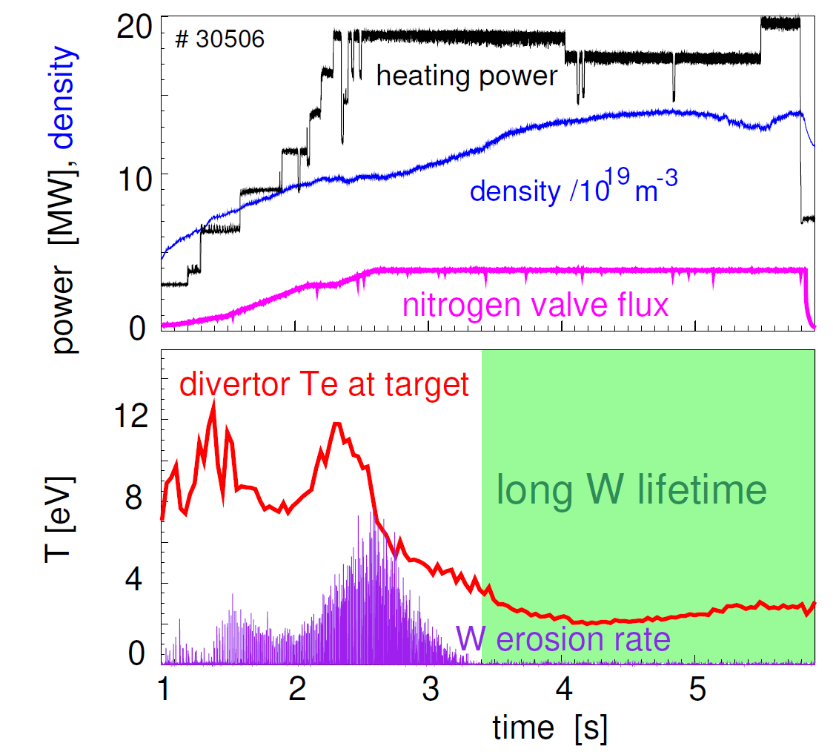
Tungsten divertor erosion switched off with nitrogen seeding
W erosion switched off when T_{e} < 4 eV
Note that a high plasma density is required
to for efficient divertor cooling

Slide 14
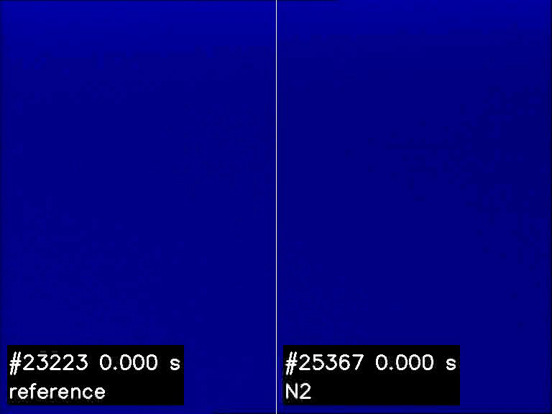
Video: effect of nitrogen seeding on divertor heat load

Slide 15
Power balance in a reactor: need to add outer core radiation
fusion amplification factor =25
1600 MW leave as neutrons
converted to heat in the blanket
400 MW heat plasma (α particles)
80 MW for control, current drive
480 MW have to be transmitted to cooling system:
360 MW core radiation, 120 MW to divertor
80 MW
2000 MW
strong outer core radiation
similar to ITER solution ?
may be more challenging in a reactor due to lower divertor density
→ alternative divertor ?
combination of outer core and divertor radiation calls for an impurity mix (e.g., Ar + Xe)

Slide 16
Open problems in tokamak research
Power exhaust
Avoidance of transients (edge localised modes, disruptions)
Stationary tokamak operation
Predicting the plasma properties
Individual solutions for 1-4 available, but integration into 1 reactor scenario challenging

Slide 17
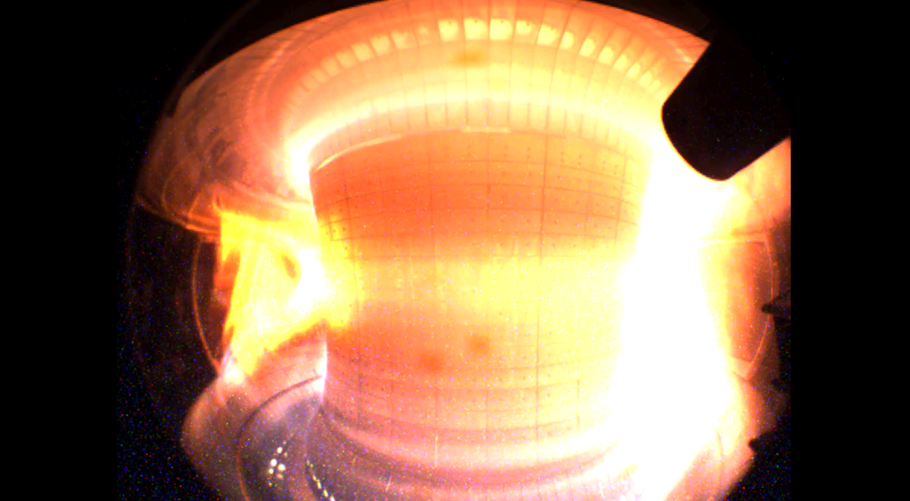
Transients: Avoid of Mitigate
Edge localized modes: repetitive power pulses, degrade W divertor surface
(Disruptions: Strong forces on plasma facing components, structural elements and coils)
➔ Video

Slide 18
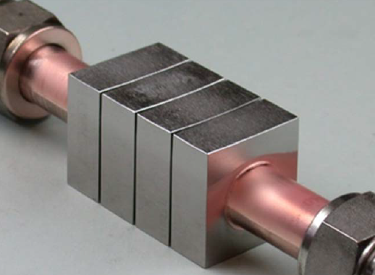
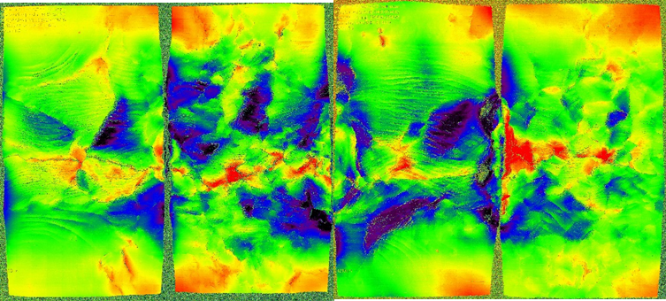
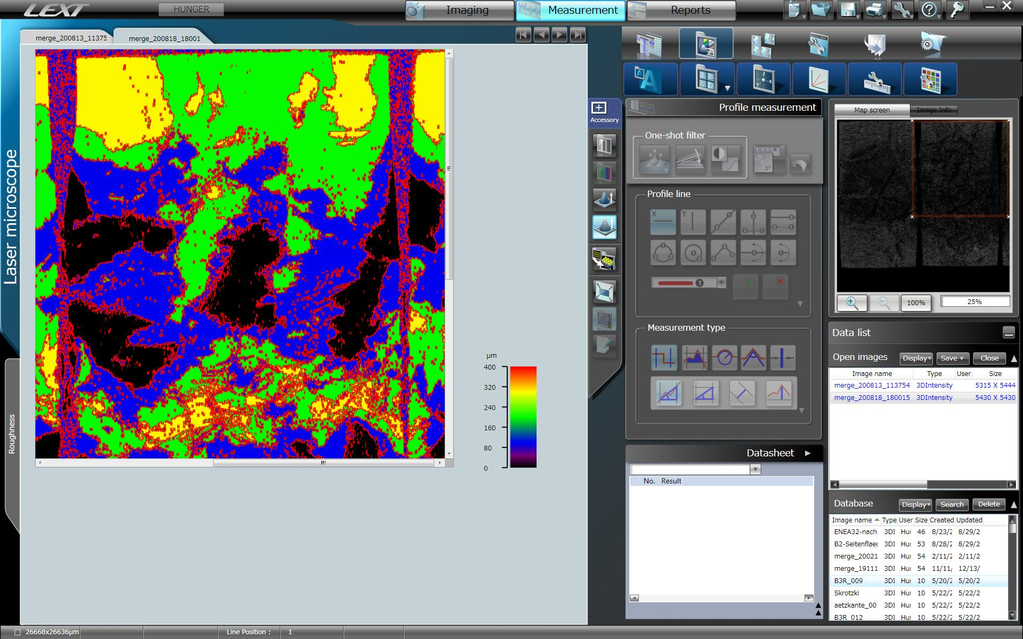
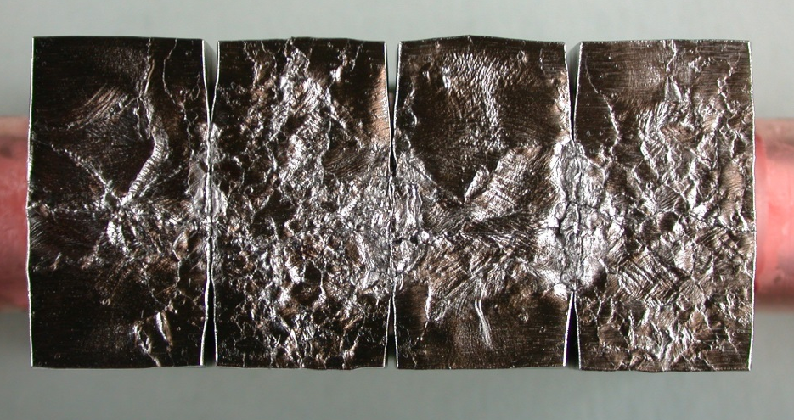
Suppression of edge localized modes (ELMs)
ELMs degrade tungsten surfaces in the divertor and may lead to excessive W erosion
After repetitive power loading with 20-25 MW/m² in GLADIS
23
~50 mm
→ a high number of large ELMs not tolerable in ITER / fusion reactor

Slide 19
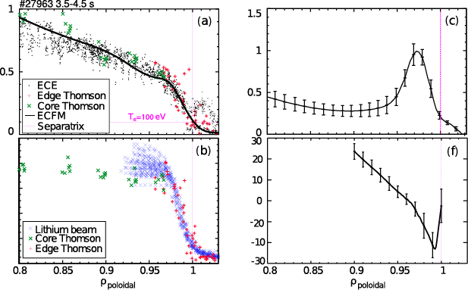
Steep edge transport barrier (ETB) root cause for ELMs
E. Wolfrum et al. Nuclear Fusion 2015 and DPG, Munich, 2019
T_{e}
<j>
steep pressure profiles
E_{r} gradients
edge current density peak j
p’ and j drive instabilities
magneto-hydrodynamic
ELMs = edge localised modes
T_{e} (keV)
j (MA m⁻²)
10
8
6
4
2
0
n_{e}
E_{r}
n_{e} (10¹⁹ m⁻³)
E_{r} (kV m⁻¹)
ETB
-10
-20
ETB sets boundary condition for core plasma performance and occurence of edge localized modes

Slide 20
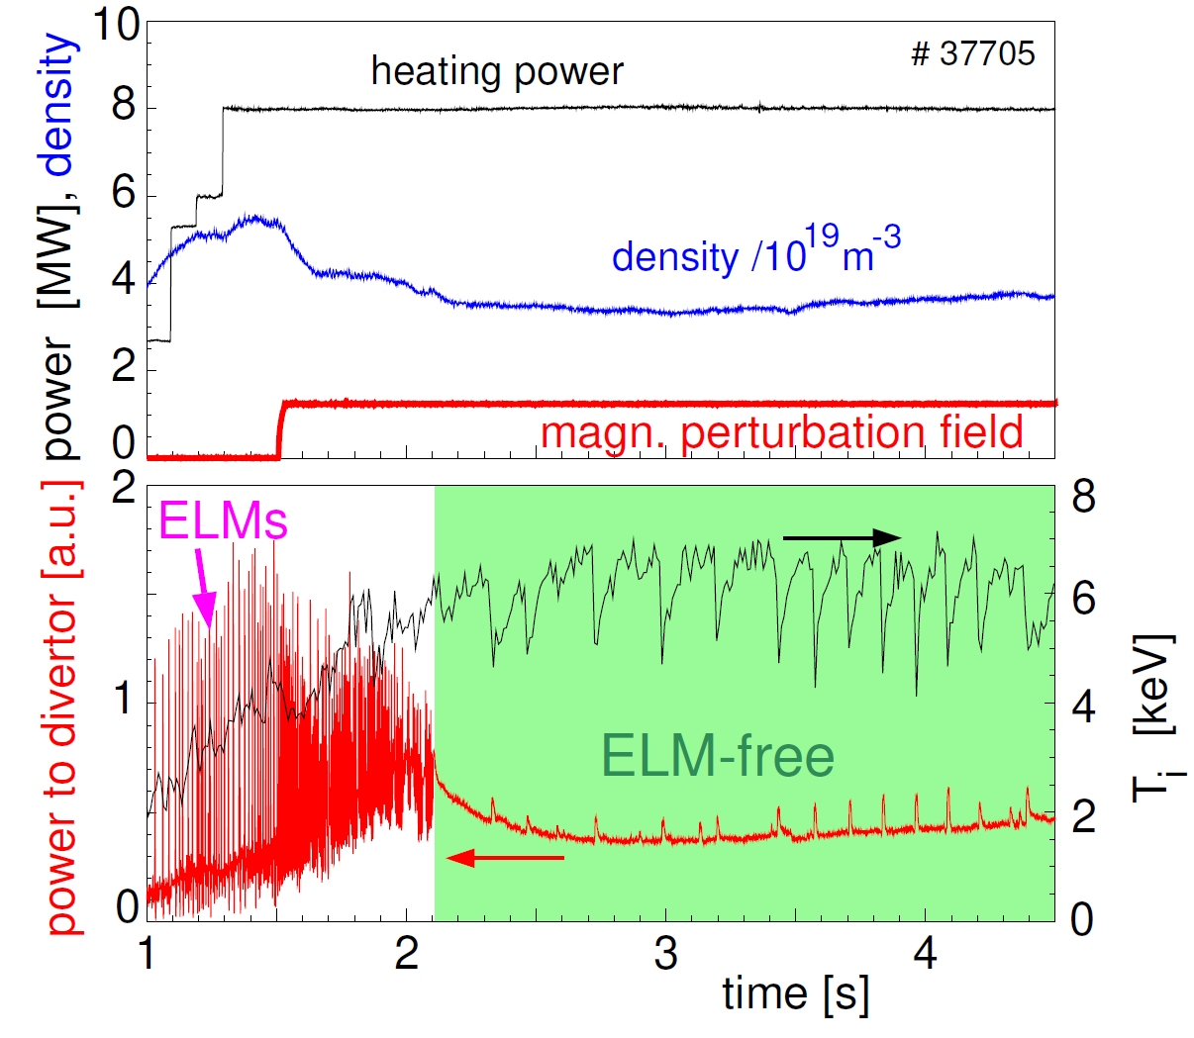
Suppression of edge localized modes (ELMs)
16 dedicated magnetic perturbation coils
installed in ASDEX Upgrade
Edge transport barrier ameliorated
ELMs completely suppressed
Note: works in ASDEX Upgrade
only at very low density
(relevant non-dimensional parameter
not yet identified. If low collisionality
required, fine for ITER)

Slide 21
Open problems in tokamak research
Power exhaust
Avoidance of transients (edge localised modes, disruptions)
Stationary tokamak operation
Predicting the plasma properties
Individual solutions for 1-4 available, but integration into 1 reactor scenario challenging

Slide 22
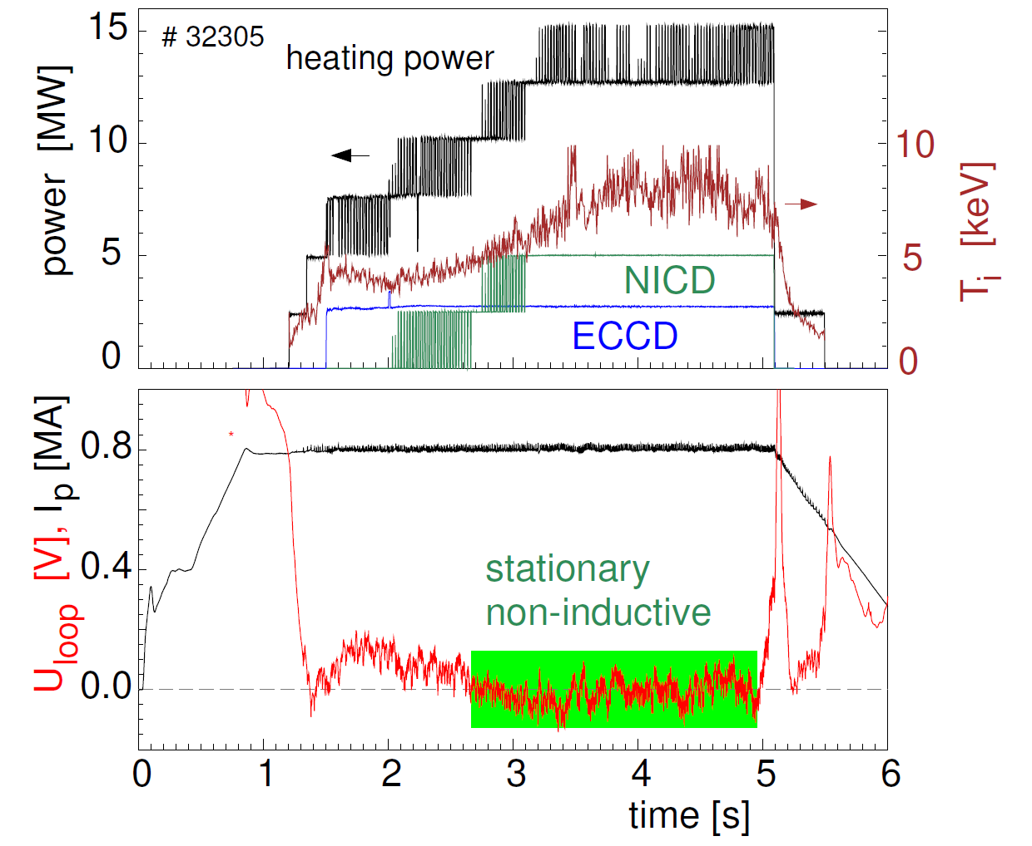
Route towards stationary operation
Loop voltage can be brought to zero
by NBI and ECRH current drive (NICD,ECCD) and
internal bootstrap current
Current profile shaping required to avoid
MHD instabilities
This corresponds to stationary tokamak operation
Note: low density is required to make
current drive efficient

Slide 23
Open problems in tokamak research
Power exhaust
Avoidance of transients (edge localised modes, disruptions)
Stationary tokamak operation
Predicting the plasma properties
Individual solutions for 1-4 available, but integration into 1 reactor scenario challenging

Slide 24
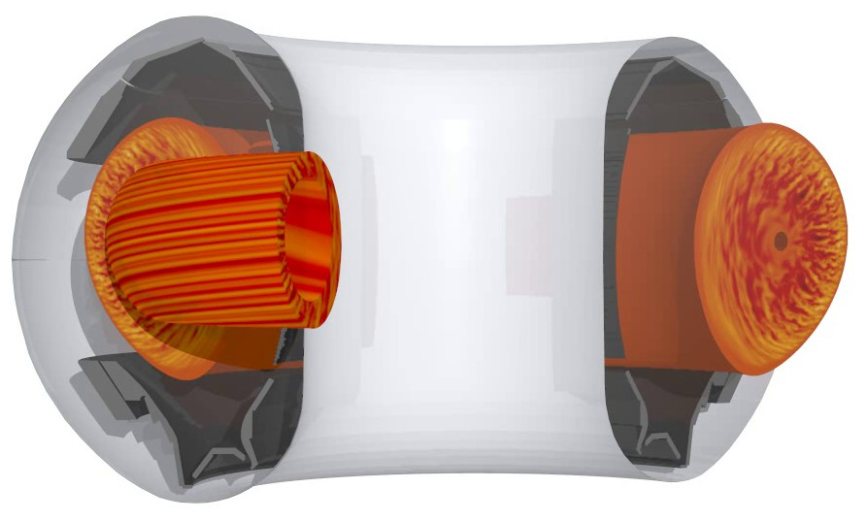
GENE code predicts turbulent transport in the plasma core
Quite well validated vs.
experiment
(with pedestal top as
boundary condition)
Turbulence driven by
∇T_{i}, ∇T_{e}
Influence of T_{e}/T_{i}, rotation,
fast particles, impurities, ..
genecode.org

Slide 25
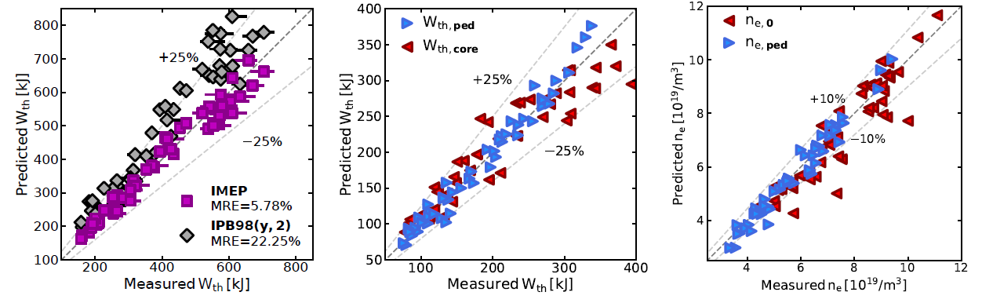
Combination of reduced physics and empirical model for pedestal
ASDEX Upgrade energy confinement well decribed using engineering parameters
Next: implementation for different tokamaks, model improvement, → tokamak flight simulator

Slide 26
Summary
Good progress achieved on several key areas:
energy confinement, power exhaust, ELM and disruption avoidance
But not simultaneously in a single discharge! Not one set of dimensionless parameters.
Accompanying first principle modelling required for extrapolation
Pedestal region still lacks coherent physics description (but expected to come)
Integration of all this requires a large device → ITER
Final model validation by testing ITER predictions in 2030s

Slide 27
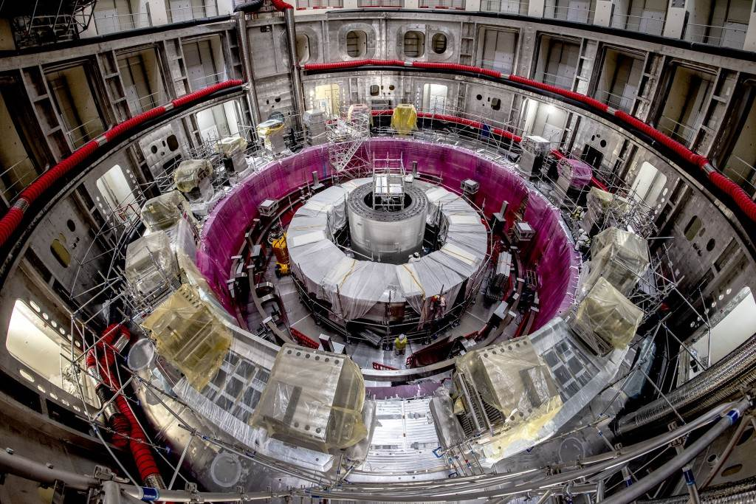
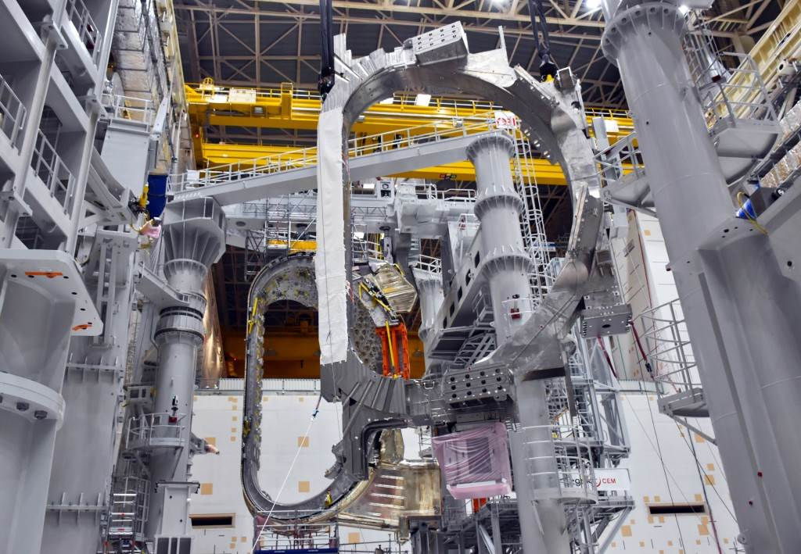
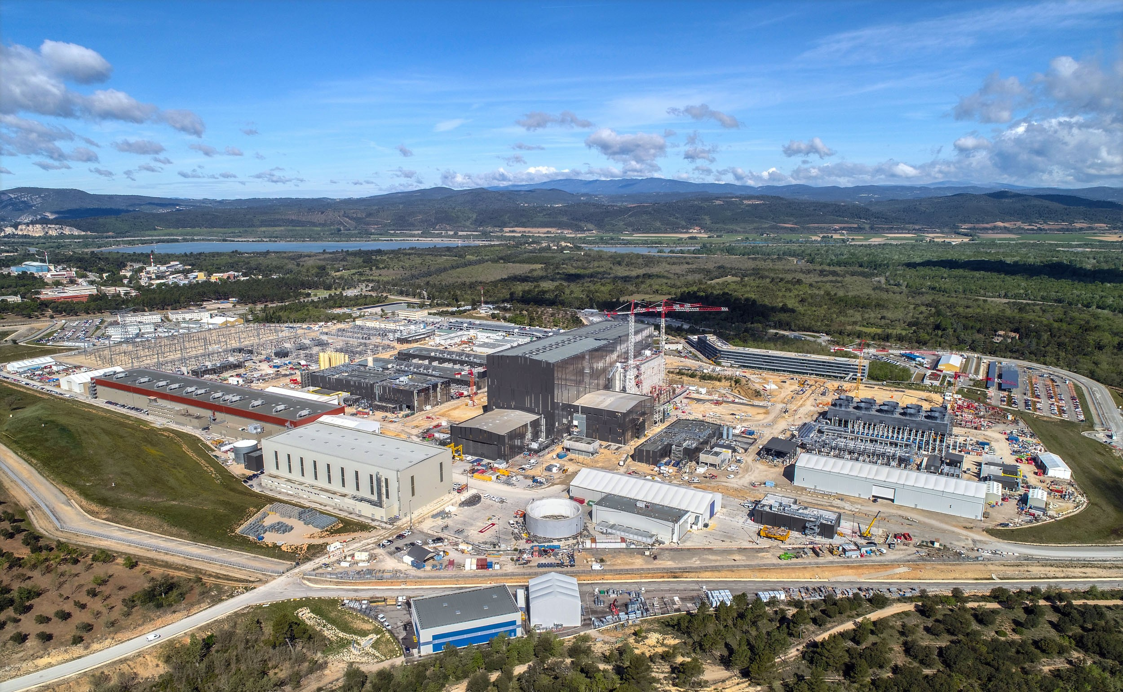
ITER site as of May 2021 (first plasma planned Dec 2025)
Photo:
ITER Organization /
EJF Riche

Slide 28
What next ?
The milestone for nuclear fusion develoment is a burning plasma in ITER
- ITER operation to start in Dec 2025, D-T fusion in 2036
regarding plasma physics, the step from ITER to a tokamak demonstration plant DEMO is not a very big one
  A tokamak DEMO will be ~ 30 % larger than ITER (in linear scale)
  Tungsten is reference surface material, but components can be further improved: e.g. by W fibre-reinforced W composites
  DEMO to start operation in the 2050s
Possibly the stellarator line qualifies as a reactor candidate (=> Stellarator DEMO?)

Slide 29
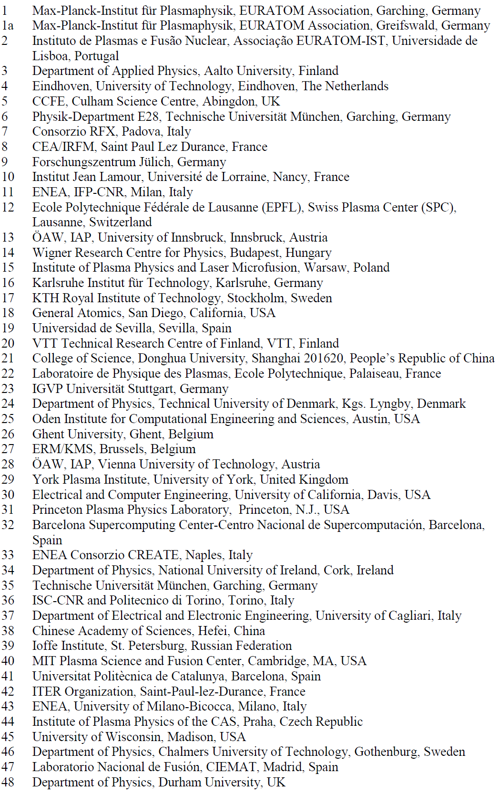
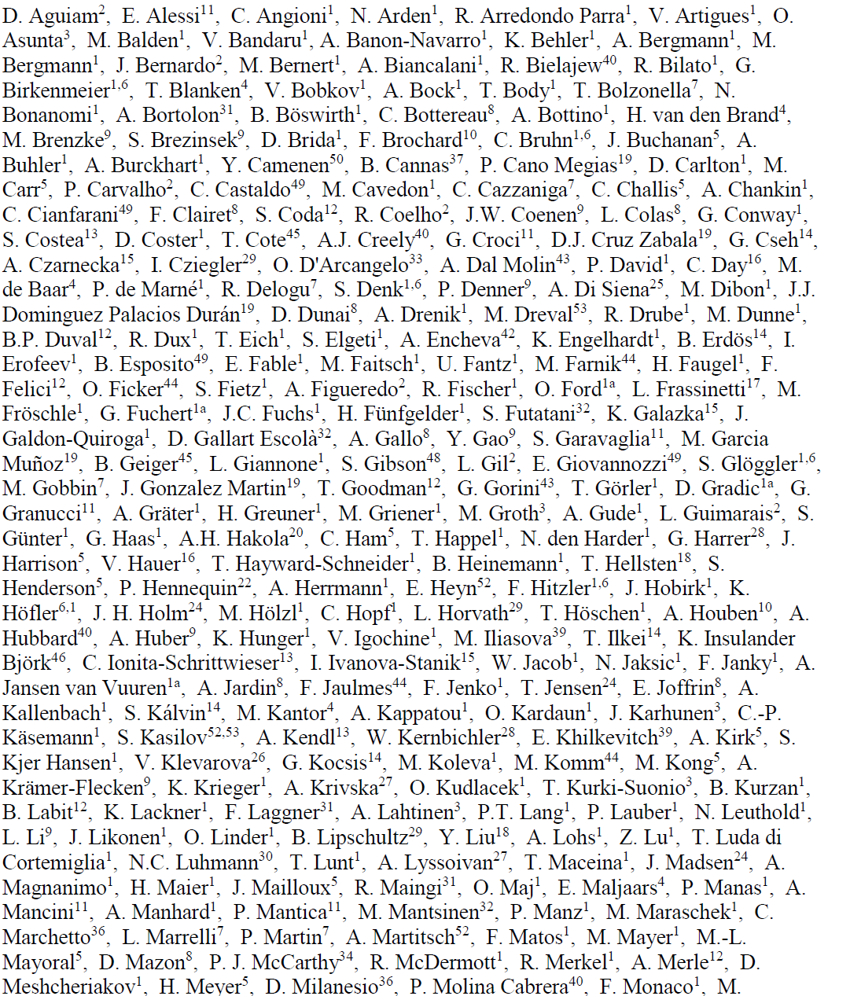
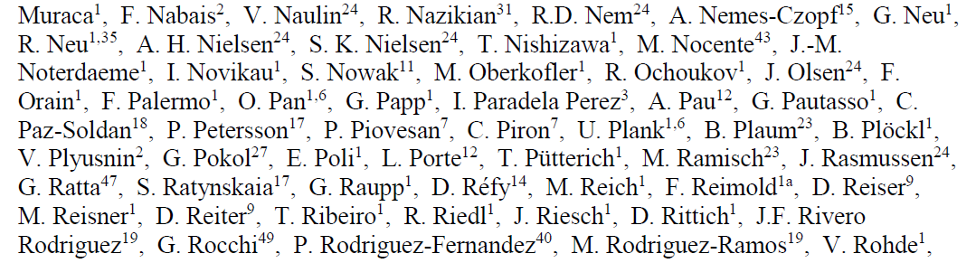
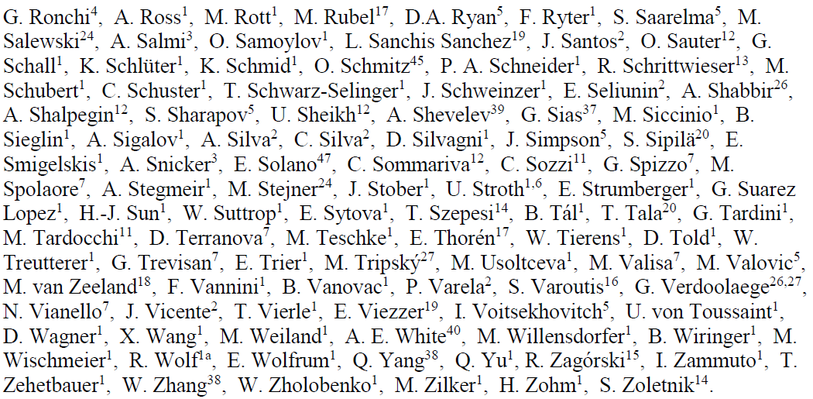
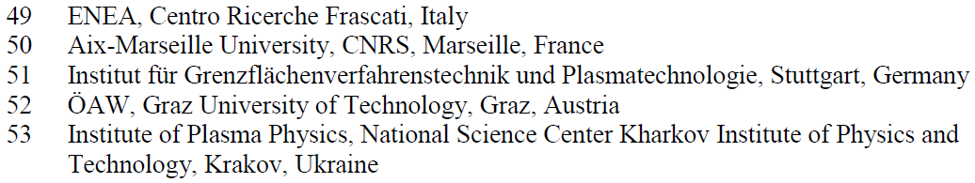
Thanks to: The ASDEX Upgrade team
Special thanks to the AUG technical staff
for excellent work in operation, maintenance
and extension

