Slide 1
Systems Studies of Fusion Power Plants
Jorrit Lion
Max-Planck-Institute for Plasmaphysics Greifwald

Slide 2
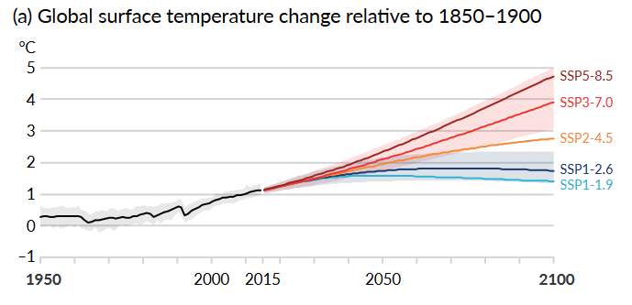
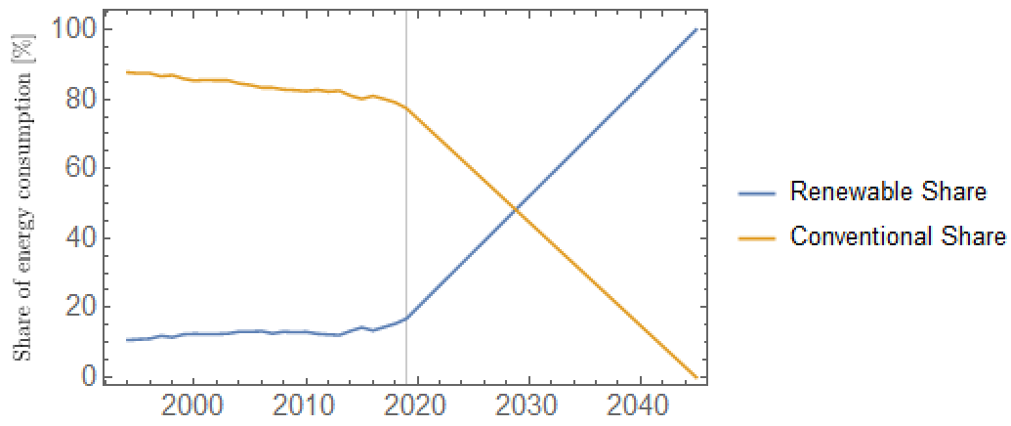
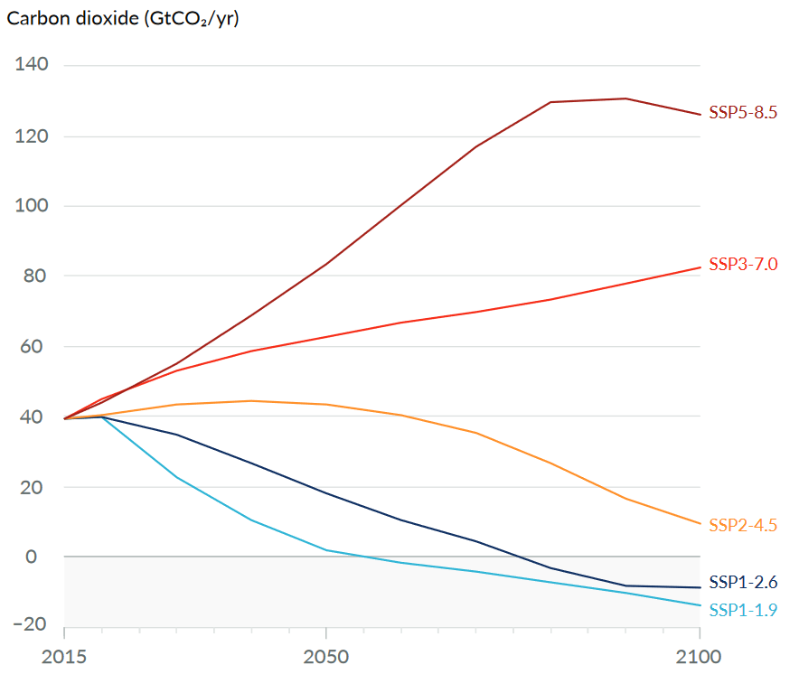
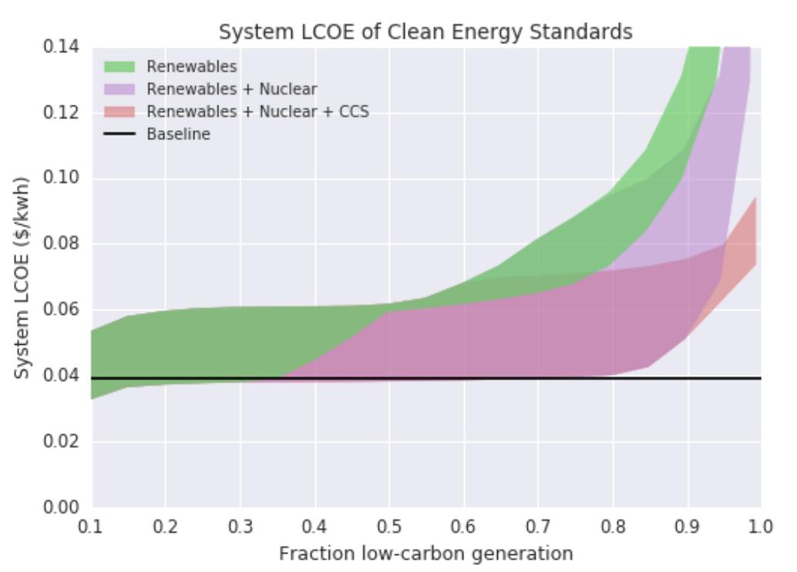
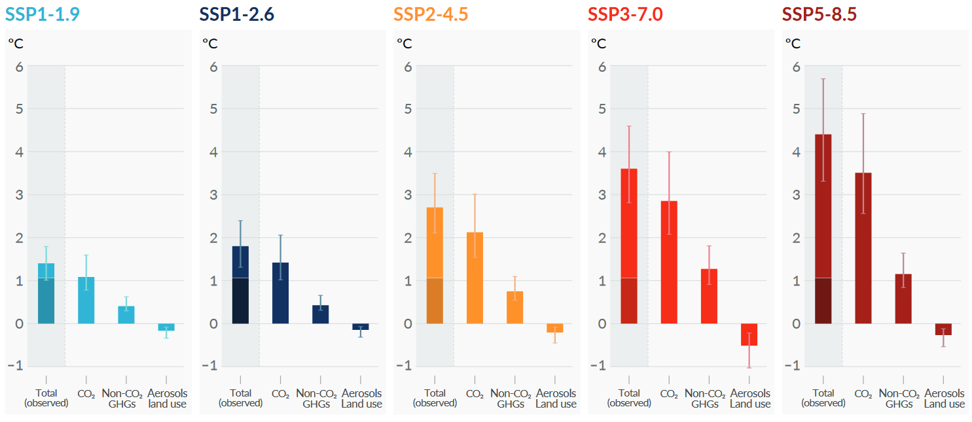
Motivation for Fusion Energy
1.5°C goal requires zero global net GHG emissions by 2050 and significant negative emissions after.
Main Share of GHG emissions is in the Energy Sector
DAC requires 300 MW/(MtCO2/yr)
70 MtCO2/yr (10% of Germany's today's GHG Emissions) requires 21 GW additional power (1/3 of today's electricity production in Germany)
Intermittent renewables require:
Load Management
Base-Load
Storage
Dispatchable sources
Transmission Lines
Future demand for GHG emission free power sources, baseload compatible: E.g. Fusion
Energy Consumption Germany
Data
Extrapolation
Noah McQueen et al Prog. Energy 3 (2021)
Target
Data: Andrew, Robbie M., & Peters, Glen P. (2021). "The Global Carbon Project's fossil CO2 emissions dataset"
Platt, John and Pritchard, Orion and Bryant, Drew, Analyzing Energy Technologies and Policies Using DOSCOE, SRNN (2017).
IPCC, 2021: "Climate Change 2021: The Physical Science Basis."
Notes:
DAC: Direct Air Capture, DACCS: Direct Air Carbon Capture and Storage

Slide 3
Fusion – the D-T fuel cycle
D-T cross section 1000 times larger at 10 keV than other fuels
Deuterium and Lithium reserves:
Deuterium in seawater (0.015%)
Li Reserves:
Current on-land reserves: ~30 Mt
24 EWh/year requires 10 Mt Li for 1000 years
Li seawater > 200 Gt
With higher confinement, other burn fuels appear possible (D-He3 e.g.)
D-Li energy density 2 $∙{10}^{8}$ MJ/kg
(Oil 45 MJ/kg, U-235 8$∙{10}^{7}$ MJ/kg)
Plasma
+
+
D
+
He-4
+3.5 MeV
+
n
+14.1 MeV
T
+
He-4
+
Li-6
+
T
+
Breeding Blanket
Notes:
D extracted by electrolysis of heavy water obtained from freshwater via the GS (Girdler sulfide) isotopic
exchange process

Slide 4
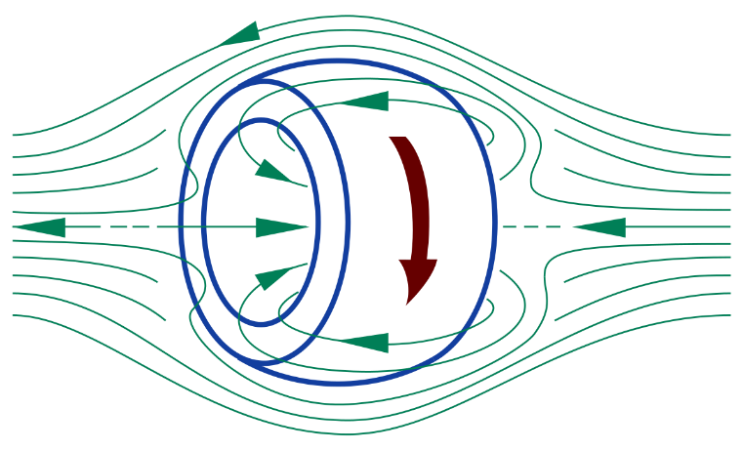
Fusion – Confinement Concepts
Confined by magnetic fields
Magnetic confinement
Tokamak
Stellarator
Z-Pinch
FRC (field – reversed - configurations)
Spheromak
Inertial confinement
wikipedia.org/wiki/Field-reversed_configuration
Confined by inertia

Slide 5
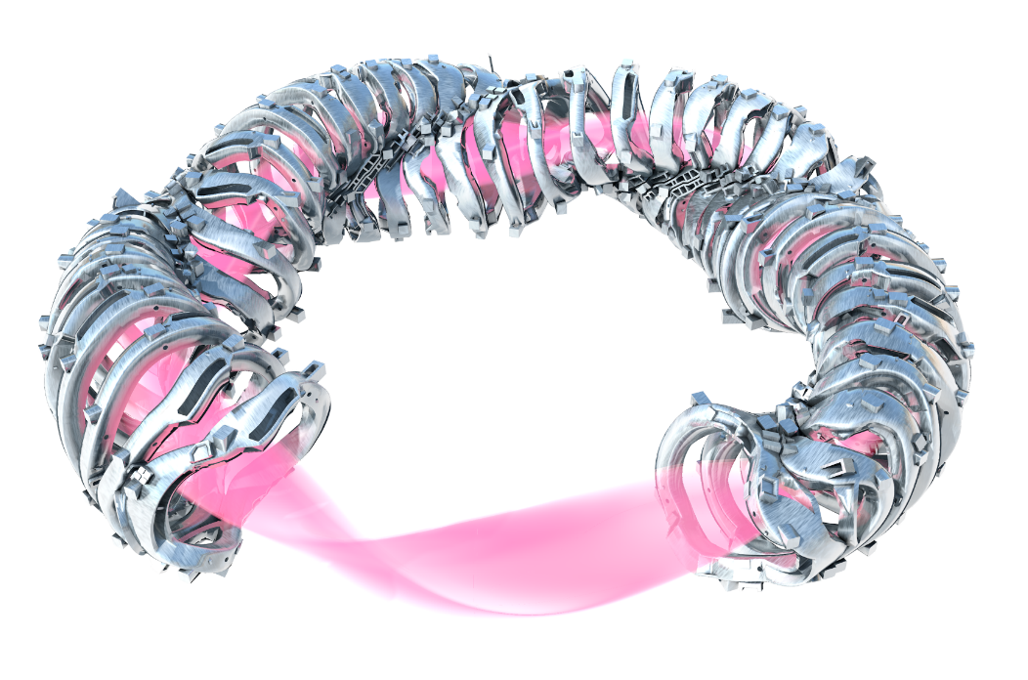
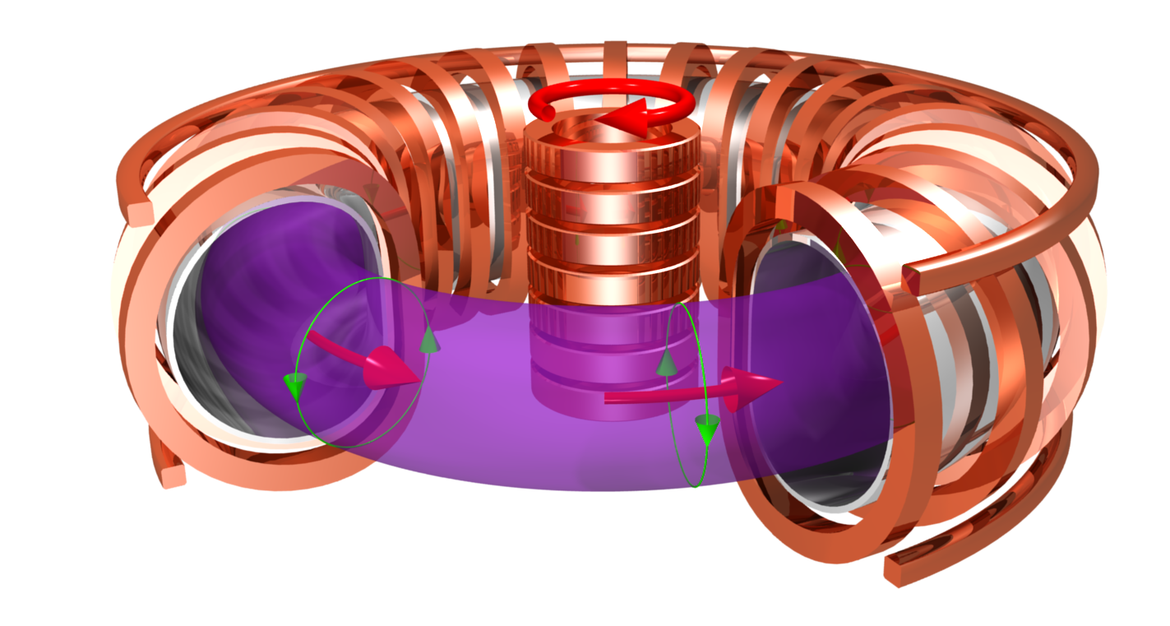
Stellarators and Tokamaks
Tokamak
Poloidal field produced by plasma current
Plasma current drive needed
Poloidal field coils
Planar coils
Pulsed operation
Stellarator
Poloidal field produced by coils
No current drive needed
No poloidal field coils required
Non-planar coils
Steady state operation

Slide 6
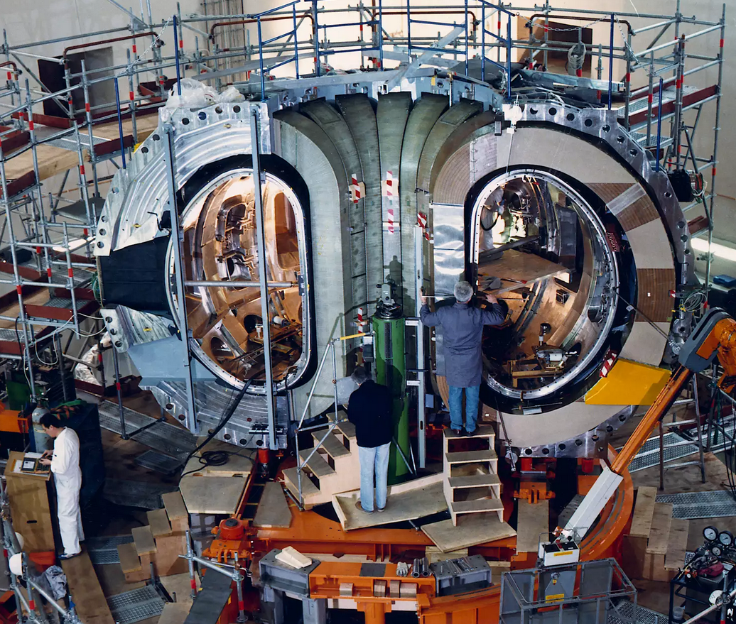
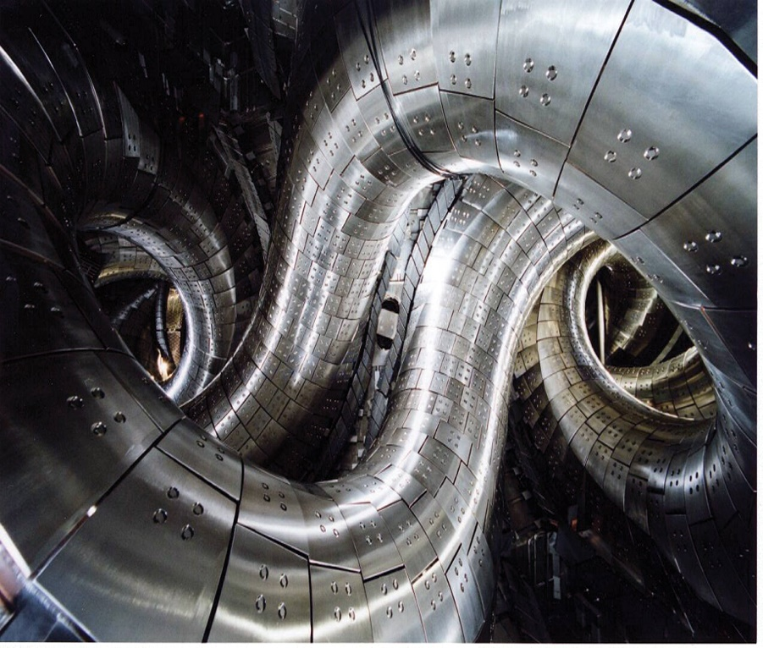
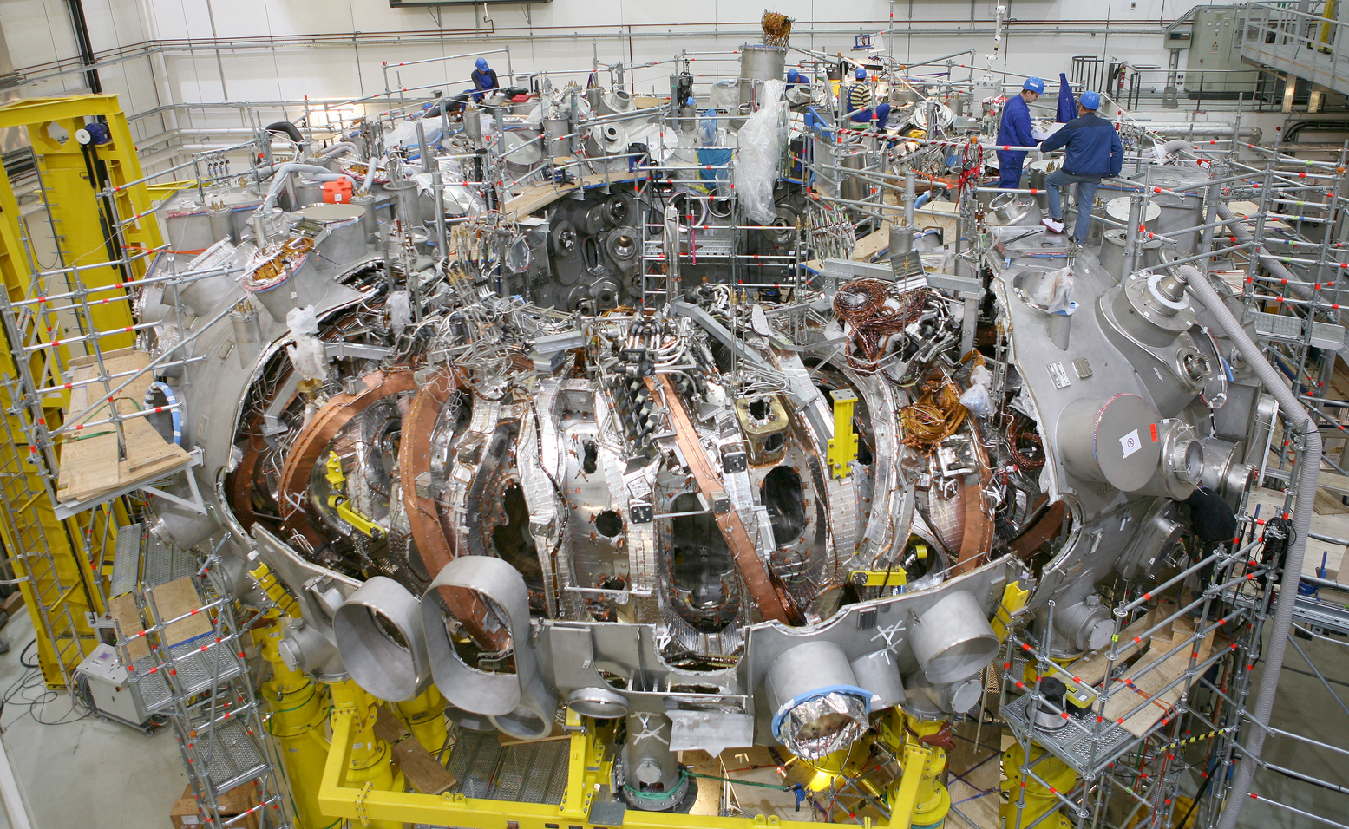
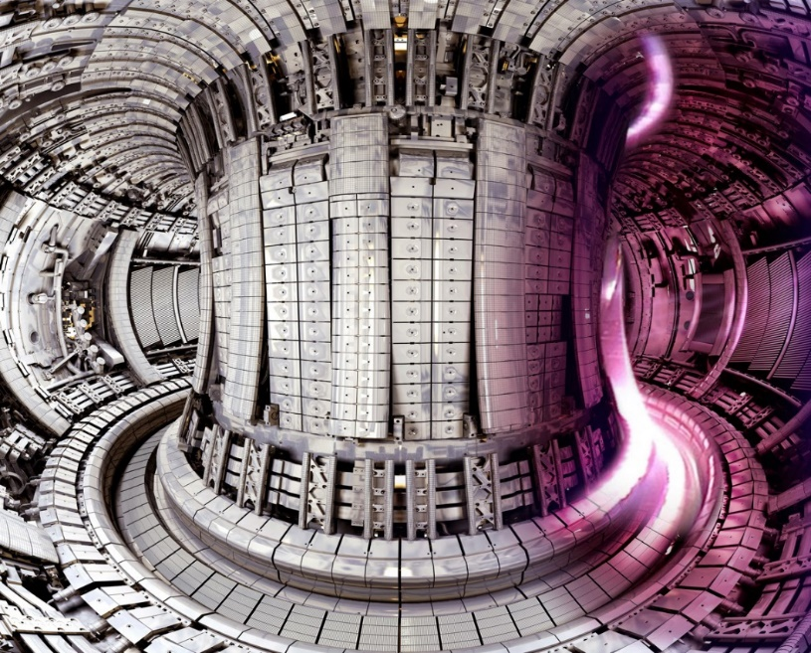
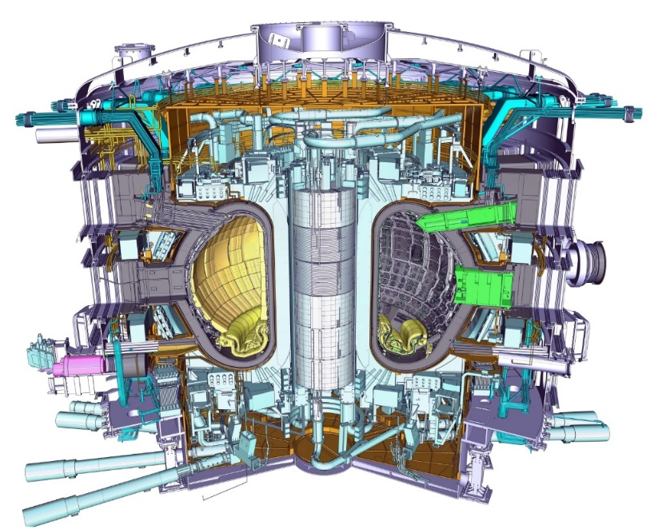
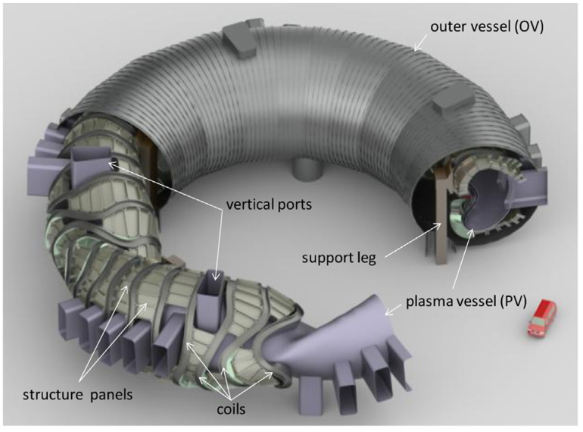
Stellarators and Tokamaks: Realised Experiments
LHD (Toki, Japan)
ASDEX Upgrade (Garching, Germany)
W-7X (Greifswald, Germany)
JET (Culham, UK)
ITER (Cadarache, France)
Fusion Reactor (???)
…
under construction
Conceptional Stage

Slide 7
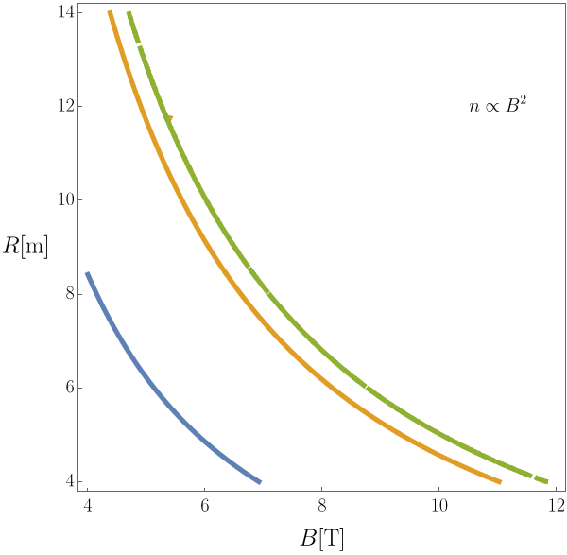
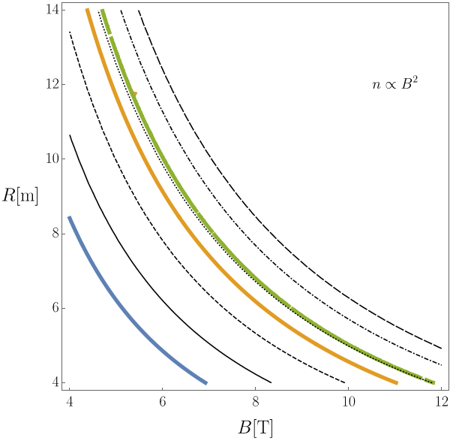
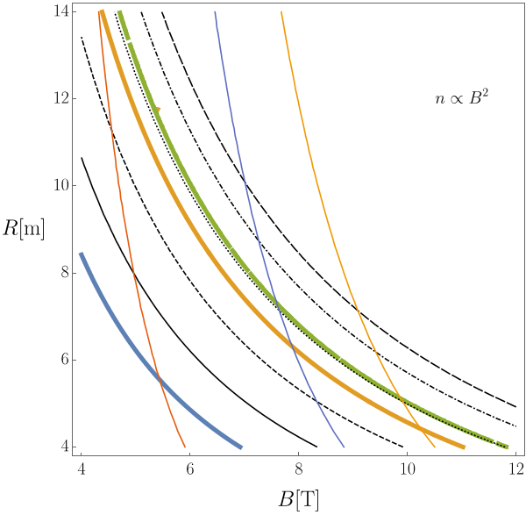
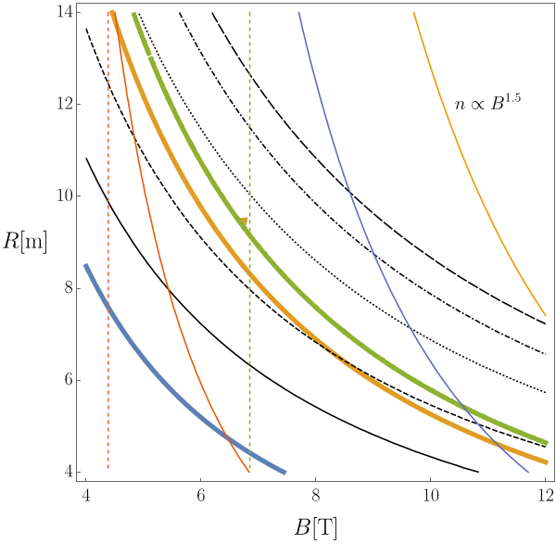
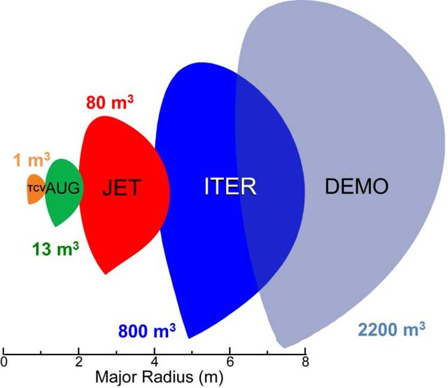
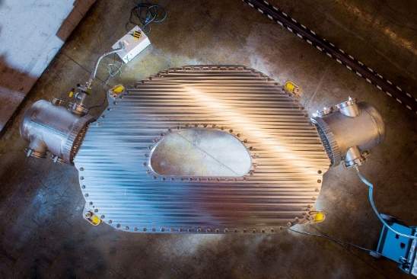
Extrapolating to a Reactor Plant (on the back of an envelope)
Lines of constant
$P_{Wall}$=1 MW/$m^{2}$
$P_{Wall}$=5 MW/$m^{2}$
Energy balance:
$P_{Wall}$=10 MW/$m^{2}$
"High Volume" Fusion
Confinement Loss
Fusion Heating
ignition
Bremsstrahlung
Aux. Heating
$A$=6 $f_{α}$=95%
$f_{ren}$=1.4
${\left\langle T\right\rangle }_{V}$=7 keV
$\frac{τ_{He}^{∗}}{τ_{e}}$=1
An involved systems problem!
$P_{Fusion}$=2 GW
$P_{Fusion}$=1 GW
$P_{Fusion}$=2 GW
High field magnets
$P_{Fusion}$=500 MW
$P_{Fusion}$=1 GW
Q=$∞$
Q=10
Q=1
$P_{Fusion}$=500 MW
"High Field" Fusion
Commonwealth Fusion Systems (2021

Slide 8
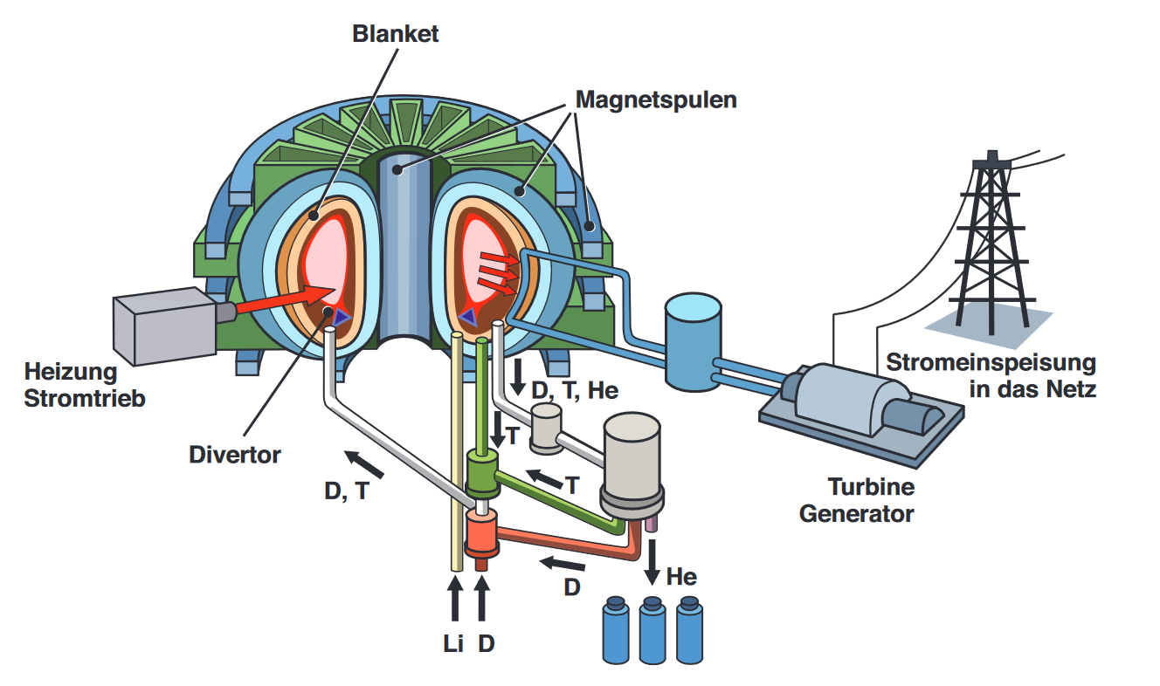
Fusion Reactor – Key Technological Entities
Coils
Super-conductor properties
Insulation
Coolant
Stresses
Blanket
Neutron loads
Tritium breeding ratio
First Wall
Thermal loads (neutrons, alphas, fast neutrals, gammas)
Sputtering
Divertor
Thermal loads
Support structure
Stresses, ports
Heating
other reactor components (turbines, tritium handling, vacuum pumps,…)
IPP, Karin Hirl

Slide 9
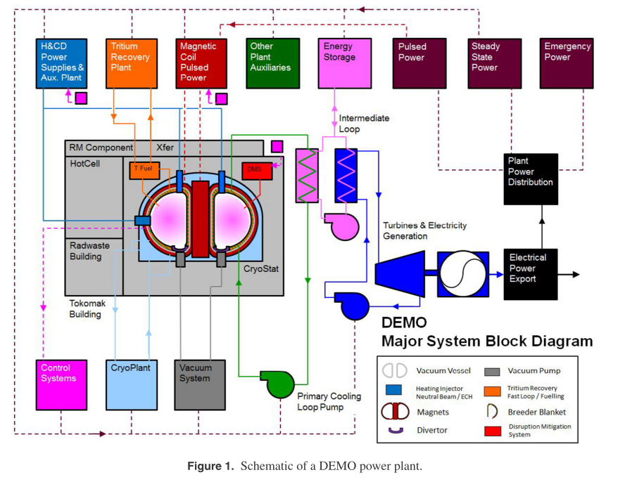
A systematic way: Systems Codes
Comprehensive models of an entire fusion power plant
Multidisciplinary (physics, engineering, economics)
Fast (design space exploration)
Modular (easily adoptable to new developments)

Slide 10
A systematic way: Systems Codes - Continued
Optimization Vector
objective function
inequality
equality
Problem: Find saddle point of
Iteration Variable: E.g. major radius, magnetic field strength, temperature, density…
Objective function: E.g. cost of electricity, or capital costs, ..
Inequality Constraints: E.g. heat flux limits, neutron damage, coil forces, quench protection…
Equality Constraints: E.g. power output, Q, …

Slide 11
Coil related example systems code model

Slide 12
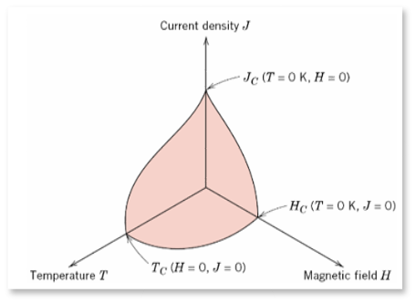
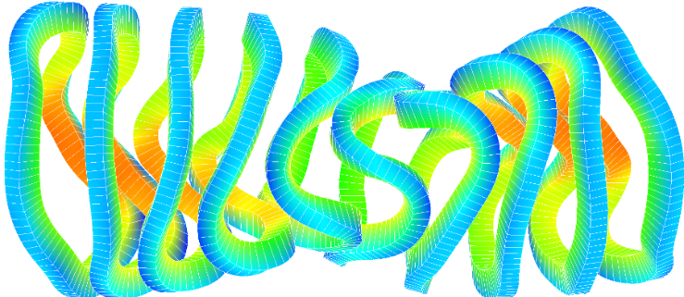
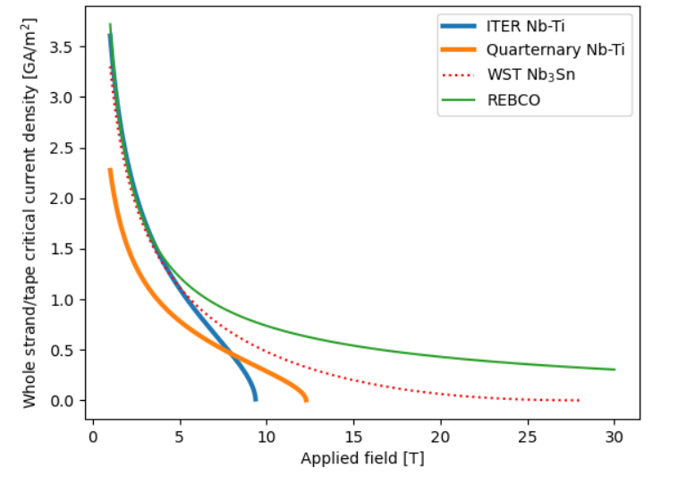
Technological Constraints in Coils: Critical Current Density
Superconductors require an operating window:
$$j<j_{crit}\left(B,T,ε\right)$$
Imposes limits on the magnetic field in the coils
Temperature given by coolant:
Helium ~ 4 K (or ~2K superfluid)
Neon ~20 K
Nitrogen ~70 K
Strain: bending strain, depends on conductor size
C. Donelly (2017)
Magnetic Field
Conductor Strain
Cryogenic Temperature
T=4K

Slide 13
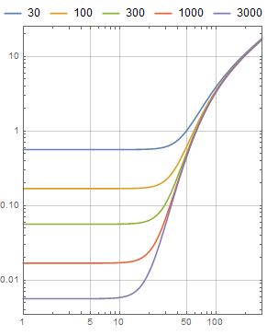
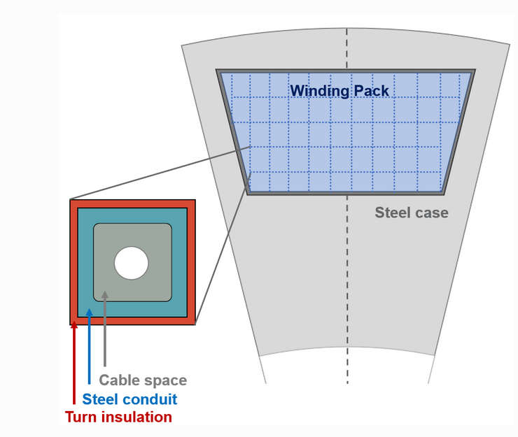
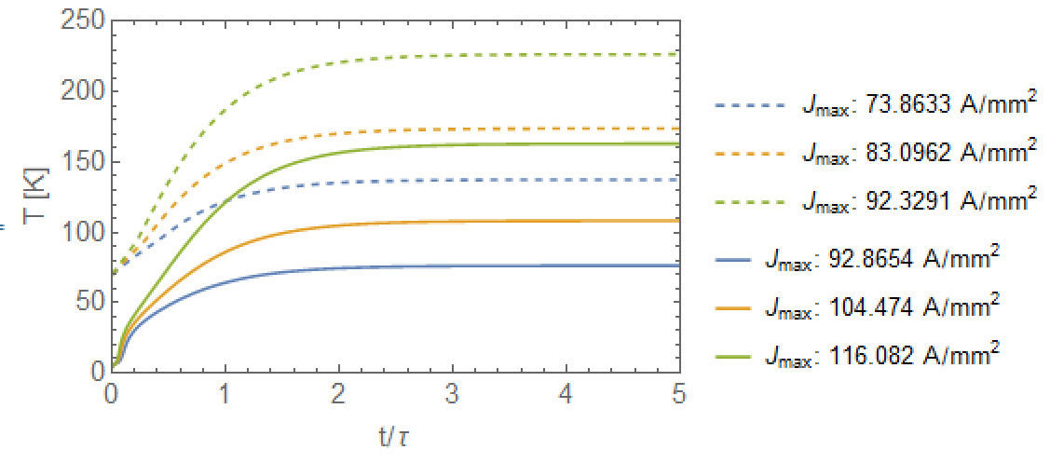
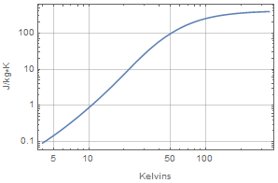
Technological Constraints in Coils: Quench protection
RRR
Copper el. Resistivity
Coil Quench:
Local heat entry prevents superconductivity
Current flows through copper
Current in resistive copper leads to temperature rise!
Determines minimal amount of copper
electrical resistivity [n$Ωm$]
Heat deposition
Temperature Rise
Energy
Heat capacity and density of copper and coolant (Helium, Nitrogen)
Copper
Superconductor
Copper Heat Capacity

Slide 14
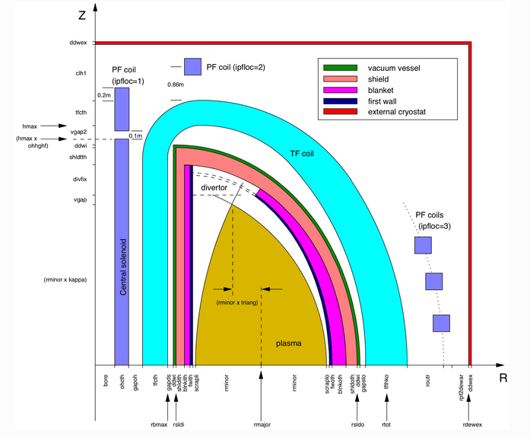
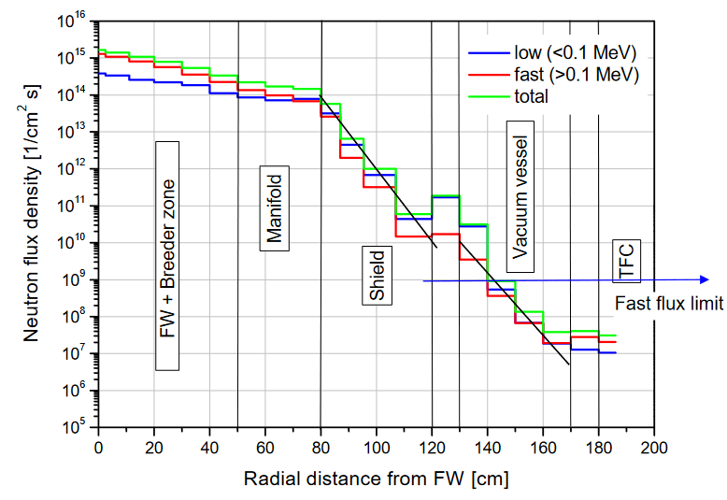
Other constraints in a fusion power plant
MHD
Heat Exhaust
Forces/Stress
Coil Quench
Strain
Critical current density
Operational Limits
Neoclassic transport
Turbulent transport
Diagnostics
Remote Maintenance
Tritium Breeding
Neutrons (appm, tbr, dpa flux)
Impurities
Helium Ash
…
DEMO
U. Fischer, EF Report D1a_2AHVKD (2008)

Slide 15
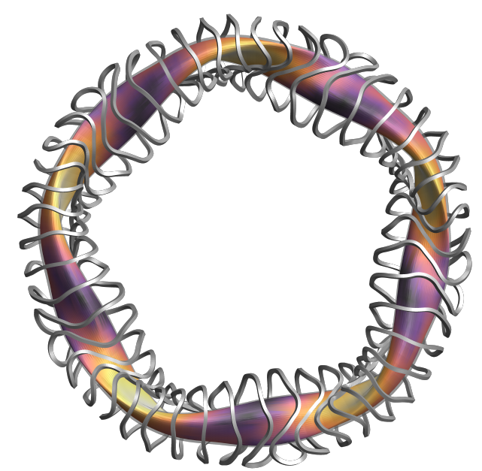
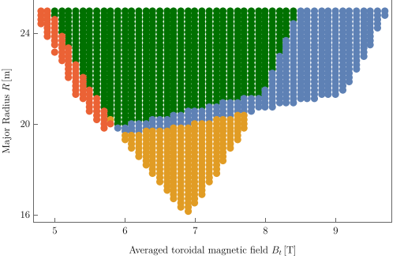
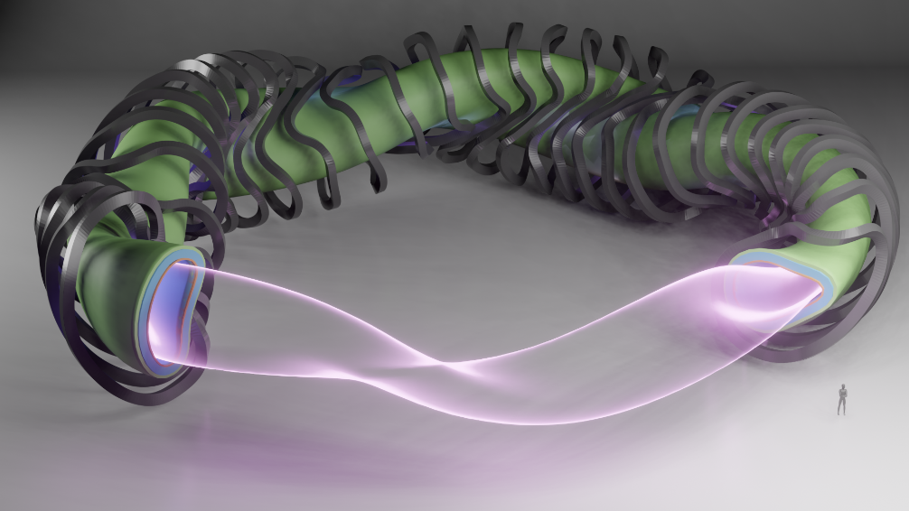
Application: HSR-5 – Extrapolating the W7-X line with a systems code
Kovari, M. et al. Fus. Eng. Des. (2014)
Lion, J. et al. Nucl. Fus. (2021)
Systems Code: PROCESS
High aspect ratio machine (A=12)
Assumed W7-X like transport
Systems codes models allows finding limiting constraints
"W7-X" - like
ignited HSR5 points (ISS04)
$$feasible$$
Quench Protection
Confinement
Blanket Requirements
Coil-Plasma distance insufficient

Slide 16
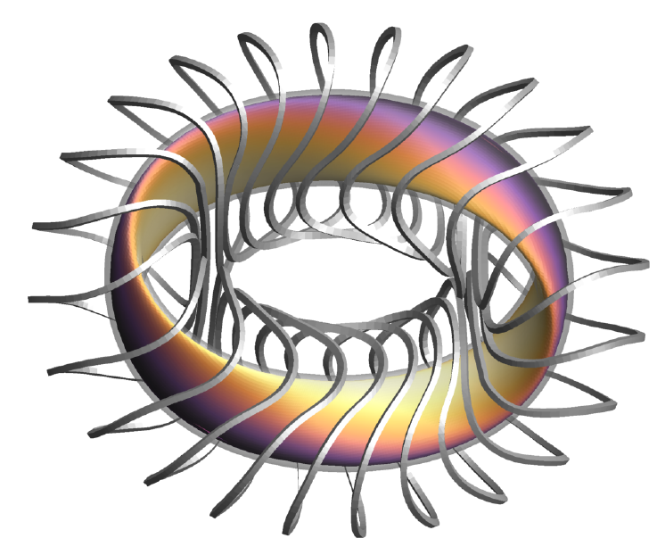
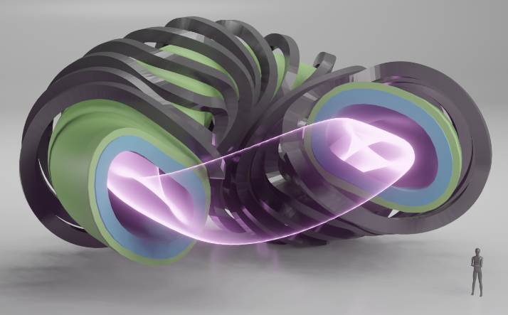
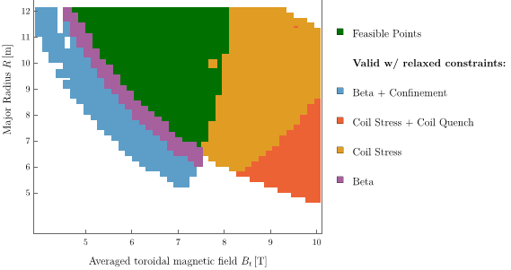
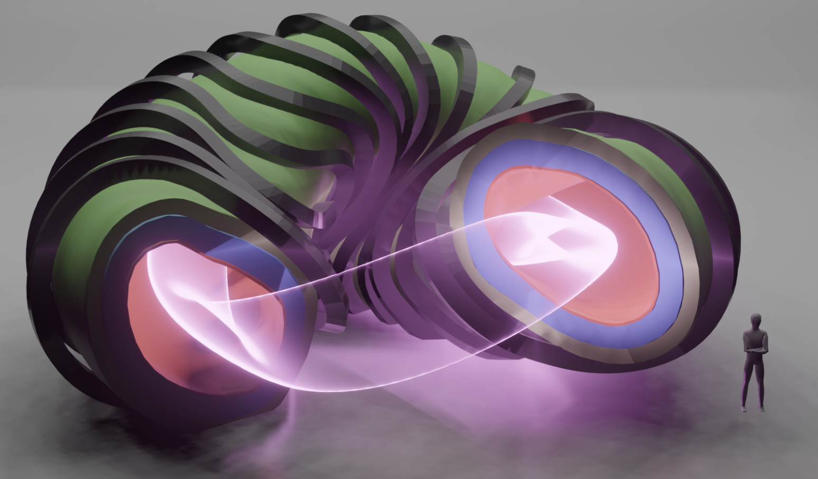
Application: Compact QA-Stellarators (Conceptional)
Ignited Reactor configurations, 1.5 GW Fusion power
Assuming W7-X like transport
Cost drivers: Beta limit and Stress
Configuration from: M. Landreman, E. Paul, Phys. Rev. Letters (2022)
$$"feasible"$$
$$f_{rad}d_{rad}>σ_{max}$$
$$β>β_{max}$$
$$f_{ren}>1.4$$
$$T_{Quench}>T_{max}$$

Slide 17
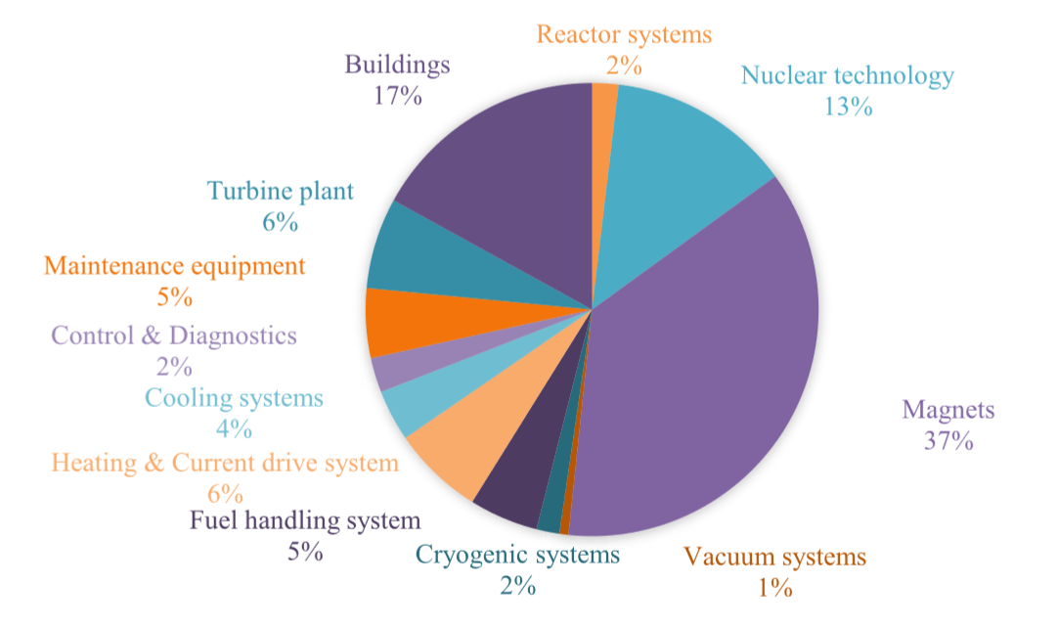
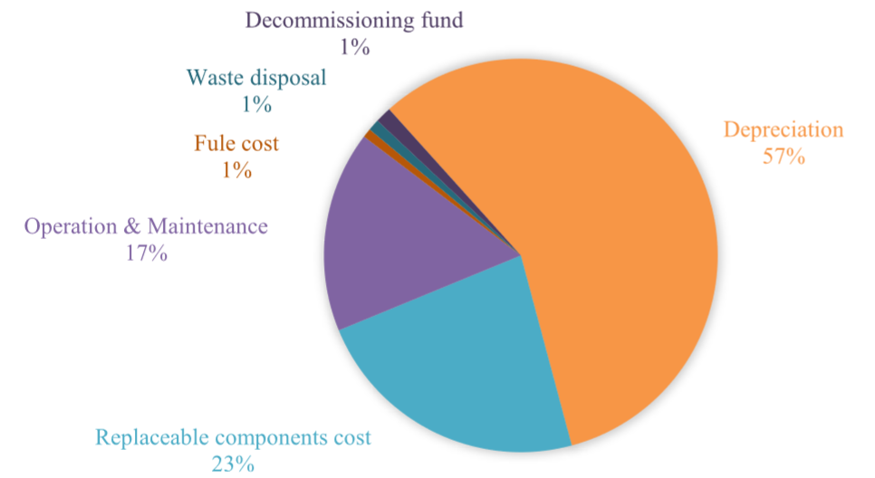
Cost Models
Capital Costs
Systems codes typically also include cost models
PROCESS (eurofusion systems code for DEMO):
Largest component in Capital costs are magnets and nuclear technology
COE dominated by deprecation and replaceable components
Disclaimer: Cost models are up for large uncertainties, especially for components and procedures without sufficient experience (e.g. Li-blanket, remote maintenance)
COE
S. Entler et al. "Approximation of the economy of fusion energy", Energy 152 (2018)

Slide 18
Summary & Conclusion
Fusion power is a promising candidate for a GHG emission free, long-term power source
Feasibility (burning plasma, tritium breeding) yet to be fully shown (by ITER, SPARC)
Fusion reactor design is a complex, multidisciplinary systems optimization problem
One way to approach this is by utilizing systems codes
Collection of physics and technological models that reflect all relevant reactor features
Allows a high level, holistic view of the full power plant
Can be used to re-iterate with technology and physics optimization
Allows detailed insights at specific design regions
Economic feasibility will depend on the price of fusion: systems studies necessary part for economic fusion and thus commercialization of fusion energy
Email: jorrit.lion@ipp.mpg.de

