Slide 1
Simulation of an electromagnetic vibration energy harvester
Eugen Vambolt
18.03.2024

Slide 2
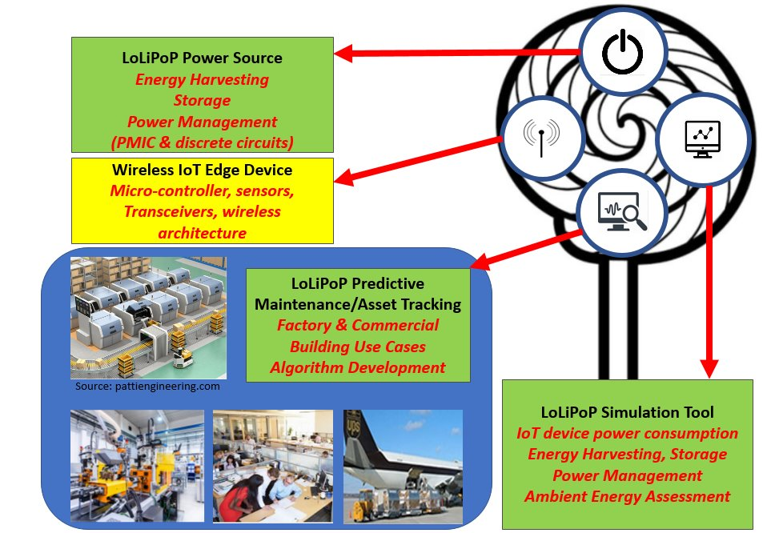
Agenda
What is LoLiPoP IoT?
Energy Harvester
Electromagnetic Vibration Energy Harvester
Results
Next Steps

Slide 3
LoLiPoP IoT – Long Life Power Platforms for Internet of Things
-Significant project funded by the EU
-38 Partners from 10 countries (Ireland, Spain, Italy, Turkey, Germany, …)
-German partners: Fraunhofer IIS, Infineon,
Nuremberg Institute of Technology, …
Goal:
-develop energy harvesting and micro-power management solutions
for wireless IoT edge devices
-> Wireless network of sensor nodes powered by energy harvesters
-> reduce carbon emissions, integration of renewable energy sources
and increase energy independence
Gateway node

Slide 4
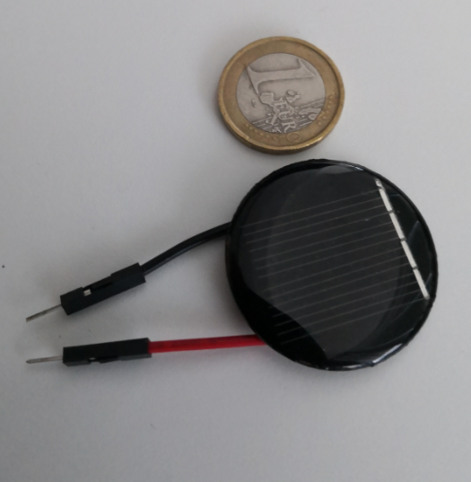
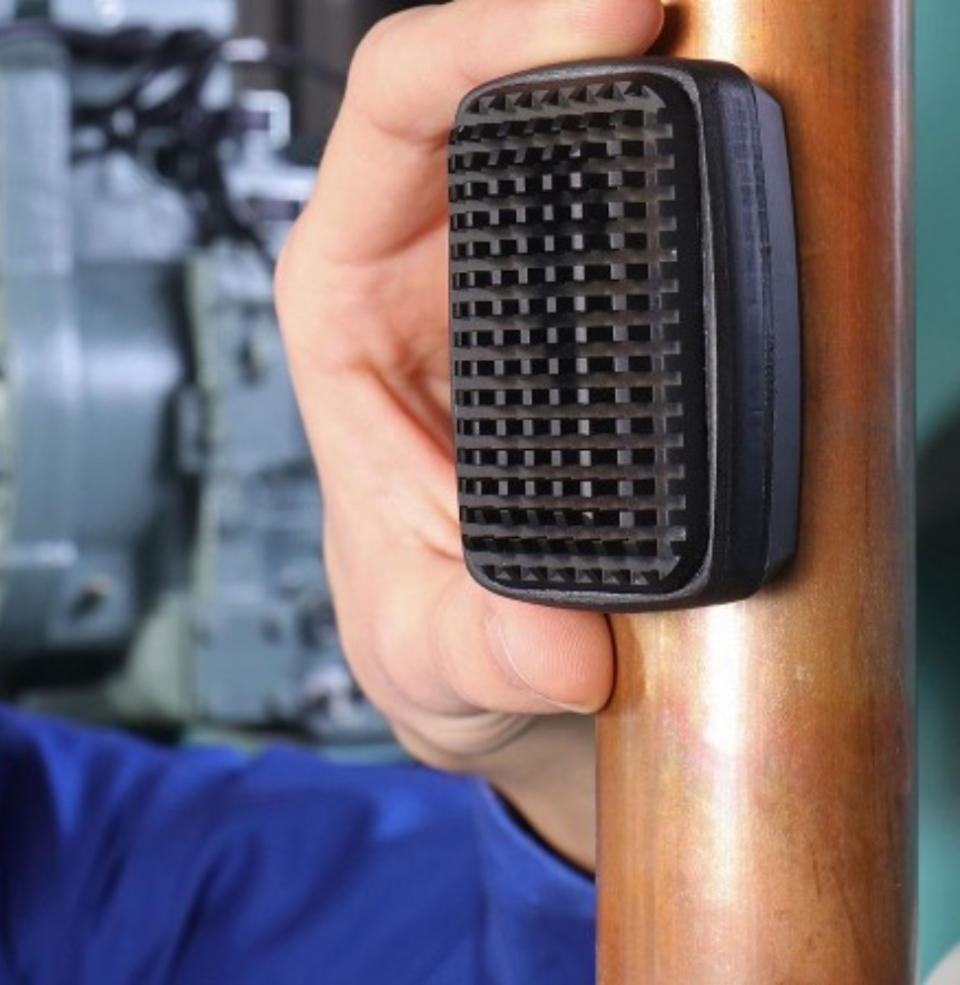
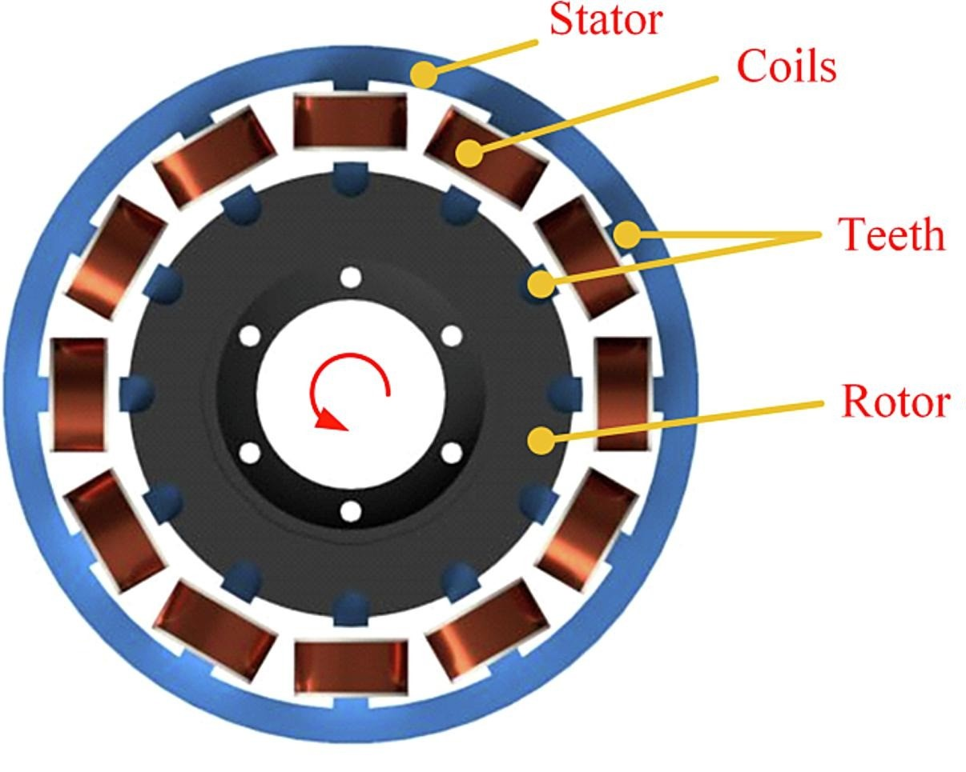
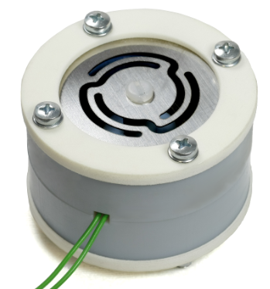
LoLiPoP IoT – Long Life Power Platforms for Internet of Things
-> Power supplied by different kinds of energy harvesters
Thermoelectric generators (TEG)
Variable reluctance energy harvester
Vibration energy harvester
Solar cells
https://www.iis.fraunhofer.de/de/ff/lv/iot-system/anwproj/energie-fuer-industrie.html
https://www.insgmbh.de/produkte
Enhanced variable reluctance energy harvesting for self-powered monitoring - ScienceDirect

Slide 5
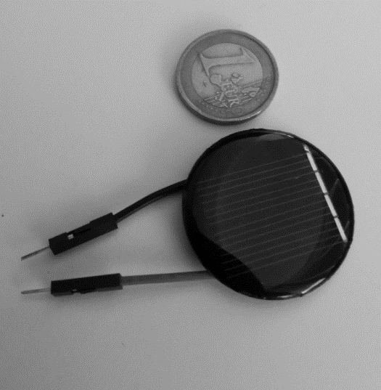
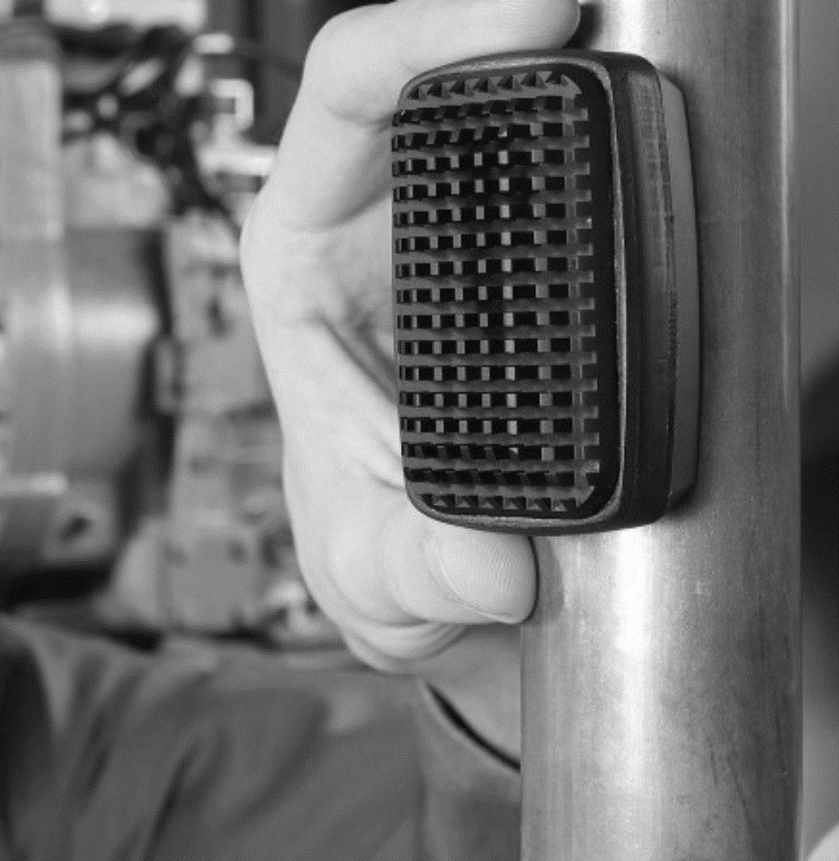
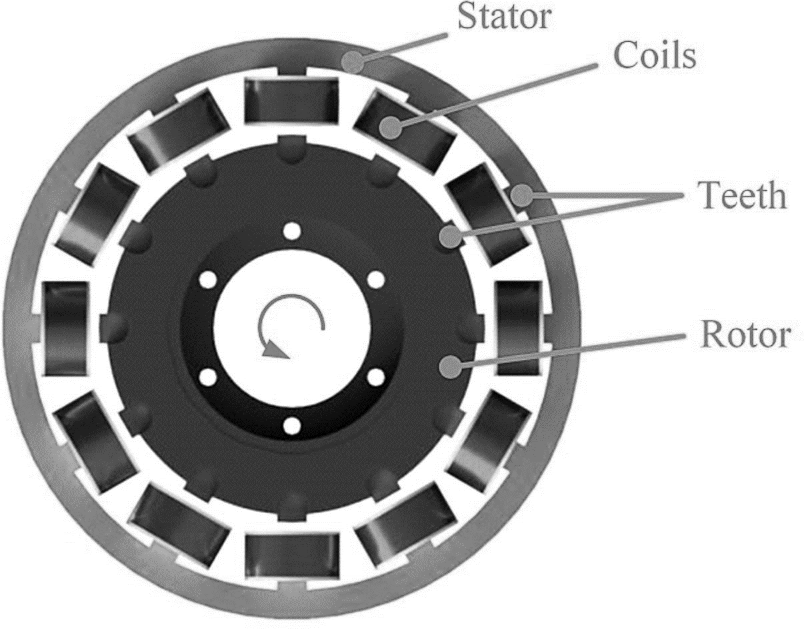
LoLiPoP IoT – Long Life Power Platforms for Internet of Things
-> Power supplied by different kinds of energy harvesters
Thermoelectric generators (TEG)
Rotation energy harvester
Vibration energy harvester
Solar cells
https://www.insgmbh.de/produkte
https://www.iis.fraunhofer.de/de/ff/lv/iot-system/anwproj/energie-fuer-industrie.html
Enhanced variable reluctance energy harvesting for self-powered monitoring - ScienceDirect

Slide 6
Analytical Model: Forced Oscillator (single degree of freedom)
Differential equation of motion:
$$m⋅\ddot{z}\left(t\right)+D⋅\dot{z}\left(t\right)+k⋅z\left(t\right)=m⋅\ddot{y}(t)$$
$$k_{1}$$
$$R_{C}$$
$$z\left(t\right)=\frac{η^{2}Y_{0}}{\sqrt{{\left(1−η^{2}\right)}^{2}+{\left(2θ_{T}η\right)}^{2}}}sin(Ωt+φ)$$
$$z(t)$$
m
$$R_{L}$$
$$L_{C}$$
$$D=d_{E}+d_{M}:Damping coeff.$$
$$k_{2}$$
$$Ω:excitation circular frequency$$
$$ω_{n}:natural circular frequency$$
$$y\left(t\right)=Y_{0}sin(Ωt)$$
$$η=\frac{Ω}{ω_{n}}$$

Slide 7
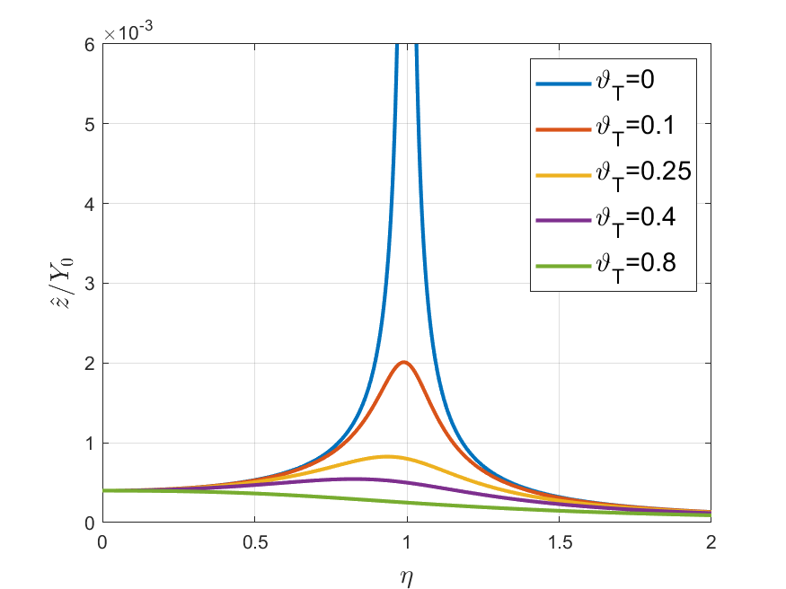
Analytical Model: Forced Oscillator -> Resonance
$$\hat{z}=\frac{η^{2}Y_{0}}{\sqrt{{\left(1−η^{2}\right)}^{2}+{\left(2θ_{T}η\right)}^{2}}}$$
$$θ_{T}=θ_{M}+θ_{E}:Mech. and el. damping$$
If $η=1$ and $θ_{T}=0$
$$⇒ \hat{z}→∞$$
Best Case: $θ_{M}=0, θ_{T}=θ_{E}>0$
-> All kinetic energy is converted into electrical energy

Slide 8
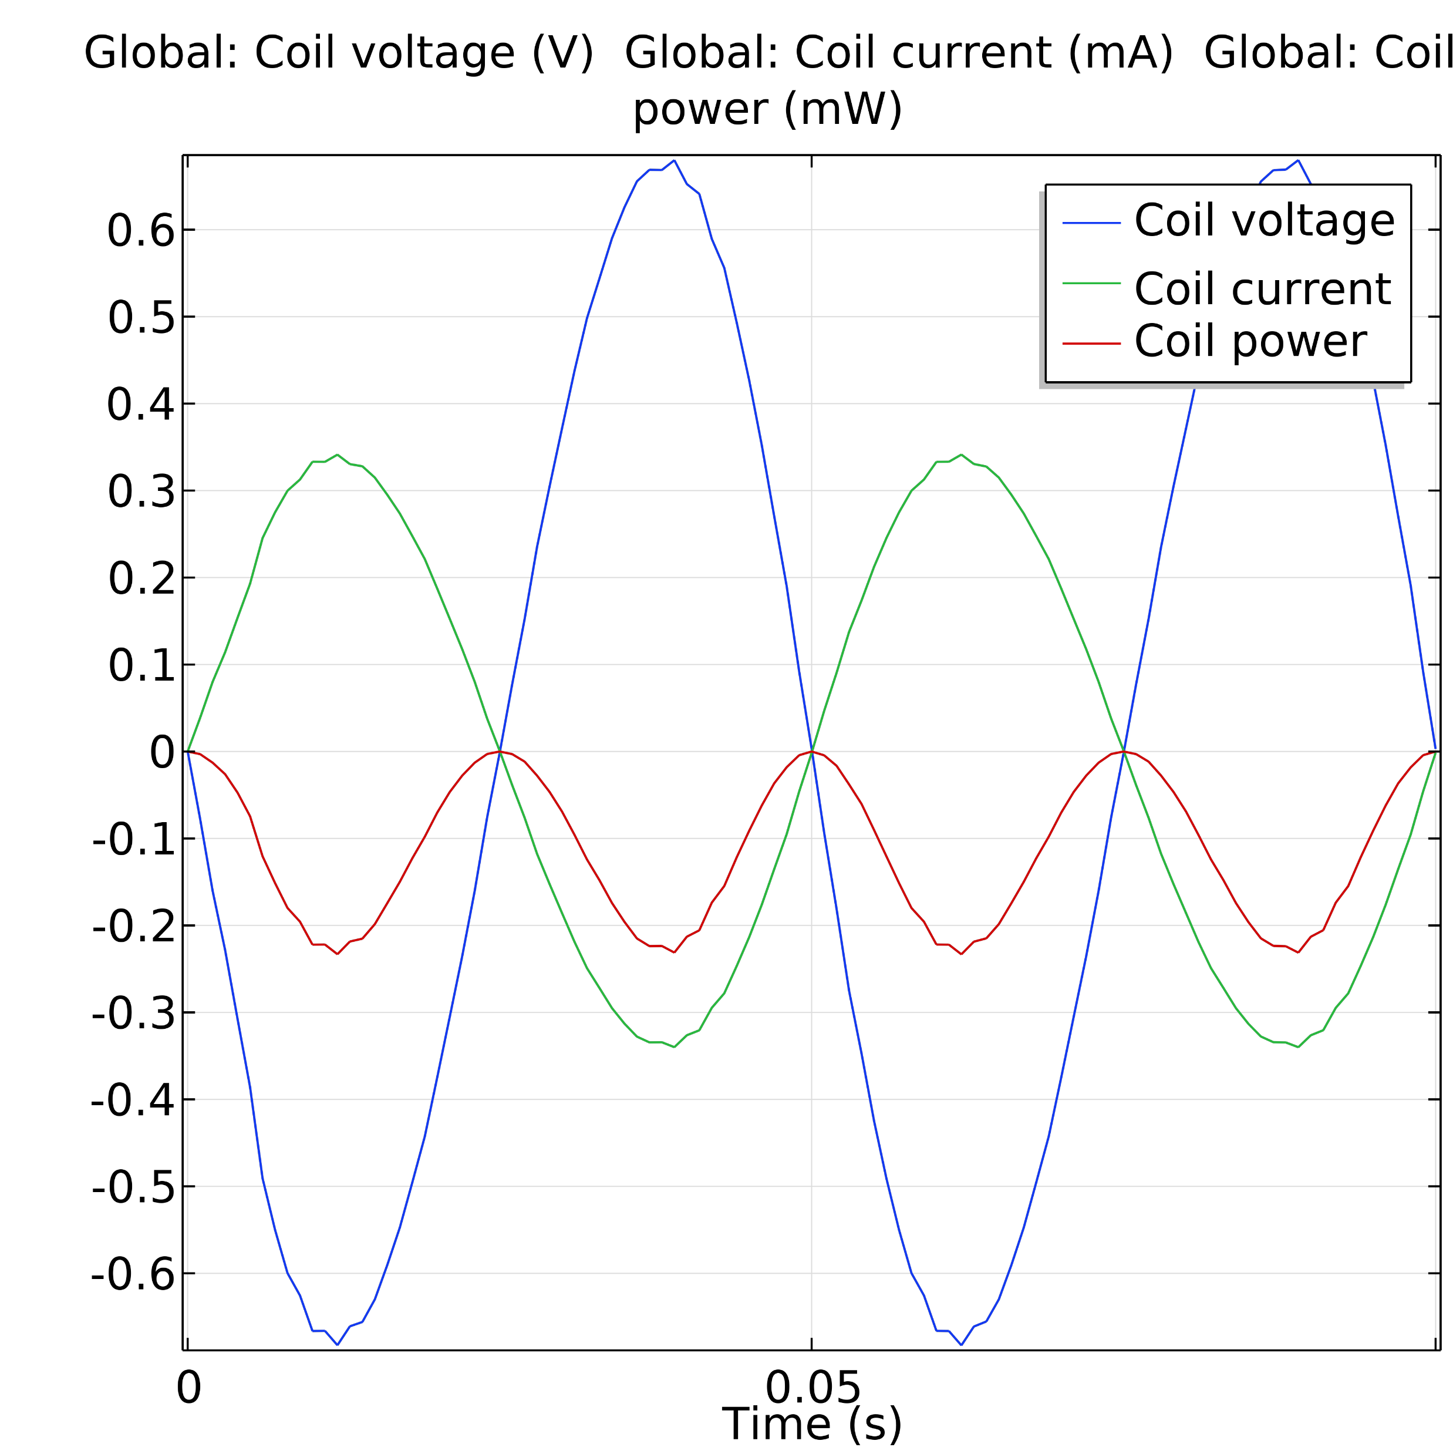
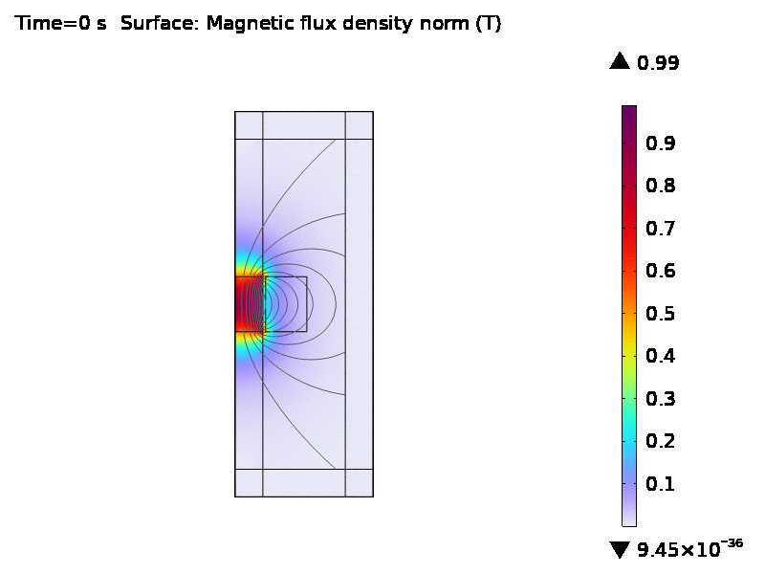
Results of Simulation
In order to keep the model simple the mechanical damping $θ_{M}$ was set to 0.
=> Simulation without springs.
Next Step:
Optimize geometry of the energy harvester to increase the efficiency and scalability.

Slide 9
Funded by
Thank you very much for your attention.

Slide 10
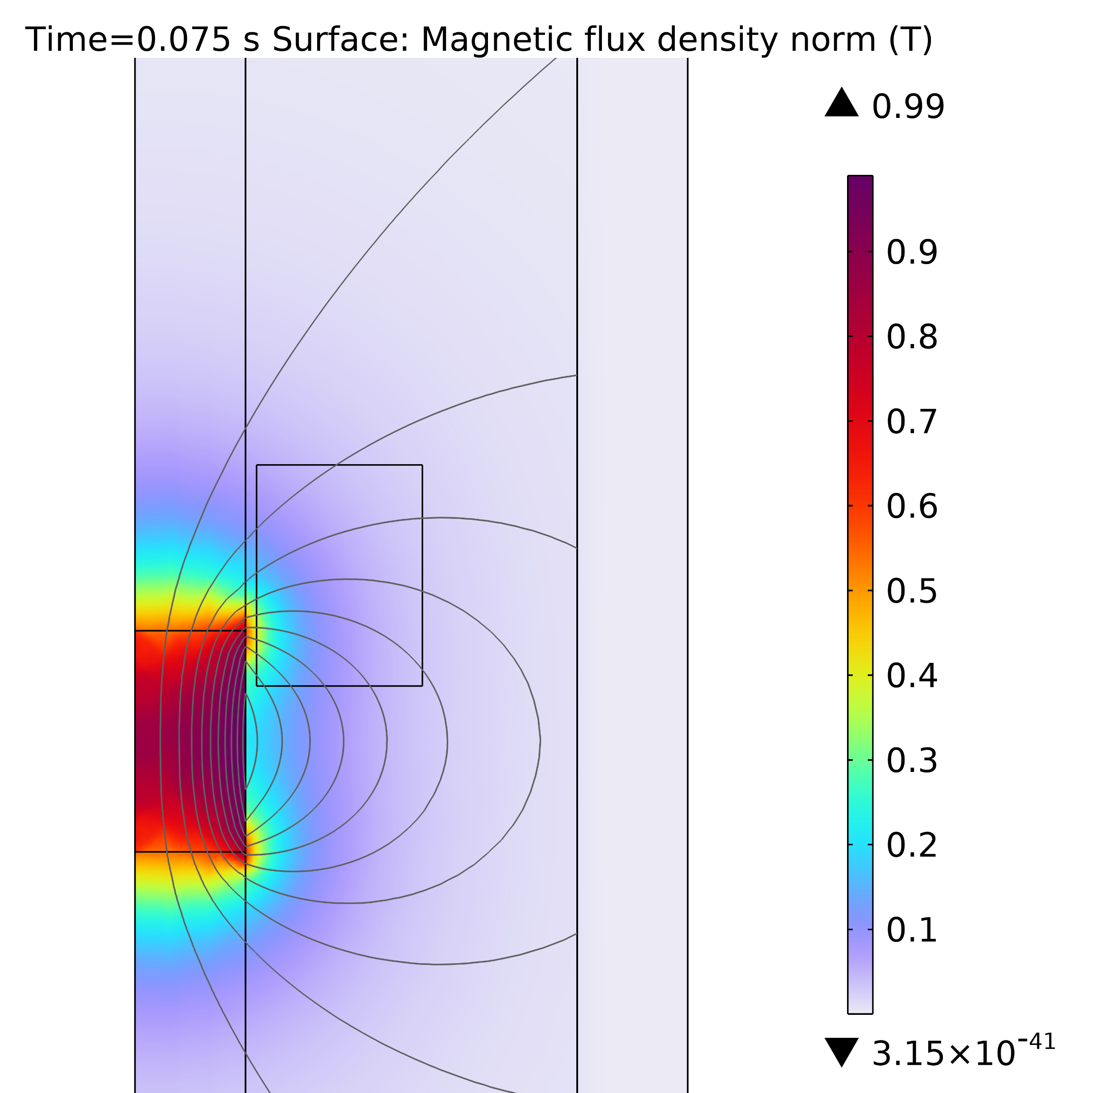
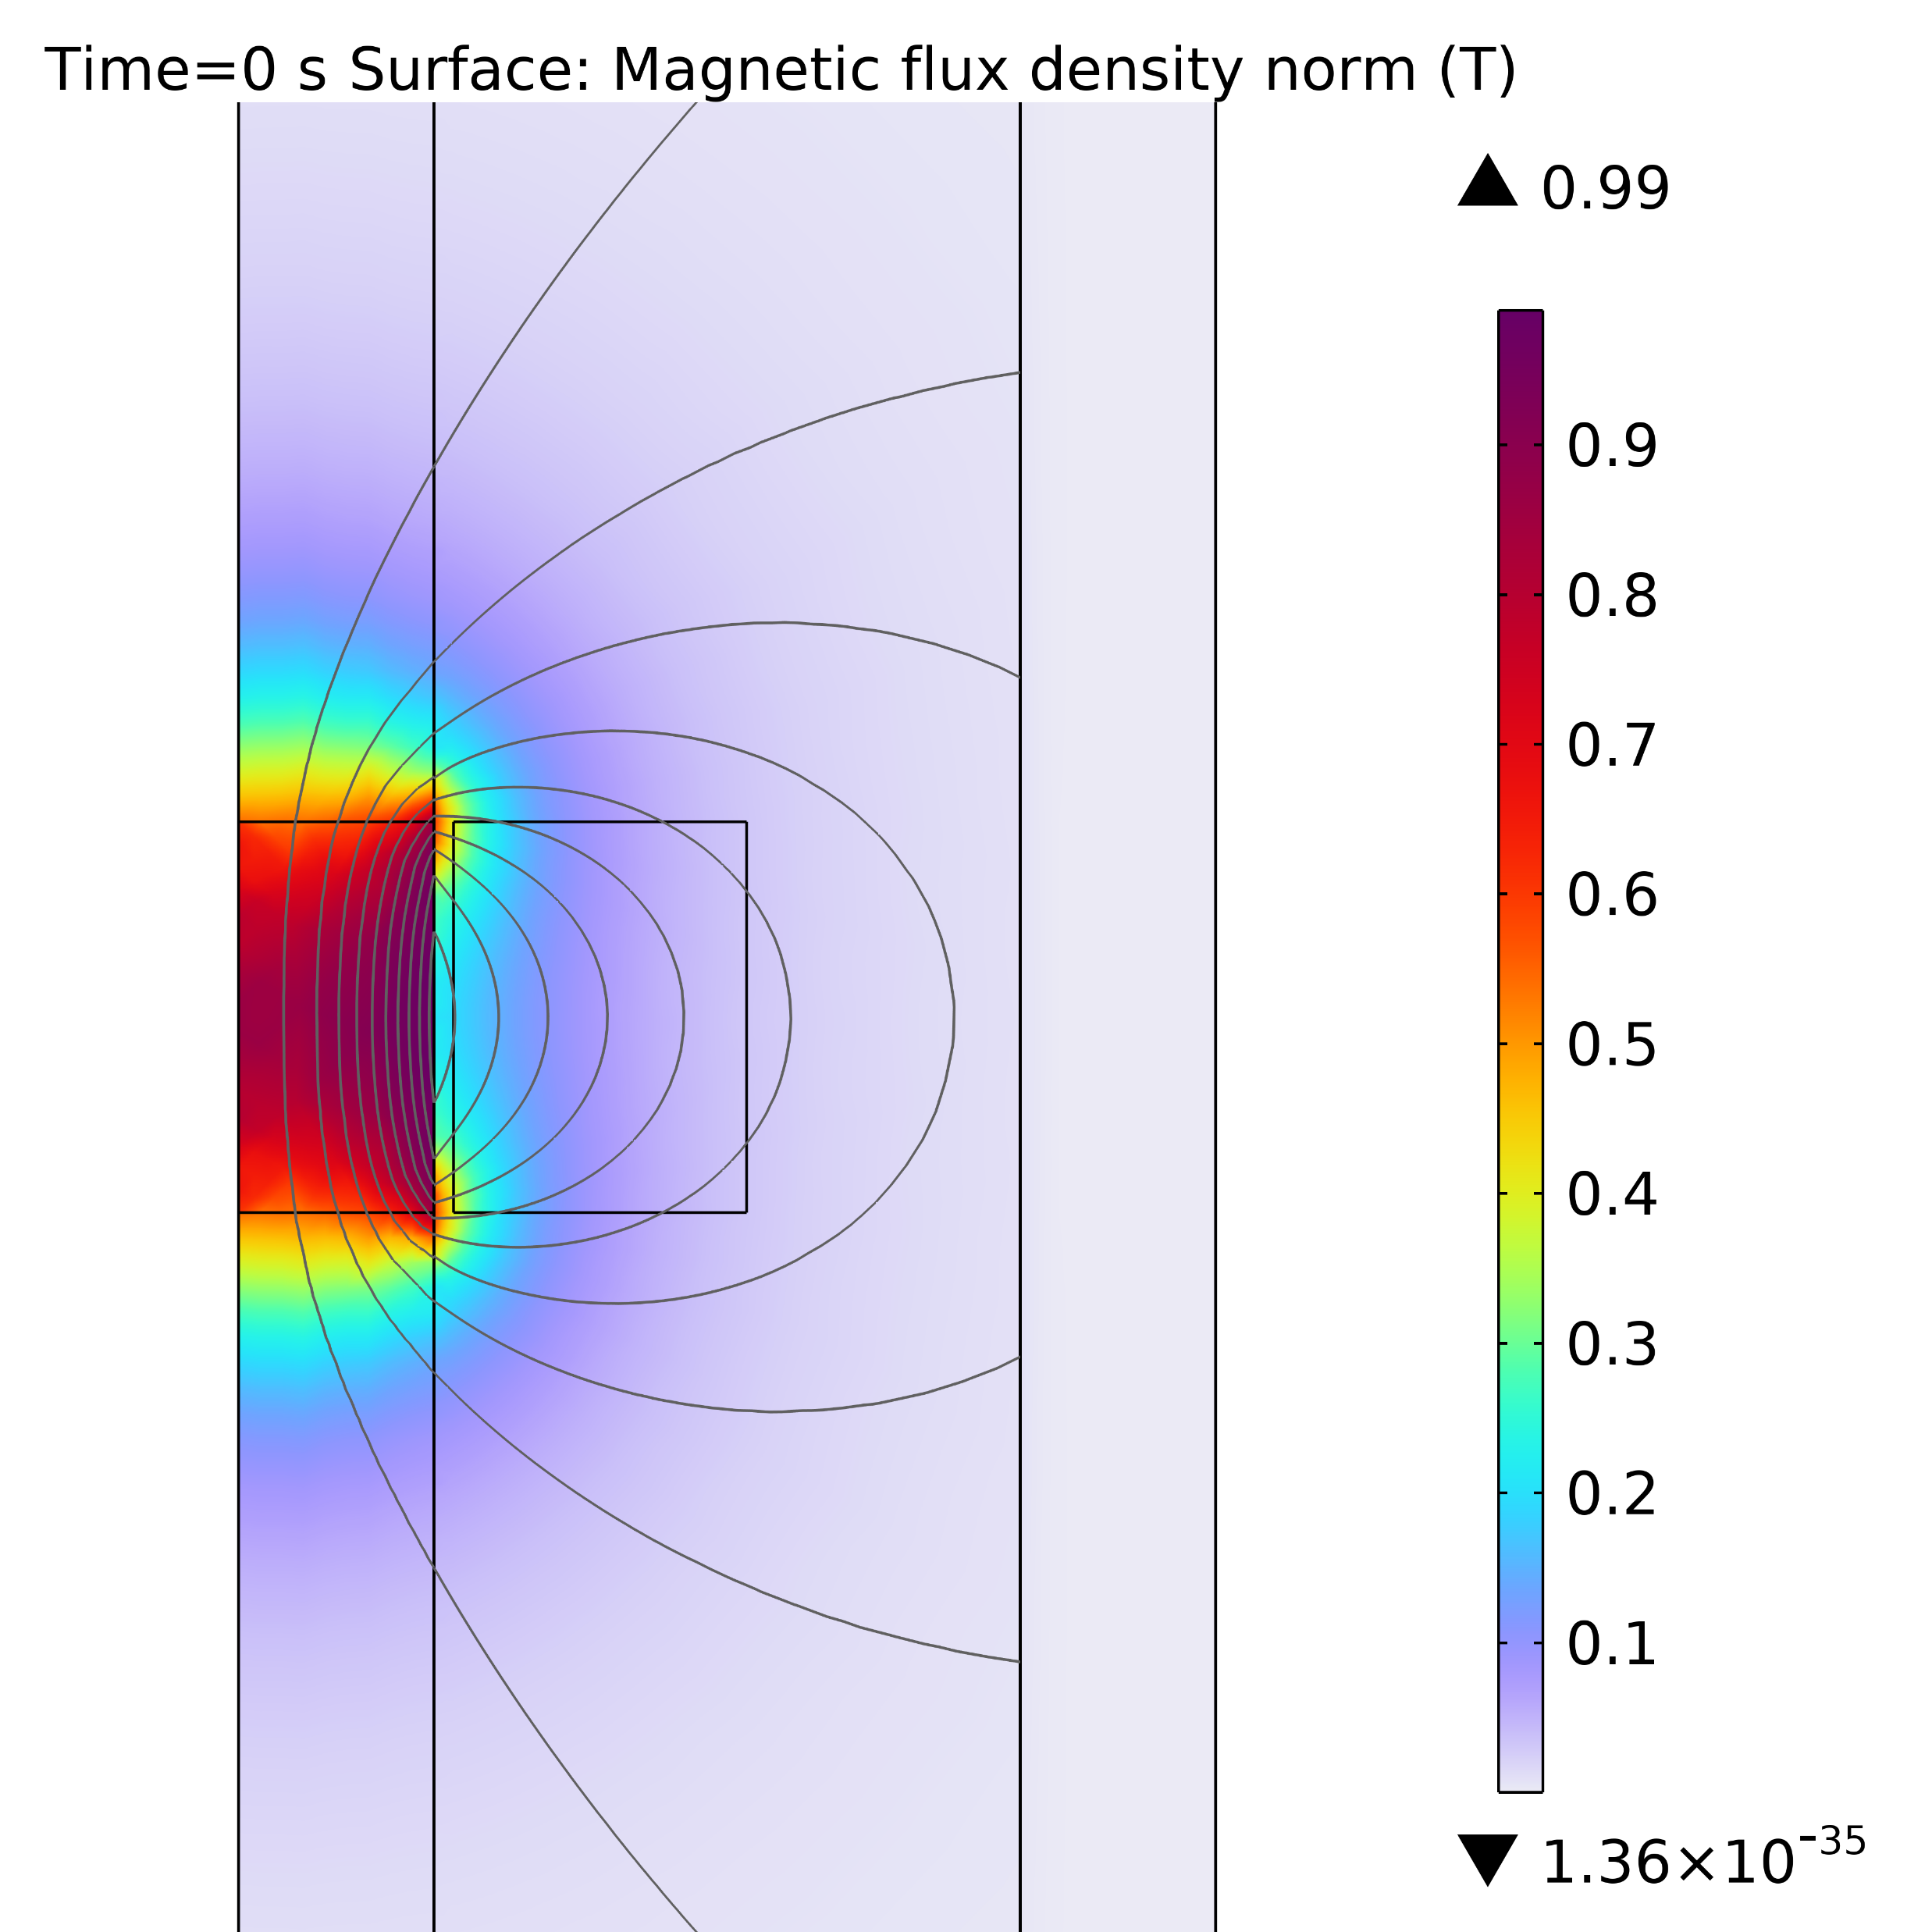
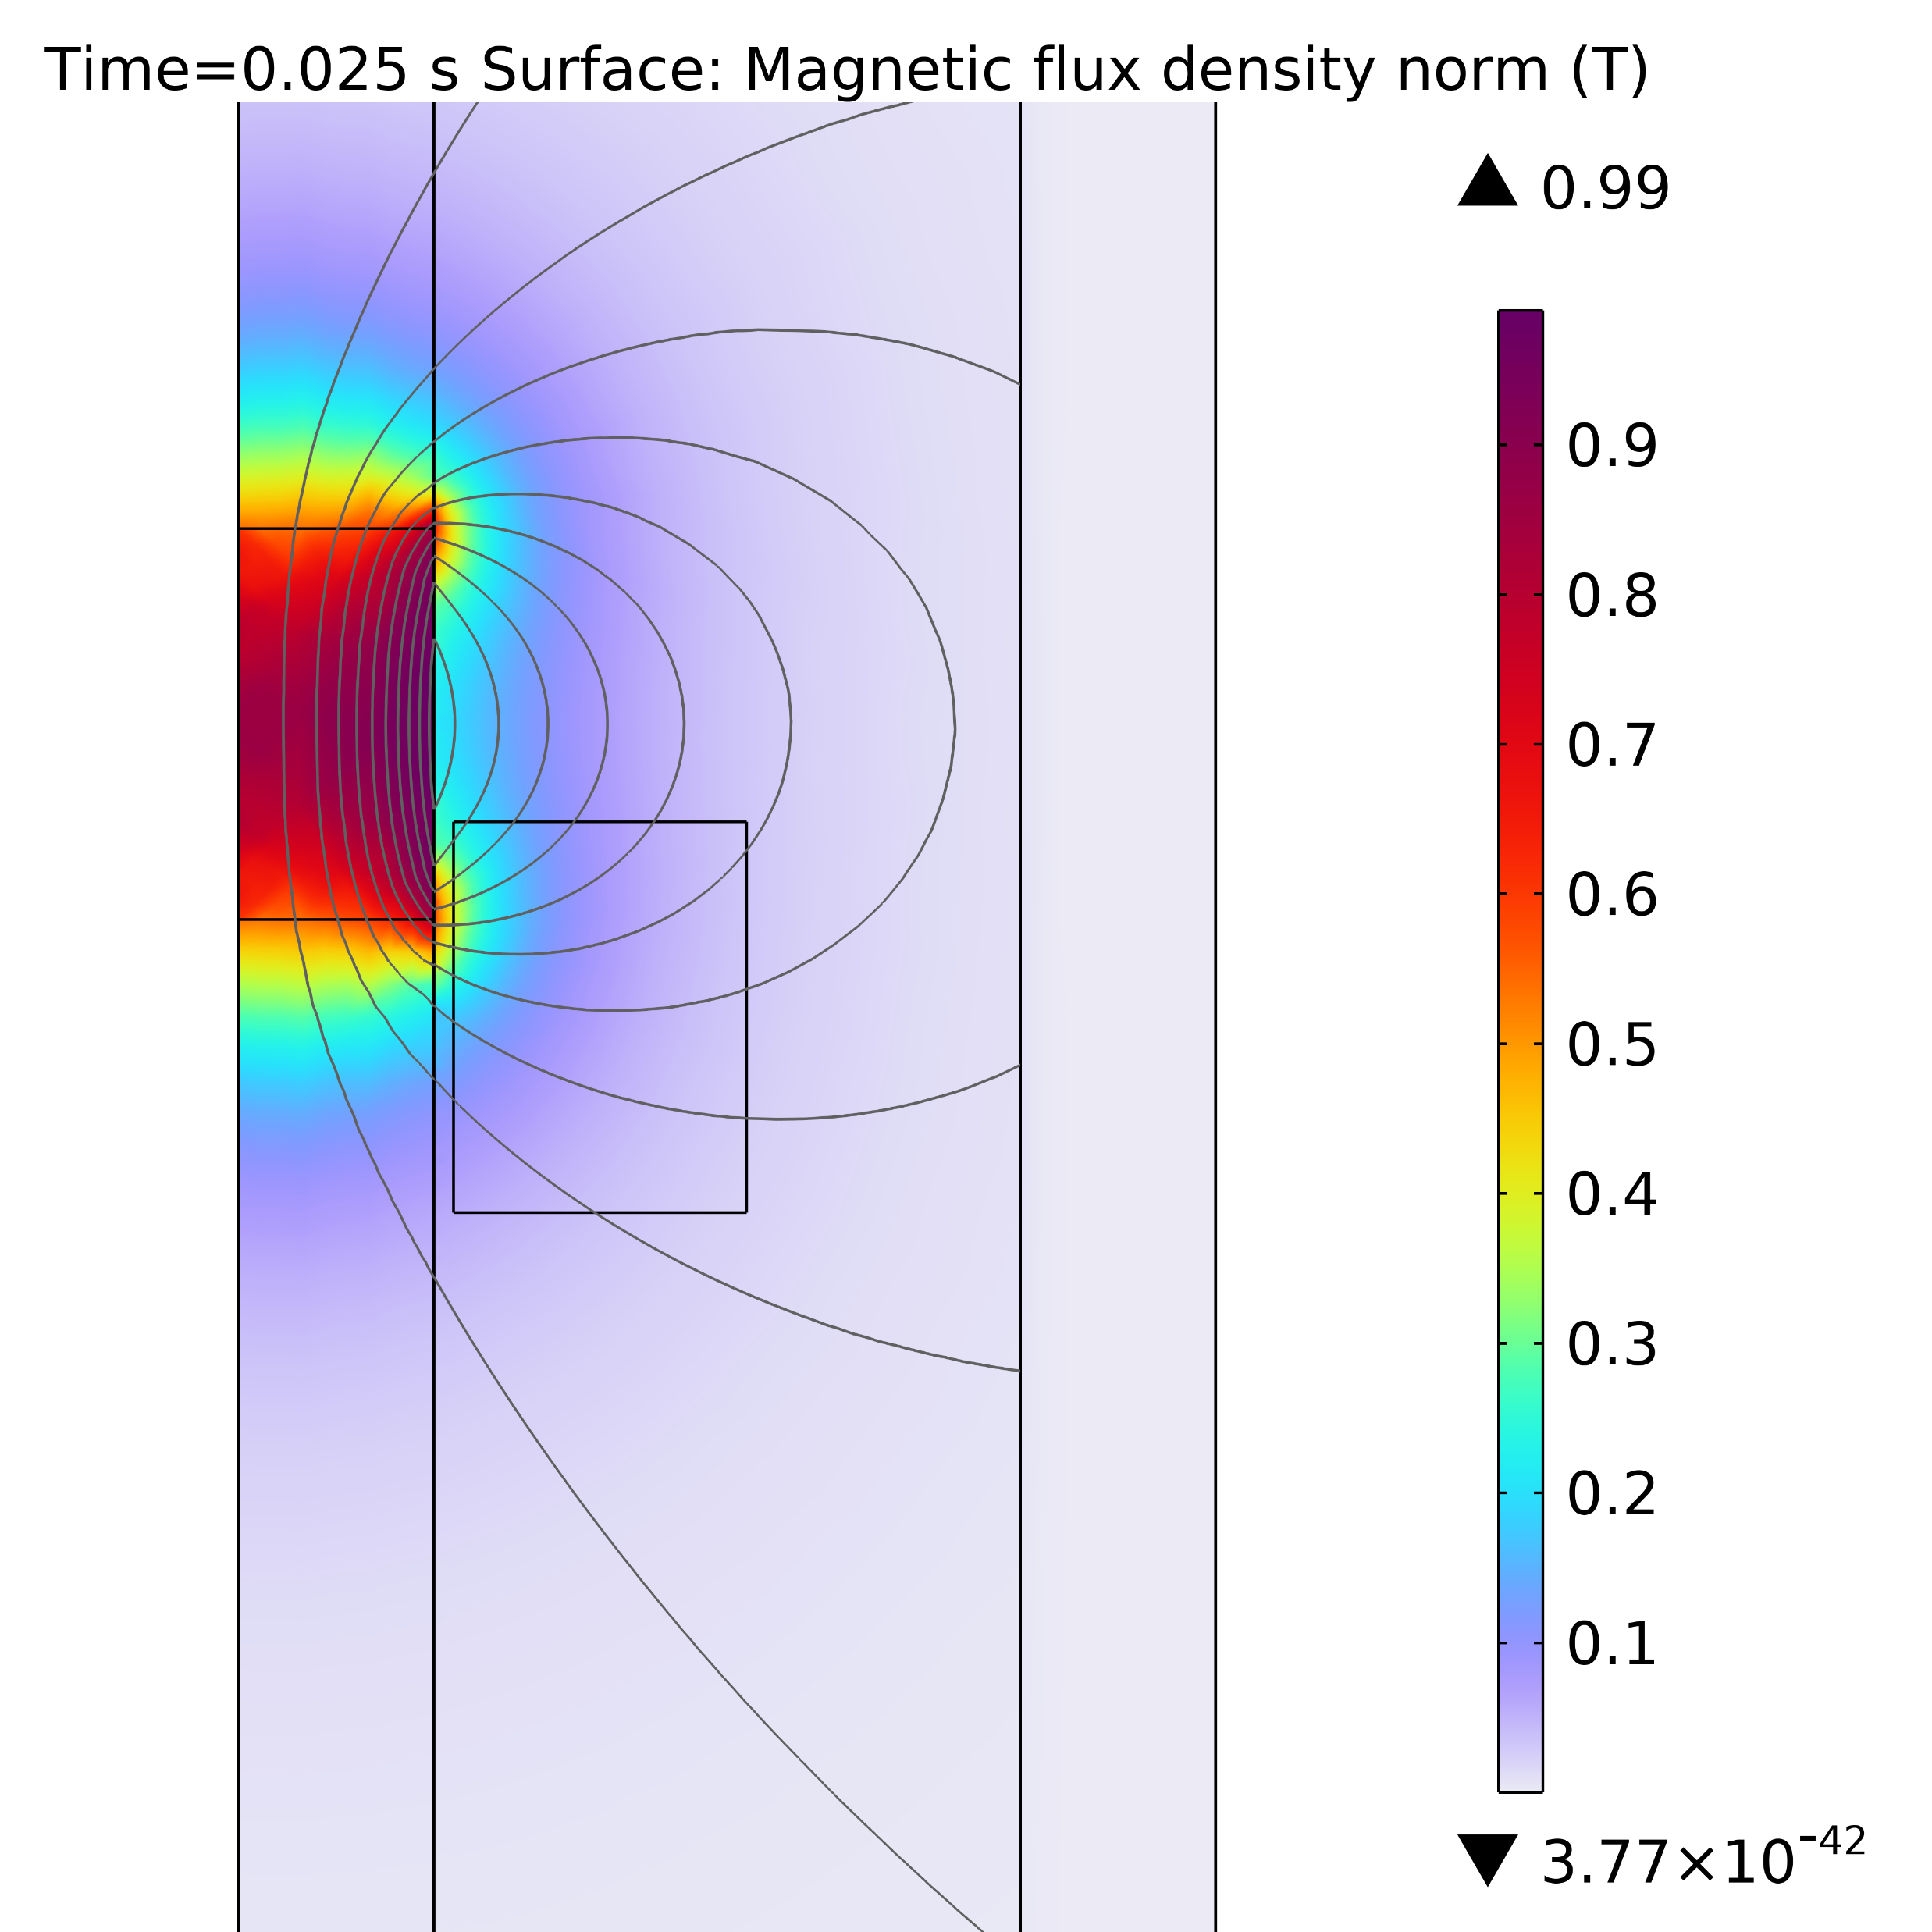
Results of Simulation
In order to keep the model simple the mechanical damping $θ_{M}$ was set to 0.
=> Simulation without springs.
Next Step:
Optimize geometry of the energy harvester to increase the efficiency and scalability.

