Slide 1

Effects of Aluminum trifluoride AlF₃ impurities on NMC₈₁₁ /Graphite Lithium-ion battery performance
Slaheddine Jabri, Simon Grundmeier, Markus Etzkorn, Daniel Schröder, Uta Schlickum
Institute of Applied Physics, TU Braunschweig, 38106 Braunschweig, Germany
Institute of Energy and Process Systems Engineering of TU Braunschweig, 38106 Braunschweig, Germany
KFM 24: Focus Session: Battery Materials – Ion Transport, Impurity Effects and Modelling
21. Mars 2024, 12:55–13:15
1

Slide 2
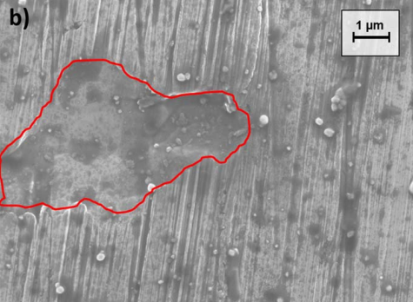
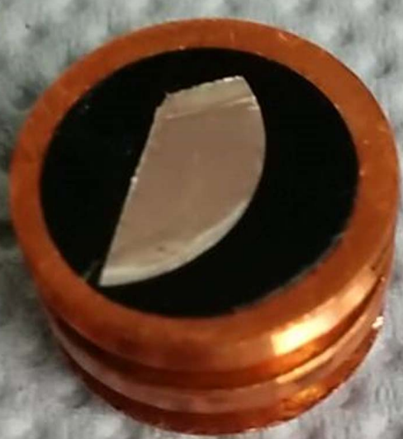
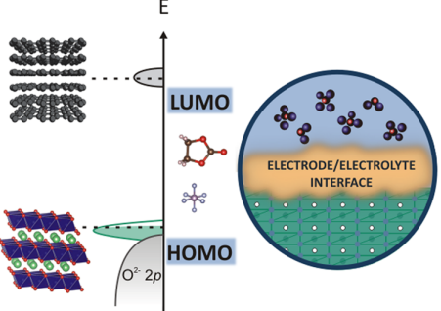
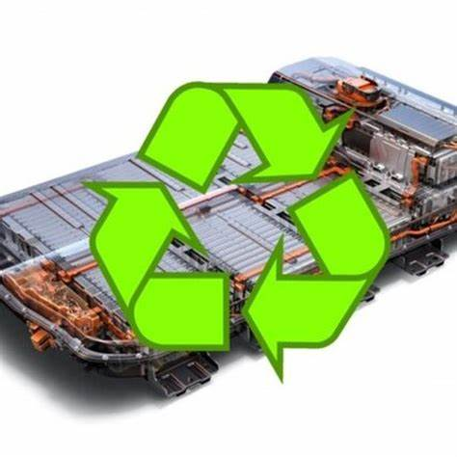
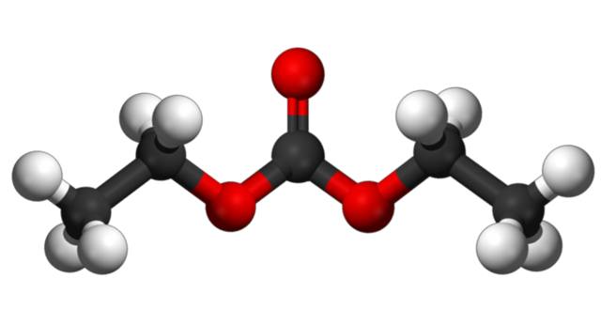
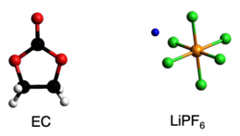
Introduction
Oxidation reaction of electrolyte
Conductivity ionic
Exfoliation
Impurity
NiF₂
AlF₃
CoF₂
Low performance
J Electrochem Soc, 164 (7) A1474-A1479 (2017)
Al³⁺+ 3 PF₆ → 3PF₅ + AlF₃
Al₂O₃ + 6 HF → 2 AlF₃ + 3 H₂O
Al³⁺+3F⁻ → AlF₃
J. Phys. Chem. Lett. 2015, 6, 4653−4672
Recycling with low impurities
Working at high voltage
Long lifetime
High performance
2

Slide 3
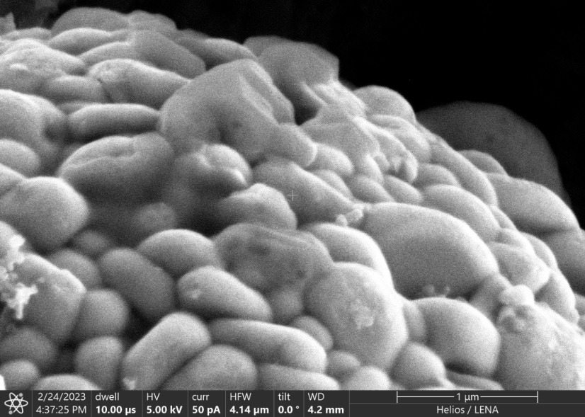

Motivation
NMC₈₁₁ active material
Al³⁺+ 3 PF₆ → 3 PF₅ + AlF₃
Al₂O₃ + 6 HF → 2 AlF₃ + 3 H₂O
Al³⁺+3F⁻ → AlF₃
LiPF₆ +EC+EMC+VC
AlF₃ ??
Electrolyte degradation
Structure modification
(XPS, Raman Spectroscopy)
(SEM-FIB)
AlF₃ impurity effect
on battery performance
3

Slide 4
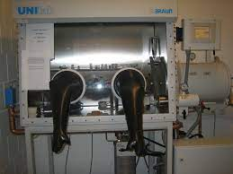

Sample preparation
Battery cell preparation
Uncontaminated Cell | Contaminated Cell
Electrode NMC811/G vs. Li/Li⁺ PAT-cells | Electrode NMC811/G vs. Li/Li⁺ PAT-cells
Glass fiber separator 260 µm | Glass fiber separator 260 µm
Electrolyte 1 m LiPF₆ in EC:EMC (3:7) + 2% VC | Electrolyte 1 m LiPF₆ in EC:EMC (3:7) + 2% VC
----- | AlF₃ impurity (1000 µg/L)
Sample sets
Cycle numbers | Charge rate | Discharge rate
250 | 1C | 1C
By Simon
Room temperature
50 °C
$O_{2}$ < 1.5 ppm
$H_{2}O$ ≈ 0
Argon + Stickstoff
Battery cell disassembly
Glove box
PAT-cell
4

Slide 5
Electrochemical Results
At Room Temperatur
At 50 °C
%
%
Average
Average
Discharge capacity decreases in presence of AlF₃ impurity
Low battery performance at high temperature
5

Slide 6
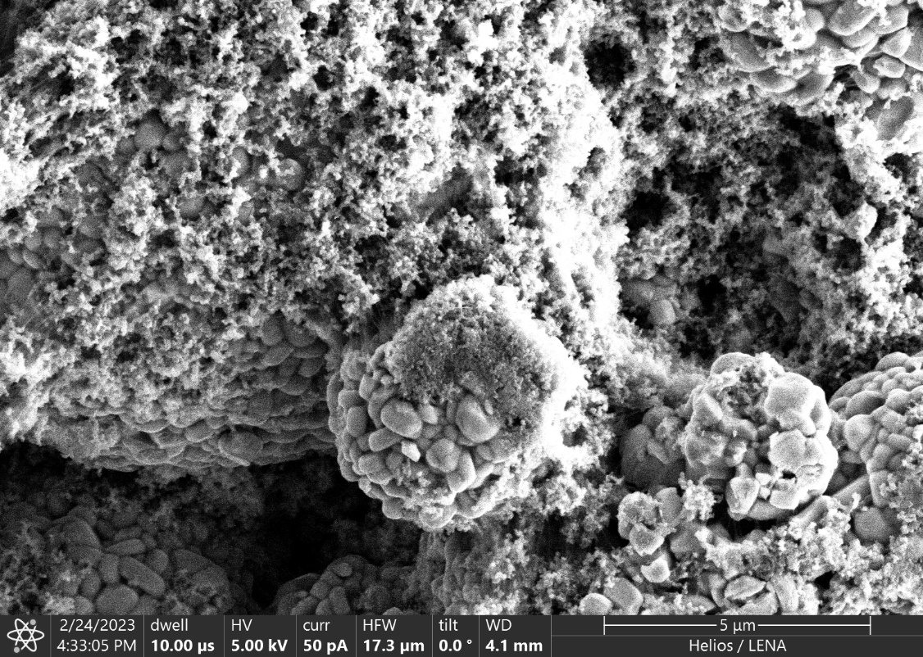
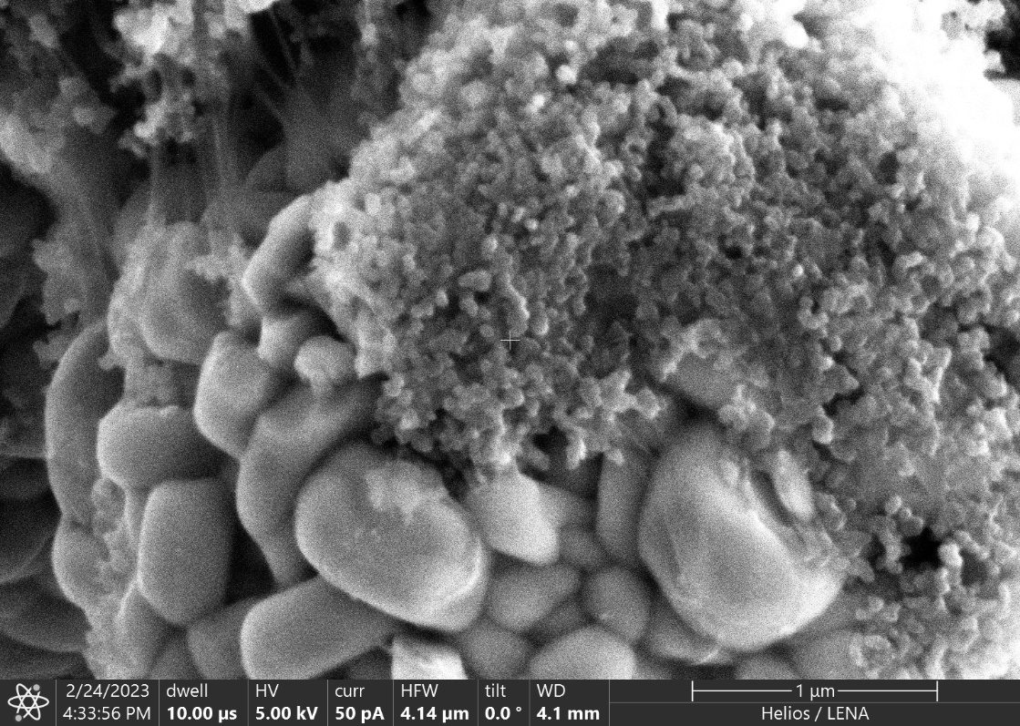
SEM-FIB results of fresh NMC ₈₁₁ cathode
PVDF
5 µm
1 µm
Secondary particles
Primary particle
Carbon Black
6

Slide 7
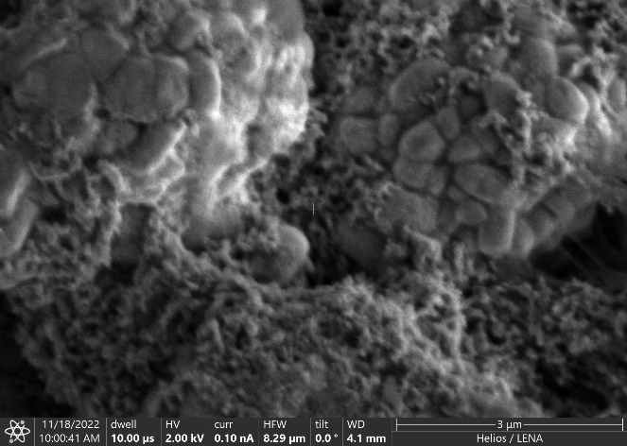
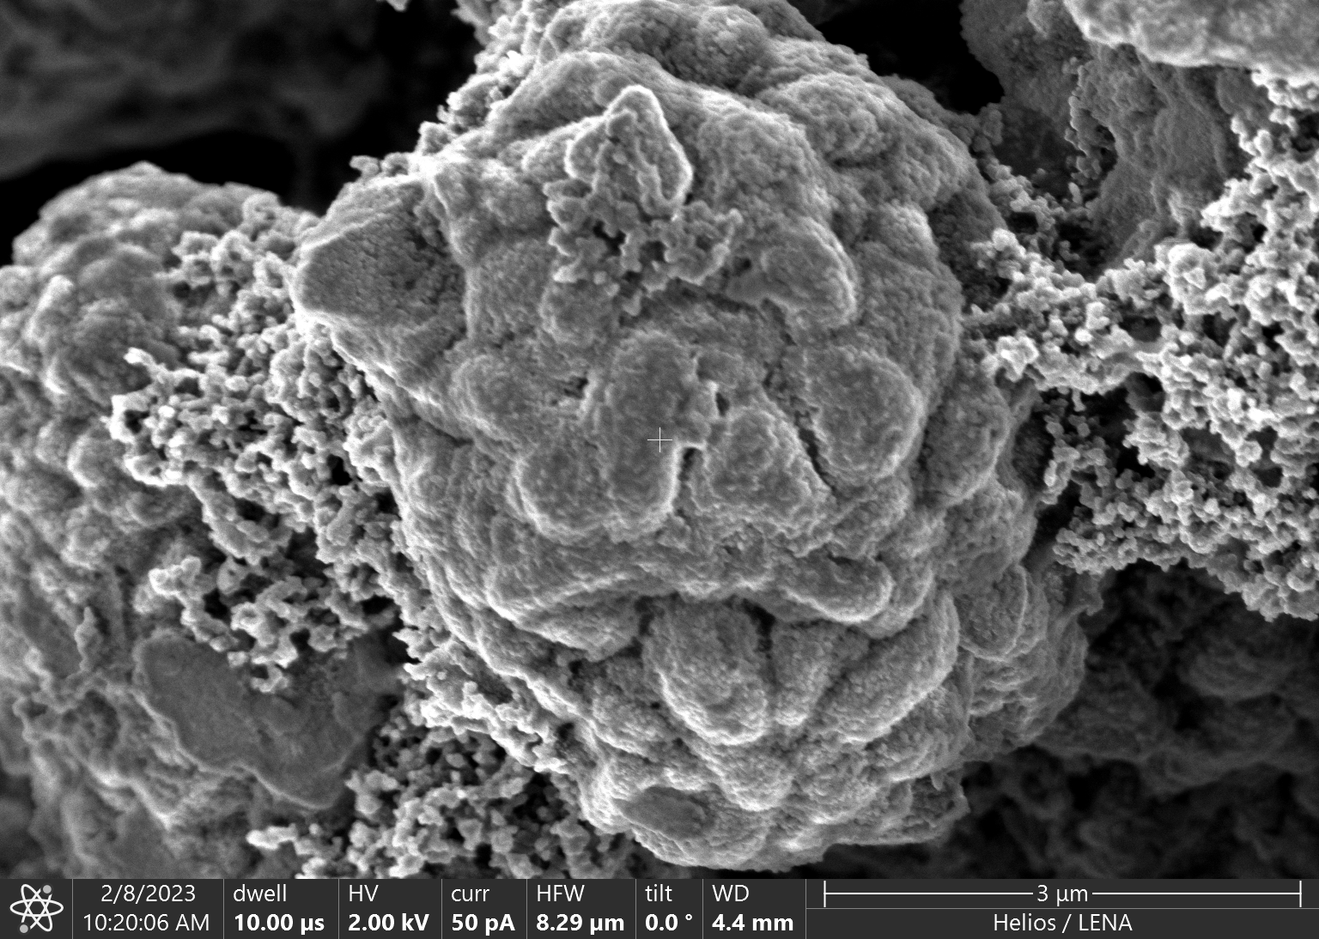
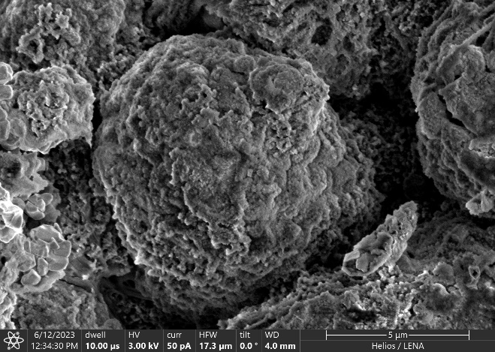
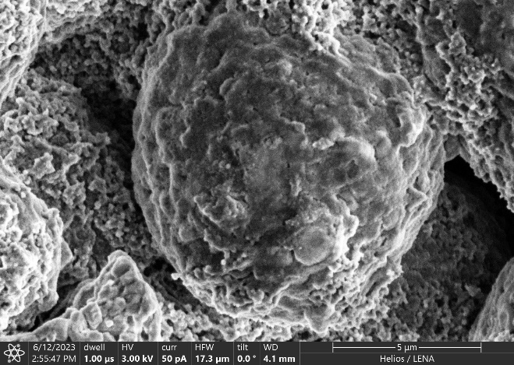
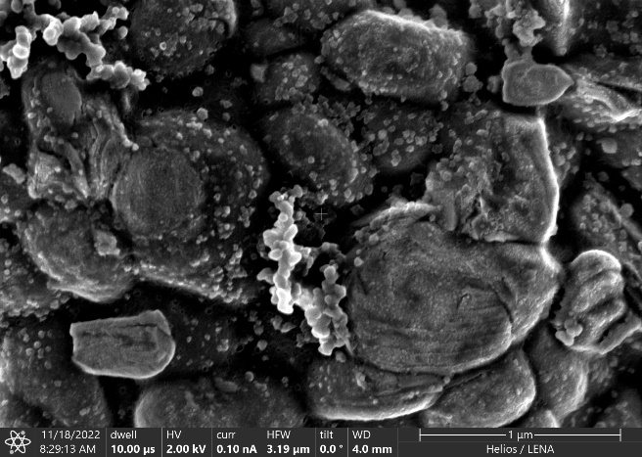
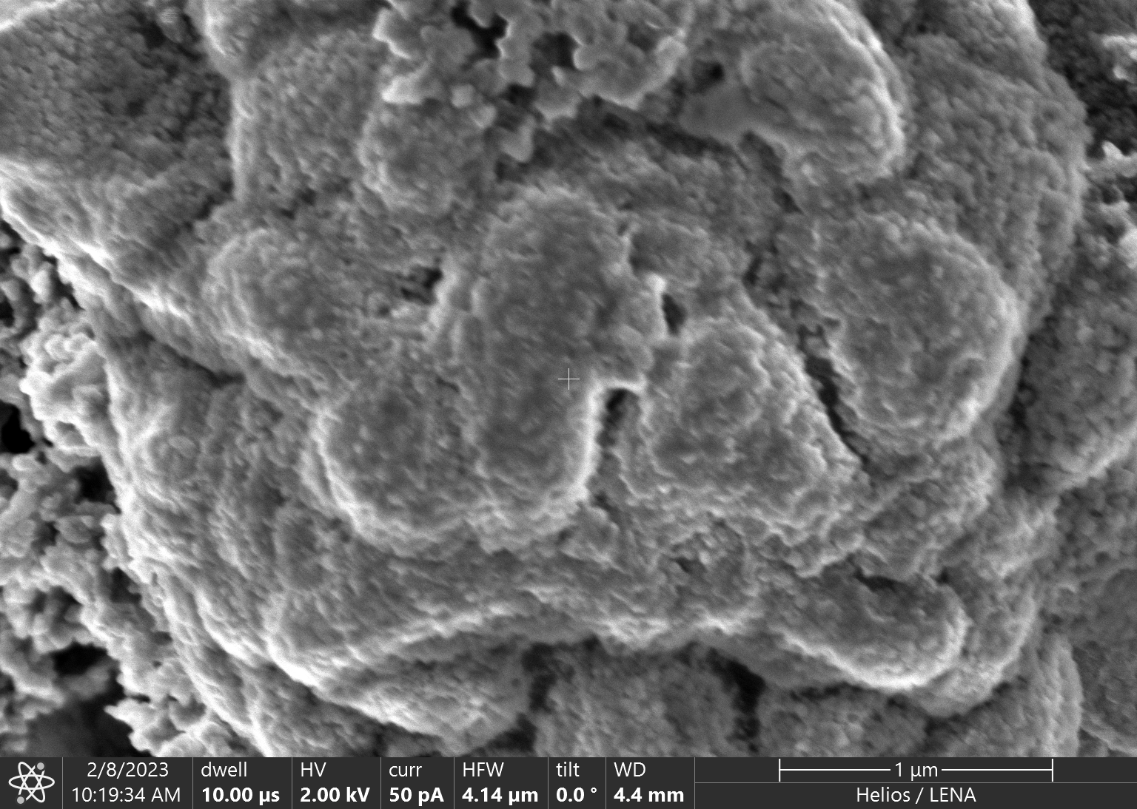
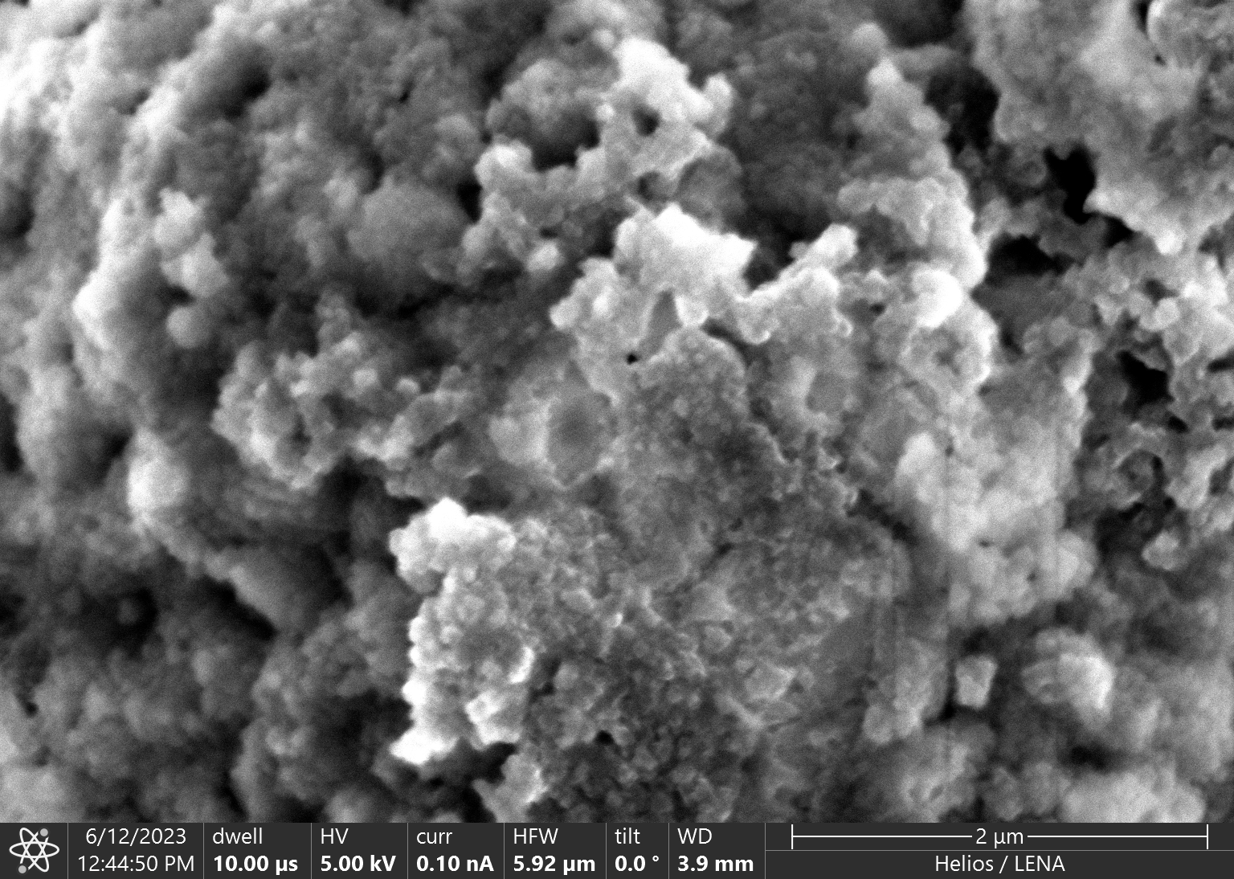
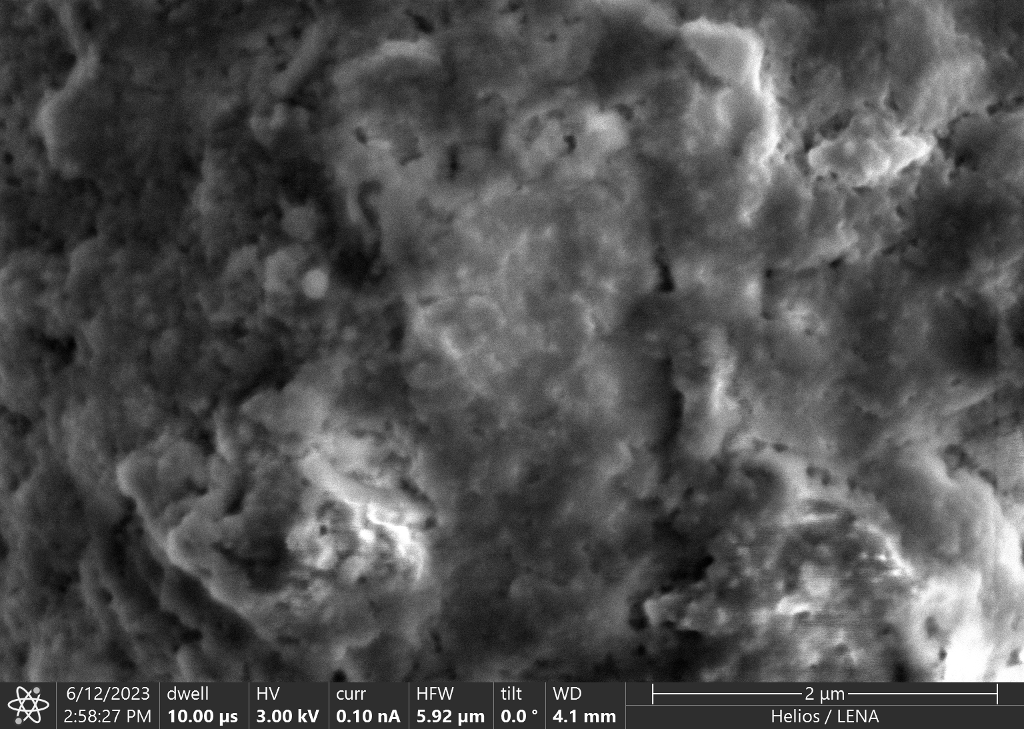
SEM-FIB results of aged NMC ₈₁₁ cathode
Surface of aged cathode NMC₈₁₁ electrode
Without AlF₃
With AlF₃
Without AlF₃
50 °C
With AlF₃
25 °C
3 µm
3 µm
3 µm
3 µm
Primary particle
Film
1 µm
1 µm
1 µm
1 µm
Thicker CEI layer cover the active material due to degradation of electrolyte
7

Slide 8
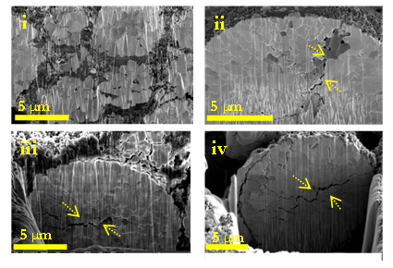
SEM-FIB results of aged NMC ₈₁₁ cathode
Cross-section of cathode NMC₈₁₁
Without AlF₃
With AlF₃
25 °C
Crakes
50 °C
No significant morphology modification inside the secondary particle
8

Slide 9


XPS of aged NMC ₈₁₁ Cathode electrode
3 µm
3 µm
PVDF, carbon black
O(C=O)R
PEG (-CH₂-CH₂-O-)n
NMCO lattice , O-C=O
O(C=O)R
PEG (-CH₂-CH₂-O-)_{n}
P-O salt
Li_{x} PF_{y+1} O_{z}
PVDF
LiF
C_{n}F_{n}
Li_{x}PF_{Y+1} O_{Z}
9

Slide 10
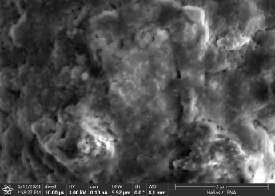
XPS of aged NMC ₈₁₁ Cathode electrode
CoF₂
MnF₂
Li_{x}PF_{Y+1} O_{Z}
LiF
NiF₂
CoF₂
Li_{x}PF_{Y+1} O_{Z}
LiF
MnF₂,
More Metal dissolution from the active material and forms MF₂
1 µm
10

Slide 11

Polymerisation of Electrolyte
Appearance of Polymer species
Fresh NMC ₈₁₁ particle
Aged NMC ₈₁₁ particle
Electrolyte degradation due to presence of lewis acid catalysist as Al (OR)₃
11

Slide 12

Conclusion and Outlook
1 µm
1 µm
Film
1 µm
1 µm
Polymer species
Li_{x}PF_{Y+1} O_{Z} Salt degradation
Formation of metal fluoride CoF₂, MnF₂, NiF₂
Discharge capacity decreases in presence of AlF₃ impurities
More electrolyte degradation on cathode and anode surface
Increasing of CEI and SEI layer thickness
Identifying the low AlF₃ impurities that could not drastically damage the cell performance
12

