Slide 1
Frühjahrstagung der Deutschen Physikalischen Gesellschaft 2025
Arbeitskreis Energie
Optimized transformation planning for regional energy systems
by coupling Agent-Based Modelling and Linear Programming
Hannes Koch¹, Stefan Lechner¹, Michael Düren², Peter Winker²
¹ Technische Hochschule Mittelhessen, Gießen
² Justus-Liebig-Universität Giessen, Gießen
hannes.koch@me.thm.de

Slide 2
We need Energy Scenarios on a regional level
Most of the energy transition takes place on the regional level
Our bottom-up framework uses spatial building representation including energy consumption
Coupling of classical optimization methods with Agent-Based Modelling allows for comprehensive transformation planning up to the year 2045

Slide 3
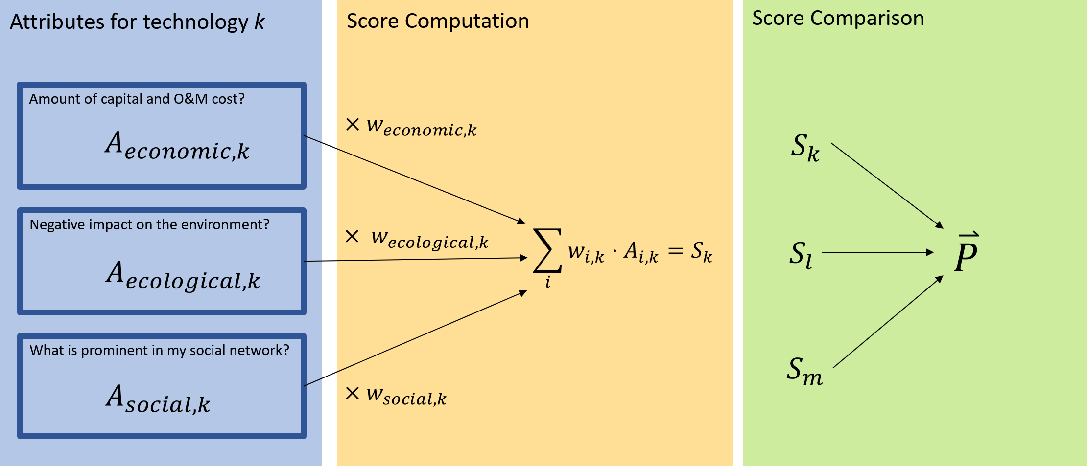
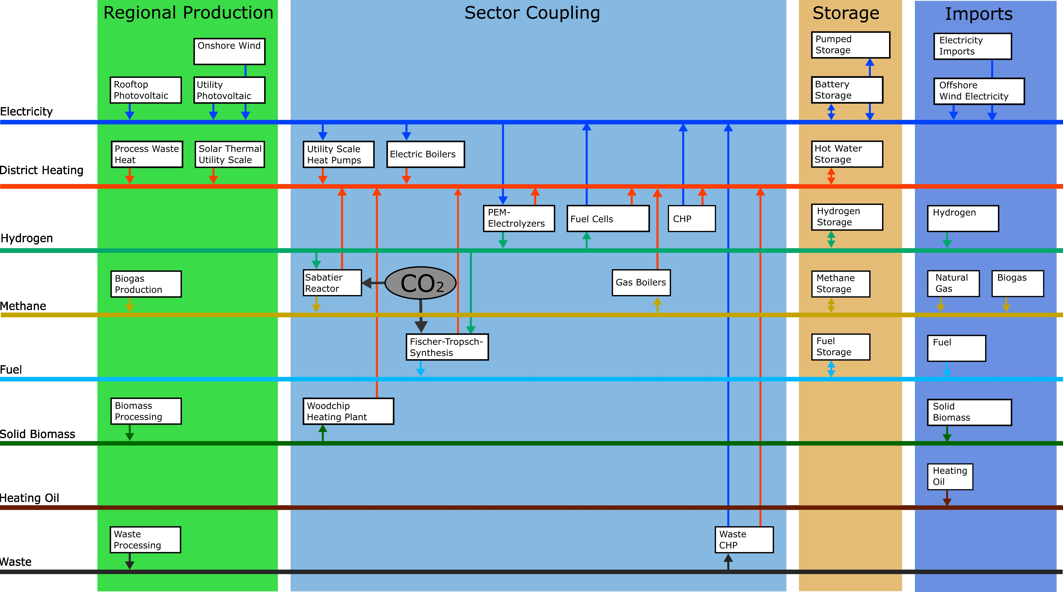
Modelling Approach & Resulting Framework
Multiple Energy Carriers
Agent Based Modelling for
Energy Customer simulation
Simulation of technology adoption and diffusion among energy customers
Multi-Carrier Energy System Optimization
Investment and capacitiy planning optimization over a multi-decade time horizon
Electricity
District Heating
100% renewable energy supply
Hydrogen
Methane
Oil
Biomass
Fuel

Slide 4
Modelling Approach & Resulting Framework
Multiple Energy Carriers
Agent Based Modelling for
Energy Customer simulation
Simulation of technology adoption and diffusion among energy customers
Multi-Carrier Energy System Optimization
Investment and capacitiy planning optimization over a multi-decade time horizon
Electricity
District Heating
100% renewable energy supply
Hydrogen
Methane
Oil
Biomass
Fuel

Slide 5
Agent-Based Modelling – Design
Electricity Rooftop photovoltaic, battery storage, grid-based supply
Heating
Type of heating technology, hot water tanks, geothermal capabilities
Agent Each agent represents
a building and its inhabitants
Mobility Electric vehicle, combustion vehicle or fuel cell vehicle, public transport utilization
Notes:
Each agent represents a household or public or commercial building
Every agent makes technology decisions in all of the three sectors every time a technical lifespan expires:
Every agent‘s energy balance is then simulated on an hourly basis to create load profiles for every energy carrier
The resulting load profiles are aggregated and passed to the energy supply system optimization

Slide 6
Agent-Based Modelling – the decision-making
Attributes for technology k
Score computation
Score comparison
Amount of capital and O&M cost?
$${×w}_{economic,k}$$
$$A_{economic,k}$$
$S_{k}$
Negative impact on the environment?
$${× w}_{ecological,k}$$
$$\sum_{i}{w_{i,k}⋅A_{i,k}=S_{k}}$$
$S_{l}$
$$\overset{⃑}{P}$$
$$A_{ecological,k}$$
What is prominent in my social network?
$S_{m}$
$$A_{social,k}$$
$${×w}_{social,k}$$

Slide 7
Modelling Approach & Resulting Framework
Multiple Energy Carriers
Agent Based Modelling for
Energy Customer simulation
Simulation of technology adoption and diffusion among energy customers
Multi-Carrier Energy System Optimization
Investment and capacitiy planning optimization over a multi-decade time horizon
Electricity
District Heating
100% renewable energy supply
Hydrogen
Methane
Oil
Biomass
Fuel

Slide 8
Multi-Carrier Energy System
Energy Customer Demands

Slide 9
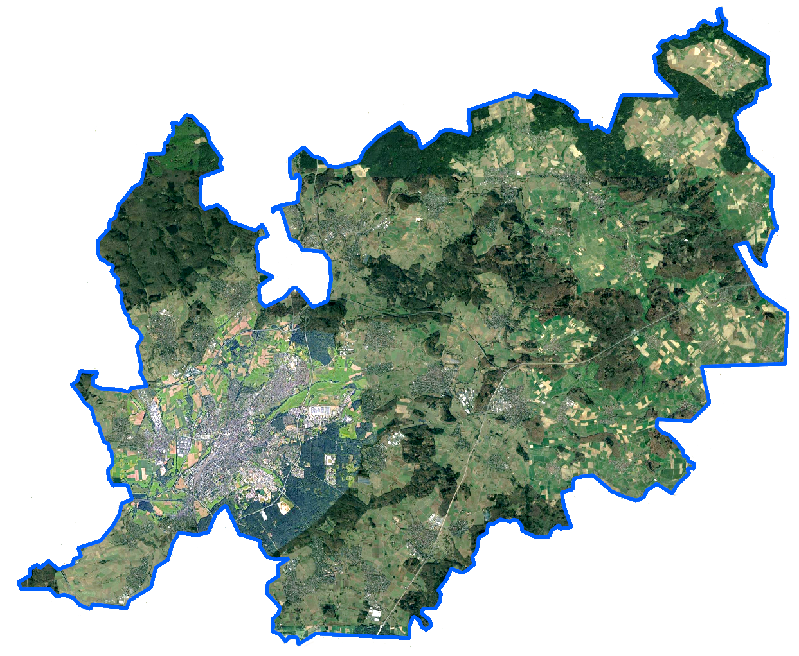
Case study: City of Giessen and surroundings
Simulation and optimization of two scenarios
„Moderate“ scenario
Moderate adoption of rooftop photovoltaics and battery storage
Mix of heat pumps and conventional heating technologies
Mix of electric and combustion vehicles
Low renovation rate in the building sector
„Ambitioned“ scenario
High adoption of rooftop photovoltaics and battery storage
Focus on heat pumps and pellet boilers for room heating
High adoption of electric vehicles
High renovation rate in the building sector
Giessen
23 km
Notes:
About 190.000 Inhabitants and roughly 40.000 buildings

Slide 10
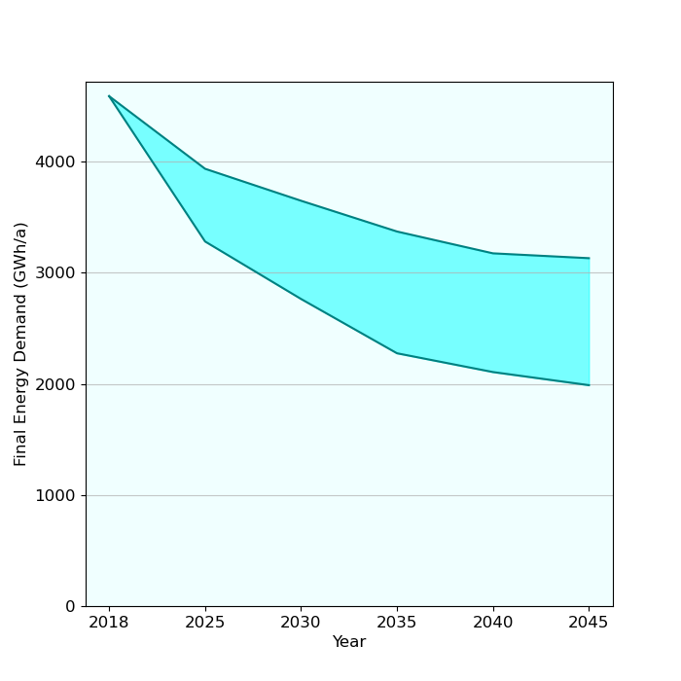
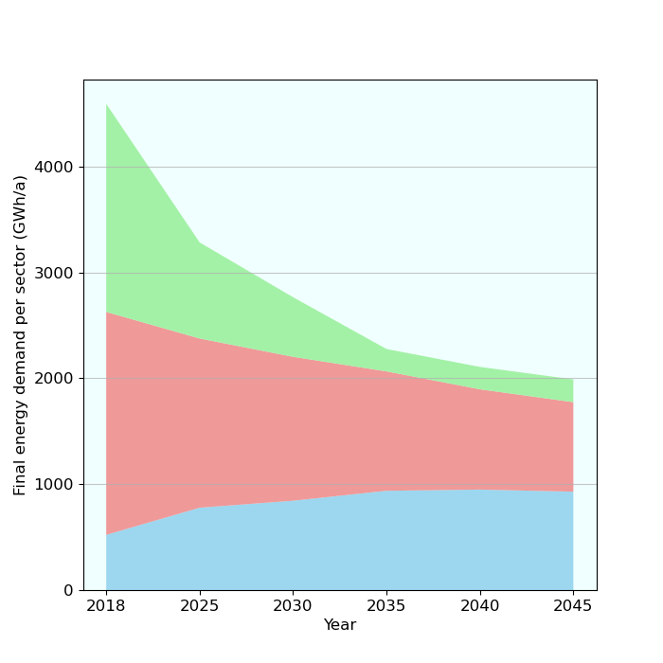
Primary energy demand comparison/demand in sectors
Final energy demand in both scenarios
Final energy demand across sectors
Real-world meter data
Moderate
Mobility
Ambitioned
Heating
Electricity

Slide 11
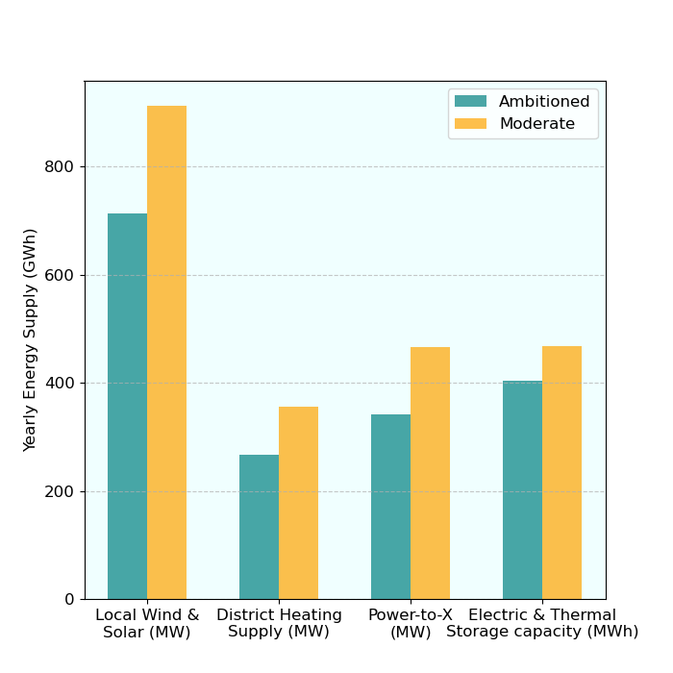
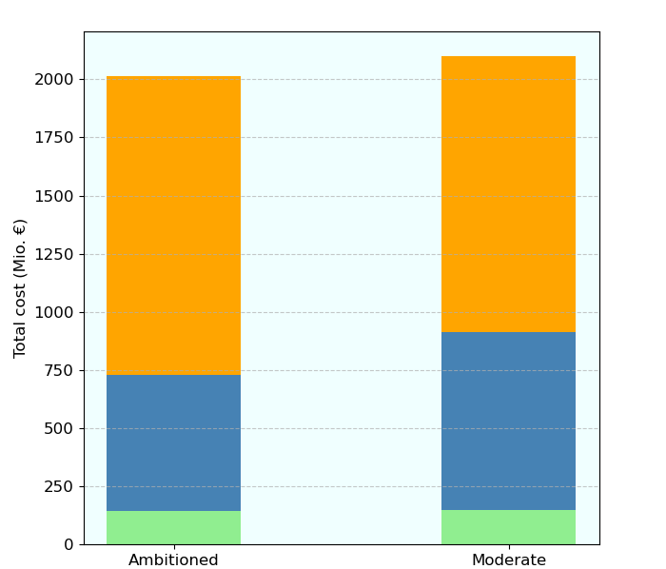
Scenario comparison of energy supply and cost distribution
Centrally supplied energy in 2045
Annualized cost distribution in 2045
Distributed technology and renovation
Energy Carrier Imports
Central Energy Supply

Slide 12
Conclusions
Renovation of buildings and electrification greatly reduce final and primal energy demand
Reduction of primary energy facilitates decarbonization
Local renewable electricity generation is economically feasible
Importing renewable energy carriers is expensive: Reducing primary energy demand reduces import costs
„Take Home Message“:
Reduction of primary energy demand is the primal leverage for economically feasible decarbonization
Most effective measures are renovation and switching to efficient end consumer technologies
High investments by energy customers contribute to economically and ecologically sound energy systems

